Slide 1
WVU HPC Summer Institute
Introduction to Linux

Slide 2
outline
What is Linux
Brief History of Linux
Why use Linux?
Basic Characteristics
Linux Shell and Basic Commands
Labs

Slide 3


What is linux?
Linux is an Operating System (OS)
Allows interaction between hardware and software applications.

Slide 4
Brief History of Linux
Derived from UNIX Operating System
UNIX created by Bells Labs in 1969
Originally written in Assembler
Expensive, proprietary software and still in use in various forms today
Examples: AIX, HPUX, Solaris

Slide 5
History cont.
Unix needed for the masses
Richard Stallman started GNU Project in 1983 … free UNIX for the masses
Linus Torvalds created first Linux Kernel in 1991 written from scratch

Slide 6
Hist cont.
Linux is used in a variety of products
Smartphones
Gaming platforms
Routers
Appliances

Slide 7
Popular Linux Distributions
Red Hat Enterprise Linux (RHEL)
Paid subscription / Commercial support
Centered on stability and performance
Popular in private/public sector businesses and education
Widely used in HpC Environments
CENTOS
Recompiled version of RHEL
Provides performance and stability of RHEL without the added cost/support
Fedora
Community driven version of Red Hat
Uses latest code and not as stable as RHEL/CENTOS
Debian
Very stable distribution
Not as popular as a couple years ago
Ubuntu
Based on Debian but uses bleeding edge code
Typically reserved for desktop use.
Mint Linux
Based on Ubuntu
Centers on simplicity and looks to provide users a Windows feel
Typically reserved for desktop use

Slide 8
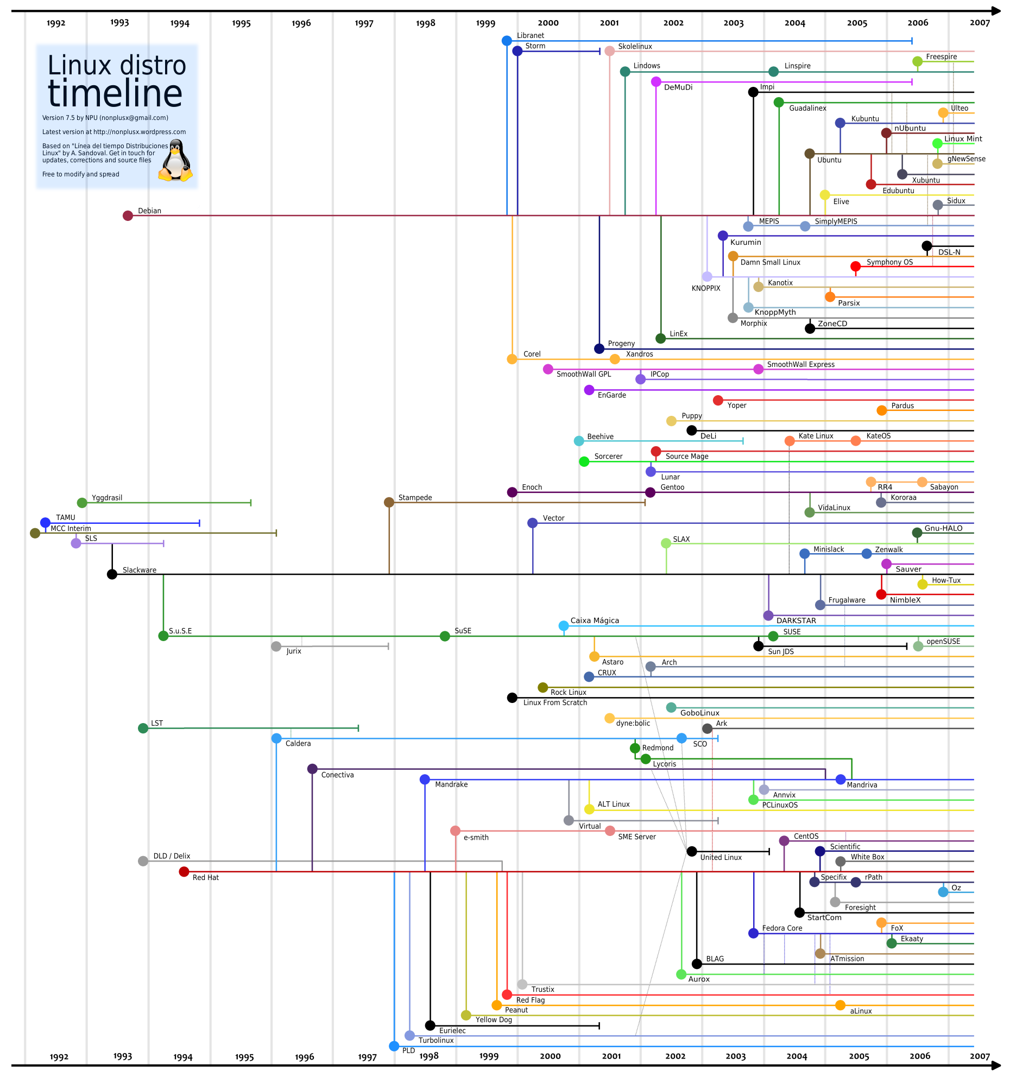

Slide 9
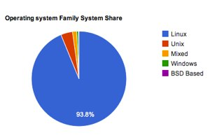
Why use linux?
Performance:
Allows for large scale, multi user environment
Allows many nodes/hosts to work as one
Open source and community driven
Many academic, scientific, and system tools available
Provides very stable environment
94% of the Top500 systems use Linux based OS

Slide 10
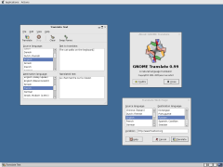
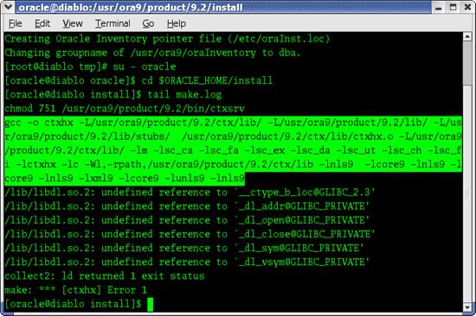
Basic characteristics
Linux is an OS that controls hardware for applications
Can be controlled via command line interface (CLI) or GUI

Slide 11
Basics: Linux Shell
Linux shells allow for interaction with Linux Kernel.
The kernel is the core of the OS, it receives tasks from the shell and executes them
Common shells:
bash, ksh, tcsh, csh

Slide 12
Basics: Linux Shell Cont.
Shells are case sensitive
Be more careful … often no warnings or undos when a command is executed
For example: no Windows recycling bin

Slide 13
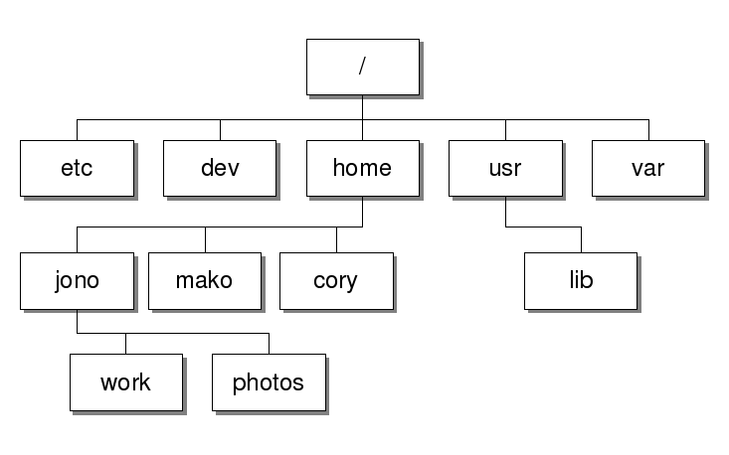
Basics: Directory Tree
Linux systems typically follow a common directory tree
Root (“/”) is the parent directory

Slide 14
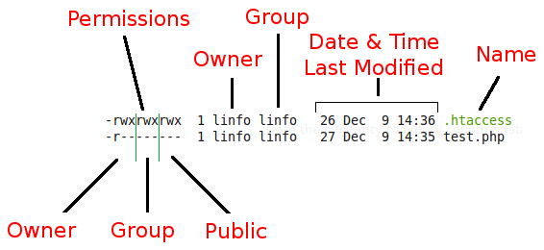
Basics: files and permissions
Directories contain files
Linux stores data in files
All directories and files have ownership and permissions set

Slide 15
Basic Commands
Name | Description
man | read system manual pages
pwd | identify the working directory
ls | display contents of a directory
mkdir | create a directory
cd | change the working directory
echo | display a string
cat | display text of file
Name | Description
more | display text of file
cp | copy a file
rm | remove a file
mv | move a file
rmdir | remove directory
exit | end session
ssh | initiate remote connection

Slide 16
Basic Commands cont.
Name | Description
scp | copy a remote file
tar | archive files
find | find files or directories
less | less is more (with benefits)
vi | edit files
hostname | list name of current machine
ln | create links
Name | Description
history | show command history
ps | show running processes
kill | kill a running process
chmod | change permissions
chown | change ownership
file | determine file type
grep | search file for text

Slide 17
Helpful Resources
man pages
Web sites:
http://www.ee.surrey.ac.uk/Teaching/Unix/
http://www.linux.org/tutorial
http://docs.redhat.com
Putty for Windows
http://www.chiark.greenend.org.uk/~sgtatham/putty/download.html
VIM Tutor
Execute vimtutor on your system or mountaineer

Slide 18
Lab 1: Login to mountaineer
Open terminal
ssh mountaineer.hpc.wvu.edu –l username
Default password: HpC2013
Prompt to change password
Reenter default password
Enter your password in twice
Congrats you are now on the mountaineer system

Slide 19
Lab 2: Edit a File
Untar lab2.tgz
cd ~$HOME
tar xzvf hpc2013.tgz
mv mynameis.txt yourname.txt
vi yourname.txt
wait for instructions

