Slide 1

An overview of High Performance Computing Resources at WVU

Slide 2
HPC and Scientific Computing
“I have a computer – why do I need high performance computing?”
Answer – some problems are just too big to run on an available desktop or laptop computer…
…in a reasonable amount of time

Slide 3
HPC and Scientific Computing
Consider these computational problems---
…assume a single core machine running at 3.0 Ghz…
and three problems---
Calculate a volume of a cube - h x w x d (three multiplications)
multiply the values of a 1000 element array by 3.14 (1000 multiplications)
calculate the temperature of all points in a volume based on the average for six adjacent points in a volume with 10,000 x 10,000 x 10,000 points over 1000 time steps (6,000,000,000,000,000 additions/divisions)

Slide 4
HPC and Scientific Computing
How long would it take
Problem #1 - ~ 0.0000000006 seconds
Problem #2 – ~ 0.0000003 seconds
Problem #3 – ~ over 15.5 days
Problem #4 - what if problem #3 had a 1000 step algorithm to be applied to each cell of the volume?
>400 days

Slide 5
HPC and Scientific Computing
So, what are going to do?
We could make faster processors.
We seemed to have reached a plateau in terms of processor speed
We could employ different core processor architectures
Only incremental improvements at this point

Slide 6
HPC and Scientific Computing
There are other architectures and technologies that can give us better computational performance *
Symmetric Multi-Processors (SMP)
Distributed Memory Clusters
Accelerators

Slide 7
HPC and Scientific Computing
Symmetric Multi-Processors (SMP)
Core
Core
Core
Core
Memory (usually a large amount)
Core
Core
Core
Core
Core
Core

Slide 8
Memory
Memory
Memory
Distributed Memory Cluster
Each node has its own memory
Nodes communicate/collaborate through Interconnect
Proc1
Proc2
Proc1
Proc2
Proc1
Proc2
Interconnect
Proc1
Proc2
Proc1
Proc2
Proc1
Proc2
Memory
Memory
Memory

Slide 9
HPC and Scientific Computing
Accelerators
GPUs – massive number of simple cores that do the same thing at the same time
Data
Data
Data
Data
Data
….
Data
data
+-*/
+-*/
+-*/
+-*/
+-*/
….
+-*/
+-*/
ModData
ModData
ModData
ModData
ModData
….
ModData
ModData

Slide 10
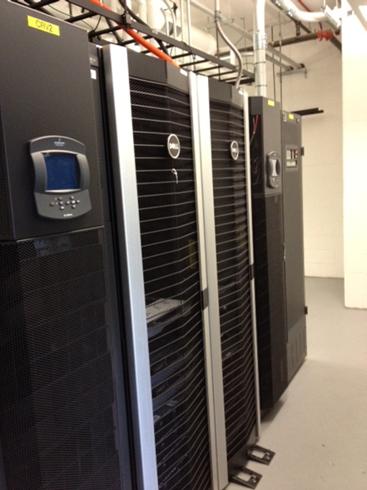
Mountaineer
32 Compute Nodes
Dual 6 core Intel Xeon (Westmere) processors (12 cores)
48 Gbytes of memory (4 GB per core)
10 Gbps Ethernet Interconnect
50 Terabytes of shared storage
Open access

Slide 11
Spruce Knob
73 Compute Nodes
Four kinds of nodes
16 core – small memory nodes (2 GB/core – 32 GB)*(Ivy Bridge)
16 core – medium memory nodes (4 GB/core – 64 GB) (Ivy Bridge)
16 core – large memory nodes (32 GB/core – 512 GB) (Ivy Bridge)
32 core SMP nodes (2 GB/core – 64 GB) (Sandy Bridge)
54 Gbps Infiniband Interconnect

Slide 12
Spruce Knob
171+ Terabytes of parallel scratch storage (coming soon)
Optional Nvidia K20 GPUs * 9 (2496 cores each)
10 Gbs link to campus network, Internet2,…
Array of software
Intel Compiler suite, Matlab, R, SAS, MPI, OpenMP, Galaxy,…

Slide 13
Spruce Knob
Modes of participation
Condo model
Faculty pay for any nodes that they want in the cluster
Faculty investors (and their research teams) have priority access to their nodes
Any Spruce HPC users can use idle faculty owned nodes for up to 4 hours

Slide 14
Spruce Knob
Modes of participation
Community model
About thirty nodes are generally available to the HPC community (WV)
Fair-share scheduling, not subject to owner preemption

Slide 15
Getting Started with HPC
Batch processing (mostly)
You need –
An account (how to get one)
Some knowledge of Linux
An application (some software that you want to run)
Some data (probably)
A job submission script
Some knowledge of job control commands (submitting, monitoring and retrieving your jobs)

Slide 16
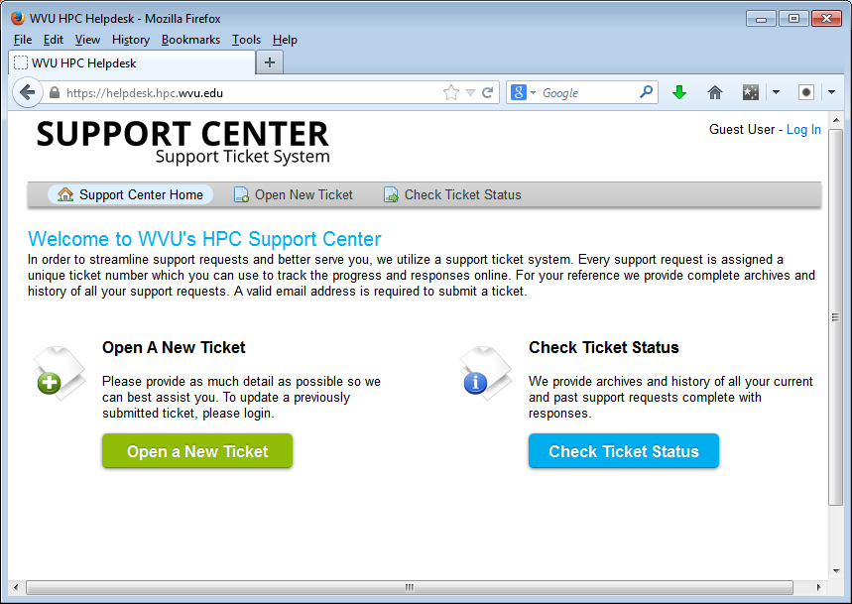
HPC and Scientific Computing
Getting Started
Go to https://helpdesk.hpc.wvu.edu
Click “Submit New Ticket”
Select option to “Request New Account”
Enter requested information
Click on Submit

Slide 17
HPC and Scientific Computing Scheduling and running Jobs
MOAB/PBS job script
#!/bin/bash
#PBS -q long
#PBS -l nodes=1:ppn=8
#PBS -m ae
#PBS -M fjkl@mail.wvu.edu
#PBS -N mybigjob
cd /home/fjkl/DIRECTORY
mpirun -machinefile $PBS_NODEFILE -np 8 ./myprog.exe

Slide 18
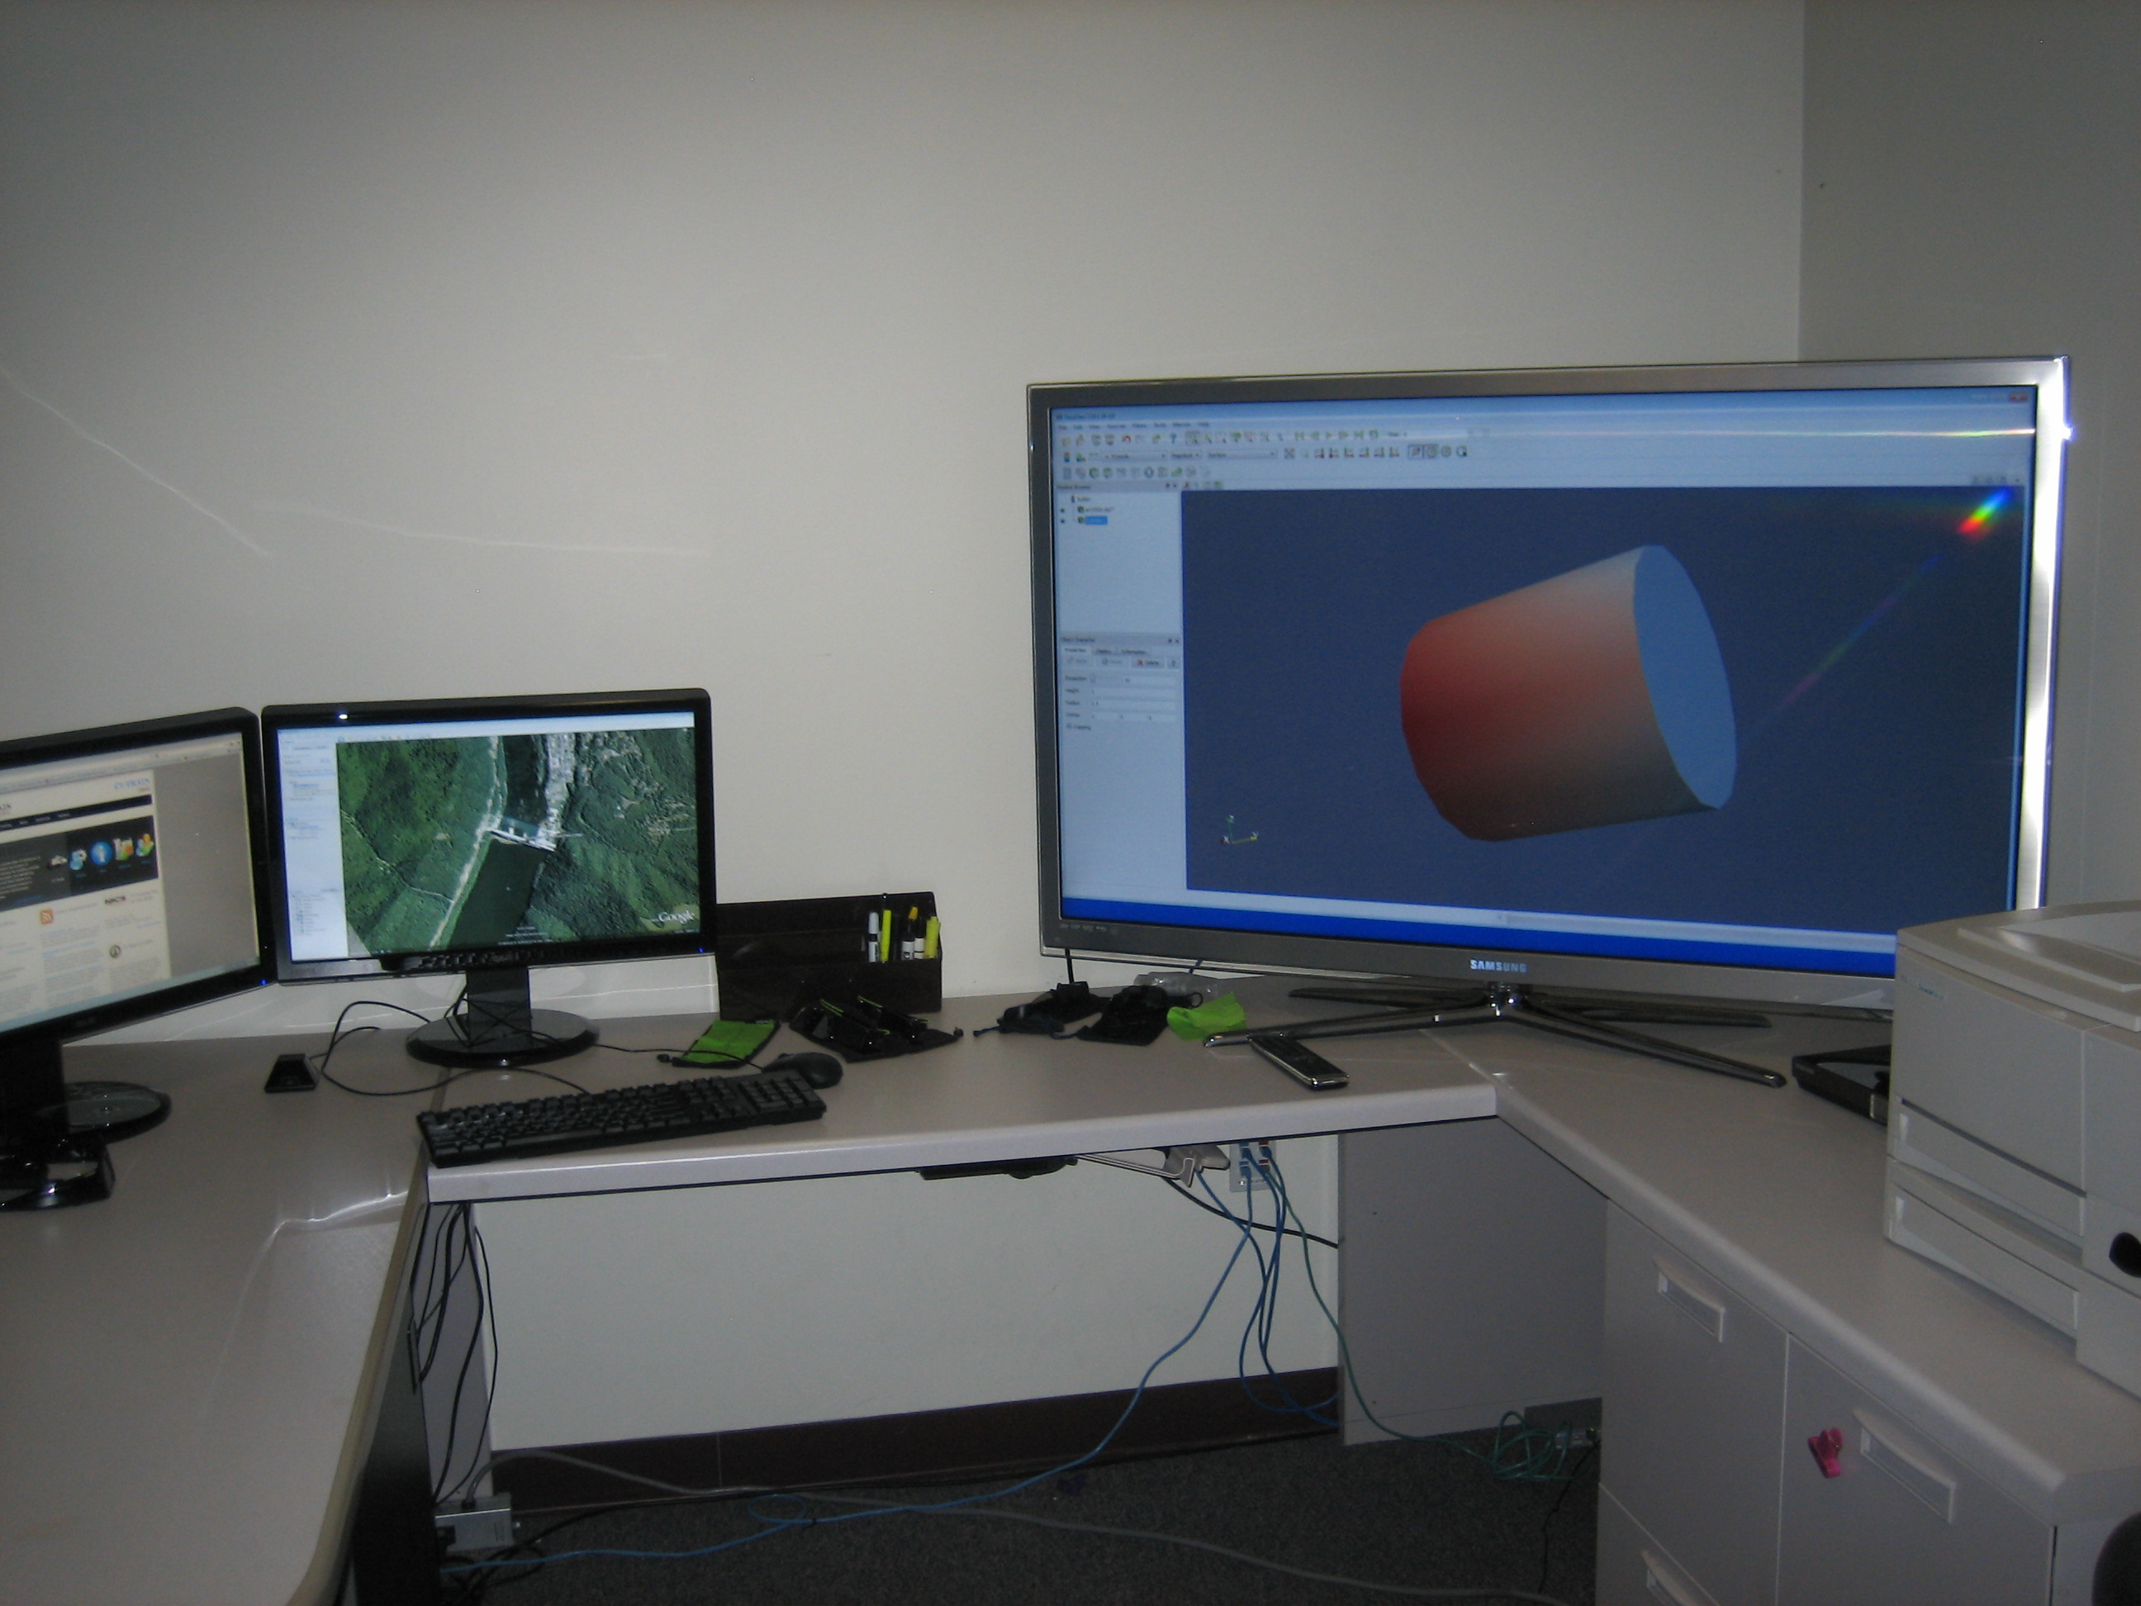
HPC and Scientific Computing
Visualization Resources
Visualization Workstation
Workstation – 12 core processor
2x Nvidia Quadro 5000 2.5 Gb graphics Cards
48GB Memory
4TB Data storage
55” 240Hz 3D TV
3x 23” 3D Monitors
3D Stereo glasses

Slide 19
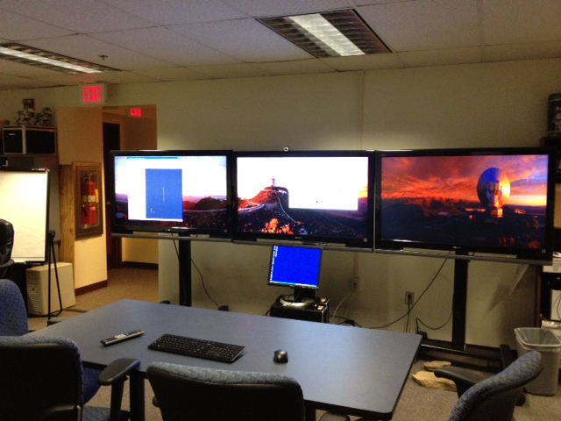
HPC and Scientific Computing
Visualization Resources
Collaboration Workstation
Panoramic 3 screen display
3*52” HD Displays
2x Nvidia graphics Cards
HD Webcam
256 GB Data storage
Designed to support collaboration – Skype, Evo, …

Slide 20
HPC and Scientific Computing
Research Networking---
WVU-Pittsburgh Internet2 connection = 10Gbps
WVU research network to Pittsburgh shared with DOE - NETL
WVU – member of Internet2
Internet2 100 Gbps nationwide network
3ROX recently implemented a 100 Gbps connection to I2

Slide 21
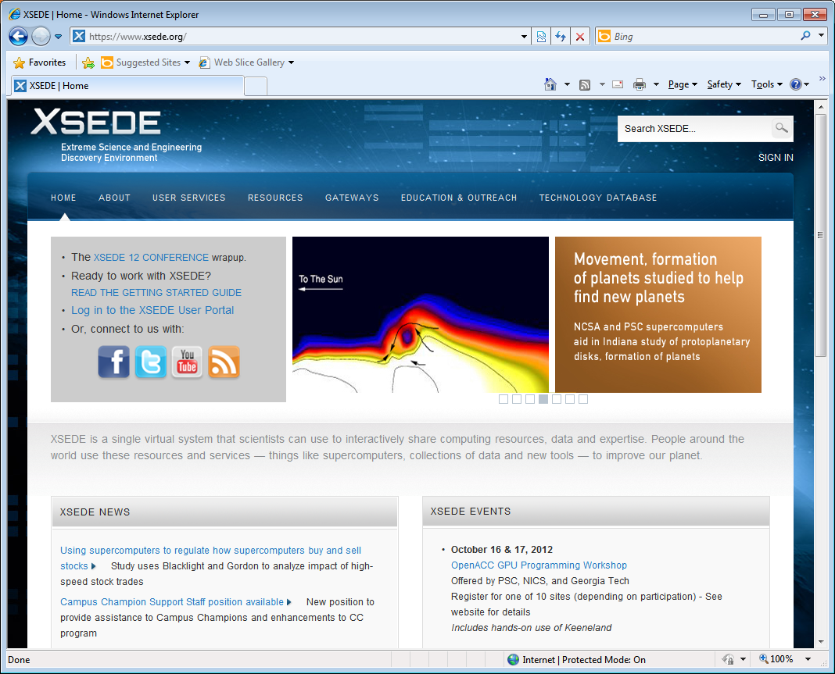
HPC and Scientific Computing
XSEDE
NSF sponsored national computational infrastructure
13 of the most powerful academic supercomputers in U.S.
Allocations competitively awarded
Free allocations available through Campus Champion program
http://www.xsede.org

Slide 22
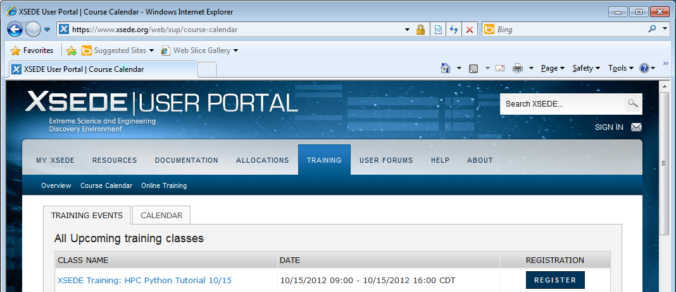
HPC and Scientific Computing – XSEDE Training
https://www.xsede.org/web/xup/course-calendar

Slide 23
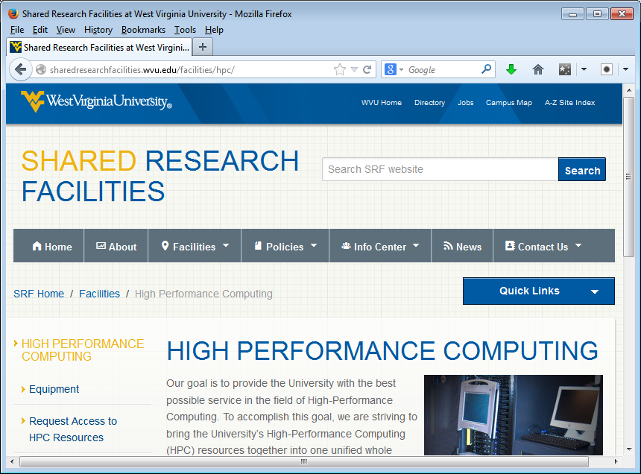
Learning more
http://sharedresearchfacilities.wvu.edu/facilities/hpc/

Slide 24
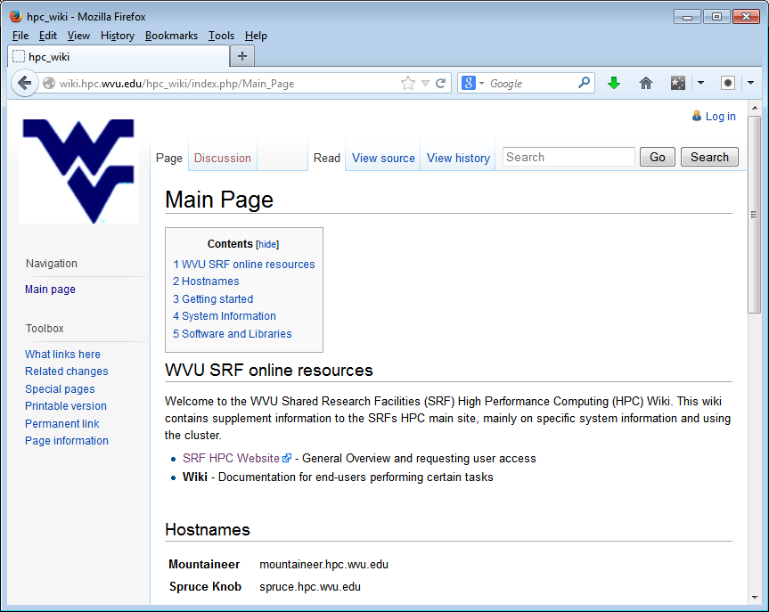
HPC and Scientific Computing
Learning more
http://wiki.hpc.wvu.edu/hpc_wiki/index.php/Main_Page

Slide 25
HPC and Scientific Computing
Workshops –
An overview of High Performance Computing Resources at WVU – February 5th
Basic Command Line Linux – February 20th
Using Moab/PBS on Mountaineer and Spruce – February 27th
MPI – XSEDE Monthly HPC Workshop – March 5th & 6th
Hosted at NRCCE – Need to register through the XSEDE Portal

Slide 26
HPC and Scientific Computing
Questions –
What do you need?
Thoughts? Comments?

Slide 27
HPC and Scientific Computing
For more information
Don McLaughlin
Don.McLaughlin@mail.wvu.edu or (304) 293-0388
Nathan Gregg
Nathan.Gregg@mail.wvu.edu or (304) 293-0963
Lisa Sharpe
Lisa.Sharpe@mail.wvu.edu or (304) 293-6872

Slide 28
HPC and Scientific Computing
Thank You

