Slide 1

OLSIS
User Login
Online Student Information System
Student ID
PIN
Login
Let’s go Riverhawks!
© 2017 Ellucian Company L.P. and its affiliates.

Slide 2
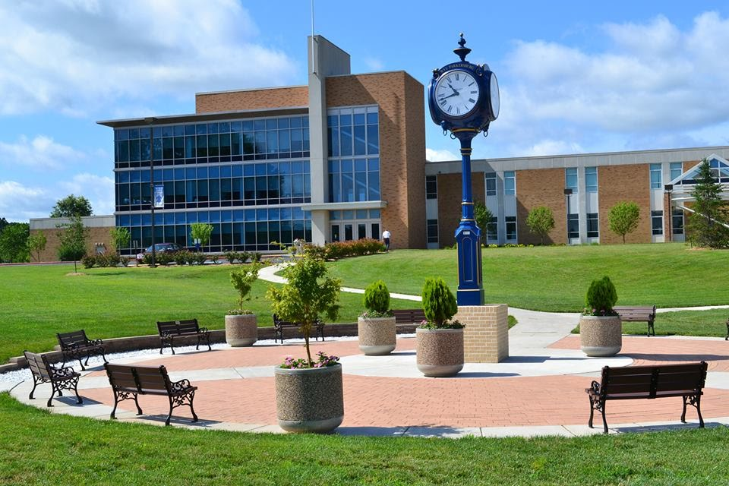

Apply for Admission or Review Existing Applications
OLSIS
STUDENT SERVICES
FINANCIAL AID
Jeremi Swann
▼
Online Student Information System
Settings
Admissions
Apply for Admission or Review Existing Applications
Registration
Check your registration status, class schedule and add or drop classes
Students Records
View your holds, grades, transcripts, MyDegree audit and account summary.
Student Accounts
View account account detail and summary information, statement and payment
information, and tax notification information
National Student Clearinghouse
Print enrollment verification certificates, order a transcript, or obtain information
regarding your student loan holders.
Apply for Graduation
Eligible students can only apply for graduation when the Registrar's Office makes
this option available during certain dates of the year.
Scholarship Application
Apply for scholarships.
© 2017 Ellucian Company L.P. and its affiliates.

Slide 3
Apply for Admission or Review Existing Applications
OLSIS
STUDENT SERVICES
FINANCIAL AID
Jeremi Swann
▼
Online Student Information System
Admissions
Application Type
Admission Application ▼
Continue
Registration
Students Records
Student Accounts
Note
If you have completed an application within the
past 12 months, or are a current student, it is
not necessary for you to apply for admission again.
National Student Clearinghouse
Apply for Graduation
Scholarship Application
© 2017 Ellucian Company L.P. and its affiliates.

Slide 4
Apply for Admission or Review Existing Applications
OLSIS
STUDENT SERVICES
FINANCIAL AID
Jeremi Swann
▼
Online Student Information System
Admissions
Select Term
Registration
Add / Drop Classes
Students Records
Student Accounts
Find Classes
Registration Status
National Student Clearinghouse
Apply for Graduation
Active Registration
Scholarship Application
Concise Student Schedule
Purchase Textbooks from Barnes and Noble
Registration History
Student Invoice (Registration Fee Assessment)
Withdrawal Information
Week at a Glance
© 2017 Ellucian Company L.P. and its affiliates.

Slide 5
Apply for Admission or Review Existing Applications
OLSIS
Jeremi Swann
▼
Online Student Information System
STUDENT SERVICES
Spring 2018
Add / Drop Classes
Admissions
Notice
Tuition & fees are due by 4pm on Friday, December 29, 2017
Any student with an unpaid account, without an authorized payment plan, or without authorized financial aid will be withdrawn from their courses on Friday, December 29, 2017.
Registrations after due dates must be accompanied by immediate payment or authorized payment arrangement.
Directions
To add a class, enter the CRN in the Add Classes section. To drop a class, use the options available in the Action pull-down list.
If you are registering to repeat a course in which you previously earned a grade of D, F, FIW, or R, use the options available in the Action pull-down list and select "Repeat Course".
Registration
Add Classes by CRN
Students Records
Student Accounts
National Student Clearinghouse
Apply for Graduation
Scholarship Application
Current Schedule
FINANCIAL AID
CS 220
Action ▼
CS 260
Action ▼
CS 101
Action ▼
CS 121
Action ▼
© 2017 Ellucian Company L.P. and its affiliates.

Slide 6
Apply for Admission or Review Existing Applications
OLSIS
STUDENT SERVICES
FINANCIAL AID
Jeremi Swann
▼
Online Student Information System
Admissions
View Holds
Registration
View Student Information
Student Records
Student Accounts
Midterm Grades
Final Grades
National Student Clearinghouse
Apply for Graduation
Academic Transcript
Scholarship Application
Course Catalog
MyDegree
© 2017 Ellucian Company L.P. and its affiliates.

Slide 7
