Slide 1
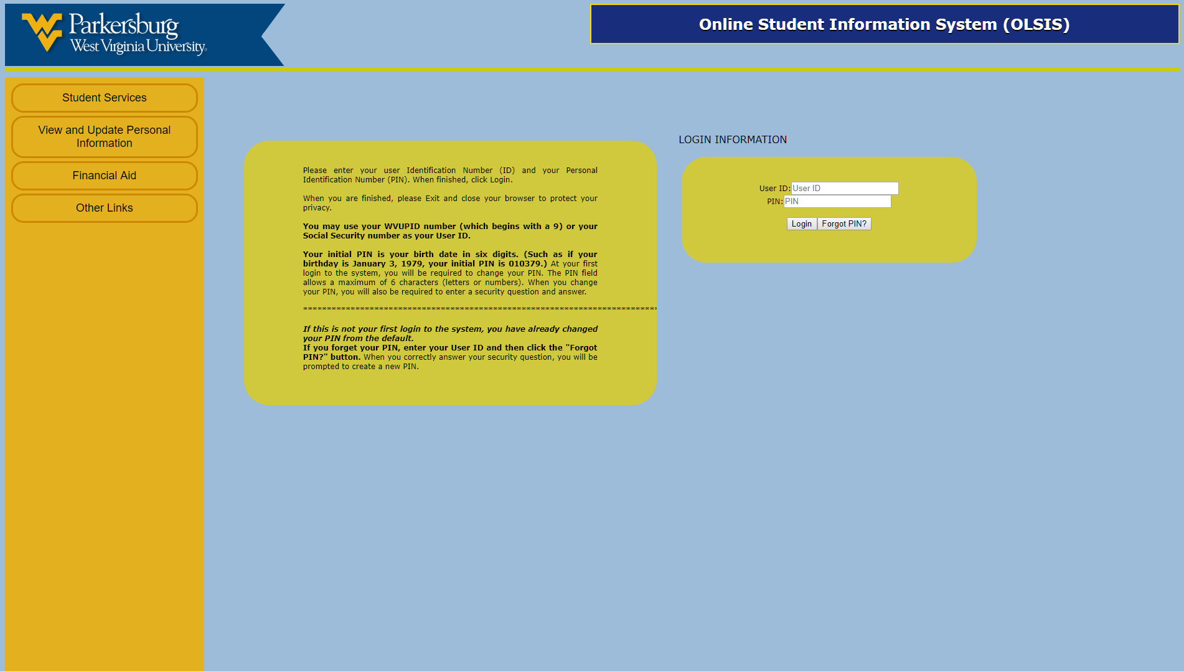
October, 2010
Su
Mo
Tu
We
Th
Fr
Sa
26
27
28
29
30
1
2
3
4
5
6
7
8
9
10
11
12
13
14
15
16
17
18
19
20
21
22
23
24
25
26
27
28
29
30
31
1
2
3
4
5
6
OLSIS RECREATE STORYBOARD *WORK IN PROGRESS*

Slide 2

October, 2010
Su
Mo
Tu
We
Th
Fr
Sa
26
27
28
29
30
1
2
3
4
5
6
7
8
9
10
11
12
13
14
15
16
17
18
19
20
21
22
23
24
25
26
27
28
29
30
31
1
2
3
4
5
6
OLSIS RECREATE STORYBOARD *WORK IN PROGRESS*

Slide 3
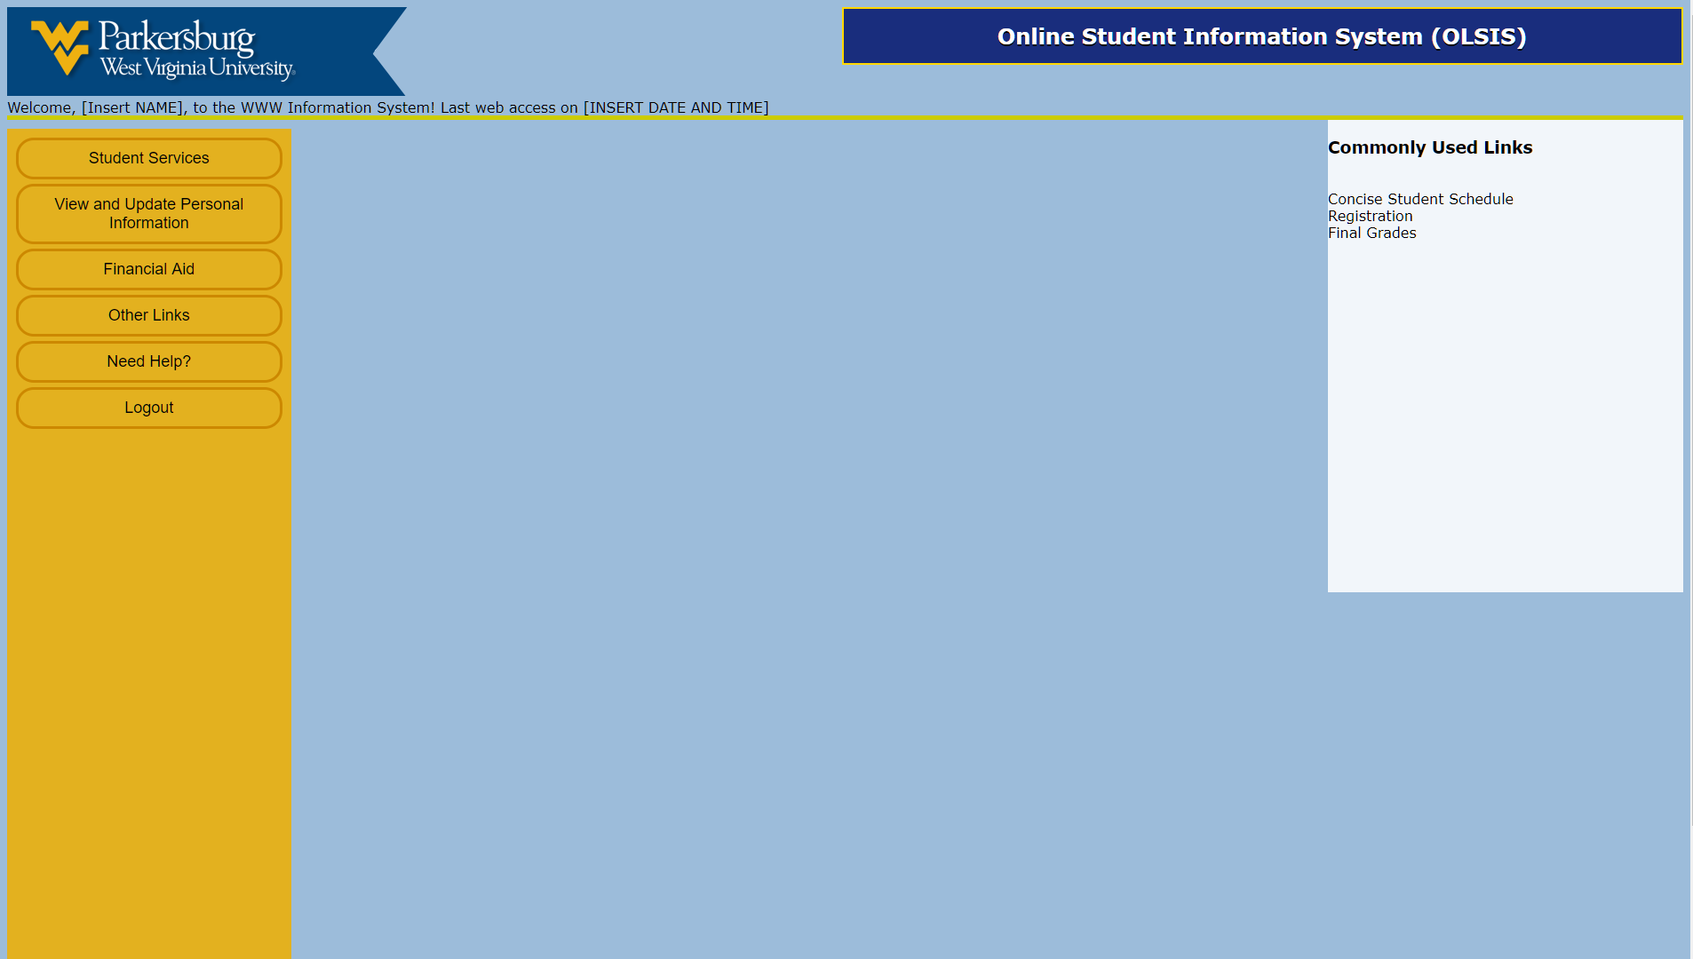
OLSIS RECREATE STORYBOARD *WORK IN PROGRESS*

Slide 4
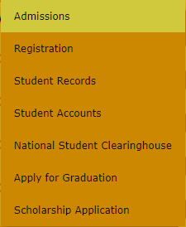


Slide 5
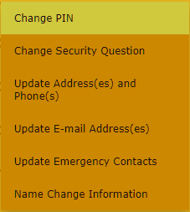

Slide 6
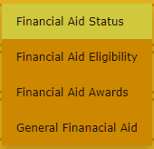

Slide 7


Slide 8


Slide 10
October, 2010
Su
Mo
Tu
We
Th
Fr
Sa
26
27
28
29
30
1
2
3
4
5
6
7
8
9
10
11
12
13
14
15
16
17
18
19
20
21
22
23
24
25
26
27
28
29
30
31
1
2
3
4
5
6
You have successfully logged out.
OLSIS RECREATE STORYBOARD *WORK IN PROGRESS*

