Slide 1





Browse
Friends
Try Prime
Store
…

Slide 2

Browse
Friends
Try Prime
Store
…
About
Sponsors
Downloads
Help
Harambe
Friends

Slide 3

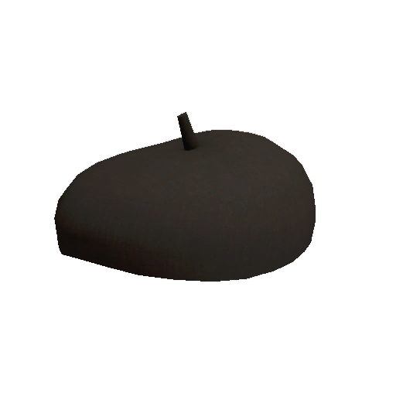
Browse
Get Desktop
Try Prime
Store
…
Friends
Harambe
Levi Bee Butcher
Creels b4d @lol
Gary
Trick2g
Rust Gameplay
Olsis is inferior

Slide 4

Browse
Get Desktop
Try Prime
Store
…
Friends
Harambe
Levi Bee Butcher
Creels b4d @lol
Gary
Trick2g
Rust Gameplay
Olsis is inferior

