Slide 1

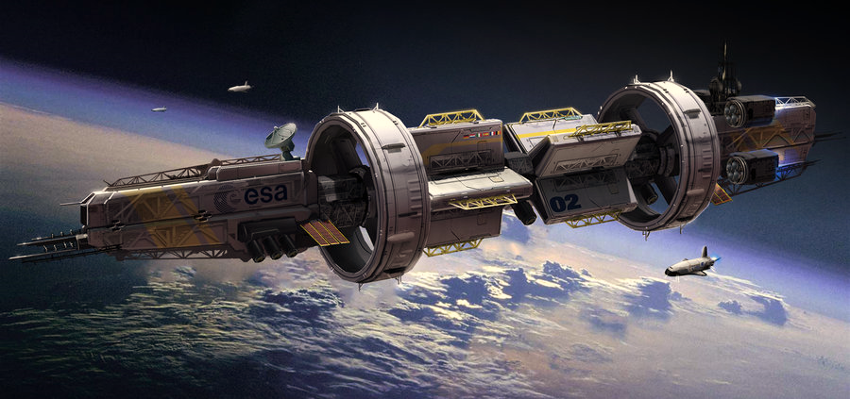
ABOUT
CONTACT US
CAREERS
RECRUITMENT
SEARCH
Welcome to Your Newest Branch of the United States Armed Forces
The United States Space Force (USSF) is America’s first line of defense in the growing threat of stellar warfare and interstellar threats. USSF provides space situational advantage; battle management command and control of space forces; space lift and range operations; space support to nuclear command and control; missile warning; satellite communications and position, navigation and timing, nuclear intercontinental ballistic missiles, cyber operations and the total missile defense missions.
Notes:
Home page. What the user first sees when entering SpaceForce.gov.

Slide 2

ABOUT
CONTACT US
CAREERS
RECRUITMENT
SEARCH
Welcome to Your Newest Branch of the United States Armed Forces
The United States Space Force (USSF) is America’s first line of defense in the growing threat of stellar warfare and interstellar threats. USSF provides space situational advantage; battle management command and control of space forces; space lift and range operations; space support to nuclear command and control; missile warning; satellite communications and position, navigation and timing, nuclear intercontinental ballistic missiles, cyber operations and the total missile defense missions.
Notes:
Demonstrates slider on home page. Automatic and manual.

Slide 3
ABOUT
CONTACT US
CAREERS
RECRUITMENT
SEARCH
Welcome to Your Newest Branch of the United States Armed Forces
The United States Space Force (USSF) is America’s first line of defense in the growing threat of stellar warfare and interstellar threats. USSF provides space situational advantage; battle management command and control of space forces; space lift and range operations; space support to nuclear command and control; missile warning; satellite communications and position, navigation and timing, nuclear intercontinental ballistic missiles, cyber operations and the total missile defense missions.
Notes:
Demonstrates slider fully transitioned. More than two photos are in slider (not demonstrated). Automatic and manual.

Slide 4
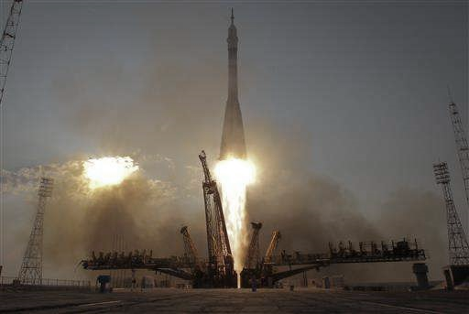
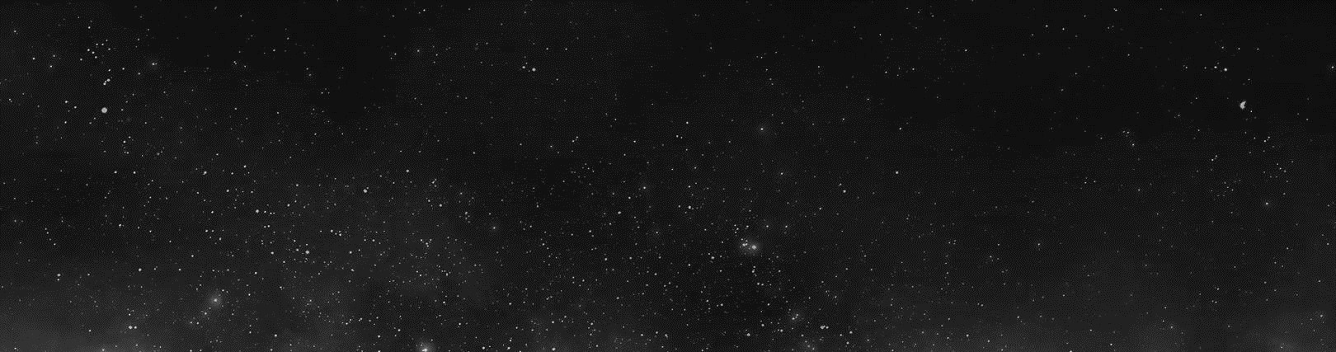

ABOUT
CONTACT US
CAREERS
RECRUITMENT
SEARCH
The United States Space Force (USSF) is America’s first line of defense in the growing threat of stellar warfare and interstellar threats. USSF provides space situational advantage; battle management command and control of space forces; space lift and range operations; space support to nuclear command and control; missile warning; satellite communications and position, navigation and timing, nuclear intercontinental ballistic missiles, cyber operations and the total missile defense missions.
Discover The United States Space Force
Mission
Education
Careers
Lifestyle
How To Join
Notes:
Demonstrates scrolling functionality. The navigation is fixed, logo is fixed.

Slide 5

Mission
Education
Careers
Lifestyle
ABOUT
CONTACT US
CAREERS
RECRUITMENT
SEARCH
How To Join
Start your journey. Transform your life and become part of something out of this world.
Recruitment begins now. Visit out recruitment page to learn how to apply today. Or visit one of hundreds of recruitment facilities across the United States.
You can contact the our recruitment officers if you have any questions about joining the USSF. Visit our contact us page for more information.
We need you. Do you think you have what it takes to protect our nation using the latest advances in technology? We are looking for technically skilled and physically skilled people that are willing to go beyond their horizons and are up for new challenges.
Notes:
Demonstrates scrolling functionality. The navigation is fixed, logo is fixed.

Slide 6

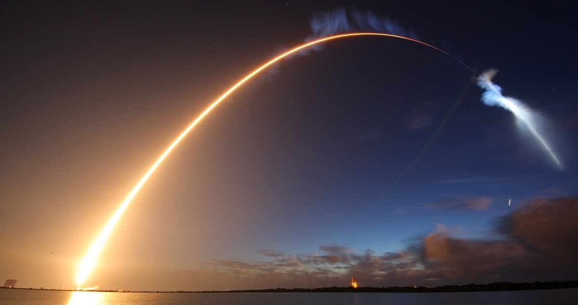
Recruitment begins now. Visit out recruitment page to learn how to apply today. Or visit one of hundreds of recruitment facilities across the United States.
You can contact the our recruitment officers if you have any questions about joining the USSF. Visit our contact us page for more information.
We need you. Do you think you have what it takes to protect our nation using the latest advances in technology? We are looking for technically skilled and physically skilled people that are willing to go beyond their horizons and are up for new challenges.
ABOUT
CONTACT US
CAREERS
RECRUITMENT
SEARCH
Your First Line of Defense.
Notes:
Demonstrates scrolling functionality. The navigation is fixed, logo is fixed.

Slide 7
ABOUT
CONTACT US
CAREERS
RECRUITMENT
SEARCH
Your First Line of Defense.
©2018 United States Space Force
www.SpaceForce.gov
Privacy Policy
About Our Ads
Sitemap
Terms of Use
Notes:
End of home page. Footer displays, not fixed position.

Slide 8
Functionality
Notes:
Demonstrates scrolling functionality. The navigation is fixed, logo is fixed.

Slide 9

ABOUT
CONTACT US
CAREERS
RECRUITMENT
SEARCH
Welcome to Your Newest Branch of the United States Armed Forces
The United States Space Force (USSF) is America’s first line of defense in the growing threat of stellar warfare and interstellar threats. USSF provides space situational advantage; battle management command and control of space forces; space lift and range operations; space support to nuclear command and control; missile warning; satellite communications and position, navigation and timing, nuclear intercontinental ballistic missiles, cyber operations and the total missile defense missions.
Notes:
On hover on the homepage, linkes turn white to verify user to click there.

Slide 10
ABOUT
CONTACT US
CAREERS
RECRUITMENT
SEARCH
Welcome to Your Newest Branch of the United States Armed Forces
The United States Space Force (USSF) is America’s first line of defense in the growing threat of stellar warfare and interstellar threats. USSF provides space situational advantage; battle management command and control of space forces; space lift and range operations; space support to nuclear command and control; missile warning; satellite communications and position, navigation and timing, nuclear intercontinental ballistic missiles, cyber operations and the total missile defense missions.
Notes:
SpaceForce logo acts as a “home” button. You see this on many sites and is a native behavior for many people. It also GROWS for user comfort.

Slide 11
ABOUT
CONTACT US
CAREERS
RECRUITMENT
SEARCH
Welcome to Your Newest Branch of the United States Armed Forces
The United States Space Force (USSF) is America’s first line of defense in the growing threat of stellar warfare and interstellar threats. USSF provides space situational advantage; battle management command and control of space forces; space lift and range operations; space support to nuclear command and control; missile warning; satellite communications and position, navigation and timing, nuclear intercontinental ballistic missiles, cyber operations and the total missile defense missions.
Notes:
Slideshow arrows turn white for user comfort.

Slide 12
ABOUT
CONTACT US
CAREERS
RECRUITMENT
SEARCH
Welcome to Your Newest Branch of the United States Armed Forces
The United States Space Force (USSF) is America’s first line of defense in the growing threat of stellar warfare and interstellar threats. USSF provides space situational advantage; battle management command and control of space forces; space lift and range operations; space support to nuclear command and control; missile warning; satellite communications and position, navigation and timing, nuclear intercontinental ballistic missiles, cyber operations and the total missile defense missions.
Notes:
Search expands on click.

Slide 13
ABOUT
CONTACT US
CAREERS
RECRUITMENT
SEARCH
SEARCH
Welcome to Your Newest Branch of the United States Armed Forces
The United States Space Force (USSF) is America’s first line of defense in the growing threat of stellar warfare and interstellar threats. USSF provides space situational advantage; battle management command and control of space forces; space lift and range operations; space support to nuclear command and control; missile warning; satellite communications and position, navigation and timing, nuclear intercontinental ballistic missiles, cyber operations and the total missile defense missions.
Notes:
Search expands on click.

Slide 14
ABOUT
CONTACT US
CAREERS
RECRUITMENT
SEARCH
The United States Space Force (USSF) is America’s first line of defense in the growing threat of stellar warfare and interstellar threats. USSF provides space situational advantage; battle management command and control of space forces; space lift and range operations; space support to nuclear command and control; missile warning; satellite communications and position, navigation and timing, nuclear intercontinental ballistic missiles, cyber operations and the total missile defense missions.
Discover The United States Space Force
Mission
Education
Careers
Lifestyle
How To Join
Notes:
“Discover” section links become white, bold, and arrow image moves toward the link.

Slide 15
ABOUT
CONTACT US
CAREERS
RECRUITMENT
SEARCH
The United States Space Force (USSF) is America’s first line of defense in the growing threat of stellar warfare and interstellar threats. USSF provides space situational advantage; battle management command and control of space forces; space lift and range operations; space support to nuclear command and control; missile warning; satellite communications and position, navigation and timing, nuclear intercontinental ballistic missiles, cyber operations and the total missile defense missions.
Discover The United States Space Force
Mission
Education
Careers
Lifestyle
How To Join
Notes:
“Discover” section links become white, bold, and arrow image moves toward the link.

Slide 16
Mission
Education
Careers
Lifestyle
ABOUT
CONTACT US
CAREERS
RECRUITMENT
SEARCH
How To Join
Start your journey. Transform your life and become part of something out of this world.
Recruitment begins now. Visit out recruitment page to learn how to apply today. Or visit one of hundreds of recruitment facilities across the United States.
You can contact the our recruitment officers if you have any questions about joining the USSF. Visit our contact us page for more information.
We need you. Do you think you have what it takes to protect our nation using the latest advances in technology? We are looking for technically skilled and physically skilled people that are willing to go beyond their horizons and are up for new challenges.
Notes:
Maybe image goes to recruitment page? [undecided]

Slide 17
ABOUT
CONTACT US
CAREERS
RECRUITMENT
SEARCH
Your First Line of Defense.
©2018 United States Space Force
www.SpaceForce.gov
Privacy Policy
About Our Ads
Sitemap
Terms of Use
Notes:
Footer links turn white.

