Slide 1


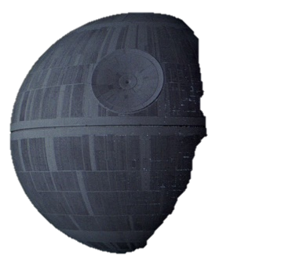
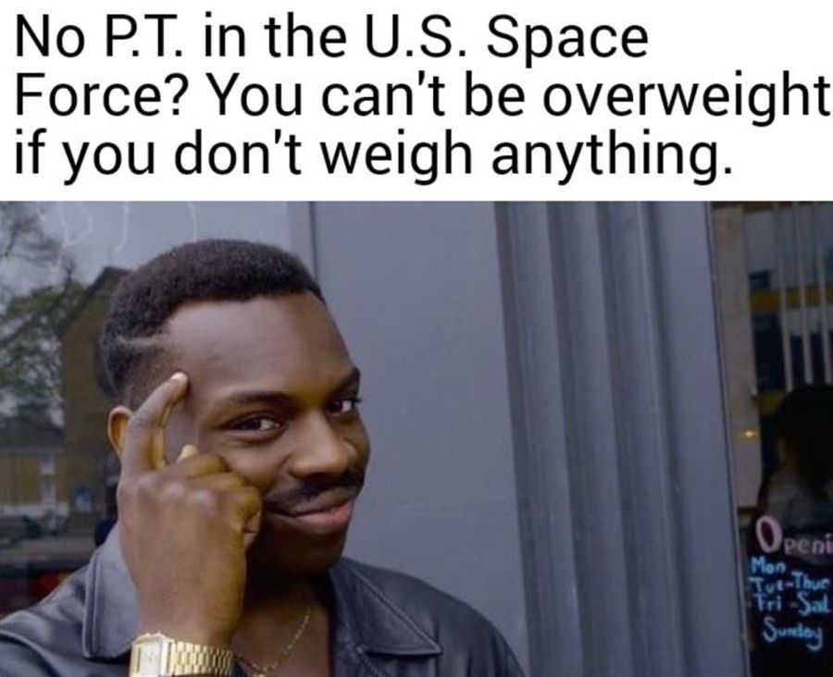



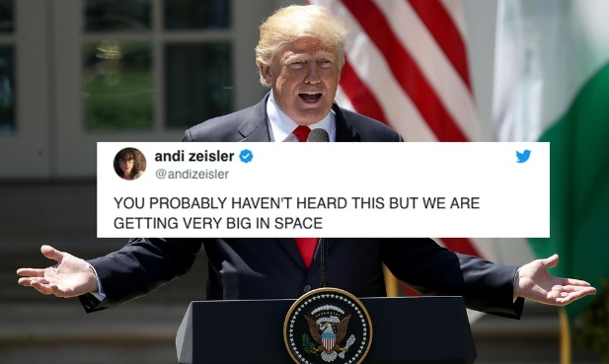
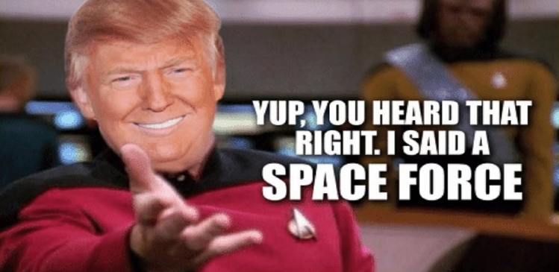
Login
Register
Home
Home News Enroll Memes History About
What is space force?
The president has proposed the creation of a new military branch that his defense department actually opposes. With a fighter jet positioned behind him, President Trump…

Slide 2
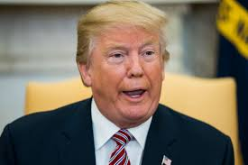
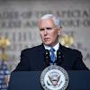

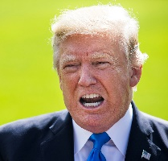
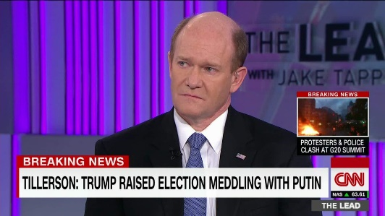
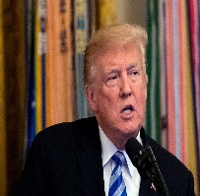
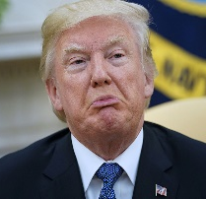
Login
Register
News
Home News Enroll Memes History About
Trump Administration Advances Controversial Space Force Plans
Warning of increasing adversarial threats to the nation’s satellites and other space capabilities, U.S. vice president Mike Pence reiterated on Tuesday that the Trump administration hopes to establish a Space Force as a sixth branch of the nation’s military by 2020. In addition, the National Space Council, which Pence chairs, on Tuesday approved a series of recommendations that provide a road map for establishing such a…Read more>>
Trump Administration Advances Controversial Space Force Plans
Warning of increasing adversarial threats to the nation’s satellites and other space capabilities, U.S. vice president Mike Pence reiterated on Tuesday that the Trump administration hopes to establish a Space Force as a sixth branch of the nation’s military by 2020. In addition, the National Space Council, which Pence chairs, on Tuesday approved a series of recommendations that provide a road map for establishing such a…Read more>>
Trump Administration Advances Controversial Space Force Plans
Warning of increasing adversarial threats to the nation’s satellites and other space capabilities, U.S. vice president Mike Pence reiterated on Tuesday that the Trump administration hopes to establish a Space Force as a sixth branch of the nation’s military by 2020. In addition, the National Space Council, which Pence chairs, on Tuesday approved a series of recommendations that provide a road map for establishing such a…Read more>>
Trump Administration Advances Controversial Space Force Plans
Warning of increasing adversarial threats to the nation’s satellites and other space capabilities, U.S. vice president Mike Pence reiterated on Tuesday that the Trump administration hopes to establish a Space Force as a sixth branch of the nation’s military by 2020. In addition, the National Space Council, which Pence chairs, on Tuesday approved a series of recommendations that provide a road map for establishing such a…Read more>>
REAL News
Fake News

Slide 3

Login
Register
Enroll
Home News Enroll Memes History About
“America is in need of a strong force for interstellar attacks from Huge meteors, space aliens and foreign invaders. If interested please fill out the form below and we will get ahold of you to formally enlist you into the Space Force . Together we will make space great again. #MakeSpaceGreatAgain” –President Donald J Trump via Twitter
Full Name
DOB
Address
Favorite Color
Submit

Slide 4

<<<< Click This In Presentation Mode
Home News Enroll
Memes History
About
What is space force?
The president has proposed the creation of a new military branch that his defense department actually opposes. With a fighter jet positioned behind him, President Trump…

