Slide 1

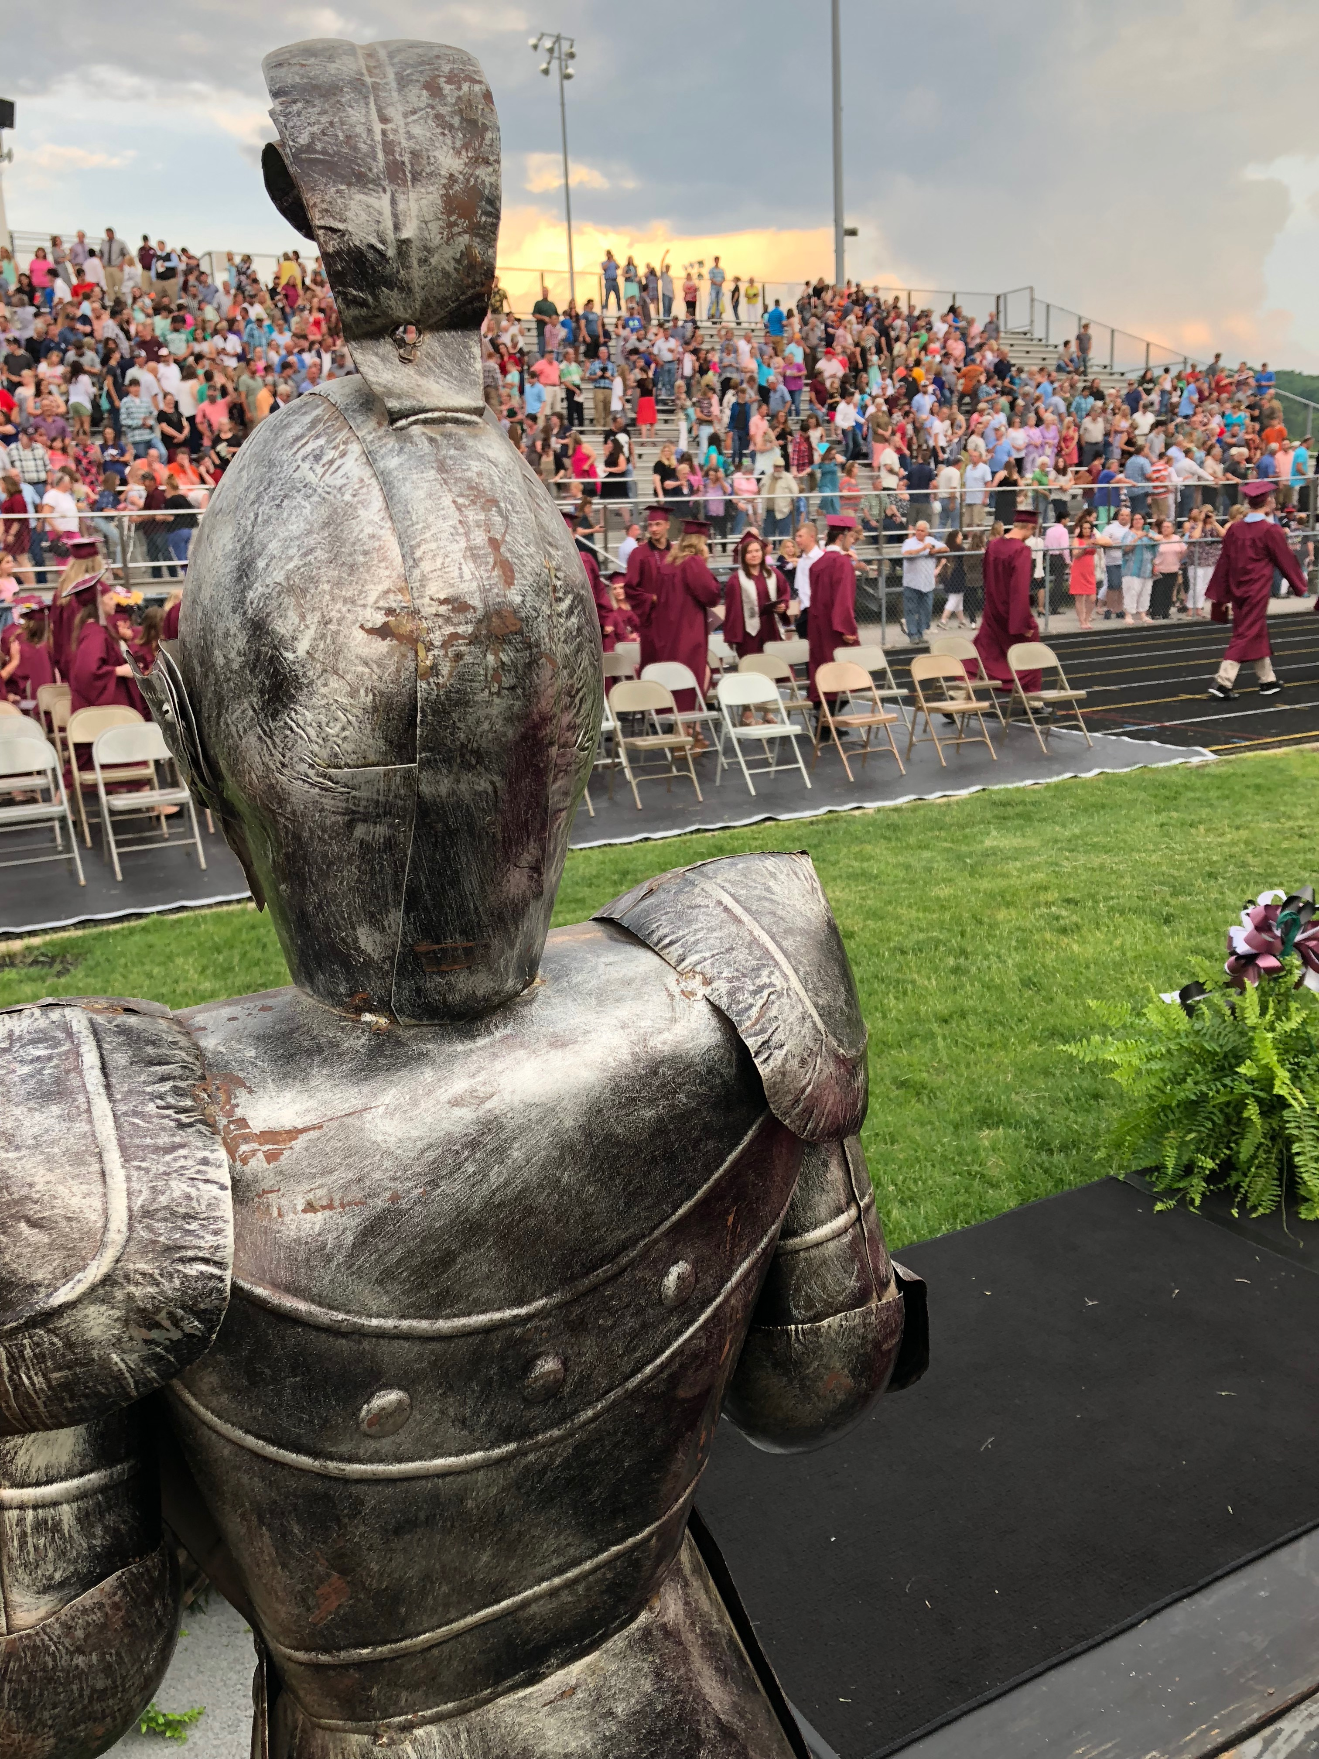

Roane County Schools
Login
Register
Home
News
Directory
FAQ
On Hover
Roane County High School
Go Raiders!!
Welcome to the Raiders Online Boosters Portal
Welcome Parents/Guardians!
If you are new to the site please “Register” for an account
to access all necessary forms in one easy to complete
location.
Feel free to access our “News” section to stay informed about all
the exciting things that Roane Raiders Boosters are undertaking.
If you have any questions please check out our “FAQ” section

Slide 2
Roane County Schools
Login
Register
Home
News
Directory
FAQ

Slide 3
Roane County Schools
Login
Register
Home
News
Directory
FAQ

Slide 4
Roane County Schools
Login
Register
Home
News
Directory
FAQ

Slide 5
Roane County Schools
Login
Register
Home
News
Directory
FAQ
On Hover
Roane County High School Boosters
Welcome to the Raiders Online Boosters Portal
Welcome Parents/Guardians!
If you are new to the site please “Register” for an account
to access all necessary forms in one easy to complete
location.
Feel free to access our “News” section to stay informed about all
the exciting things that Roane Raiders Boosters are undertaking.
If you have any questions please check out our “FAQ” section
Go Raiders!!

Slide 6
Welcome
Profile
Student(s)
Welcome Parents/ Guardians
To first register please sign up with your email
and create a password
1. Place Holder
2. Validate by “@”
3. Email not in use
If Not Display
*Email Already Taken*
or
*Not A Valid Email*
Email Address | johndoe@gmail.com
Password between 8-20 characters in length
Must have at least 1 Lower and Upper case letter
Must include at least one number
Must use one special character “!@#$%^&*()”
Password
Confirm
*Passwords Do Not Match* or *Password Does Not Meet Requirements* or Both
Start Over
Next

Slide 7
Welcome
Profile
Student(s)
Please finish creating your profile to continue
Parent/Guardian
First Name
Last Name
Address
Street
City |  | State | *Drop Down* | ZIP
Start Over
Next

Slide 8
Welcome
Profile
Student(s)
Please finish creating your profile to continue
Student Information
First Name
Last Name
DOB | *Calender*
Grade Level
Select All That Apply
 | Football |  | Volleyball
 | Baseball |  | Track and Field
 | Softball |  | Basketball
 | Golf |  | Cross Country
 | Cheerleading |  | Wrestling
Start Over
Next

