Slide 1
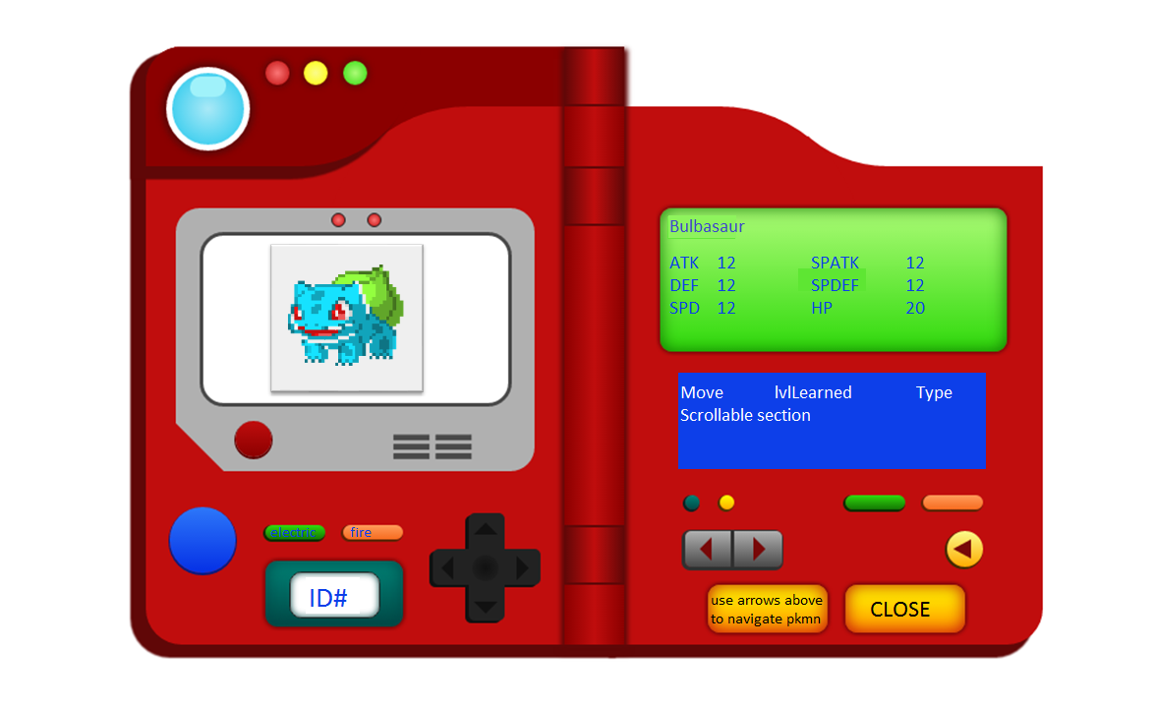
modal
Reverse stat and move sections… need more room for moveset (move name, lvl learned, type, power)

Slide 2
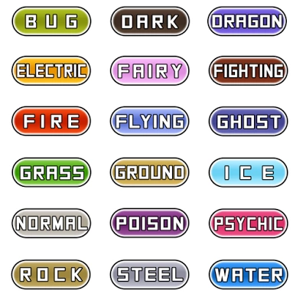

Filter by type
Filter by Generation
Default filter, Gen 1.
Depending on filter on type or generation, bottom of page and “Generation” changes to “Type”.
Find graphic for generations?
Create classes that look like type icons for pkmn type below.
Generation
ID Name Type1 Type2 ID Name Type1 Type2
1 Bulbasuar Grass Poison
3 Venusaur Grass Poison
5 Charmeleon Fire
2 Ivysaur Grass Poison
4 Charmander Fire
6 Charizard Fire Flying
Previous generation Next Generation

