Slide 1
Discussion
For Final Project
By Jacob Goff aka YeetBoy

Slide 2
Some ideas…
Organizing the Pokémon types into categories.
Have a UI for fast travel to certain places.
Tips on the Pokémon // Weaknesses // Strengths
Photos to make the site not so boring.
Memes are just nice.

Slide 3
Implementation
Have a side bar for navigation with hyperlinks for fast travel.
Have a modal for tips near the certain Pokémon.
Have Pokémon pictures near the certain Pokémon

Slide 4
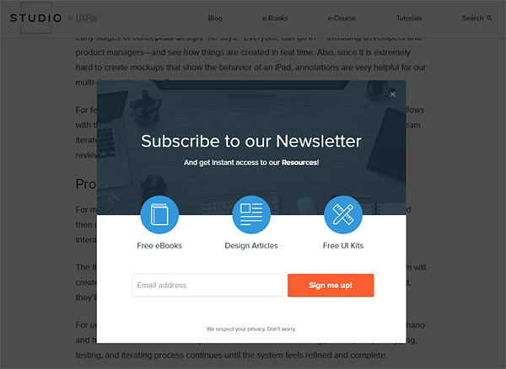
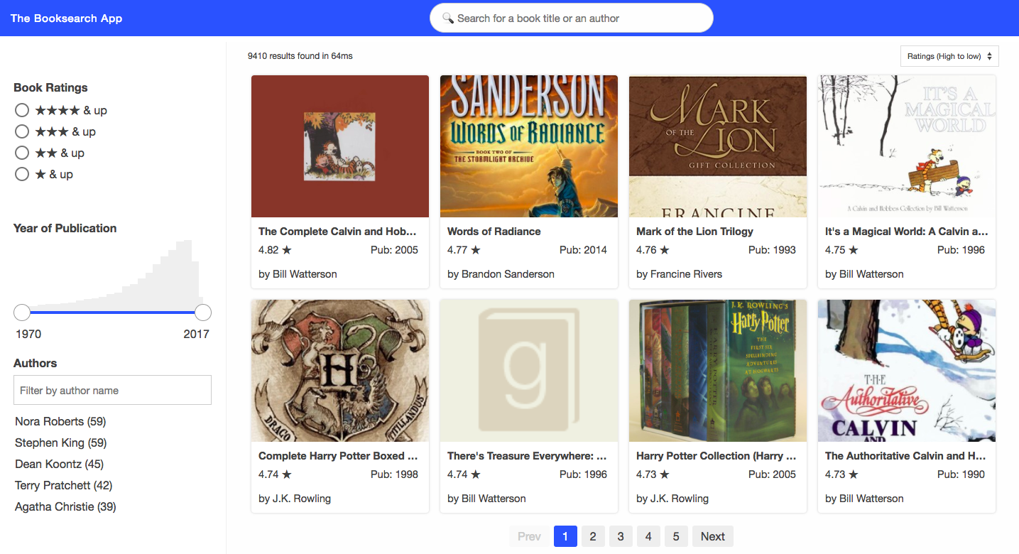

How to put the side bar nav.
How the modal should be
Where the picture should be

Slide 5
THE END

