Slide 1

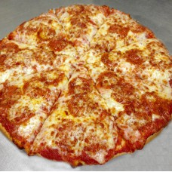
Menu
Specials
Order

Slide 2
Menu
Specials
Order
Large Cheese Pizza: 8.99
Additional Toppings: 1.50 each
Medium Cheese Pizza: 7.99
Additional Toppings: 1.00 each
Personal Medium Cheese Pizza: 5.99
Additional toppings: 5.00 each
Sandwiches:
Spicy Italian: 7.99
Meatball Sub: 7.99
Pizza Sub: 7.99

Slide 3
Menu
Specials
Order
Any large pizza just 10.99 on Thursdays.
Breadsticks come with a free 2-liter.
Personal pizzas come with a free 20oz. soda on Mondays.
Free sweaty gym shorts with equal or greater value gym shorts.
Extra pizza on your pizza at no extra charge.
Answers for stupid questions on the phone will only cost you .50c each upon check out.
Large waffle with purchase of equal or greater butter sticks for only $4.99 more.

Slide 4
Menu
Specials
Order
Be a team player, don’t try to convince us to allow web orders. Nobody likes those.
Phone number:305-7452-1234
If you ask us if it’s the crusty crab, you get an automatic 25% off discount.
Address: 2071 Perkins Street.

