Slide 1
TV Junkie
Search
Contribute
Watch
home

Slide 2

Results
No Results to Display
search
home > search
advanced

Slide 3
Results for “Scott Bakula”
NCIS New Orleans
Quantum Leap
Star Trek Enterprise
Scott Bakula
home > search
advanced

Slide 4
Star Trek Enterprise
Seasons: 4 Total Episodes: 234
Genre: Science Fiction
Air Dates: 1/1/11 – 3/3/13
Released for Syndication: Yes
Show Summary: Post First Contact, Pre Original Series…
Cast: Scott Bakula, Joe Blow, Woman 1, Man 1, Woman 2, Man 2
S01E01: Broken Bow, Part 1
S01E02: Broken Bow, Part 2
S01E03: Made up name
S01E04: Another made up name
search
home > search
advanced

Slide 5
Advanced Search
Actor
Series
Date
Summary
search
home > search > advanced search

Slide 6
Add a TV Show
Update a TV Show
Remove a TV Show
What would you like to do?
home > contribute

Slide 7
Add Show
home > contribute > add show

Slide 8
Update Show
home > contribute > update show

Slide 9
Remove Show
home > contribute > remove show

Slide 10



1:08 / 4:27
Star Trek Enterprise
Season: 01
Episode: 01
More Info
Broken Bow, Part 1
home > watch

Slide 11
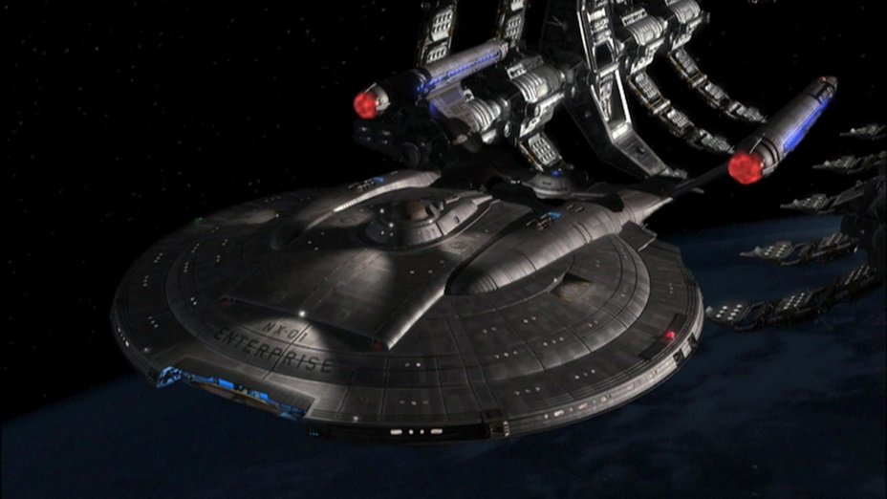
Name: Broken Bow, Part 1 (Season 1, Episode 1)
Genre: Science Fiction
Air Date: 1/1/11
Synopsis: Summary of episode goes here
Blah blah blah, more stuff here…
Just taking up room
Little more
And done.
Cast: Scott Bakula, Woman 1, Man 1, Woman 2, Man 2, Woman 3
1:08 / 4:27
Star Trek Enterprise
Season: 01
Episode: 01
Broken Bow, Part 1
home > watch > more info

