Slide 1
EE 329: Fourier Series Brief Project Overview

Slide 2
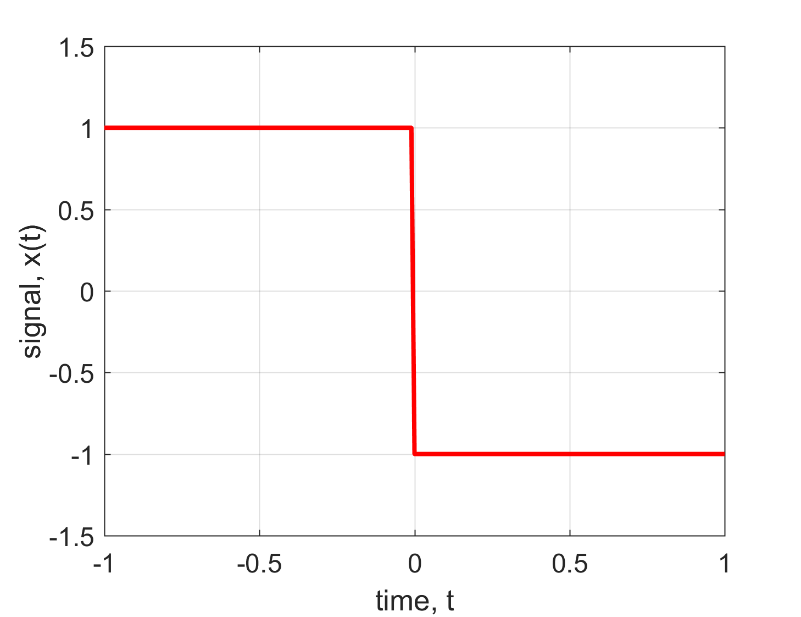
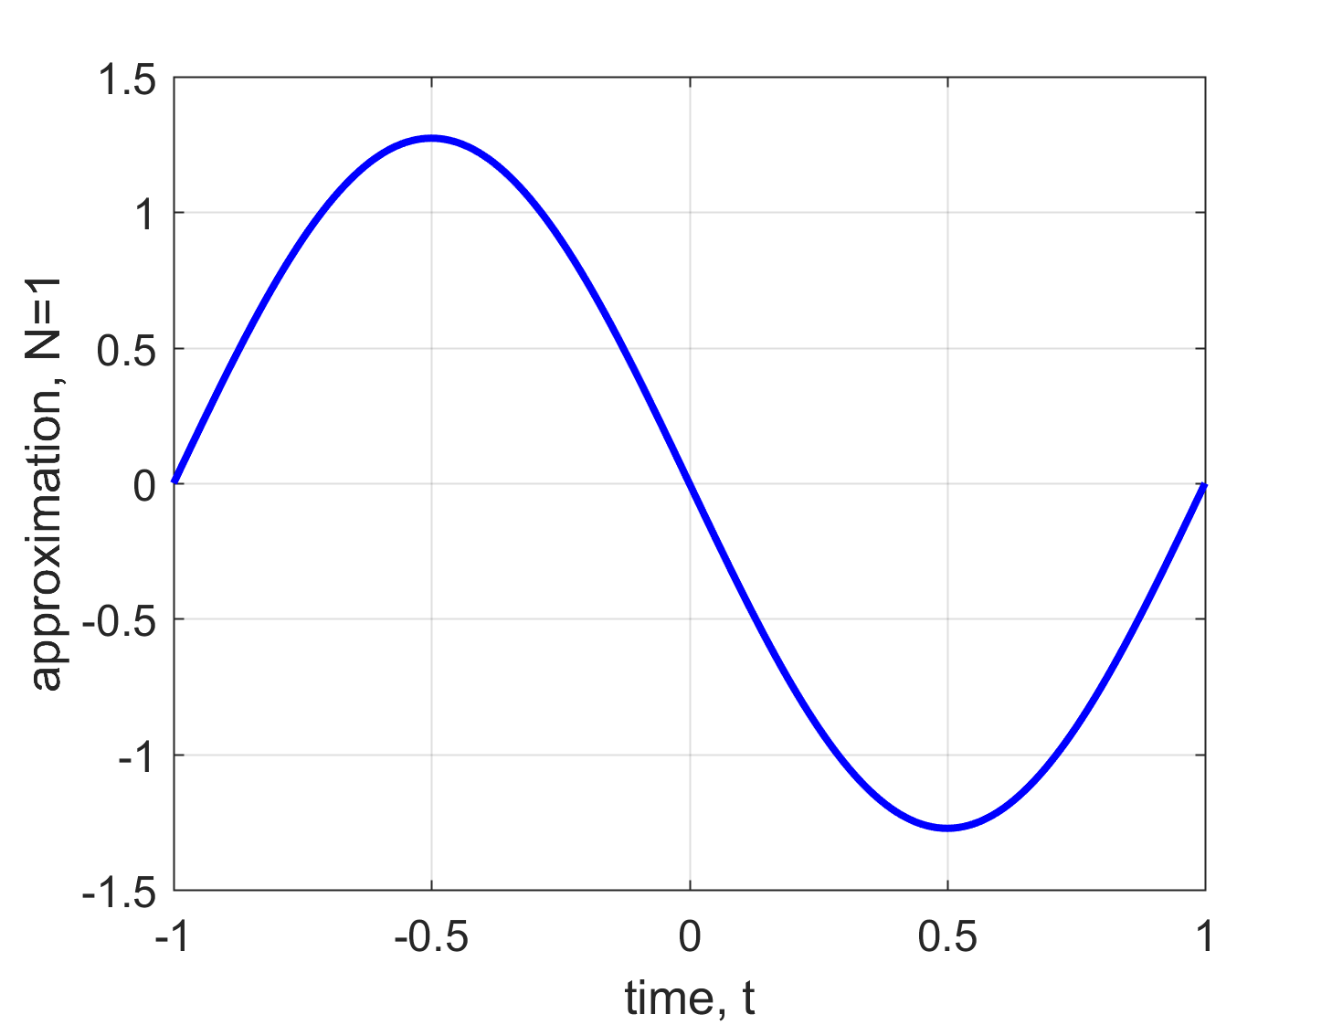
Order of Approximation N = 1

Slide 3
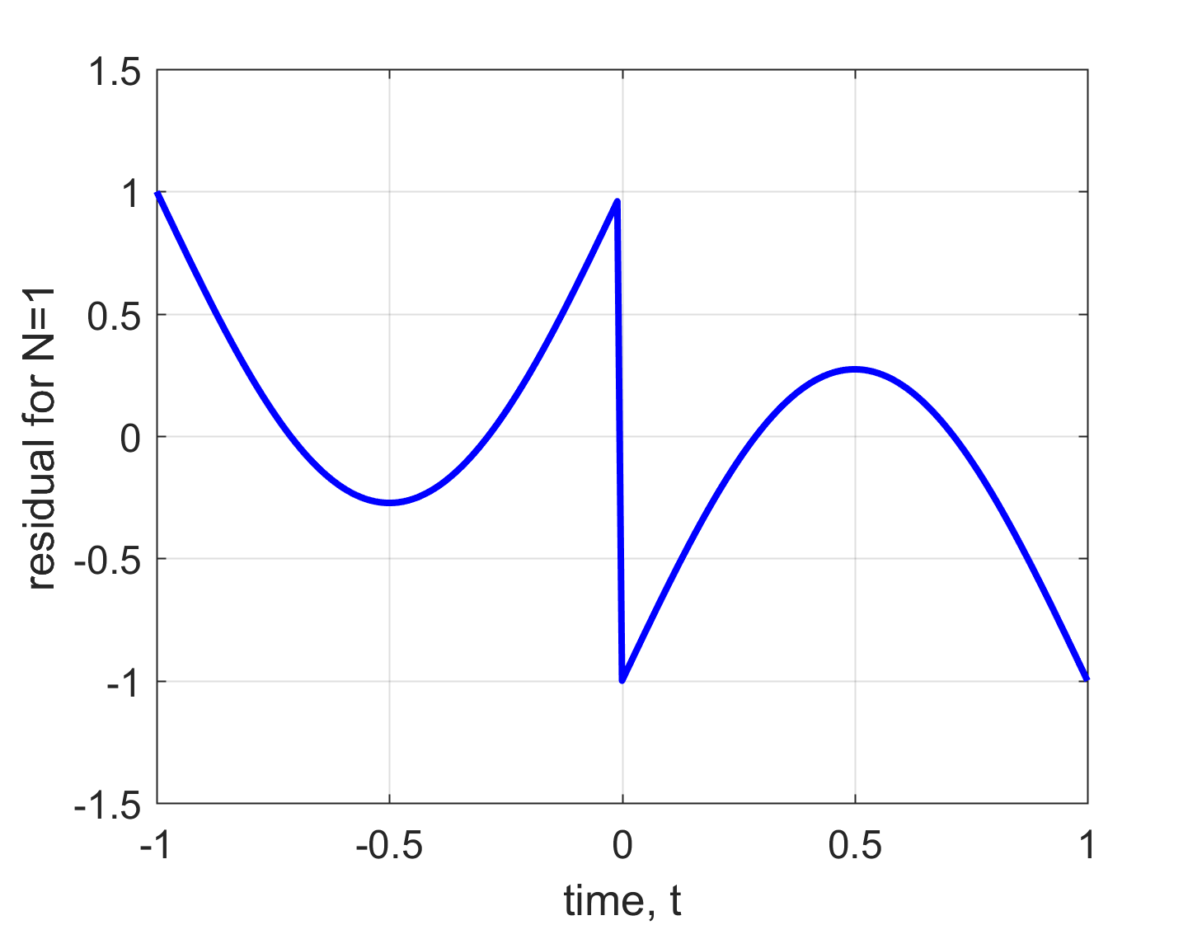
Subtract the two signals
Residual power = 0.1964
(Watts)

Slide 4
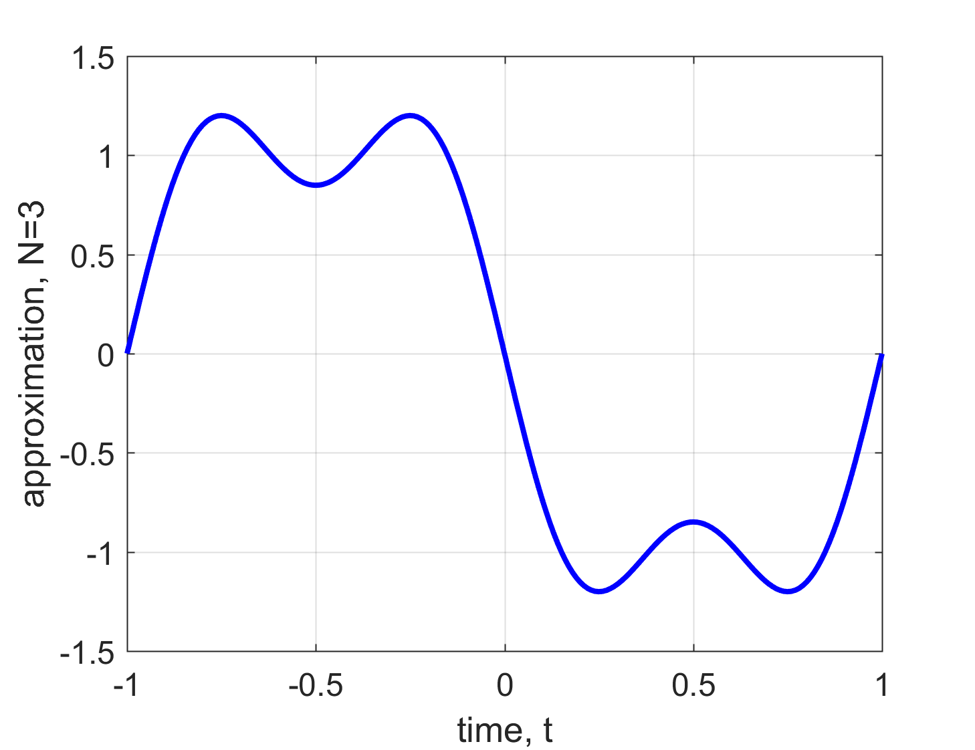
Order of Approximation N = 3

Slide 5
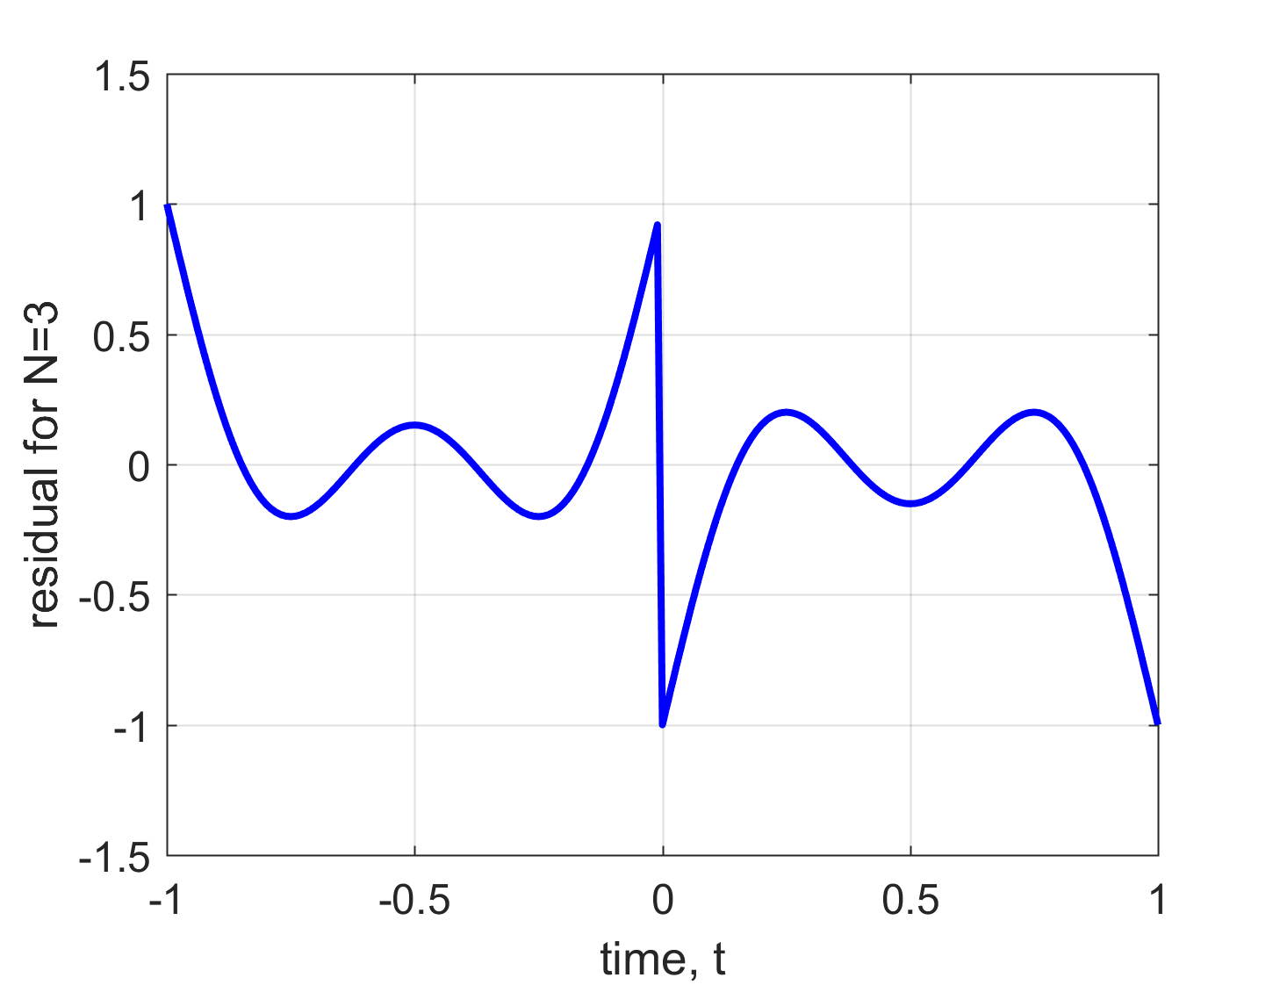
Subtract the two signals
Residual power = 0.1046

Slide 6
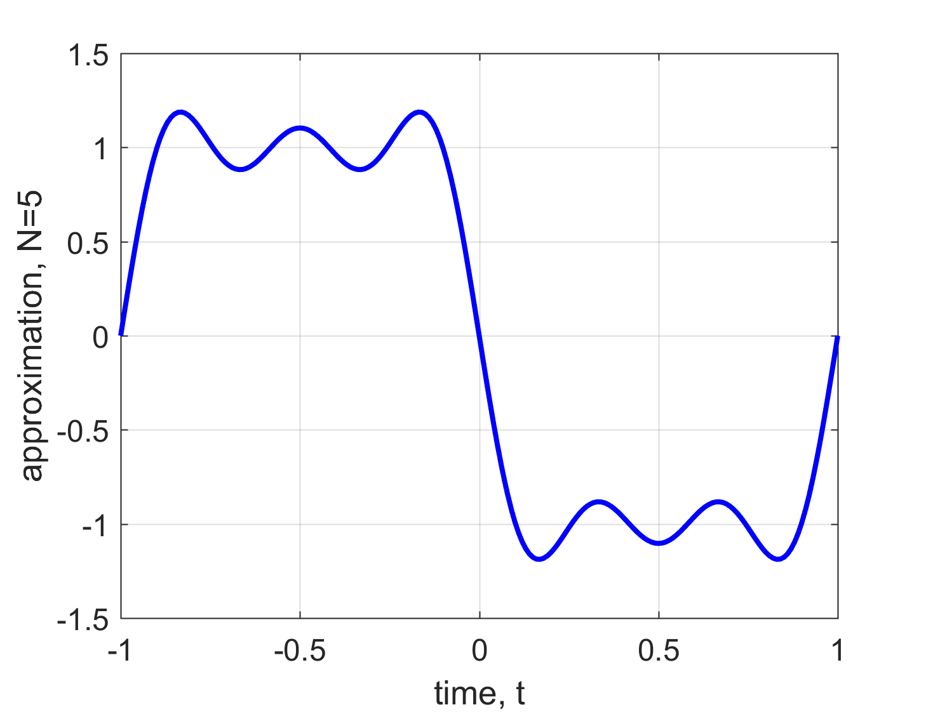
Order of Approximation N = 5

Slide 7
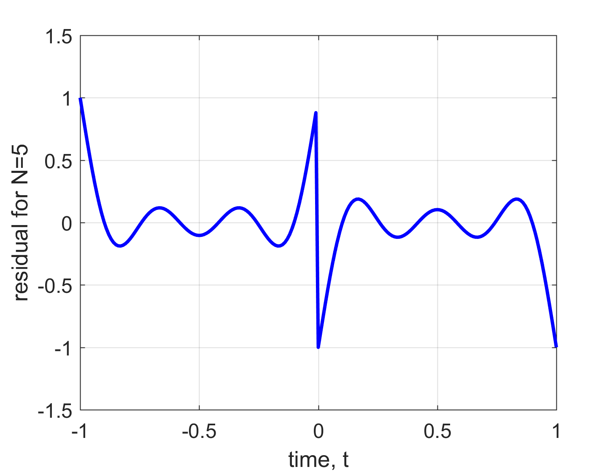
Subtract the two signals
Residual power = 0.0723

Slide 8
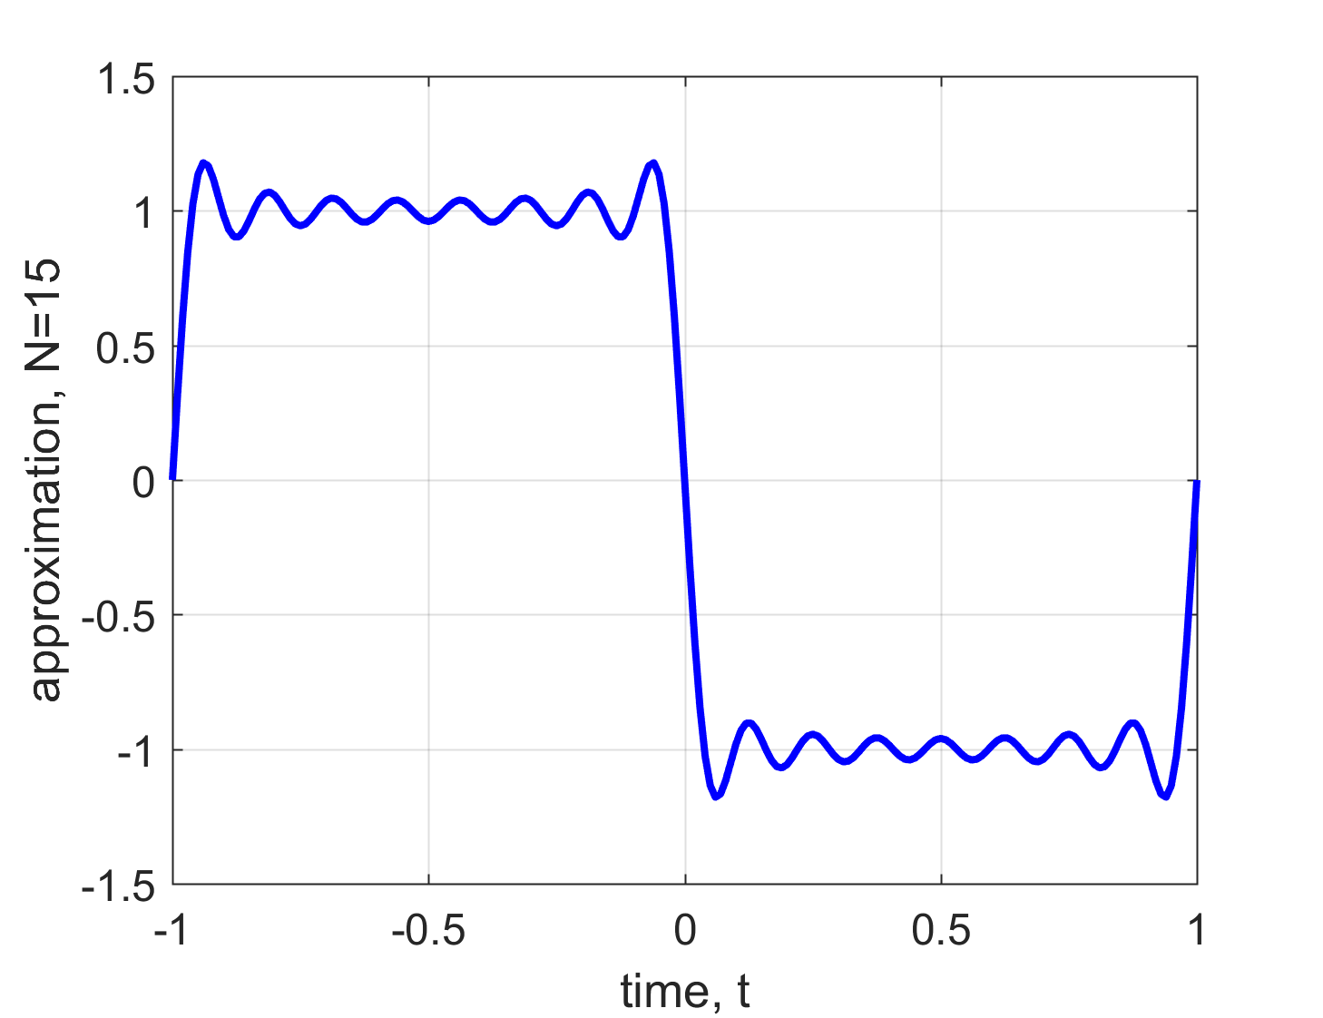
Order of Approximation N = 15

Slide 9
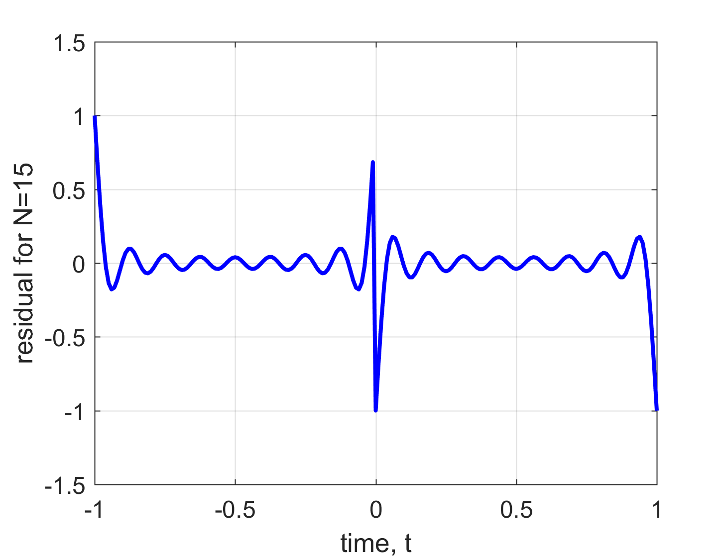
Subtract the two signals
Residual power = 0.031 4

Slide 10
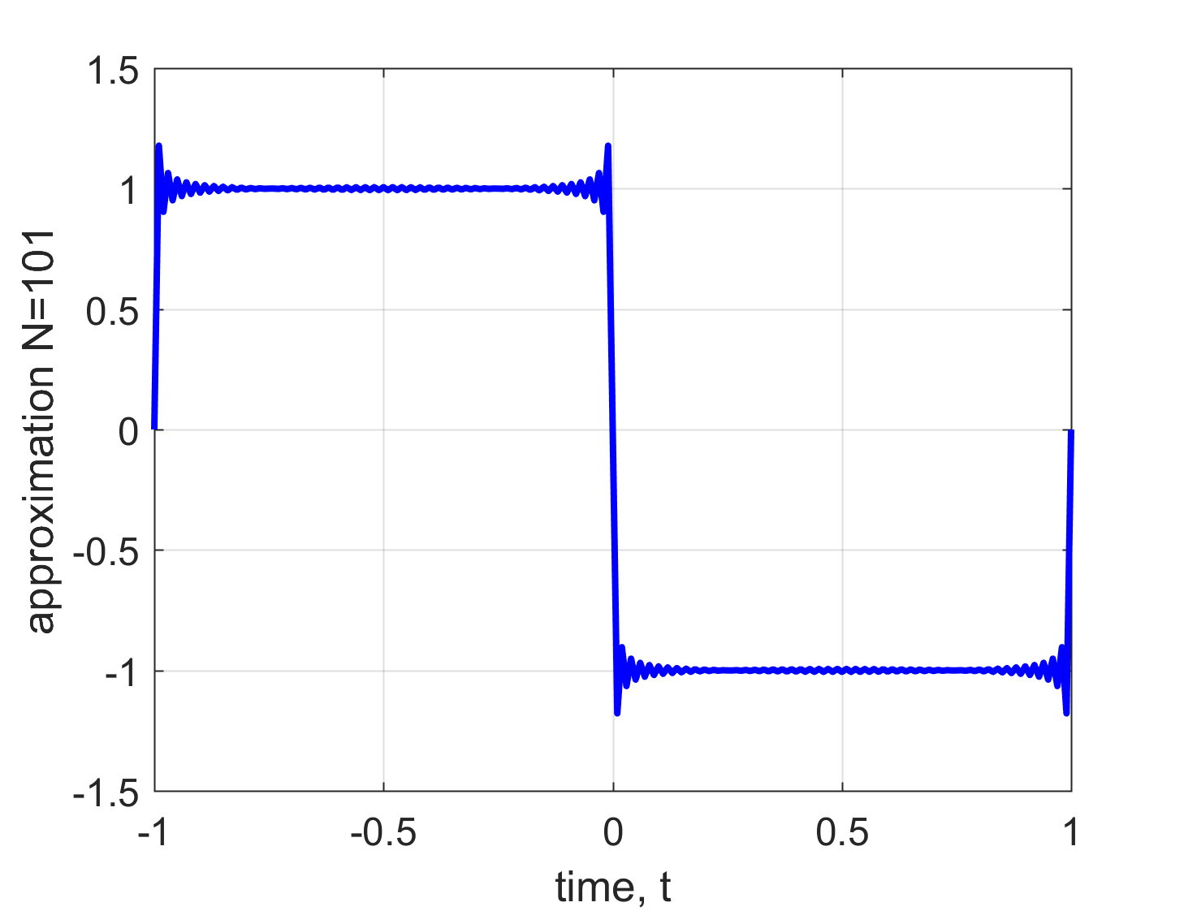
Order of Approximation N = 101

Slide 11
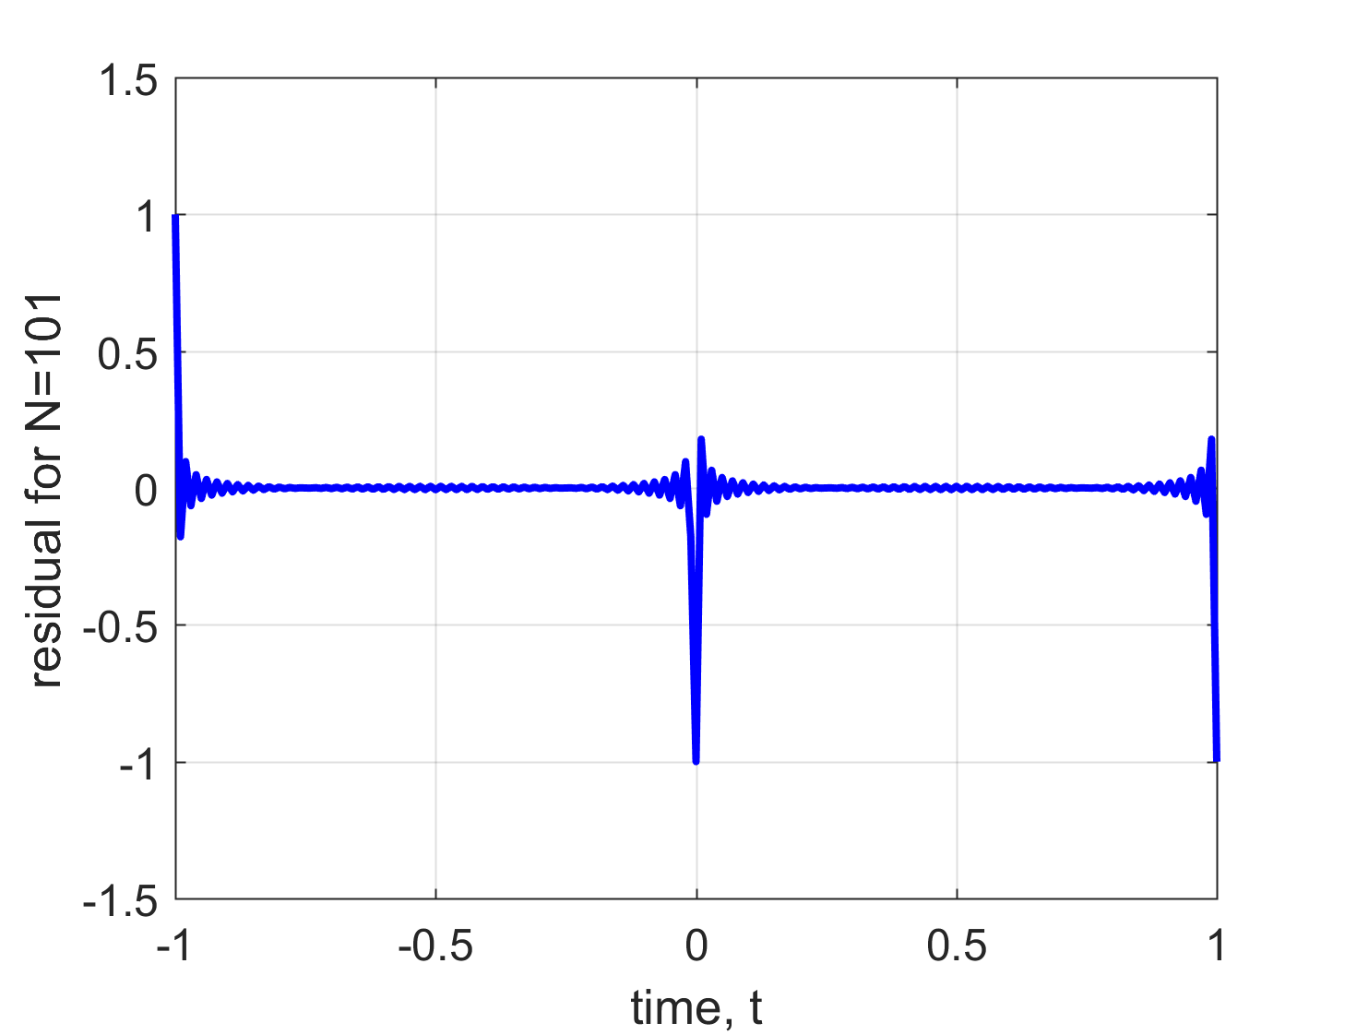
Subtract the two signals
Residual power = 0.0161

