Slide 1
Sound = pressure wave

Slide 2
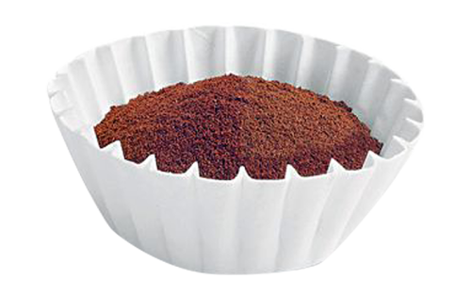
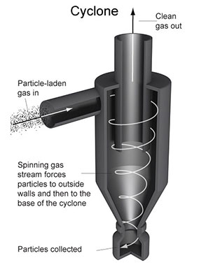
Filters
Coffee filter
Particle filter (to measure pollutions)
Filters in Signal Processing (remove or attenuate some frequencies while keeping the others without any change)

Slide 3
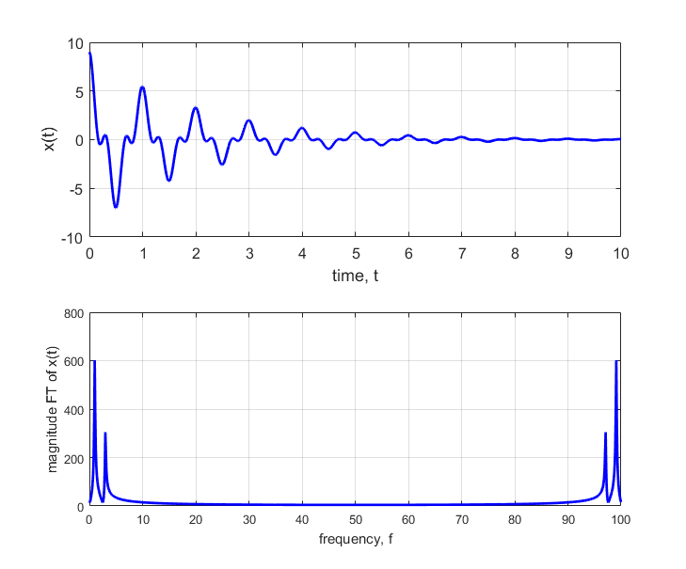
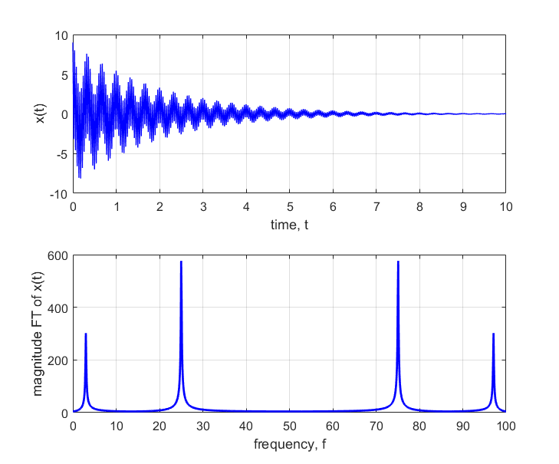

Recall (Lecture 3)
A signal can be presented as a mixture of sines and cosines (complex exponentials)
$$\int_{−∞}^{+∞}{X\left(f\right)e^{−j2πft}}df=x(t)$$
$X(f)$ tell us how much each frequency contributes

Slide 4
Illustration

Slide 5
Illustration

Slide 6
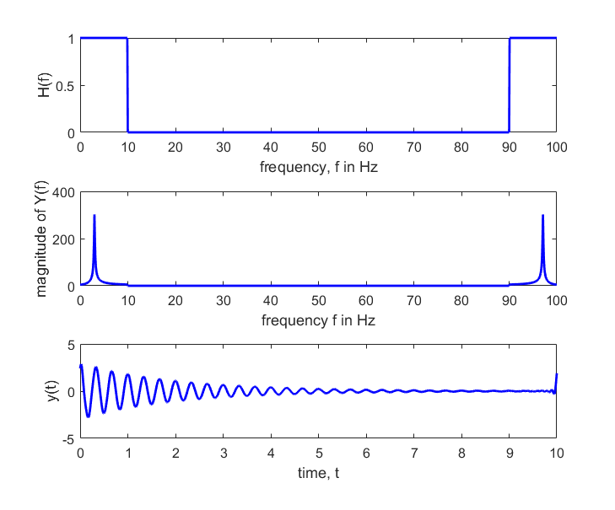
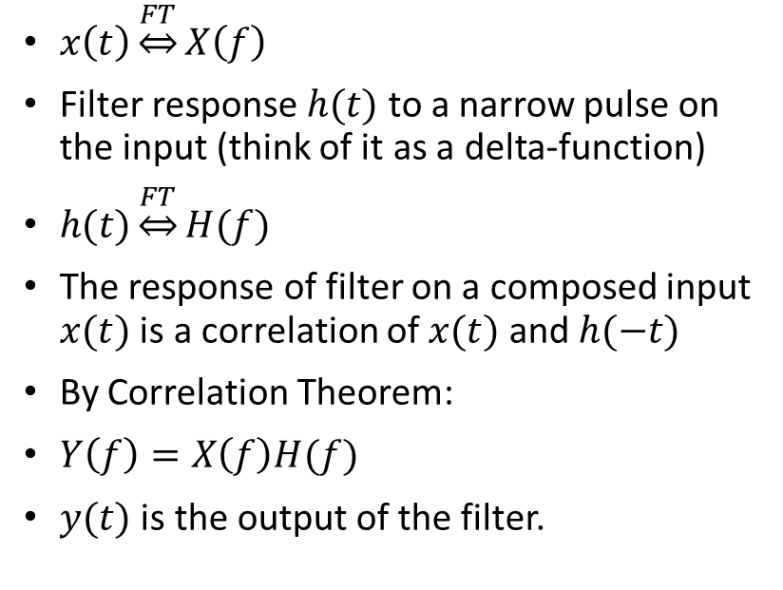
How are filters applied?
$x\left(t\right)\underset{⇔}{FT}X\left(f\right)$
Filter response $h(t)$ to a narrow pulse on the input (think of it as a delta-function)
$h(t)\underset{⇔}{FT}H(f)$
The response of filter on a composed input $x(t)$ is a correlation of $x(t)$ and $h(−t)$
By Correlation Theorem:
$Y\left(f\right)=X\left(f\right)H(f)$
$y(t)$ is the output of the filter.

Slide 7
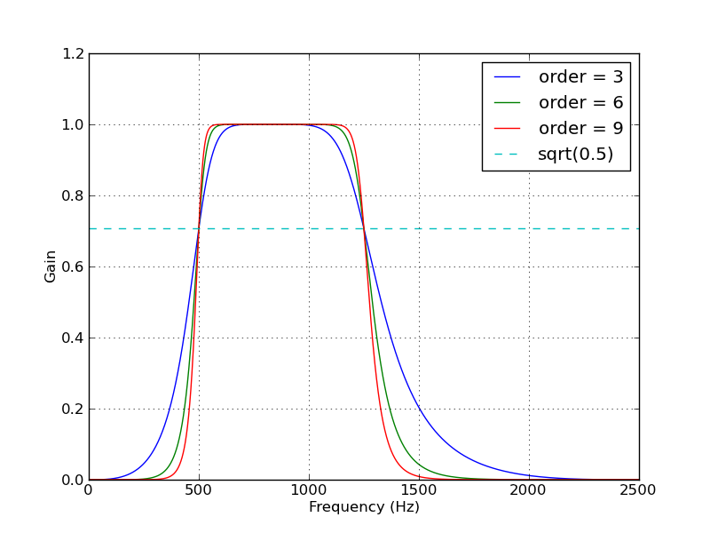
Four types of filters
Low pass = suppresses high frequencies, passes low frequencies
High pass = passes high frequencies and suppresses low
Band pass = passes medium frequencies, suppresses low and high
Band stop

Slide 8
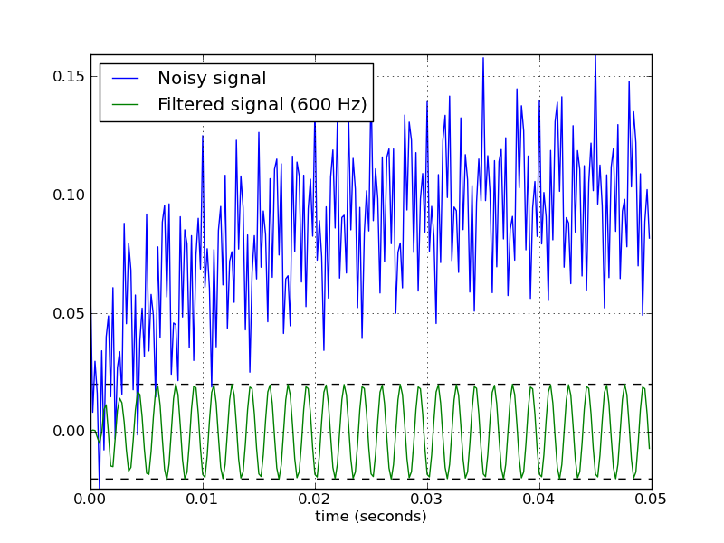
Illustration

Slide 9
Low pass filtering: the original signal and its FT

Slide 10
Signal and its FT after low pass filtering

Slide 11
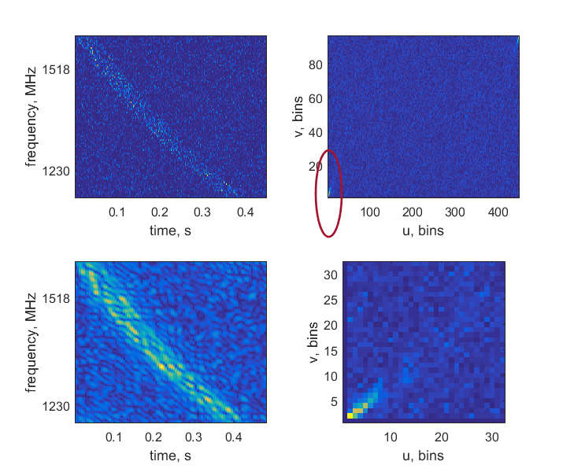
Filtering in 2D
Simulated pulse in filter-bank format (image)
DM = 375
S/N = 25
Pulse width T = 50 ms
Apply low-pass filter in 2d FT space

