Slide 1

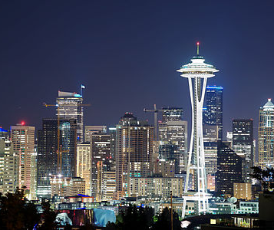

Mixing = modulation
A low pass signal (described by low frequencies) such as voice and video cannot be sent from New York to Seattle.
In fact, voice loses power $\sim \frac{1}{d^{2}}$ (you cannot hear me speaking if you are 30 meters away)
The fact that voice dissipates indicates that the environment (air) is resistant to low frequencies.
We can transmit voice as is, but we will need an antenna of size 10-100 km.

Slide 2

How to overcome the resistance of the air?
Air (channel) acts as a band pass filter.
Voice, video, etc. are low pass signals.
To pass voice over channel, we need to translate voice to medium frequency.
This is done through modulation (mixing).

Slide 3
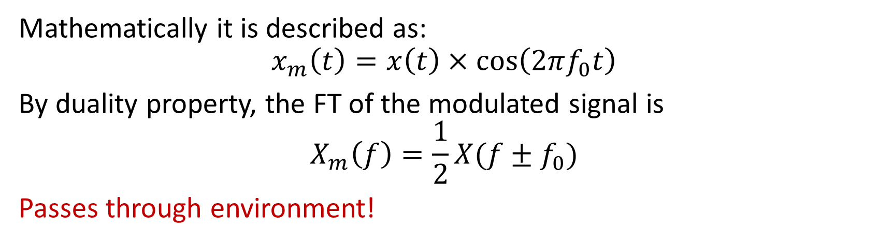
How do we do this?
We want:
Mathematically it is described as:
$$x_{m}\left(t\right)=x\left(t\right)×\cos\left(2πf_{0}t\right)$$
By duality property, the FT of the modulated signal is
$$X_{m}\left(f\right)=\frac{1}{2}X(f±f_{0})$$
Passes through environment!

Slide 4

Demodulation (how to extract voice from modulated signal?)
Multiply the modulated signal by the same cosine function.
$x_{m}(t)×cos⁡(2πf_{0}t)$
Pass the result through a low pass filter (set $f_{cutoff}=W$)
Amplify the signal

Slide 5
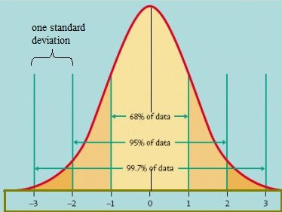
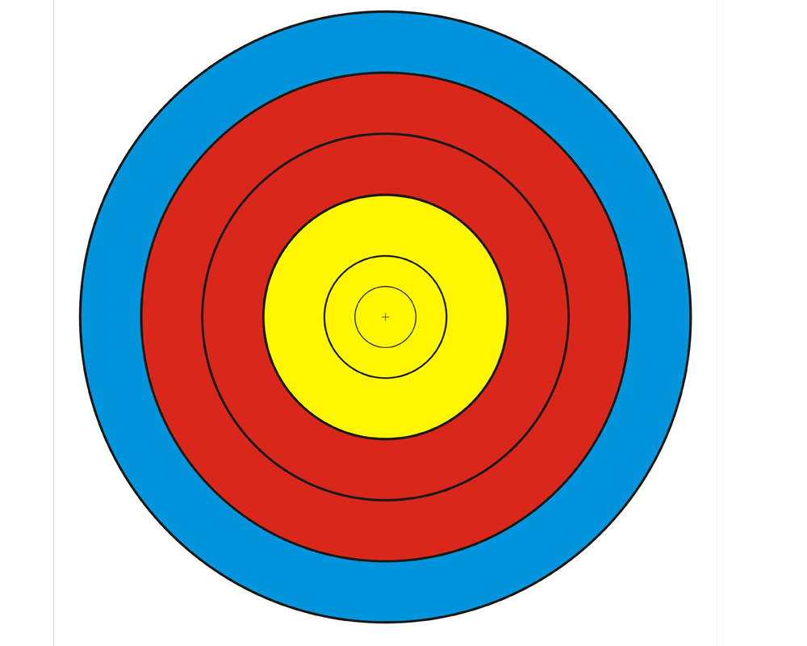
A random experiment
Random experiment = outcome cannot be predicted
Example: Bow and arrows (2d target)
Outcomes and their probabilities = weights (how often do we observe an outcome?)
Fit a 2D function into the point on the target and look at the slice – it is a Gaussian bell.

Slide 6
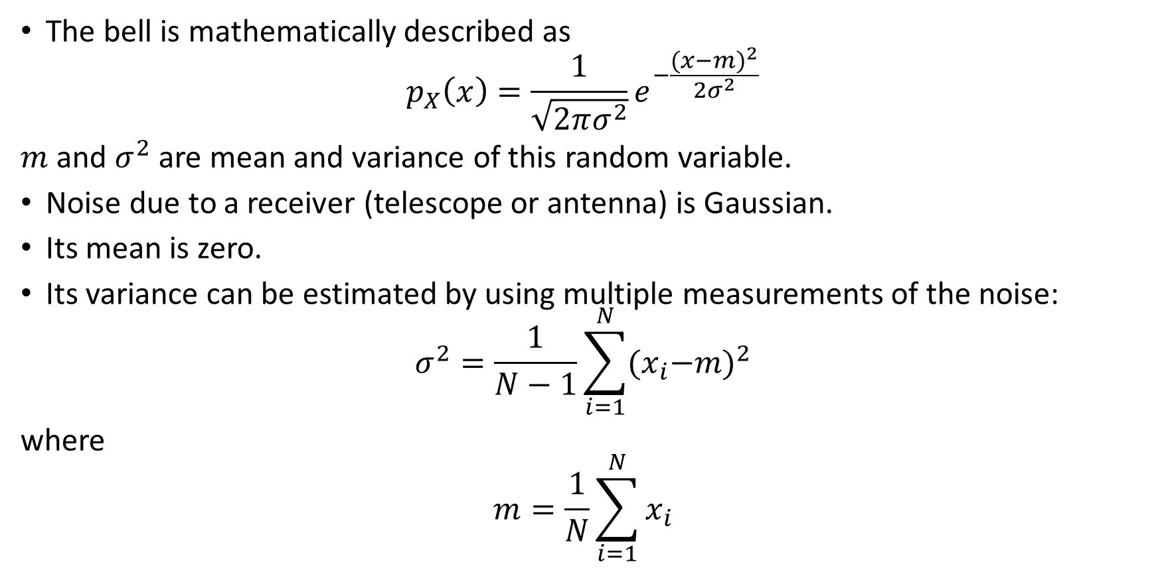
Gaussian probability density function
The bell is mathematically described as
$$p_{X}\left(x\right)=\frac{1}{\sqrt{2πσ^{2}}}e^{−\frac{{(x−m)}^{2}}{2σ^{2}}}$$
$m$ and $σ^{2}$ are mean and variance of this random variable.
Noise due to a receiver (telescope or antenna) is Gaussian.
Its mean is zero.
Its variance can be estimated by using multiple measurements of the noise:
$$σ^{2}=\frac{1}{N−1}\sum_{i=1}^{N}{{{(x}_{i}−m)}^{2}}$$
where
$$m=\frac{1}{N}\sum_{i=1}^{N}{x_{i}}$$

