Slide 1
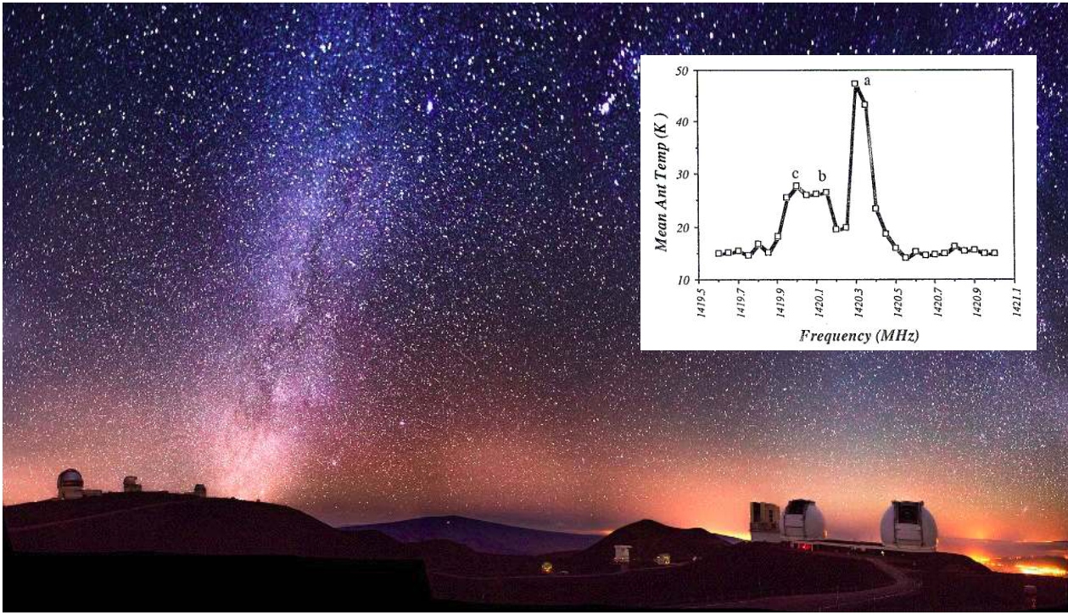
An Introduction to Astronomy
Notes:
Source edition: assets/lessons/lectures/astronomy/units-and-scales.pdf, page 1. Original author and figure credits remain on the slide. Text is editable; illustrations retain their source artwork.

Slide 2

A Rough Course Outline
Part I - Introductory material – Today to 6-July
The motions in the sky
Early history of Astronomy
Light and telescopes
Part II – Stars – 7-July to 10-July
Stars and the Sun
Stellar birth, evolution, and death
Part III - Galaxies and cosmology – 11-July to 19-July
HI and the Interstellar Medium
The Milky Way
The origin and evolution of the Universe
Life Beyond Earth
Notes:
Source edition: assets/lessons/lectures/astronomy/units-and-scales.pdf, page 2. Original author and figure credits remain on the slide. Text is editable; illustrations retain their source artwork.

Slide 3

Goals for Today
Goals for Today
1) Scientific notation and units
2) Where are we?
3) How did we get here?
4)
How are we moving?
Notes:
Source edition: assets/lessons/lectures/astronomy/units-and-scales.pdf, page 3. Original author and figure credits remain on the slide. Text is editable; illustrations retain their source artwork.

Slide 4

Units
In astronomy (and science in general) we use SI
(Systeme Internationale) units.
The SI system uses length, mass, time, and temperature
as its basic properties
The basic units for these properties are:
length: the meter (m) (about a yard, 3 feet)
mass: the kilogram (kg) (2.2 pounds)
time: the second (s)
temperature: the Kelvin (K) (same increments as
Celsius, but 273 degrees higher)
We will encounter some other units also
Light years, parsecs, astronomical units, solar
masses etc.
Notes:
Source edition: assets/lessons/lectures/astronomy/units-and-scales.pdf, page 4. Original author and figure credits remain on the slide. Text is editable; illustrations retain their source artwork.

Slide 5
Scientific Notation
Astronomers use numbers that are often very large
or small and writing out the numbers is
cumbersome.
•
The distance to the nearest star:
40,000,000,000,000km
•
The radius of an atomic nucleus: 0.0000000001 m
We use
scientific notation
to express numbers
compactly.
•
The distance to the nearest star is
4 x 10
13
km
(4 times 10 to the 13 km)
•
The radius of an atomic nucleus is 1 x 10
-10
m
(1 times 10 to the minus 10 m)
Notes:
Source edition: assets/lessons/lectures/astronomy/units-and-scales.pdf, page 5. Original author and figure credits remain on the slide. Text is editable; illustrations retain their source artwork.

Slide 6

Scientific Notation
Positive exponents and common abbreviations
Just count the zeros!
10
1
= 10 = ten
10
2
= 10x10 = 100 = hundred
10
3
= 10x10x10 = 1,000 = thousand
(kilo- k)
10
4
= 10,000 = ten thousand
10
5
= 100,000 = hundred thousand
10
6
= 1,000,000 = million
(Mega- M)
10
7
= 10,000,000 ten million
10
8
= 100,000,000 = hundred million
10
9
= 1,000,000,000 = billion
(Giga- G)
Notes:
Source edition: assets/lessons/lectures/astronomy/units-and-scales.pdf, page 6. Original author and figure credits remain on the slide. Text is editable; illustrations retain their source artwork.

Slide 7

Scientific Notation
Negative exponents and common
abbreviations
Count the zeros (including the one to the left
of the decimal place)!
10
-1
= (1/10) = 0.1 = one tenth
10
-2
= (1/100) = 0.01 one hundredth
(centi)
10
-3
= 0.001 = one thousandth
(milli)
10
-4
= 0.0001 = one ten thousandth
10
-5
= 0.00001 = one hundred thousandth
10
-6
= 0.000001 = one millionth (micro)
10
-7
= 0.0000001 = one ten millionth
10
-8
= 0.00000001 = one hundred millionth
10
-9
= 0.000000001 = one billionth (nano)
Notes:
Source edition: assets/lessons/lectures/astronomy/units-and-scales.pdf, page 7. Original author and figure credits remain on the slide. Text is editable; illustrations retain their source artwork.

Slide 8
For you to do....
Write the following in scientific
notation (3 min):
1) 100 billion (# stars in Milky Way)
2) 0.009154 (Earth's diameter
compared to the Sun's)
3) 18,332,507,225,851 (US national
debt as of 4 August 2015)
Notes:
Source edition: assets/lessons/lectures/astronomy/units-and-scales.pdf, page 8. Original author and figure credits remain on the slide. Text is editable; illustrations retain their source artwork.

Slide 9
For you to do....
Write the following in scientific
notation (3 min):
1) 100 billion = 1.00 x 10
11
2) 0.009154 = 9.15 x 10
-3
3) 18,332,507,225,851 = 1.83 x 10
13
Notes:
Source edition: assets/lessons/lectures/astronomy/units-and-scales.pdf, page 9. Original author and figure credits remain on the slide. Text is editable; illustrations retain their source artwork.

Slide 10
Where are we?
“I’m a lonely insignificant speck on a has-been
planet orbited by a cold and indifferent sun.”
–
Homer in “El Viaje Misterioso de Nuestro Homer”
OR
We live on a rocky planet in the inner part
of our Solar System that orbits an average
size star in the outer part of a large galaxy
inside a small group of about 30 galaxies,
in our local supercluster, in the Universe.
Notes:
Source edition: assets/lessons/lectures/astronomy/units-and-scales.pdf, page 10. Original author and figure credits remain on the slide. Text is editable; illustrations retain their source artwork.

Slide 11
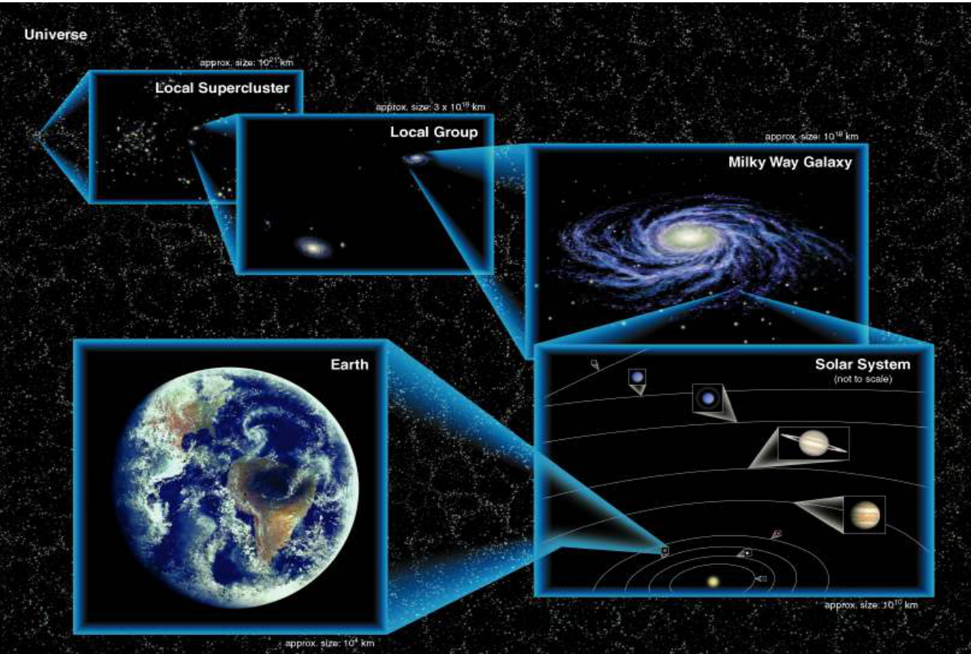
Where are we?
Notes:
Source edition: assets/lessons/lectures/astronomy/units-and-scales.pdf, page 11. Original author and figure credits remain on the slide. Text is editable; illustrations retain their source artwork.

Slide 12
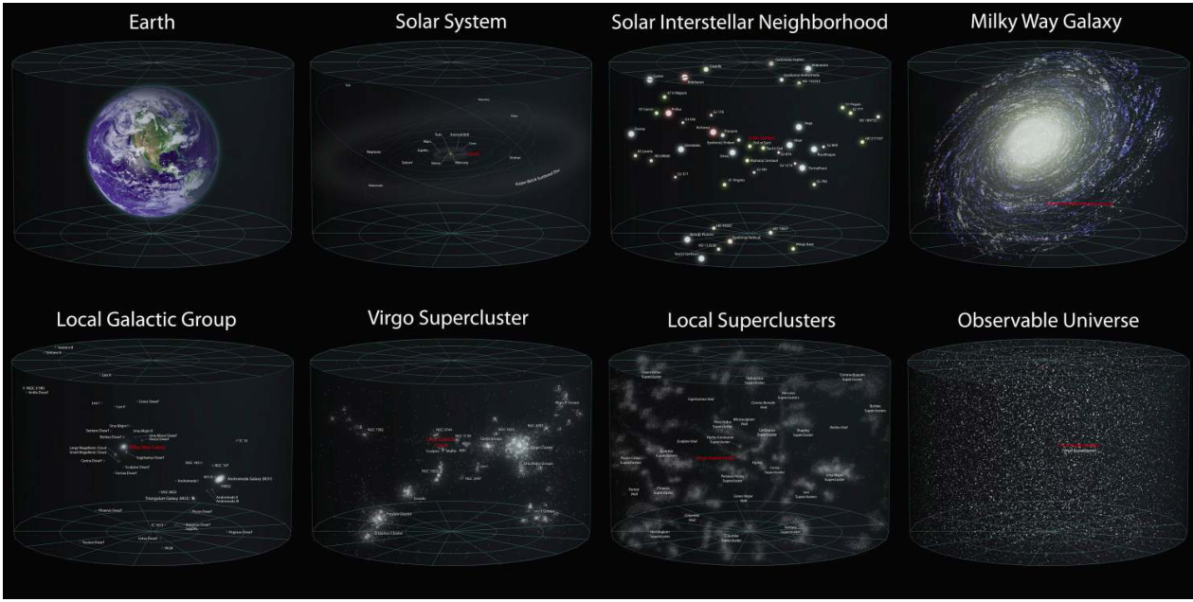
Units and scales
Notes:
Source edition: assets/lessons/lectures/astronomy/units-and-scales.pdf, page 12. Original author and figure credits remain on the slide. Text is editable; illustrations retain their source artwork.

Slide 13

Components of our Solar System
A
solar system
is: A star and all the material
that orbits it, including its planets and
moons.
The Sun
Planets and their moons
- Now only eight planets (Sorry Pluto)
Asteroids/Comets/Planetoids
Spacecraft and space junk
Notes:
Source edition: assets/lessons/lectures/astronomy/units-and-scales.pdf, page 13. Original author and figure credits remain on the slide. Text is editable; illustrations retain their source artwork.

Slide 14
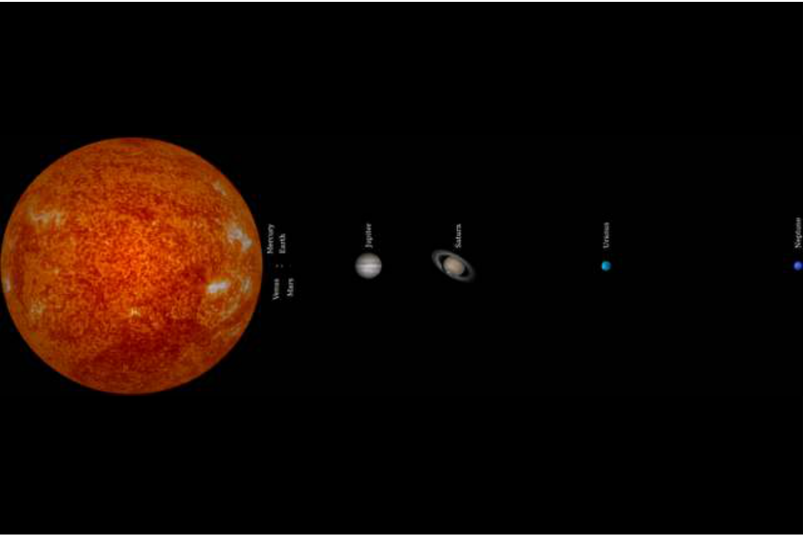
Our Solar System (distances to scale)
Notes:
Source edition: assets/lessons/lectures/astronomy/units-and-scales.pdf, page 14. Original author and figure credits remain on the slide. Text is editable; illustrations retain their source artwork.

Slide 15
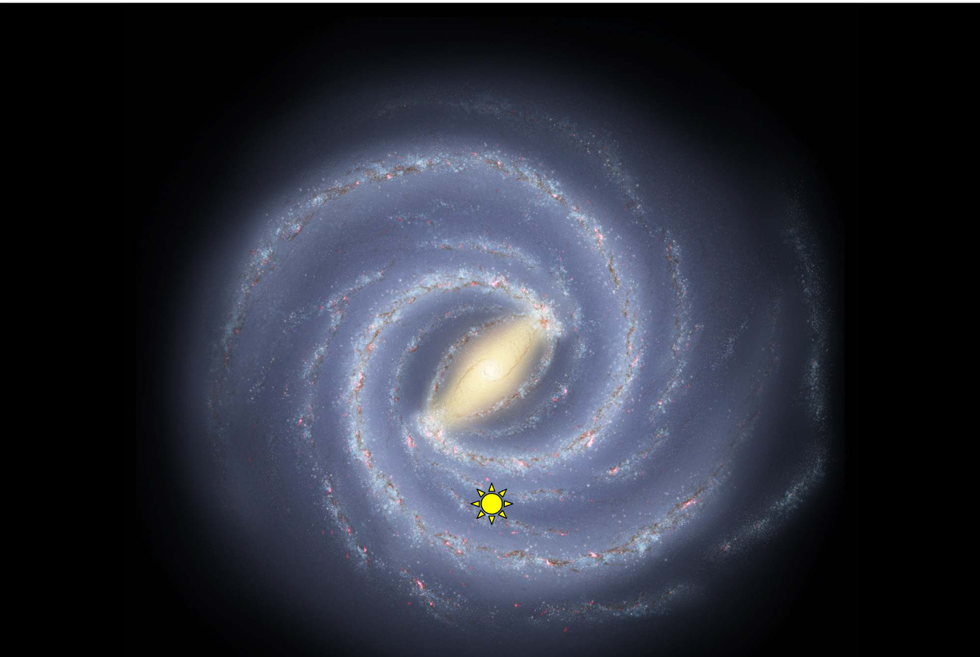
Our Galaxy
100 billion stars! That’s 10
11
!
100 billion stars means 100 billion other
solar systems that may have Earth-like
planets orbiting them
Notes:
Source edition: assets/lessons/lectures/astronomy/units-and-scales.pdf, page 15. Original author and figure credits remain on the slide. Text is editable; illustrations retain their source artwork.

Slide 16
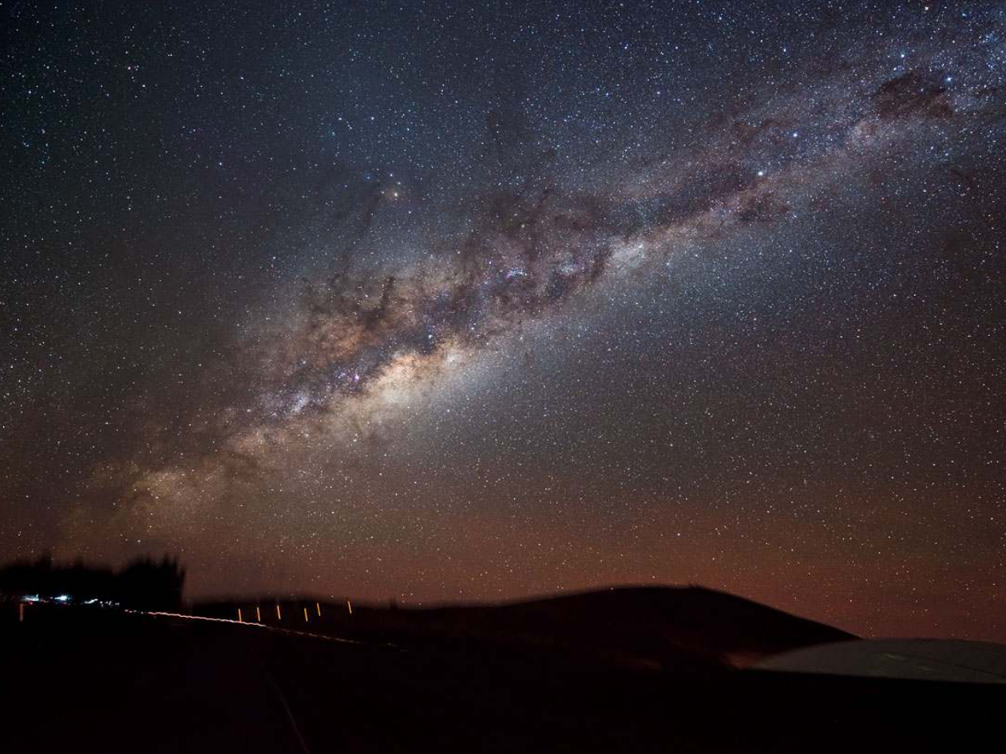
Units and scales
Notes:
Source edition: assets/lessons/lectures/astronomy/units-and-scales.pdf, page 16. Original author and figure credits remain on the slide. Text is editable; illustrations retain their source artwork.

Slide 17
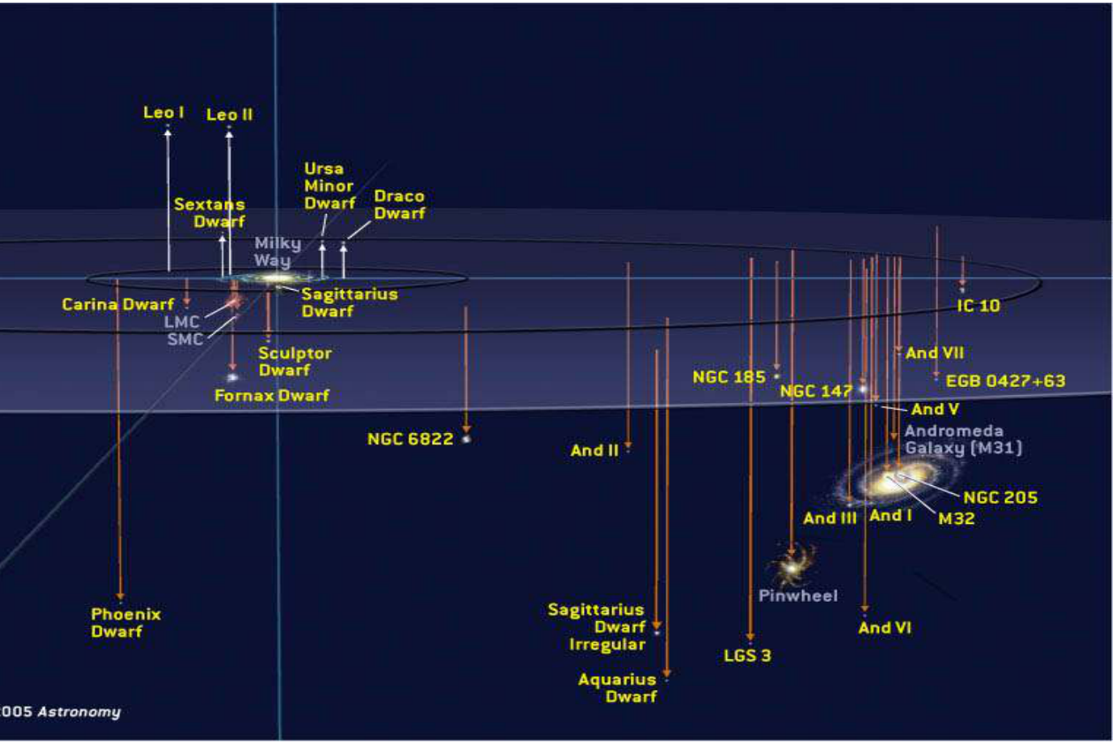
Local Group
Notes:
Source edition: assets/lessons/lectures/astronomy/units-and-scales.pdf, page 17. Original author and figure credits remain on the slide. Text is editable; illustrations retain their source artwork.

Slide 18
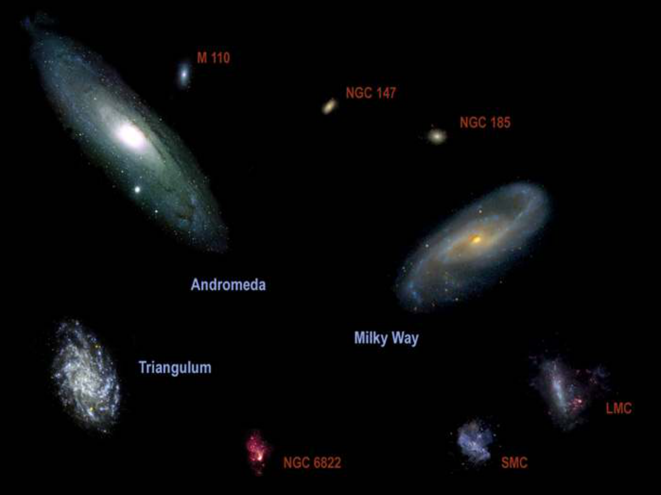
Local Group Galaxies
Notes:
Source edition: assets/lessons/lectures/astronomy/units-and-scales.pdf, page 18. Original author and figure credits remain on the slide. Text is editable; illustrations retain their source artwork.

Slide 19

The Universe
At Least 100 billion (10
11
) galaxies.
If each galaxy has 100 billion stars, there
are 10
11
x 10
11
= 10
22
stars in the universe,
more than all the grains of sand on all the
beaches on Earth.
NOTE: EXPONENTS ADD WHEN MULTIPLIED
Notes:
Source edition: assets/lessons/lectures/astronomy/units-and-scales.pdf, page 19. Original author and figure credits remain on the slide. Text is editable; illustrations retain their source artwork.

Slide 20
The Virgo Supercluster
The local grouping of galaxies.
Contains the Local Group and the Virgo
Cluster, in addition to about 100 other
galaxy groups and clusters.
Notes:
Source edition: assets/lessons/lectures/astronomy/units-and-scales.pdf, page 20. Original author and figure credits remain on the slide. Text is editable; illustrations retain their source artwork.

Slide 21
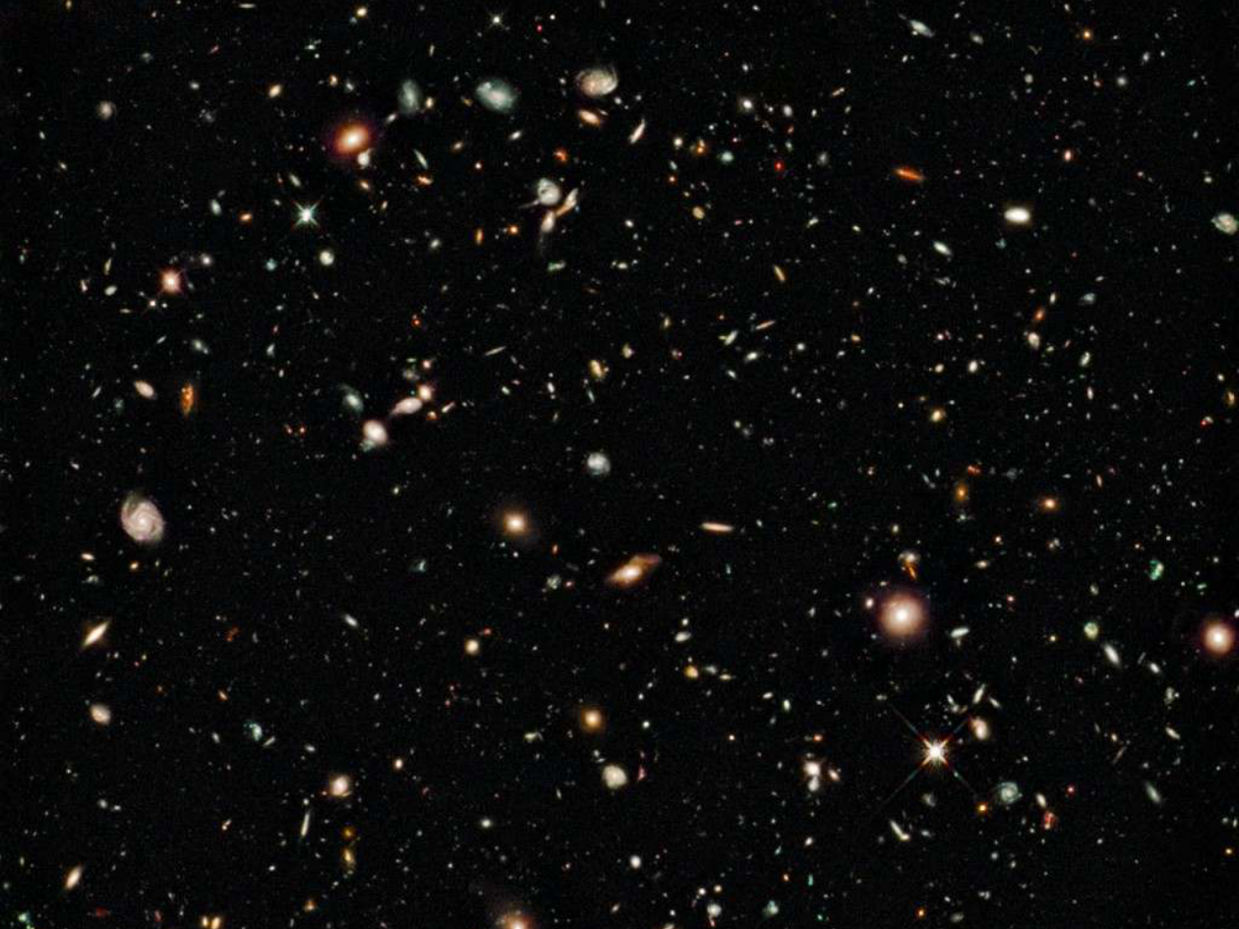
Units and scales
Notes:
Source edition: assets/lessons/lectures/astronomy/units-and-scales.pdf, page 21. Original author and figure credits remain on the slide. Text is editable; illustrations retain their source artwork.

Slide 22
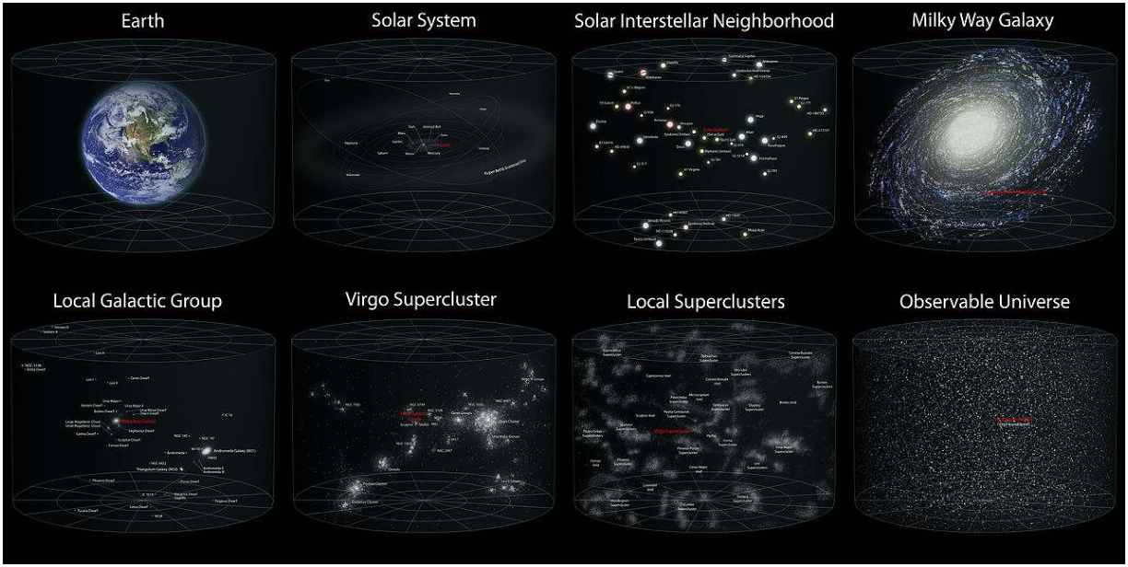
Where are we? (review)
We live on a rocky planet in the inner part of our Solar
System that orbits an average size star in the outer
part of a large galaxy inside a small group of about 30
galaxies, in our local supercluster, in the Universe.
Notes:
Source edition: assets/lessons/lectures/astronomy/units-and-scales.pdf, page 22. Original author and figure credits remain on the slide. Text is editable; illustrations retain their source artwork.

Slide 23
Where are we videos
http://htwins.net/scale2/
http://www.youtube.com/watch?
v=17jymDn0W6U
Notes:
Source edition: assets/lessons/lectures/astronomy/units-and-scales.pdf, page 23. Original author and figure credits remain on the slide. Text is editable; illustrations retain their source artwork.

Slide 24
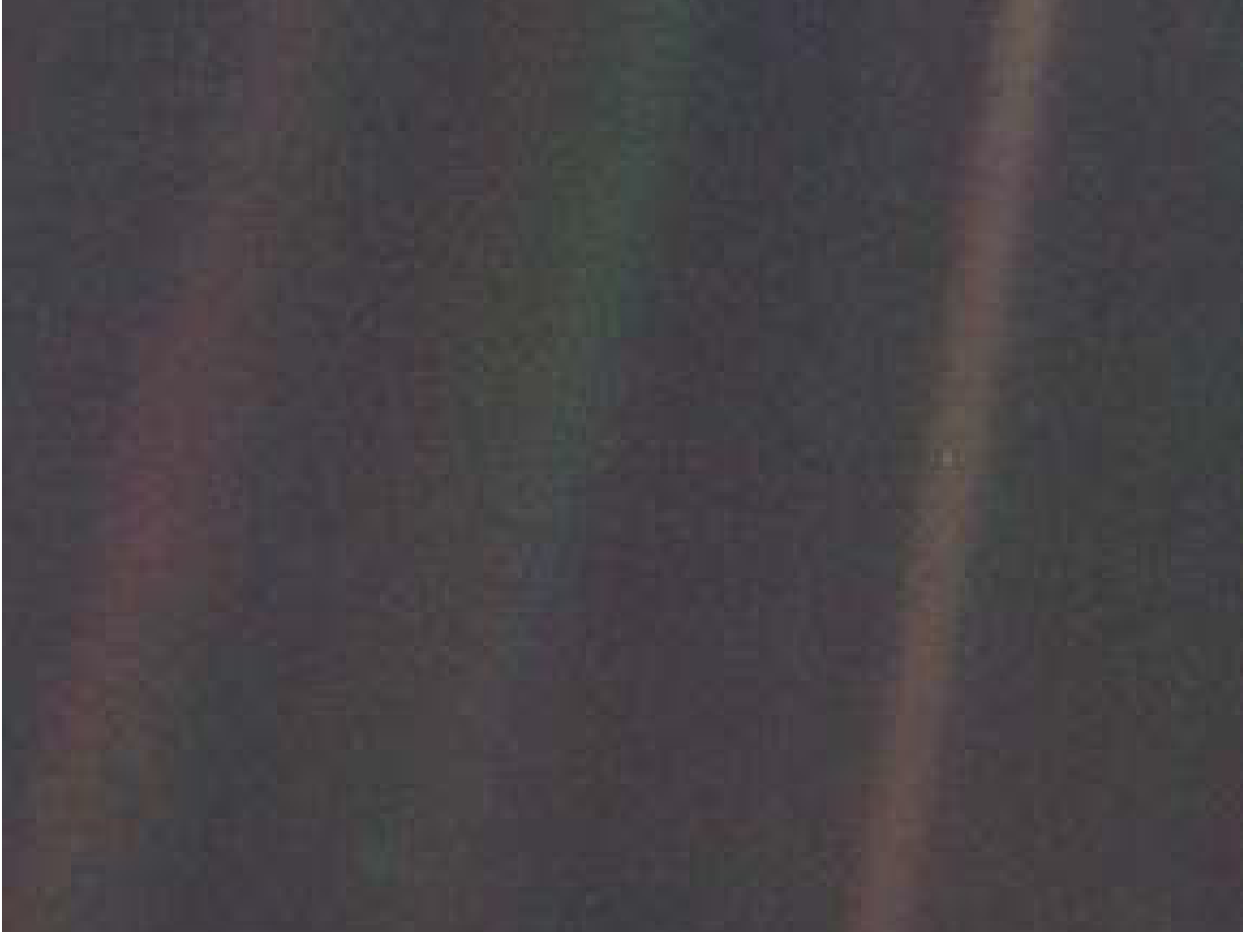
Units and scales
Carl Sagan’s Pale Blue Dot
https://www.youtube.com/watch?
v=b58SfRphkKc
Notes:
Source edition: assets/lessons/lectures/astronomy/units-and-scales.pdf, page 24. Original author and figure credits remain on the slide. Text is editable; illustrations retain their source artwork.

Slide 25

How did we get here?
Steps in your creation:
~
14 billion years ago
, the Universe was created in a
violent explosion called the Big Bang.
Our Milky Way Galaxy formed ~2 billion years after
the Big Bang.
Five billion years ago
(9 billion years after the Big
Bang) the Sun and the solar system forms.
4 billion years ago
the most primitive life forms on
Earth.
100,000 years ago
modern humans evolved in Africa.
Some decades ago, you gained consciousness
(finally!).
Notes:
Source edition: assets/lessons/lectures/astronomy/units-and-scales.pdf, page 25. Original author and figure credits remain on the slide. Text is editable; illustrations retain their source artwork.

Slide 26
Units and scales
How did we get here? (Cosmic Timeline)
January 1
Big Bang
February 1
Milky Way forms
September 3
Earth forms
September 22
First life on Earth
December 26
th
Dinosaurs evolve
December 30
th
Dinosaurs die of
December 31
st
11:58 pm
Modern humans
25 seconds ago
Agriculture arises
11 seconds ago
Pyramids built
0.05 seconds ago
You were born
https://www.youtube.com/watch?
v=ShTxGumvbno
Notes:
Source edition: assets/lessons/lectures/astronomy/units-and-scales.pdf, page 26. Original author and figure credits remain on the slide. Text is editable; illustrations retain their source artwork.

Slide 27
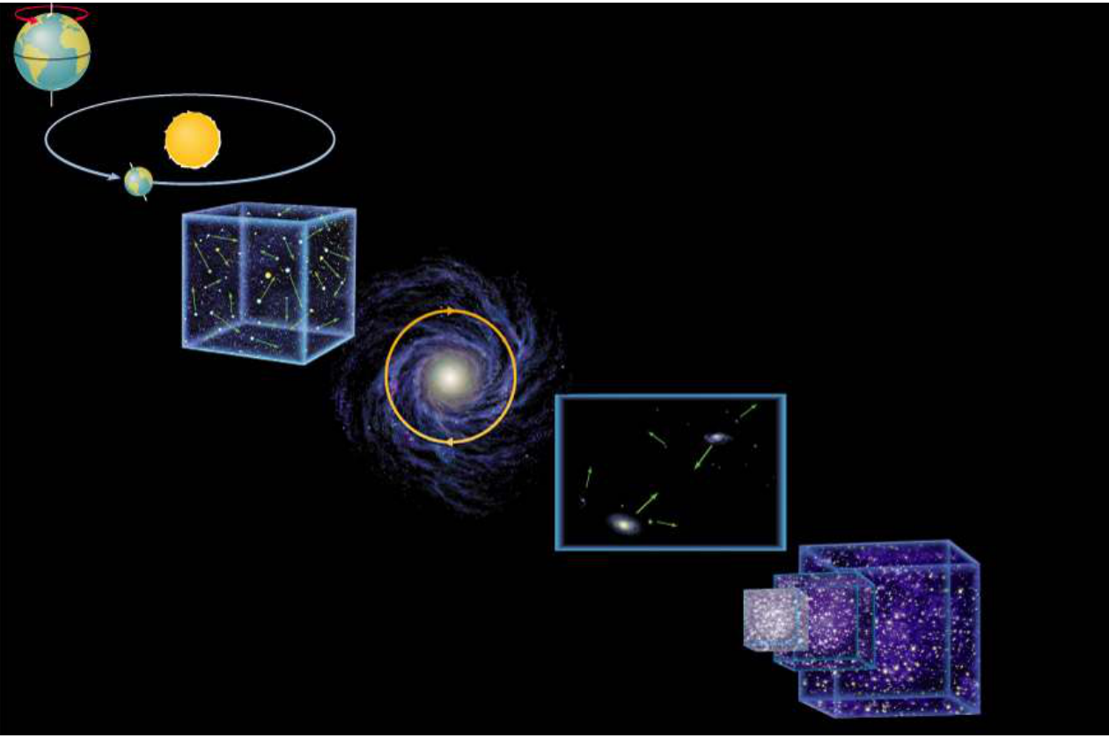
How are we Moving?
•
Earth rotation
Earth orbit
Random Solar motion
Solar motion around
center of the Milky Way
Milky Way motion
–
in local group
•
Expansion of the Universe
Notes:
Source edition: assets/lessons/lectures/astronomy/units-and-scales.pdf, page 27. Original author and figure credits remain on the slide. Text is editable; illustrations retain their source artwork.

Slide 28
Review
Goals for Today
1) Scientific notation and units
Know them!
2) Where are we?
We are in the Universe, in the Local Group, in
the Milky Way, in the Solar System, on Earth
3) How did we get here?
Universe created 14 GYr ago, Milky Way 12
GYr ago, Earth 4 GYr ago, man 100,000 yr
ago, and you ~20 years ago.
4) Everything is in motion!
Notes:
Source edition: assets/lessons/lectures/astronomy/units-and-scales.pdf, page 28. Original author and figure credits remain on the slide. Text is editable; illustrations retain their source artwork.

Slide 29
The Light Year
A LIGHT YEAR IS A DISTANCE!!!!!!!!!!
The speed of light is a constant – it is not
infinitely fast
–
The speed of light is the fastest that
anything can travel!
A light year is the distance light travels in
one year
It is 9 x 10
15
m
Also, A LIGHT YEAR IS A DISTANCE!
Notes:
Source edition: assets/lessons/lectures/astronomy/units-and-scales.pdf, page 29. Original author and figure credits remain on the slide. Text is editable; illustrations retain their source artwork.

