Slide 1
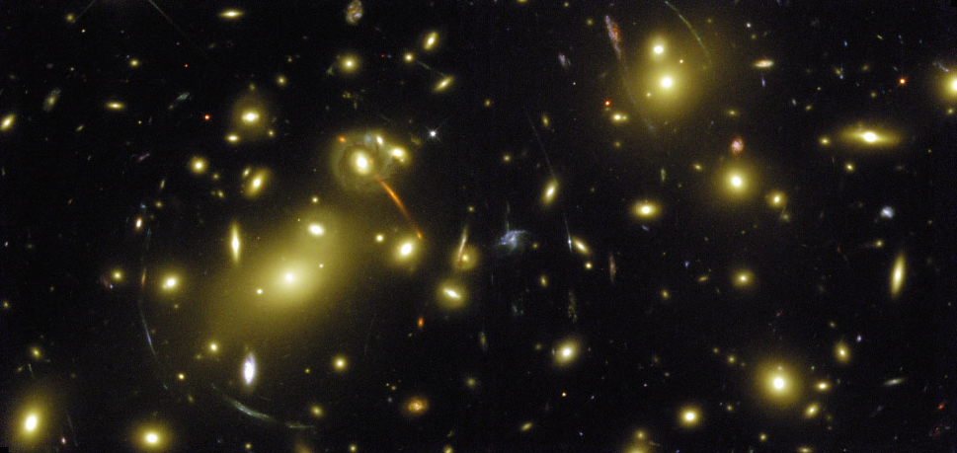
Dark Matter
Notes:
‹#›

Slide 2
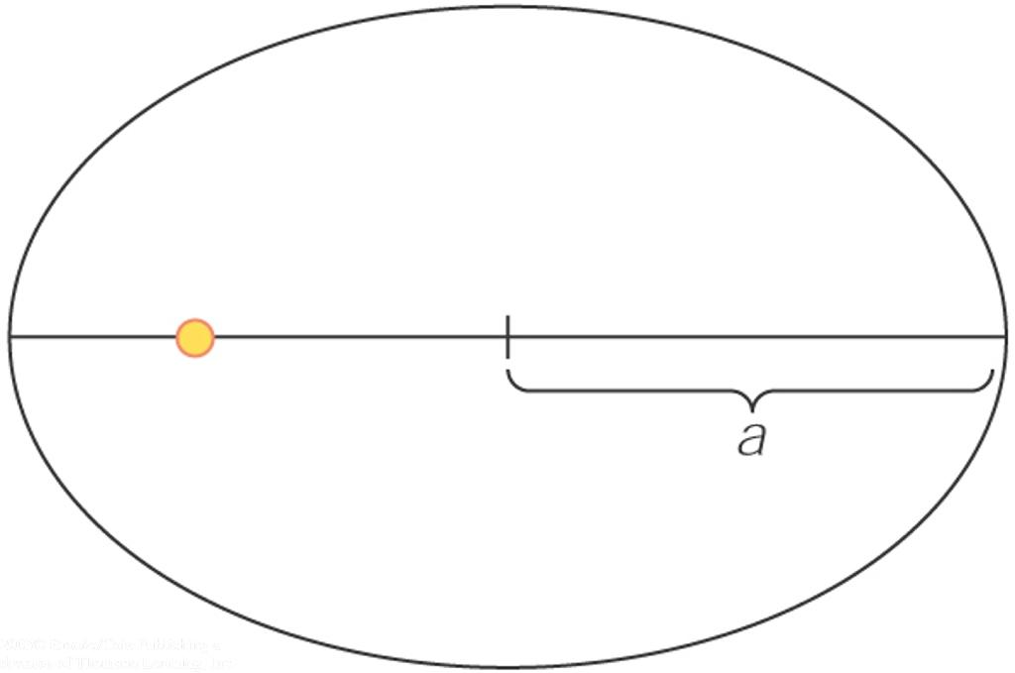
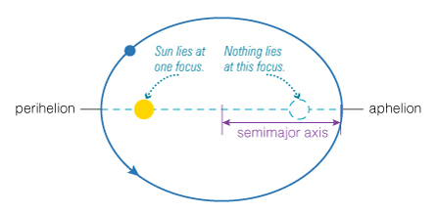
Kepler’s 1st Law
Law #1: The orbits of the planets are ellipses with the Sun at one focus.
c
Eccentricity e = c/a

Slide 3
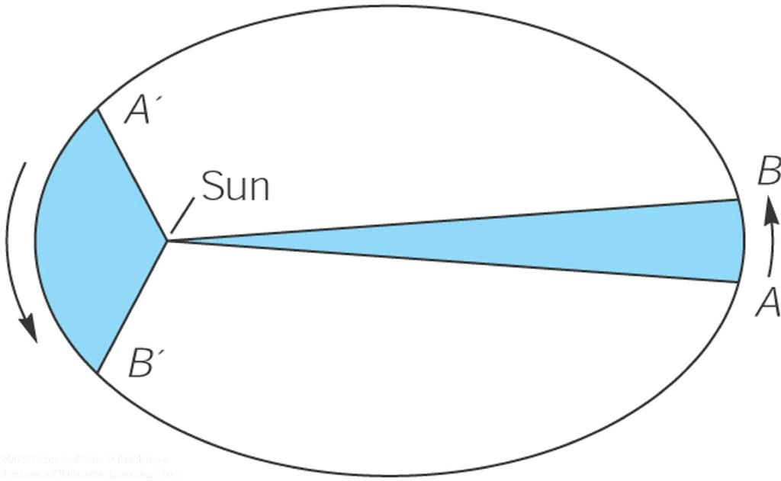
Kepler’s 2nd Law
Law #2: A line from a planet to the sun sweeps over equal areas in equal intervals of time.
(When it’s closer to the Sun, a planet moves faster)
Therefore, a planet travels faster when it is nearer to the Sun and slower when it is farther from the Sun.

Slide 4
Kepler’s 3rd Law
A planet’s orbital period (P) squared is proportional to its average distance from the sun (a) cubed:
Closer orbits go faster
P_{y}² = a_{AU}³
(P_{y} = period in years; a_{AU} = distance in AU)
http://www.solarsystemscope.com/
http://astro.unl.edu/naap/pos/animations/kepler.html

Slide 5
Concept Quiz
Which planet will orbit in the smallest amount of time?
Something with the mass of Jupiter at the orbital distance of Jupiter
Something with the mass of Earth at the orbital distance of Jupiter
Something with the mass of Earth at the orbital distance of Earth
Something with the mass of Jupiter at the orbital distance of Earth
c) and d) would be equal

Slide 6
Concept Quiz
Which planet will orbit in the smallest amount of time?
Something with the mass of Jupiter at the orbital distance of Jupiter
Something with the mass of Earth at the orbital distance of Jupiter
Something with the mass of Earth at the orbital distance of Earth
Something with the mass of Jupiter at the orbital distance of Earth
c) and d) would be equal

Slide 7
Concept Quiz
How long does it take Mars to orbit the Sun?
More than a year
Less than a year
One year

Slide 8
Concept Quiz
How long does it take Mars to orbit the Sun?
More than a year
Less than a year
One year

Slide 9
Orbits, mass, and radius
Orbital speed is related to the mass interior to the orbit, and the orbital radius
https://phet.colorado.edu/en/simulations/gravity-and-orbits
If P² = a³, P = a^{3/2}
v = 2πa/P
-> v ~ a/a^{3/2} = a^{-1/2}

Slide 10
LT Book
“Dark Matter,” 143, #1-9

Slide 11
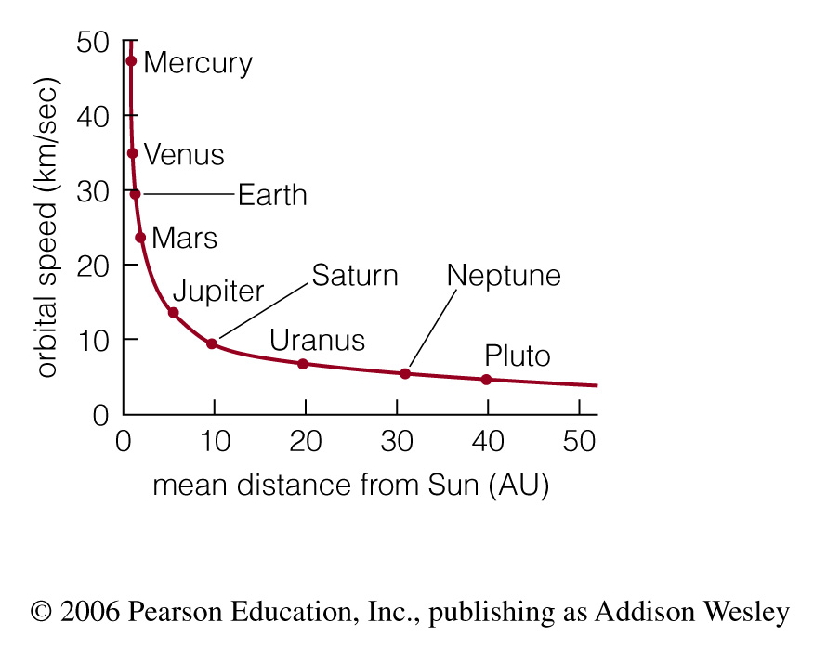
Solar System Rotation Curve
v ~ a/a^{3/2} = a^{-1/2}
Solar system’s rotation curve declines because Sun has almost all the mass
Called “Keplarian” since this is what is expected from Kepler’s 3rd law

Slide 12
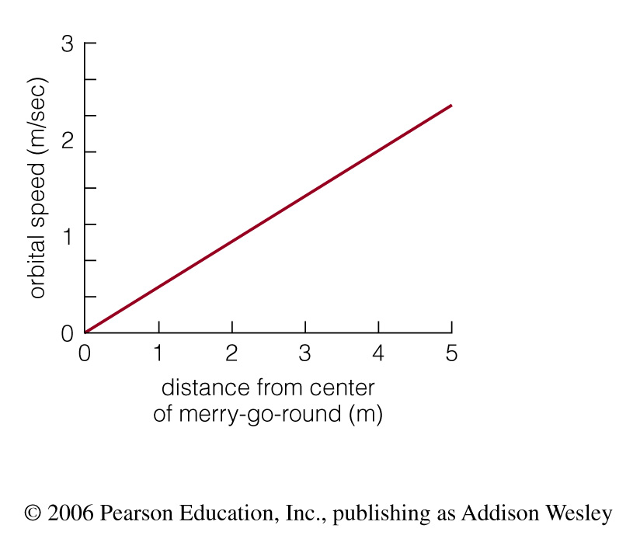
Merry-go-round Rotation Curve
All periods are the same
v = 2πa/P
-> v ~ a
Rotation curve of merry-go-round rises with radius because mass is spread out with radius. Called “Solid body”

Slide 13
Concept Quiz
What will the rotation curve of our Galaxy look like?
Like that of the Solar System
Like that of the Merry-go-round

Slide 14
Concept Quiz
What will the rotation curve of our Galaxy look like?
Like that of the Solar System
Like that of the Merry-go-round
Neither! Ha!

Slide 15
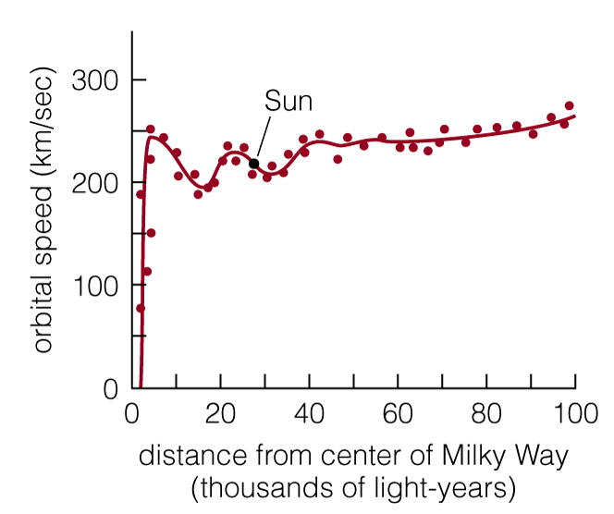
Milky Way Rotation Curve
Rotation curve of Milky Way stays flat with distance
=>Mass must be more spread out than in solar system, but not as much as for a merry-go-round

Slide 16
Milky Way Rotation Curve
But from visible matter, we would expect something more like what we see in the Solar System because most of the mass is in the center of the Galaxy.

Slide 17
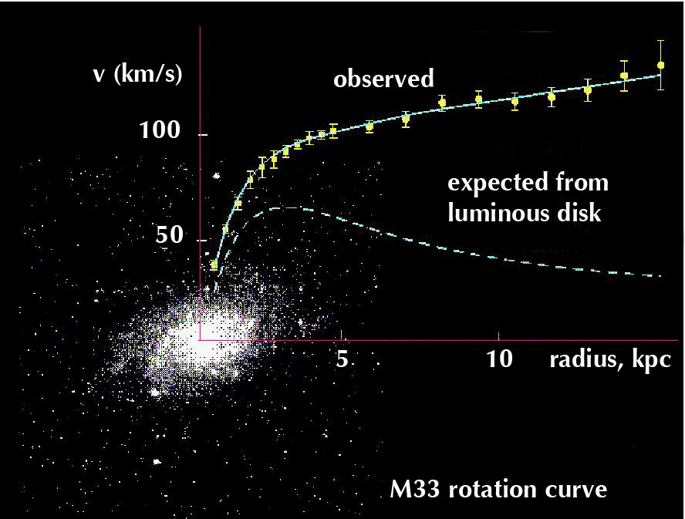
Evidence for Dark Matter
We hypothesize that dark matter exists from comparisons between the mass of the matter we can see and the mass calculated from gravity

Slide 18
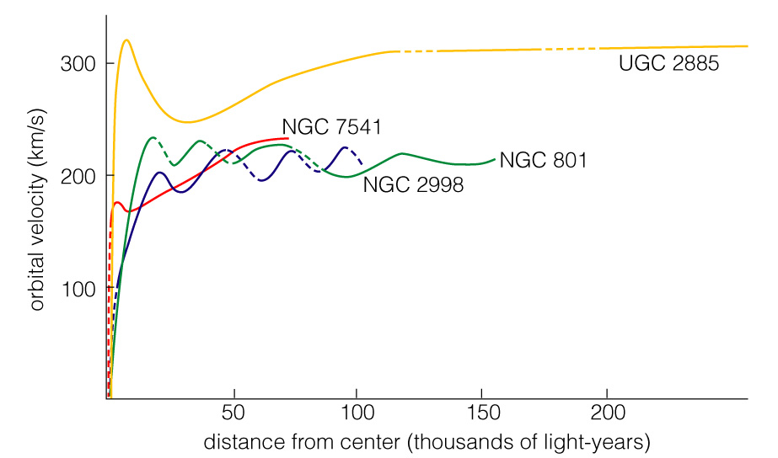
Dark Matter in Spirals
Spiral galaxies all tend to have flat rotation curves
-> Lots of Dark Matter!

Slide 19
On a sheet of paper…
We are going to work out how we know dark matter exists by making plots of the rotation speed versus distance for two scenarios:
Our Solar system
A Merry-go-round
What is different about the mass distribution in these two scenarios?

Slide 20
More Questions
It’s not obvious from the plot, but the Milky Way rotation curve rises linearly within the bulge. What can we say about the distribution of mass here – what example is it like?
If the dark matter ended half way out from the center, what would the Milky Way rotation curve look like?

Slide 21
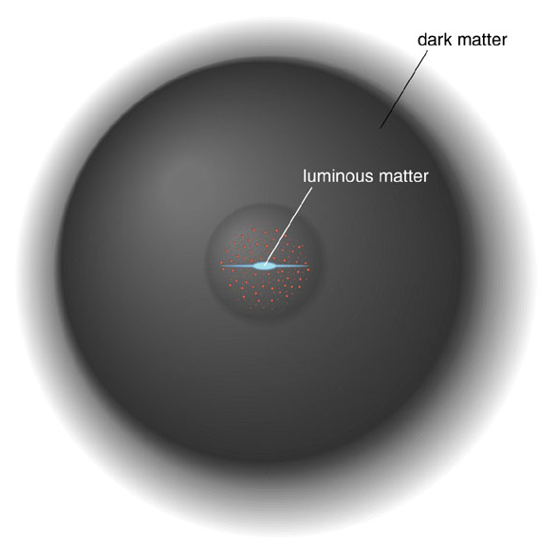
Dark Matter
The visible portion of a galaxy lies deep in the heart of a large halo of dark matter
Dark Matter provides the missing mass

Slide 22
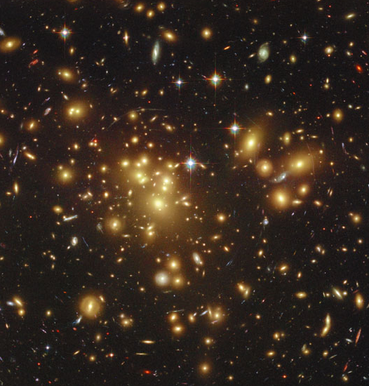
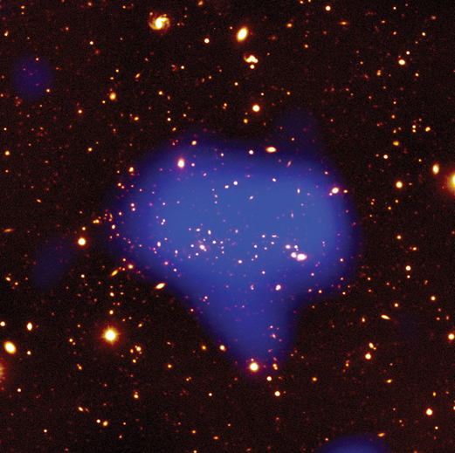
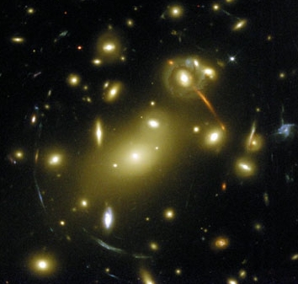
Dark Matter in Clusters
Clusters are large groups of galaxies
There are three ways to find cluster mass

Slide 23
1) Velocities of galaxies
The galaxies are moving too fast, indicating unseen mass
The mass we calculate from galaxy motions in a cluster is about
50 times larger than the mass in stars!

Slide 24
2) Mass traced through X-rays
Clusters contain large amounts of X-ray emitting hot gas
Temperature of hot gas (particle motions) tells us cluster mass. The gas is hotter than it would be if there was no dark matter.
85% dark matter
13% hot gas
2% stars

Slide 25
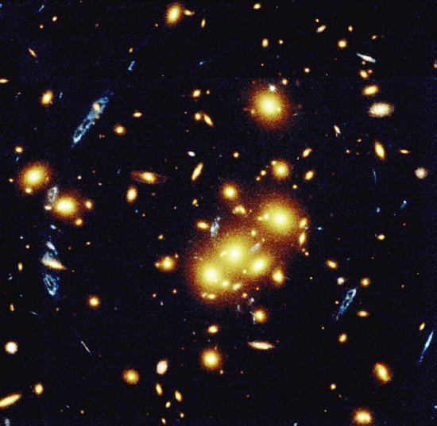
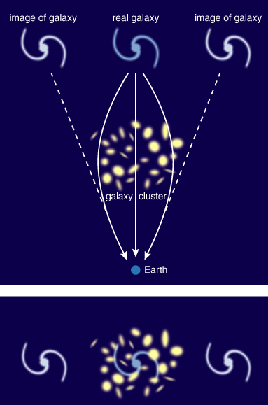
3) Gravitational Lensing
Gravitational lensing, the bending of light rays by gravity, can also tell us a cluster’s mass
Light is bending more than expected

Slide 26
Cluster Masses
All three methods of measuring cluster mass indicate similar amounts of dark matter

Slide 27
But Does Dark Matter Really Exist???
Something is needed to explain the discrepancy between the mass measured through gravity and the mass directly observed.
Dark matter really exists, and we are observing the effects of its gravitational attraction
Something is wrong with our understanding of gravity, causing us to mistakenly infer the existence of dark matter
Because gravity is so well tested, most (but not all!) astronomers prefer option #1

Slide 28
How dark is dark matter?
… not as bright as a star.

Slide 29
Two Basic Options
Ordinary Dark Matter (MACHOS)
  Massive Compact Halo Objects:
dead or failed stars in halos of galaxies – basically brown dwarfs
Extraordinary Dark Matter (WIMPS)
  Weakly Interacting Massive Particles:
a new type of particle – possibly similar to a neutrino

Slide 30
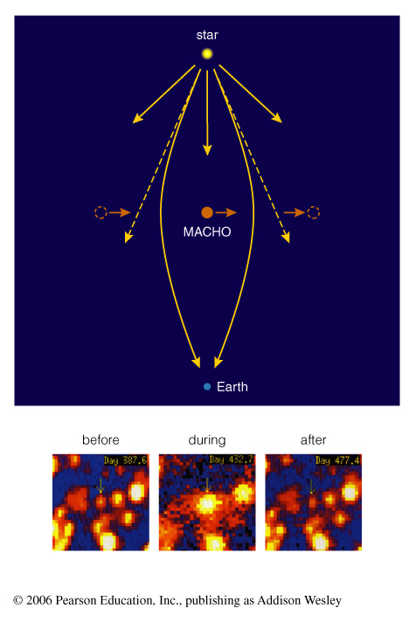
Evidence for MACHOS
MACHOs occasionally make other stars appear brighter through lensing
… but there are not enough lensing events to explain all the dark matter

Slide 31
Evidence for WIMPs
There’s not enough ordinary matter
WIMPs could be left over from Big Bang
Models involving WIMPs explain how galaxy formation works

Slide 32
Unseen Influences
Dark Matter: An undetected form of mass that does not emit light but whose existence we infer from its gravitational influence
Dark Energy: An unknown form of energy that seems to be the source of a repulsive force causing the expansion of the universe to accelerate

Slide 33
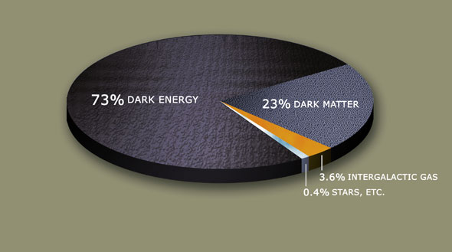
Contents of Universe
“Normal” Matter: ~ 4%
Dark Matter: ~ 23%
Dark Energy ~ 73%

Slide 34
Contents of the Universe
The energy of the Universe is roughly 2/3 dark energy and 1/3 matter
Of the matter, about 10% is normal matter (protons, neutrons) and 90% is dark matter
We can see only 4% of the energy of the Universe
  We cannot see most of what makes up the Universe!
WTF????

