Slide 1
Dark matter
Using gravity to investigate unseen mass
WVU DSPIRA astronomy
Adapted from lecture material credited to Mark Voit
Notes:
Adapted from lecture material credited to Mark Voit.

Slide 2
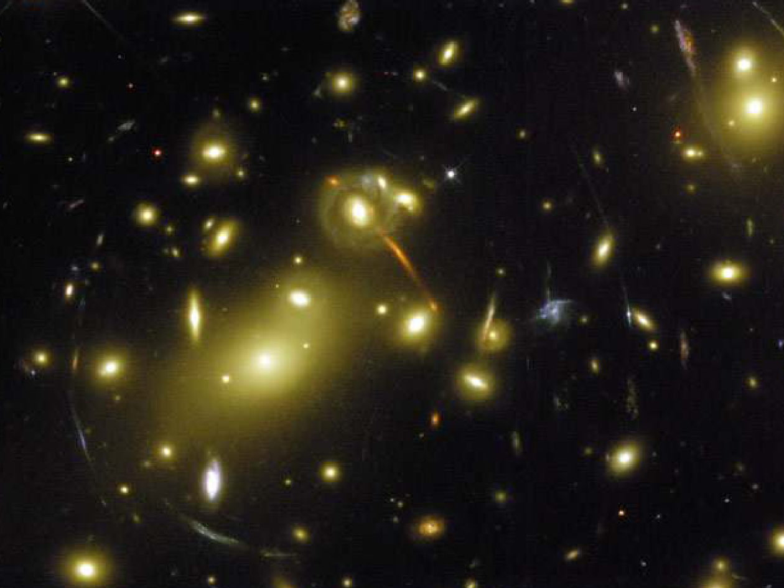
How can we detect unseen mass?
Compare mass inferred from gravity with the matter we observe.
Use galaxy rotation, cluster motions, hot gas, and gravitational lensing.
Galaxy cluster image retained from the source lecture.
Notes:
Adapted from lecture material credited to Mark Voit.
https://science.nasa.gov/dark-matter/
Source figure: original slide 1. Original figure credits and rights remain in effect.

Slide 3
Explore orbits and mass
1. Open Gravity and Orbits and choose Model.
2. Change the central mass and orbital distance.
3. Show velocity and describe how the orbit changes.
Open Gravity and Orbits — PhET
Notes:
Adapted from lecture material credited to Mark Voit.

Slide 4
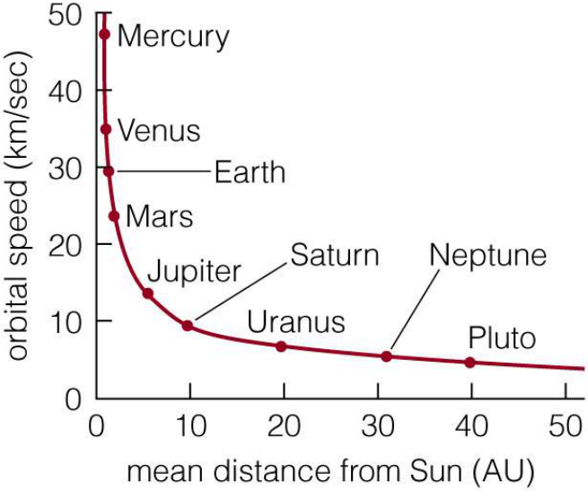
The Solar System rotation curve
The Sun contains nearly all the Solar System’s mass.
For circular orbits, v² = GM/r.
With fixed central mass, orbital speed falls as radius increases.
Orbital speed decreases with distance from the Sun.
Notes:
Adapted from lecture material credited to Mark Voit.
Source figure: original slide 4. Original figure credits and rights remain in effect.

Slide 5
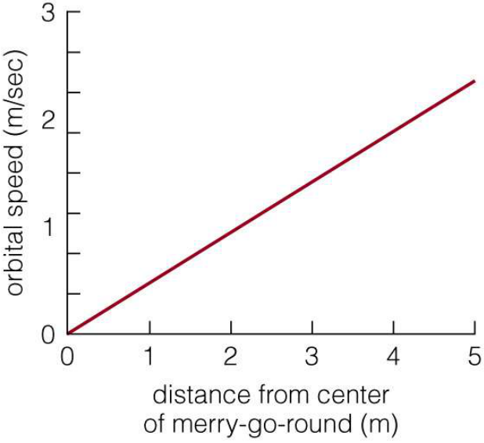
Rotation of a merry-go-round
Every point completes a turn in the same time.
Angular speed ω is constant, so v = ωr.
Points farther from the center move faster.
Rigid rotation gives a rising speed-versus-radius curve.
Notes:
Adapted from lecture material credited to Mark Voit.
Source figure: original slide 5. Original figure credits and rights remain in effect.

Slide 6
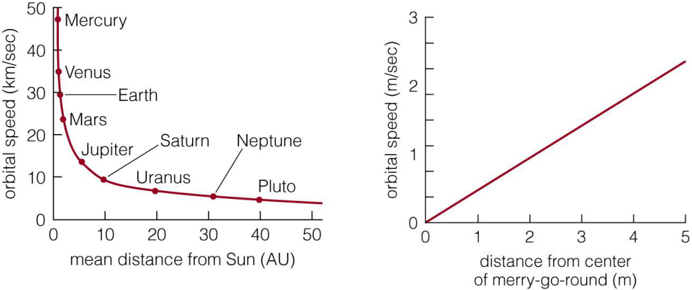
Predict the Galactic rotation curve
Will it fall like the Solar System, rise like rigid rotation, or follow another pattern? Explain your choice.
Notes:
Adapted from lecture material credited to Mark Voit.
Pause for discussion. The next slide shows the observed pattern. Repeated quiz slides from the source are consolidated here.
Source figure: original slide 6. Original figure credits and rights remain in effect.

Slide 7
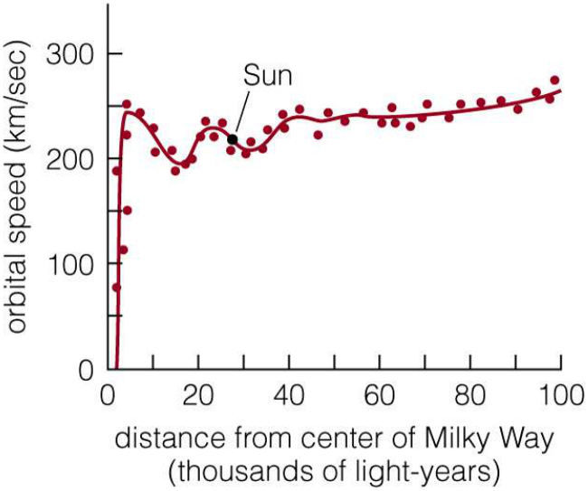
The Milky Way rotation curve
Outer orbital speeds change little with radius.
A concentrated central mass predicts a declining curve.
What mass distribution could explain the difference?
The outer rotation curve is approximately flat.
Notes:
Adapted from lecture material credited to Mark Voit.
Source figure: original slide 8. Original figure credits and rights remain in effect.

Slide 8
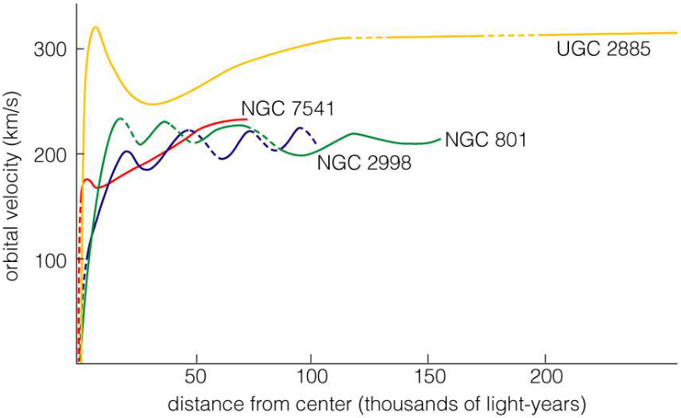
Other spiral galaxies show the pattern
Many spiral galaxies have extended, nearly flat rotation curves.
Notes:
Adapted from lecture material credited to Mark Voit.
The figure is retained from the source lecture. Stellar motions also provide mass estimates in elliptical galaxies.
Source figure: original slide 10. Original figure credits and rights remain in effect.

Slide 9
Compare two mass estimates
Matter we observe
Estimate stars and gas from their radiation.
Use a model to predict their gravitational effects.
Mass inferred from gravity
Measure orbital motions.
Compare the required mass with the observed stars and gas.
Notes:
Adapted from lecture material credited to Mark Voit.
https://science.nasa.gov/dark-matter/

Slide 10
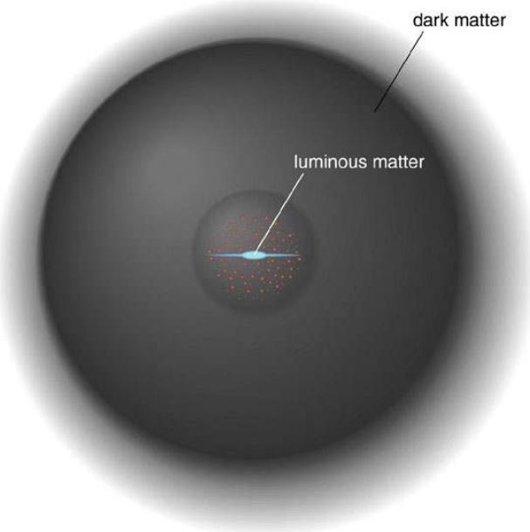
A dark matter halo
An extended halo adds mass beyond the bright disk.
Its gravity can help explain the rotation curve.
The halo is inferred from observations and models.
The visible galaxy lies within a much larger halo.
Notes:
Adapted from lecture material credited to Mark Voit.
https://science.nasa.gov/dark-matter/
Source figure: original slide 12. Original figure credits and rights remain in effect.

Slide 11
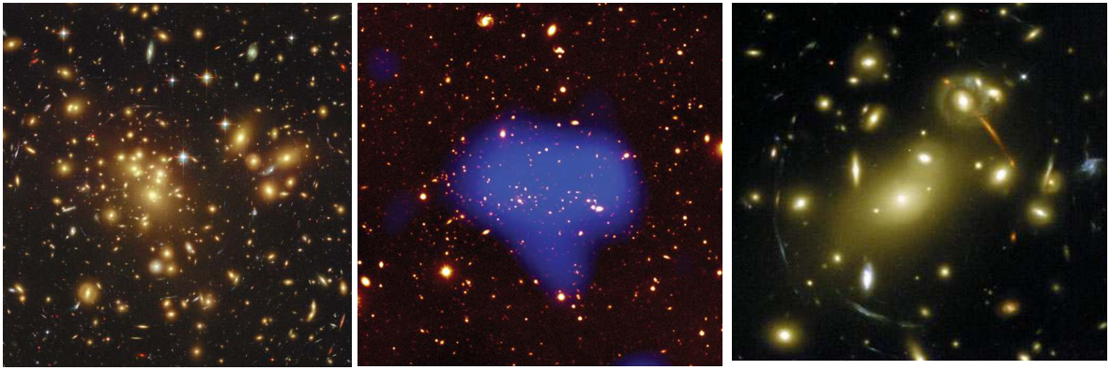
Test the idea in galaxy clusters
Three probes: galaxy motions, hot gas, and gravitational lensing.
Notes:
Adapted from lecture material credited to Mark Voit.
Original cluster figures retained from the source lecture.
Source figure: original slide 15. Original figure credits and rights remain in effect.

Slide 12
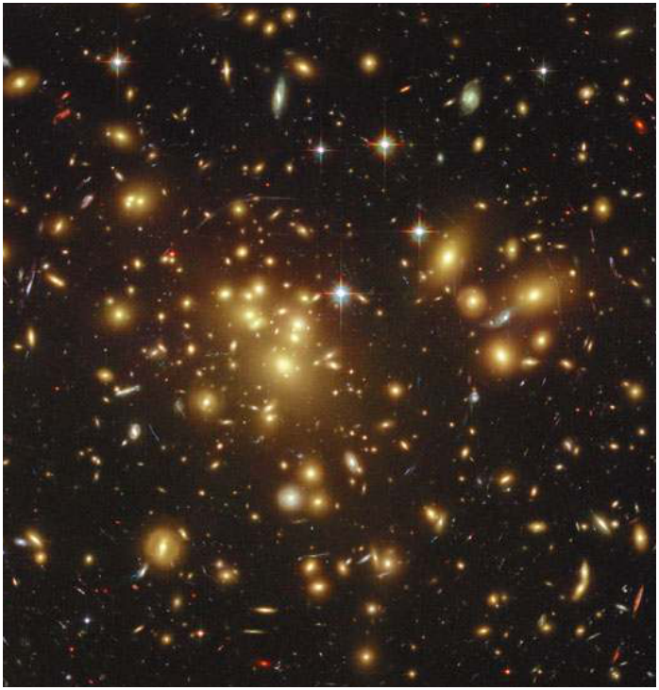
Measure galaxy motions
Measure the velocities of galaxies in a cluster.
Use their motions to estimate the mass needed to bind the system.
Stars alone do not supply enough mass.
Galaxy motions probe the gravitational field of a cluster.
Notes:
Adapted from lecture material credited to Mark Voit.
Source figure: original slide 16. Original figure credits and rights remain in effect.

Slide 13
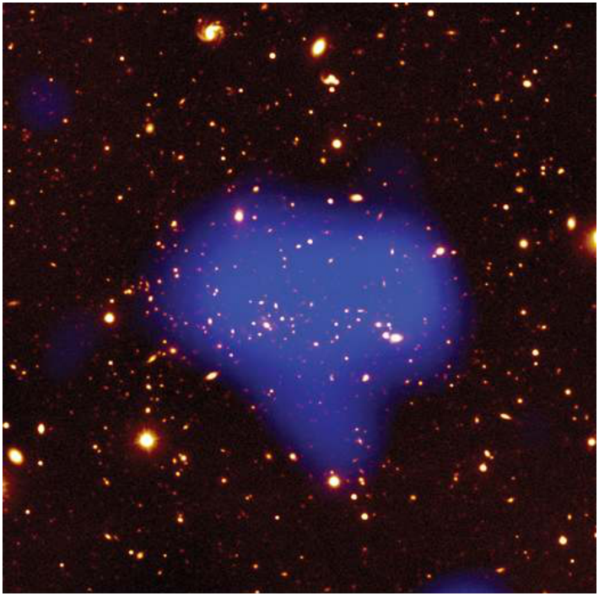
Measure hot gas with X-rays
Hot gas outweighs the stars.
Gas temperature and density help us estimate the total mass.
That mass exceeds the gas and stars we observe.
X-rays reveal hot gas between the galaxies.
Notes:
Adapted from lecture material credited to Mark Voit.
Source figure: original slide 17. Original figure credits and rights remain in effect.

Slide 14
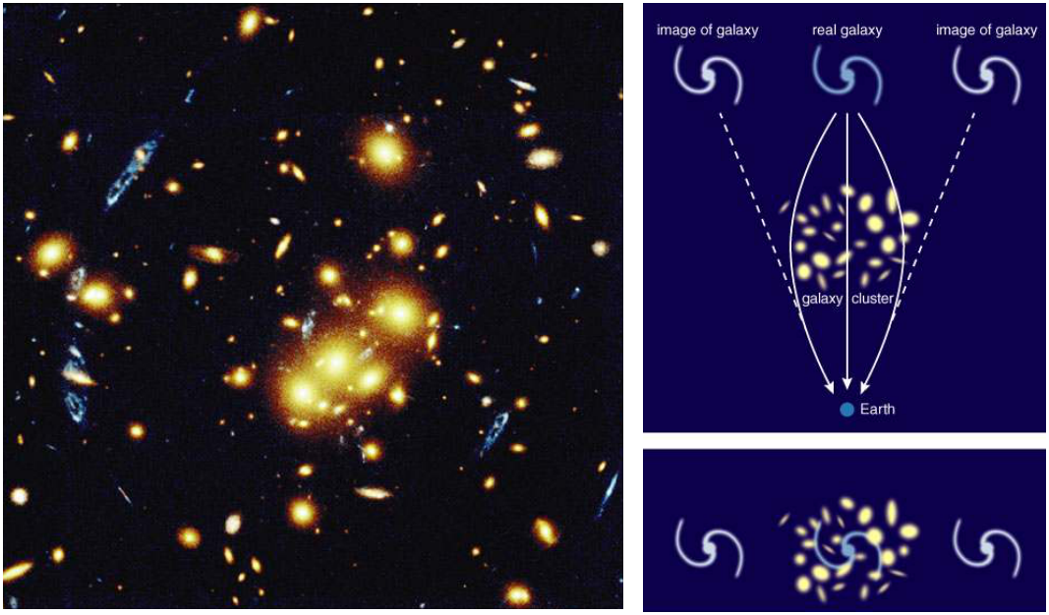
Measure gravitational lensing
A cluster’s gravity bends background light. The distortions reveal its mass distribution.
Notes:
Adapted from lecture material credited to Mark Voit.
https://science.nasa.gov/dark-matter/
Source figure: original slide 18. Original figure credits and rights remain in effect.

Slide 15
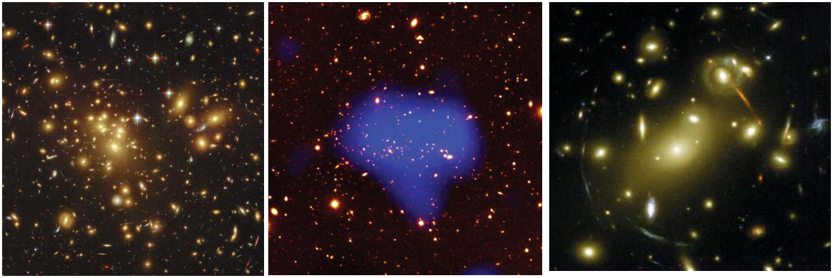
Compare independent measurements
Galaxy motions, X-ray gas, and lensing all support substantial unseen mass in clusters.
Notes:
Adapted from lecture material credited to Mark Voit.
The three methods have different assumptions and uncertainties. Compare their broad agreement rather than claiming identical results.
Source figure: original slide 19. Original figure credits and rights remain in effect.

Slide 16
Test the explanation
Additional matter
Dark matter supplies gravitational mass beyond the observed stars and gas.
Test this model across galaxies, clusters, and cosmology.
Modified gravity
Alternative models change the gravitational law.
A successful explanation must address all the observations together.
Notes:
Adapted from lecture material credited to Mark Voit.
https://science.nasa.gov/dark-matter/

Slide 17
What could dark matter be?
Compact objects
MACHO means massive compact halo object.
Examples include faint stars and stellar remnants.
New particles
WIMP means weakly interacting massive particle.
WIMPs are one proposed particle candidate, not a confirmed discovery.
Notes:
Adapted from lecture material credited to Mark Voit.
https://science.nasa.gov/dark-matter/

Slide 18
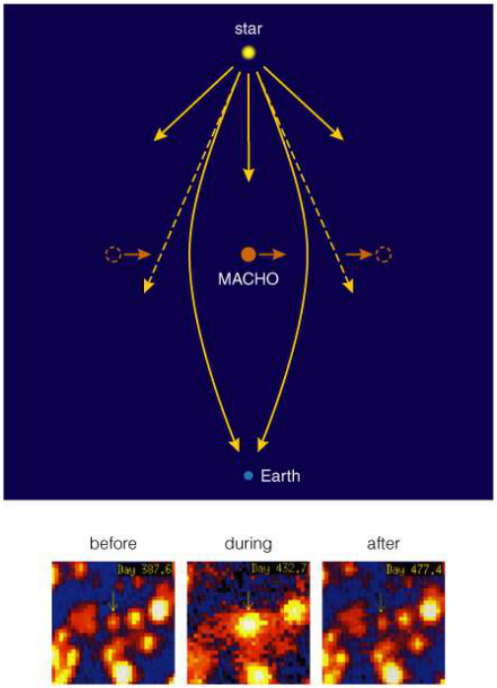
Search through microlensing
Microlensing surveys search for these brightening events.
The results constrain compact objects in Galactic halos.
Ordinary faint objects cannot explain all the dark matter.
A foreground compact object can temporarily magnify a background star.
Notes:
Adapted from lecture material credited to Mark Voit.
Original microlensing figure retained. Dark matter overview: https://science.nasa.gov/dark-matter/
Source figure: original slide 23. Original figure credits and rights remain in effect.

Slide 19
Particle models remain hypotheses
Why consider particles?
Early-universe models can produce particles that survive today.
Their gravity can affect the growth of galaxies.
What would confirm them?
Search for particle interactions and astrophysical signatures.
A successful model must agree with measured limits.
Notes:
Adapted from lecture material credited to Mark Voit.
https://science.nasa.gov/dark-matter/

Slide 20
Dark matter and dark energy
Dark matter
Unseen matter inferred through gravity.
It helps explain the motions and growth of cosmic structures.
Dark energy
The name for whatever drives the accelerated expansion of the universe.
Its physical nature remains uncertain.
Notes:
Adapted from lecture material credited to Mark Voit.
https://spaceplace.nasa.gov/dark-matter/en/

Slide 21
The cosmic mass-energy budget
Component | Approximate share
Ordinary matter | 5%
Dark matter | 27%
Dark energy | 68%
Present-day estimates in the standard cosmological model. Source: NASA Space Place.
Notes:
Adapted from lecture material credited to Mark Voit.
https://spaceplace.nasa.gov/dark-matter/en/

Slide 22
Discuss the evidence
How do dark matter and dark energy differ?
What do galaxy rotation curves tell us?
Why compare three cluster-mass measurements?
What evidence could distinguish dark matter candidates?
Notes:
Adapted from lecture material credited to Mark Voit.

Slide 23
Teaching references
Original lecture
Credited to Mark Voit in the source collection.
Original reading prompt:
LT Book
“Dark Matter,” 143, #1-9
Additional reading
NASA dark matter overview
NASA Space Place
Original figure credits and rights remain in effect.
Notes:
Adapted from lecture material credited to Mark Voit.
The source did not identify the edition of LT Book. Match the quoted assignment to the book used in your class. Original third-party figures remain subject to their existing rights. Source records: https://github.com/WVURAIL/dspira/blob/main/assets/lessons/lectures/SOURCE-NOTICE.txt

