Slide 1

WVU DSPIRA
WEST VIRGINIA UNIVERSITY
Galaxy Interactions
Dark Matter
D.J. Pisano
July 14, 2017
wvurail.org/dspira
1 of 34
Notes:
Source edition: assets/lessons/lectures/astronomy/galaxy-interactions-and-dark-matter.pdf, page 1. Original author and figure credits remain on the slide. Text is editable; illustrations retain their source artwork.

Slide 2
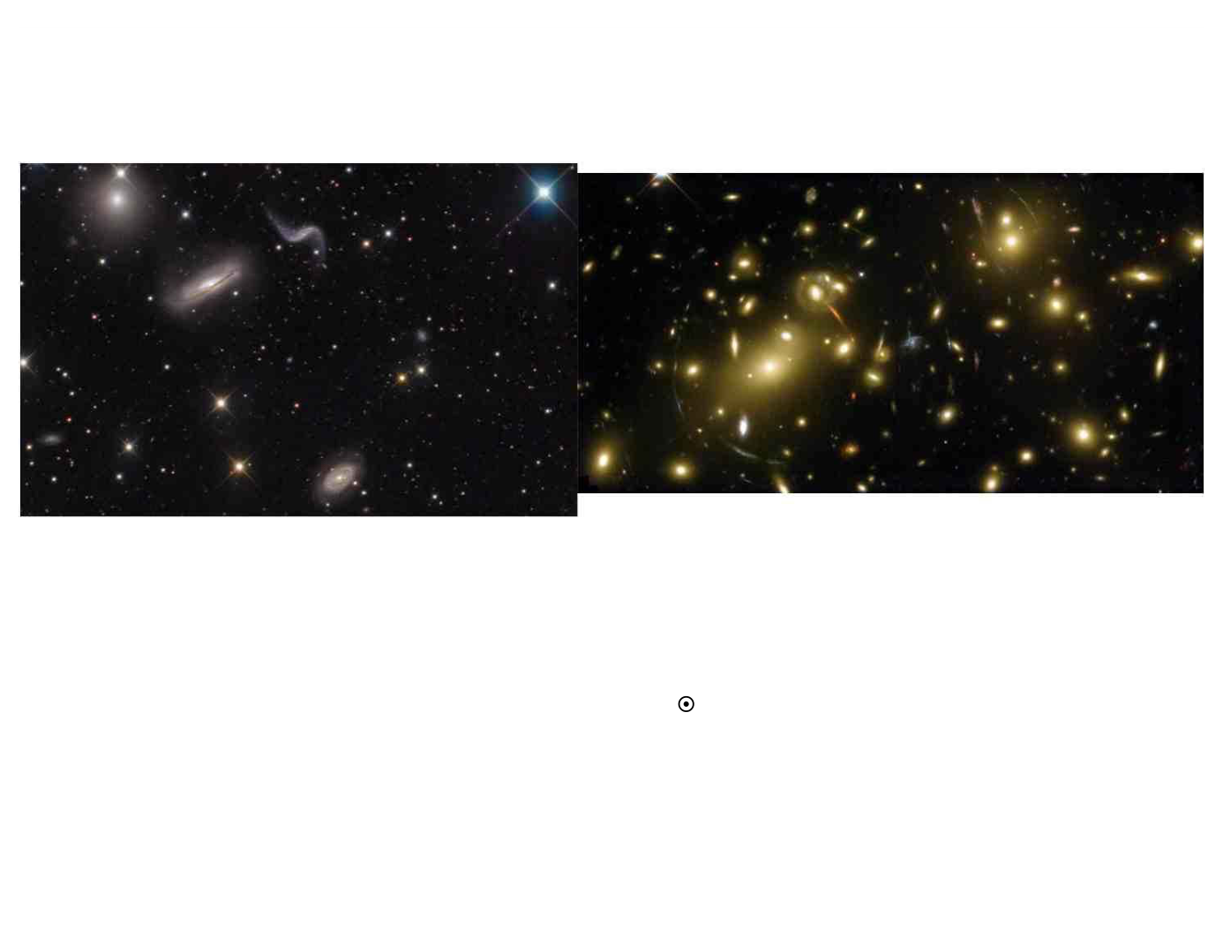
WVU DSPIRA
WEST VIRGINIA UNIVERSITY
Groups and Clusters
•
Galaxies are very social and typically reside in small groups or large
clusters.
•
Galaxies may be separated by only a couple times their size.
•
Large clusters have masses ≥ 10
14
M
, large enough to bend light
(
gravitational lensing
). Groups and clusters span about 1 million
parsecs (1 Mpc).
•
The Milky Way resides in the Local Group, a collection of ~ 50
galaxies.
wvurail.org/dspira
2 of 34
Notes:
Source edition: assets/lessons/lectures/astronomy/galaxy-interactions-and-dark-matter.pdf, page 2. Original author and figure credits remain on the slide. Text is editable; illustrations retain their source artwork.

Slide 3
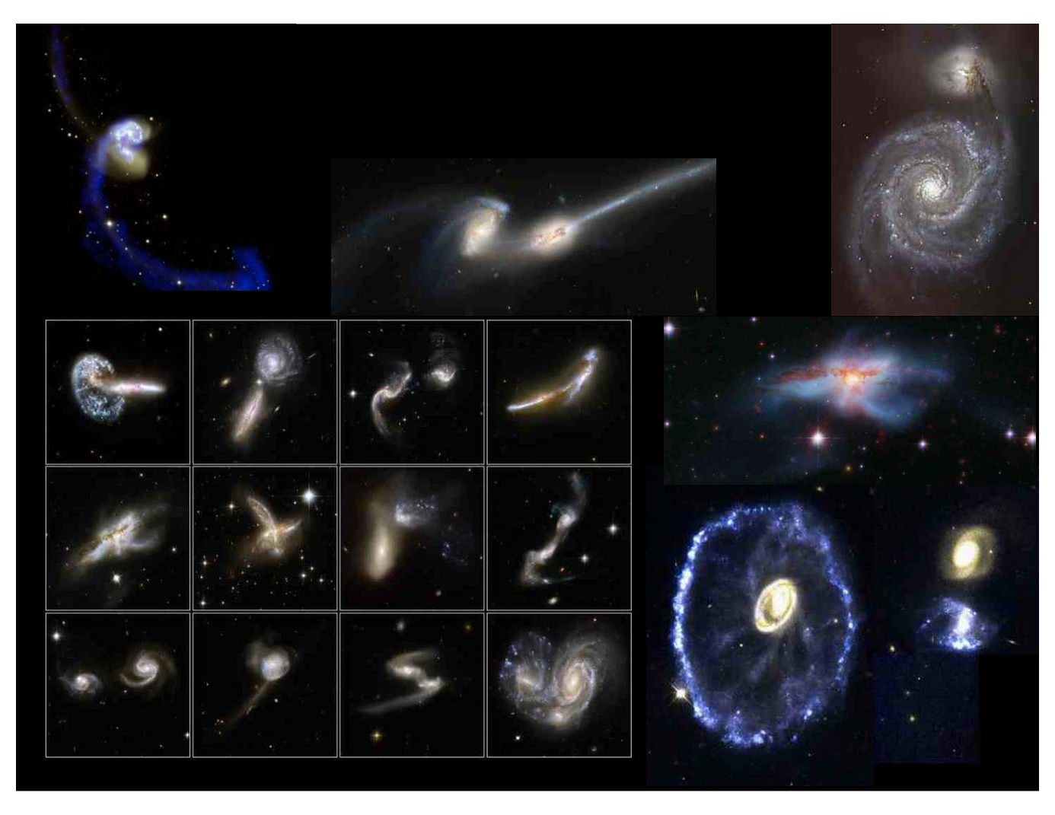
WVU DSPIRA
WEST VIRGINIA UNIVERSITY
Interacting Galaxies
GalCrash
wvurail.org/dspira
3 of 34
Notes:
Source edition: assets/lessons/lectures/astronomy/galaxy-interactions-and-dark-matter.pdf, page 3. Original author and figure credits remain on the slide. Text is editable; illustrations retain their source artwork.

Slide 4
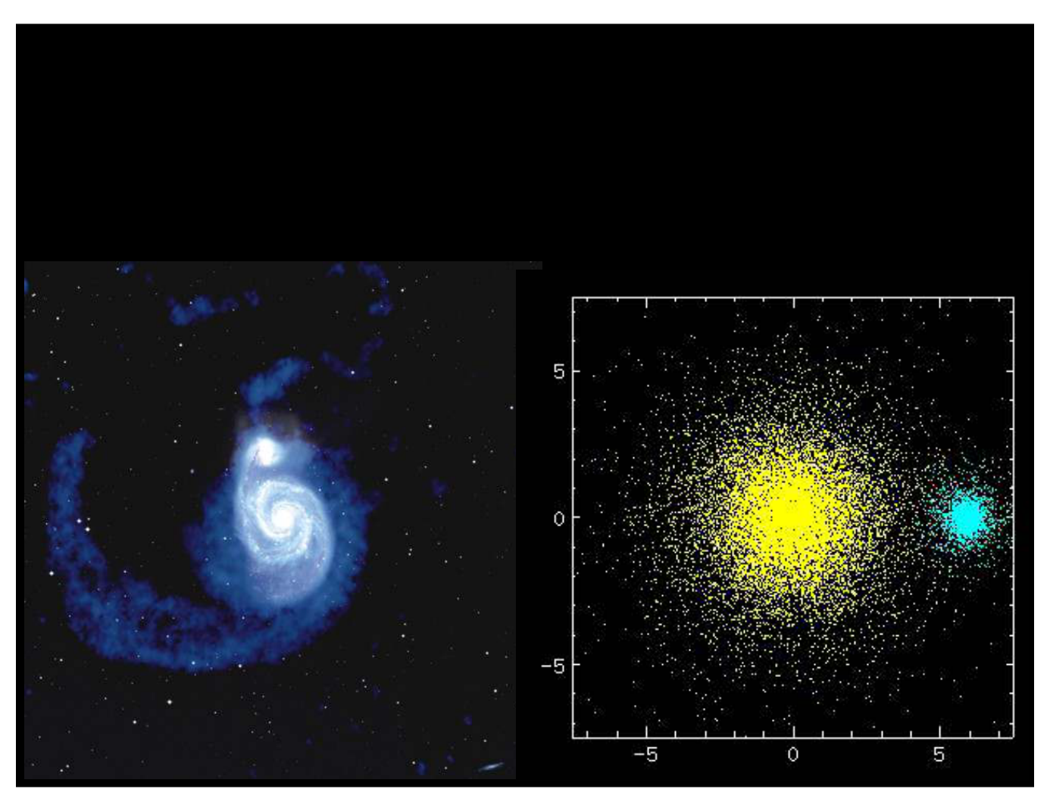
WVU DSPIRA
WEST VIRGINIA UNIVERSITY
Minor Mergers: Making bigger
spiral galaxies
wvurail.org/dspira
4 of 34
Notes:
Source edition: assets/lessons/lectures/astronomy/galaxy-interactions-and-dark-matter.pdf, page 4. Original author and figure credits remain on the slide. Text is editable; illustrations retain their source artwork.

Slide 5
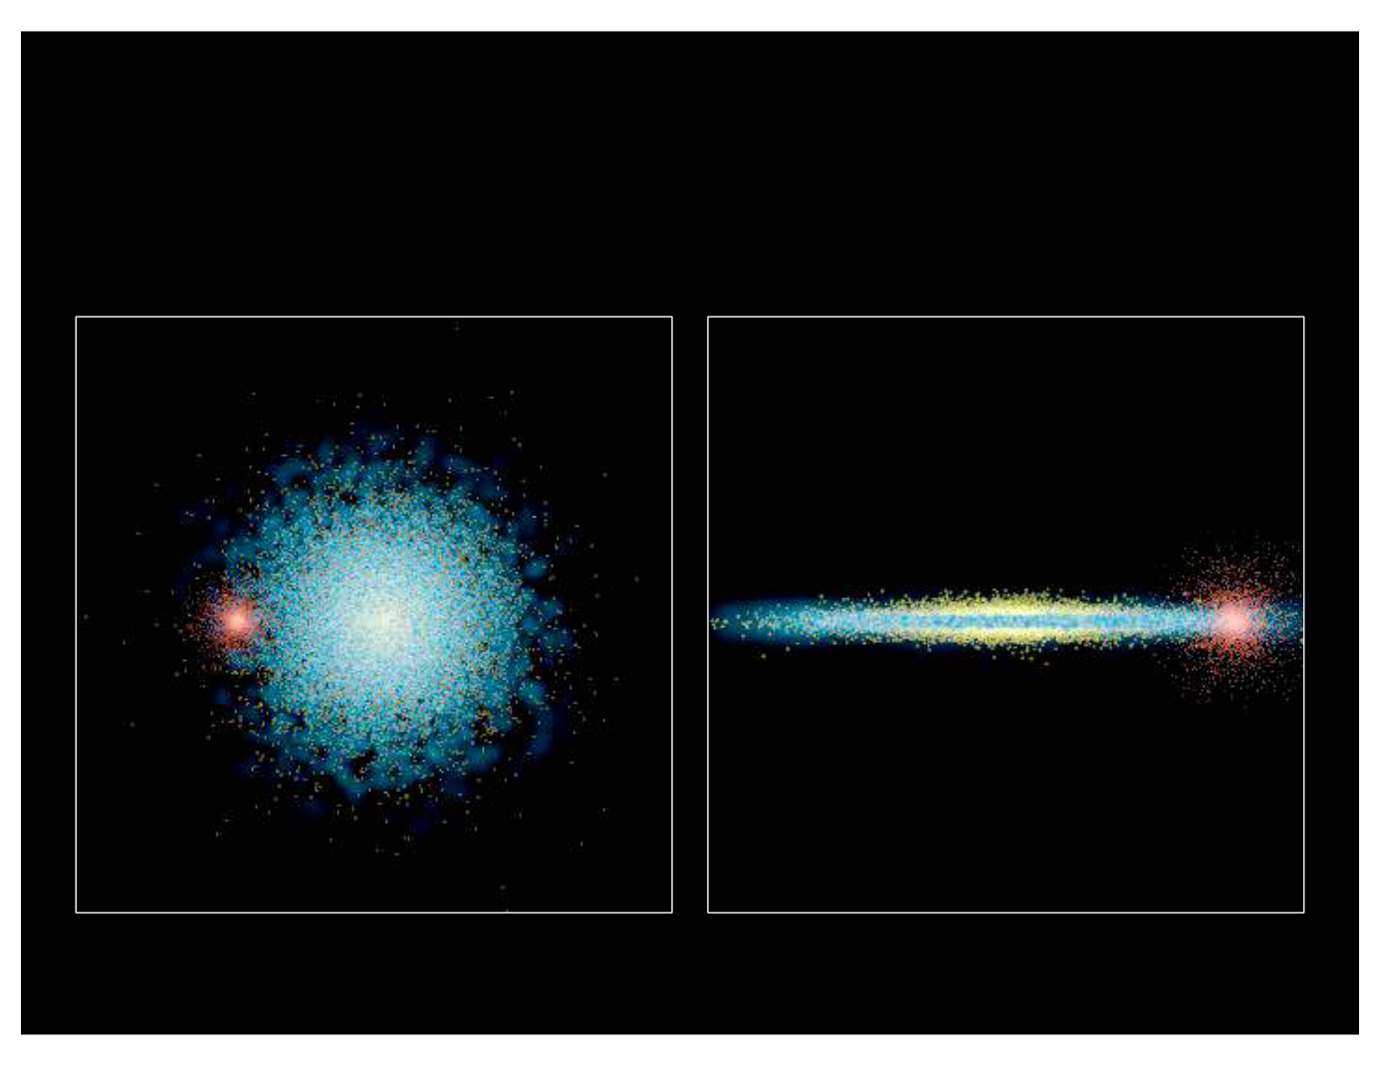
WVU DSPIRA
WEST VIRGINIA UNIVERSITY
Another simulation of a minor
merger:
wvurail.org/dspira
5 of 34
Notes:
Source edition: assets/lessons/lectures/astronomy/galaxy-interactions-and-dark-matter.pdf, page 5. Original author and figure credits remain on the slide. Text is editable; illustrations retain their source artwork.

Slide 6
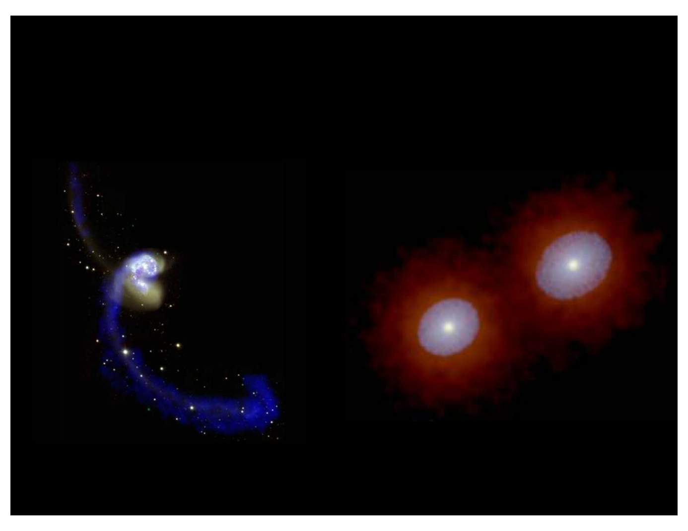
WVU DSPIRA
WEST VIRGINIA UNIVERSITY
Major Mergers:
Forming Elliptical Galaxies
wvurail.org/dspira
6 of 34
Notes:
Source edition: assets/lessons/lectures/astronomy/galaxy-interactions-and-dark-matter.pdf, page 6. Original author and figure credits remain on the slide. Text is editable; illustrations retain their source artwork.

Slide 7
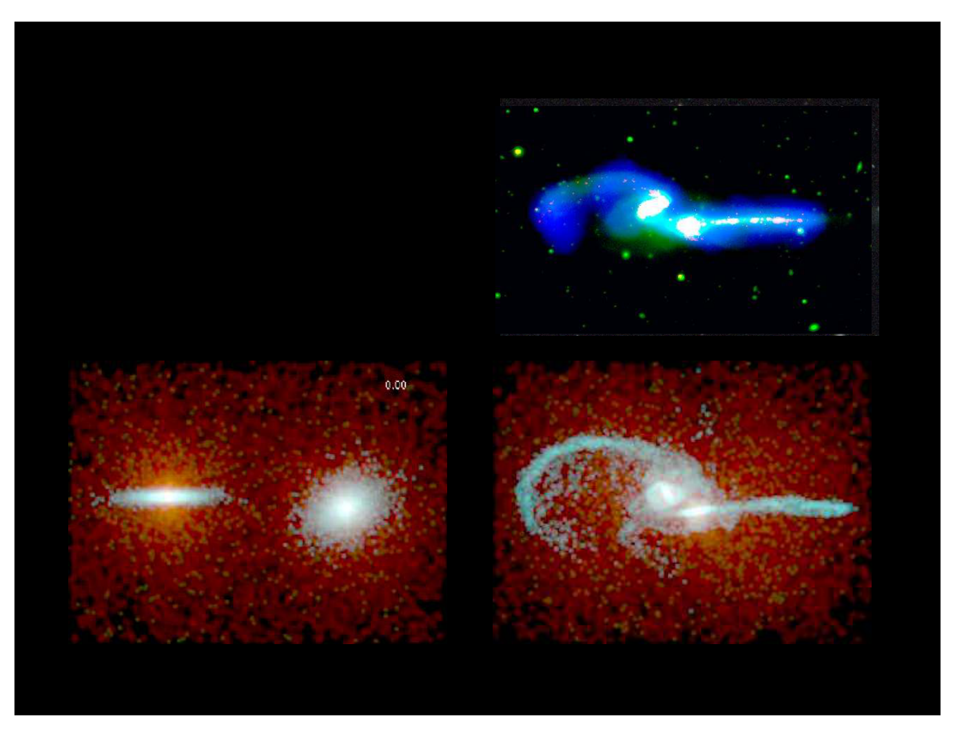
WVU DSPIRA
WEST VIRGINIA UNIVERSITY
N-body simulation of NGC 4676 “The Mice”
Hibbard & Barnes, in preparation
N-body simulations
provide past/future
evolution and 3-D
geometry
wvurail.org/dspira
7 of 34
Notes:
Source edition: assets/lessons/lectures/astronomy/galaxy-interactions-and-dark-matter.pdf, page 7. Original author and figure credits remain on the slide. Text is editable; illustrations retain their source artwork.

Slide 8
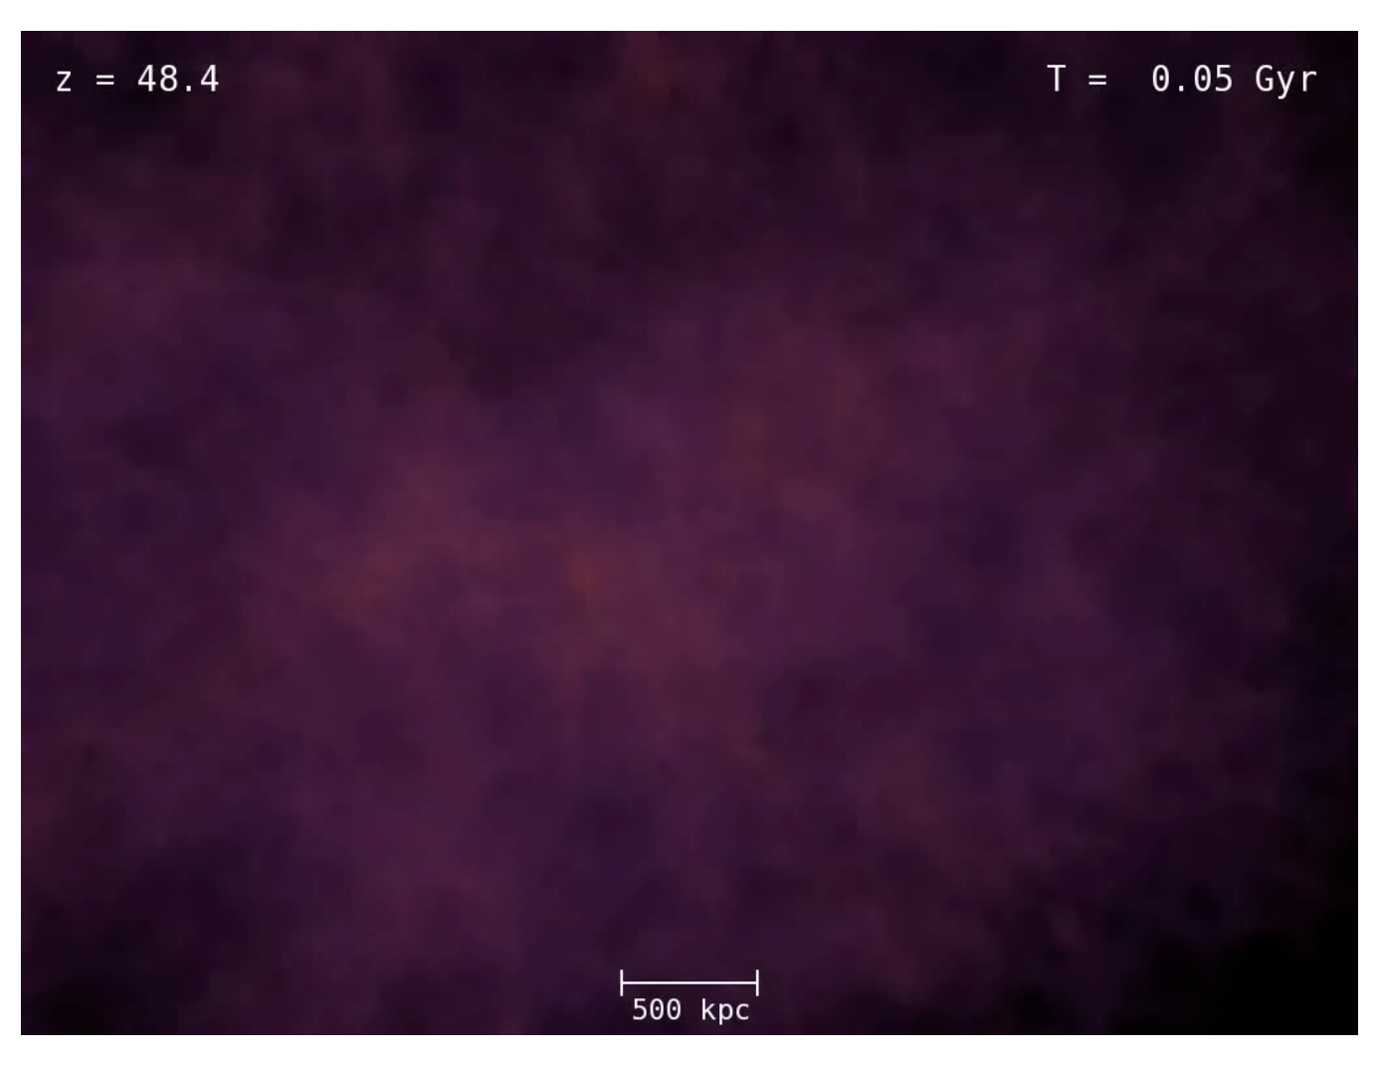
WVU DSPIRA
WEST VIRGINIA UNIVERSITY
Galaxy Formation occurs via mergers
(dark matter)
wvurail.org/dspira
8 of 34
Notes:
Source edition: assets/lessons/lectures/astronomy/galaxy-interactions-and-dark-matter.pdf, page 8. Original author and figure credits remain on the slide. Text is editable; illustrations retain their source artwork.

Slide 9

WVU DSPIRA
WEST VIRGINIA UNIVERSITY
Galaxy Formation occurs via mergers
(dark matter and gas)
wvurail.org/dspira
9 of 34
Notes:
Source edition: assets/lessons/lectures/astronomy/galaxy-interactions-and-dark-matter.pdf, page 9. Original author and figure credits remain on the slide. Text is editable; illustrations retain their source artwork.

Slide 10
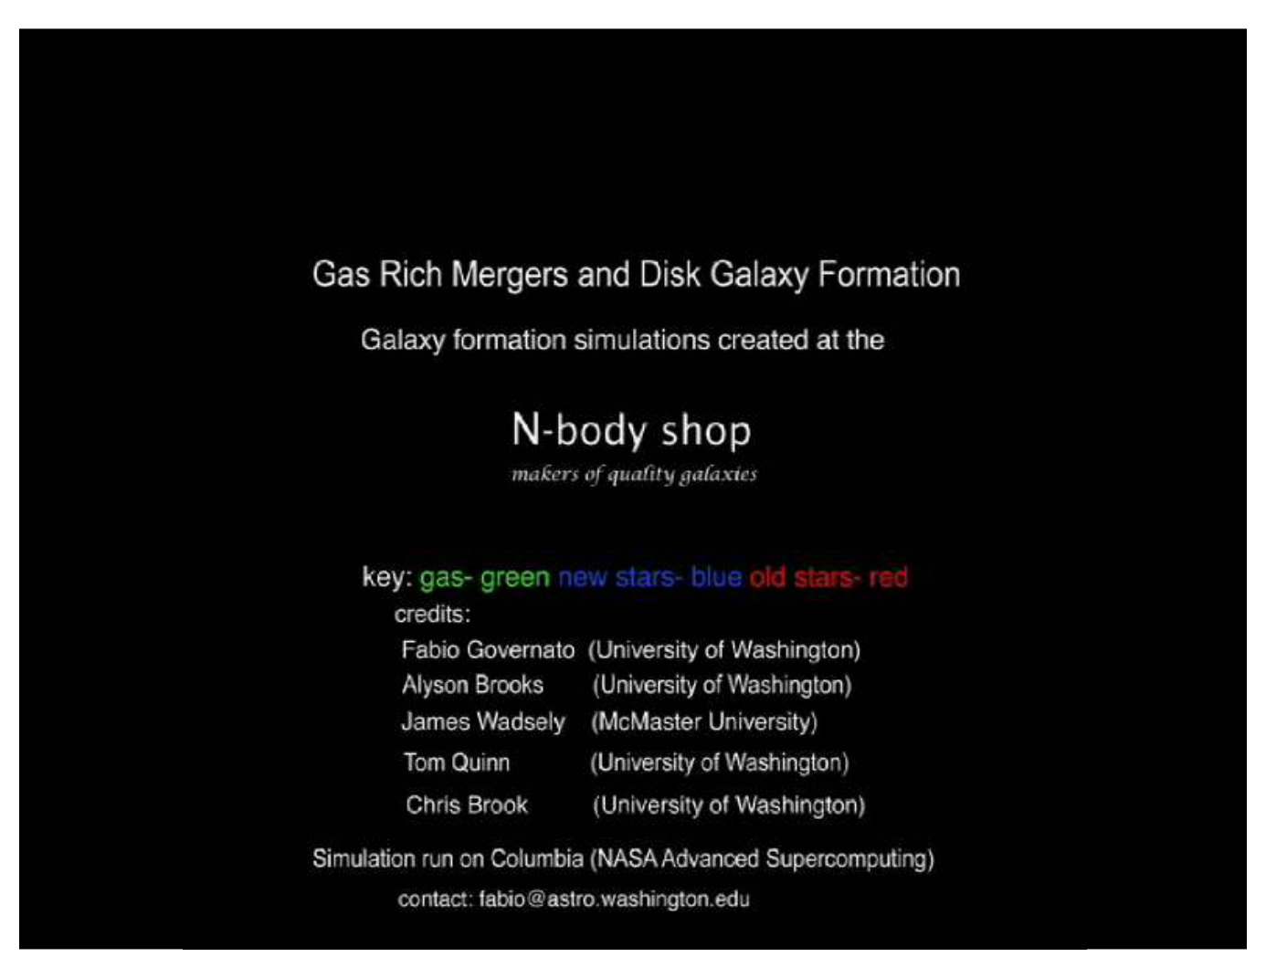
WVU DSPIRA
WEST VIRGINIA UNIVERSITY
Galaxy Formation occurs via mergers
(one galaxy)
wvurail.org/dspira
10 of 34
Notes:
Source edition: assets/lessons/lectures/astronomy/galaxy-interactions-and-dark-matter.pdf, page 10. Original author and figure credits remain on the slide. Text is editable; illustrations retain their source artwork.

Slide 11
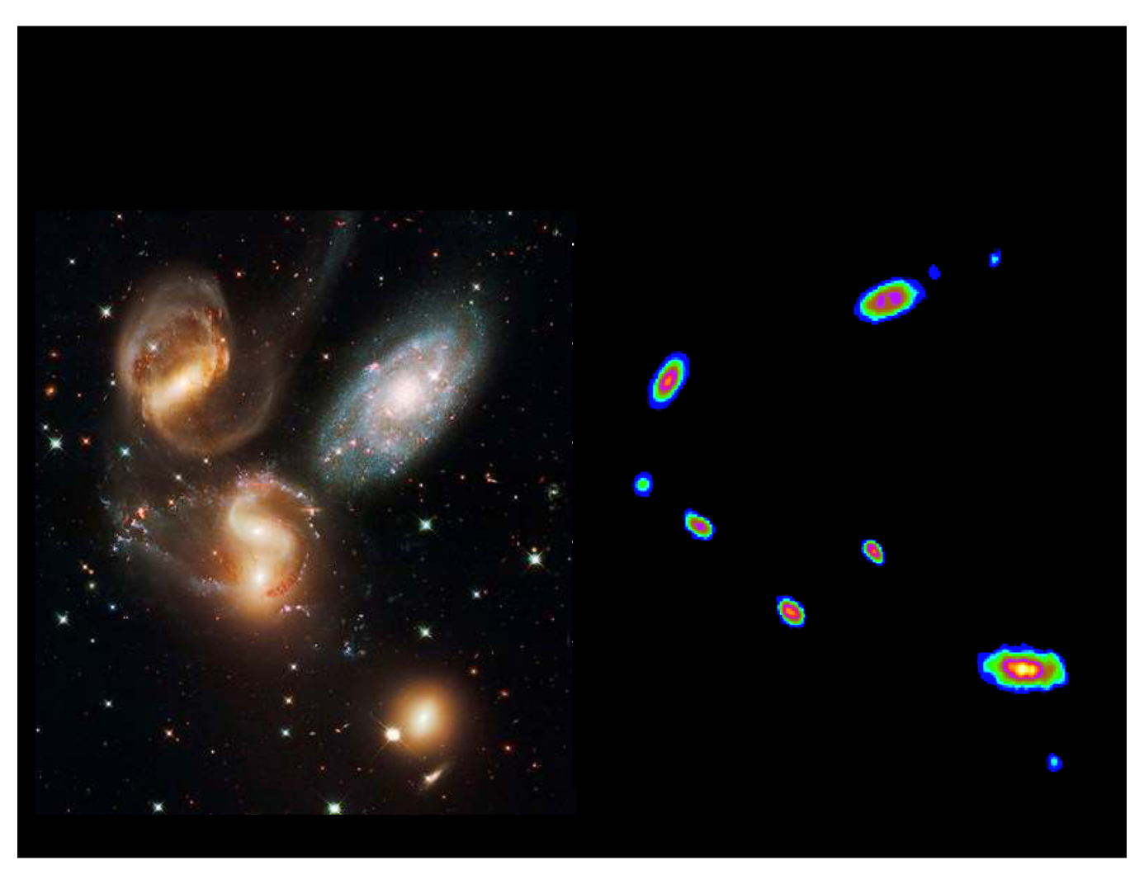
WVU DSPIRA
WEST VIRGINIA UNIVERSITY
Where do interactions occur?
Groups of Galaxies
wvurail.org/dspira
11 of 34
Notes:
Source edition: assets/lessons/lectures/astronomy/galaxy-interactions-and-dark-matter.pdf, page 11. Original author and figure credits remain on the slide. Text is editable; illustrations retain their source artwork.

Slide 12
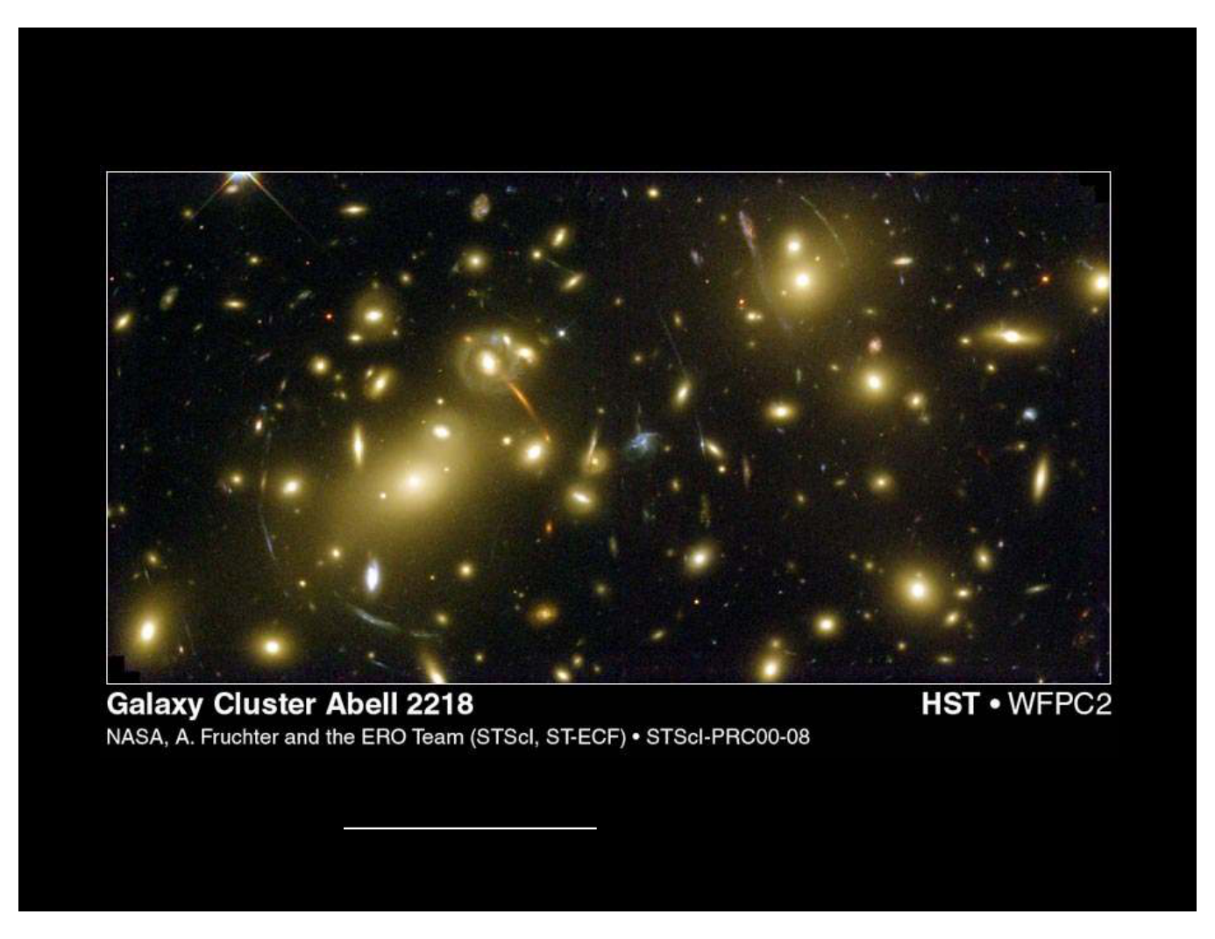
WVU DSPIRA
WEST VIRGINIA UNIVERSITY
Clusters of Galaxies
See the arcs of light?
Those are gravitational lensed images of background galaxies
Their shape is due to the dark matter in the cluster.
wvurail.org/dspira
12 of 34
Notes:
Source edition: assets/lessons/lectures/astronomy/galaxy-interactions-and-dark-matter.pdf, page 12. Original author and figure credits remain on the slide. Text is editable; illustrations retain their source artwork.

Slide 13
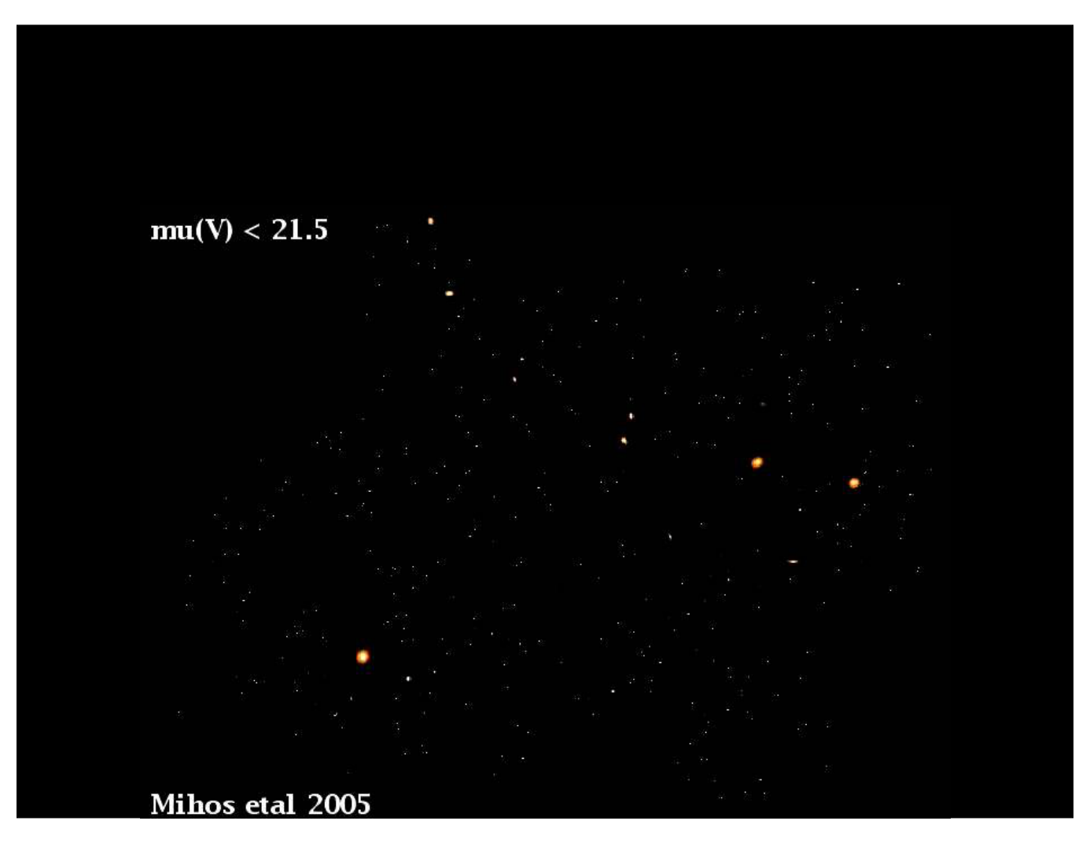
WVU DSPIRA
WEST VIRGINIA UNIVERSITY
Galaxy Interactions in Clusters
wvurail.org/dspira
13 of 34
Notes:
Source edition: assets/lessons/lectures/astronomy/galaxy-interactions-and-dark-matter.pdf, page 13. Original author and figure credits remain on the slide. Text is editable; illustrations retain their source artwork.

Slide 14
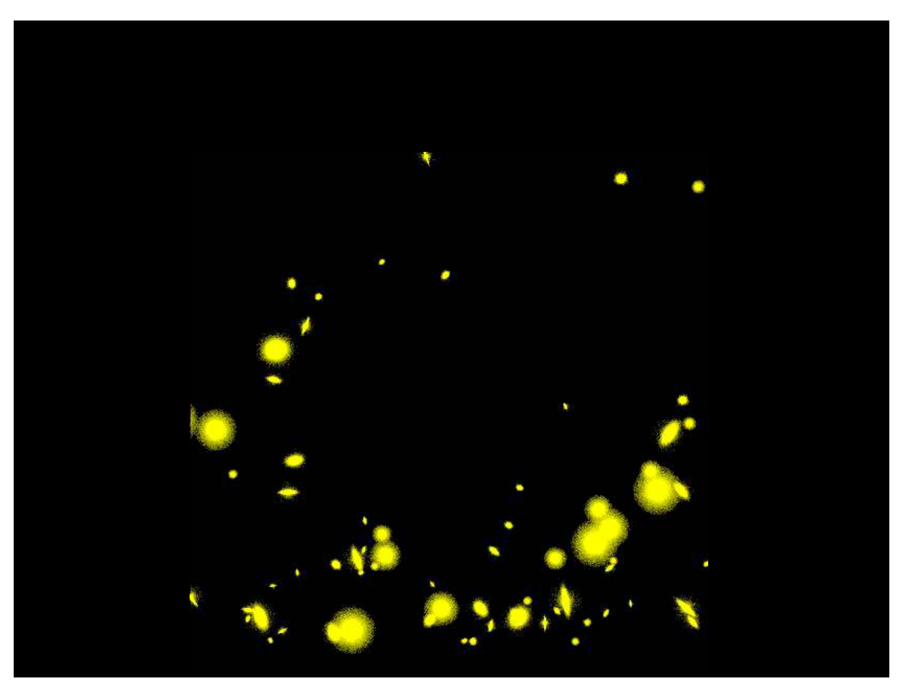
WVU DSPIRA
WEST VIRGINIA UNIVERSITY
The Future:
Forming Even Larger Galaxies?
wvurail.org/dspira
14 of 34
Notes:
Source edition: assets/lessons/lectures/astronomy/galaxy-interactions-and-dark-matter.pdf, page 14. Original author and figure credits remain on the slide. Text is editable; illustrations retain their source artwork.

Slide 15
WVU DSPIRA
WEST VIRGINIA UNIVERSITY
Starburst Galaxies
•
Galaxy interactions can compress gas
clouds in a galaxy triggering star formation
(particularly in the center of a galaxy).
•
It can also fuel a black hole in the center of
a galaxy.
•
Major mergers may also form elliptical
galaxies.
wvurail.org/dspira
15 of 34
Notes:
Source edition: assets/lessons/lectures/astronomy/galaxy-interactions-and-dark-matter.pdf, page 15. Original author and figure credits remain on the slide. Text is editable; illustrations retain their source artwork.

Slide 16
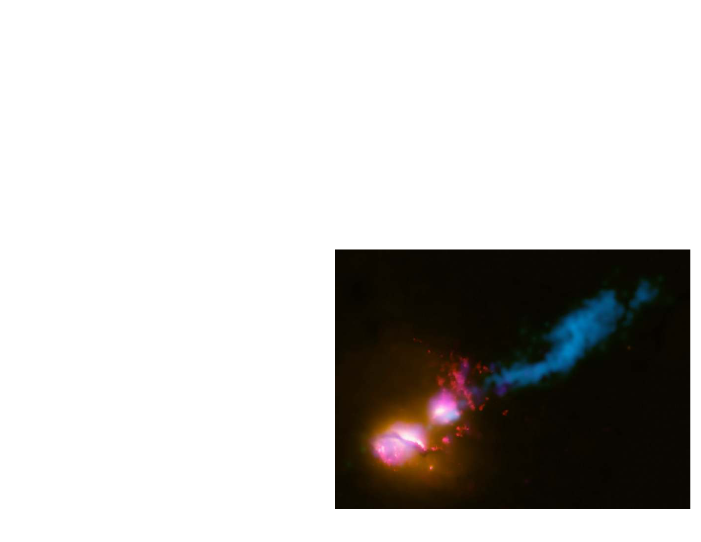
WVU DSPIRA
WEST VIRGINIA UNIVERSITY
Active Galaxies
•
Often referred to as Active Galactic Nuclei
(AGN)
•
Otherwise normal galaxies with an active black
hole in their center that is producing jets (often
seen in radio light).
•
May be triggered by
interactions
•
Jets can affect the
surrounding galaxies.
wvurail.org/dspira
16 of 34
Notes:
Source edition: assets/lessons/lectures/astronomy/galaxy-interactions-and-dark-matter.pdf, page 16. Original author and figure credits remain on the slide. Text is editable; illustrations retain their source artwork.

Slide 17
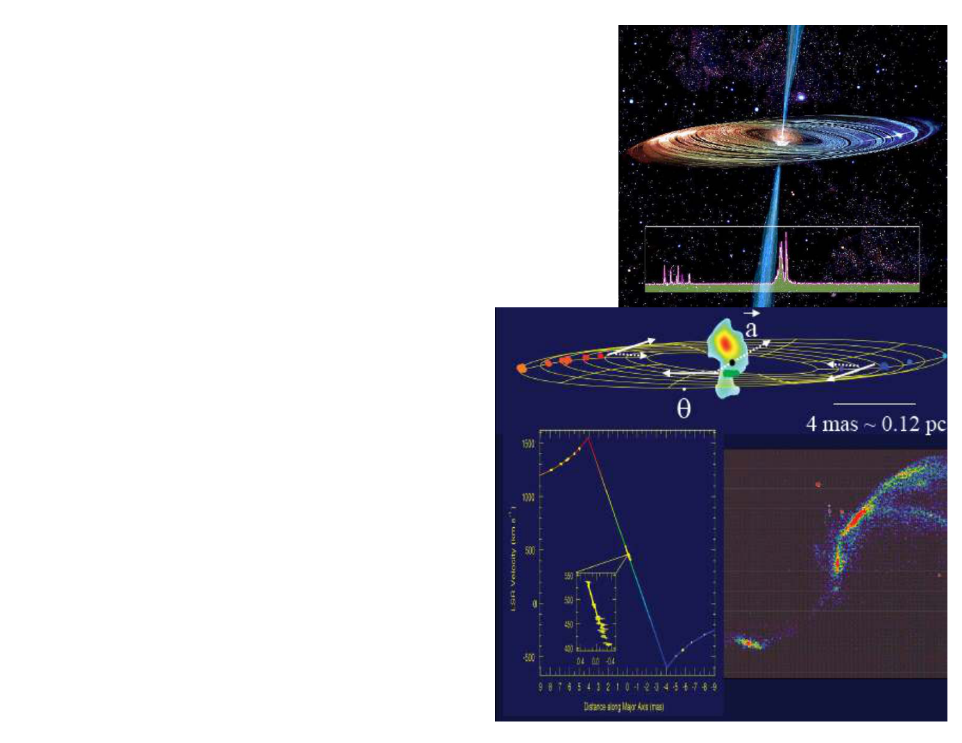
WVU DSPIRA
WEST VIRGINIA UNIVERSITY
Supermassive Black
Holes
•
Astronomers use widely
separated radio telescopes to
trace the motion of objects in
the center of other galaxies.
•
We can measure both the
apparent motion of these
objects and their velocities.
•
Combined, these data allow
us to measure the mass of
the black hole
•
We also see radio jet coming
from near the black hole.
•
Supermassive Black holes
are found in all galaxies
with spheroids (ellipticals
and early-type spirals)
wvurail.org/dspira
17 of 34
Notes:
Source edition: assets/lessons/lectures/astronomy/galaxy-interactions-and-dark-matter.pdf, page 17. Original author and figure credits remain on the slide. Text is editable; illustrations retain their source artwork.

Slide 18
WVU DSPIRA
WEST VIRGINIA UNIVERSITY
Which type of galaxy is
most
likely to contain a supermassive
black hole?
A.
Dwarf irregular
B.
Elliptical
C. Irregular
D. A spiral galaxy with a small bulge.
wvurail.org/dspira
18 of 34
Notes:
Source edition: assets/lessons/lectures/astronomy/galaxy-interactions-and-dark-matter.pdf, page 18. Original author and figure credits remain on the slide. Text is editable; illustrations retain their source artwork.

Slide 19
WVU DSPIRA
WEST VIRGINIA UNIVERSITY
How do we measure the mass of a
galaxy?
•
We need to know the mass of a galaxy in
order to determine its nature and how it
formed.
•
Different physics are involved in forming a
single star as opposed to a cluster of stars
and in contrast to an entire galaxy.
•
There are a couple methods.
wvurail.org/dspira
19 of 34
Notes:
Source edition: assets/lessons/lectures/astronomy/galaxy-interactions-and-dark-matter.pdf, page 19. Original author and figure credits remain on the slide. Text is editable; illustrations retain their source artwork.

Slide 20
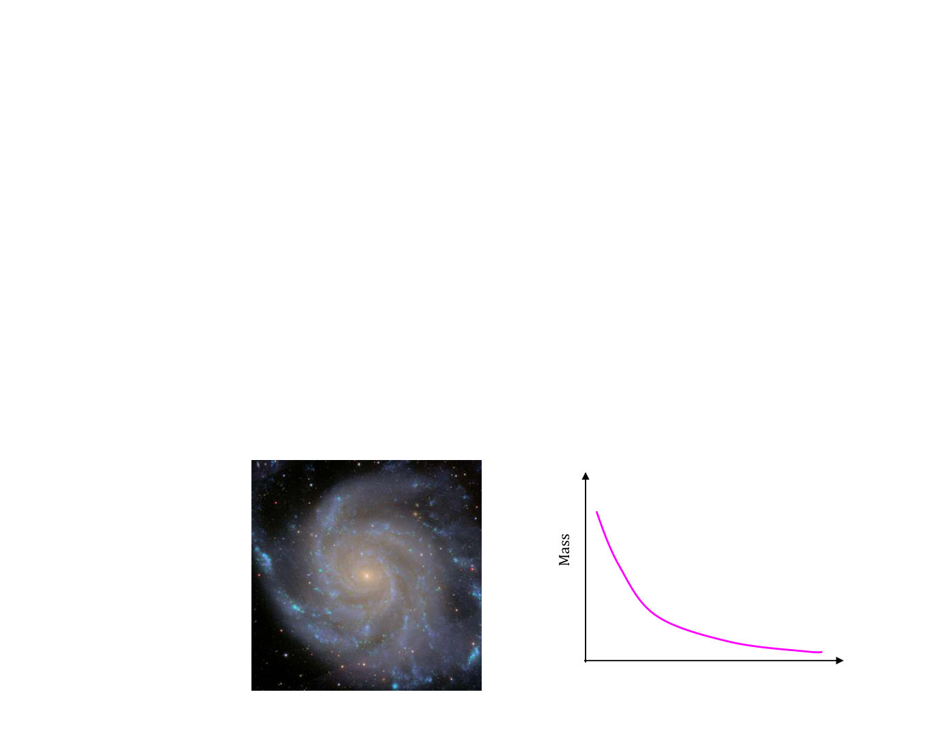
WVU DSPIRA
WEST VIRGINIA UNIVERSITY
How do we measure the mass of a
galaxy?
Method 1:Count all the stars and gas in a galaxy and add
up all their masses.
Pros: It is a relatively straight-forward measurement.
Getting the total gas mass is fairly easy and robust.
Cons: It is pretty hard to actually count all the individual
stars in a galaxy so you have to assume you know what
types of stars are in the galaxy.
Distance
wvurail.org/dspira
20 of 34
Notes:
Source edition: assets/lessons/lectures/astronomy/galaxy-interactions-and-dark-matter.pdf, page 20. Original author and figure credits remain on the slide. Text is editable; illustrations retain their source artwork.

Slide 21
WVU DSPIRA
WEST VIRGINIA UNIVERSITY
How do we measure the mass of a
galaxy?
Method 2:Use the motions of objects in the
galaxy to determine the mass.
Pros: Simple measurement that gives you
all
the mass of a galaxy.
Cons: Need to have an object emitting light
in order to measure mass at that position.
wvurail.org/dspira
21 of 34
Notes:
Source edition: assets/lessons/lectures/astronomy/galaxy-interactions-and-dark-matter.pdf, page 21. Original author and figure credits remain on the slide. Text is editable; illustrations retain their source artwork.

Slide 22
WVU DSPIRA
WEST VIRGINIA UNIVERSITY
Mass of the Solar System
•
What is the mass of the solar system?
– about 1 solar mass
•
Where is most of the mass in the solar
system?
– in the center
•
We can use the velocity of the planets
versus their position to measure the mass
of the solar system.
wvurail.org/dspira
22 of 34
Notes:
Source edition: assets/lessons/lectures/astronomy/galaxy-interactions-and-dark-matter.pdf, page 22. Original author and figure credits remain on the slide. Text is editable; illustrations retain their source artwork.

Slide 23
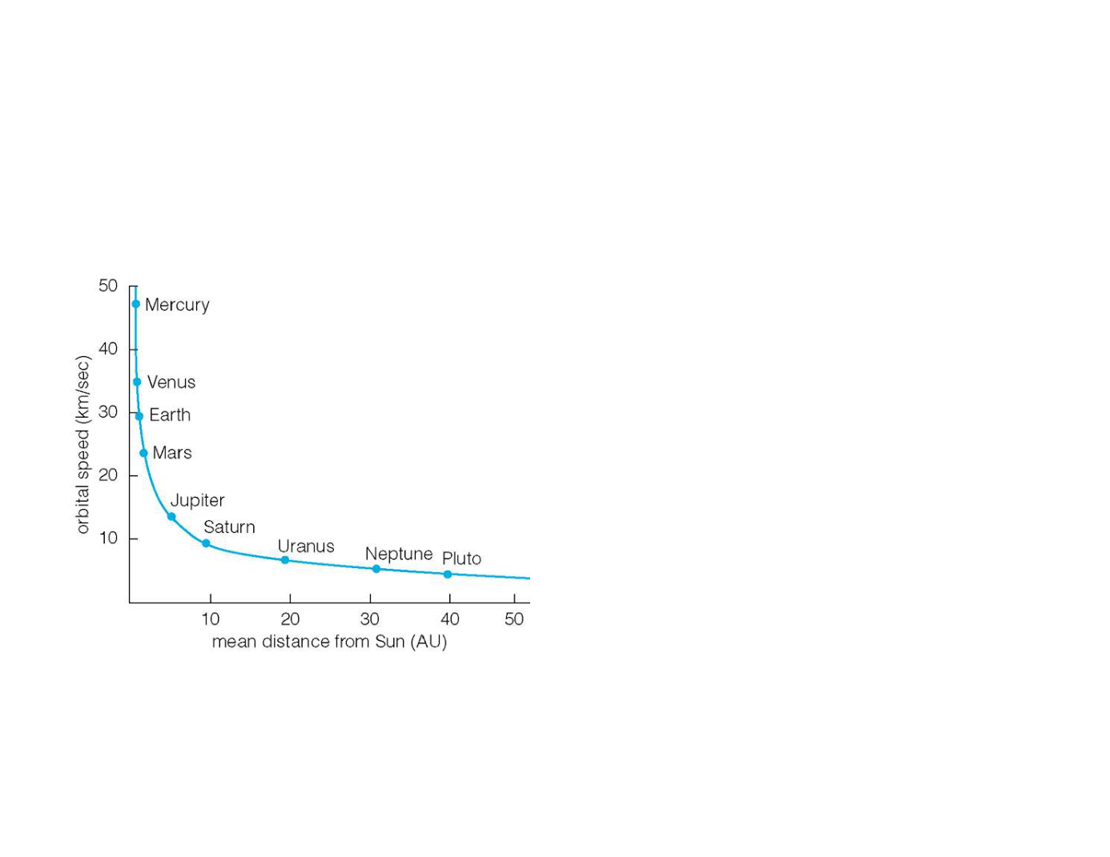
WVU DSPIRA
WEST VIRGINIA UNIVERSITY
Mass of the Solar System
•
This is what the
rotation curve
of the Solar System looks like.
•
As the semi-major axis of a
planet is increased, its velocity
decreases.
•
This curve is called a
Keplerian rotation curve.
•
It implies that all the mass is
in the center of the system.
•
This is the same rotation
curve as is seen for objects
around black holes.
wvurail.org/dspira
23 of 34
Notes:
Source edition: assets/lessons/lectures/astronomy/galaxy-interactions-and-dark-matter.pdf, page 23. Original author and figure credits remain on the slide. Text is editable; illustrations retain their source artwork.

Slide 24
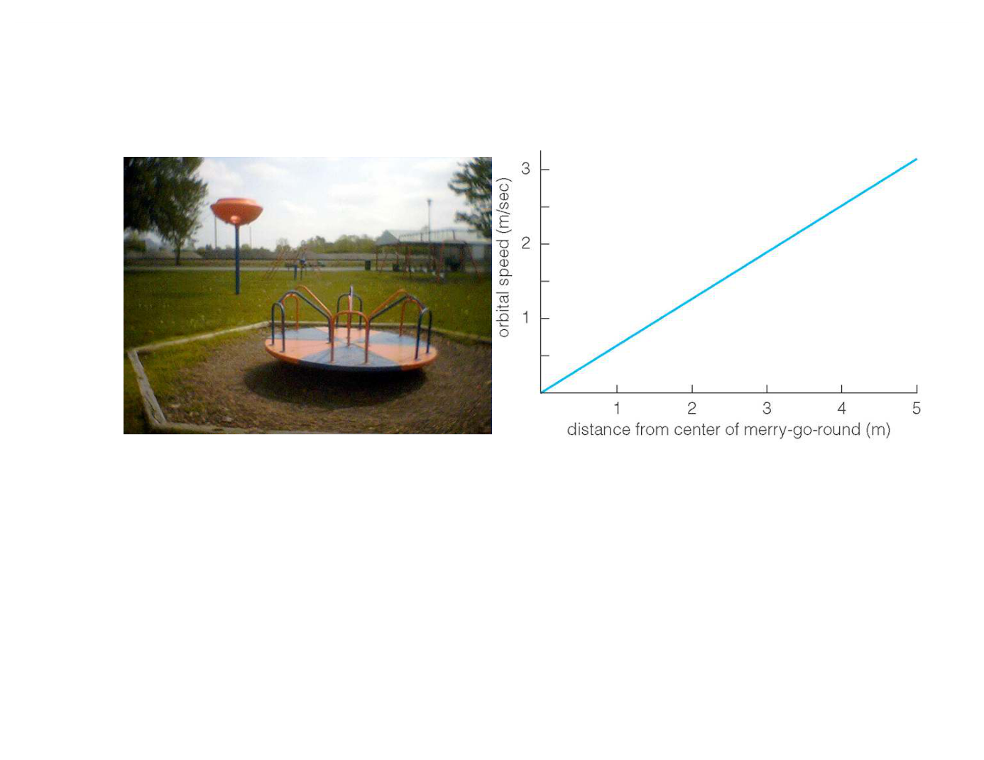
WVU DSPIRA
WEST VIRGINIA UNIVERSITY
Mass of a merry-go-round
•
As you move from the center to the edge, you go faster
and faster since each part of the merry-go-round needs
to complete a circle in the same amount of time.
•
As you move to the edge, more of the mass of the
merry-go-round is between you and the center.
•
This curve implies that mass is
increasing
with radius.
wvurail.org/dspira
24 of 34
Notes:
Source edition: assets/lessons/lectures/astronomy/galaxy-interactions-and-dark-matter.pdf, page 24. Original author and figure credits remain on the slide. Text is editable; illustrations retain their source artwork.

Slide 25
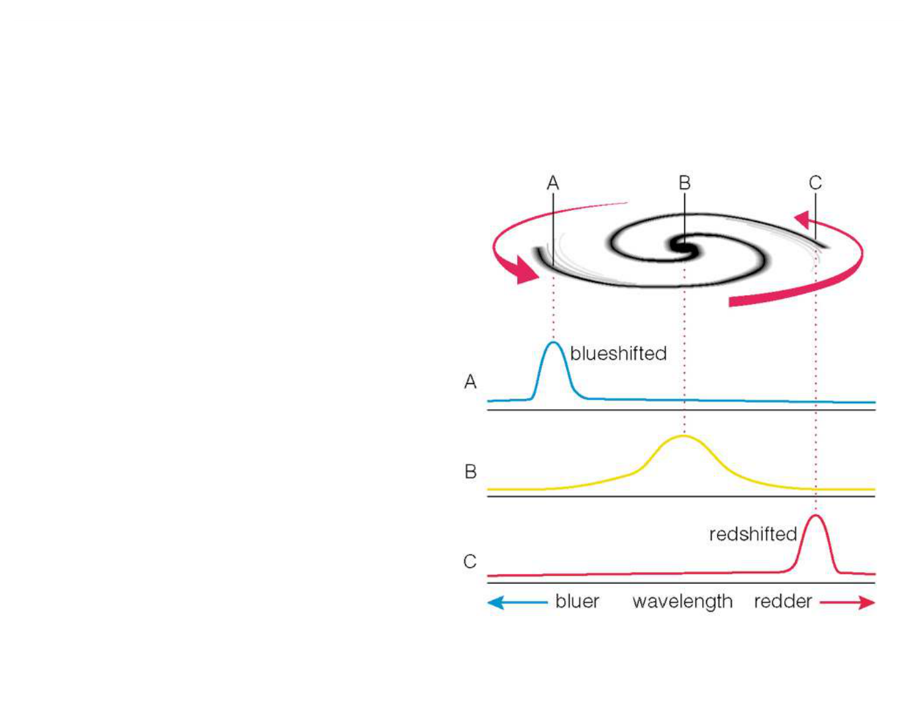
WVU DSPIRA
WEST VIRGINIA UNIVERSITY
Mass of a Galaxy
•
Using the Doppler effect
we can measure the
rotation of a spiral galaxy.
•
One side is blue-shifted,
one side is red-shifted
with respect to the center.
•
The total shift
corresponds to the
rotation velocity of the
galaxy
wvurail.org/dspira
25 of 34
Notes:
Source edition: assets/lessons/lectures/astronomy/galaxy-interactions-and-dark-matter.pdf, page 25. Original author and figure credits remain on the slide. Text is editable; illustrations retain their source artwork.

Slide 26
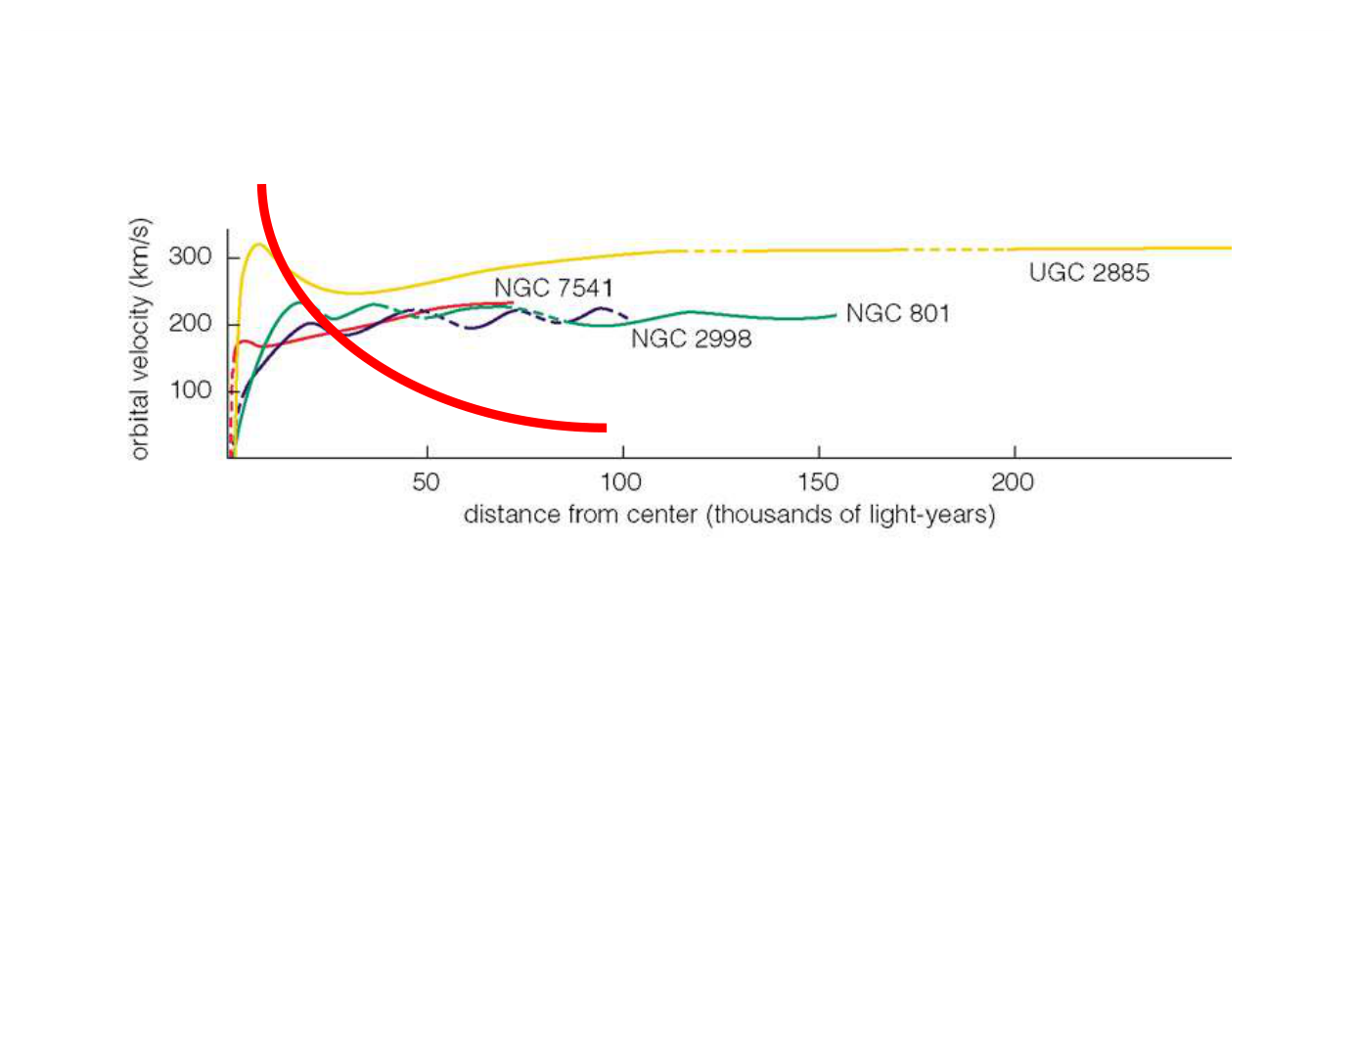
WVU DSPIRA
WEST VIRGINIA UNIVERSITY
Mass of a Galaxy
•
For
all
spiral galaxies, we see a rotation curve like those above.
•
The center parts look like a merry-go-round (solid body)
•
The outer parts are flat.
•
The height and extent of the curve give you the total mass.
–
higher and longer curves = larger total mass
•
No
galaxy has a
declining, Keplerian
rotation curve.
•
This implies that the mass of a galaxy continues to increase
with radius.
wvurail.org/dspira
26 of 34
Notes:
Source edition: assets/lessons/lectures/astronomy/galaxy-interactions-and-dark-matter.pdf, page 26. Original author and figure credits remain on the slide. Text is editable; illustrations retain their source artwork.

Slide 27
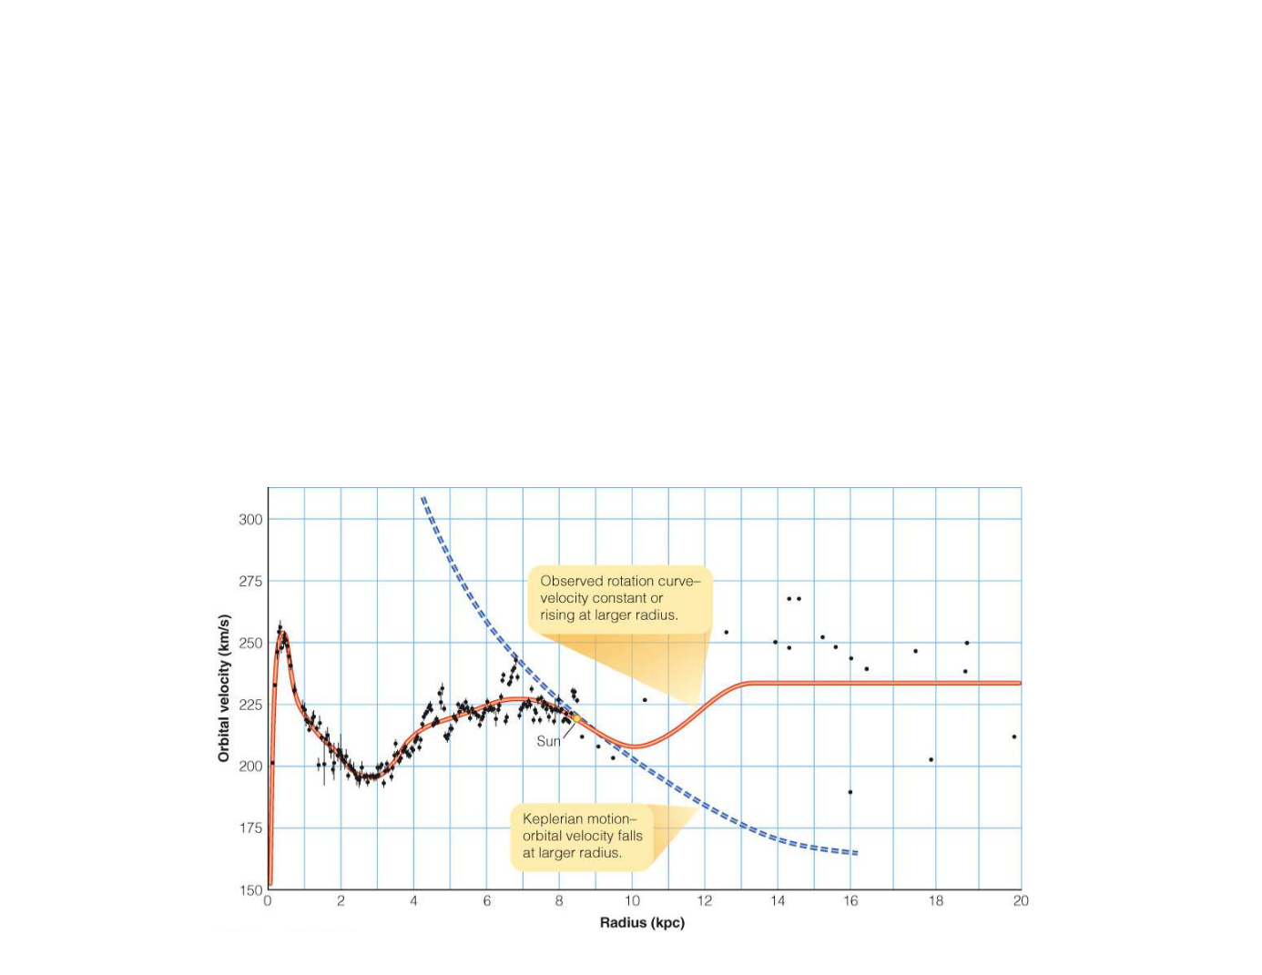
WVU DSPIRA
WEST VIRGINIA UNIVERSITY
Mass of the Milky Way
•
Same rotation curve seen for the Milky Way.
•
The mass continue to increase beyond the edge of the
disk of stars and gas out to the very edge of the halo.
•
What is this missing mass???
wvurail.org/dspira
27 of 34
Notes:
Source edition: assets/lessons/lectures/astronomy/galaxy-interactions-and-dark-matter.pdf, page 27. Original author and figure credits remain on the slide. Text is editable; illustrations retain their source artwork.

Slide 28
WVU DSPIRA
WEST VIRGINIA UNIVERSITY
Masses of other galaxies
•
While not all galaxies rotate, the motions
of their stars and gas
all
indicate some
missing mass.
•
The motions of galaxies in pairs, in
groups, and in clusters also provide
evidence for missing mass.
•
As does gravitational lensing by clusters.
wvurail.org/dspira
28 of 34
Notes:
Source edition: assets/lessons/lectures/astronomy/galaxy-interactions-and-dark-matter.pdf, page 28. Original author and figure credits remain on the slide. Text is editable; illustrations retain their source artwork.

Slide 29
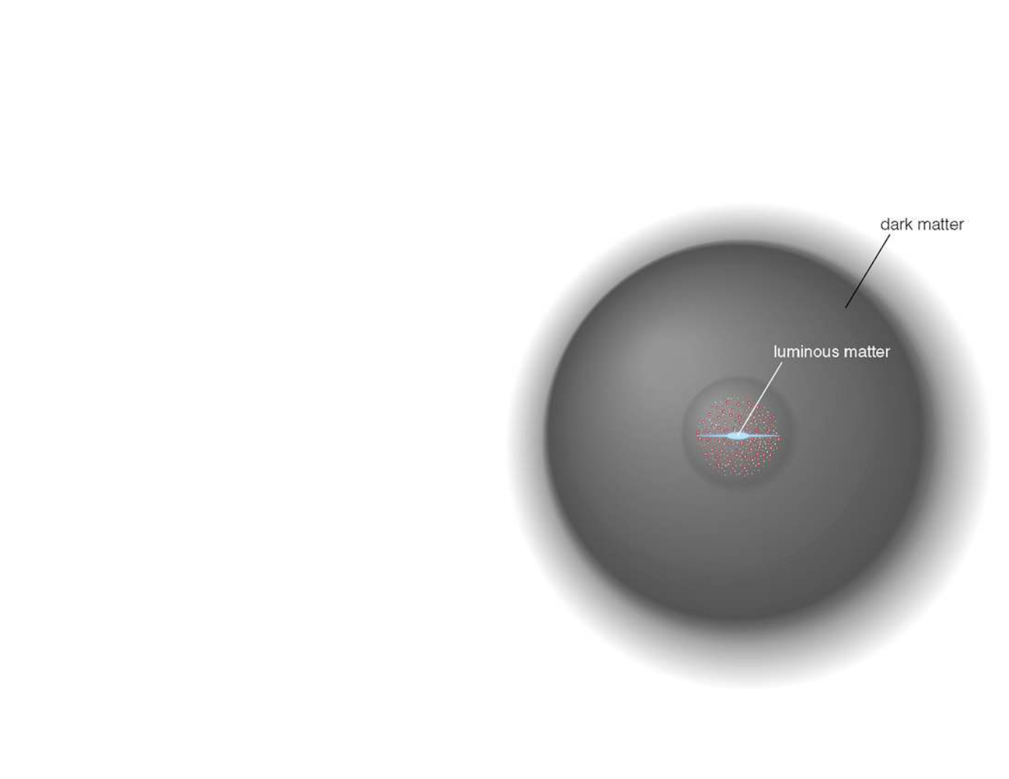
WVU DSPIRA
WEST VIRGINIA UNIVERSITY
Mass in stars versus Total Mass
•
Most of the missing
mass is in the
outskirts of
galaxies.
•
Can only account
for about 10% of
the total mass of
galaxies in stars
and gas.
wvurail.org/dspira
29 of 34
Notes:
Source edition: assets/lessons/lectures/astronomy/galaxy-interactions-and-dark-matter.pdf, page 29. Original author and figure credits remain on the slide. Text is editable; illustrations retain their source artwork.

Slide 30
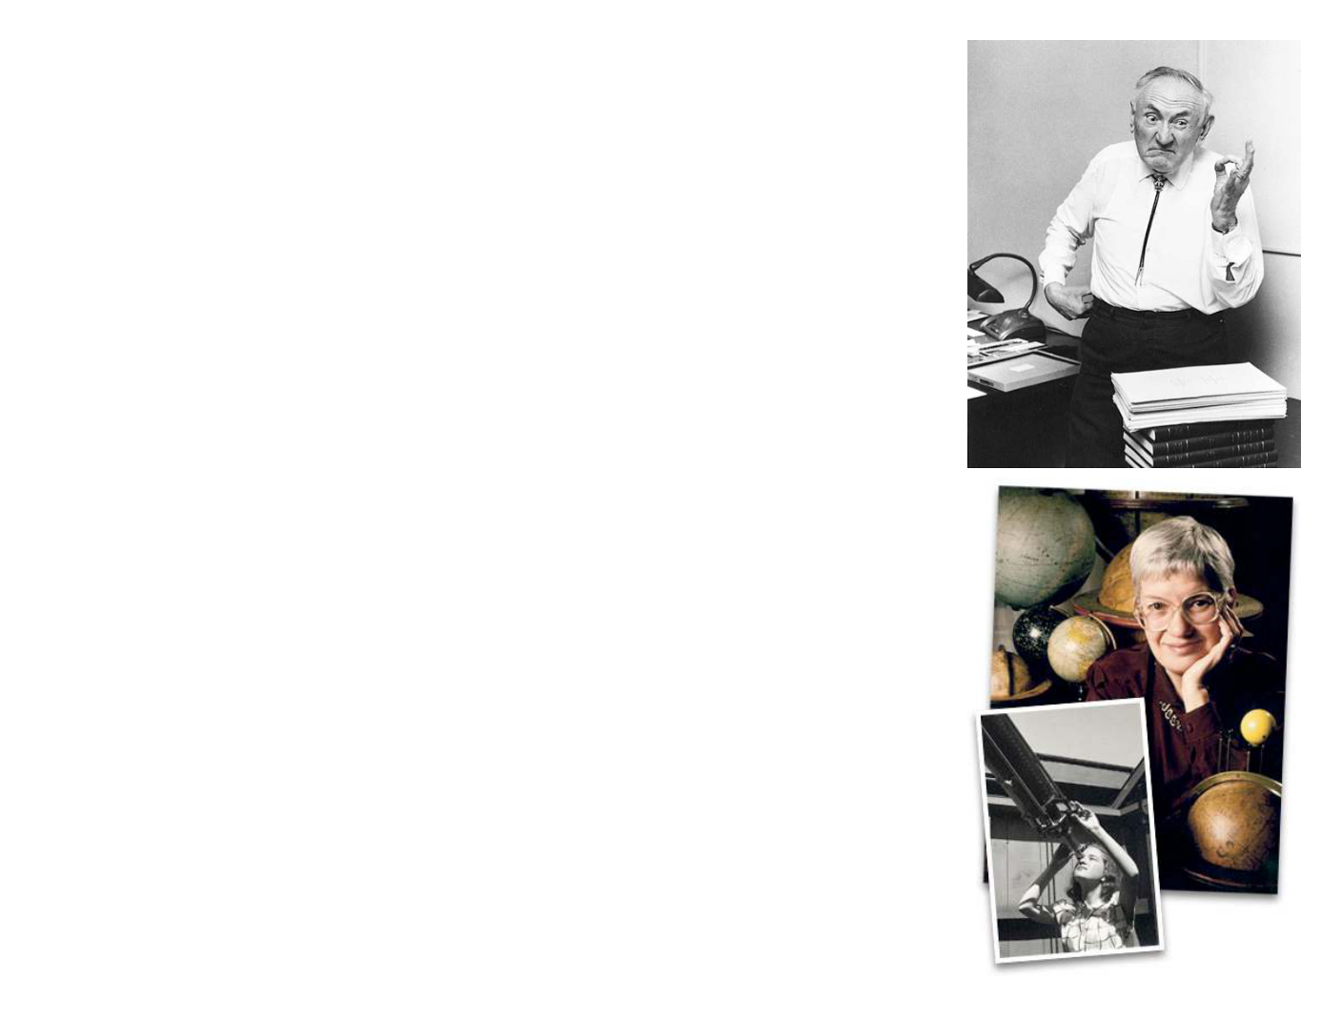
WVU DSPIRA
WEST VIRGINIA UNIVERSITY
Dark Matter
•
This missing mass is called
dark
matter
. It is matter that does not emit
light, or at least can’t be seen.
•
You are a form of dark matter.
•
It is
not
the same as a dark nebula or
black holes.
•
First suggested to exist by Fritz
Zwicky in the 1930s!
•
Observational evidence first provided
in the 1970s by Vera Rubin.
•
We still don’t know what it is only that
it is seen almost everywhere.
wvurail.org/dspira
30 of 34
Notes:
Source edition: assets/lessons/lectures/astronomy/galaxy-interactions-and-dark-matter.pdf, page 30. Original author and figure credits remain on the slide. Text is editable; illustrations retain their source artwork.

Slide 31
WVU DSPIRA
WEST VIRGINIA UNIVERSITY
Which of the following does not provide
evidence for the existence of dark
matter?
A.
Rotation Curves of galaxies
B.
The orbits of the planets
C. Gravitational lenses
D. Motions of galaxies in groups
E.
They all provide evidence
wvurail.org/dspira
31 of 34
Notes:
Source edition: assets/lessons/lectures/astronomy/galaxy-interactions-and-dark-matter.pdf, page 31. Original author and figure credits remain on the slide. Text is editable; illustrations retain their source artwork.

Slide 32
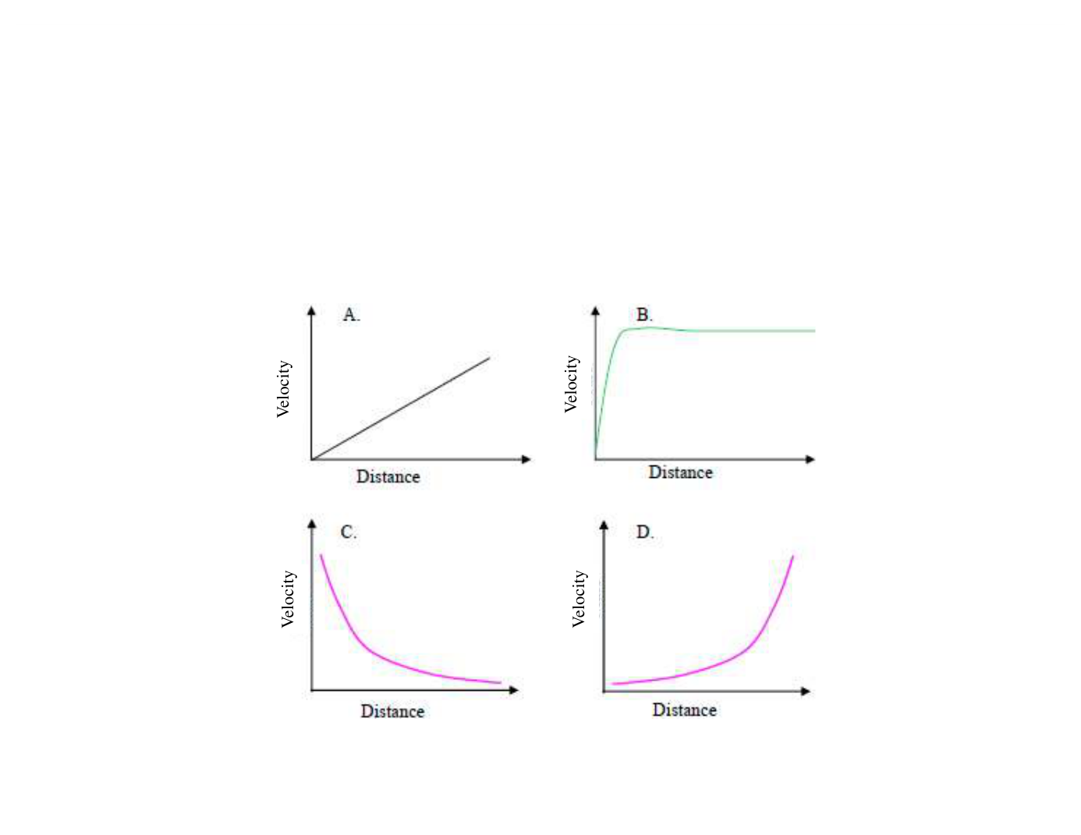
WVU DSPIRA
WEST VIRGINIA UNIVERSITY
Which of the following could be a
rotation curve for the solar system?
wvurail.org/dspira
32 of 34
Notes:
Source edition: assets/lessons/lectures/astronomy/galaxy-interactions-and-dark-matter.pdf, page 32. Original author and figure credits remain on the slide. Text is editable; illustrations retain their source artwork.

Slide 33
WVU DSPIRA
WEST VIRGINIA UNIVERSITY
Which of the following could be a
rotation curve for stars around a
supermassive black hole?
wvurail.org/dspira
33 of 34
Notes:
Source edition: assets/lessons/lectures/astronomy/galaxy-interactions-and-dark-matter.pdf, page 33. Original author and figure credits remain on the slide. Text is editable; illustrations retain their source artwork.

Slide 34
WVU DSPIRA
WEST VIRGINIA UNIVERSITY
Which of the following rotation curves
would be for a galaxy?
wvurail.org/dspira
34 of 34
Notes:
Source edition: assets/lessons/lectures/astronomy/galaxy-interactions-and-dark-matter.pdf, page 34. Original author and figure credits remain on the slide. Text is editable; illustrations retain their source artwork.

