Slide 1
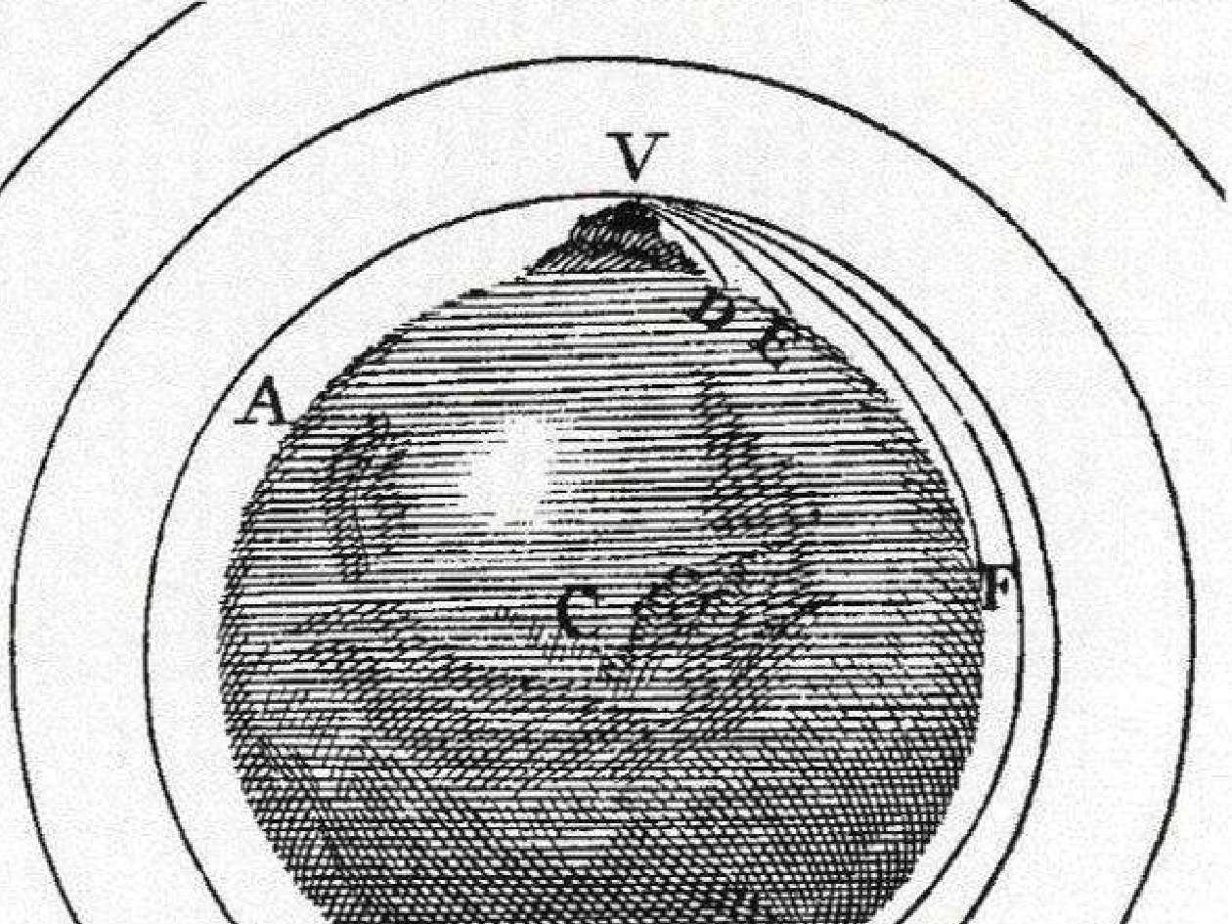
WVU DSPIRA
WEST VIRGINIA UNIVERSITY
Gravity
wvurail.org/dspira
1 of 27
Notes:
Source edition: assets/lessons/lectures/astronomy/gravity.pdf, page 1. Original author and figure credits remain on the slide. Text is editable; illustrations retain their source artwork.

Slide 2
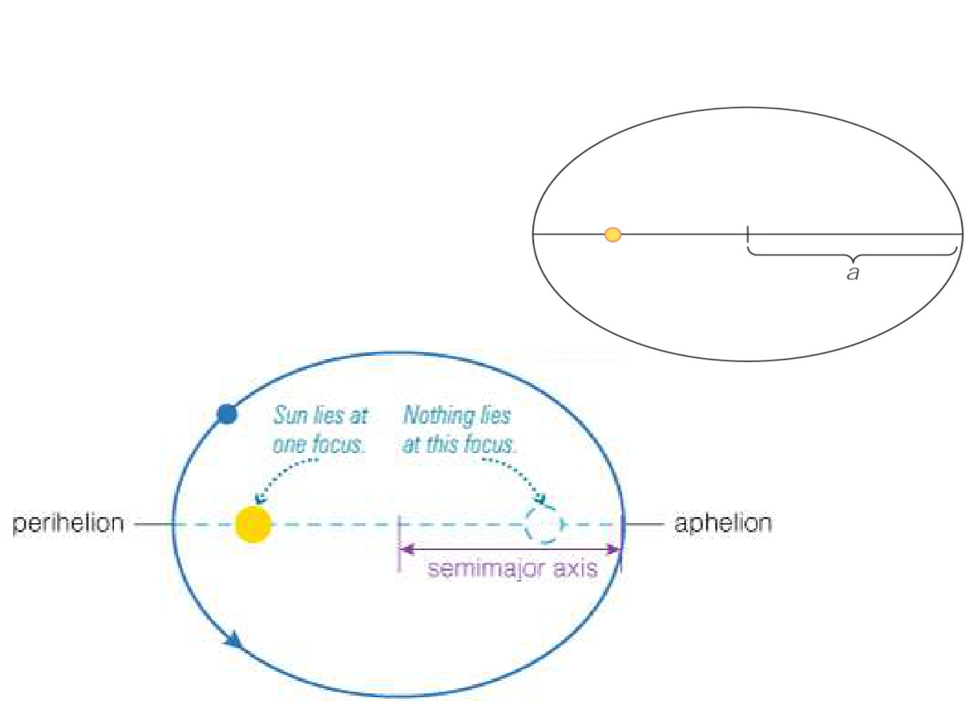
WVU DSPIRA
WEST VIRGINIA UNIVERSITY
Kepler’s 1
st
Law
Law #1
: The orbits of the
planets are ellipses with
the Sun at one focus.
c
Eccentricity e = c/a
wvurail.org/dspira
2 of 27
Notes:
Source edition: assets/lessons/lectures/astronomy/gravity.pdf, page 2. Original author and figure credits remain on the slide. Text is editable; illustrations retain their source artwork.

Slide 3
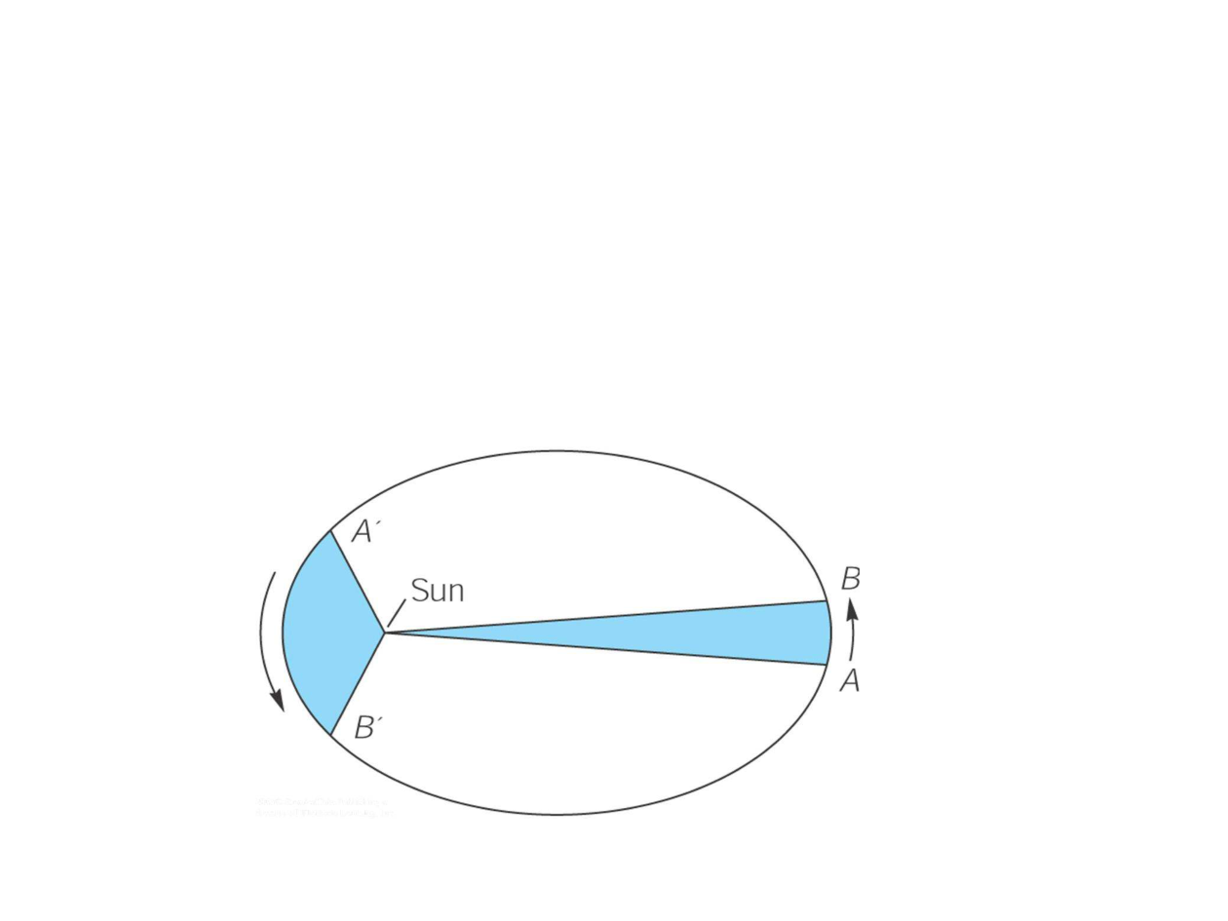
WVU DSPIRA
WEST VIRGINIA UNIVERSITY
Kepler’s 2
nd
Law
Law #2
: A line from a planet to the sun
sweeps over equal areas in equal
intervals of time.
(When it’s closer to the Sun, a planet
moves faster)
⇒
Therefore, a planet travels faster when it is nearer to the
Sun and slower when it is farther from the Sun.
wvurail.org/dspira
3 of 27
Notes:
Source edition: assets/lessons/lectures/astronomy/gravity.pdf, page 3. Original author and figure credits remain on the slide. Text is editable; illustrations retain their source artwork.

Slide 4

WVU DSPIRA
WEST VIRGINIA UNIVERSITY
Kepler’s 3
rd
Law
A planet’s orbital period (P) squared is
proportional to its average distance from the
sun (a) cubed:
Closer orbits go faster
(P
= period in years; a
P
2
= a
3
y
AU
y
AU
= distance in AU)
http://www.solarsystemscope.com/
http://astro.unl.edu/naap/pos/animations/
kepler.html
wvurail.org/dspira
4 of 27
Notes:
Source edition: assets/lessons/lectures/astronomy/gravity.pdf, page 4. Original author and figure credits remain on the slide. Text is editable; illustrations retain their source artwork.

Slide 5

WVU DSPIRA
WEST VIRGINIA UNIVERSITY
Concept Quiz
Which planet will orbit in the smallest
amount of time?
a) Something with the mass of Jupiter at
the orbital distance of Jupiter
b) Something with the mass of Earth at the
orbital distance of Jupiter
c)
Something with the mass of Earth at the
orbital distance of Earth
d) Something with the mass of Jupiter at
the orbital distance of Earth
e) c) and d) would be equal
wvurail.org/dspira
5 of 27
Notes:
Source edition: assets/lessons/lectures/astronomy/gravity.pdf, page 5. Original author and figure credits remain on the slide. Text is editable; illustrations retain their source artwork.

Slide 6
WVU DSPIRA
WEST VIRGINIA UNIVERSITY
Concept Quiz
Which planet will orbit in the smallest
amount of time?
a) Something with the mass of Jupiter at
the orbital distance of Jupiter
b) Something with the mass of Earth at the
orbital distance of Jupiter
c)
Something with the mass of Earth at the
orbital distance of Earth
d) Something with the mass of Jupiter at
the orbital distance of Earth
e) c) and d) would be equal
wvurail.org/dspira
6 of 27
Notes:
Source edition: assets/lessons/lectures/astronomy/gravity.pdf, page 6. Original author and figure credits remain on the slide. Text is editable; illustrations retain their source artwork.

Slide 7
WVU DSPIRA
WEST VIRGINIA UNIVERSITY
Concept Quiz
How long does it take Mars to orbit the
Sun?
a) More than a year
b) Less than a year
c)
One year
wvurail.org/dspira
7 of 27
Notes:
Source edition: assets/lessons/lectures/astronomy/gravity.pdf, page 7. Original author and figure credits remain on the slide. Text is editable; illustrations retain their source artwork.

Slide 8
WVU DSPIRA
WEST VIRGINIA UNIVERSITY
Concept Quiz
How long does it take Mars to orbit the
Sun?
a) More than a year
b) Less than a year
c)
One year
wvurail.org/dspira
8 of 27
Notes:
Source edition: assets/lessons/lectures/astronomy/gravity.pdf, page 8. Original author and figure credits remain on the slide. Text is editable; illustrations retain their source artwork.

Slide 9
WVU DSPIRA
WEST VIRGINIA UNIVERSITY
Goals for Today
1)
What is gravity?
2) What is proportionality?
3) What is the inverse square law?
wvurail.org/dspira
9 of 27
Notes:
Source edition: assets/lessons/lectures/astronomy/gravity.pdf, page 9. Original author and figure credits remain on the slide. Text is editable; illustrations retain their source artwork.

Slide 10
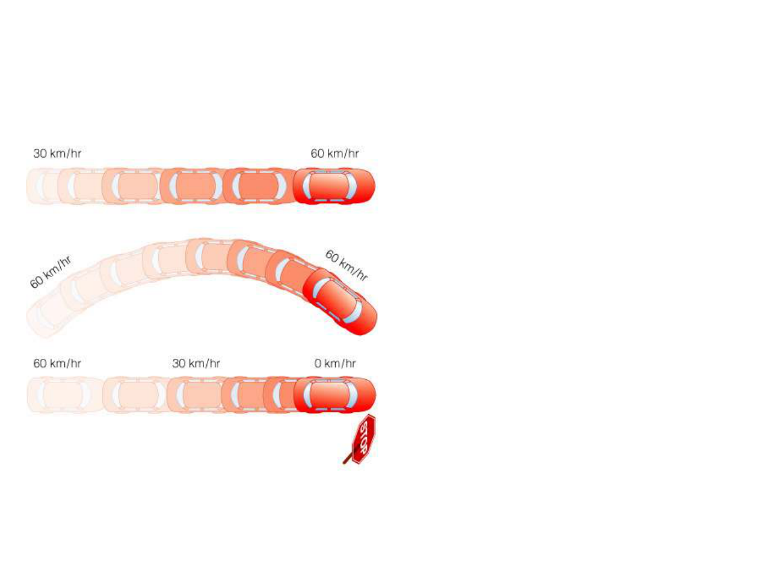
WVU DSPIRA
WEST VIRGINIA UNIVERSITY
How do we describe motion?
Speed
:
The rate at which
an object moves
example: 10 m/s
Velocity
:
Speed +
direction
example: 10 m/s, due
east
Acceleration
:
Any change
in velocity, including a
change in direction.
wvurail.org/dspira
10 of 27
Notes:
Source edition: assets/lessons/lectures/astronomy/gravity.pdf, page 10. Original author and figure credits remain on the slide. Text is editable; illustrations retain their source artwork.

Slide 11
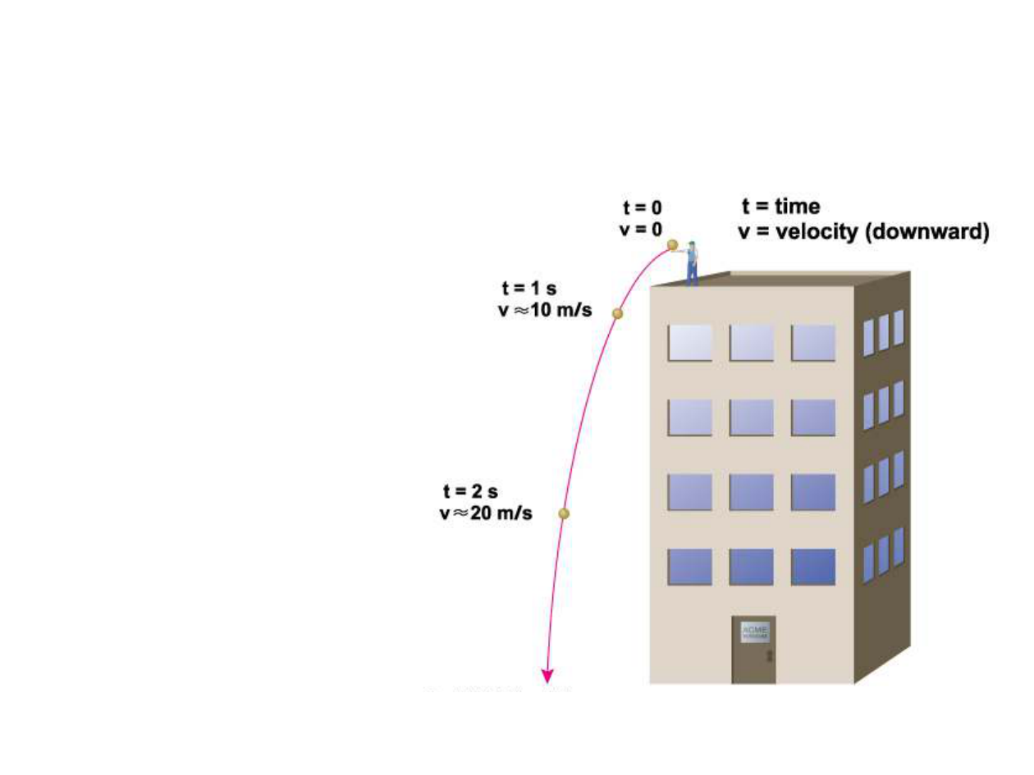
WVU DSPIRA
WEST VIRGINIA UNIVERSITY
Gravity is an Acceleration!
On Earth, speed
increases 10 m/s
with each
second of falling
time.
This increase in
speed is the
acceleration due
to gravity
wvurail.org/dspira
11 of 27
Notes:
Source edition: assets/lessons/lectures/astronomy/gravity.pdf, page 11. Original author and figure credits remain on the slide. Text is editable; illustrations retain their source artwork.

Slide 12
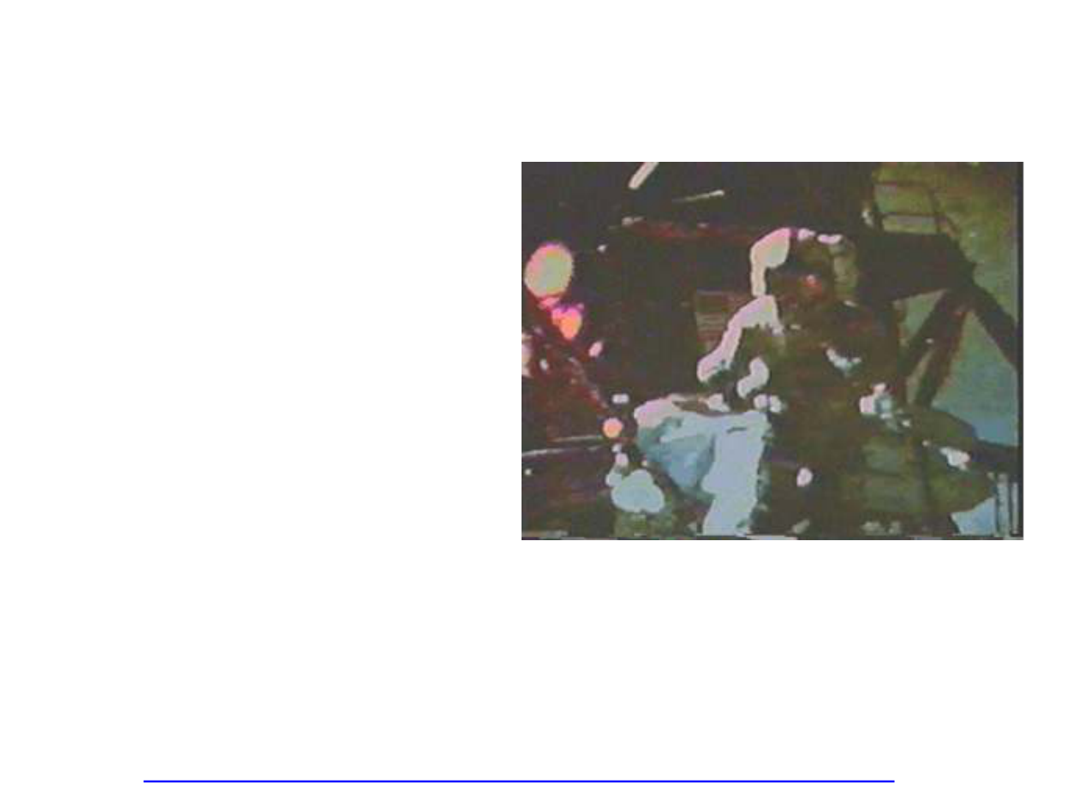
WVU DSPIRA
WEST VIRGINIA UNIVERSITY
The Acceleration due to Gravity
Galileo showed that
the gravitational
acceleration is the
same for all falling
objects, regardless
of their mass.
Air resistance, not
an object’s mass, is
what causes some
Apollo 15 demonstration
objects to fall
slower than others.
http://www.youtube.com/watch?v=-4_rceVPVSY
wvurail.org/dspira
12 of 27
Notes:
Source edition: assets/lessons/lectures/astronomy/gravity.pdf, page 12. Original author and figure credits remain on the slide. Text is editable; illustrations retain their source artwork.

Slide 13
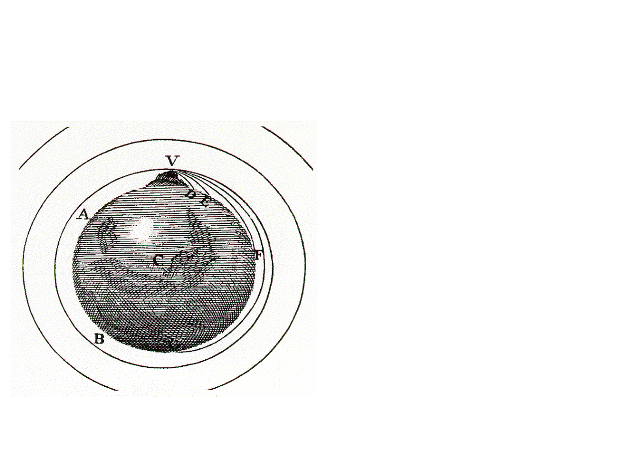
WVU DSPIRA
WEST VIRGINIA UNIVERSITY
Why are astronauts “weightless”
in space?
There
is
gravity
in space
Weightlessness
is due to a
constant state of
free-fall
wvurail.org/dspira
13 of 27
Notes:
Source edition: assets/lessons/lectures/astronomy/gravity.pdf, page 13. Original author and figure credits remain on the slide. Text is editable; illustrations retain their source artwork.

Slide 14
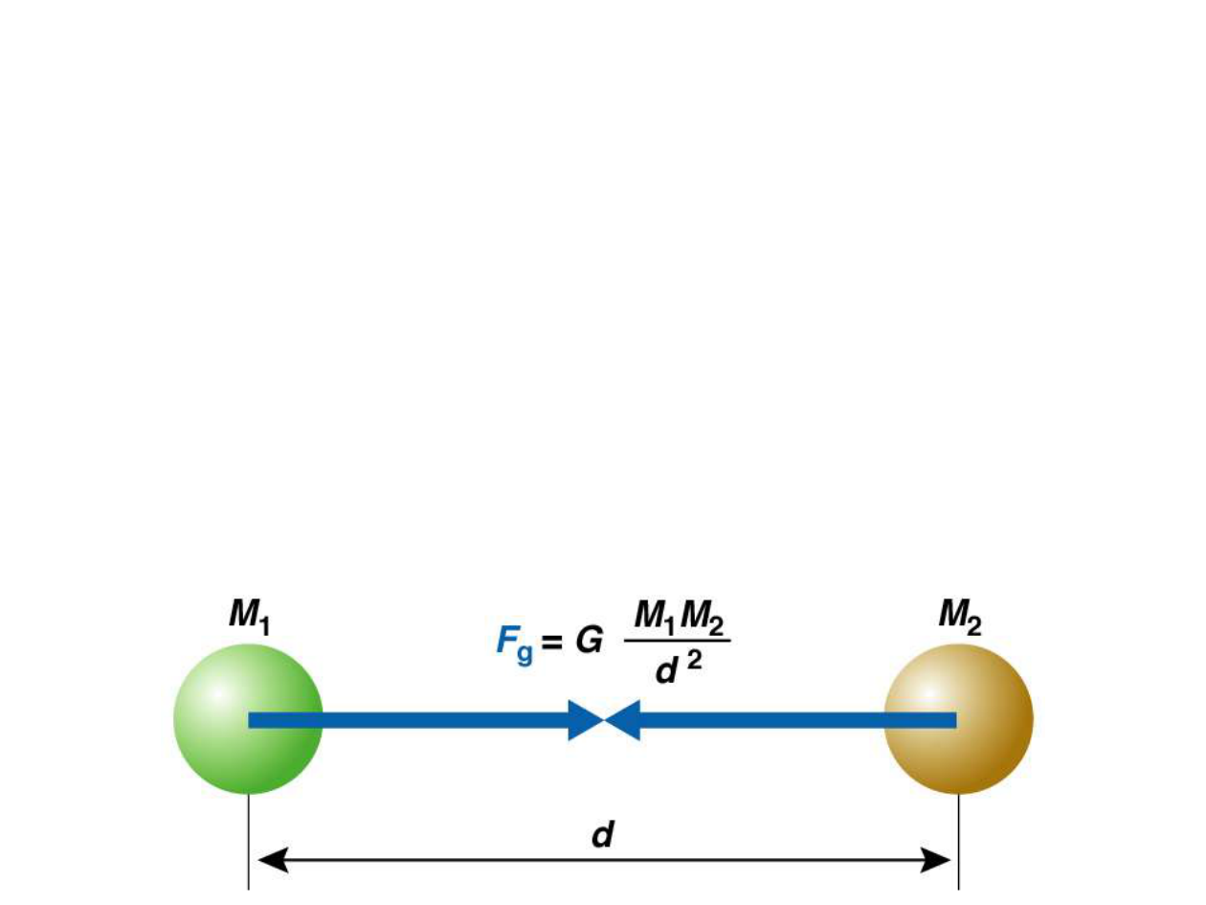
WVU DSPIRA
WEST VIRGINIA UNIVERSITY
The Universal Law of Gravitation
Every mass attracts every other mass.
Attraction is directly proportional to the product
of their masses.
–
As the masses increase, so does the gravitational
force
Attraction is inversely proportional to the
square of the distance between their centers.
–
As the distances decrease, the gravitational force
increases quickly
wvurail.org/dspira
14 of 27
Notes:
Source edition: assets/lessons/lectures/astronomy/gravity.pdf, page 14. Original author and figure credits remain on the slide. Text is editable; illustrations retain their source artwork.

Slide 15
WVU DSPIRA
WEST VIRGINIA UNIVERSITY
Proportionality
When two terms are proportional, as
one increases the other one increases
Terms can be inversely proportional: as
one increases the other decreases.
Important!!!
wvurail.org/dspira
15 of 27
Notes:
Source edition: assets/lessons/lectures/astronomy/gravity.pdf, page 15. Original author and figure credits remain on the slide. Text is editable; illustrations retain their source artwork.

Slide 16
WVU DSPIRA
WEST VIRGINIA UNIVERSITY
Concept Quiz
The force of gravity is proportional to
__________ and inversely proportional
to ____________.
a) acceleration, distance between
objects
b) distance between objects, product
of object masses
c)
product of object masses,
acceleration
d) product of object masses, distance
between objects
wvurail.org/dspira
16 of 27
Notes:
Source edition: assets/lessons/lectures/astronomy/gravity.pdf, page 16. Original author and figure credits remain on the slide. Text is editable; illustrations retain their source artwork.

Slide 17
WVU DSPIRA
WEST VIRGINIA UNIVERSITY
Concept Quiz
The force of gravity is proportional to
__________ and inversely proportional
to ____________.
a) acceleration, distance between
objects
b) distance between objects, product
of object masses
c)
product of object masses,
acceleration
d) product of object masses, distance
between objects
wvurail.org/dspira
17 of 27
Notes:
Source edition: assets/lessons/lectures/astronomy/gravity.pdf, page 17. Original author and figure credits remain on the slide. Text is editable; illustrations retain their source artwork.

Slide 18
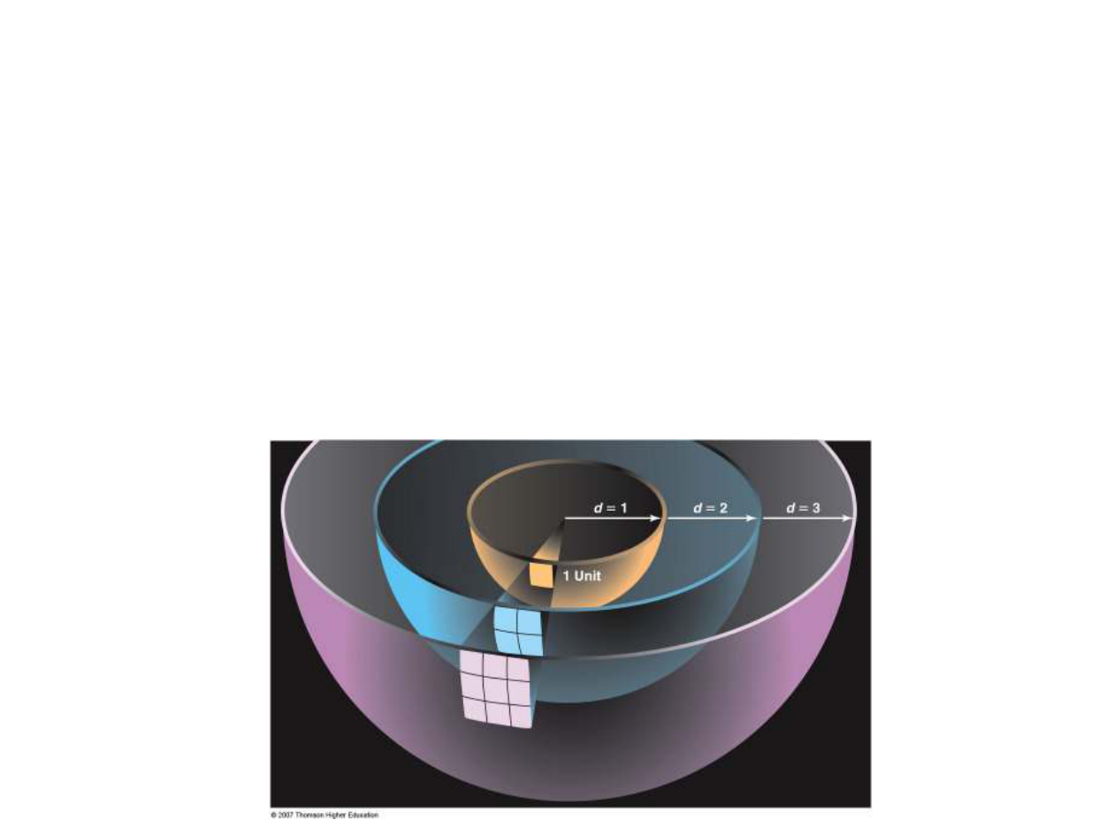
WVU DSPIRA
WEST VIRGINIA UNIVERSITY
Inverse Square Law
An
inverse square law
is a relation where the
quantity decreases with the square of the
distance
OR: Intensity decreases with distance, quickly
Examples: Light, gravity, and sound
wvurail.org/dspira
18 of 27
Notes:
Source edition: assets/lessons/lectures/astronomy/gravity.pdf, page 18. Original author and figure credits remain on the slide. Text is editable; illustrations retain their source artwork.

Slide 19
WVU DSPIRA
WEST VIRGINIA UNIVERSITY
Concept Quiz
If the Earth were moved to 2AU, how
would the force of gravity between it
and the Sun change?
a) Impossible to know
b) Decrease by a factor of 2
c)
Increase by a factor of 4
d) Decrease by a factor of 4
wvurail.org/dspira
19 of 27
Notes:
Source edition: assets/lessons/lectures/astronomy/gravity.pdf, page 19. Original author and figure credits remain on the slide. Text is editable; illustrations retain their source artwork.

Slide 20
WVU DSPIRA
WEST VIRGINIA UNIVERSITY
Concept Quiz
If the Earth were moved to 2AU, how
would the force of gravity between it
and the Sun change?
a) Impossible to know
b) Decrease by a factor of 2
c)
Increase by a factor of 4
d) Decrease by a factor of 4
Twice as far away = 4 times less (2
2
)
wvurail.org/dspira
20 of 27
Notes:
Source edition: assets/lessons/lectures/astronomy/gravity.pdf, page 20. Original author and figure credits remain on the slide. Text is editable; illustrations retain their source artwork.

Slide 21
WVU DSPIRA
WEST VIRGINIA UNIVERSITY
Concept Quiz
If the Earth were moved to 0.5AU, how
would the force of gravity between it
and the Sun change?
a) Impossible to know
b) Decrease by a factor of 2
c)
Increase by a factor of 4
d) Decrease by a factor of 4
wvurail.org/dspira
21 of 27
Notes:
Source edition: assets/lessons/lectures/astronomy/gravity.pdf, page 21. Original author and figure credits remain on the slide. Text is editable; illustrations retain their source artwork.

Slide 22
WVU DSPIRA
WEST VIRGINIA UNIVERSITY
Concept Quiz
If the Earth were moved to 0.5AU, how
would the force of gravity between it
and the Sun change?
a) Impossible to know
b) Decrease by a factor of 2
c)
Increase by a factor of 4
d) Decrease by a factor of 4
Half as far away = 4 times greater
(0.5
-2
) = 4
wvurail.org/dspira
22 of 27
Notes:
Source edition: assets/lessons/lectures/astronomy/gravity.pdf, page 22. Original author and figure credits remain on the slide. Text is editable; illustrations retain their source artwork.

Slide 23
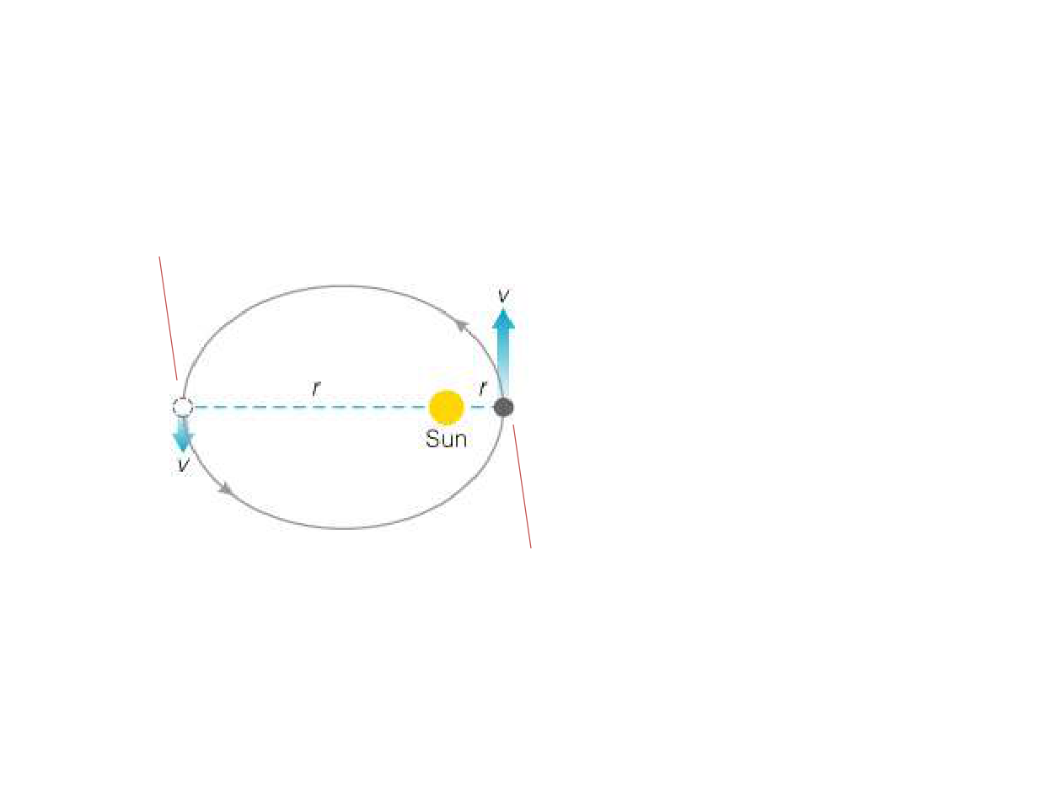
WVU DSPIRA
WEST VIRGINIA UNIVERSITY
Gravity and Orbits
More gravitational energy;
Less kinetic energy
Total orbital
energy
(gravitational +
kinetic) stays
constant if
there is no
external force
Orbits cannot
change
Less gravitational energy;
spontaneously.
More kinetic energy
Total orbital energy stays constant
wvurail.org/dspira
23 of 27
Notes:
Source edition: assets/lessons/lectures/astronomy/gravity.pdf, page 23. Original author and figure credits remain on the slide. Text is editable; illustrations retain their source artwork.

Slide 24
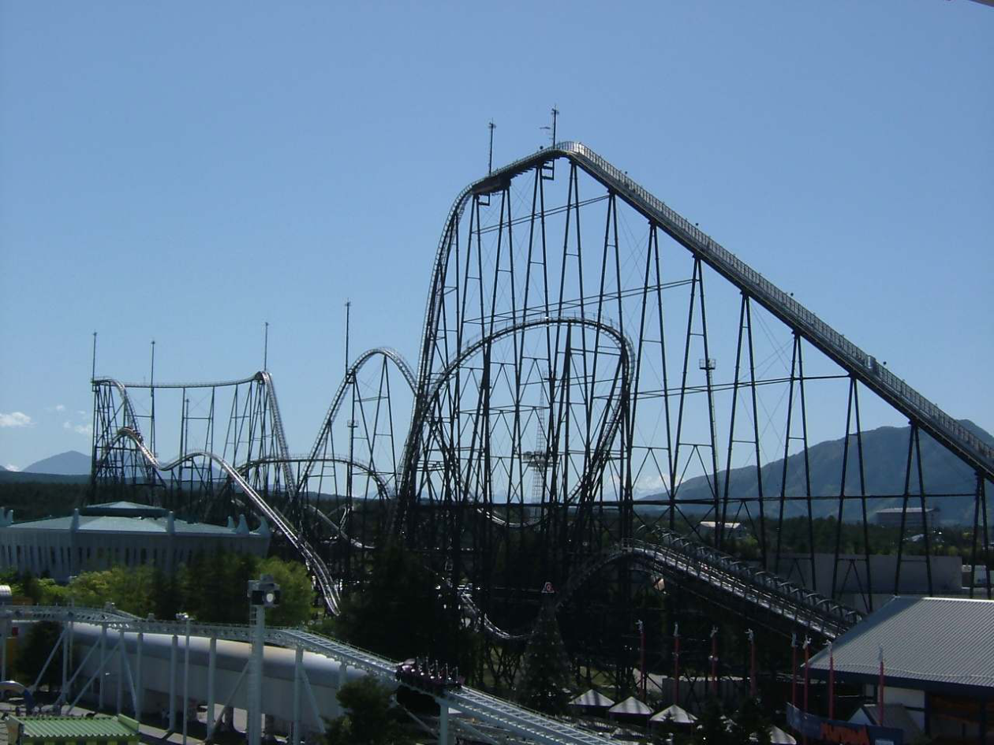
WVU DSPIRA
WEST VIRGINIA UNIVERSITY
wvurail.org/dspira
24 of 27
Notes:
Source edition: assets/lessons/lectures/astronomy/gravity.pdf, page 24. Original author and figure credits remain on the slide. Text is editable; illustrations retain their source artwork.

Slide 25
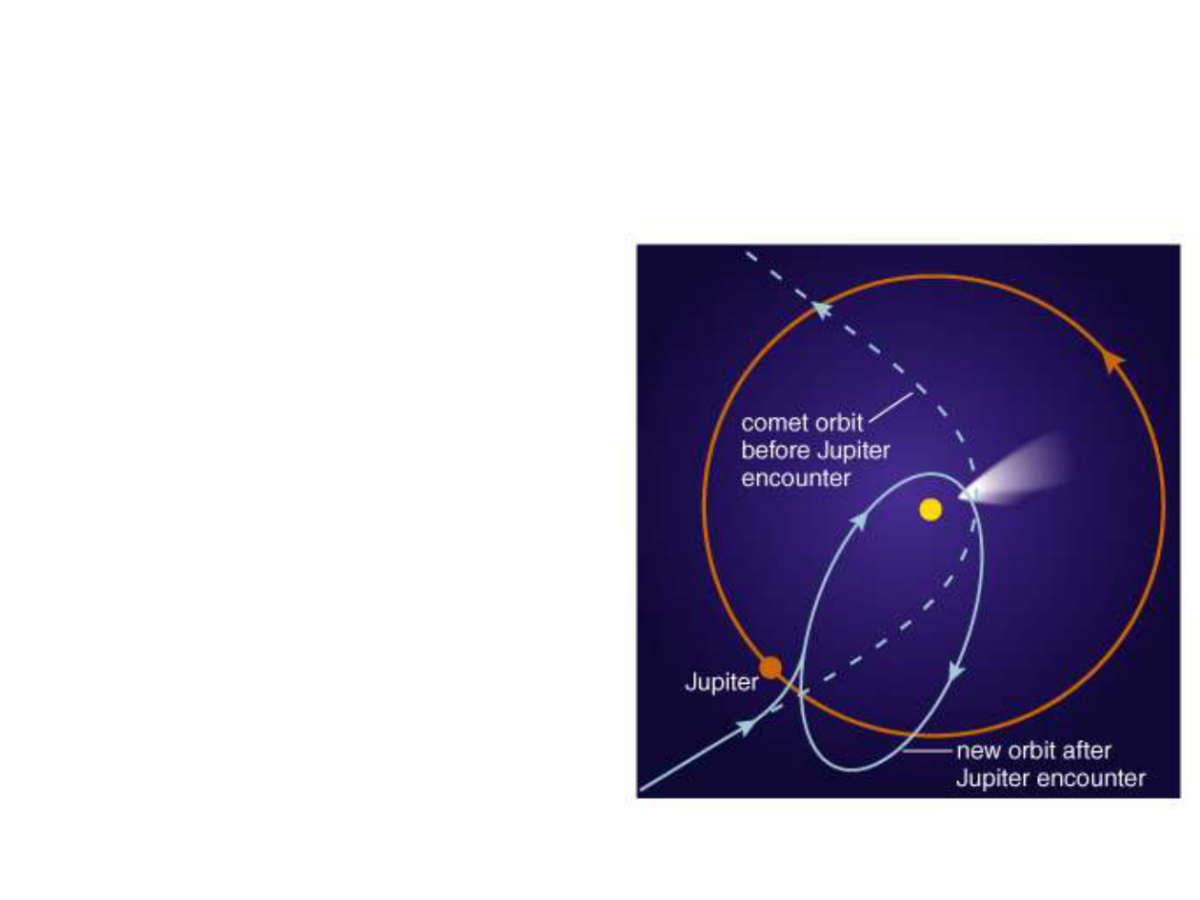
WVU DSPIRA
WEST VIRGINIA UNIVERSITY
Changing an Orbit
⇒
So what can make an
object gain or lose
orbital energy?
•
Friction or atmospheric
drag
–
Reduces velocity
–
Decreases kinetic
energy
–
Orbit decreases in size
•
A gravitational
encounter.
–
Energy can transfer to
the other body
wvurail.org/dspira
25 of 27
Notes:
Source edition: assets/lessons/lectures/astronomy/gravity.pdf, page 25. Original author and figure credits remain on the slide. Text is editable; illustrations retain their source artwork.

Slide 26
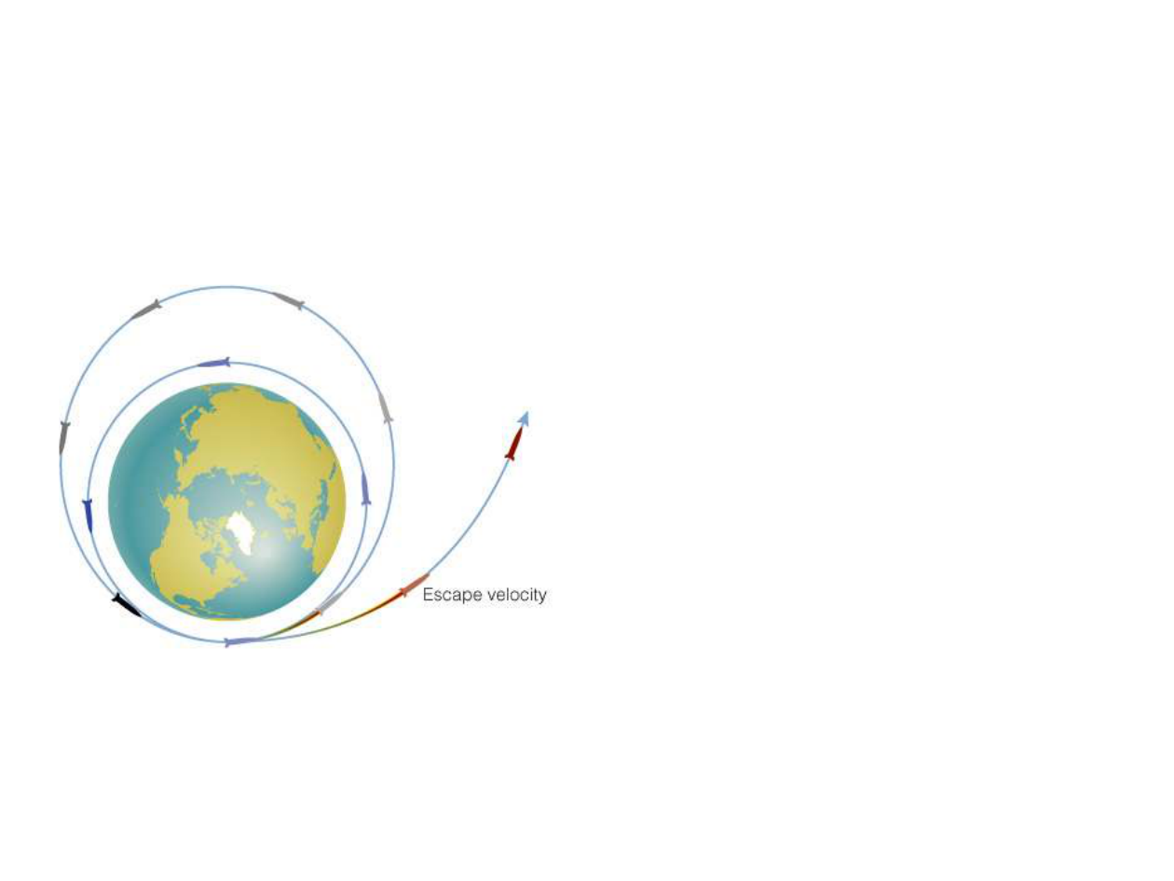
WVU DSPIRA
WEST VIRGINIA UNIVERSITY
Escape Velocity
If an object gains
enough orbital energy, it
may escape (change
from a bound to
unbound orbit)
Escape velocity
from
Earth ≈ 11 km/s from
sea level (about 40,000
km/hr)
wvurail.org/dspira
26 of 27
Notes:
Source edition: assets/lessons/lectures/astronomy/gravity.pdf, page 26. Original author and figure credits remain on the slide. Text is editable; illustrations retain their source artwork.

Slide 27
WVU DSPIRA
WEST VIRGINIA UNIVERSITY
What have we learned?
1) What is gravity?
Gravity is an acceleration due to the
gravitational force.
2) What is proportionality?
Two terms are proportional if an increase in one
quantity leads to an increase in the other. They
are inversely proportional if an increase in one
quantity leads to a decrease in the other.
3) What is an inverse square law?
An inverse square law is a relation where the
quantity decreases with the square of the
distance
wvurail.org/dspira
27 of 27
Notes:
Source edition: assets/lessons/lectures/astronomy/gravity.pdf, page 27. Original author and figure credits remain on the slide. Text is editable; illustrations retain their source artwork.

