Slide 1
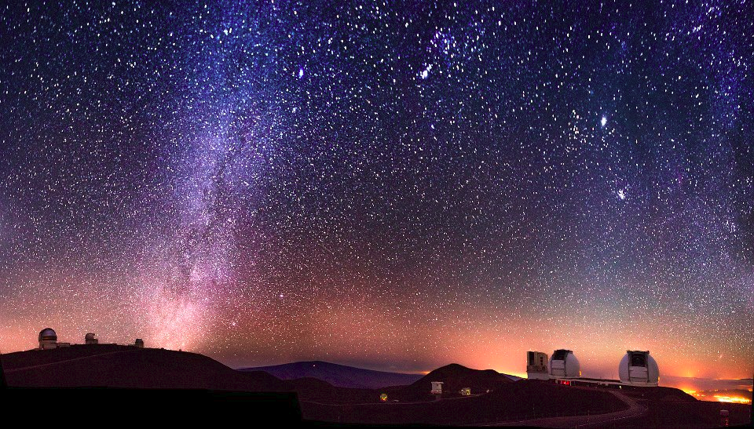
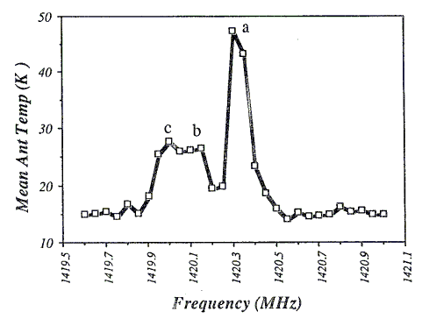
Intro to Astronomy
WVU DSPIRA
WEST VIRGINIA UNIVERSITY
wvurail.org/dspira
1 of 33

Slide 2
WVU DSPIRA
WEST VIRGINIA UNIVERSITY
A Rough Course Outline
Part I - Coordinates and the Sky – Week 1
  The motions in the sky
  Coordinate systems
  Planetarium show (Friday)
Part II - Understanding your Experiment - Week 3
  HI and the Interstellar Medium
  The Milky Way
wvurail.org/dspira
2 of 33
Notes:
‹#›

Slide 3
WVU DSPIRA
WEST VIRGINIA UNIVERSITY
Goals for Today
Goals for Today
1) Scientific notation and units
2) Where are we?
3) How did we get here?
4) How are we moving?
wvurail.org/dspira
3 of 33
Notes:
‹#›

Slide 4
WVU DSPIRA
WEST VIRGINIA UNIVERSITY
Units
In astronomy (and science in general) we use SI (Systeme Internationale) units.
The SI system uses length, mass, time, and temperature as its basic properties
The basic units for these properties are:
length: the meter (m) (about a yard, 3 feet)
mass: the kilogram (kg) (2.2 pounds)
time: the second (s)
temperature: the Kelvin (K) (same increments as Celsius, but 273 degrees higher)
We will encounter some other units also
Light years, parsecs, astronomical units, solar masses etc.
wvurail.org/dspira
4 of 33
Notes:
‹#›

Slide 5
WVU DSPIRA
WEST VIRGINIA UNIVERSITY
The Light Year
A LIGHT YEAR IS A DISTANCE!!!!!!!!!!
The speed of light is a constant – it is not infinitely fast
  The speed of light is the fastest that anything can travel!
A light year is the distance light travels in one year
It is 9 x 10¹⁵ m
Also, A LIGHT YEAR IS A DISTANCE!
wvurail.org/dspira
5 of 33
Notes:
‹#›

Slide 6
WVU DSPIRA
WEST VIRGINIA UNIVERSITY
Thought Question
The Earth is 1.6 x 10⁻⁵ light years, or 8.5 light minutes, from the Sun. If the Sun exploded, how long would it take us to find out?
a) Immediately (it would be cold)
b) 8.5 minutes
c) 17 minutes
d) one year
wvurail.org/dspira
6 of 33
Notes:
‹#›

Slide 7
WVU DSPIRA
WEST VIRGINIA UNIVERSITY
Thought Question
The Earth is 1.6 x 10⁻⁵ light years, or 8.5 light minutes, from the Sun. If the Sun exploded, how long would it take us to find out?
a) Immediately (it would be cold)
b) 8.5 minutes
c) 17 minutes
d) one year
wvurail.org/dspira
7 of 33
Notes:
‹#›

Slide 8
WVU DSPIRA
WEST VIRGINIA UNIVERSITY
Scientific Notation
Astronomers use numbers that are often very large or small and writing out the numbers is cumbersome.
The distance to the nearest star: 40,000,000,000,000 km
The radius of an atomic nucleus: 0.0000000001 m
We use scientific notation to express numbers compactly.
The distance to the nearest star is 4 x 10¹³ km
(4 times 10 to the 13 km)
The radius of an atomic nucleus is 1 x 10⁻¹⁰ m
(1 times 10 to the minus 10 m)
wvurail.org/dspira
8 of 33
Notes:
‹#›

Slide 9
WVU DSPIRA
WEST VIRGINIA UNIVERSITY
Scientific Notation
Positive exponents and common abbreviations
Just count the zeros!
10¹ = 10 = ten
10² = 10x10 = 100 = hundred
10³ = 10x10x10 = 1,000 = thousand (kilo- k)
10⁴ = 10,000 = ten thousand
10⁵ = 100,000 = hundred thousand
10⁶ = 1,000,000 = million (Mega- M)
10⁷ = 10,000,000 ten million
10⁸ = 100,000,000 = hundred million
10⁹ = 1,000,000,000 = billion (Giga- G)
wvurail.org/dspira
9 of 33
Notes:
‹#›

Slide 10
WVU DSPIRA
WEST VIRGINIA UNIVERSITY
Scientific Notation
Negative exponents and common abbreviations
Count the zeros (including the one to the left of the decimal place)!
10⁻¹ = (1/10) = 0.1 = one tenth
10⁻² = (1/100) = 0.01 one hundredth (centi)
10⁻³ = 0.001 = one thousandth (milli)
10⁻⁴ = 0.0001 = one ten thousandth
10⁻⁵ = 0.00001 = one hundred thousandth
10⁻⁶ = 0.000001 = one millionth (micro)
10⁻⁷ = 0.0000001 = one ten millionth
10⁻⁸ = 0.00000001 = one hundred millionth
10⁻⁹ = 0.000000001 = one billionth (nano)
wvurail.org/dspira
10 of 33
Notes:
‹#›

Slide 11
WVU DSPIRA
WEST VIRGINIA UNIVERSITY
For you to do....
Write the following in scientific notation (3 min):
1) 100 billion (# stars in Milky Way)
2) 0.009154 (Earth's diameter compared to the Sun's)
3) 21,173,113,600,851 (US national debt as of 26 June 2018)
wvurail.org/dspira
11 of 33
Notes:
‹#›

Slide 12
WVU DSPIRA
WEST VIRGINIA UNIVERSITY
For you to do....
Write the following in scientific notation (3 min):
1) 100 billion = 1.00 x 10¹¹
2) 0.009154 = 9.15 x 10⁻³
3) 21,173,113,600,851 = 2.12 x 10¹³
wvurail.org/dspira
12 of 33
Notes:
‹#›

Slide 13
WVU DSPIRA
WEST VIRGINIA UNIVERSITY
Where are we?
“I’m a lonely insignificant speck on a has-been planet orbited by a cold and indifferent sun.” – Homer in “El Viaje Misterioso de Nuestro Homer”
OR
We live on a rocky planet in the inner part of our Solar System that orbits an average size star in the outer part of a large galaxy inside a small group of about 30 galaxies, in our local supercluster, in the Universe.
wvurail.org/dspira
13 of 33
Notes:
‹#›

Slide 14
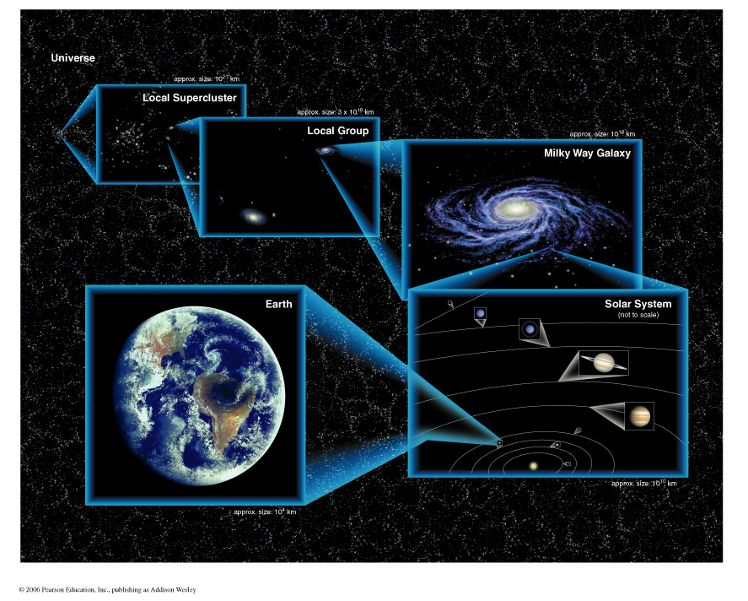
WVU DSPIRA
WEST VIRGINIA UNIVERSITY
Where are we?
wvurail.org/dspira
14 of 33
Notes:
‹#›

Slide 15
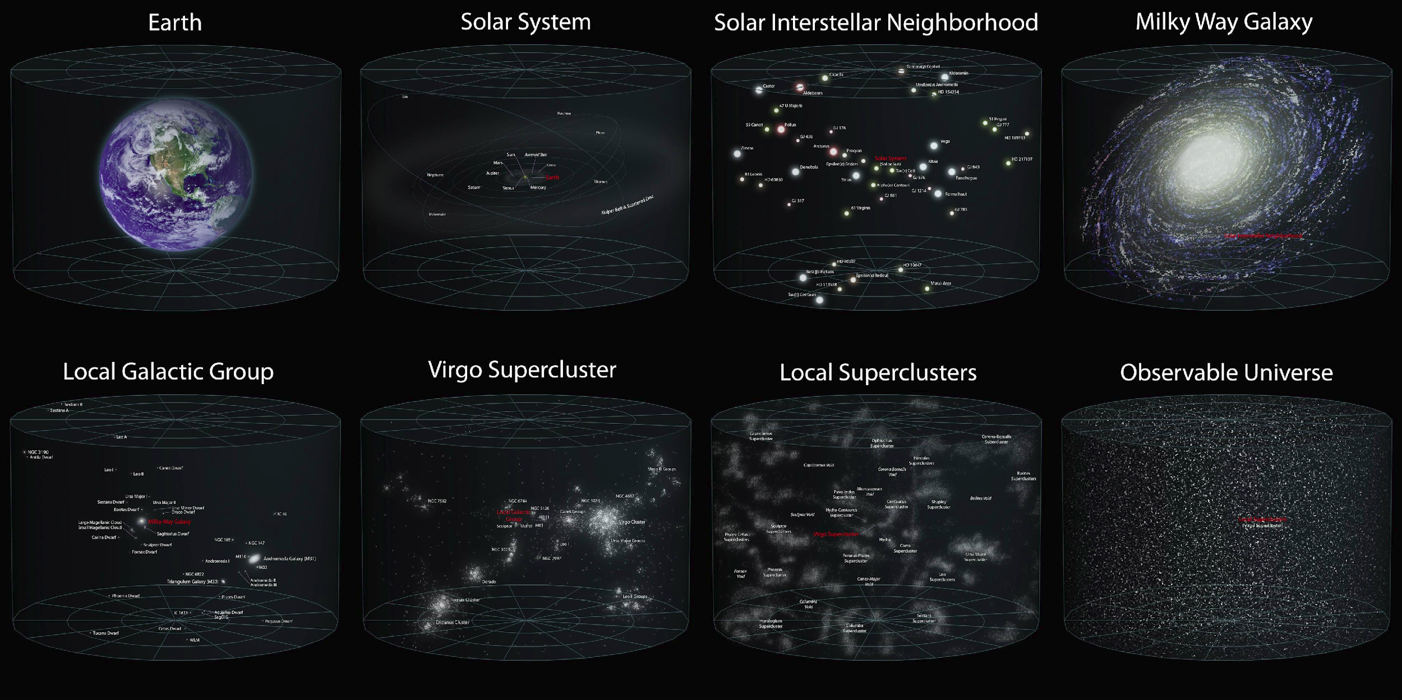
WVU DSPIRA
WEST VIRGINIA UNIVERSITY
wvurail.org/dspira
15 of 33

Slide 16
WVU DSPIRA
WEST VIRGINIA UNIVERSITY
Components of our Solar System
A solar system is: A star and all the material that orbits it, including its planets and moons.
The Sun
Planets and their moons
- Now only eight planets (Sorry Pluto)
Asteroids/Comets/Planetoids
Spacecraft and space junk
wvurail.org/dspira
16 of 33
Notes:
‹#›
We’ll talk about the Sun in detail a little bit later in the course.
Eight planets
There are all kinds of leftover clumps that didn’t make it into planets that are still floating around out there. In 2003, astronomers found Eris, which is larger than Pluto and presumably part of a large collection of such objects inhabiting the outer solar system. We didn’t want to keep adding plantes as we found them ,so we designated pluto a dwarf planet along with Ceres the asteroid and Eris.

Slide 17

WVU DSPIRA
WEST VIRGINIA UNIVERSITY
Our Solar System (distances to scale)
wvurail.org/dspira
17 of 33
Notes:
‹#›

Slide 18
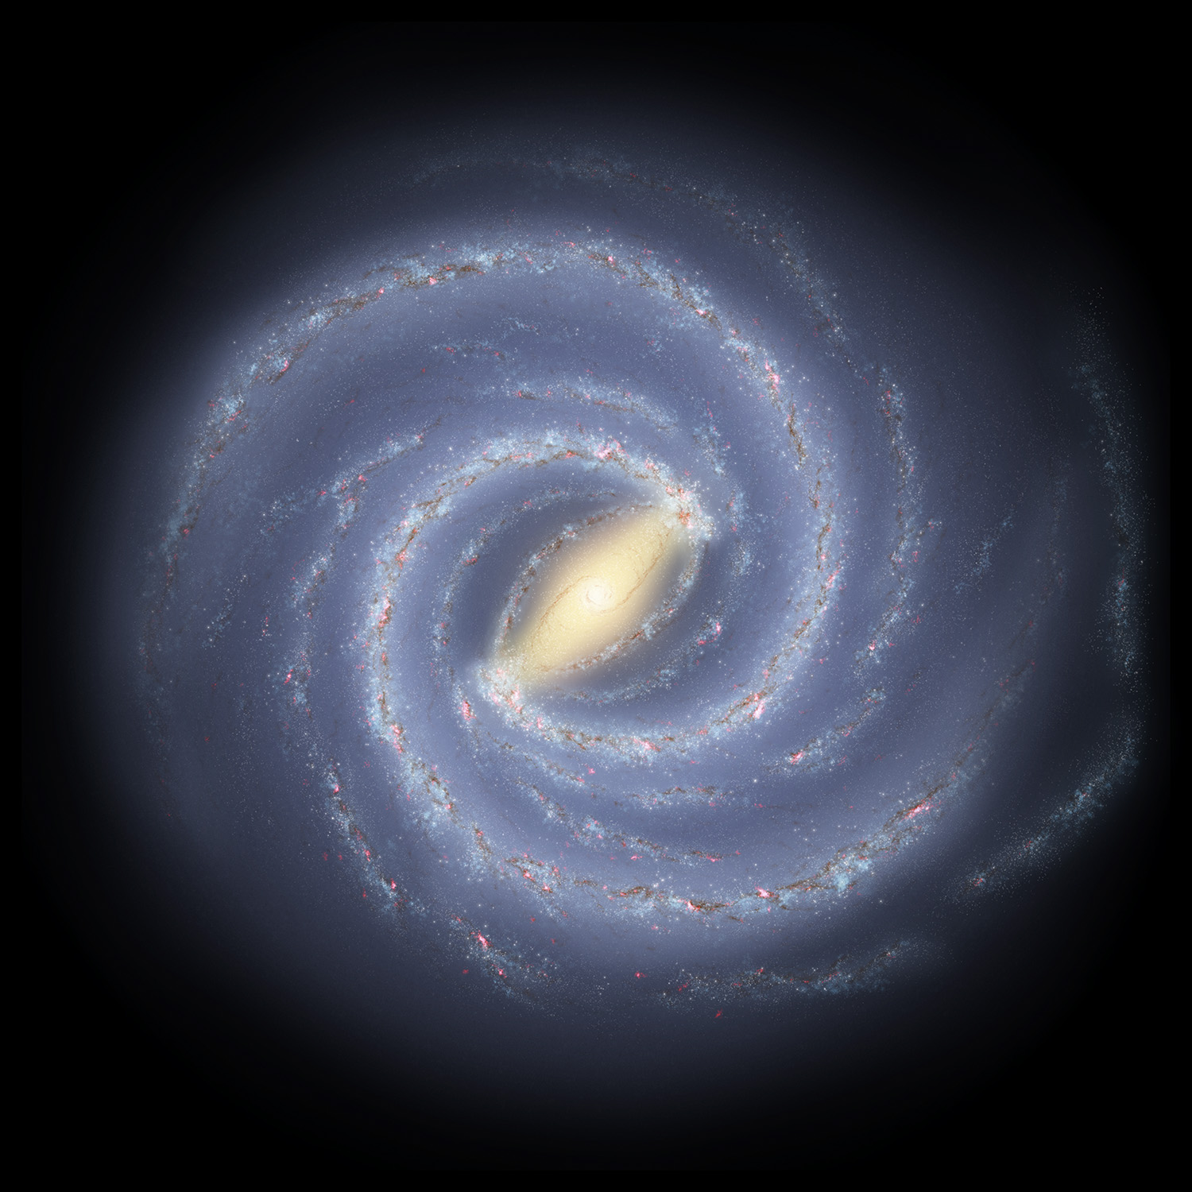
WVU DSPIRA
WEST VIRGINIA UNIVERSITY
Our Galaxy
100 billion stars! That’s 10¹¹!
  100 billion stars means 100 billion other solar systems that may have Earth-like planets orbiting them
wvurail.org/dspira
18 of 33
Notes:
‹#›

Slide 19
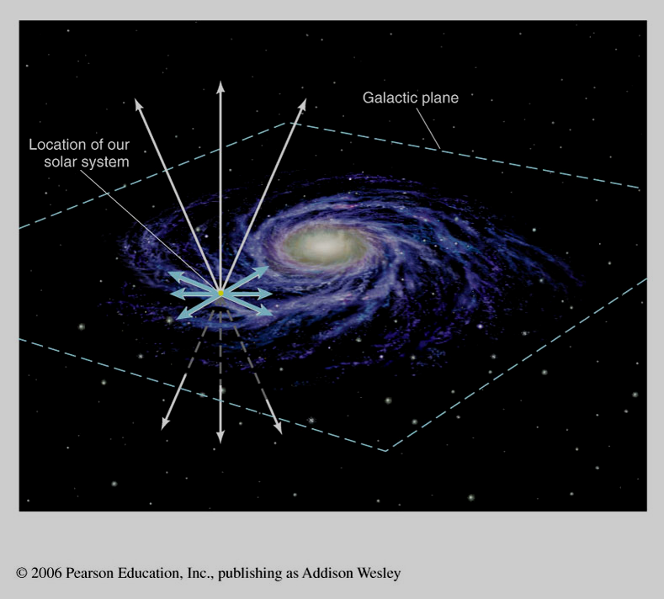
WVU DSPIRA
WEST VIRGINIA UNIVERSITY
Our Galaxy
wvurail.org/dspira
19 of 33
Notes:
‹#›

Slide 20
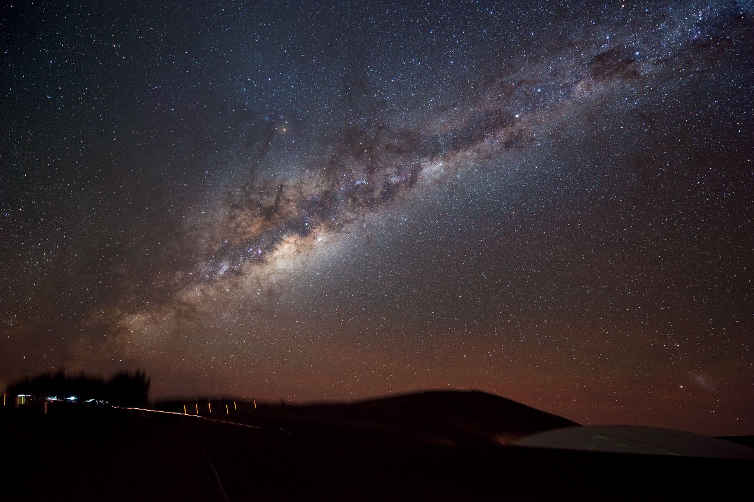
WVU DSPIRA
WEST VIRGINIA UNIVERSITY
wvurail.org/dspira
20 of 33
Notes:
‹#›

Slide 21
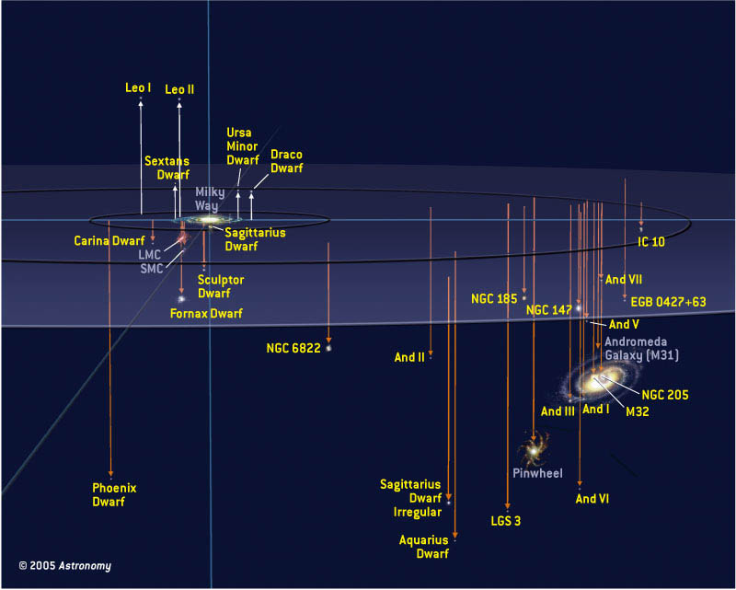
WVU DSPIRA
WEST VIRGINIA UNIVERSITY
Local Group
wvurail.org/dspira
21 of 33
Notes:
‹#›

Slide 22
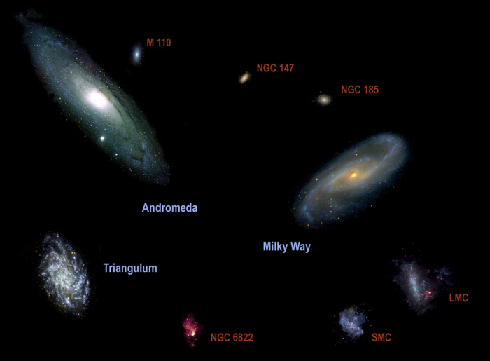
WVU DSPIRA
WEST VIRGINIA UNIVERSITY
Local Group Galaxies
wvurail.org/dspira
22 of 33
Notes:
‹#›

Slide 23
WVU DSPIRA
WEST VIRGINIA UNIVERSITY
The Universe
At Least 100 billion (10¹¹) galaxies.
  If each galaxy has 100 billion stars, there are 10¹¹ x 10¹¹ = 10²² stars in the universe, more than all the grains of sand on all the beaches on Earth.
NOTE: EXPONENTS ADD WHEN MULTIPLIED
wvurail.org/dspira
23 of 33
Notes:
‹#›

Slide 24
WVU DSPIRA
WEST VIRGINIA UNIVERSITY
The Virgo Supercluster
The local grouping of galaxies.
Contains the Local Group and the Virgo Cluster, in addition to about 100 other galaxy groups and clusters.
wvurail.org/dspira
24 of 33

Slide 25
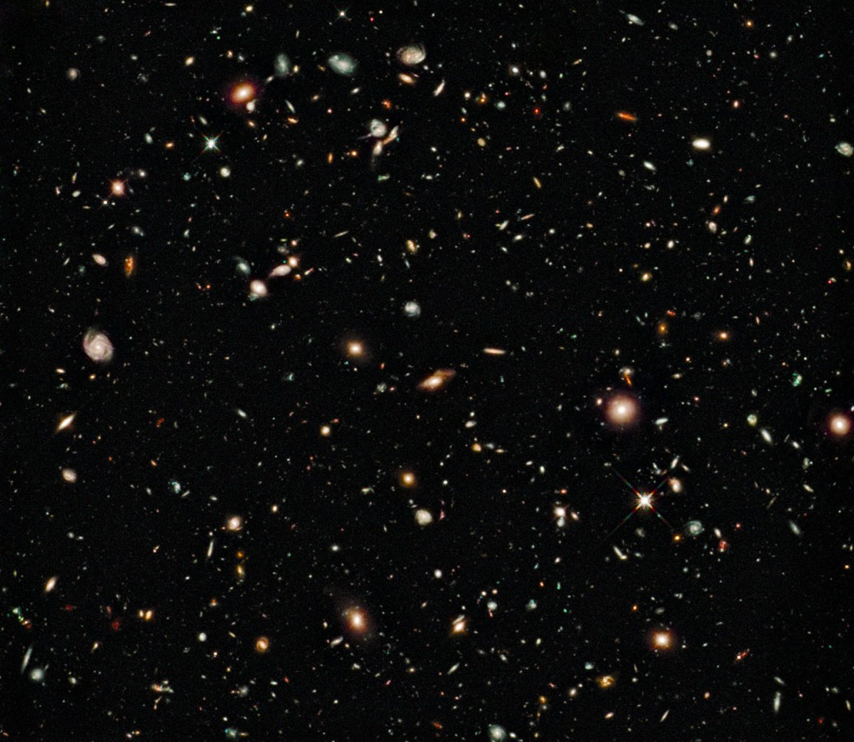
WVU DSPIRA
WEST VIRGINIA UNIVERSITY
wvurail.org/dspira
25 of 33
Notes:
‹#›

Slide 26
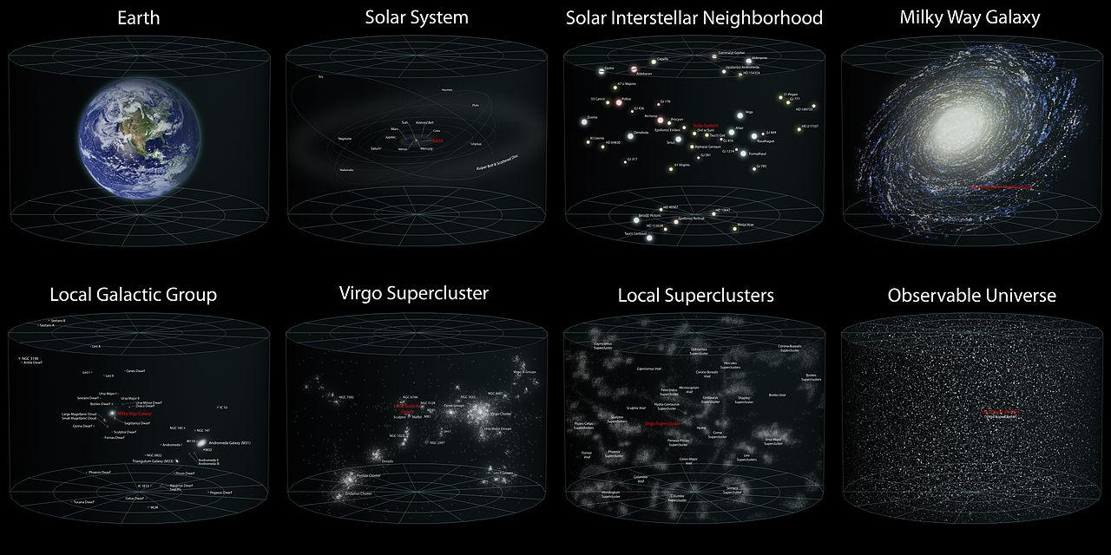
WVU DSPIRA
WEST VIRGINIA UNIVERSITY
Where are we? (review)
We live on a rocky planet in the inner part of our Solar System that orbits an average size star in the outer part of a large galaxy inside a small group of about 30 galaxies, in our local supercluster, in the Universe.
wvurail.org/dspira
26 of 33
Notes:
‹#›
Two things to note:
Universe is really big.
Most of the Universe is nothing.
HOW FAR IS A LIGHTYEAR?

Slide 27
WVU DSPIRA
WEST VIRGINIA UNIVERSITY
Where are we videos
http://htwins.net/scale2/
http://www.youtube.com/watch?v=17jymDn0W6U
wvurail.org/dspira
27 of 33

Slide 28
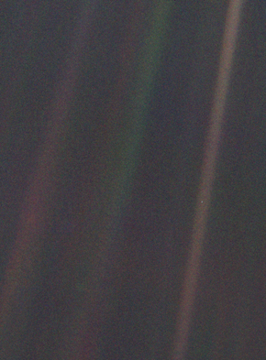
WVU DSPIRA
WEST VIRGINIA UNIVERSITY
Carl Sagan’s Pale Blue Dot https://www.youtube.com/watch?v=b58SfRphkKc
wvurail.org/dspira
28 of 33

Slide 29
WVU DSPIRA
WEST VIRGINIA UNIVERSITY
How did we get here?
Steps in your creation:
~14 billion years ago, the Universe was created in a violent explosion called the Big Bang.
Our Milky Way Galaxy formed ~2 billion years after the Big Bang.
Five billion years ago (9 billion years after the Big Bang) the Sun and the solar system forms.
4 billion years ago the most primitive life forms on Earth.
100,000 years ago modern humans evolved in Africa.
Some decades ago, you gained consciousness (finally!).
wvurail.org/dspira
29 of 33
Notes:
‹#›
What is a ~?

Slide 30
WVU DSPIRA
WEST VIRGINIA UNIVERSITY
How did we get here? (Cosmic Timeline)
January 1 Big Bang
February 1 Milky Way forms
September 3 Earth forms
September 22 First life on Earth
December 26th Dinosaurs evolve
December 30th Dinosaurs die off
December 31st
11:58 pm Modern humans
25 seconds ago Agriculture arises
11 seconds ago Pyramids built
0.05 seconds ago You were born
https://www.youtube.com/watch?v=ShTxGumvbno
wvurail.org/dspira
30 of 33
Notes:
‹#›

Slide 31
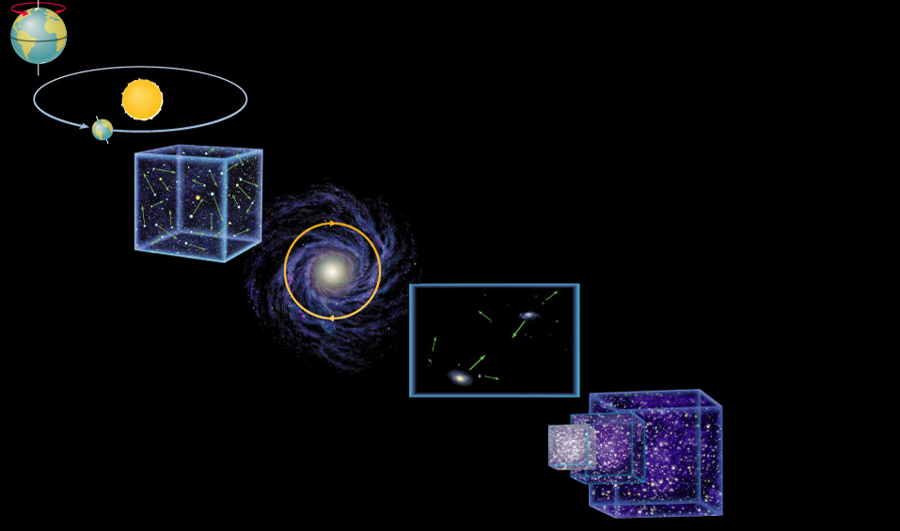
WVU DSPIRA
WEST VIRGINIA UNIVERSITY
How are we Moving?
Earth rotation
Earth orbit
Random solar motion
Solar motion around the center of the Milky Way
Milky Way motion in the local group
Expansion of the Universe
wvurail.org/dspira
31 of 33
Notes:
‹#›

Slide 32
WVU DSPIRA
WEST VIRGINIA UNIVERSITY
Review
Goals for Today
1) Scientific notation and units
Know them!
2) Where are we?
We are in the Universe, in the Local Group, in the Milky Way, in the Solar System, on Earth
3) How did we get here?
Universe created 14 GYr ago, Milky Way 12 GYr ago, Earth 4 GYr ago, man 100,000 yr ago, and you ~20 years ago.
4) How are we moving?
Everything is in motion!
wvurail.org/dspira
32 of 33
Notes:
‹#›

Slide 33
WVU DSPIRA
WEST VIRGINIA UNIVERSITY
Galaxy Song!!!
From Monty Python’s “Meaning of Life”
http://www.youtube.com/watch?v=vIy76M-4txo
(PG-13) https://www.youtube.com/watch?v=buqtdpuZxvk
Where are we?
http://www.youtube.com/watch?v=17jymDn0W6U
wvurail.org/dspira
33 of 33

