Slide 1

WVU DSPIRA
WEST VIRGINIA UNIVERSITY
Light & Telescopes
D.J. Pisano
Associate Professor of Physics & Astronomy
July 6, 2017
wvurail.org/dspira
1 of 54
Notes:
Source edition: assets/lessons/lectures/astronomy/light-and-telescopes.pdf, page 1. Original author and figure credits remain on the slide. Text is editable; illustrations retain their source artwork.

Slide 2
WVU DSPIRA
WEST VIRGINIA UNIVERSITY
Light and Telescopes
With few exceptions, astronomers can only
learn about the Universe by using
telescopes
to look at
light
from distant
objects.
We can not do experiments on the Universe
(or even small parts of it).
We must
observe
the Universe.
wvurail.org/dspira
2 of 54
Notes:
Source edition: assets/lessons/lectures/astronomy/light-and-telescopes.pdf, page 2. Original author and figure credits remain on the slide. Text is editable; illustrations retain their source artwork.

Slide 3
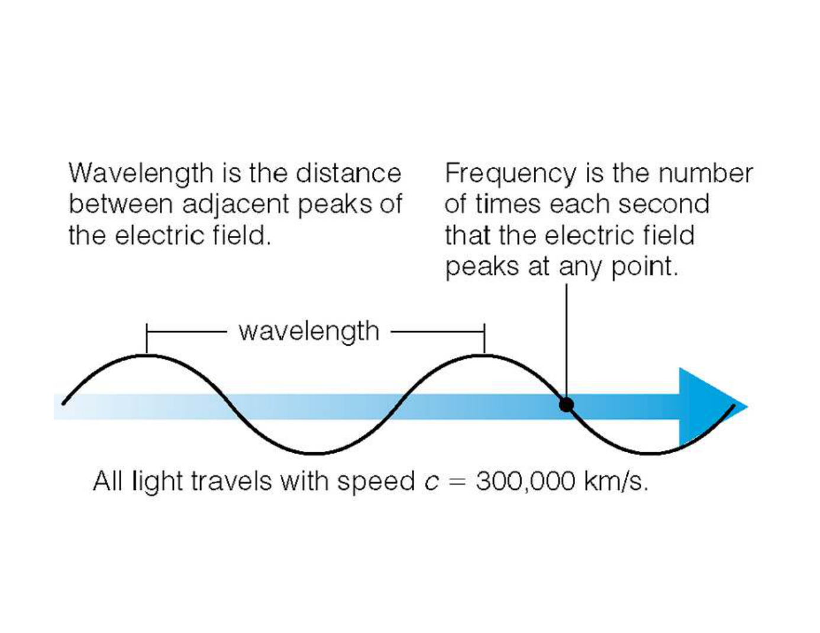
WVU DSPIRA
WEST VIRGINIA UNIVERSITY
Light is a wave
wvurail.org/dspira
3 of 54
Notes:
Source edition: assets/lessons/lectures/astronomy/light-and-telescopes.pdf, page 3. Original author and figure credits remain on the slide. Text is editable; illustrations retain their source artwork.

Slide 4
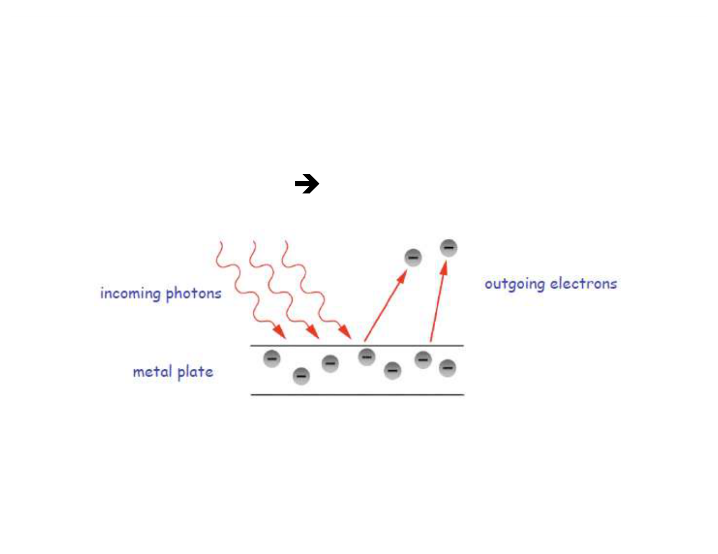
WVU DSPIRA
WEST VIRGINIA UNIVERSITY
Light is a particle
•
In 1905, Einstein discovered that light had
discrete energies
light can appear as
particles called
photons
.
This is called the
photoelectric effect
.
It is how light sensors for doors, toilets, etc. work.
wvurail.org/dspira
4 of 54
Notes:
Source edition: assets/lessons/lectures/astronomy/light-and-telescopes.pdf, page 4. Original author and figure credits remain on the slide. Text is editable; illustrations retain their source artwork.

Slide 5

WVU DSPIRA
WEST VIRGINIA UNIVERSITY
Light as photons
The
energy
of a
photon
is proportional to the
frequency
of the light.
Higher frequency means higher energy.
The energy of light is
not
related to
intensity
(how
bright it is).
Higher intensities mean
more
photons mean
brighter light.
wvurail.org/dspira
5 of 54
Notes:
Source edition: assets/lessons/lectures/astronomy/light-and-telescopes.pdf, page 5. Original author and figure credits remain on the slide. Text is editable; illustrations retain their source artwork.

Slide 6
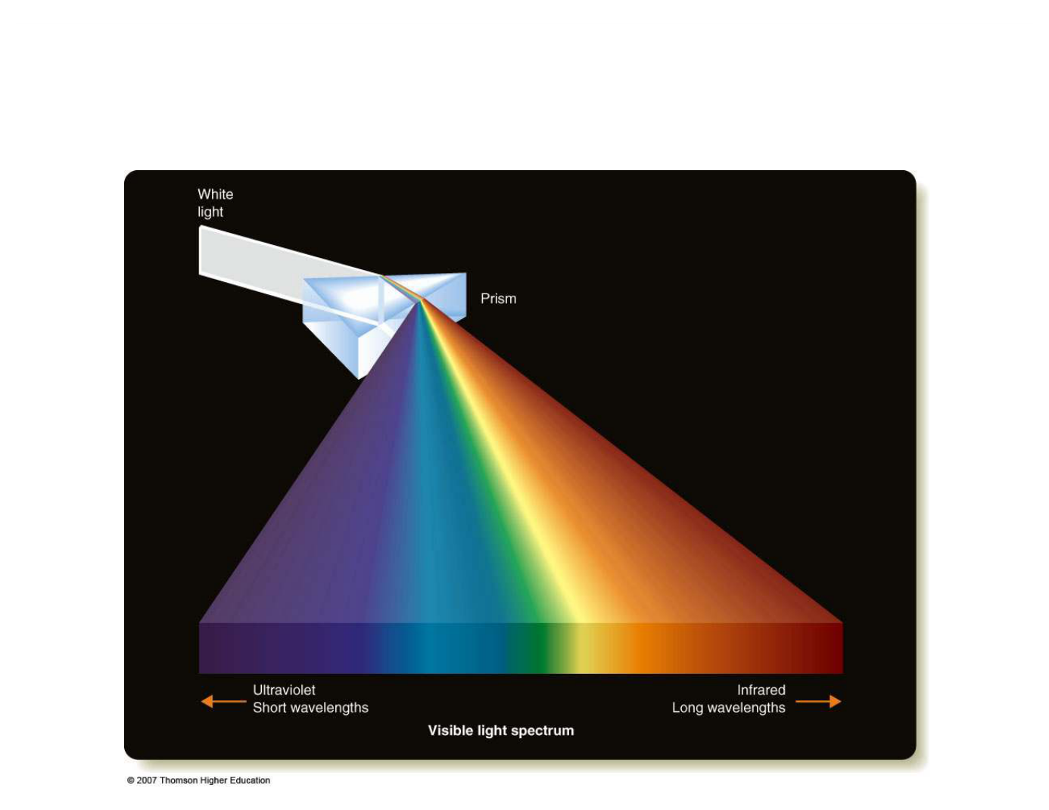
WVU DSPIRA
WEST VIRGINIA UNIVERSITY
The Electromagnetic Spectrum
wvurail.org/dspira
6 of 54
Notes:
Source edition: assets/lessons/lectures/astronomy/light-and-telescopes.pdf, page 6. Original author and figure credits remain on the slide. Text is editable; illustrations retain their source artwork.

Slide 7
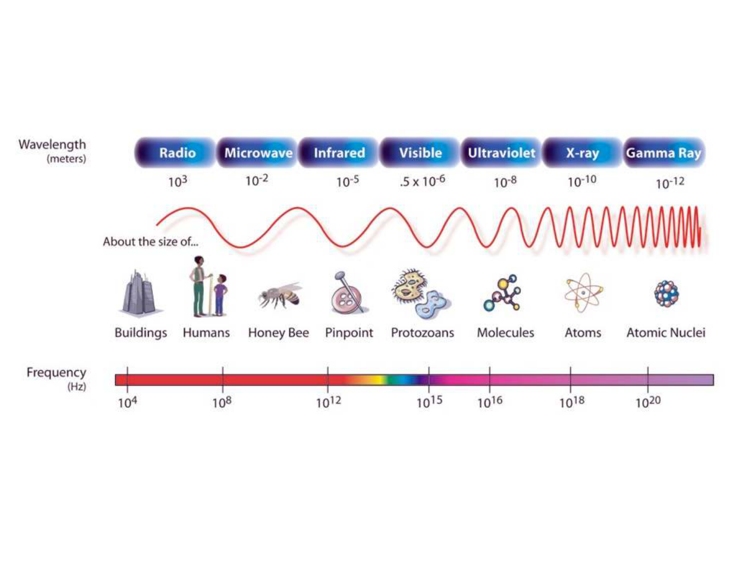
WVU DSPIRA
WEST VIRGINIA UNIVERSITY
The Electromagnetic Spectrum
Lower Frequency = Longer Wavelength = Low Energy
Higher Frequency = Shorter Wavelength = High Energy
wvurail.org/dspira
7 of 54
Notes:
Source edition: assets/lessons/lectures/astronomy/light-and-telescopes.pdf, page 7. Original author and figure credits remain on the slide. Text is editable; illustrations retain their source artwork.

Slide 8
WVU DSPIRA
WEST VIRGINIA UNIVERSITY
The world looks different at
different wavelengths of light
Consider infrared light...otherwise
known as
heat
.
wvurail.org/dspira
8 of 54
Notes:
Source edition: assets/lessons/lectures/astronomy/light-and-telescopes.pdf, page 8. Original author and figure credits remain on the slide. Text is editable; illustrations retain their source artwork.

Slide 9
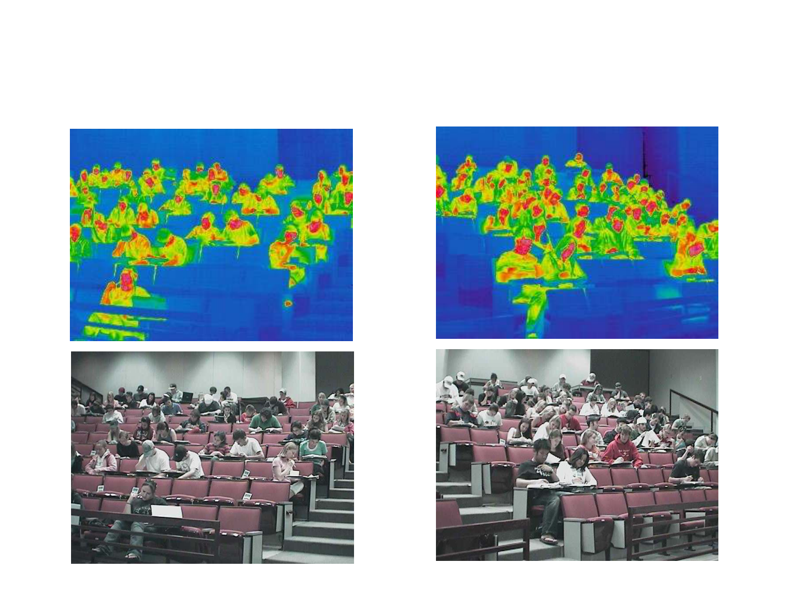
WVU DSPIRA
WEST VIRGINIA UNIVERSITY
This is an astronomy class seen in
infrared and visible light.
wvurail.org/dspira
9 of 54
Notes:
Source edition: assets/lessons/lectures/astronomy/light-and-telescopes.pdf, page 9. Original author and figure credits remain on the slide. Text is editable; illustrations retain their source artwork.

Slide 10
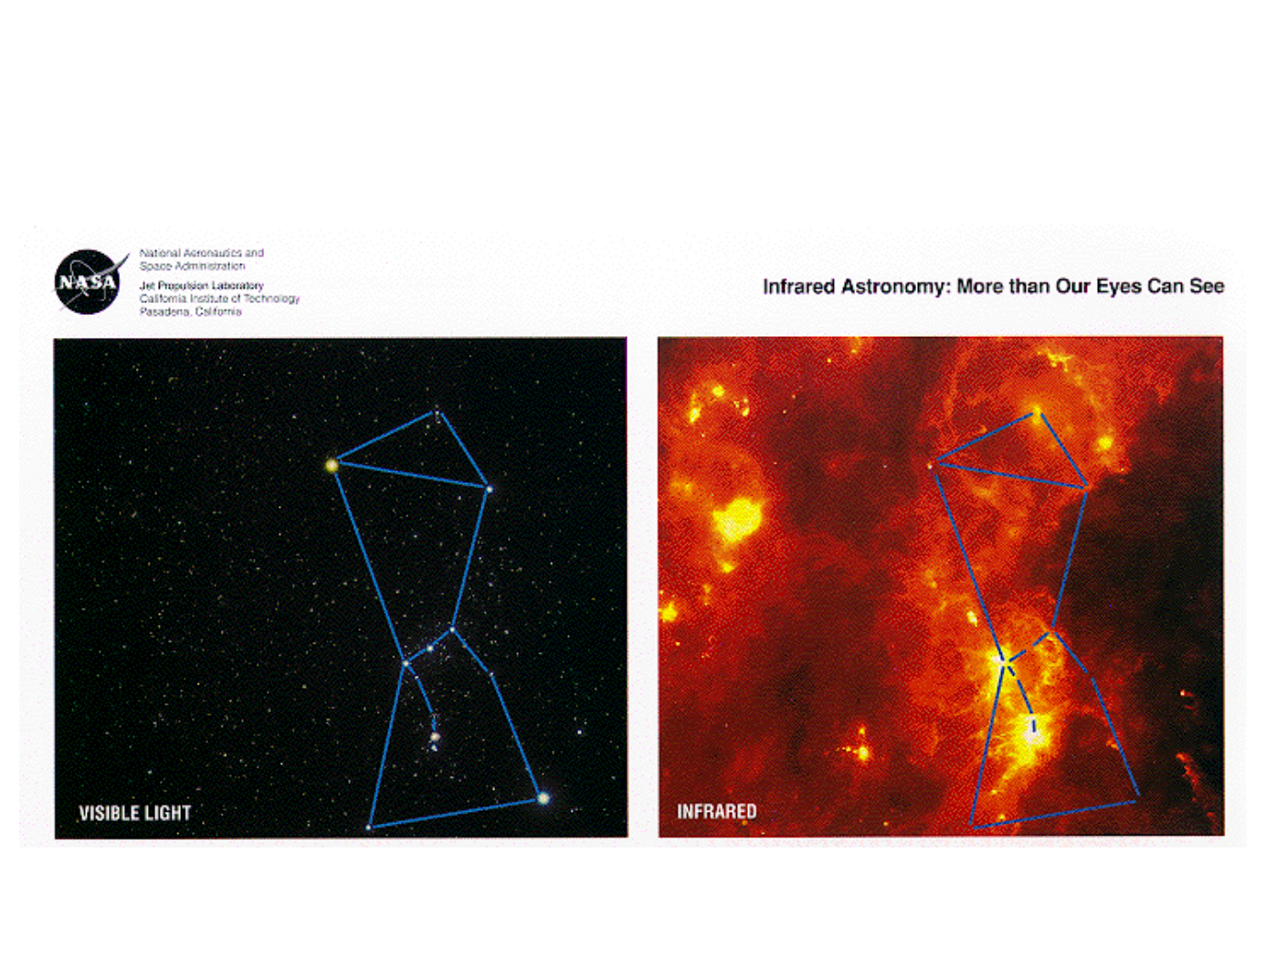
WVU DSPIRA
WEST VIRGINIA UNIVERSITY
Consider Orion as Seen in Different Wavelengths of Light!
wvurail.org/dspira
10 of 54
Notes:
Source edition: assets/lessons/lectures/astronomy/light-and-telescopes.pdf, page 10. Original author and figure credits remain on the slide. Text is editable; illustrations retain their source artwork.

Slide 11
WVU DSPIRA
WEST VIRGINIA UNIVERSITY
Review Questions
wvurail.org/dspira
11 of 54
Notes:
Source edition: assets/lessons/lectures/astronomy/light-and-telescopes.pdf, page 11. Original author and figure credits remain on the slide. Text is editable; illustrations retain their source artwork.

Slide 12
WVU DSPIRA
WEST VIRGINIA UNIVERSITY
Question 1:
Light with a shorter wavelength has a
______ frequency.
A.
higher
B.
lower
wvurail.org/dspira
12 of 54
Notes:
Source edition: assets/lessons/lectures/astronomy/light-and-telescopes.pdf, page 12. Original author and figure credits remain on the slide. Text is editable; illustrations retain their source artwork.

Slide 13
WVU DSPIRA
WEST VIRGINIA UNIVERSITY
Question 2:
Light with a higher frequency has a ______
energy.
A.
higher
B.
lower
wvurail.org/dspira
13 of 54
Notes:
Source edition: assets/lessons/lectures/astronomy/light-and-telescopes.pdf, page 13. Original author and figure credits remain on the slide. Text is editable; illustrations retain their source artwork.

Slide 14
WVU DSPIRA
WEST VIRGINIA UNIVERSITY
Question 3:
Light with a higher frequency travels ______
light with a lower frequency.
A.
faster than
B.
slower than
C. at the same speed as
wvurail.org/dspira
14 of 54
Notes:
Source edition: assets/lessons/lectures/astronomy/light-and-telescopes.pdf, page 14. Original author and figure credits remain on the slide. Text is editable; illustrations retain their source artwork.

Slide 15
WVU DSPIRA
WEST VIRGINIA UNIVERSITY
Question 4:
Which of the following does not emit light?
A.
A light bulb
B.
The Sun
C. People
D. A fire
E.
All of the above emit light
wvurail.org/dspira
15 of 54
Notes:
Source edition: assets/lessons/lectures/astronomy/light-and-telescopes.pdf, page 15. Original author and figure credits remain on the slide. Text is editable; illustrations retain their source artwork.

Slide 16
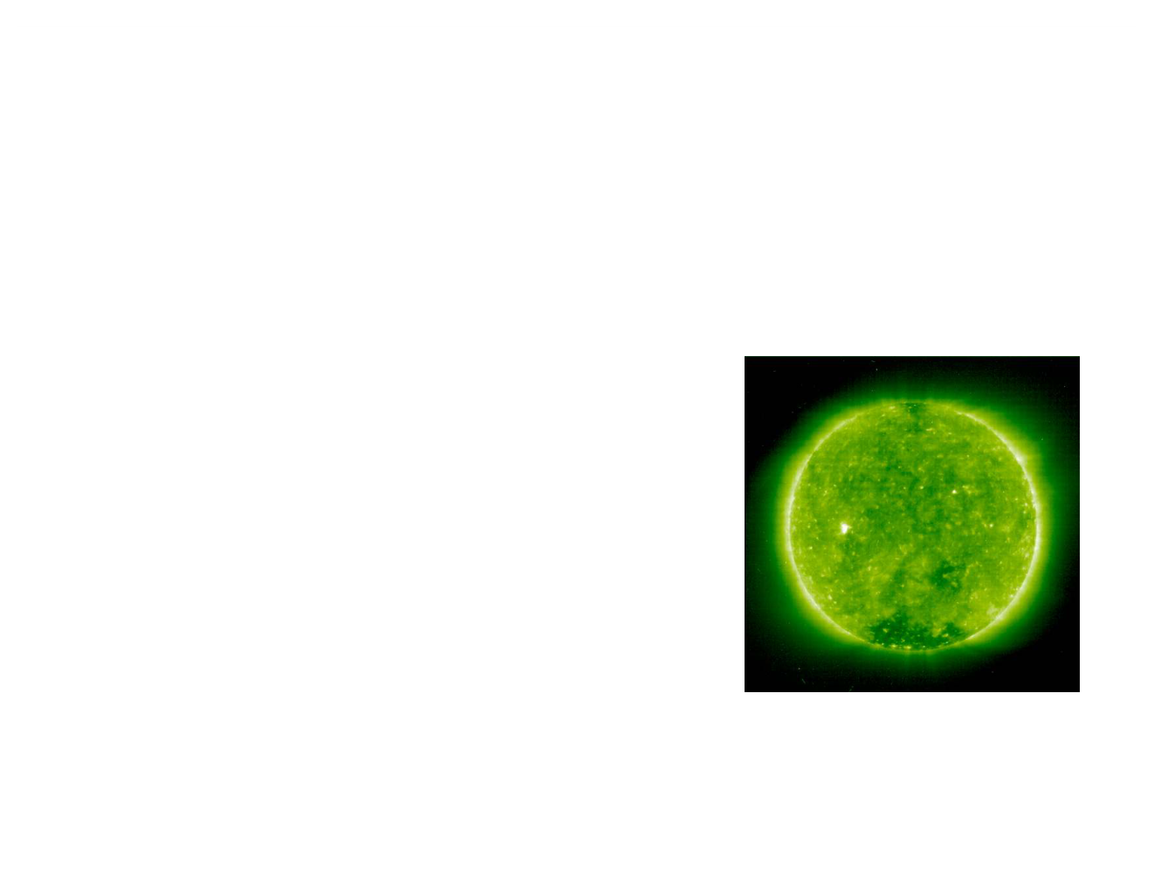
WVU DSPIRA
WEST VIRGINIA UNIVERSITY
Sunlight
By observing light from a star, we can learn
about a star’s:
1.
Total Energy Output
2.
Surface Temperature
3.
Radius
4.
Chemical Composition
5.
Velocity relative to Earth
And more…
wvurail.org/dspira
16 of 54
Notes:
Source edition: assets/lessons/lectures/astronomy/light-and-telescopes.pdf, page 16. Original author and figure credits remain on the slide. Text is editable; illustrations retain their source artwork.

Slide 17
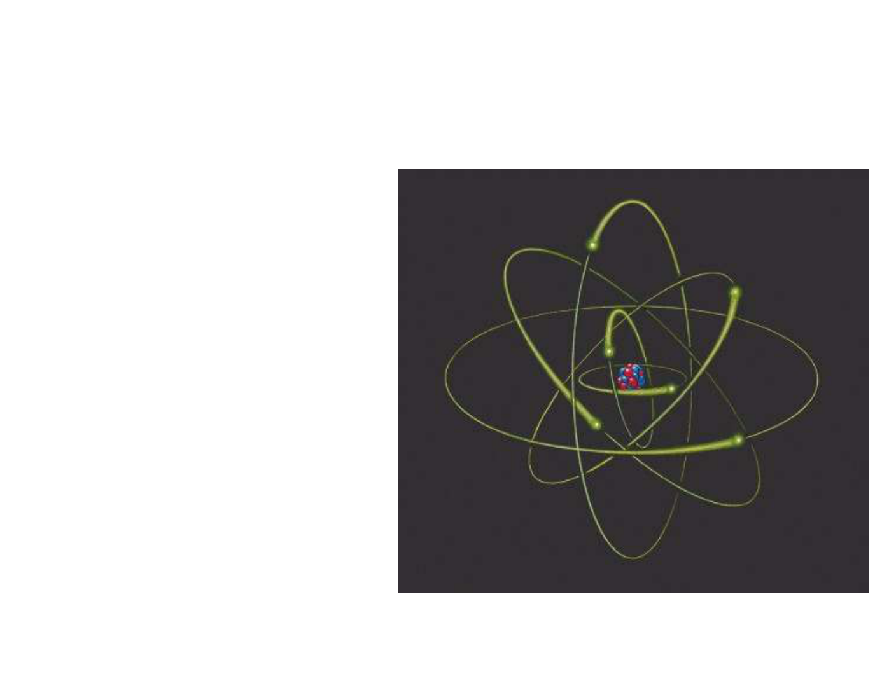
WVU DSPIRA
WEST VIRGINIA UNIVERSITY
Everything is made of atoms
•
All material is made
up of
atoms
.
•
Atoms are made
from
protons
,
neutrons,
and
electrons.
•
Protons and
neutrons are in the
nucleus. Electrons
move around the
nucleus.
wvurail.org/dspira
17 of 54
Notes:
Source edition: assets/lessons/lectures/astronomy/light-and-telescopes.pdf, page 17. Original author and figure credits remain on the slide. Text is editable; illustrations retain their source artwork.

Slide 18
WVU DSPIRA
WEST VIRGINIA UNIVERSITY
But where does the light come from?
•
When something is hot, it’s atoms move around
bumping into each other and the electrons in the
material. The hotter it is, the more the atoms
and electrons bump into each other.
•
The electrons are accelerated when they are
bumped and emit energy as
thermal radiation.
wvurail.org/dspira
18 of 54
Notes:
Source edition: assets/lessons/lectures/astronomy/light-and-telescopes.pdf, page 18. Original author and figure credits remain on the slide. Text is editable; illustrations retain their source artwork.

Slide 19
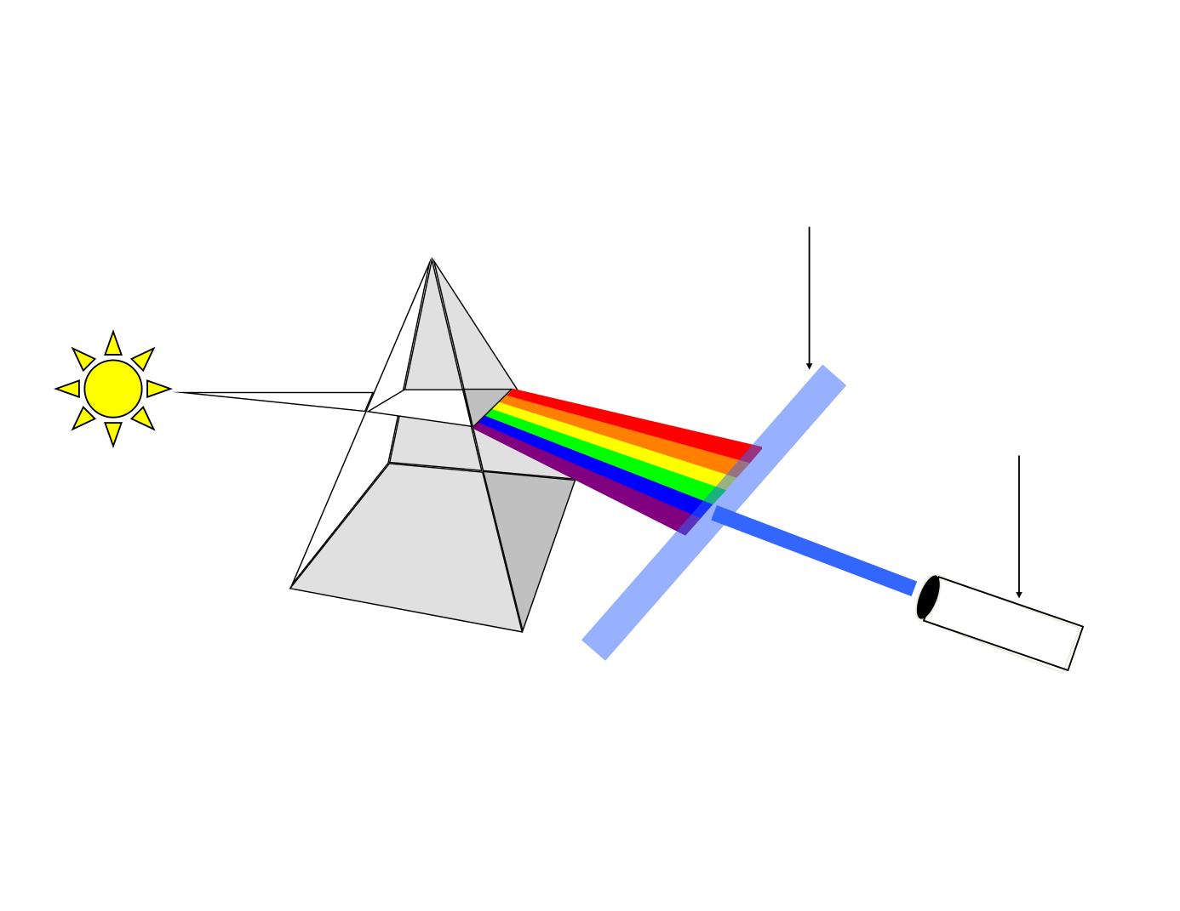
WVU DSPIRA
WEST VIRGINIA UNIVERSITY
Filter
Detector
wvurail.org/dspira
19 of 54
Notes:
Source edition: assets/lessons/lectures/astronomy/light-and-telescopes.pdf, page 19. Original author and figure credits remain on the slide. Text is editable; illustrations retain their source artwork.

Slide 20
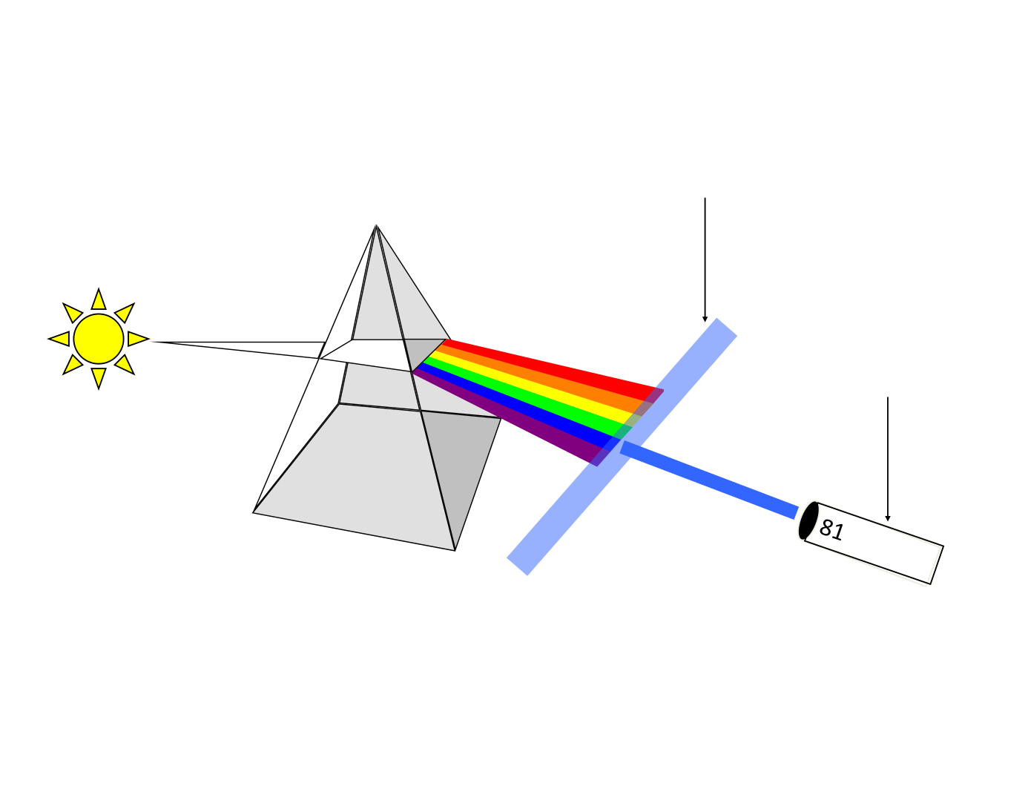
WVU DSPIRA
WEST VIRGINIA UNIVERSITY
blue 4600 A
81
Filter
Detector
wvurail.org/dspira
20 of 54
Notes:
Source edition: assets/lessons/lectures/astronomy/light-and-telescopes.pdf, page 20. Original author and figure credits remain on the slide. Text is editable; illustrations retain their source artwork.

Slide 21
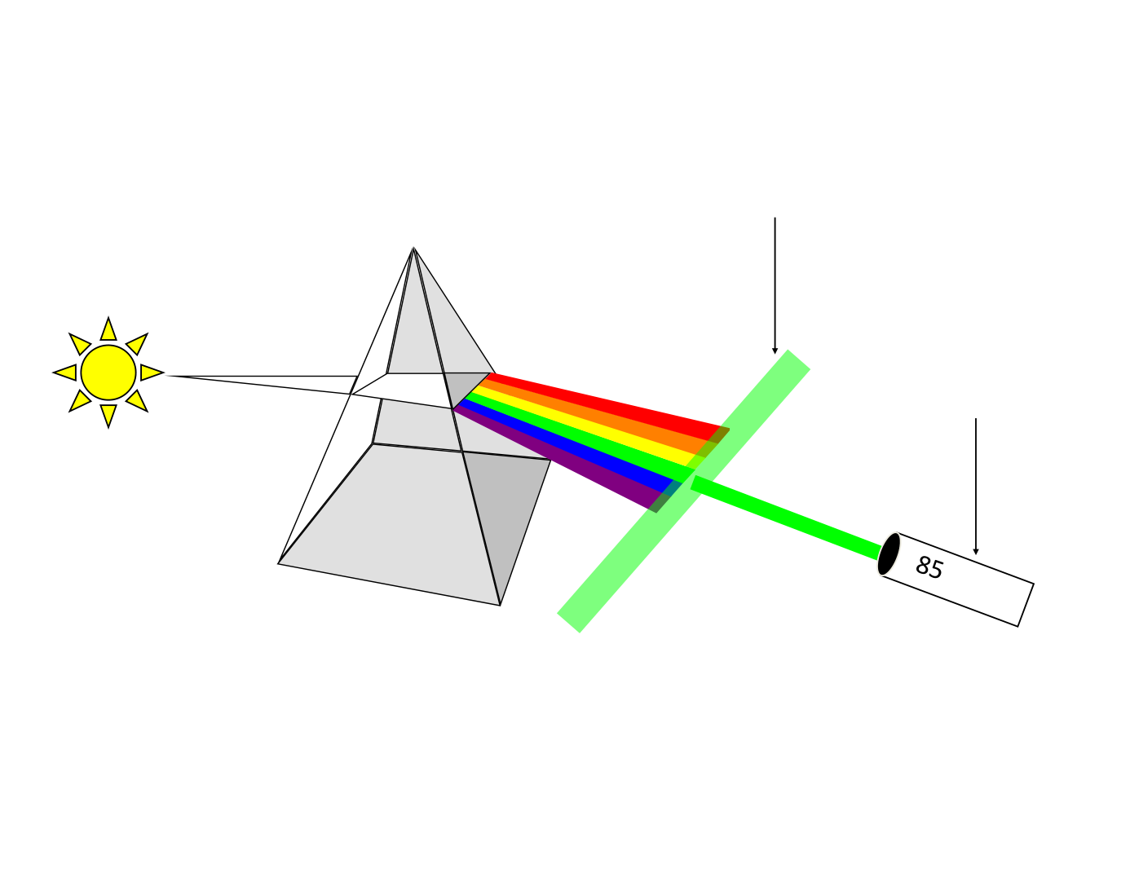
WVU DSPIRA
WEST VIRGINIA UNIVERSITY
blue 4600 A
81
green
5300 A
85
Filter
Detector
wvurail.org/dspira
21 of 54
Notes:
Source edition: assets/lessons/lectures/astronomy/light-and-telescopes.pdf, page 21. Original author and figure credits remain on the slide. Text is editable; illustrations retain their source artwork.

Slide 22
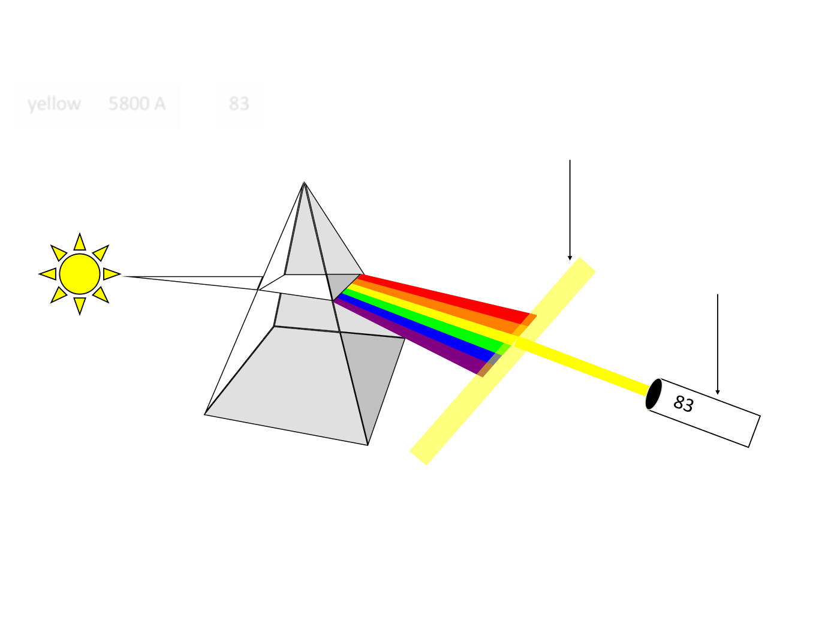
WVU DSPIRA
WEST VIRGINIA UNIVERSITY
blue 4600 A
81
green
5300 A
85
yellow
5800 A
83
Filter
Detector
wvurail.org/dspira
22 of 54
Notes:
Source edition: assets/lessons/lectures/astronomy/light-and-telescopes.pdf, page 22. Original author and figure credits remain on the slide. Text is editable; illustrations retain their source artwork.

Slide 23
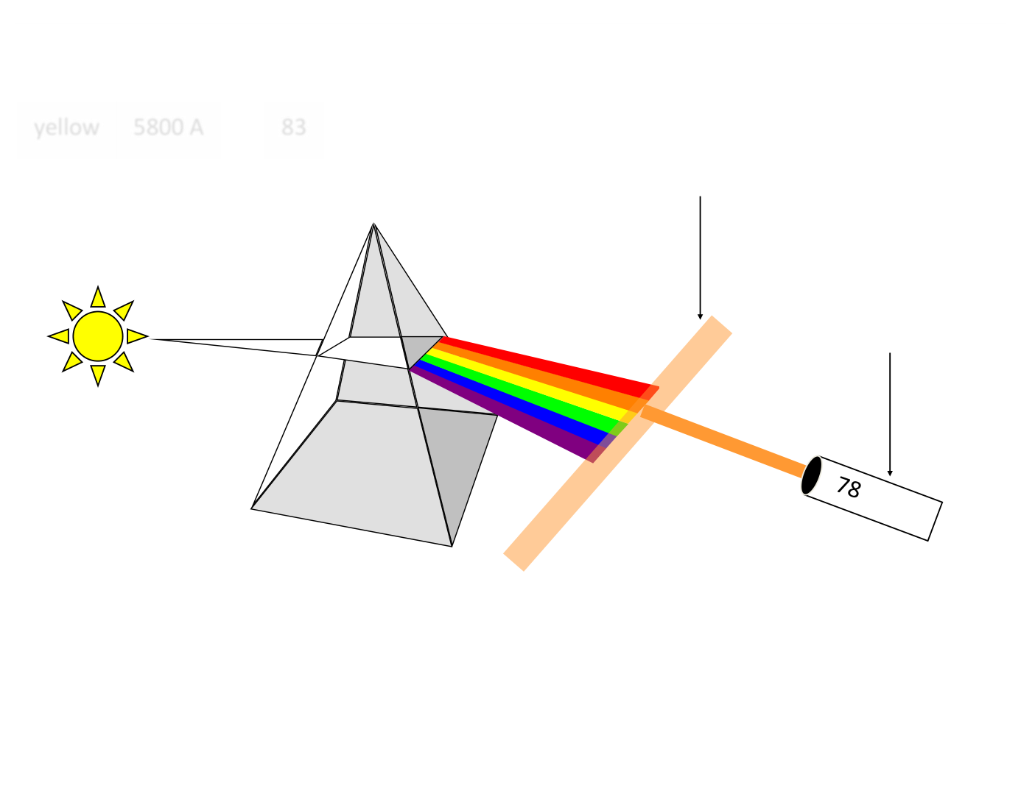
WVU DSPIRA
WEST VIRGINIA UNIVERSITY
blue 4600 A
81
green
5300 A
85
yellow
5800 A
83
orange
6100 A
78
Filter
Detector
wvurail.org/dspira
23 of 54
Notes:
Source edition: assets/lessons/lectures/astronomy/light-and-telescopes.pdf, page 23. Original author and figure credits remain on the slide. Text is editable; illustrations retain their source artwork.

Slide 24
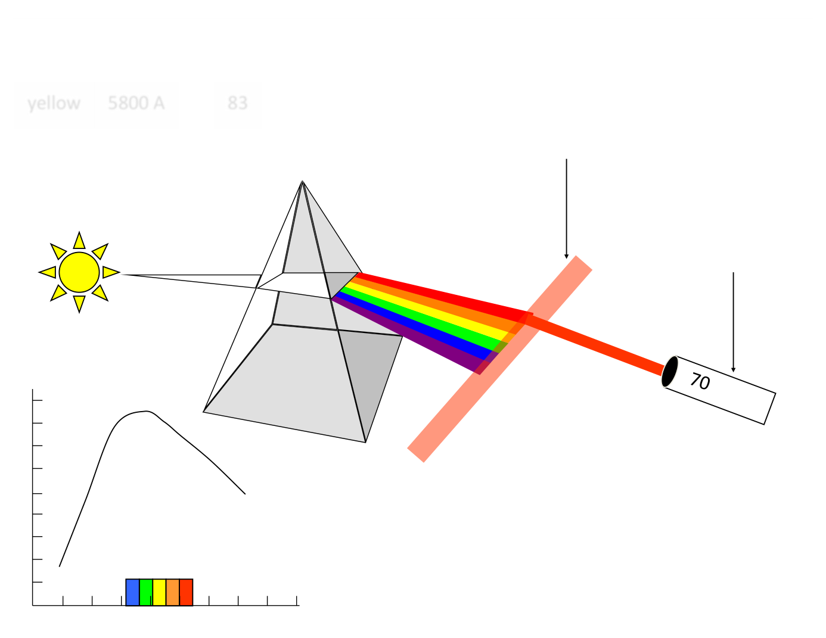
WVU DSPIRA
WEST VIRGINIA UNIVERSITY
blue 4600 A
81
green
5300 A
85
yellow
5800 A
83
orange
6100 A
78
Filter
red
6600 A
70
Detector
UV
IR
wvurail.org/dspira
24 of 54
Notes:
Source edition: assets/lessons/lectures/astronomy/light-and-telescopes.pdf, page 24. Original author and figure credits remain on the slide. Text is editable; illustrations retain their source artwork.

Slide 25
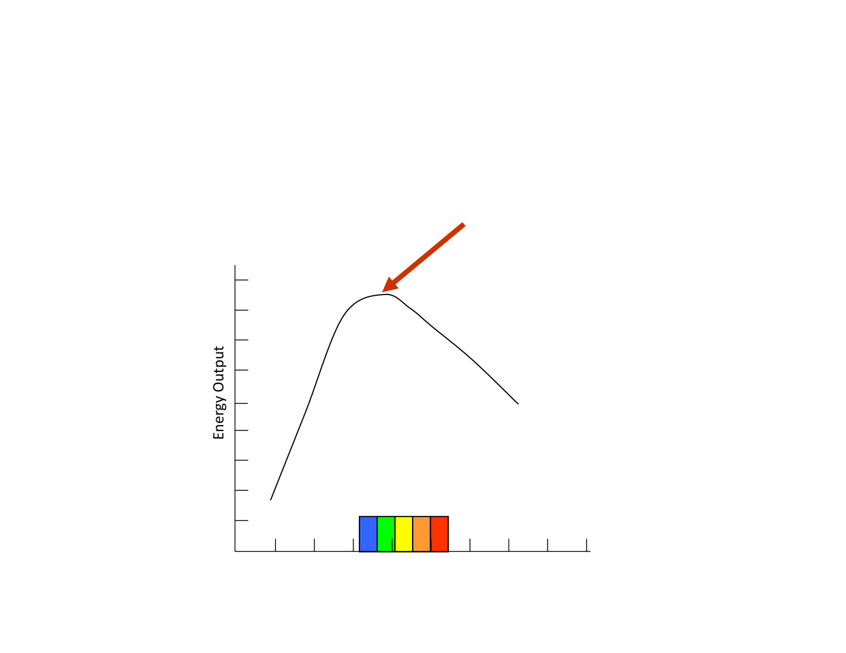
WVU DSPIRA
WEST VIRGINIA UNIVERSITY
“Blackbody Curve” - a
The WAVELENGTH that the PEAK
graph of an object’s
of this curve occurs at tells us
energy output versus
about the object’s TEMPERATURE
and COLOR.
wavelength.
UV
IR
Wavelength
wvurail.org/dspira
25 of 54
Notes:
Source edition: assets/lessons/lectures/astronomy/light-and-telescopes.pdf, page 25. Original author and figure credits remain on the slide. Text is editable; illustrations retain their source artwork.

Slide 26
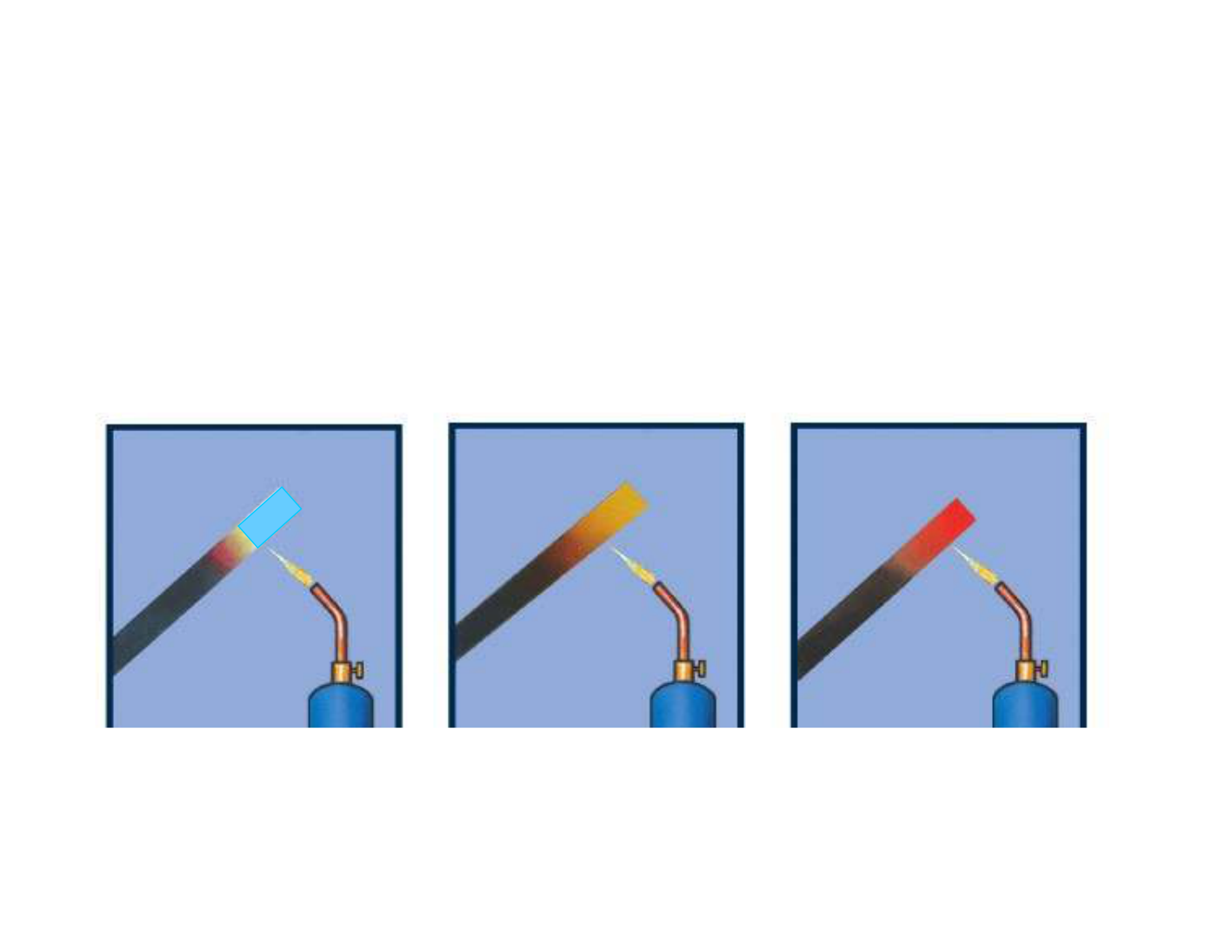
WVU DSPIRA
WEST VIRGINIA UNIVERSITY
Which object is hotter, an object that
is emitting mainly red light or mainly
blue light?
increasing temperature
wvurail.org/dspira
26 of 54
Notes:
Source edition: assets/lessons/lectures/astronomy/light-and-telescopes.pdf, page 26. Original author and figure credits remain on the slide. Text is editable; illustrations retain their source artwork.

Slide 27
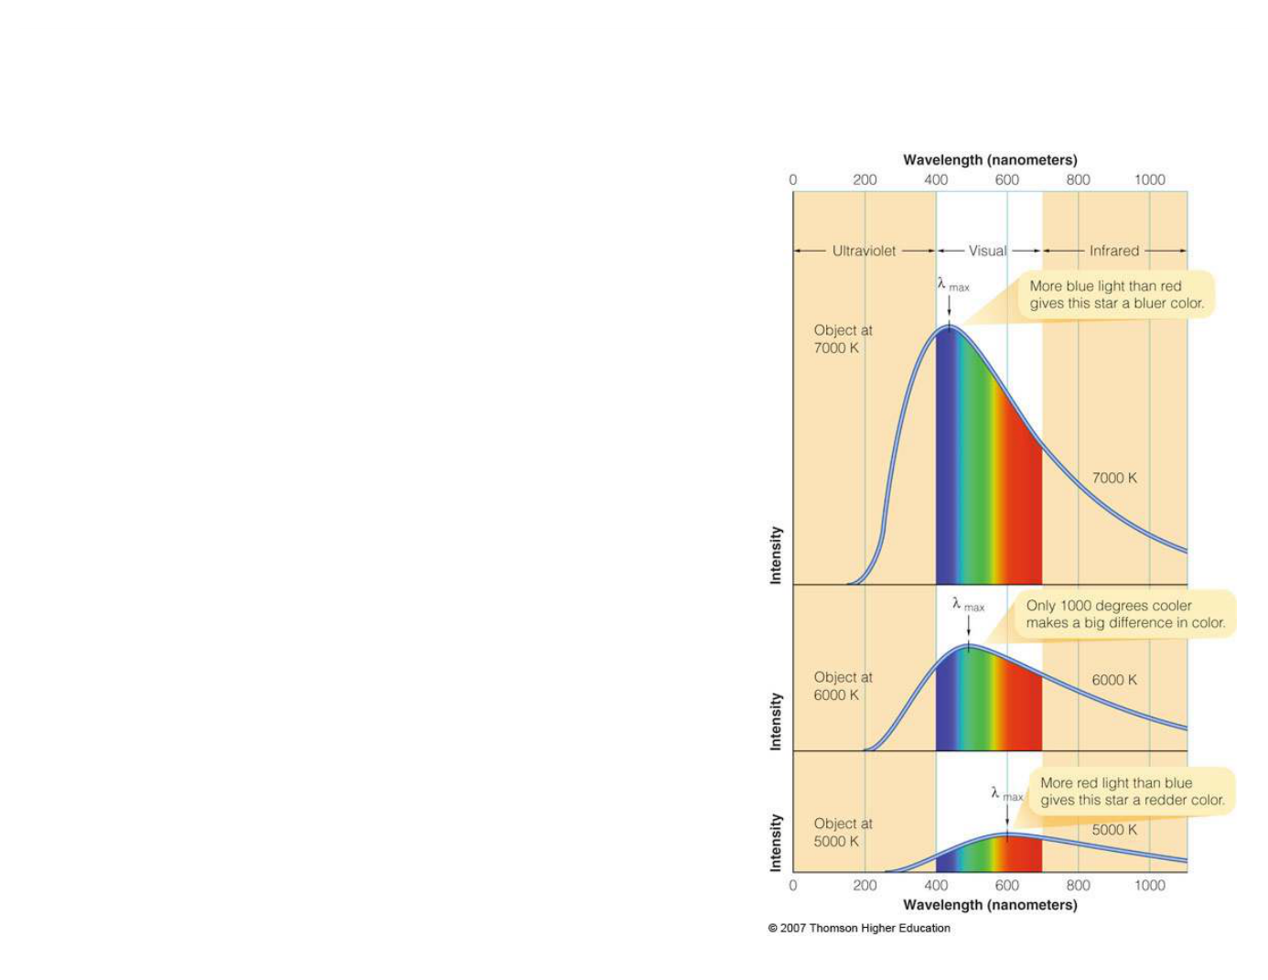
WVU DSPIRA
WEST VIRGINIA UNIVERSITY
Wien’s Law
•
The peak wavelength of
a blackbody curve is
inversely proportional
to
the temperature of the
object.
λ
= 0.289 cm / T
max
K
wvurail.org/dspira
27 of 54
Notes:
Source edition: assets/lessons/lectures/astronomy/light-and-telescopes.pdf, page 27. Original author and figure credits remain on the slide. Text is editable; illustrations retain their source artwork.

Slide 28
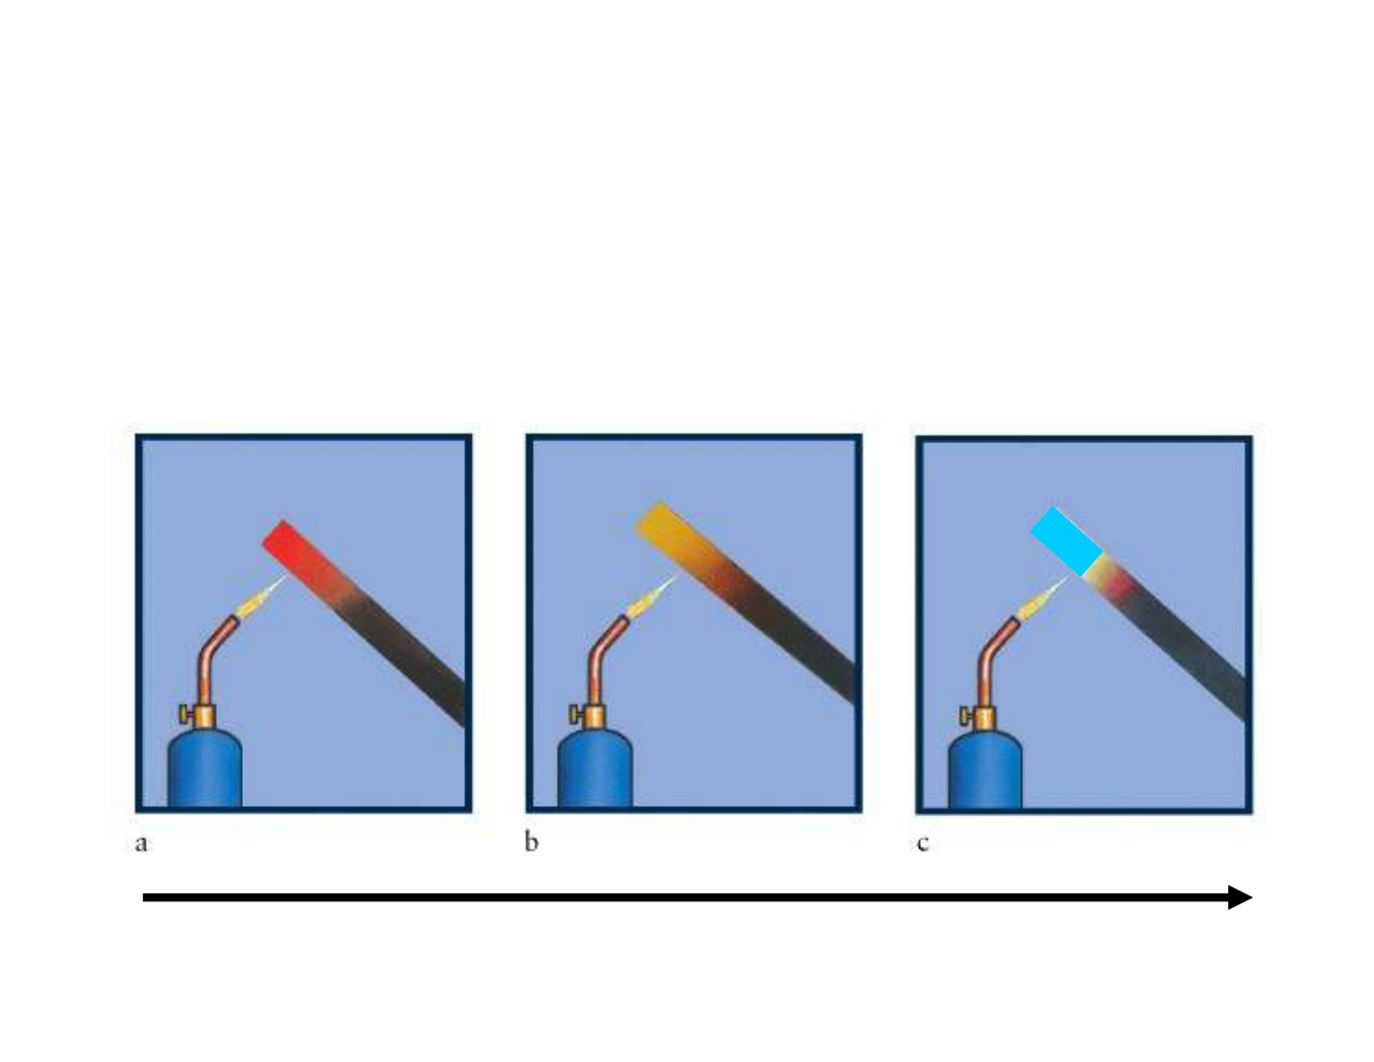
WVU DSPIRA
WEST VIRGINIA UNIVERSITY
Hot
objects emit light that
PEAKS
at
short
wavelengths
(
blue
).
Cool
objects emit light that
PEAKS
at
long
wavelengths
(
red
)
increasing temperature
wvurail.org/dspira
28 of 54
Notes:
Source edition: assets/lessons/lectures/astronomy/light-and-telescopes.pdf, page 28. Original author and figure credits remain on the slide. Text is editable; illustrations retain their source artwork.

Slide 29
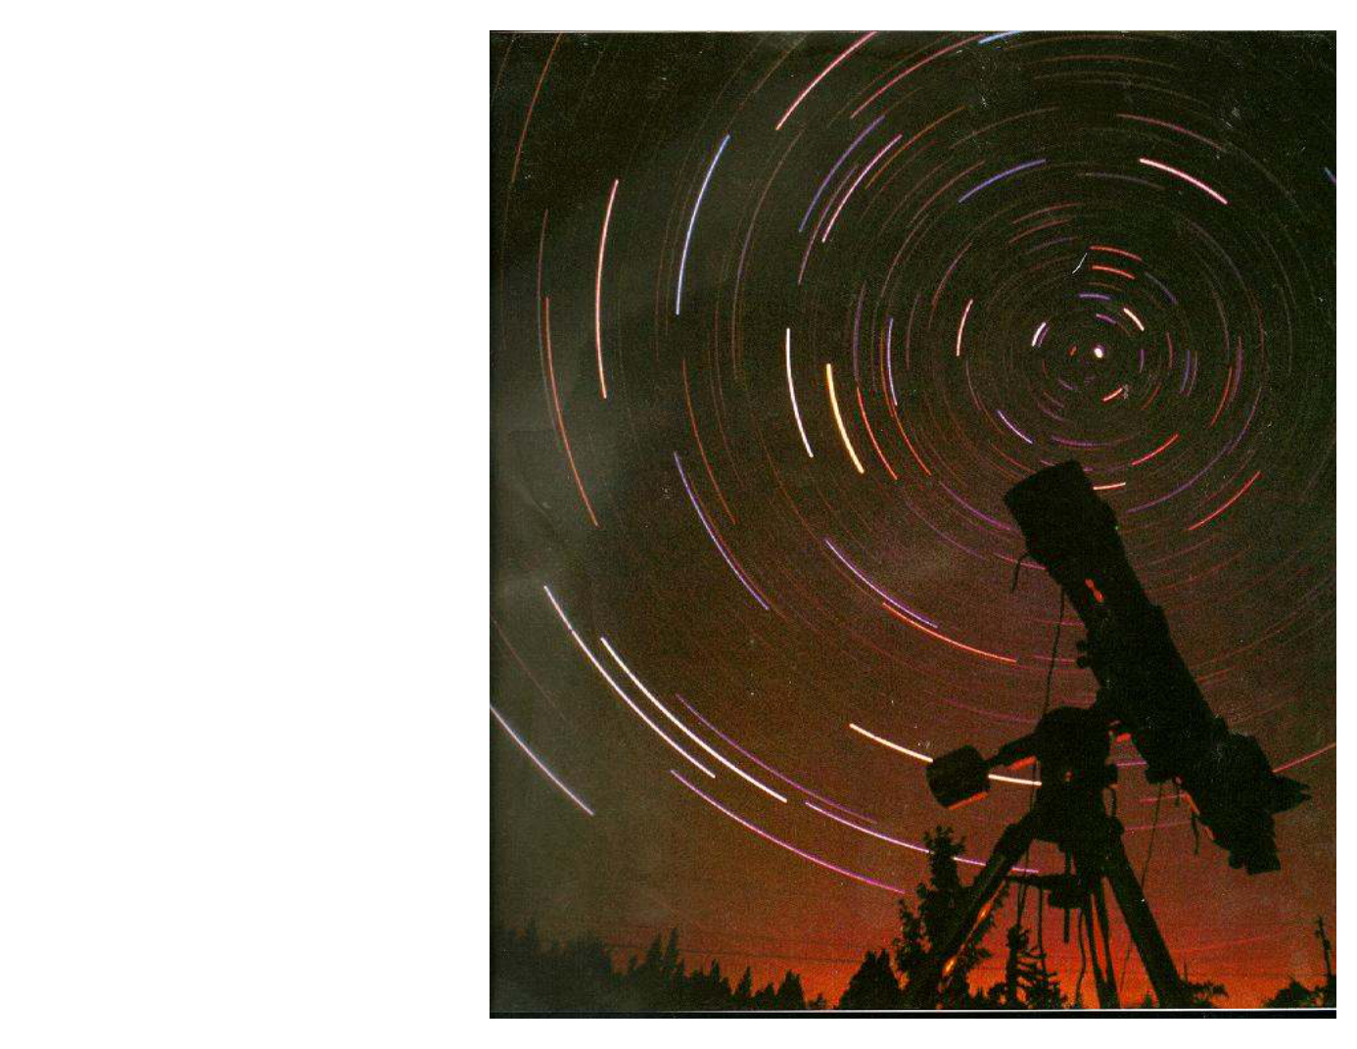
WVU DSPIRA
WEST VIRGINIA UNIVERSITY
Find the hottest
star(s), how do
you know ?
wvurail.org/dspira
29 of 54
Notes:
Source edition: assets/lessons/lectures/astronomy/light-and-telescopes.pdf, page 29. Original author and figure credits remain on the slide. Text is editable; illustrations retain their source artwork.

Slide 30
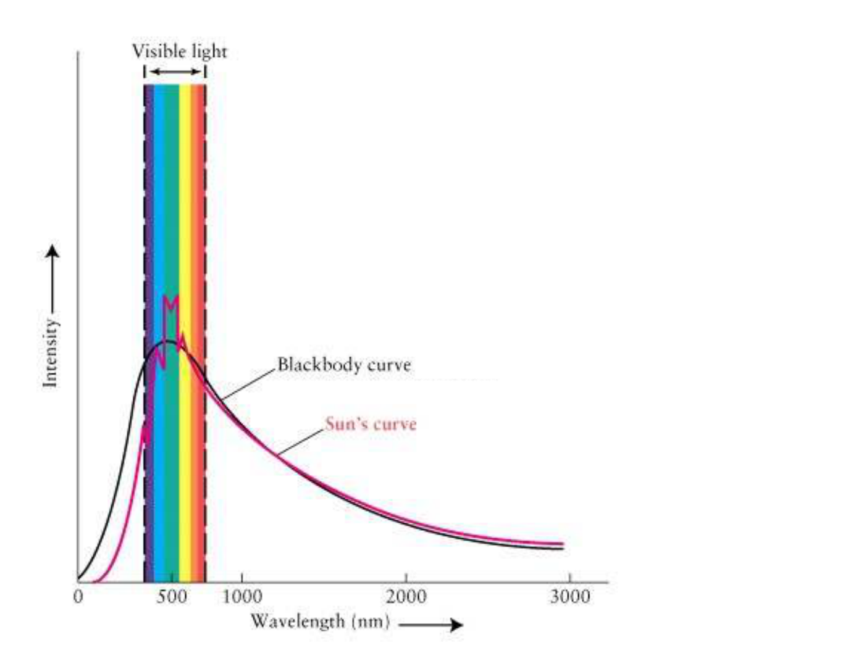
WVU DSPIRA
WEST VIRGINIA UNIVERSITY
What is the wavelength of
the PEAK of this
“Blackbody” curve
wvurail.org/dspira
30 of 54
Notes:
Source edition: assets/lessons/lectures/astronomy/light-and-telescopes.pdf, page 30. Original author and figure credits remain on the slide. Text is editable; illustrations retain their source artwork.

Slide 31
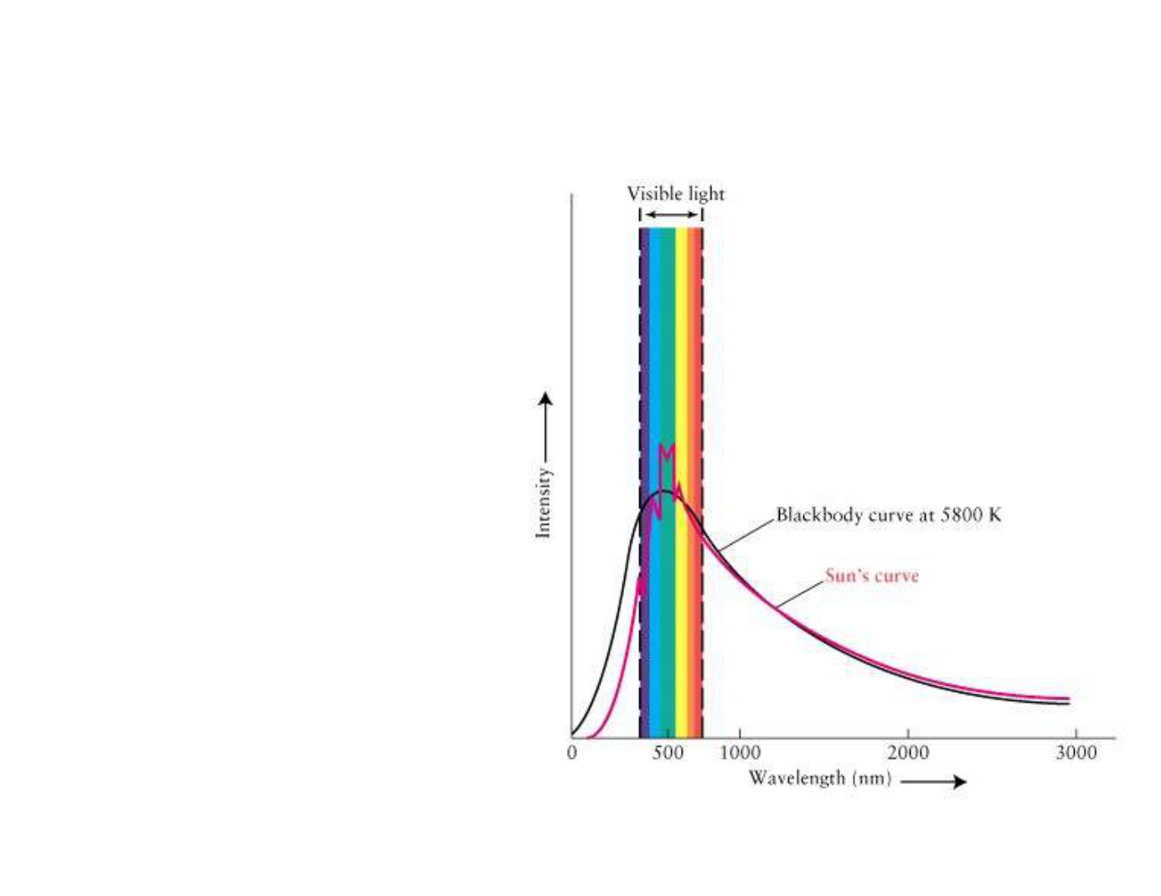
WVU DSPIRA
WEST VIRGINIA UNIVERSITY
What color is our 5800K Sun?
The Sun emits all
wavelengths of
electromagnetic
radiation (light);
however, the
wavelengths of light it
emits most intensely
are in the green/yellow
part of the spectrum.
wvurail.org/dspira
31 of 54
Notes:
Source edition: assets/lessons/lectures/astronomy/light-and-telescopes.pdf, page 31. Original author and figure credits remain on the slide. Text is editable; illustrations retain their source artwork.

Slide 32
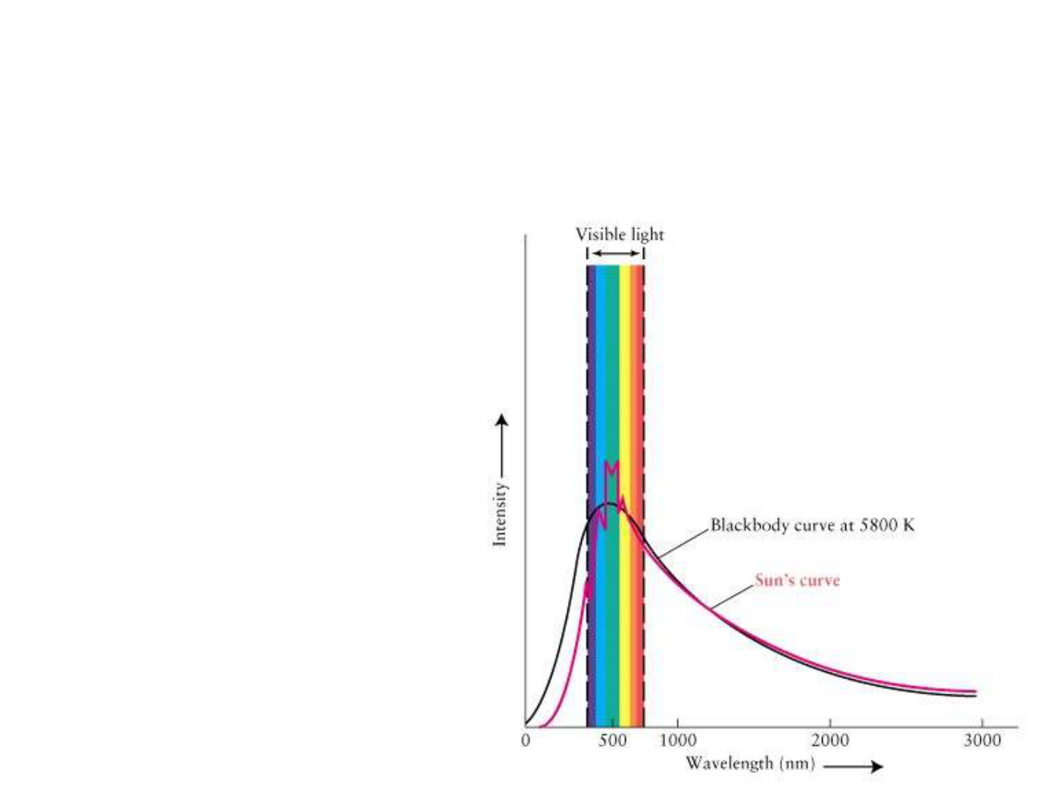
WVU DSPIRA
WEST VIRGINIA UNIVERSITY
What color does the Sun appear?
WHITE!!
A star, like the Sun,
which peaks in the
middle of the visible
part of the spectrum
(green/yellow light) will
appear WHITE to the
human eye because it
is giving off nearly
equal amounts of all
the visible colors of
light.
wvurail.org/dspira
32 of 54
Notes:
Source edition: assets/lessons/lectures/astronomy/light-and-telescopes.pdf, page 32. Original author and figure credits remain on the slide. Text is editable; illustrations retain their source artwork.

Slide 33
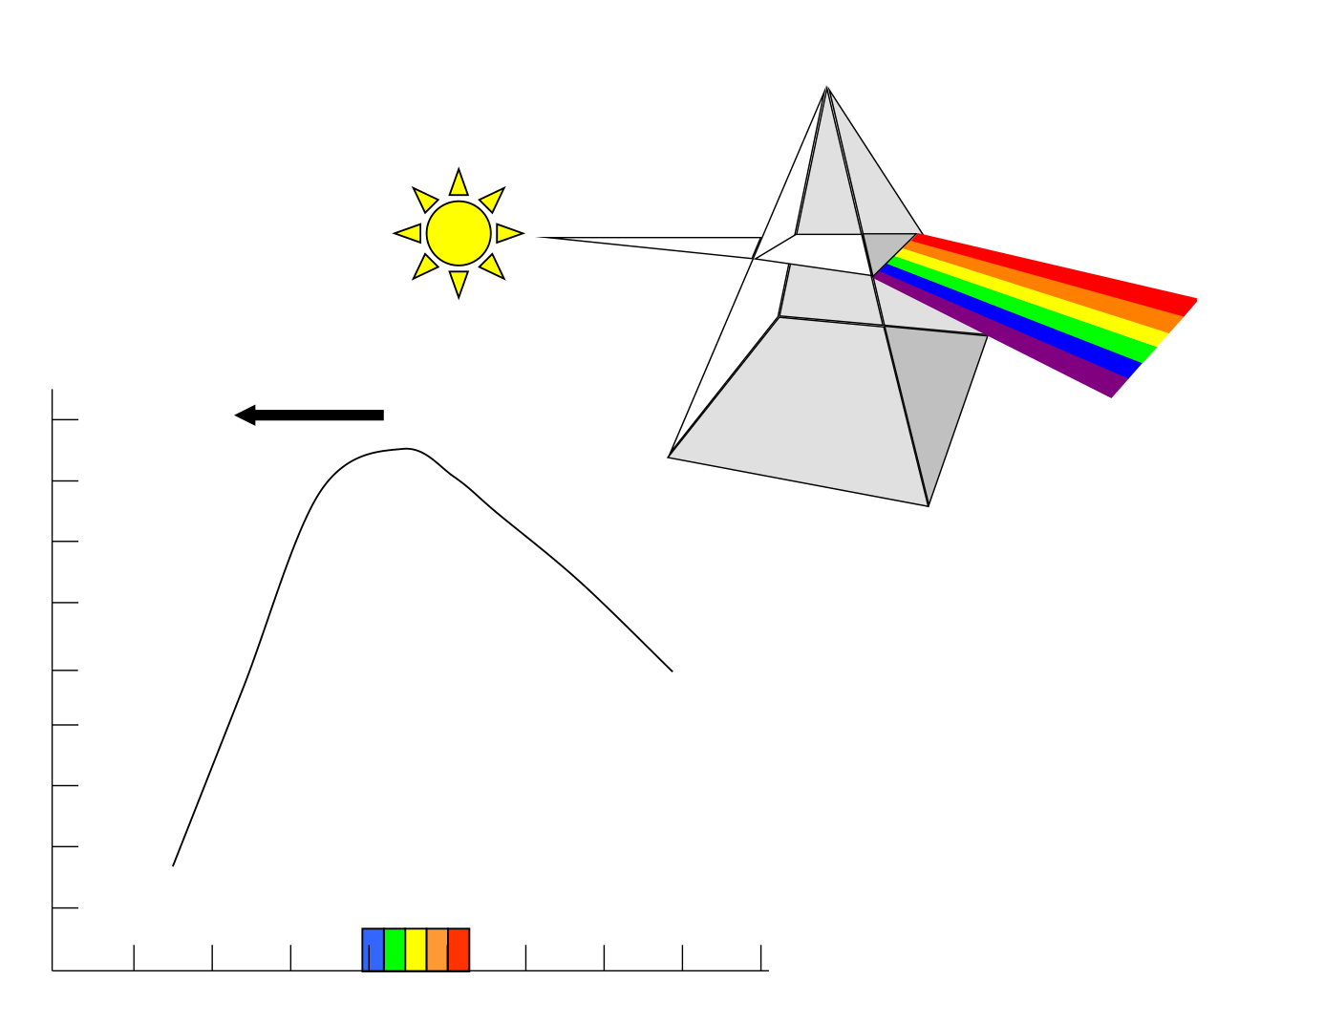
WVU DSPIRA
WEST VIRGINIA UNIVERSITY
Our Sun
What if the Sun became hotter?
wvurail.org/dspira
33 of 54
Notes:
Source edition: assets/lessons/lectures/astronomy/light-and-telescopes.pdf, page 33. Original author and figure credits remain on the slide. Text is editable; illustrations retain their source artwork.

Slide 34
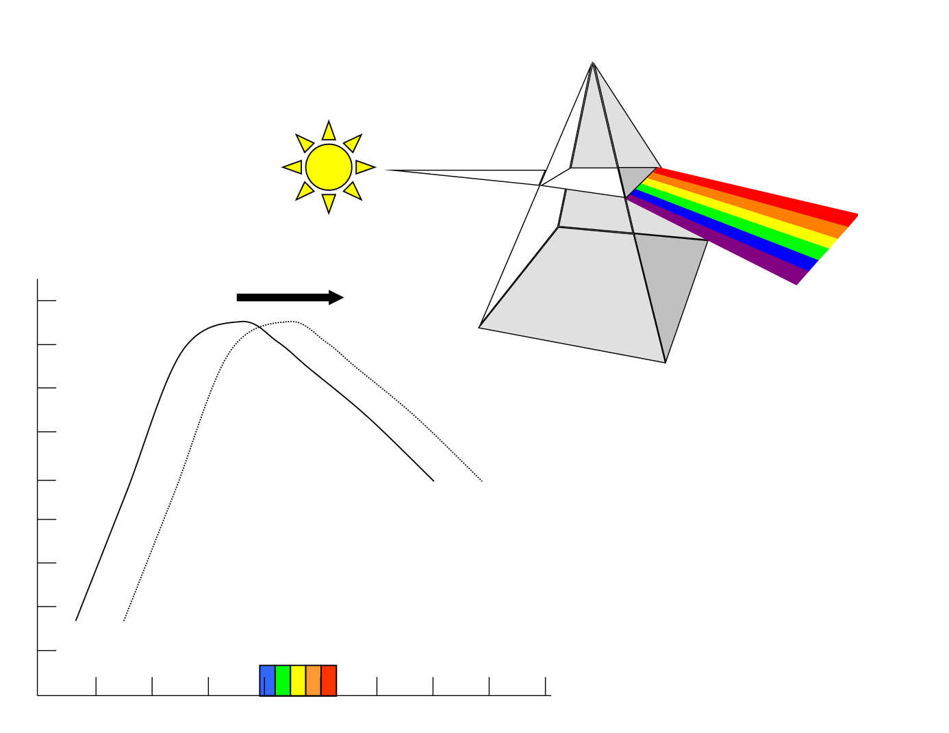
WVU DSPIRA
WEST VIRGINIA UNIVERSITY
Our Sun
What if the Sun became hotter?
What if the Sun became cooler?
wvurail.org/dspira
34 of 54
Notes:
Source edition: assets/lessons/lectures/astronomy/light-and-telescopes.pdf, page 34. Original author and figure credits remain on the slide. Text is editable; illustrations retain their source artwork.

Slide 35
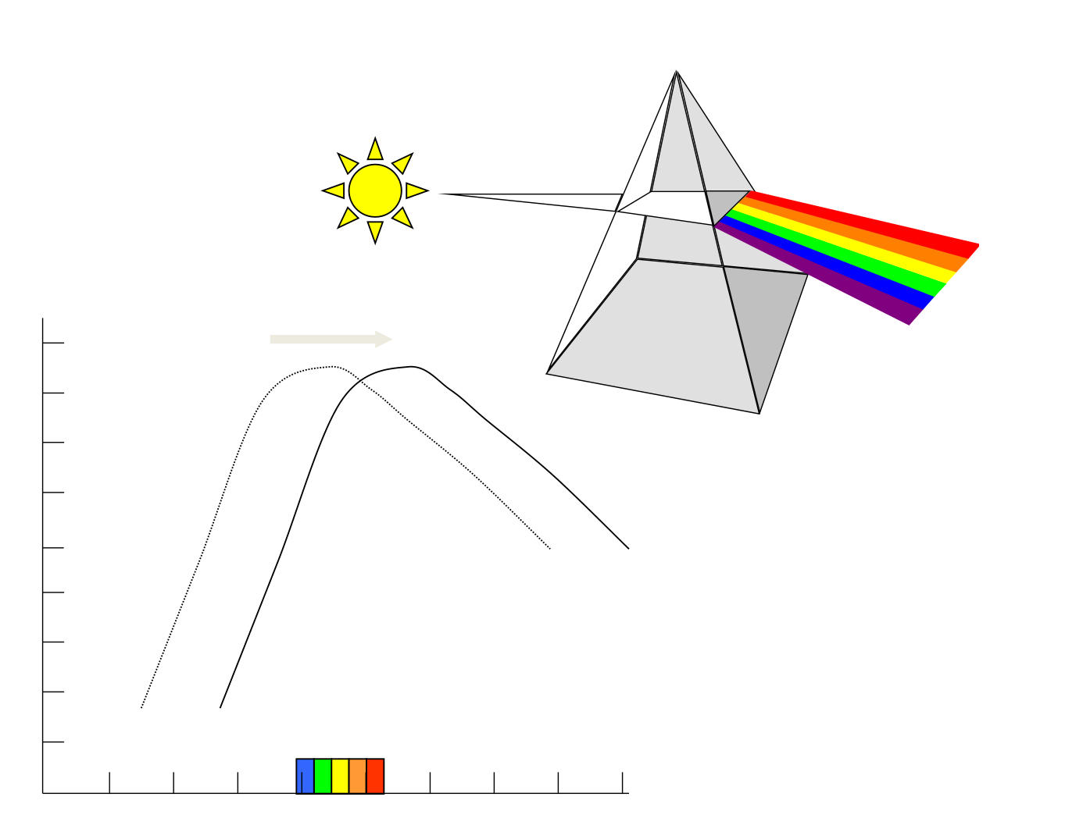
WVU DSPIRA
WEST VIRGINIA UNIVERSITY
Our Sun
What if the Sun became hotter?
What if the Sun became cooler?
wvurail.org/dspira
35 of 54
Notes:
Source edition: assets/lessons/lectures/astronomy/light-and-telescopes.pdf, page 35. Original author and figure credits remain on the slide. Text is editable; illustrations retain their source artwork.

Slide 36
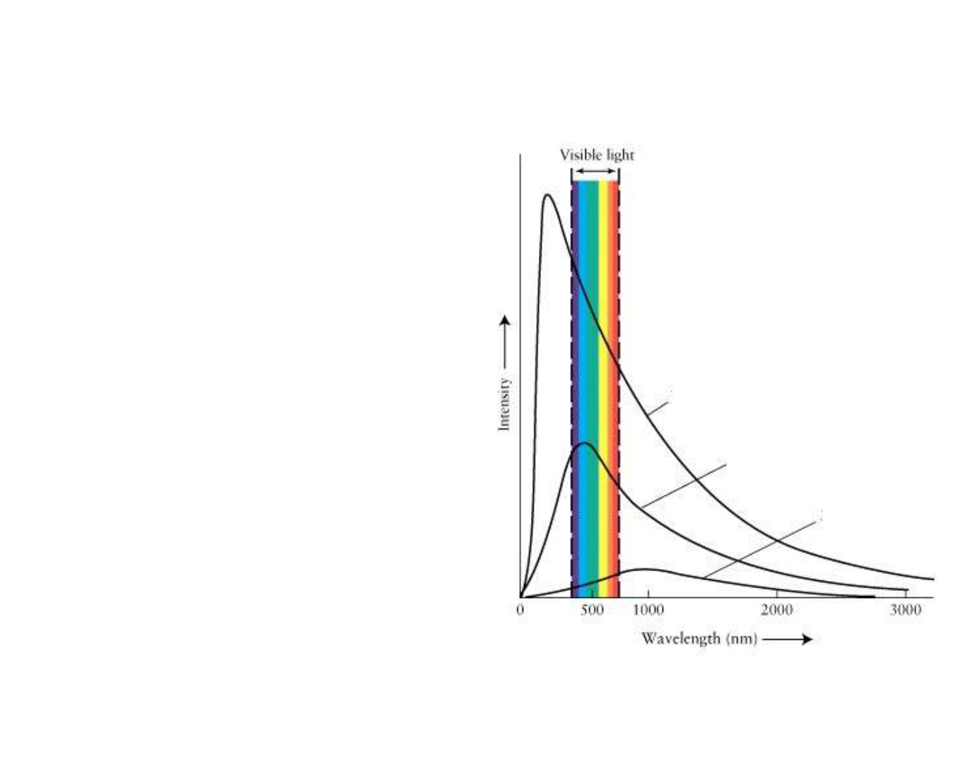
WVU DSPIRA
WEST VIRGINIA UNIVERSITY
1. Which object gives off the
greatest amount of Blue light?
2. Which object gives off the
greatest amount of Red light?
3. Which object would appear
A
Red?
B
4. Which object would have the
C
lowest temperature?
wvurail.org/dspira
36 of 54
Notes:
Source edition: assets/lessons/lectures/astronomy/light-and-telescopes.pdf, page 36. Original author and figure credits remain on the slide. Text is editable; illustrations retain their source artwork.

Slide 37
WVU DSPIRA
WEST VIRGINIA UNIVERSITY
But wait, what about how bright
something looks?
wvurail.org/dspira
37 of 54
Notes:
Source edition: assets/lessons/lectures/astronomy/light-and-telescopes.pdf, page 37. Original author and figure credits remain on the slide. Text is editable; illustrations retain their source artwork.

Slide 38
WVU DSPIRA
WEST VIRGINIA UNIVERSITY
Stefan-Boltzmann Law
•
The luminosity (brightness) of an object is
proportional to its
size
and
temperature
:
L = 5.67x10
-8
R
2
T
4
•
Big and hot objects are brighter than small
and cool objects.
•
Two objects with the same brightness and
different temperatures will have different
sizes (and vice-versa).
wvurail.org/dspira
38 of 54
Notes:
Source edition: assets/lessons/lectures/astronomy/light-and-telescopes.pdf, page 38. Original author and figure credits remain on the slide. Text is editable; illustrations retain their source artwork.

Slide 39
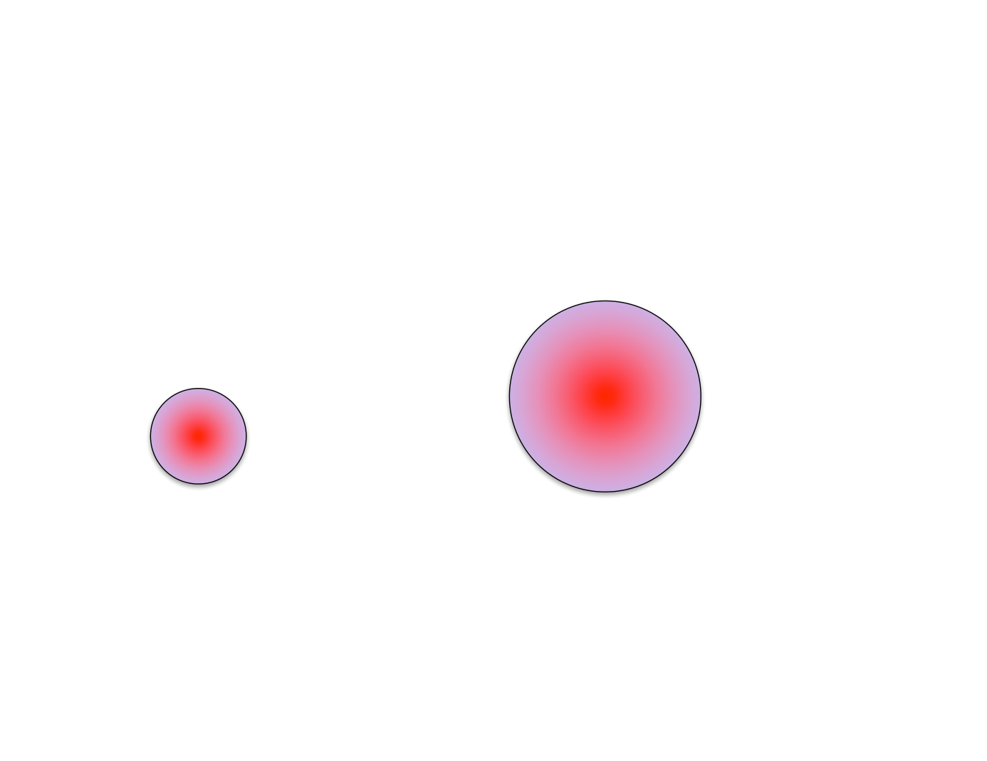
WVU DSPIRA
WEST VIRGINIA UNIVERSITY
Consider the following...
Which of these two stovetops is brighter?
A B
wvurail.org/dspira
39 of 54
Notes:
Source edition: assets/lessons/lectures/astronomy/light-and-telescopes.pdf, page 39. Original author and figure credits remain on the slide. Text is editable; illustrations retain their source artwork.

Slide 40
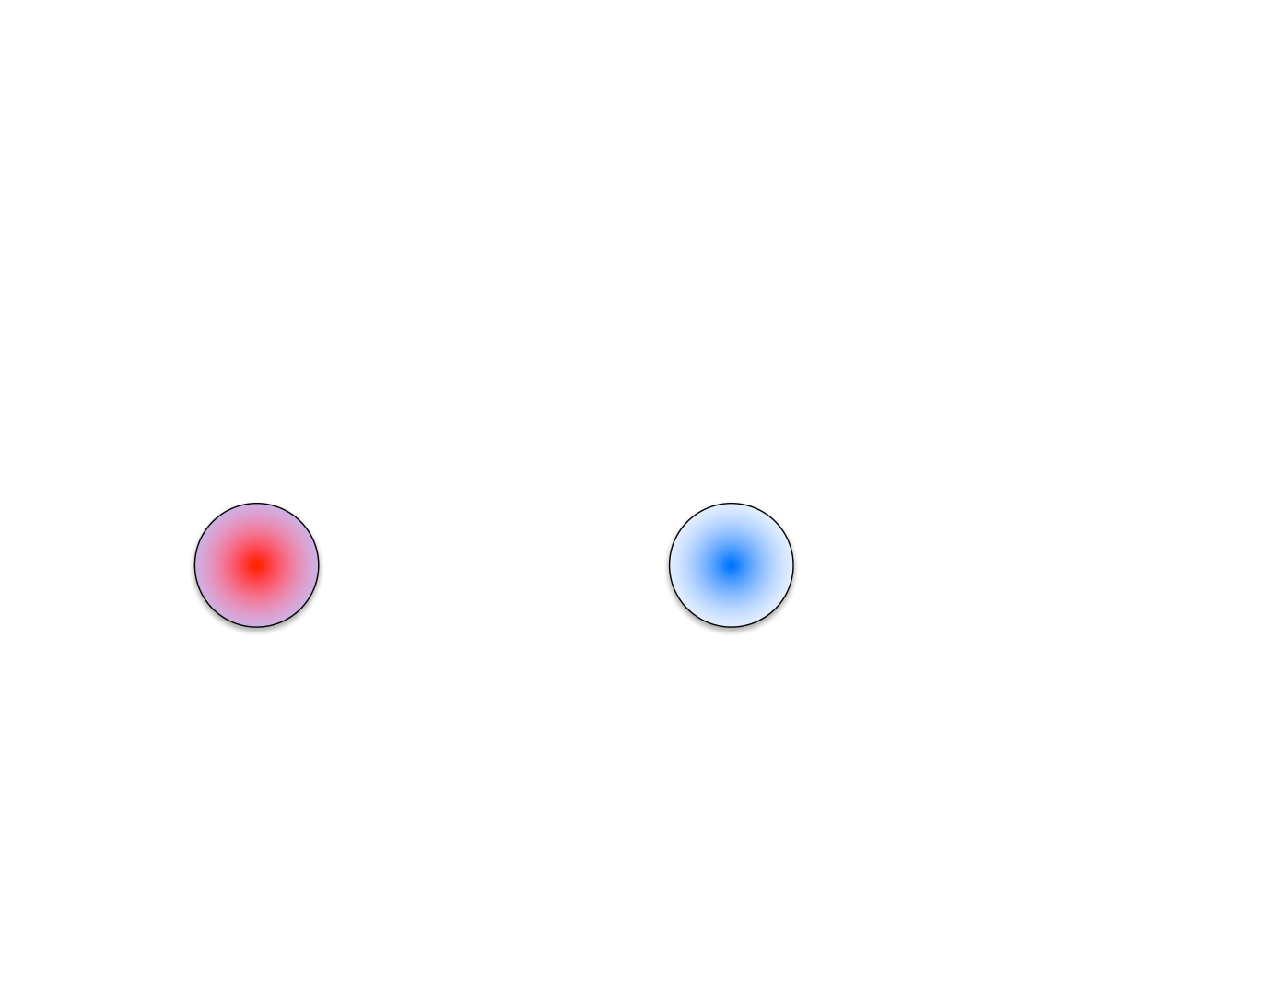
WVU DSPIRA
WEST VIRGINIA UNIVERSITY
Consider the following...
Which of these two stovetops is brighter?
A B
wvurail.org/dspira
40 of 54
Notes:
Source edition: assets/lessons/lectures/astronomy/light-and-telescopes.pdf, page 40. Original author and figure credits remain on the slide. Text is editable; illustrations retain their source artwork.

Slide 41
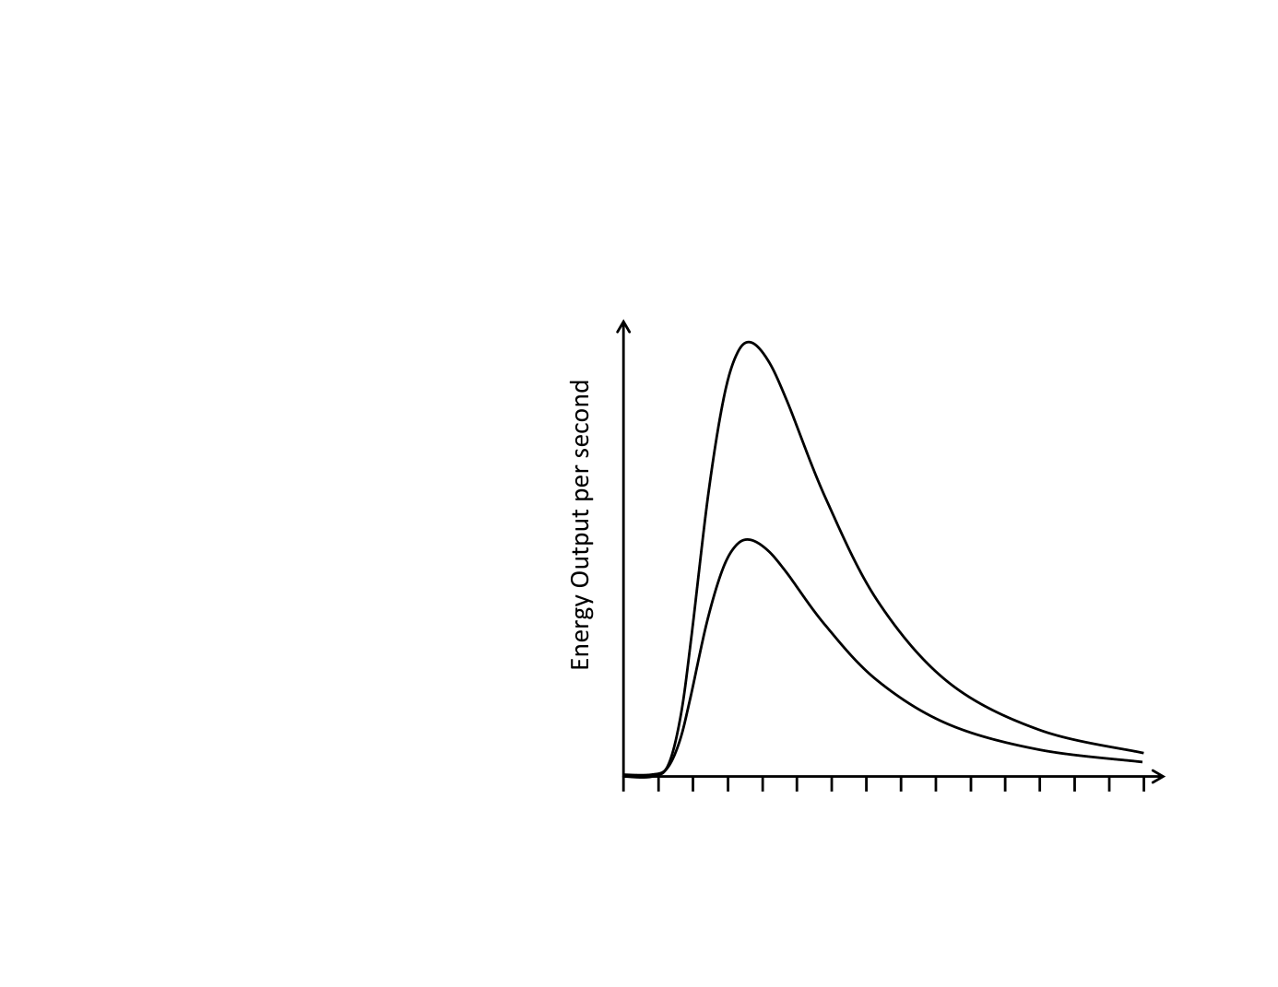
WVU DSPIRA
WEST VIRGINIA UNIVERSITY
Which star is larger?
A.
Star A
B.
Star B
Star A
C.
Same
Star B
V I B G Y O R
Wavelength
wvurail.org/dspira
41 of 54
Notes:
Source edition: assets/lessons/lectures/astronomy/light-and-telescopes.pdf, page 41. Original author and figure credits remain on the slide. Text is editable; illustrations retain their source artwork.

Slide 42
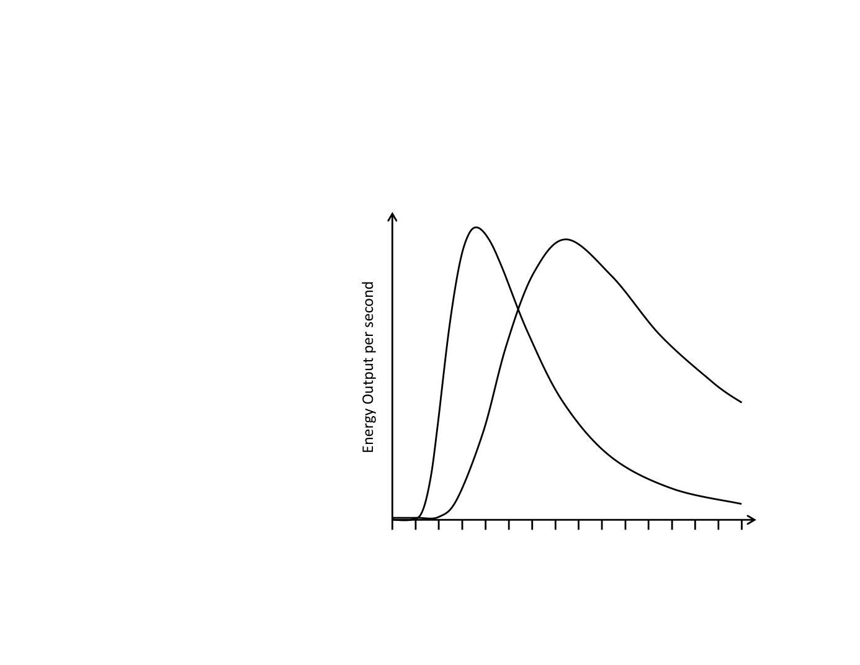
WVU DSPIRA
WEST VIRGINIA UNIVERSITY
Which star is larger Star A or Star B?
A.
Star A
Star A
Star B
B.
Star B
C.
Same
V I B G Y O R
Wavelength
wvurail.org/dspira
42 of 54
Notes:
Source edition: assets/lessons/lectures/astronomy/light-and-telescopes.pdf, page 42. Original author and figure credits remain on the slide. Text is editable; illustrations retain their source artwork.

Slide 43
WVU DSPIRA
WEST VIRGINIA UNIVERSITY
But where does the light come from?
•
When something is hot, it’s atoms move around
bumping into each other and the electrons in the
material. The hotter it is, the more the atoms
and electrons bump into each other.
•
The electrons are accelerated when they are
bumped and emit energy as
thermal radiation.
•
But there is also another way for atoms to
emit light…
wvurail.org/dspira
43 of 54
Notes:
Source edition: assets/lessons/lectures/astronomy/light-and-telescopes.pdf, page 43. Original author and figure credits remain on the slide. Text is editable; illustrations retain their source artwork.

Slide 44
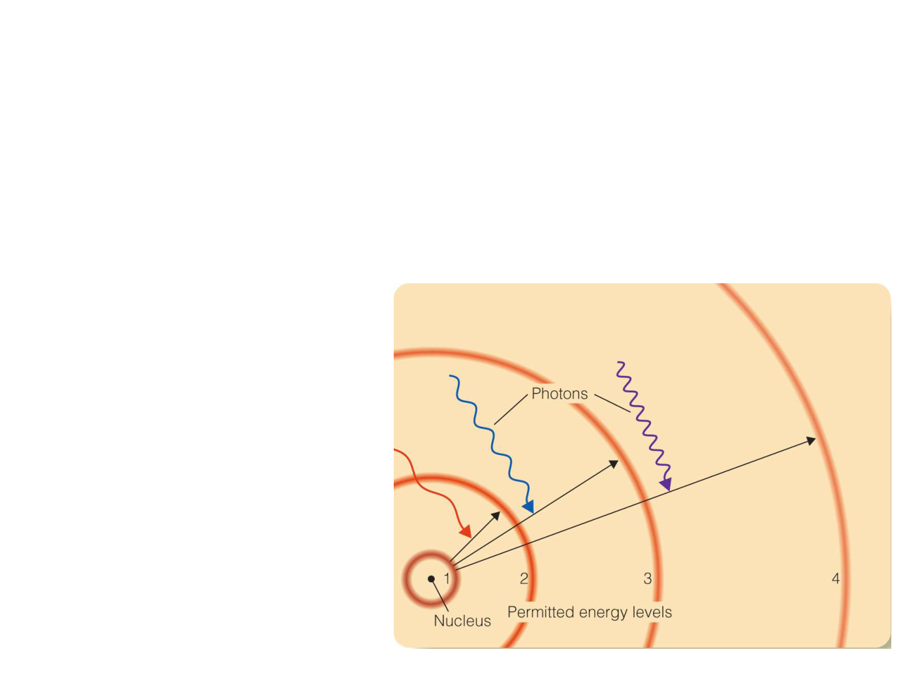
WVU DSPIRA
WEST VIRGINIA UNIVERSITY
Energy Levels
Electrons can only “orbit” at very specific
energy
levels.
The energies of these levels correspond to
the energy of specific wavelengths (frequencies) of
light. These levels
are discrete or
quantized
.
wvurail.org/dspira
44 of 54
Notes:
Source edition: assets/lessons/lectures/astronomy/light-and-telescopes.pdf, page 44. Original author and figure credits remain on the slide. Text is editable; illustrations retain their source artwork.

Slide 45
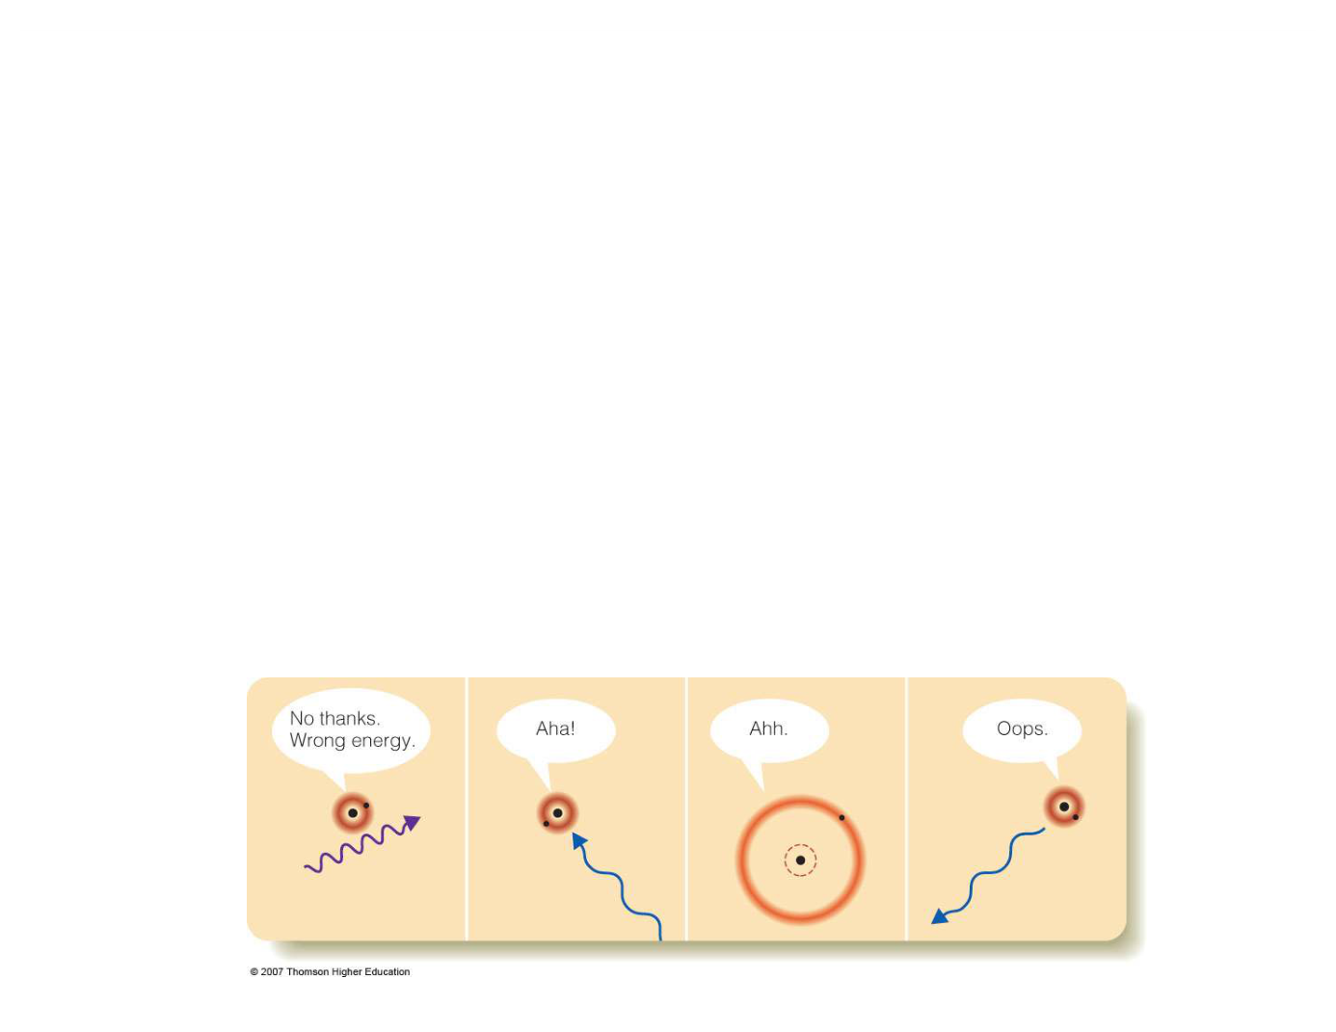
WVU DSPIRA
WEST VIRGINIA UNIVERSITY
Emission and Absorption
Imagine that the atom below has a single electron
in its lowest energy state (the
ground
state). It can
only move up a level if it absorbs a blue photon. If
it is in a higher energy (excited) state, then it can
suddenly decide to emit a blue photon (and only a
blue photon).
wvurail.org/dspira
45 of 54
Notes:
Source edition: assets/lessons/lectures/astronomy/light-and-telescopes.pdf, page 45. Original author and figure credits remain on the slide. Text is editable; illustrations retain their source artwork.

Slide 46
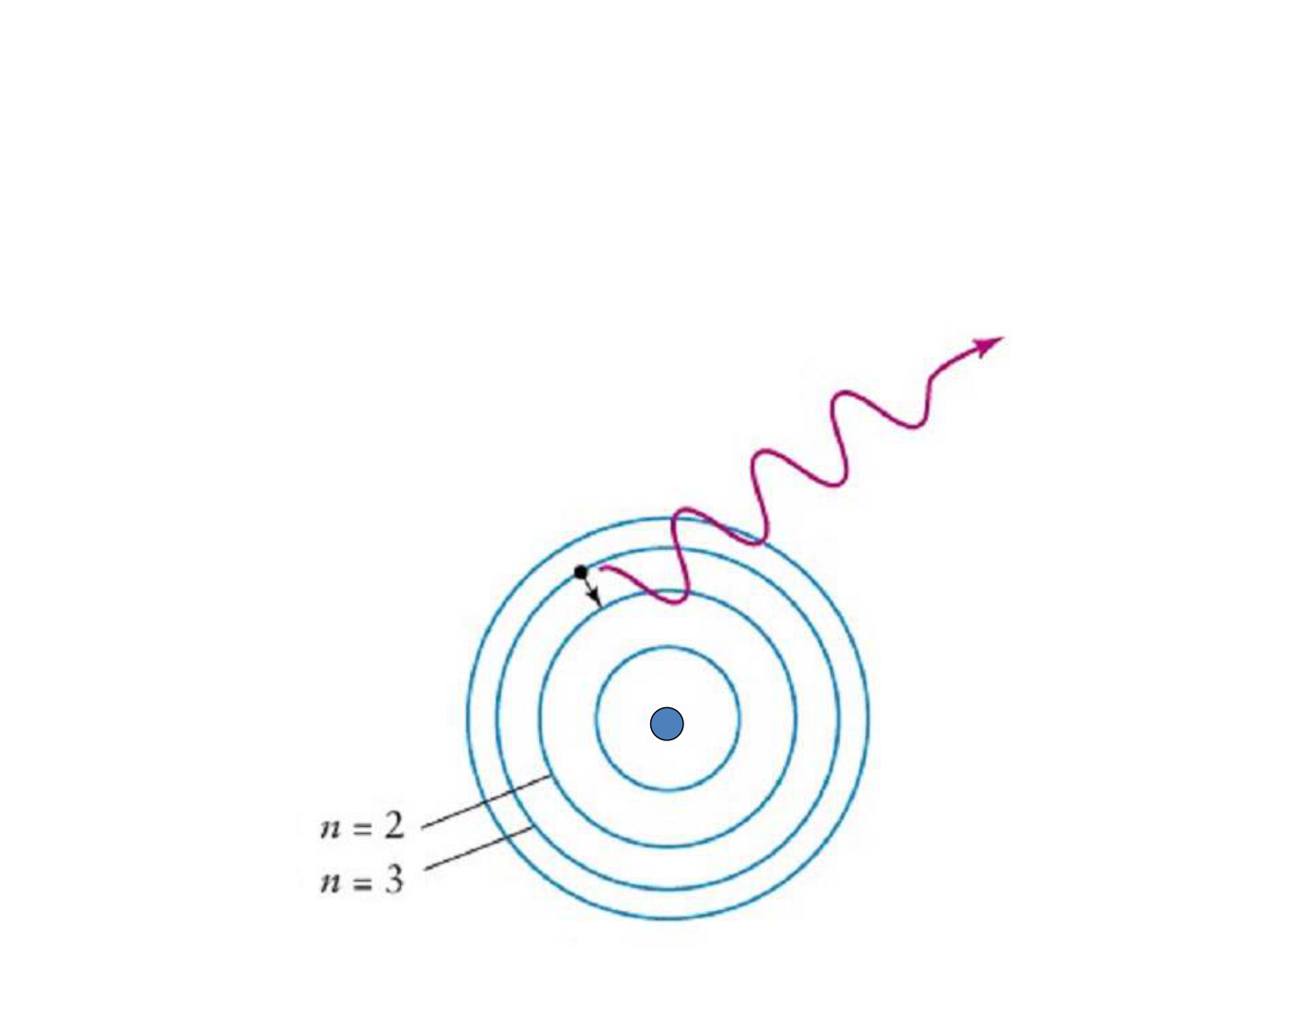
WVU DSPIRA
WEST VIRGINIA UNIVERSITY
Photons (light-waves) are emitted
from an atom when an electron
moves from a higher energy level to a
lower energy level
Nucleus
wvurail.org/dspira
46 of 54
Notes:
Source edition: assets/lessons/lectures/astronomy/light-and-telescopes.pdf, page 46. Original author and figure credits remain on the slide. Text is editable; illustrations retain their source artwork.

Slide 47
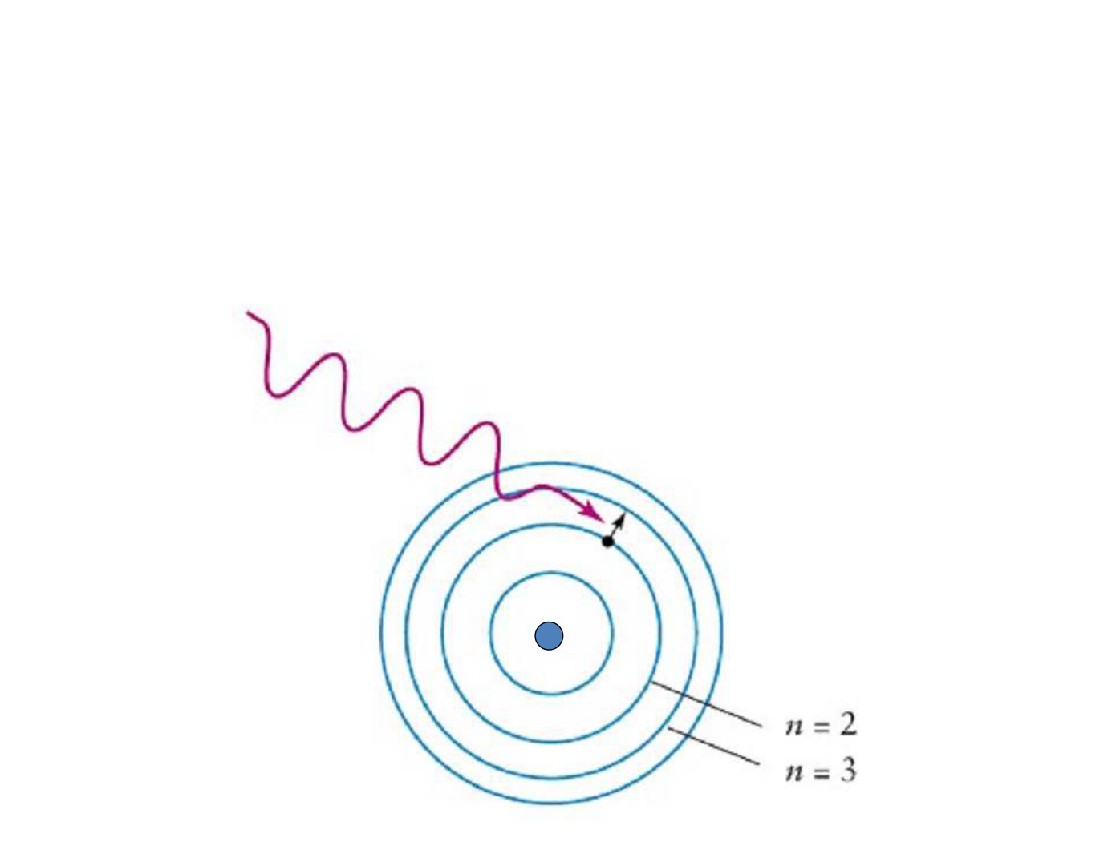
WVU DSPIRA
WEST VIRGINIA UNIVERSITY
Photons (light-waves) can also be
absorbed by an atom when an
electron moves from a lower energy
level to a higher energy level
Nucleus
wvurail.org/dspira
47 of 54
Notes:
Source edition: assets/lessons/lectures/astronomy/light-and-telescopes.pdf, page 47. Original author and figure credits remain on the slide. Text is editable; illustrations retain their source artwork.

Slide 48
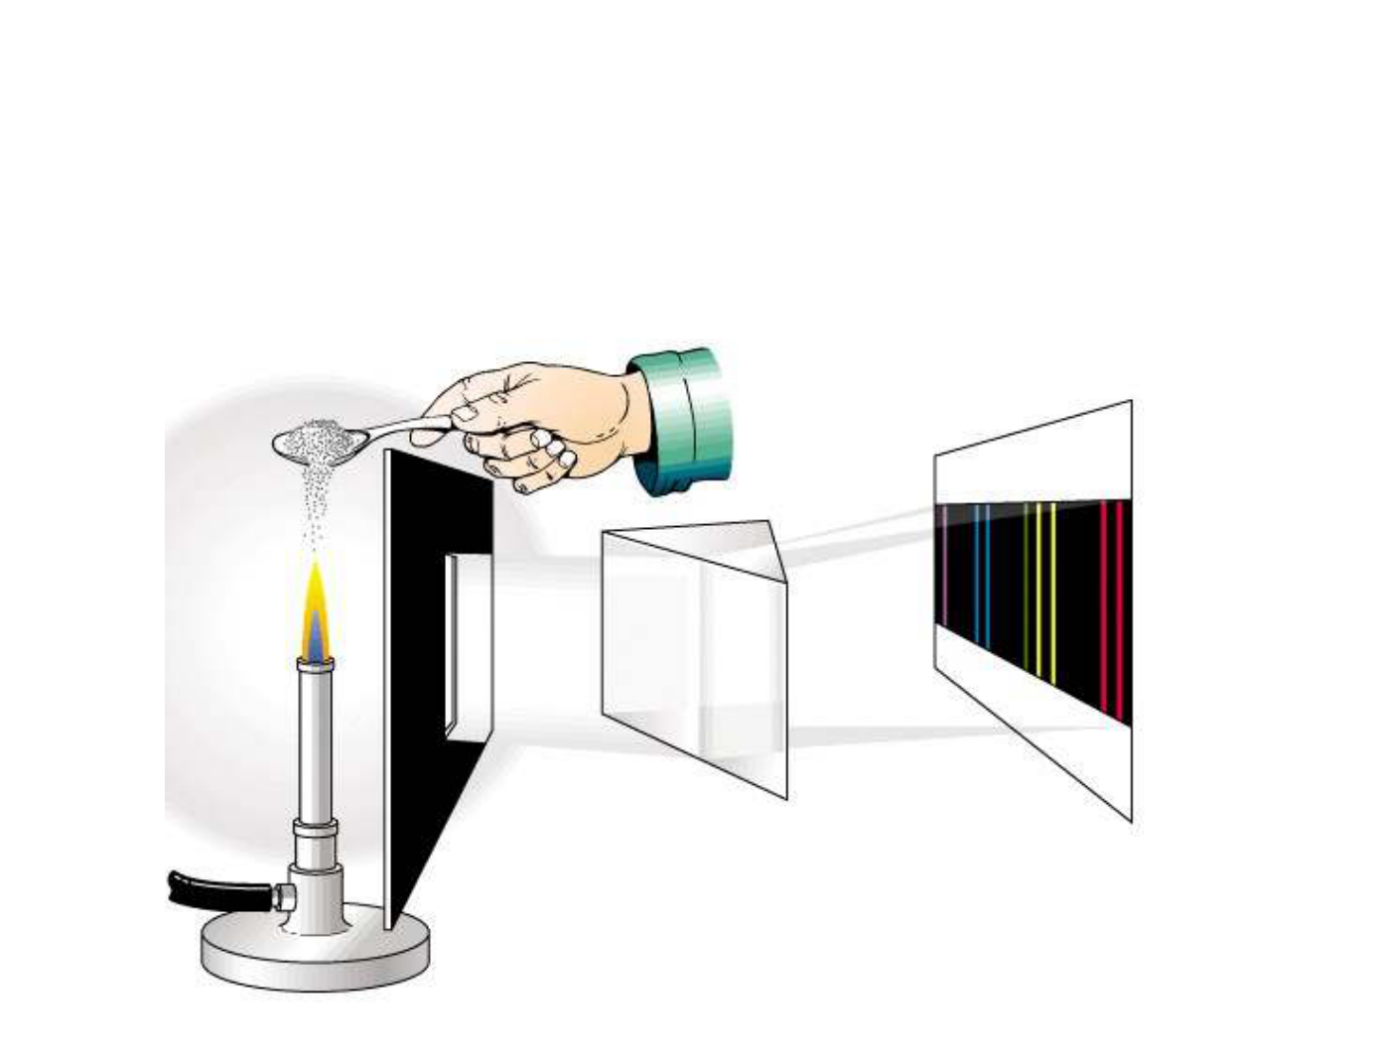
WVU DSPIRA
WEST VIRGINIA UNIVERSITY
Each chemical element produces its own
unique set of spectral lines when it is excited
wvurail.org/dspira
48 of 54
Notes:
Source edition: assets/lessons/lectures/astronomy/light-and-telescopes.pdf, page 48. Original author and figure credits remain on the slide. Text is editable; illustrations retain their source artwork.

Slide 49
WVU DSPIRA
WEST VIRGINIA UNIVERSITY
We can use these lines to determine
the chemical composition of a star.
wvurail.org/dspira
49 of 54
Notes:
Source edition: assets/lessons/lectures/astronomy/light-and-telescopes.pdf, page 49. Original author and figure credits remain on the slide. Text is editable; illustrations retain their source artwork.

Slide 50
WVU DSPIRA
WEST VIRGINIA UNIVERSITY
There are three laws that
govern the types of spectra we
see in the Universe.
wvurail.org/dspira
50 of 54
Notes:
Source edition: assets/lessons/lectures/astronomy/light-and-telescopes.pdf, page 50. Original author and figure credits remain on the slide. Text is editable; illustrations retain their source artwork.

Slide 51
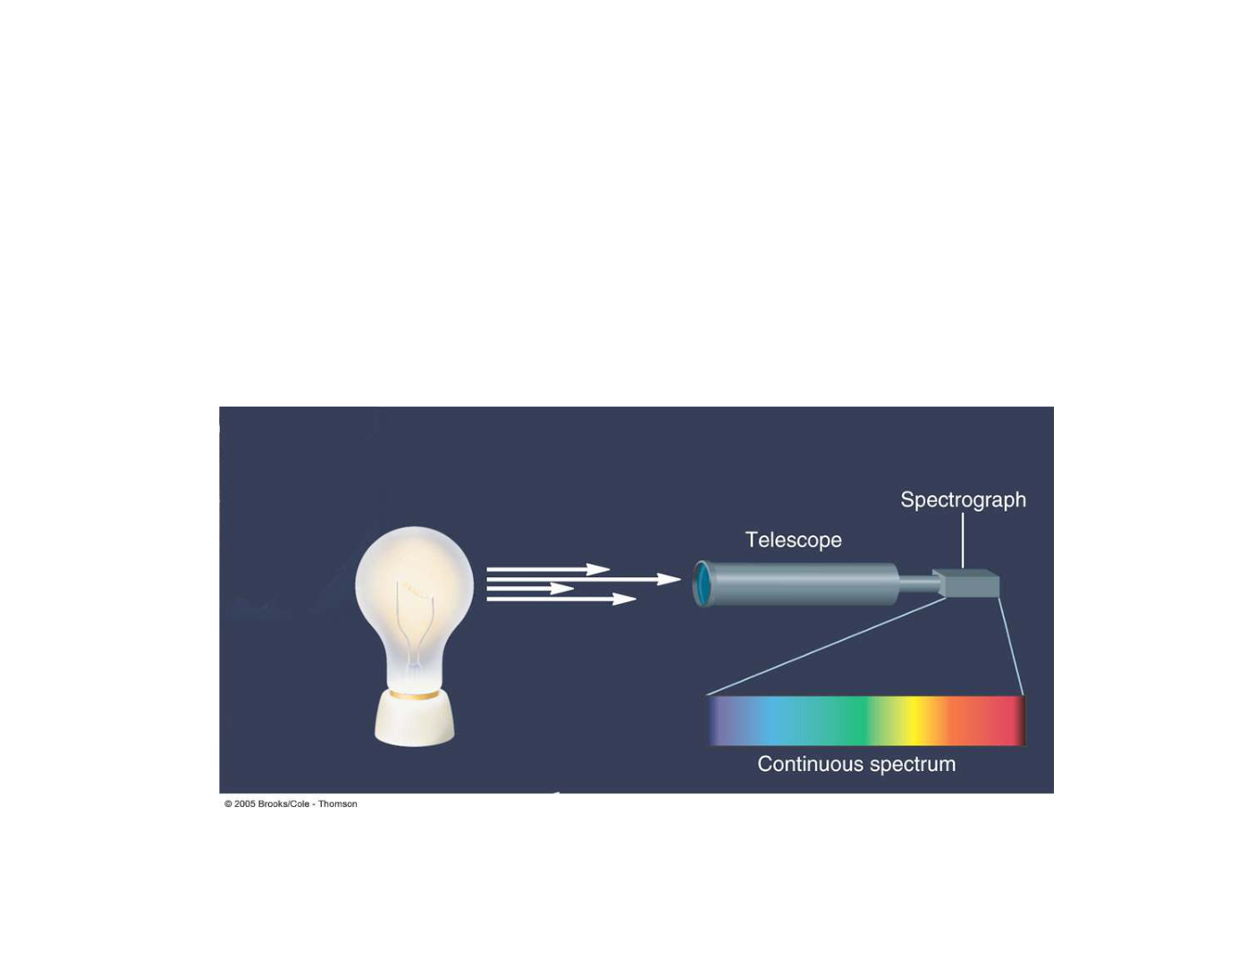
WVU DSPIRA
WEST VIRGINIA UNIVERSITY
Kirchoff’s Law #1
A hot, dense material will emit light at all
wavelengths to produce a
continuous
spectrum.
wvurail.org/dspira
51 of 54
Notes:
Source edition: assets/lessons/lectures/astronomy/light-and-telescopes.pdf, page 51. Original author and figure credits remain on the slide. Text is editable; illustrations retain their source artwork.

Slide 52
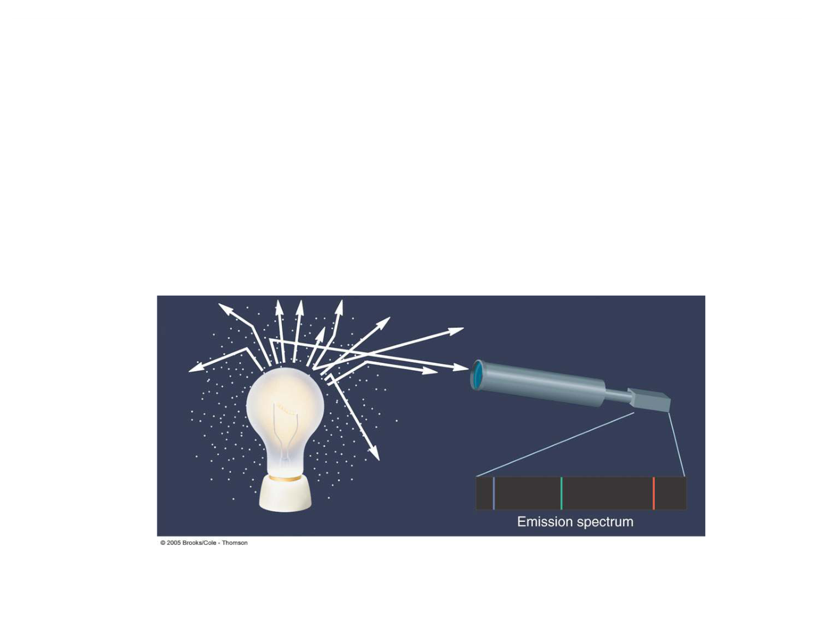
WVU DSPIRA
WEST VIRGINIA UNIVERSITY
Kirchoff’s Law #2
A hot, low-density gas will emit light at only at
specific wavelengths producing an
emission
spectrum.
wvurail.org/dspira
52 of 54
Notes:
Source edition: assets/lessons/lectures/astronomy/light-and-telescopes.pdf, page 52. Original author and figure credits remain on the slide. Text is editable; illustrations retain their source artwork.

Slide 53
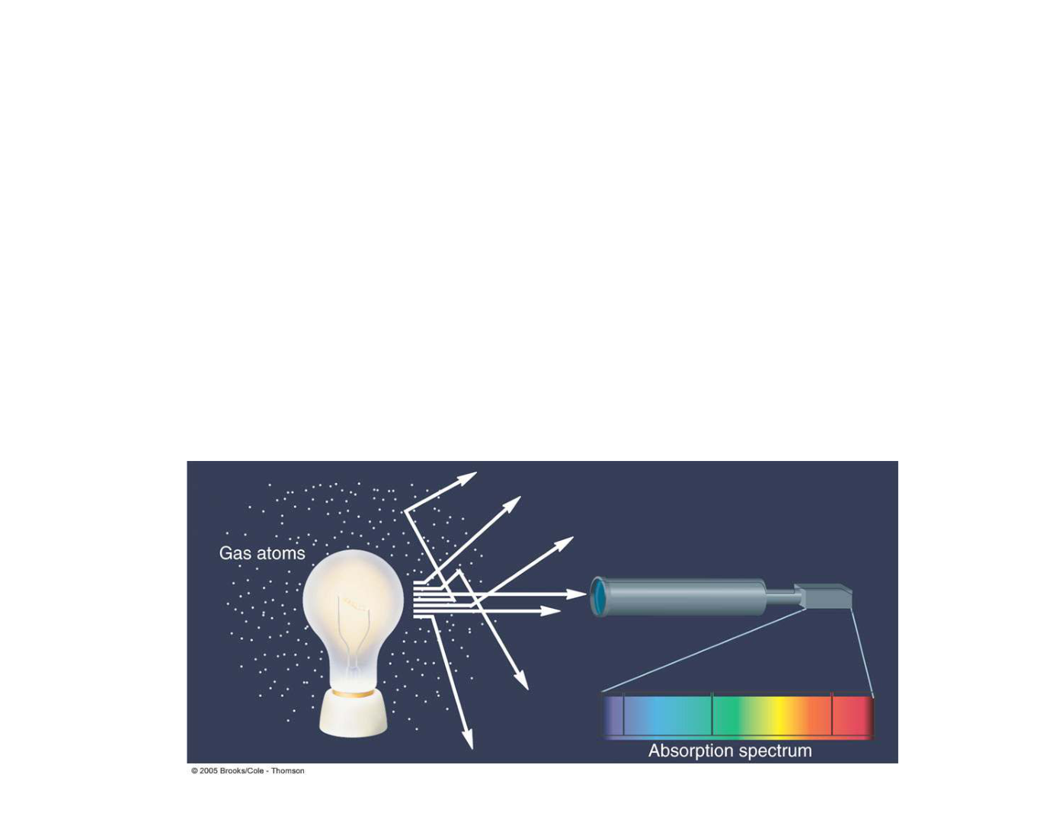
WVU DSPIRA
WEST VIRGINIA UNIVERSITY
Kirchoff’s Law #3
When light from a hot, dense object passes
through a cooler, low density gas, the result is an
absorption spectrum.
The absorption lines are at
the same location as the emission lines would be.
wvurail.org/dspira
53 of 54
Notes:
Source edition: assets/lessons/lectures/astronomy/light-and-telescopes.pdf, page 53. Original author and figure credits remain on the slide. Text is editable; illustrations retain their source artwork.

Slide 54
WVU DSPIRA
WEST VIRGINIA UNIVERSITY
Let’s look at some examples of
these laws in action.
wvurail.org/dspira
54 of 54
Notes:
Source edition: assets/lessons/lectures/astronomy/light-and-telescopes.pdf, page 54. Original author and figure credits remain on the slide. Text is editable; illustrations retain their source artwork.

