Slide 1
WVU DSPIRA
WEST VIRGINIA UNIVERSITY
Time, Planning Observations, and Coordinate Systems
wvurail.org/dspira
1 of 20

Slide 2
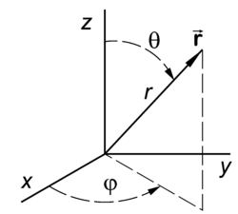
Spherical Coordinate Systems
WVU DSPIRA
WEST VIRGINIA UNIVERSITY
Astronomers use spherical coordinate systems, but many different versions.
wvurail.org/dspira
2 of 20

Slide 3
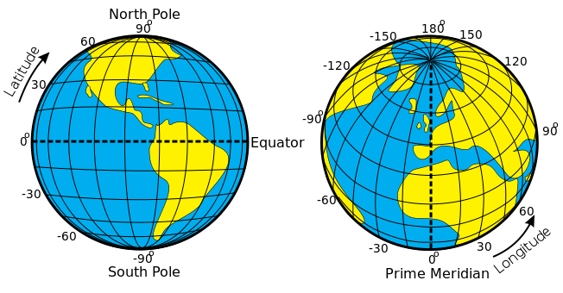
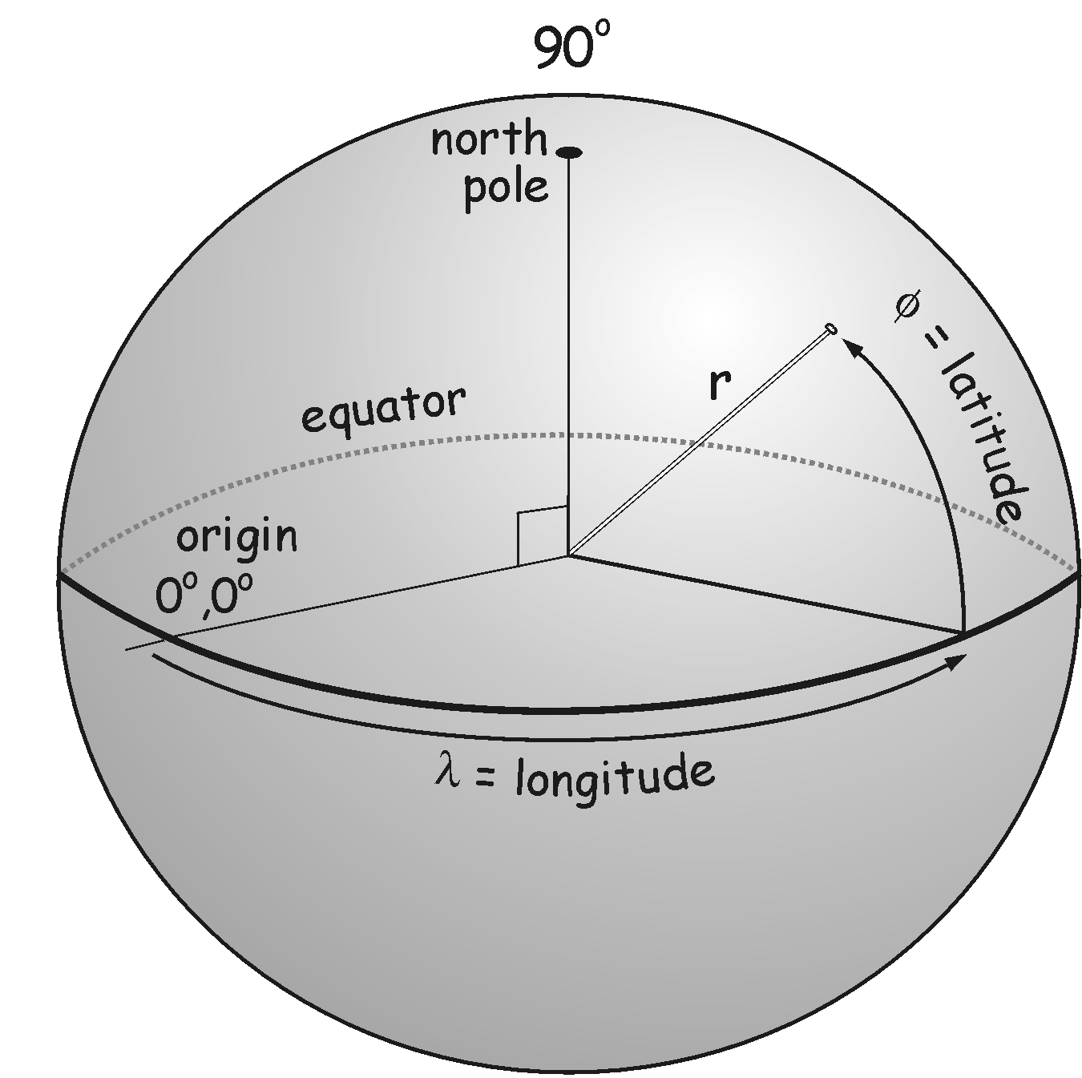
1. Longitude + Latitude on Earth
WVU DSPIRA
WEST VIRGINIA UNIVERSITY
For this system:
Longitude (longitude)
Latitude (latitude)
The Prime Meridian (0 longitude) (Grenwich, England) (increasing CCW from north pole)
The Equator (0 latitude)
Origin is the center of the Earth
Poles are north and south pole
wvurail.org/dspira
3 of 20

Slide 4
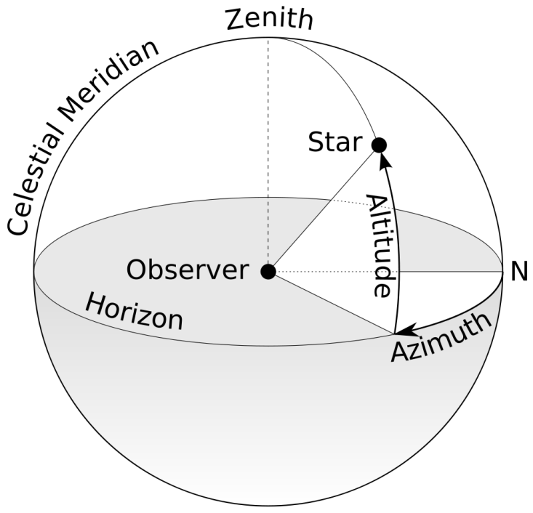
2. Horizontal or Alt/Az or El/Az
WVU DSPIRA
WEST VIRGINIA UNIVERSITY
For this system:
Azimuth (A) (longitude)
Altitude (a) (latitude)
North (0 longitude) (increasing CW from zenith)
The horizon (0 latitude)
Origin is the observer
Poles are zenith and nadir
Zenith distance is 90 - altitude
wvurail.org/dspira
4 of 20

Slide 5
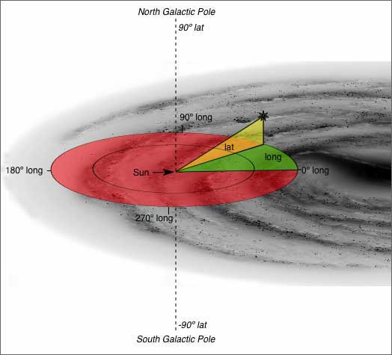
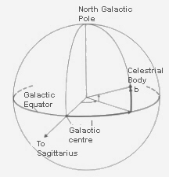
3. Galactic
WVU DSPIRA
WEST VIRGINIA UNIVERSITY
For this system:
Galactic longitude (l) (longitude) (increases CW from north Galactic pole)
Galatic latitude (b) (latitude)
The Galactic center (0 longitude)
The Galactic plane (0 latitude)
Center of the Sun
Poles are north and south Galactic poles
wvurail.org/dspira
5 of 20

Slide 6
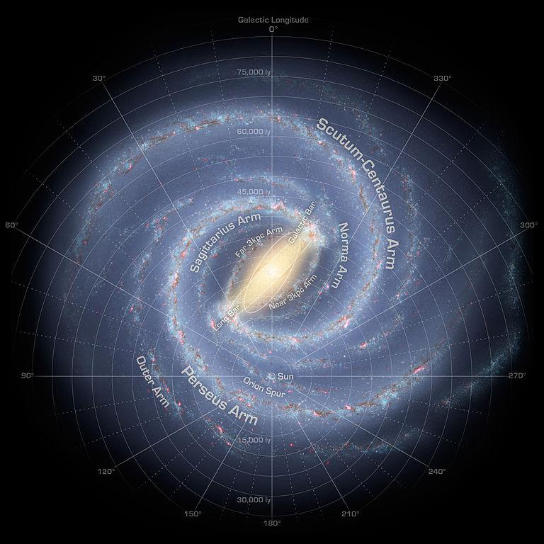
WVU DSPIRA
WEST VIRGINIA UNIVERSITY
wvurail.org/dspira
6 of 20

Slide 7
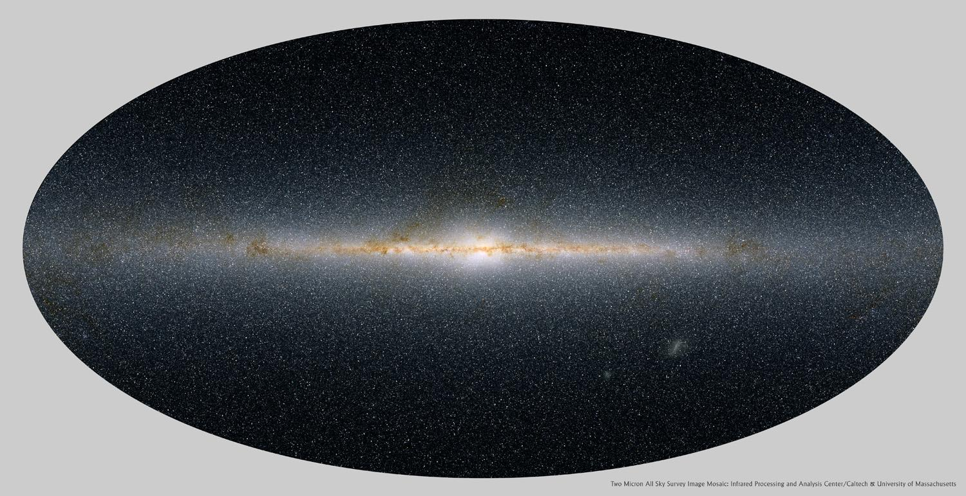
WVU DSPIRA
WEST VIRGINIA UNIVERSITY
wvurail.org/dspira
7 of 20

Slide 8
4. Ecliptic
WVU DSPIRA
WEST VIRGINIA UNIVERSITY
I’ve never seen it used – maybe for Solar astronomy?
wvurail.org/dspira
Supplemental

Slide 9
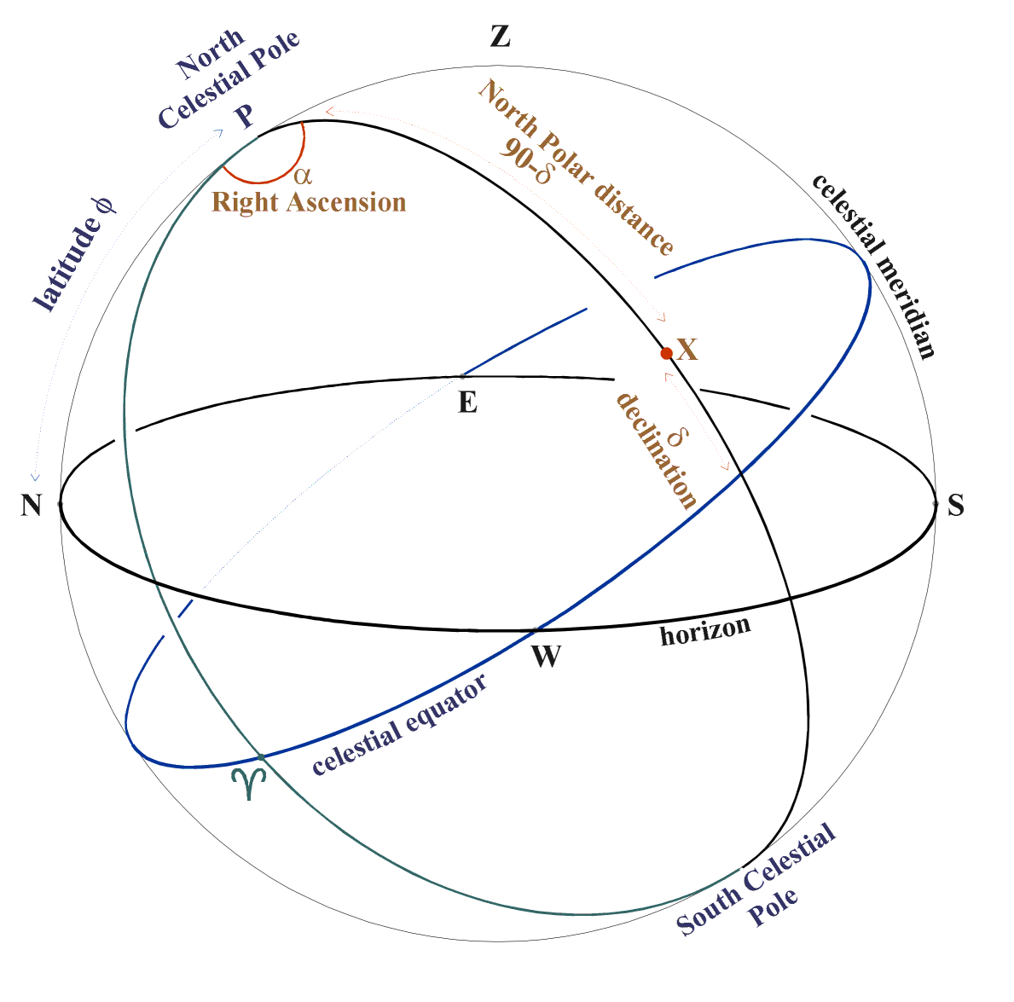
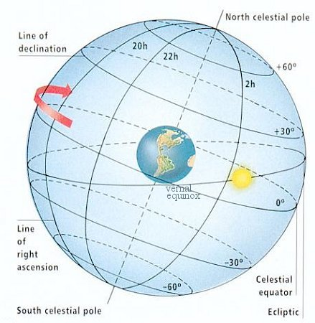
4. Equatorial
WVU DSPIRA
WEST VIRGINIA UNIVERSITY
For this system:
Right Ascention (longitude) (RA, α) (increases CCW from NCP)
Declination (latitude) (Dec., δ)
The Vernal Equinox (ϒ) defines the “prime meridian” (0 longitude)
The Celestial Equator (0 latitude)
Center of the Earth OR Center of the Sun
Poles are north (+90 deg. Dec.) and south (-90 deg. Dec.) celestial poles (NCP, SCP)
wvurail.org/dspira
8 of 20

Slide 10
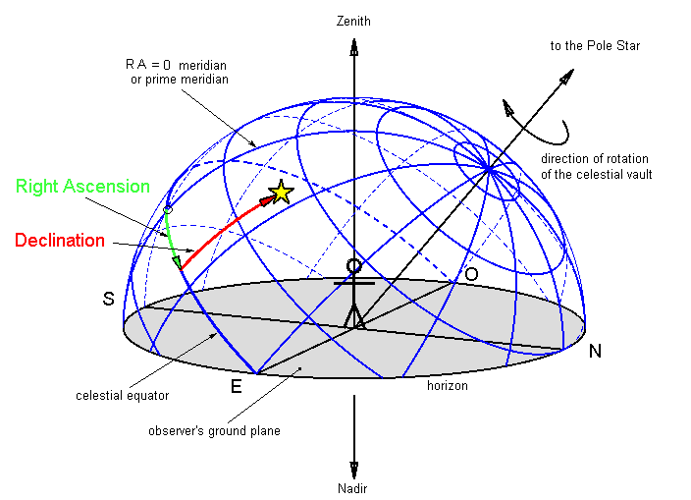
Declination
WVU DSPIRA
WEST VIRGINIA UNIVERSITY
The declination measures angular distance from the NCP or SCP
For northern hemisphere:
Sources with dec > 90 – lat are always visible (circumpolar – never visible in south for same lat)
Sources with dec < lat – 90 are never visible (circumpolar in south for same lat)
For southern hemisphere (lat is absolute value here):
Sources with dec < lat – 90 are always visible (circumpolar)
Sources with dec > 90 – lat are never visible
wvurail.org/dspira
9 of 20

Slide 11
Right Ascension and Hour Angle
WVU DSPIRA
WEST VIRGINIA UNIVERSITY
Hour Angle (HA) is the angle between the celestial meridian (from horizontal system) to the object’s RA
If an object is transiting, the HA is zero
Objects before transit have negative HA
Objects after transit have positive HA
As time passes, the HA increases
When will on object with HA = -2h transit?
wvurail.org/dspira
10 of 20

Slide 12
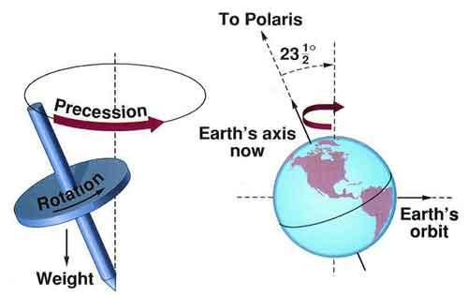
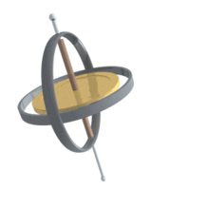
Right Ascension and Precession
WVU DSPIRA
WEST VIRGINIA UNIVERSITY
The Equitorial system needs an “Equinox,” which specifies the location of the pole (and vernal equinox) for a given year.
We are currently using “J2000,” but “B1950” is still common, and “J2050” will become popular around 2025 I guess.
The reason why we need this complication will not be completely clear until we talk about time
wvurail.org/dspira
11 of 20

Slide 13
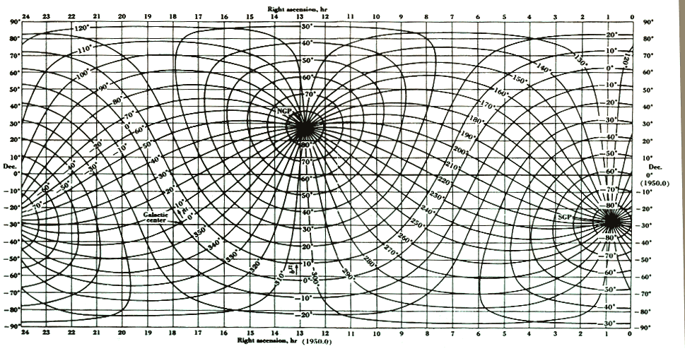
Converting Between Coordinate Systems
WVU DSPIRA
WEST VIRGINIA UNIVERSITY
Equatorial and Galactic
Use coordinate converters for accuracy of course
wvurail.org/dspira
12 of 20

Slide 14

Converting Between Coordinate Systems
WVU DSPIRA
WEST VIRGINIA UNIVERSITY
wvurail.org/dspira
13 of 20

Slide 15
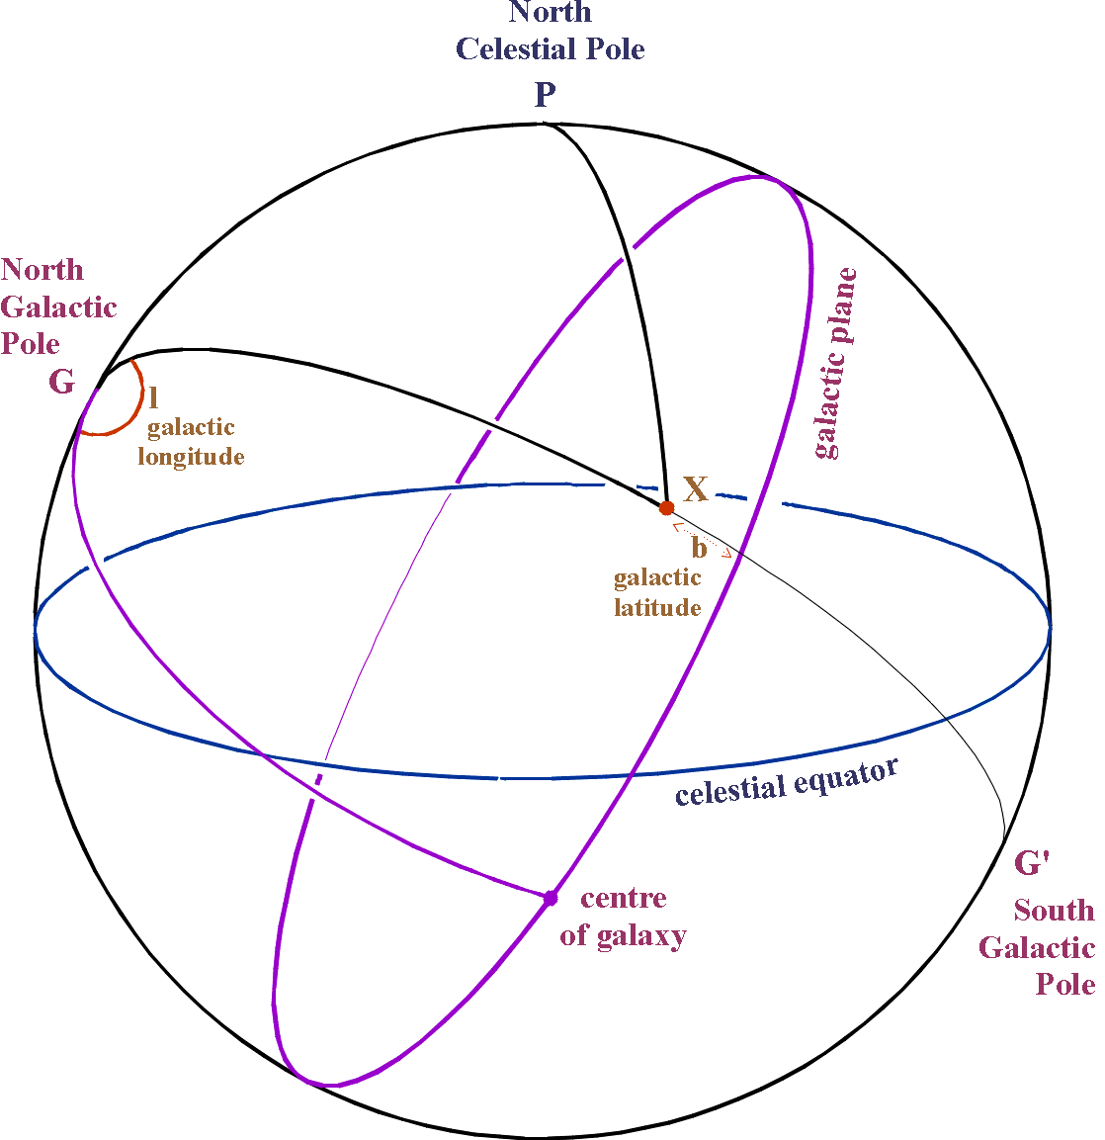
WVU DSPIRA
WEST VIRGINIA UNIVERSITY
wvurail.org/dspira
Supplemental

Slide 16
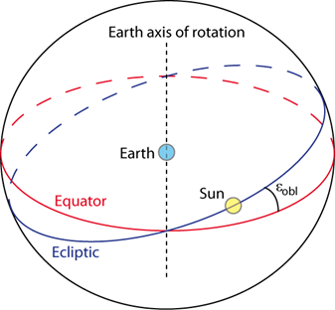
WVU DSPIRA
WEST VIRGINIA UNIVERSITY
wvurail.org/dspira
14 of 20

Slide 17
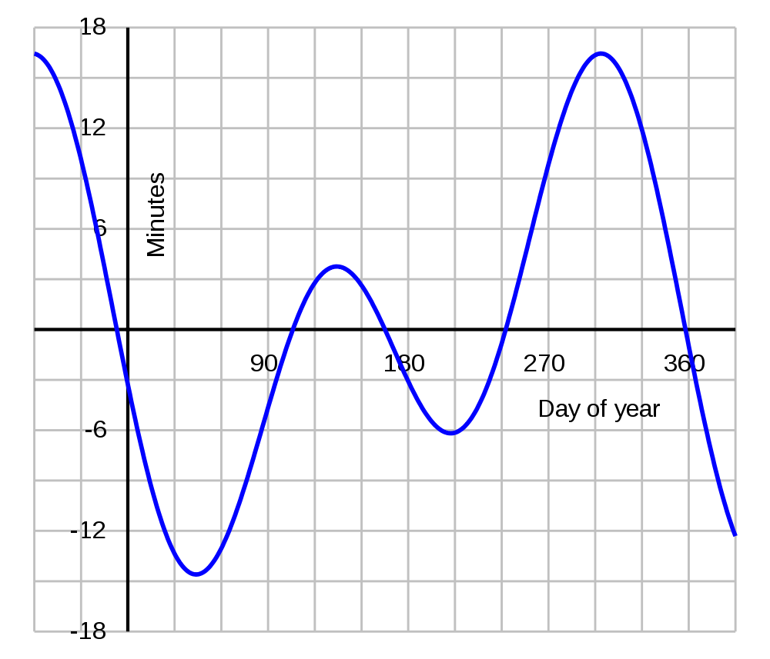
WVU DSPIRA
WEST VIRGINIA UNIVERSITY
Equation of Time
Tells you the amount of time the Sun is running fast or slow (the annalema) throughout the year.
wvurail.org/dspira
15 of 20

Slide 18
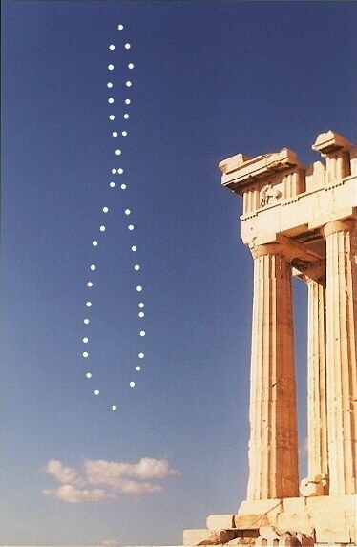
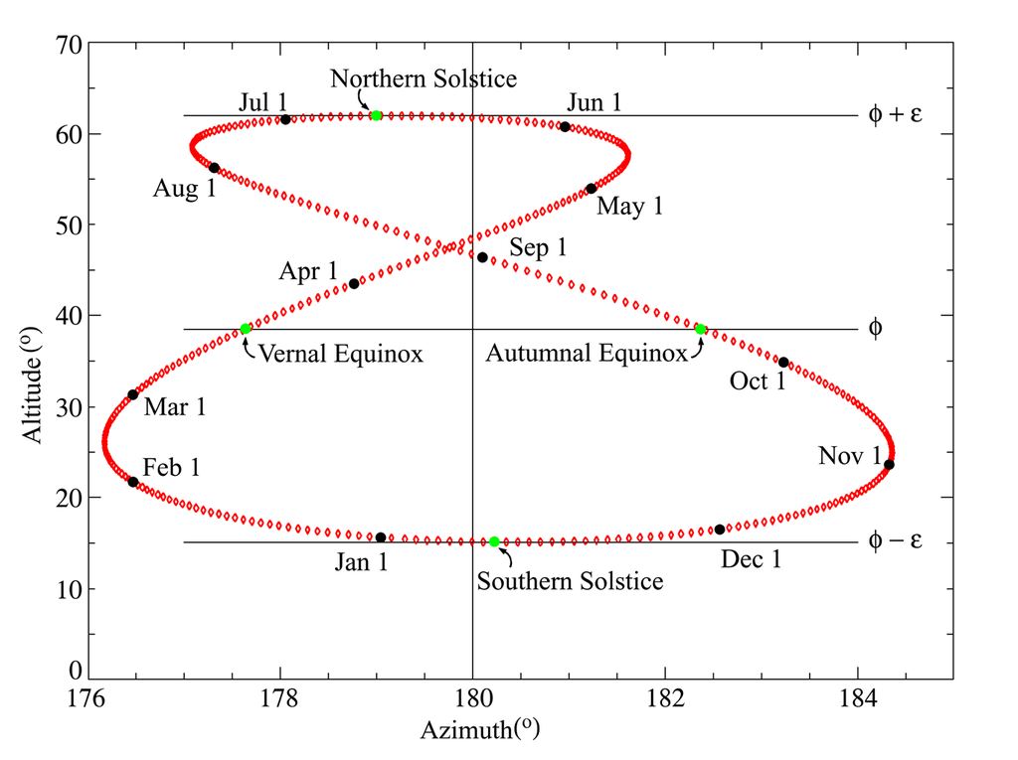
WVU DSPIRA
WEST VIRGINIA UNIVERSITY
Annalemma
The figure you get when you take a picture every day at the same time throughout the year.
Sometimes the Sun runs “fast,” sometimes “slow”
wvurail.org/dspira
16 of 20

Slide 19
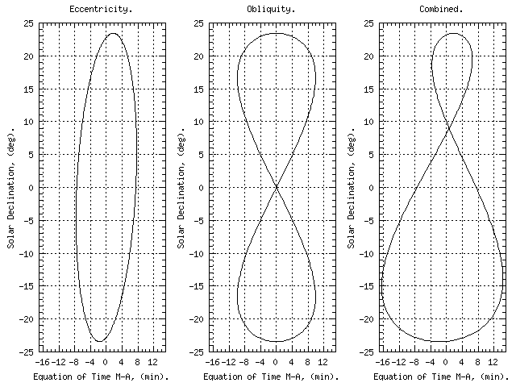
WVU DSPIRA
WEST VIRGINIA UNIVERSITY
Annalema
Shape caused by:
Eccentricity of Earth’s orbit
Tilt of Earth’s axis (“obliquity”)
Tilt of annalema due to fact that Earth’s closest, furthest distance from Sun not exactly at the equinoxes.
wvurail.org/dspira
17 of 20

Slide 20
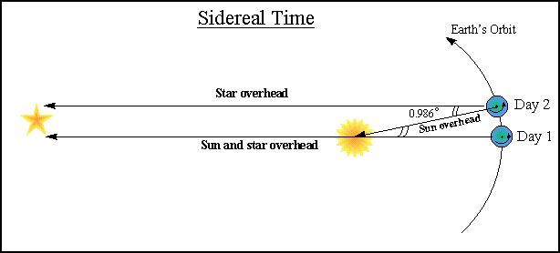
WVU DSPIRA
WEST VIRGINIA UNIVERSITY
Sidereal Time
A sidereal day is about 23h 56m long.
Every sidereal day the Sun is at the same place in the sky.
The Sun is found 4 minutes of RA different each day. 2h per month = 4m per day.
wvurail.org/dspira
18 of 20

Slide 21
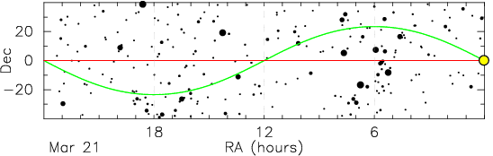
WVU DSPIRA
WEST VIRGINIA UNIVERSITY
Local Sidereal Time (LST)
The RA of an object on your meridian is by definition the LST!!
HA = LST - RA
LST is the hour angle of the vernal equinox at your location
The Sun is found 2 hours advanced in RA each month, SO THIS IS THE DIFFERENCE BETWEEN LST and “normal” time!
wvurail.org/dspira
19 of 20

Slide 22
WVU DSPIRA
WEST VIRGINIA UNIVERSITY
LST Calculators
https://aa.usno.navy.mil/data/siderealtime
Enter the date, UT1 time, and longitude.
Easiest to remove the longitude complication, for comprehension.
On the Vernal Equinox, at Grenwich England, the Sun is at 0h RA. The RA of an object on your meridian is the LST, so when the Sun is on your meridian (noon), the LST is 0h.
LST must catch up 24 hours a year, so 6 months later on the fall equinox the LST and Solar time must be identical.
Adding longitude complicates things further!
wvurail.org/dspira
20 of 20

Slide 23
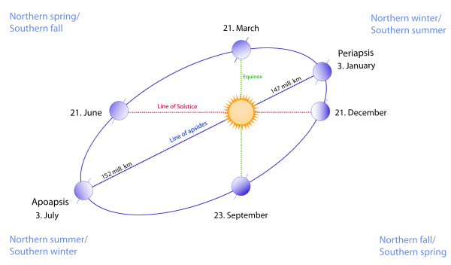
WVU DSPIRA
WEST VIRGINIA UNIVERSITY
wvurail.org/dspira
Supplemental

