Slide 1

WVU DSPIRA
WEST VIRGINIA UNIVERSITY
Galactic Rotation
wvurail.org/dspira
1 of 12
Notes:
Source edition: assets/lessons/lectures/astronomy/rotation-curves.pdf, page 1. Original author and figure credits remain on the slide. Text is editable; illustrations retain their source artwork.

Slide 2
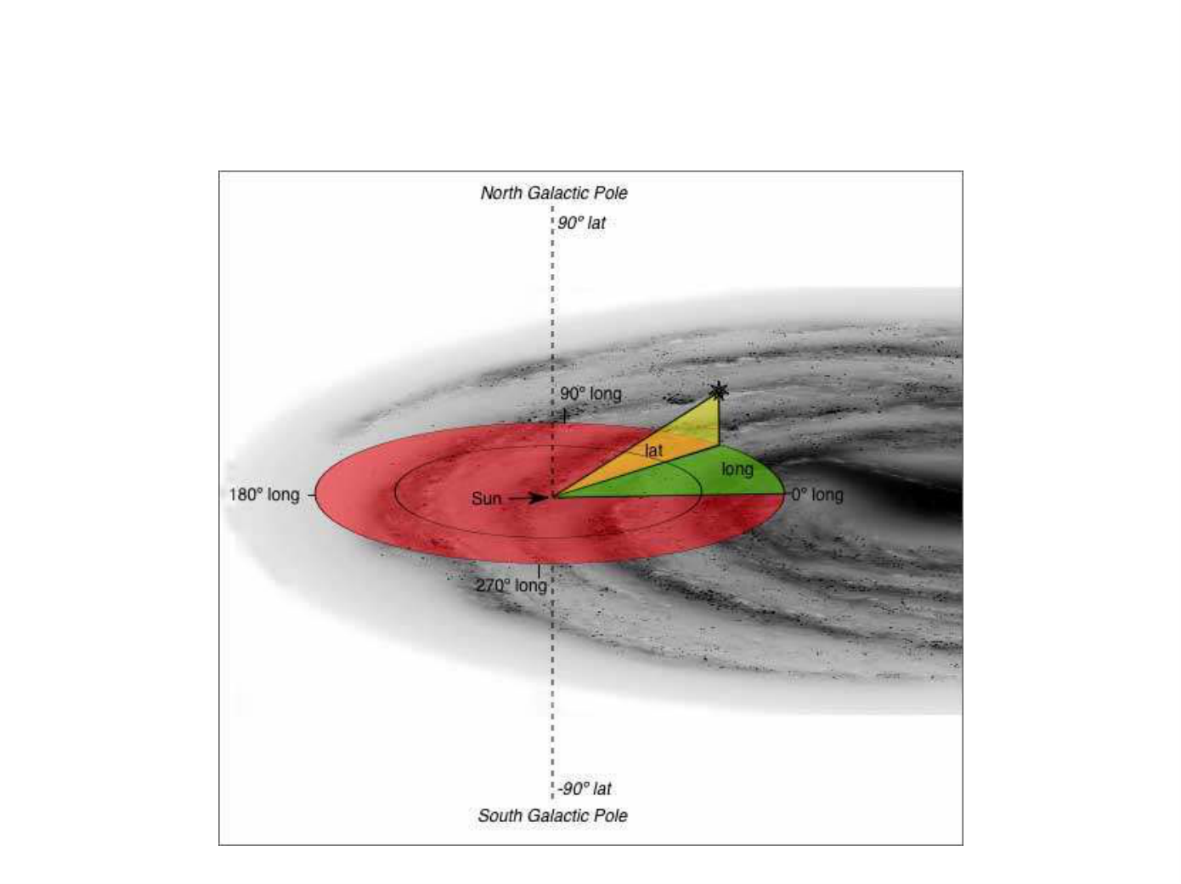
WVU DSPIRA
WEST VIRGINIA UNIVERSITY
Galactic Coordinates
wvurail.org/dspira
2 of 12
Notes:
Source edition: assets/lessons/lectures/astronomy/rotation-curves.pdf, page 2. Original author and figure credits remain on the slide. Text is editable; illustrations retain their source artwork.

Slide 3
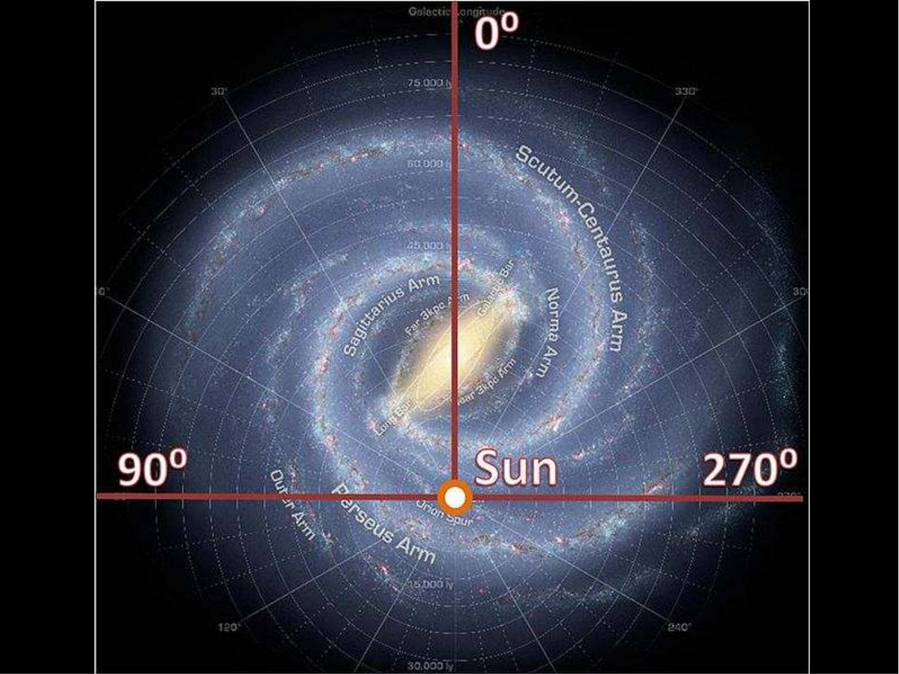
WVU DSPIRA
WEST VIRGINIA UNIVERSITY
wvurail.org/dspira
3 of 12
Notes:
Source edition: assets/lessons/lectures/astronomy/rotation-curves.pdf, page 3. Original author and figure credits remain on the slide. Text is editable; illustrations retain their source artwork.

Slide 4
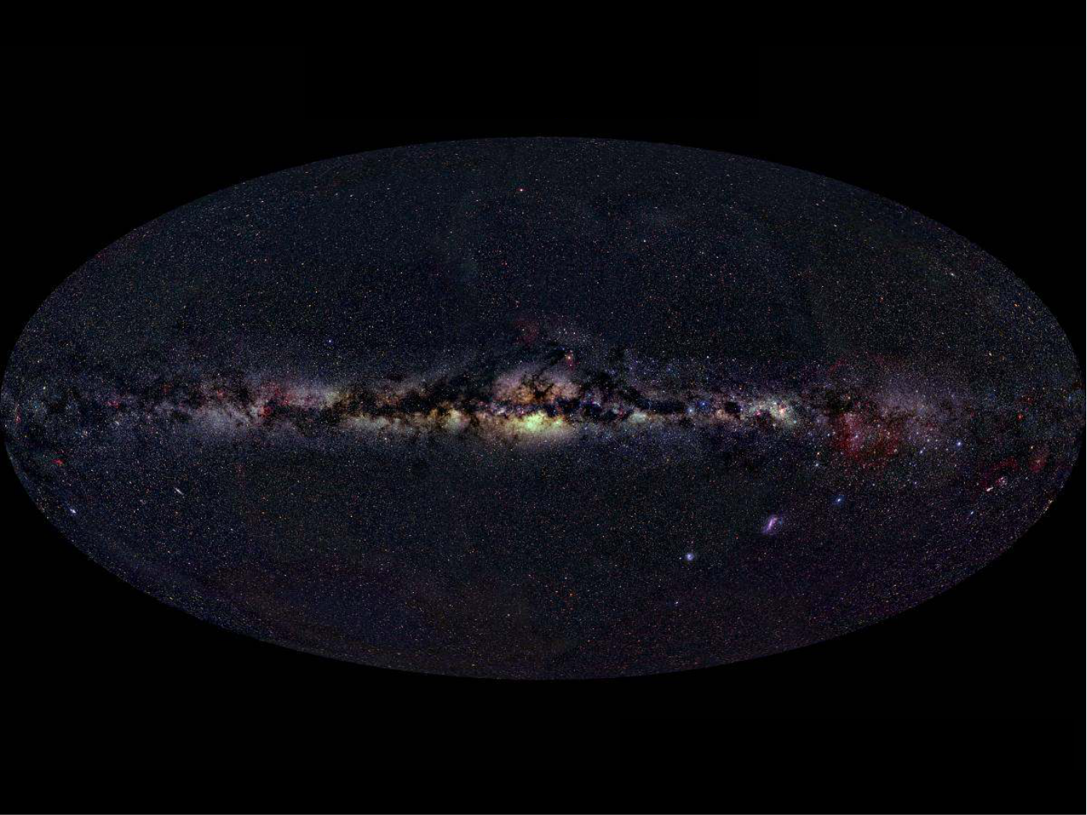
WVU DSPIRA
WEST VIRGINIA UNIVERSITY
wvurail.org/dspira
4 of 12
Notes:
Source edition: assets/lessons/lectures/astronomy/rotation-curves.pdf, page 4. Original author and figure credits remain on the slide. Text is editable; illustrations retain their source artwork.

Slide 5
WVU DSPIRA
WEST VIRGINIA UNIVERSITY
Positive Latitudes
180 deg.
180 deg.
Longitude
0 deg. Longitude
Longitude
Negative Latitudes
wvurail.org/dspira
5 of 12
Notes:
Source edition: assets/lessons/lectures/astronomy/rotation-curves.pdf, page 5. Original author and figure credits remain on the slide. Text is editable; illustrations retain their source artwork.

Slide 6
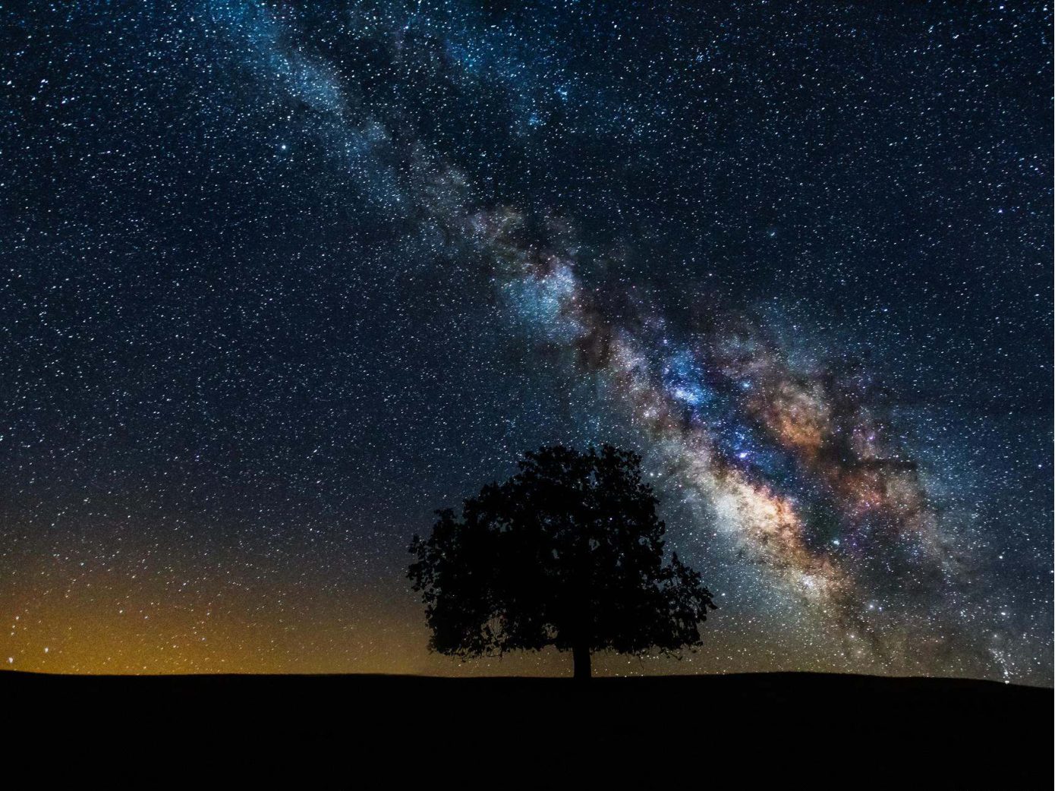
WVU DSPIRA
WEST VIRGINIA UNIVERSITY
Positive Latitudes
0 deg. Longitude
Negative Latitudes
wvurail.org/dspira
6 of 12
Notes:
Source edition: assets/lessons/lectures/astronomy/rotation-curves.pdf, page 6. Original author and figure credits remain on the slide. Text is editable; illustrations retain their source artwork.

Slide 7
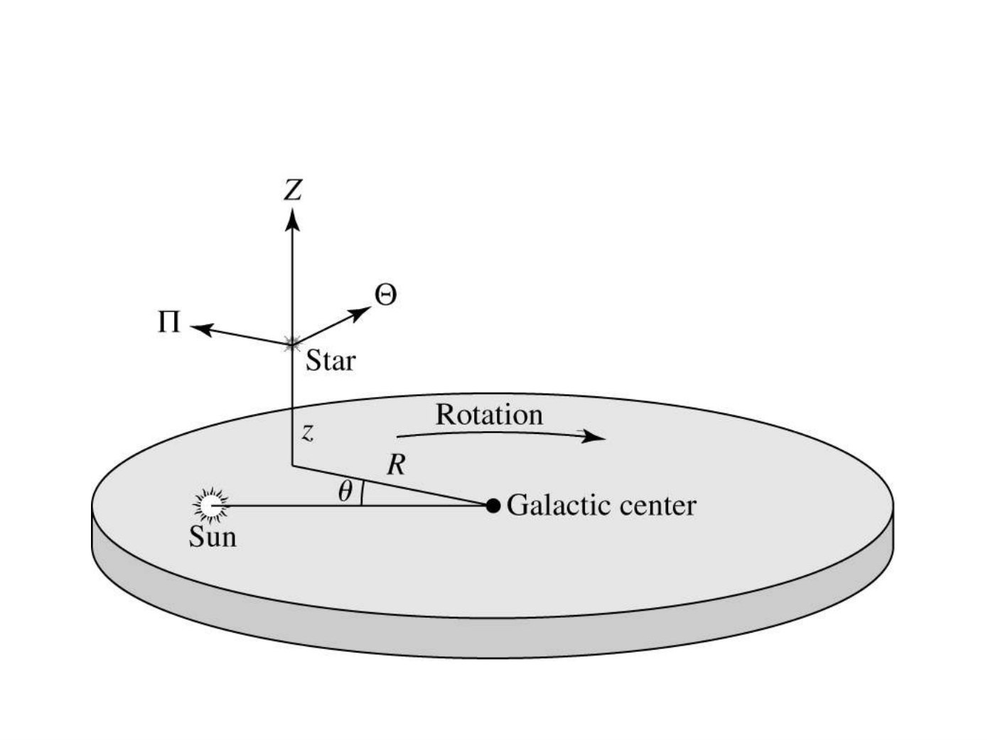
WVU DSPIRA
WEST VIRGINIA UNIVERSITY
Galactic Center Cylindrical
Coordinates
wvurail.org/dspira
7 of 12
Notes:
Source edition: assets/lessons/lectures/astronomy/rotation-curves.pdf, page 7. Original author and figure credits remain on the slide. Text is editable; illustrations retain their source artwork.

Slide 8
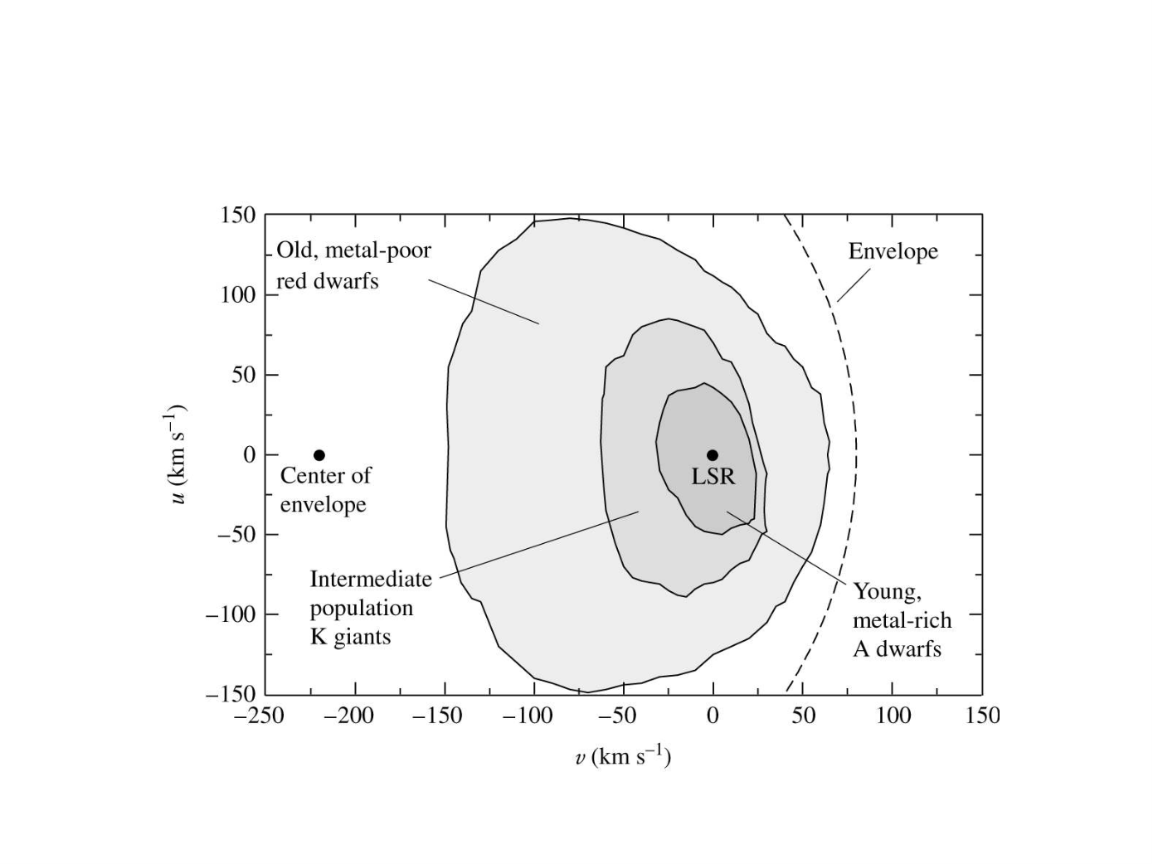
WVU DSPIRA
WEST VIRGINIA UNIVERSITY
Observations of Stars Show
wvurail.org/dspira
8 of 12
Notes:
Source edition: assets/lessons/lectures/astronomy/rotation-curves.pdf, page 8. Original author and figure credits remain on the slide. Text is editable; illustrations retain their source artwork.

Slide 9
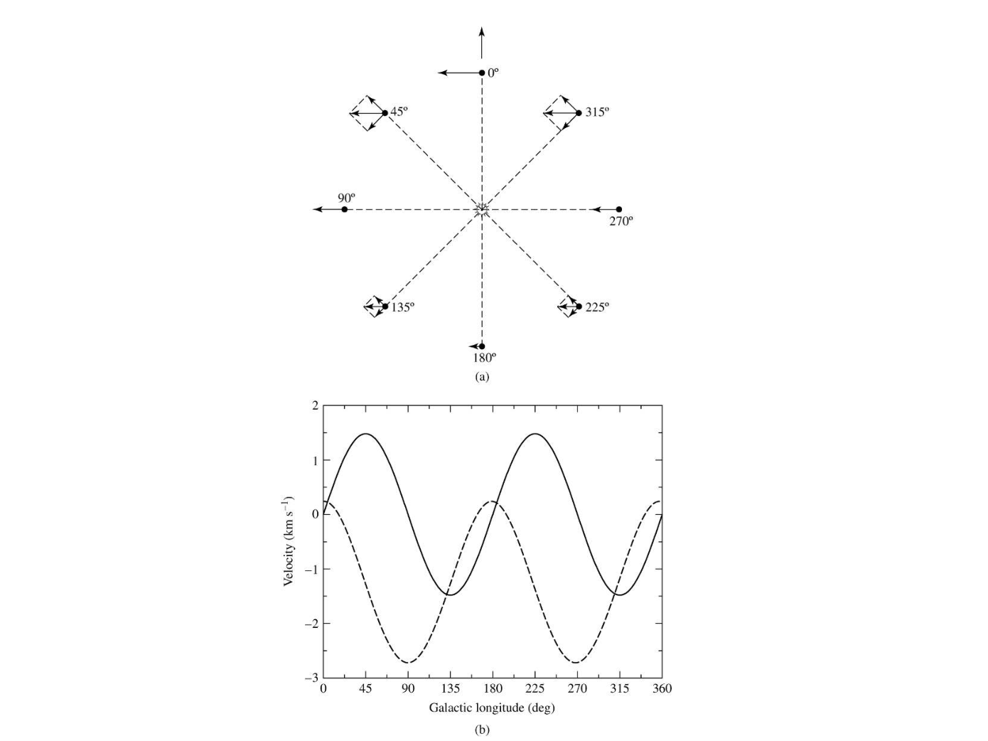
WVU DSPIRA
WEST VIRGINIA UNIVERSITY
Radial (solid) and
transverse (dashed)
velocities as a
function of
l.
Dependence is sin (2
l
)
wvurail.org/dspira
9 of 12
Notes:
Source edition: assets/lessons/lectures/astronomy/rotation-curves.pdf, page 9. Original author and figure credits remain on the slide. Text is editable; illustrations retain their source artwork.

Slide 10
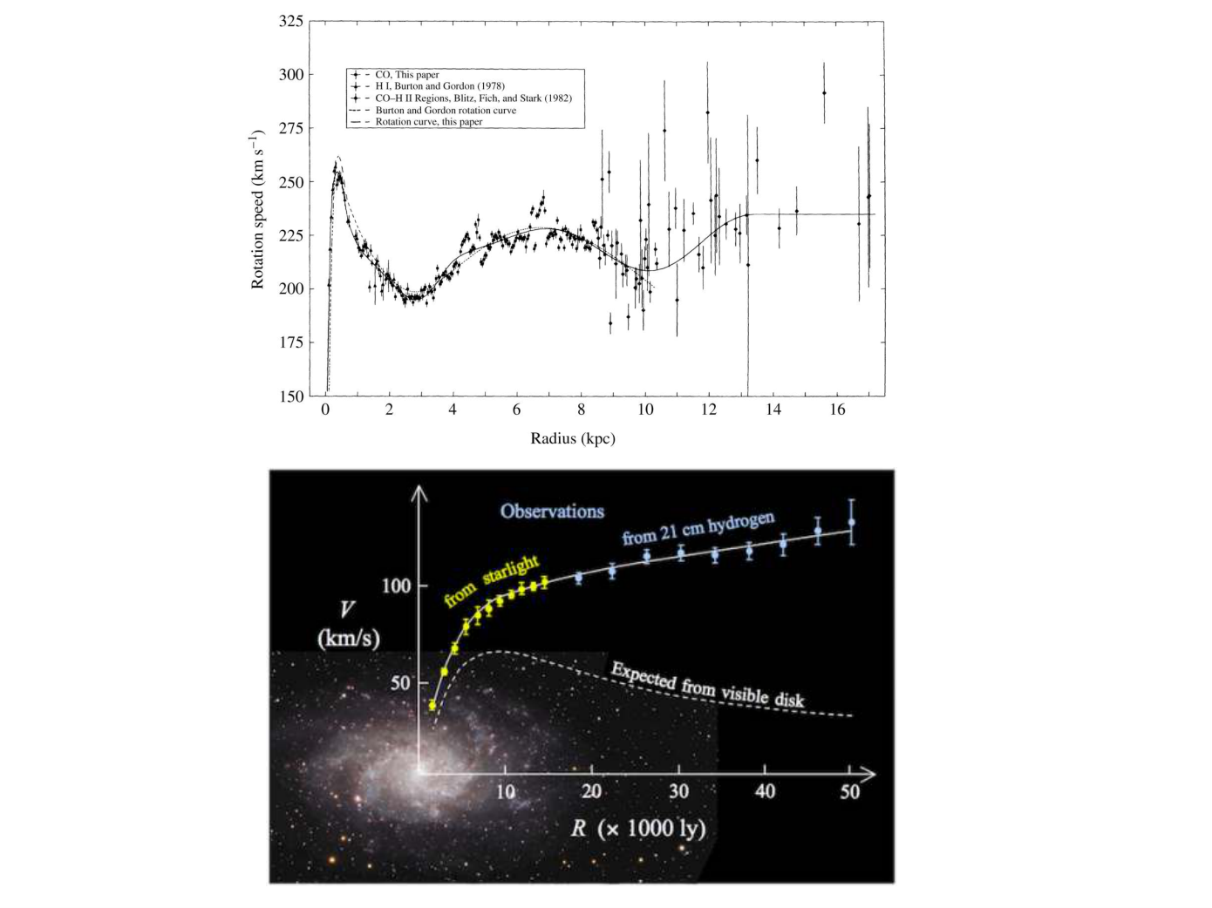
WVU DSPIRA
WEST VIRGINIA UNIVERSITY
Milky Way
Other galaxy
wvurail.org/dspira
10 of 12
Notes:
Source edition: assets/lessons/lectures/astronomy/rotation-curves.pdf, page 10. Original author and figure credits remain on the slide. Text is editable; illustrations retain their source artwork.

Slide 11
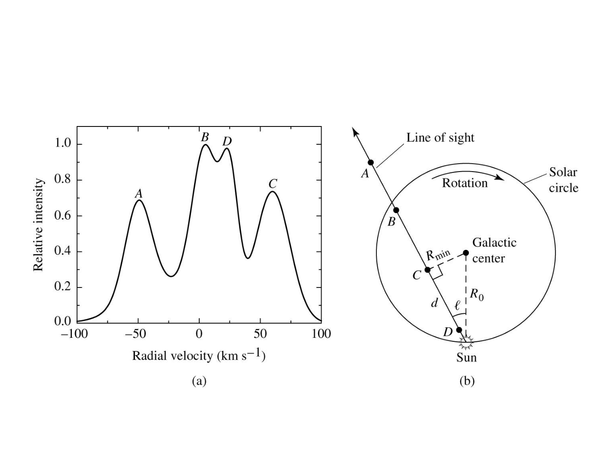
WVU DSPIRA
WEST VIRGINIA UNIVERSITY
wvurail.org/dspira
11 of 12
Notes:
Source edition: assets/lessons/lectures/astronomy/rotation-curves.pdf, page 11. Original author and figure credits remain on the slide. Text is editable; illustrations retain their source artwork.

Slide 12
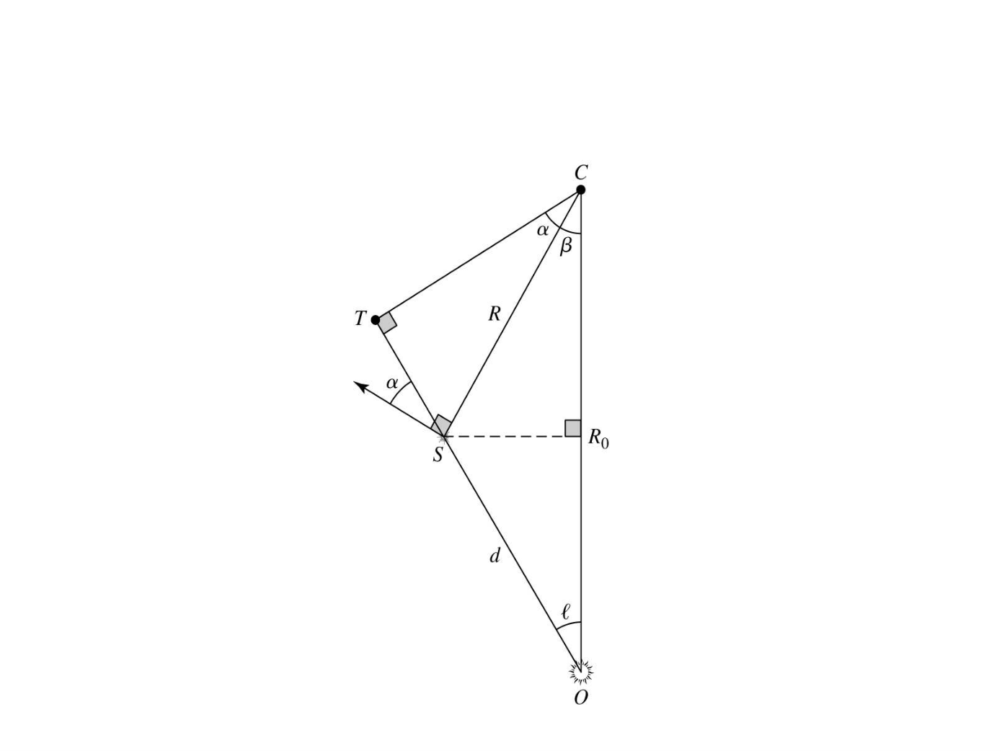
WVU DSPIRA
WEST VIRGINIA UNIVERSITY
wvurail.org/dspira
12 of 12
Notes:
Source edition: assets/lessons/lectures/astronomy/rotation-curves.pdf, page 12. Original author and figure credits remain on the slide. Text is editable; illustrations retain their source artwork.

