Slide 1

WVU DSPIRA
WEST VIRGINIA UNIVERSITY
Time and Planning
Observations
wvurail.org/dspira
1 of 8
Notes:
Source edition: assets/lessons/lectures/astronomy/time-and-planning-observations.pdf, page 1. Original author and figure credits remain on the slide. Text is editable; illustrations retain their source artwork.

Slide 2
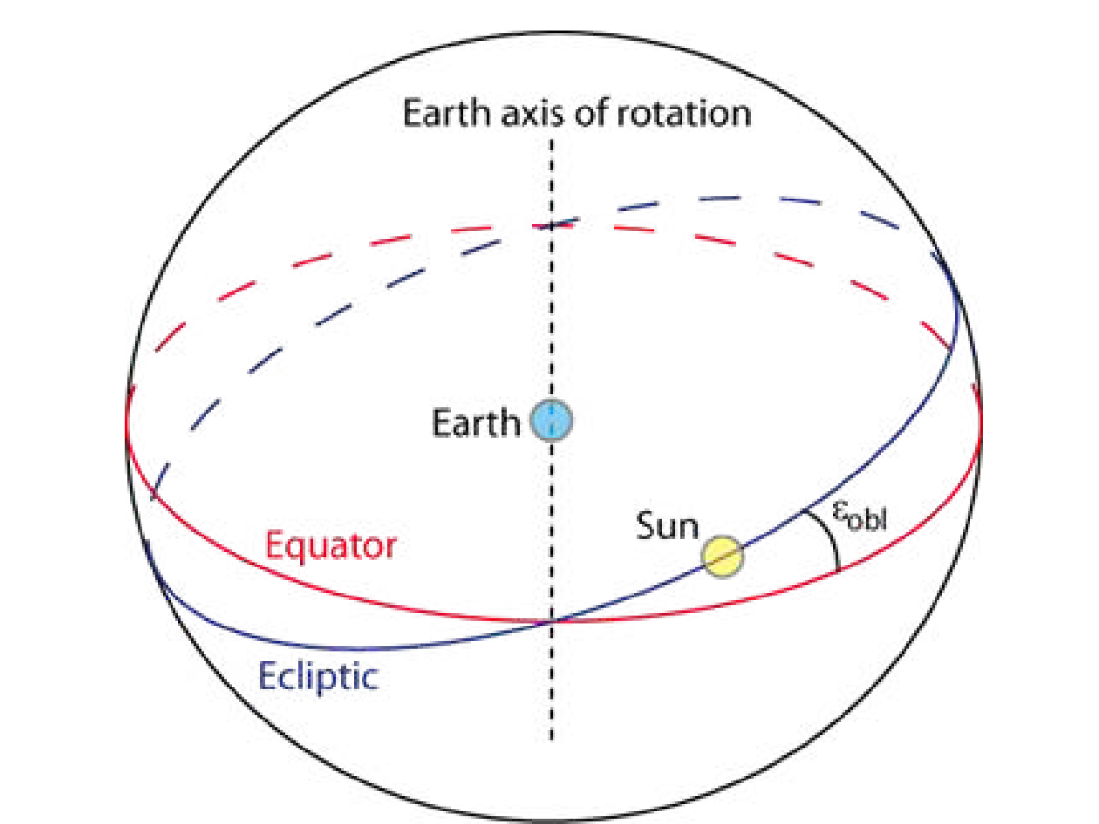
WVU DSPIRA
WEST VIRGINIA UNIVERSITY
wvurail.org/dspira
2 of 8
Notes:
Source edition: assets/lessons/lectures/astronomy/time-and-planning-observations.pdf, page 2. Original author and figure credits remain on the slide. Text is editable; illustrations retain their source artwork.

Slide 3
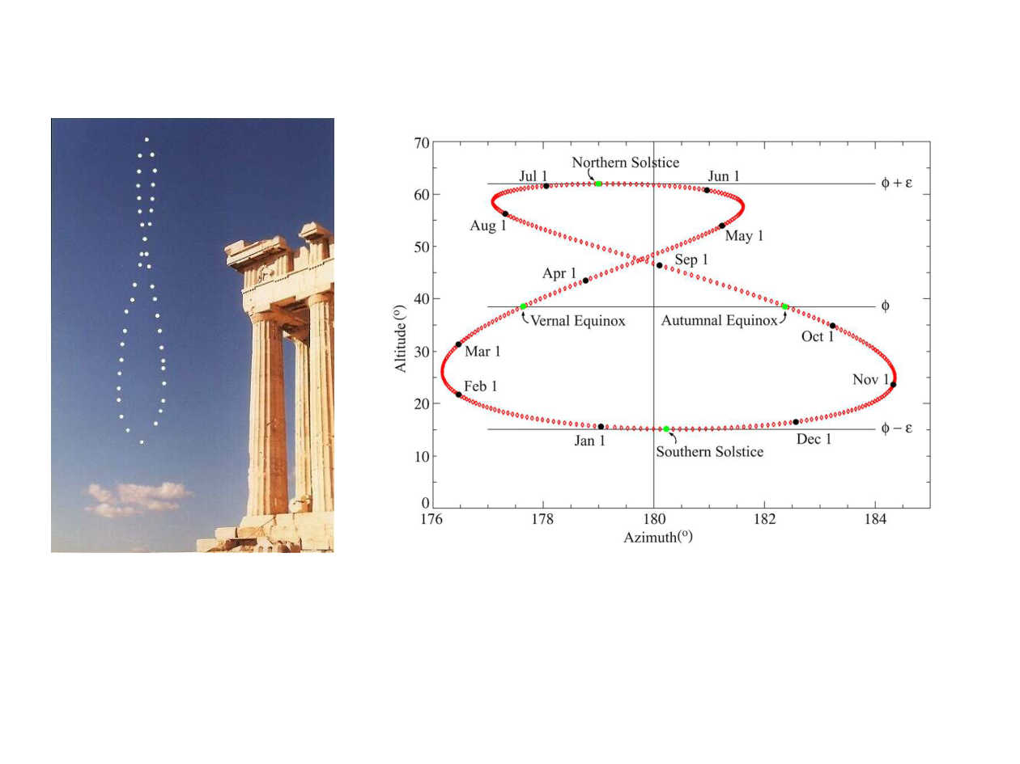
WVU DSPIRA
WEST VIRGINIA UNIVERSITY
Annalemma
The figure you get when you take a picture every
day at the same time throughout the year.
Sometimes the Sun runs “fast,” sometimes “slow”
wvurail.org/dspira
3 of 8
Notes:
Source edition: assets/lessons/lectures/astronomy/time-and-planning-observations.pdf, page 3. Original author and figure credits remain on the slide. Text is editable; illustrations retain their source artwork.

Slide 4
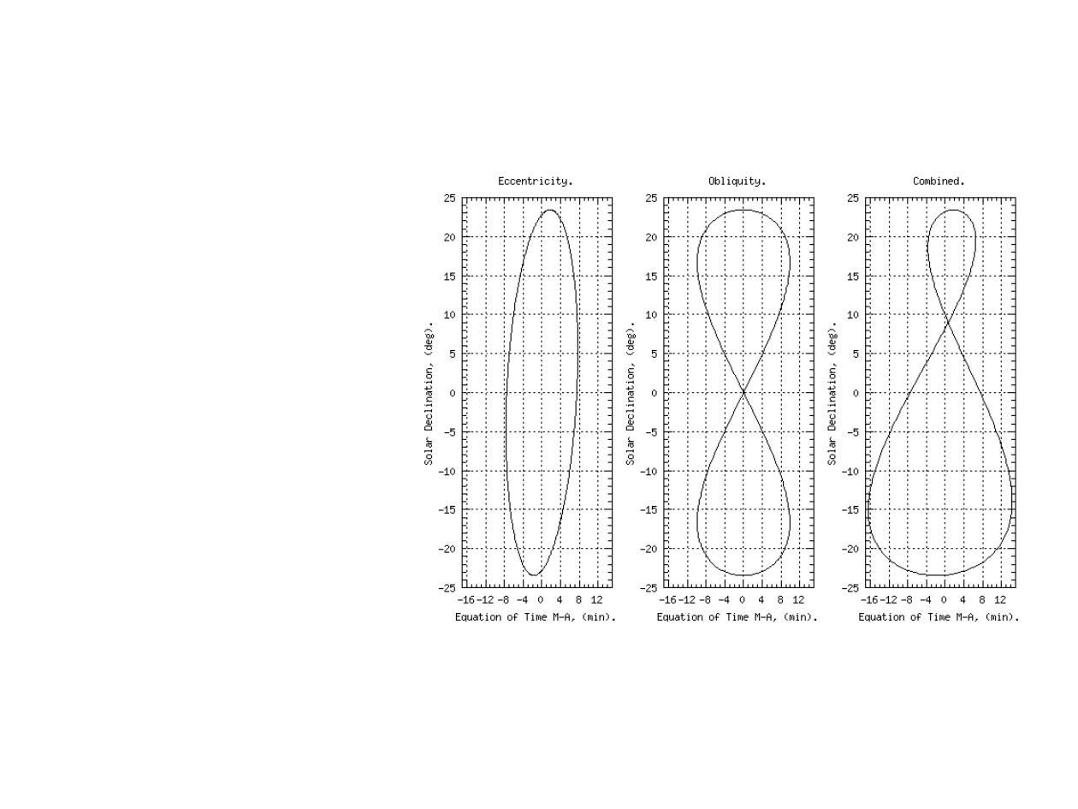
WVU DSPIRA
WEST VIRGINIA UNIVERSITY
Annalema
Shape caused by:
1)
Eccentricity of
Earth’s orbit
2)
Tilt of Earth’s
axis (“obliquity”)
3)
Tilt of annalema
due to fact that
Earth’s closest,
furthest distance
from Sun not
exactly at the
equinoxes.
wvurail.org/dspira
4 of 8
Notes:
Source edition: assets/lessons/lectures/astronomy/time-and-planning-observations.pdf, page 4. Original author and figure credits remain on the slide. Text is editable; illustrations retain their source artwork.

Slide 5
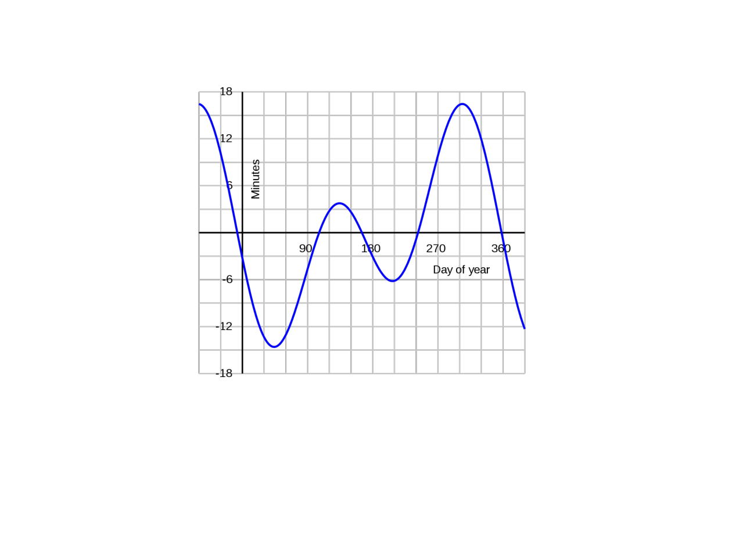
WVU DSPIRA
WEST VIRGINIA UNIVERSITY
Equation of Time
Tells you the amount of time the Sun is
running fast or slow (the annalema)
throughout the year.
wvurail.org/dspira
5 of 8
Notes:
Source edition: assets/lessons/lectures/astronomy/time-and-planning-observations.pdf, page 5. Original author and figure credits remain on the slide. Text is editable; illustrations retain their source artwork.

Slide 6
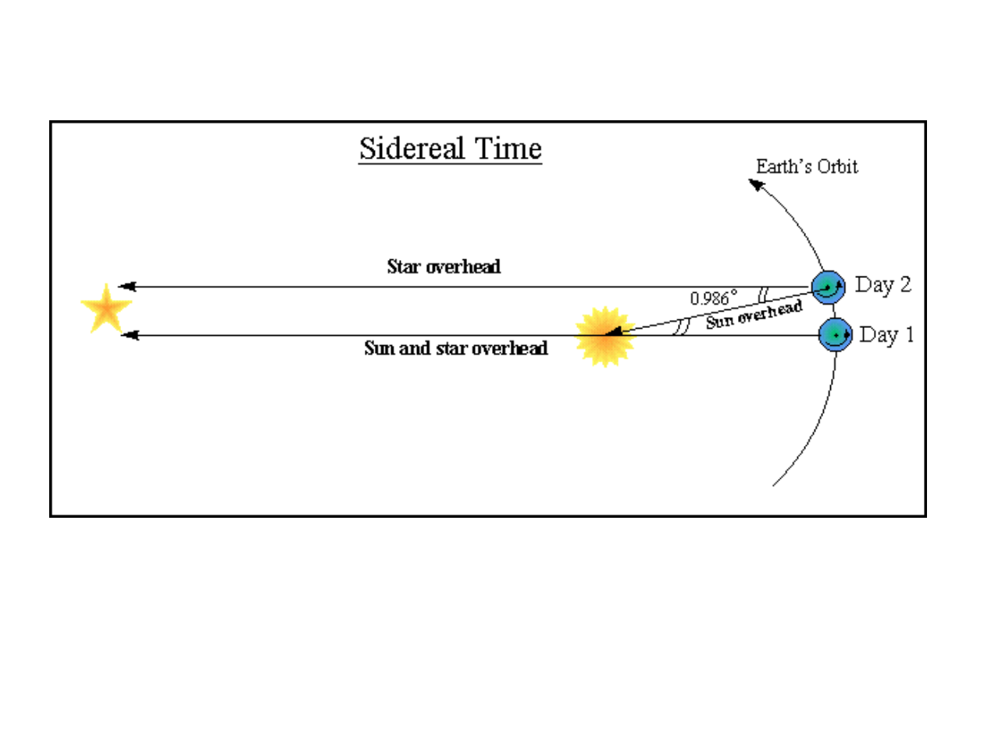
WVU DSPIRA
WEST VIRGINIA UNIVERSITY
Sidereal Time
•
A sidereal day is about 23h 56m long.
•
Every sidereal day the Sun is at the same place in the
sky.
•
The Sun is found 4 minutes of RA different each day.
2h per month = 4m per day.
wvurail.org/dspira
6 of 8
Notes:
Source edition: assets/lessons/lectures/astronomy/time-and-planning-observations.pdf, page 6. Original author and figure credits remain on the slide. Text is editable; illustrations retain their source artwork.

Slide 7
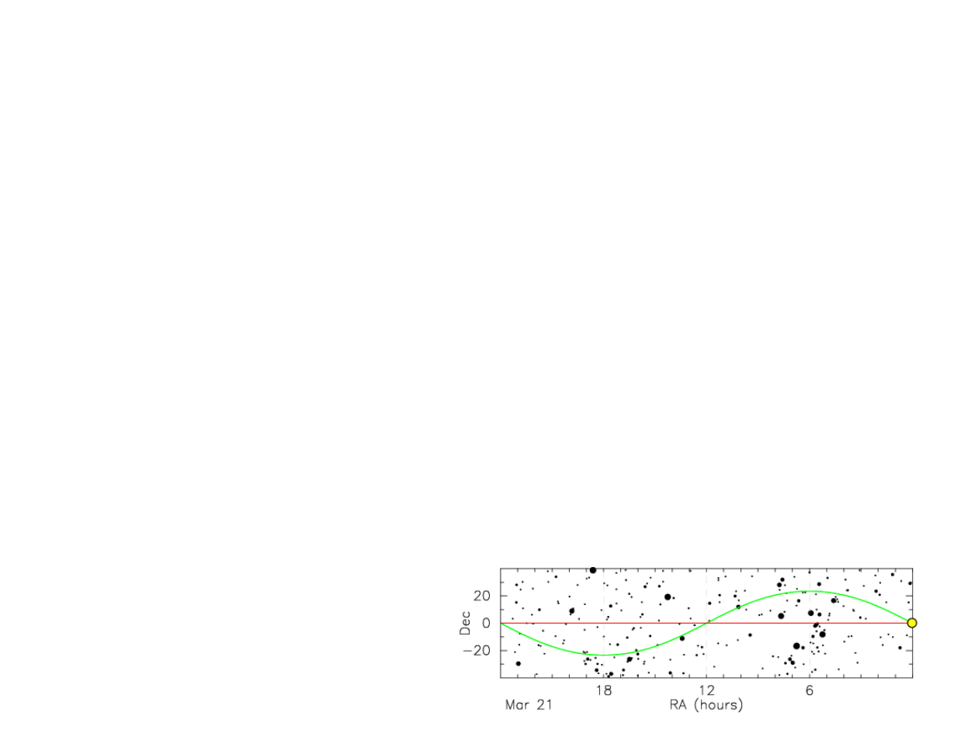
WVU DSPIRA
WEST VIRGINIA UNIVERSITY
Local Sidereal Time (LST)
•
The RA of an object on your meridian
is by definition the LST!!
•
HA = LST - RA
•
LST is the hour angle of the vernal
equinox at your location
•
The Sun is found 2 hours advanced in
RA each month, SO THIS IS THE
DIFFERENCE BETWEEN LST and
“normal” time!
wvurail.org/dspira
7 of 8
Notes:
Source edition: assets/lessons/lectures/astronomy/time-and-planning-observations.pdf, page 7. Original author and figure credits remain on the slide. Text is editable; illustrations retain their source artwork.

Slide 8

WVU DSPIRA
WEST VIRGINIA UNIVERSITY
LST Calculators
US Naval Observatory sidereal-time calculator
https://aa.usno.navy.mil/data/siderealtime
Enter the date, UT1 time, and longitude.
•
•
Easiest to remove the longitude complication, for
comprehension.
•
•
On the Vernal Equinox, at Grenwich England, the Sun is at
0h RA. The RA of an object on your meridian is the LST, so
when the Sun is on your meridian (noon), the LST is 0h.
•
LST must catch up 24 hours a year, so 6 months later on
the fall equinox the LST and Solar time must be identical.
•
•
Adding longitude complicates things further!
wvurail.org/dspira
8 of 8
Notes:
Source edition: assets/lessons/lectures/astronomy/time-and-planning-observations.pdf, page 8. Original author and figure credits remain on the slide. Text is editable; illustrations retain their source artwork.

