Slide 1

Doppler Effect Telescopes
Stars
D.J. Pisano
Associate Professor of Physics & Astronomy
July 7, 2017
Notes:
Source edition: assets/lessons/lectures/astronomy/doppler-effect-and-telescopes.pdf, page 1. Original author and figure credits remain on the slide. Text is editable; illustrations retain their source artwork.

Slide 2
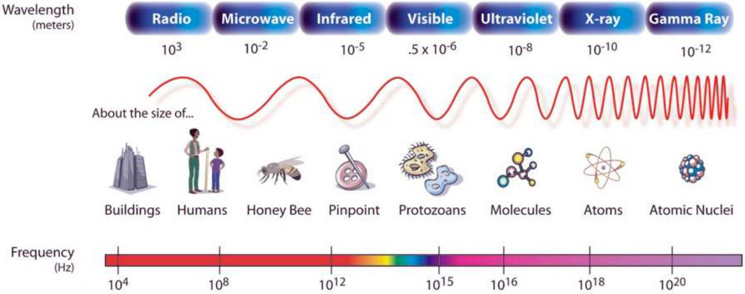
The Electromagnetic Spectrum
Lower Frequency = Longer Wavelength = Low Energy
Higher Frequency = Shorter Wavelength = High Energy
Notes:
Source edition: assets/lessons/lectures/astronomy/doppler-effect-and-telescopes.pdf, page 2. Original author and figure credits remain on the slide. Text is editable; illustrations retain their source artwork.

Slide 3
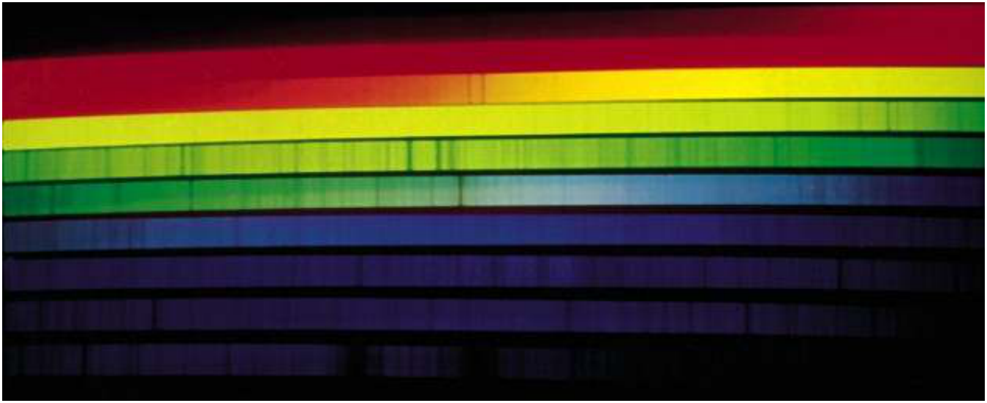
The Sun’s Spectrum
Notes:
Source edition: assets/lessons/lectures/astronomy/doppler-effect-and-telescopes.pdf, page 3. Original author and figure credits remain on the slide. Text is editable; illustrations retain their source artwork.

Slide 4
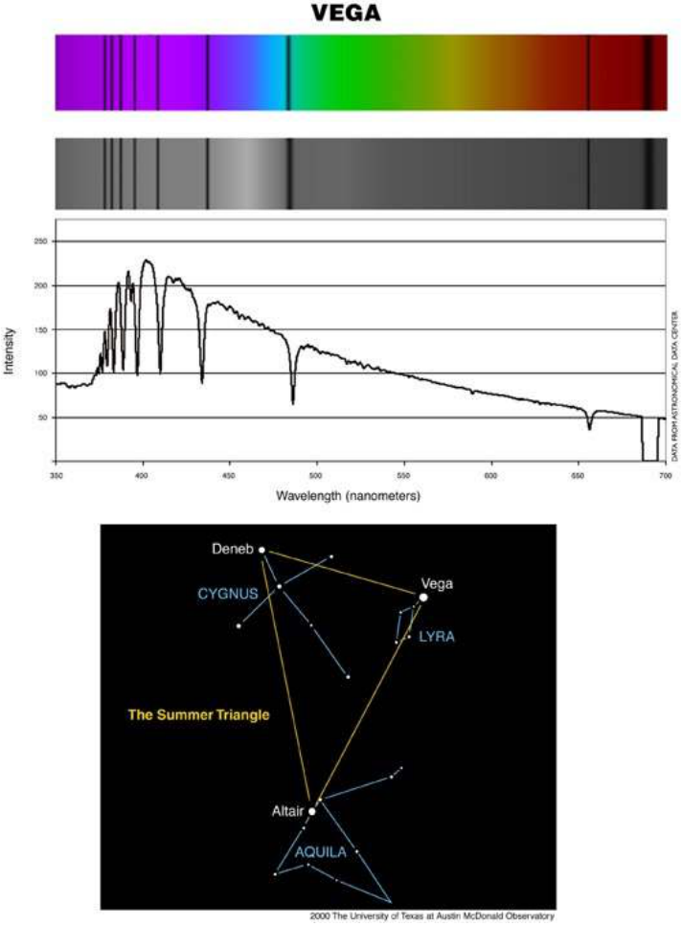
Stellar absorption spectra
All stars
produce dark
line absorption
spectra:
Why?
Notes:
Source edition: assets/lessons/lectures/astronomy/doppler-effect-and-telescopes.pdf, page 4. Original author and figure credits remain on the slide. Text is editable; illustrations retain their source artwork.

Slide 5
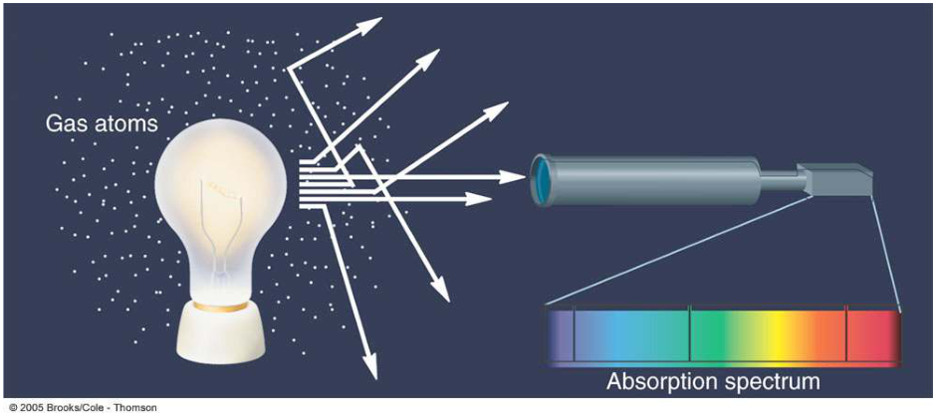
Kirchoff’s Law #3
When light from a hot, dense object passes
through a cooler, low density gas, the result is an
absorption spectrum.
The absorption lines are at
the same location as the emission lines would be.
Notes:
Source edition: assets/lessons/lectures/astronomy/doppler-effect-and-telescopes.pdf, page 5. Original author and figure credits remain on the slide. Text is editable; illustrations retain their source artwork.

Slide 6
Doppler Effect
Definition: The change in wavelength of
light due to the relative motion between
the source and the observer along the line
of sight.
Notes:
Source edition: assets/lessons/lectures/astronomy/doppler-effect-and-telescopes.pdf, page 6. Original author and figure credits remain on the slide. Text is editable; illustrations retain their source artwork.

Slide 7
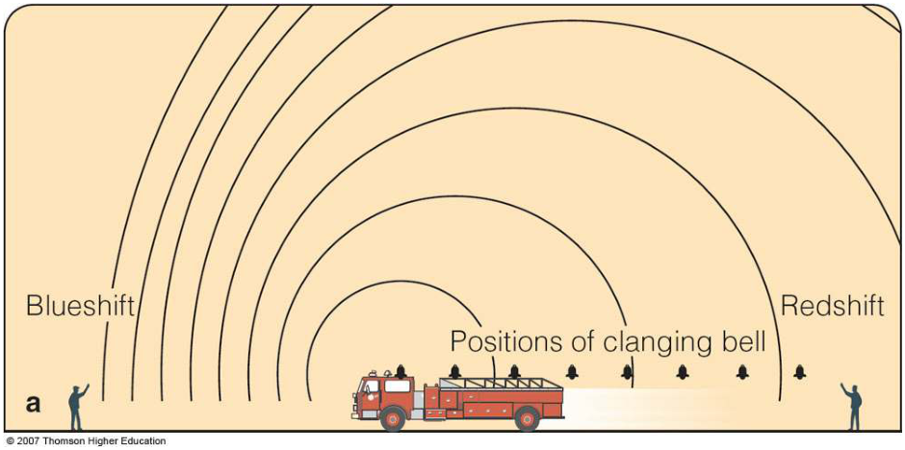
Doppler Effect
The Doppler effect is the same for light as it is for
sound.
higher frequency
lower frequency
Notes:
Source edition: assets/lessons/lectures/astronomy/doppler-effect-and-telescopes.pdf, page 7. Original author and figure credits remain on the slide. Text is editable; illustrations retain their source artwork.

Slide 8
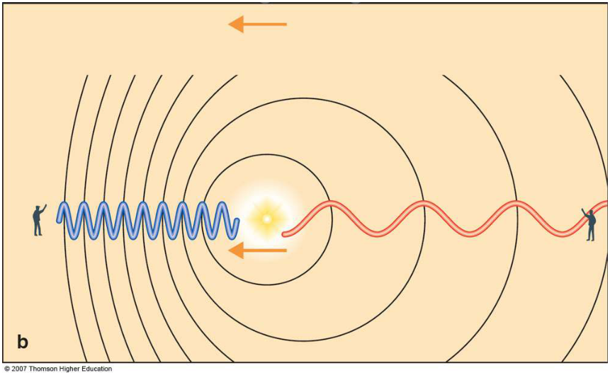
Doppler Effect
The Doppler effect is the same for light as it is for
sound.
higher frequency
lower frequency
Notes:
Source edition: assets/lessons/lectures/astronomy/doppler-effect-and-telescopes.pdf, page 8. Original author and figure credits remain on the slide. Text is editable; illustrations retain their source artwork.

Slide 9
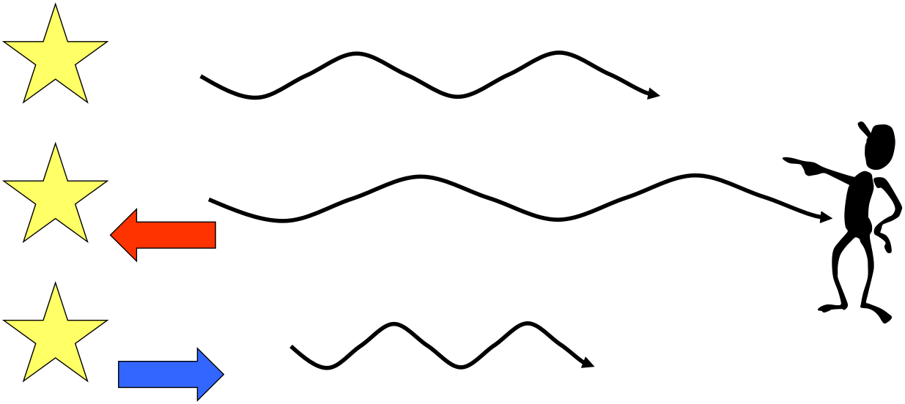
Doppler Effect
•
When something which is giving off light moves
towards
or
away
from you, the wavelength of the
emitted light is changed or shifted
V=0
redshift
blueshift
Notes:
Source edition: assets/lessons/lectures/astronomy/doppler-effect-and-telescopes.pdf, page 9. Original author and figure credits remain on the slide. Text is editable; illustrations retain their source artwork.

Slide 10
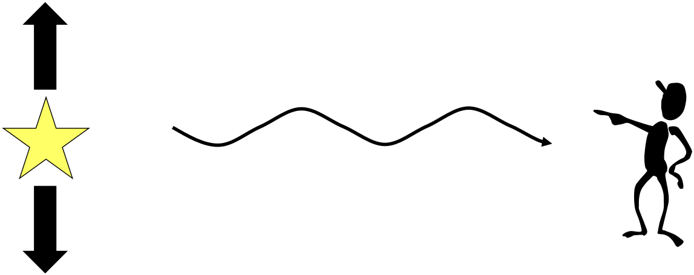
Doppler Effect
•
“
Along the line of sight
” means the
Doppler Effect happens only if the
object which is emitting light is
moving
towards
you or
away from
you
.
– An object moving “
side to side
” or
perpendicular
, relative to your line of
sight, will
not
experience a Doppler Effect.
Notes:
Source edition: assets/lessons/lectures/astronomy/doppler-effect-and-telescopes.pdf, page 10. Original author and figure credits remain on the slide. Text is editable; illustrations retain their source artwork.

Slide 11
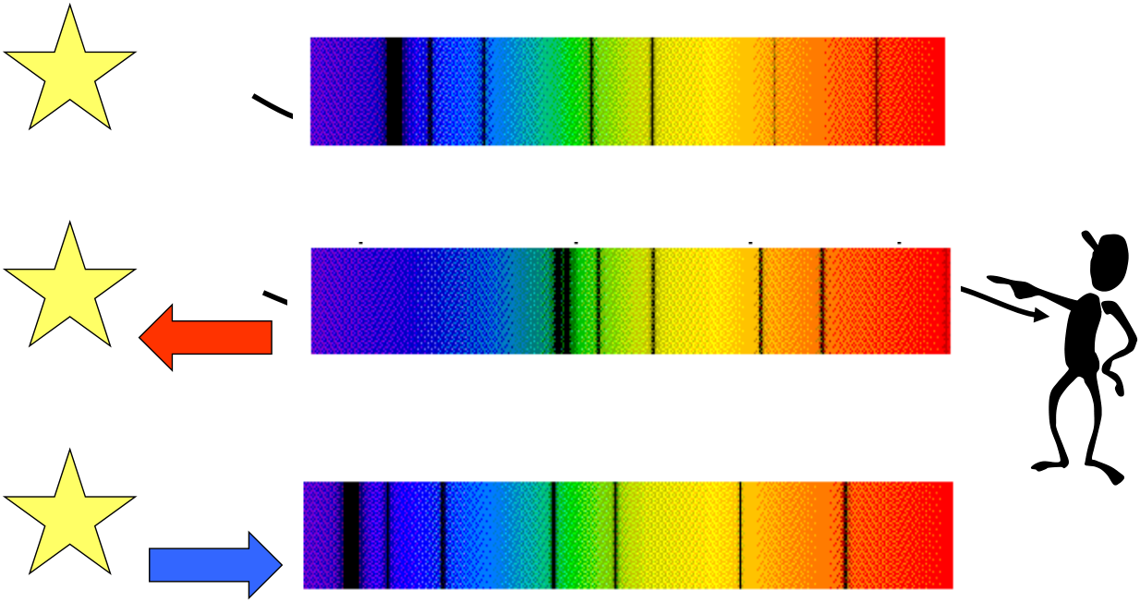
Astronomy Application
V=0
Notes:
Source edition: assets/lessons/lectures/astronomy/doppler-effect-and-telescopes.pdf, page 11. Original author and figure credits remain on the slide. Text is editable; illustrations retain their source artwork.

Slide 12
Doppler effect and telescopes
Review Questions
Notes:
Source edition: assets/lessons/lectures/astronomy/doppler-effect-and-telescopes.pdf, page 12. Original author and figure credits remain on the slide. Text is editable; illustrations retain their source artwork.

Slide 13
The Doppler Effect causes light from a source moving away to:
A.
be shifted to shorter wavelengths.
B.
be shifted to longer wavelengths.
C.
be unchanged.
Notes:
Source edition: assets/lessons/lectures/astronomy/doppler-effect-and-telescopes.pdf, page 13. Original author and figure credits remain on the slide. Text is editable; illustrations retain their source artwork.

Slide 14
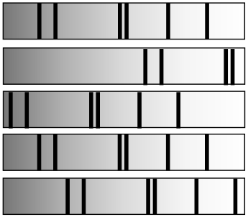
Doppler effect and telescopes
Consider the following spectra. The lab spectrum is not
moving, the remainder are from stars that are either moving
towards or away from us or are at rest.
Blue
Red
Lab Spectrum
Star A
Star B
Star C
Star D
Which star shows the greatest redshift?
(E = they are all the same)
Notes:
Source edition: assets/lessons/lectures/astronomy/doppler-effect-and-telescopes.pdf, page 14. Original author and figure credits remain on the slide. Text is editable; illustrations retain their source artwork.

Slide 15
Doppler effect and telescopes
Consider the following spectra. The lab spectrum is not
moving, the remainder are from stars that are either moving
towards or away from us or are at rest.
Blue
Red
Lab Spectrum
Star A
Star B
Star C
Star D
Which star shows the greatest blueshift?
(E = they are all the same)
Notes:
Source edition: assets/lessons/lectures/astronomy/doppler-effect-and-telescopes.pdf, page 15. Original author and figure credits remain on the slide. Text is editable; illustrations retain their source artwork.

Slide 16
Doppler shift: review question
A bright star is moving toward Earth. If you
were to look at the spectrum of this star, what
would it look like?
A.
an absorption spectrum that is redshifted relative to an unmoving star
B.
an emission spectrum that is redshifted relative to an unmoving star
C.
a continuous spectrum that is blueshifted relative to an unmoving star
D.
an absorption spectrum that is blueshifted relative to an unmoving star
E.
a continuous spectrum that is redshifted relative to an unmoving star
Notes:
Source edition: assets/lessons/lectures/astronomy/doppler-effect-and-telescopes.pdf, page 16. Original author and figure credits remain on the slide. Text is editable; illustrations retain their source artwork.

Slide 17
But to look at this light....
We need to use telescopes.
Why?
Notes:
Source edition: assets/lessons/lectures/astronomy/doppler-effect-and-telescopes.pdf, page 17. Original author and figure credits remain on the slide. Text is editable; illustrations retain their source artwork.

Slide 18
Three main functions of a telescope
Most important!!
•
Gather More Light
– (bigger Is better)
making
objects appear brighter
followed by
•
to see fine detail
(called resolution)
and least important,
•
magnify
magnification = (objective lens focal length
/
eyepiece lens focal length)
Notes:
Source edition: assets/lessons/lectures/astronomy/doppler-effect-and-telescopes.pdf, page 18. Original author and figure credits remain on the slide. Text is editable; illustrations retain their source artwork.

Slide 19
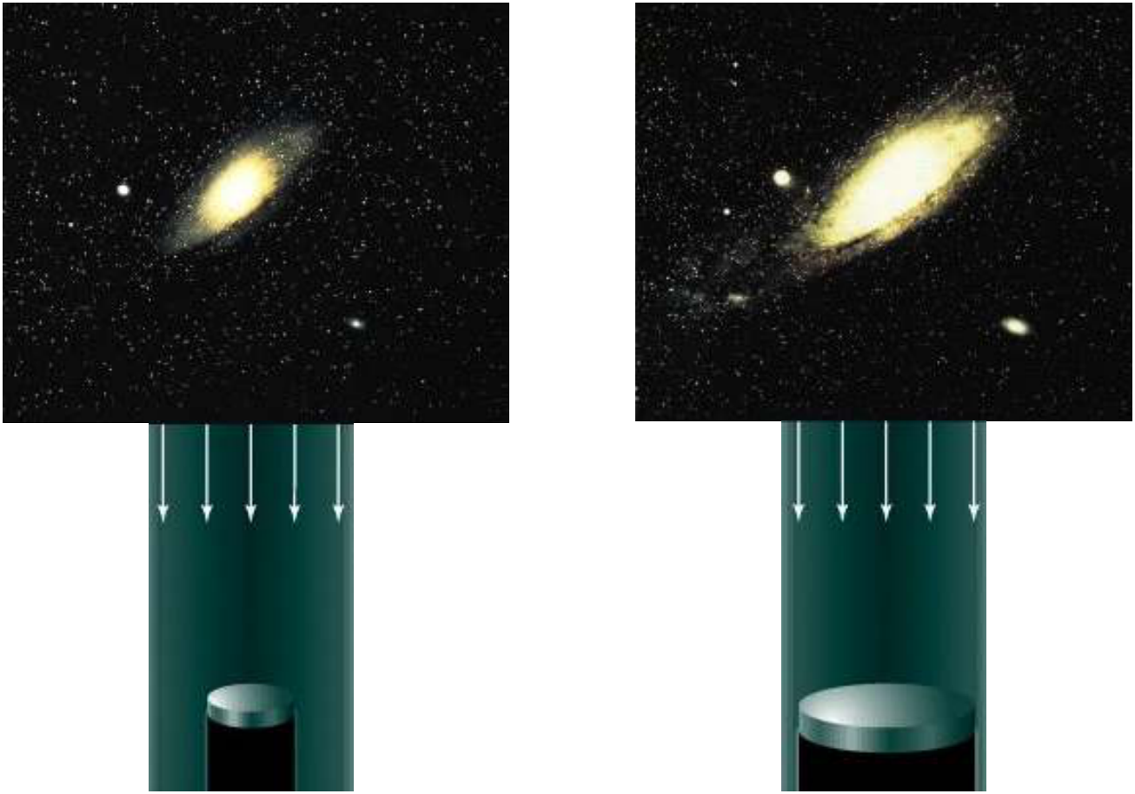
Doppler effect and telescopes
A larger
objective lens
provides a
brighter (
not
bigger
) image
Notes:
Source edition: assets/lessons/lectures/astronomy/doppler-effect-and-telescopes.pdf, page 19. Original author and figure credits remain on the slide. Text is editable; illustrations retain their source artwork.

Slide 20
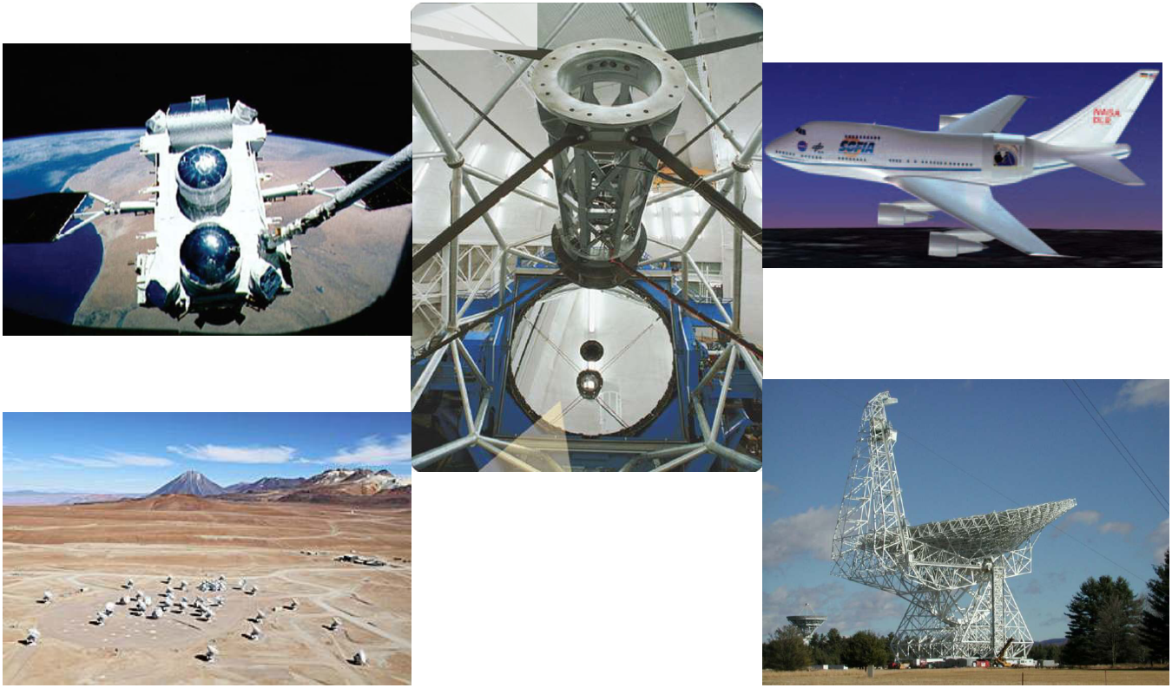
Examples of Telescopes
Visible
Gamma-ray
Infrared
X-ray
Radio
IR/Microwave
Notes:
Source edition: assets/lessons/lectures/astronomy/doppler-effect-and-telescopes.pdf, page 20. Original author and figure credits remain on the slide. Text is editable; illustrations retain their source artwork.

Slide 21
Why go into space?
To get above the atmosphere. Why?
1.
The atmosphere distorts some light that
reaches the ground.
2.
Some light does not reach the ground.
Notes:
Source edition: assets/lessons/lectures/astronomy/doppler-effect-and-telescopes.pdf, page 21. Original author and figure credits remain on the slide. Text is editable; illustrations retain their source artwork.

Slide 22
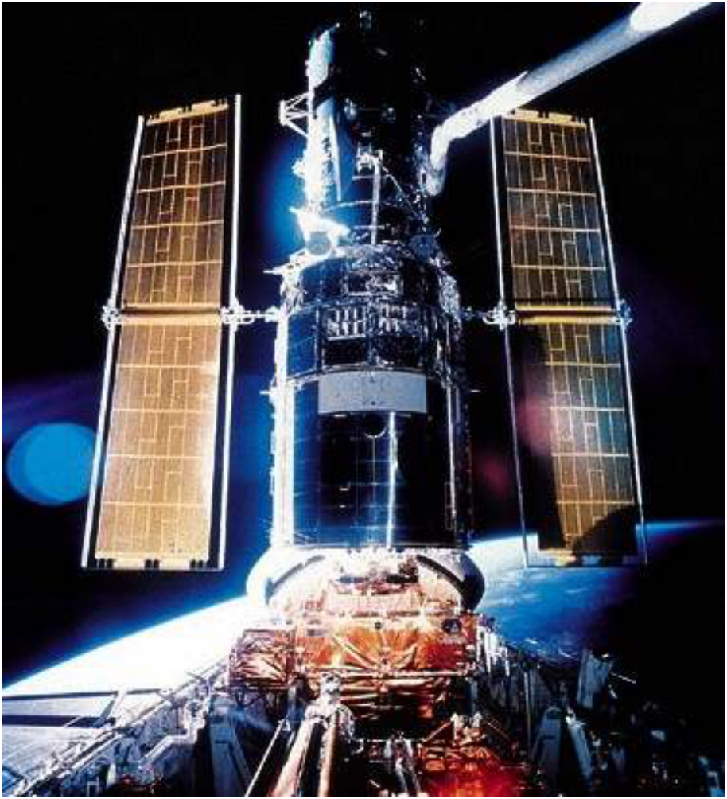
The Hubble Space Telescope
High above
Earth’s
atmosphere,
the Hubble
Space
Telescope
provides
stunning
details about
the universe
Notes:
Source edition: assets/lessons/lectures/astronomy/doppler-effect-and-telescopes.pdf, page 22. Original author and figure credits remain on the slide. Text is editable; illustrations retain their source artwork.

Slide 23
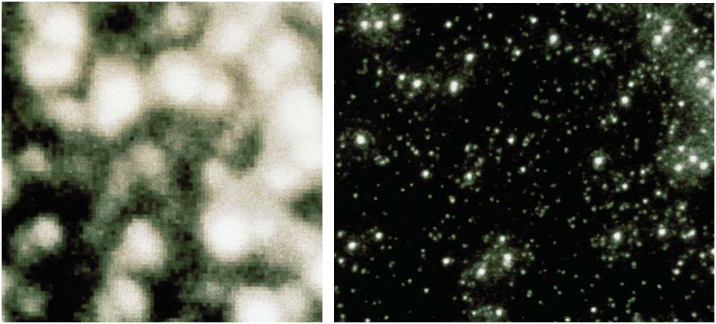
Earth’s atmosphere hinders astronomical research
Image of stars taken with a
Same picture taken with Hubble
telescope on the Earth’s
Space Telescope high above Earth’s
surface
blurring atmosphere
Notes:
Source edition: assets/lessons/lectures/astronomy/doppler-effect-and-telescopes.pdf, page 23. Original author and figure credits remain on the slide. Text is editable; illustrations retain their source artwork.

Slide 24
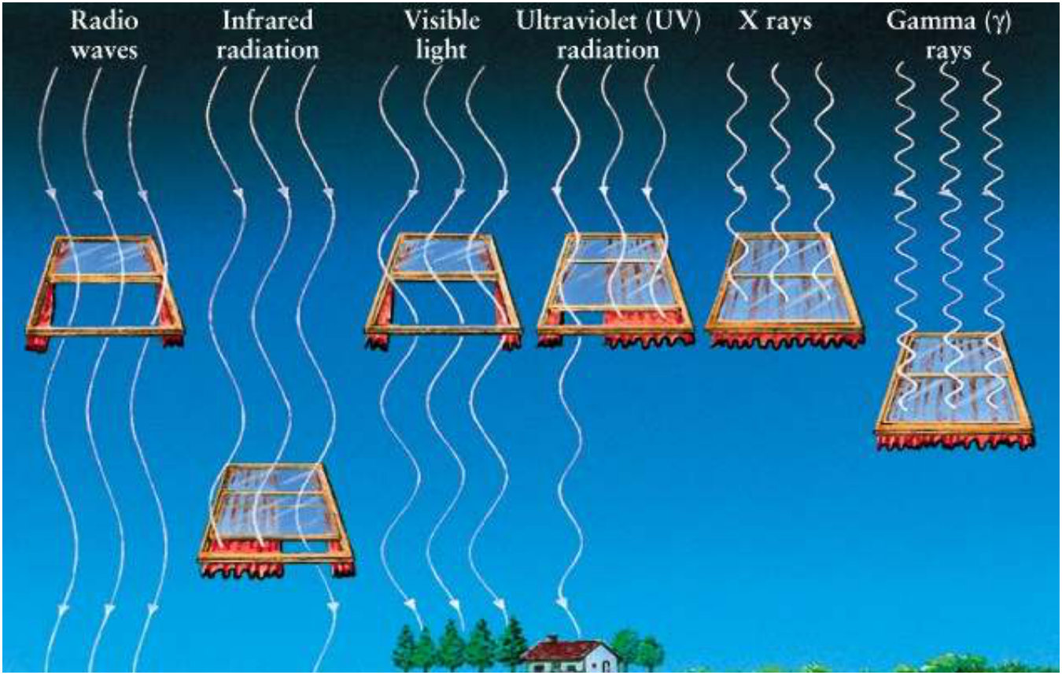
Not all EM radiation can penetrate Earth’s atmosphere.
Notes:
Source edition: assets/lessons/lectures/astronomy/doppler-effect-and-telescopes.pdf, page 24. Original author and figure credits remain on the slide. Text is editable; illustrations retain their source artwork.

Slide 25
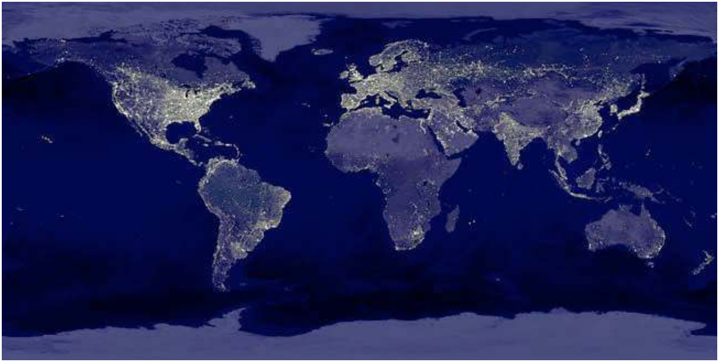
Factors in locating telescopes
For visible light telescopes: good weather, stable
atmosphere (good “seeing”), away from lights.
Notes:
Source edition: assets/lessons/lectures/astronomy/doppler-effect-and-telescopes.pdf, page 25. Original author and figure credits remain on the slide. Text is editable; illustrations retain their source artwork.

Slide 26
Factors in locating telescopes
For ultraviolet, x-ray, gamma-ray telescopes: the
light doesn’t penetrate the atmosphere, so you
need to put your telescope on a balloon, an
airplane, a rocket, or a satellite.
Notes:
Source edition: assets/lessons/lectures/astronomy/doppler-effect-and-telescopes.pdf, page 26. Original author and figure credits remain on the slide. Text is editable; illustrations retain their source artwork.

Slide 27
Factors in locating telescopes
For infrared telescopes: the light is blocked by
water and oxygen, so dry locations. Mountains,
aircraft, satellites, the South Pole.
For microwave telescopes: the same conditions
as infrared apply.
For radio telescopes: away from cellphones and
radio stations, microwave ovens, cars, airplanes,
people, etc…
Notes:
Source edition: assets/lessons/lectures/astronomy/doppler-effect-and-telescopes.pdf, page 27. Original author and figure credits remain on the slide. Text is editable; illustrations retain their source artwork.

Slide 28
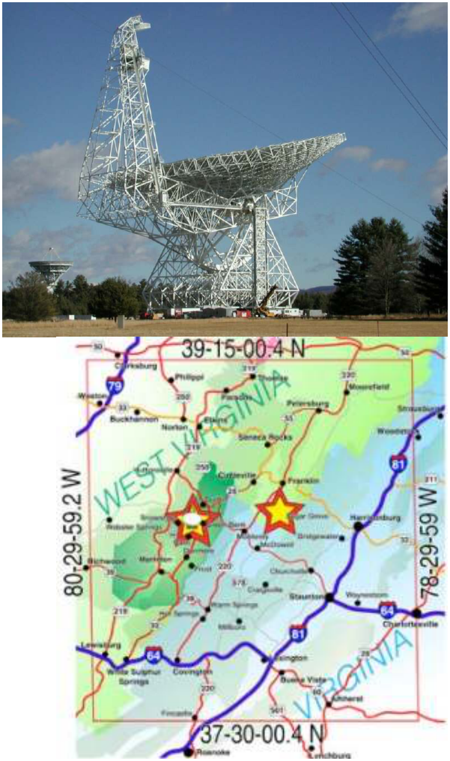
Why put a telescope in WV?
•
There are very few people.
•
There is a “National Radio
Quiet Zone”
•
Therefore, no cellphones or
radio stations near the
telescopes.
•
Also, no microwaves, Wii’s,
wireless phones/networks, or
cars with sparkplugs close to
the telescopes.
•
Minimizes light pollution in the
form of radio frequency
interference (RFI).
Notes:
Source edition: assets/lessons/lectures/astronomy/doppler-effect-and-telescopes.pdf, page 28. Original author and figure credits remain on the slide. Text is editable; illustrations retain their source artwork.

Slide 29
Choosing a telescope
Imagine you’re the head of a funding
agency that can afford to build only one
telescope. Which of the three proposed
telescopes below would be best to support?
A.
A gamma ray telescope in Antarctica
B.
A radio telescope in orbit above the Earth
C.
A visible telescope located high on a mountain in
Peru
D.
An ultraviolet telescope located in the Mojave
desert
Notes:
Source edition: assets/lessons/lectures/astronomy/doppler-effect-and-telescopes.pdf, page 29. Original author and figure credits remain on the slide. Text is editable; illustrations retain their source artwork.

Slide 30
Stars
•
So what do we know about stars by
observing them?
Notes:
Source edition: assets/lessons/lectures/astronomy/doppler-effect-and-telescopes.pdf, page 30. Original author and figure credits remain on the slide. Text is editable; illustrations retain their source artwork.

Slide 31
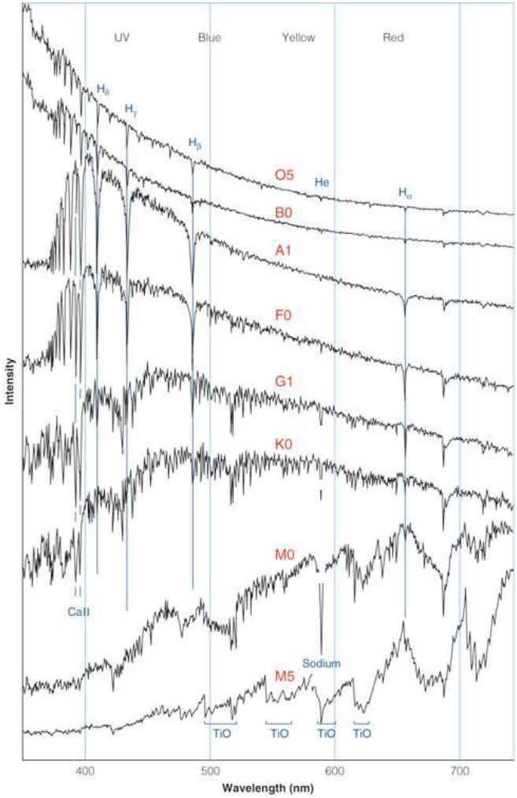
Spectra of different stars
(at the same distance)
Which star is hottest?
Which star is coolest?
Do you see any patterns?
Notes:
Source edition: assets/lessons/lectures/astronomy/doppler-effect-and-telescopes.pdf, page 31. Original author and figure credits remain on the slide. Text is editable; illustrations retain their source artwork.

Slide 32
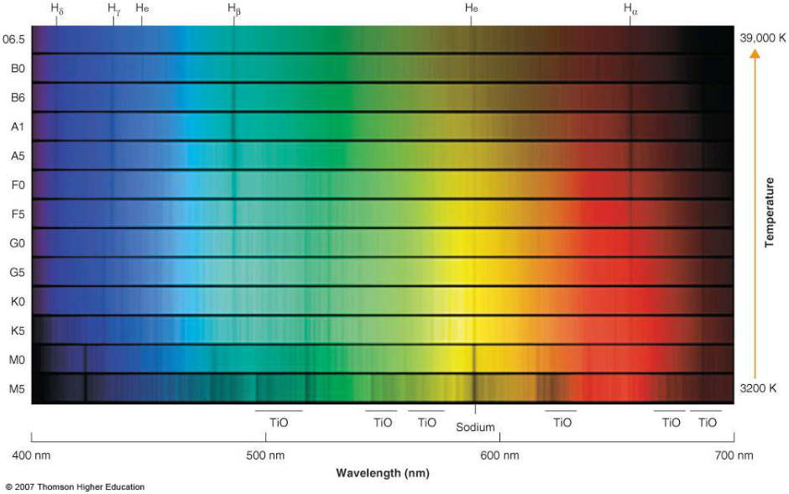
Spectral Classification
These are the same spectra in the same order you
looked at them before (ordered by temperature).
Notes:
Source edition: assets/lessons/lectures/astronomy/doppler-effect-and-telescopes.pdf, page 32. Original author and figure credits remain on the slide. Text is editable; illustrations retain their source artwork.

Slide 33
Spectral Classification
Notice that different lines appear and disappear as
the temperature changes.
Notes:
Source edition: assets/lessons/lectures/astronomy/doppler-effect-and-telescopes.pdf, page 33. Original author and figure credits remain on the slide. Text is editable; illustrations retain their source artwork.

Slide 34
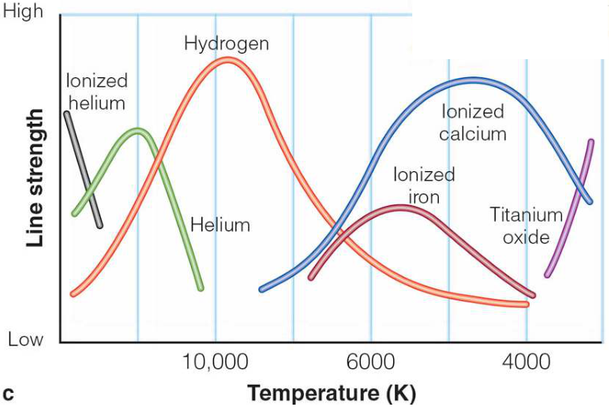
Spectral Classification
By measuring the relative depths of each line, we
can determine the temperature of a star.
Notes:
Source edition: assets/lessons/lectures/astronomy/doppler-effect-and-telescopes.pdf, page 34. Original author and figure credits remain on the slide. Text is editable; illustrations retain their source artwork.

Slide 35
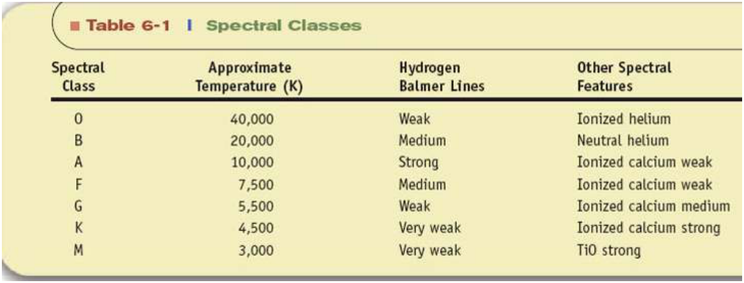
Summary of Spectral Classes
Notes:
Source edition: assets/lessons/lectures/astronomy/doppler-effect-and-telescopes.pdf, page 35. Original author and figure credits remain on the slide. Text is editable; illustrations retain their source artwork.

Slide 36
Stars are classified by their spectra as O, B, A, F, G, K, and M spectral types
•
O B A F G K M
•
hottest to coolest
•
bluish
to
reddish
•
Each class is further divided from 0-9 (e.g. A0 is
hotter than A9, A9 is hotter than F0)
•
An important sequence to remember:
–
Oh Be a Fine Guy (or Girl), Kiss Me
–
Overseas Broadcast - A Flash: Godzilla Kills Mothra
–
Oh, Boy, An F Grade Kills Me
–
Only Bad Astronomers Forget Generally Known
Mnemonics.
Notes:
Source edition: assets/lessons/lectures/astronomy/doppler-effect-and-telescopes.pdf, page 36. Original author and figure credits remain on the slide. Text is editable; illustrations retain their source artwork.

Slide 37
For thousands of nearby stars we can find:
•
the total luminosity
•
the temperature (color or spectral
type)
•
the size (radius)
•
the distance
CAN WE FIND ANY RHYME, REASON, OR
RELATIONSHIPS?
Notes:
Source edition: assets/lessons/lectures/astronomy/doppler-effect-and-telescopes.pdf, page 37. Original author and figure credits remain on the slide. Text is editable; illustrations retain their source artwork.

