Slide 1
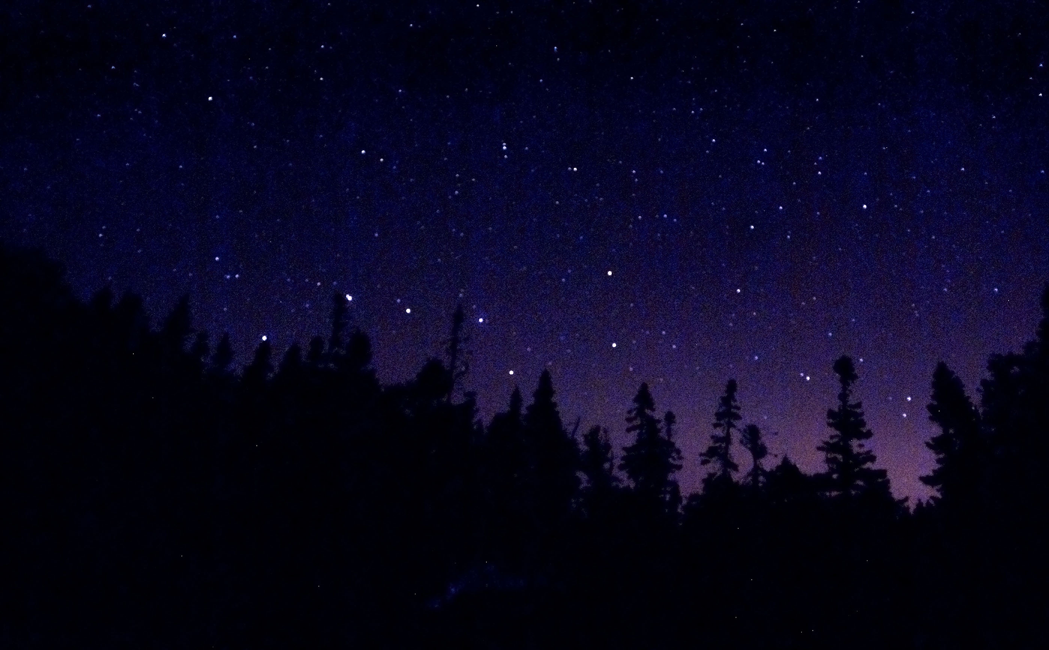
Motion of the Sky
Notes:
‹#›

Slide 2
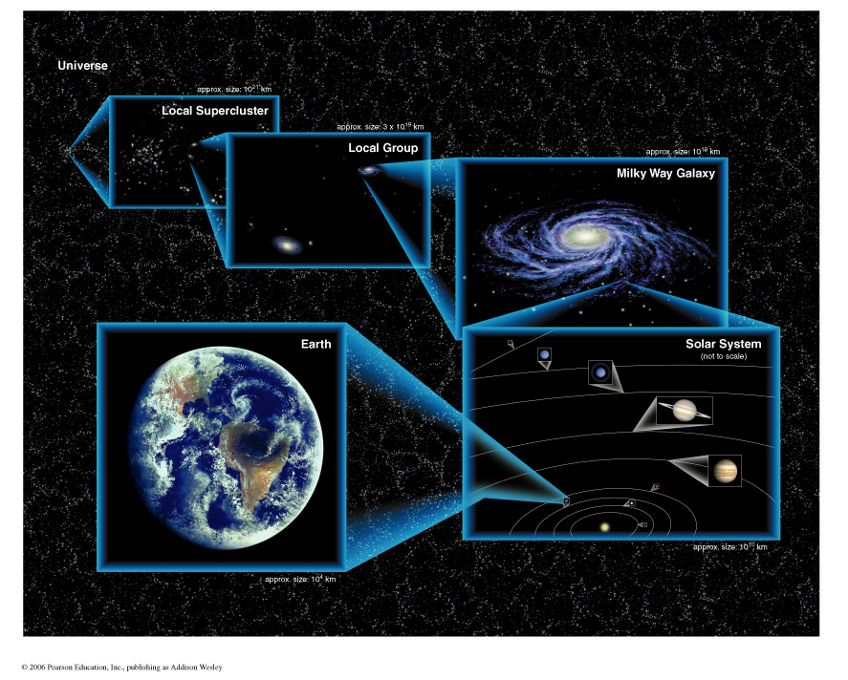
Lecture 1 Review (Where are we?)
Notes:
‹#›

Slide 3
The Night Sky
Goals for Today:
1) What does the Universe look like from Earth?
2) What are constellations?
3) What is the Celestial Sphere?
4) How does the sky move (daily)?
Words to know: Asterism, celestial north and south poles, horizon, zenith, altitude, circumpolar
Notes:
‹#›

Slide 4
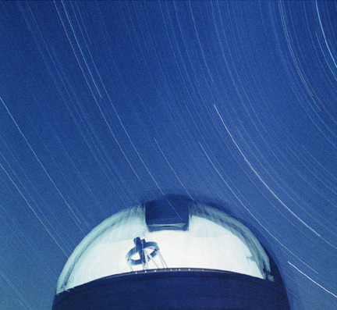
Motion of the sky
What does the Universe look like from Earth?
With the naked eye, we can see more than 2,000 stars. We can also see the Milky Way, most of the planets, many comets, a whole bunch of satellites, and some galaxies.
Notes:
‹#›

Slide 5
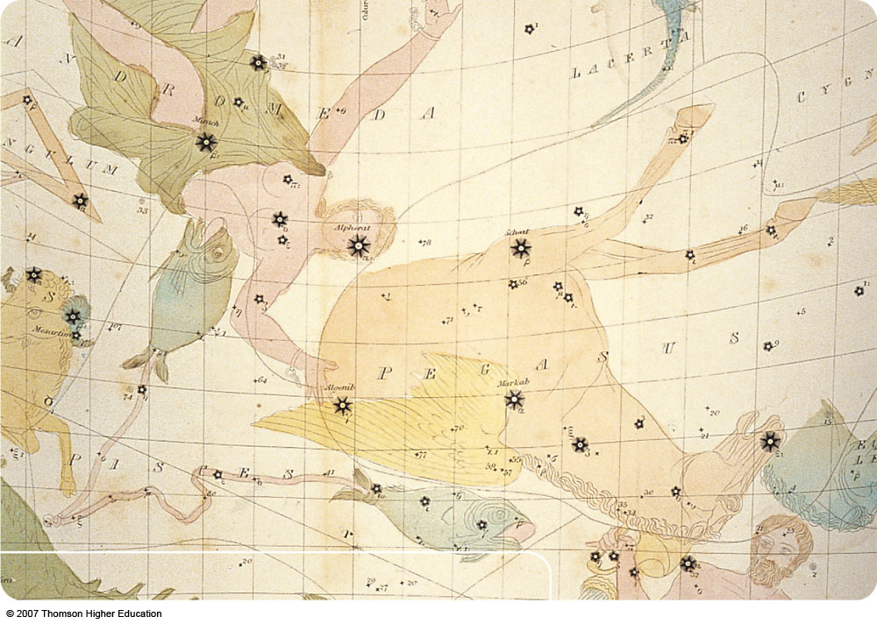
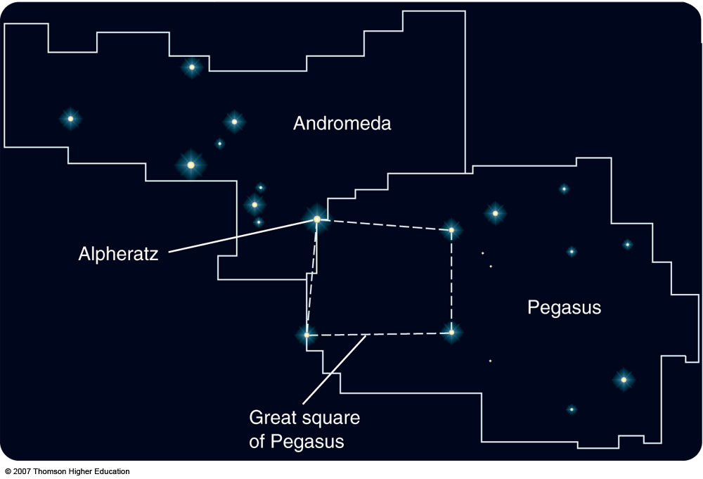
Constellations – Modern Definition
A constellation is a loose grouping of stars that appear close together in the night sky
In ancient times, they included only bright stars.
Today, there are an agreed-upon set of 88 constellations that together divide the entire sky
    Like a country boundary, “the star's address”
Notes:
‹#›

Slide 6
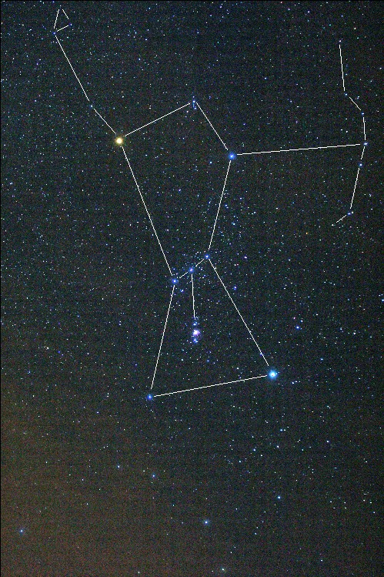
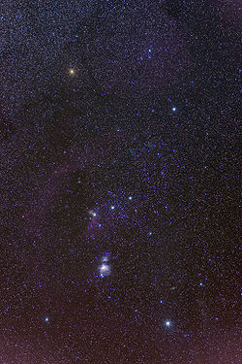
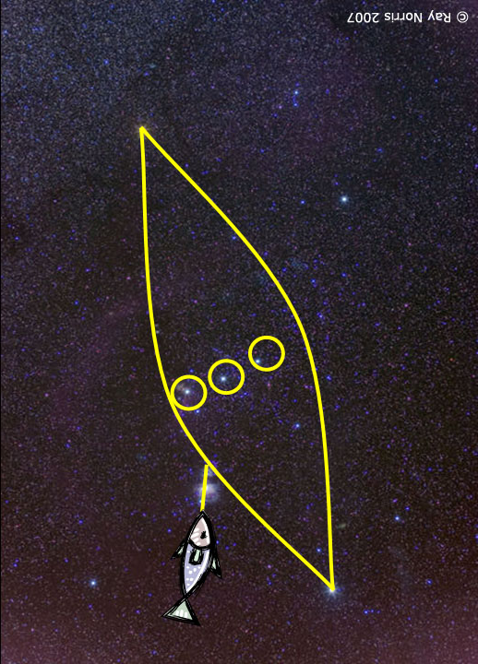
Constellations Culturally Defined
Constellations have been defined by many different cultures
Orion
Notes:
‹#›
The image above shows the constellation Orion, which is also known in Australia as "The saucepan". The Yolngu people of the Northern territory know it as Djulpan.

Slide 7
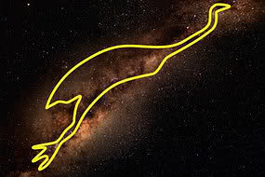
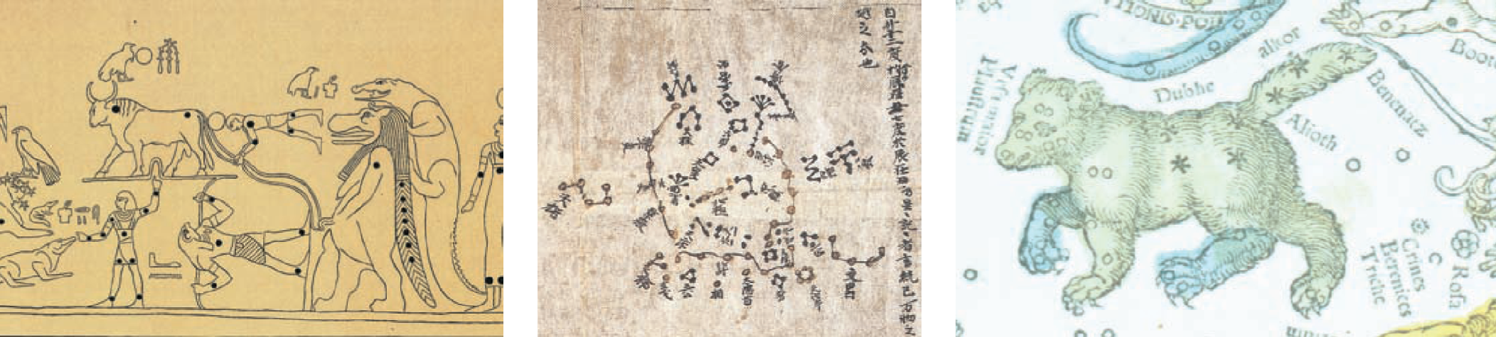
Ancient Constellations
Notes:
‹#›

Slide 8
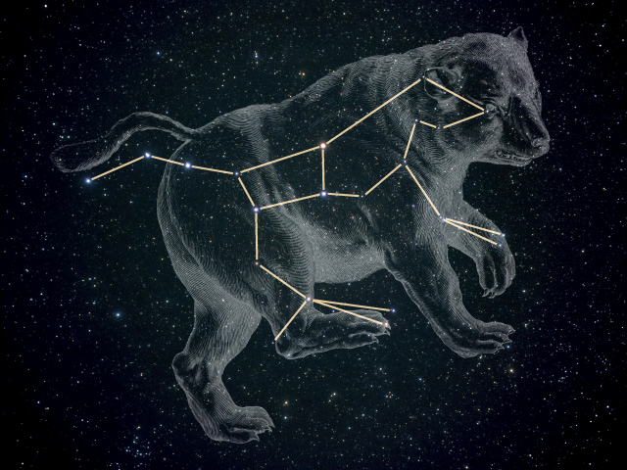
Asterisms
An asterism is a less formally defined grouping of stars, that may be a part of one or more constellations; for example, the Big Dipper in Ursa Major
Notes:
‹#›

Slide 9
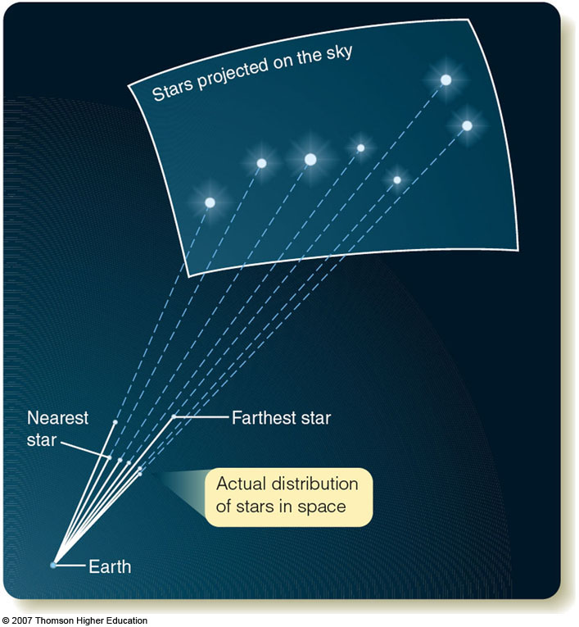
Constellations Are Not Real Groups
The stars in constellations and asterisms are not necessarily physically close to each other.
Notes:
‹#›

Slide 10

The Celestial Sphere
The celestial sphere is a model of the sky that helps us visualize the location and motion of stars.
Notes:
‹#›

Slide 11
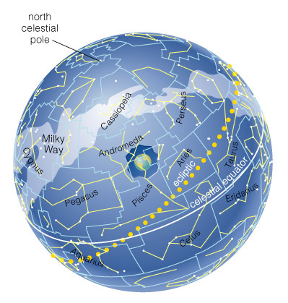
The Celestial Sphere is not Real!
It is a model - the stars are not literally on a sphere.
Notes:
‹#›

Slide 12
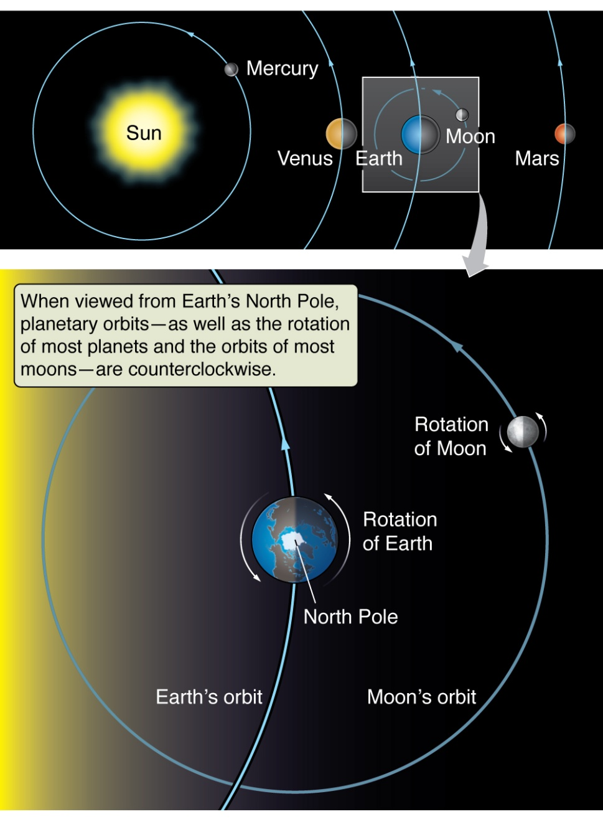
Earth Rotates on its Axis
There are two main motions that affect what we see in the sky:
Motion #1:
The Earth rotates on its axis. This causes stars to appear to rotate around the north and south celestial poles. The complete rotation of each star takes 24 hours.
(Motion #2 is due to the revolution of the Earth)
Notes:
‹#›
‹#›

Slide 13
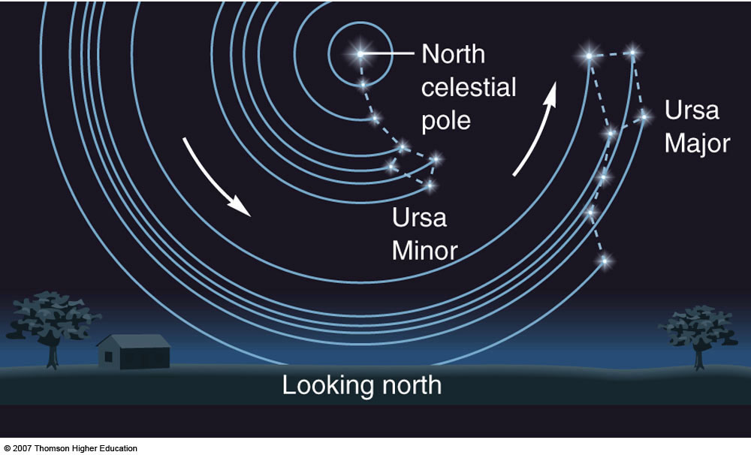
Motion of the sky
Looking North (from the Northern Hemisphere)
Some of these stars are circumpolar, never rising or setting.
Notes:
‹#›

Slide 14
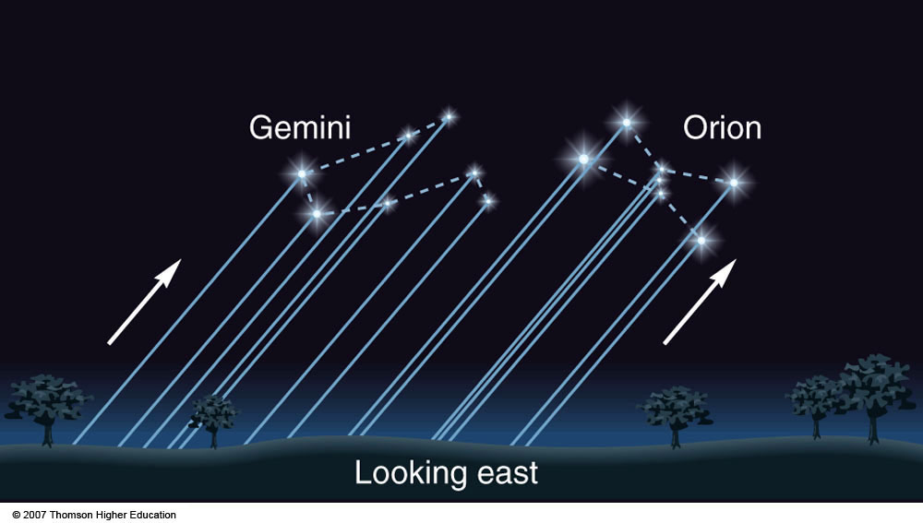
Motion of the sky
Looking East (from the Northern Hemisphere)
Stars rise in the East….
Notes:
‹#›

Slide 15
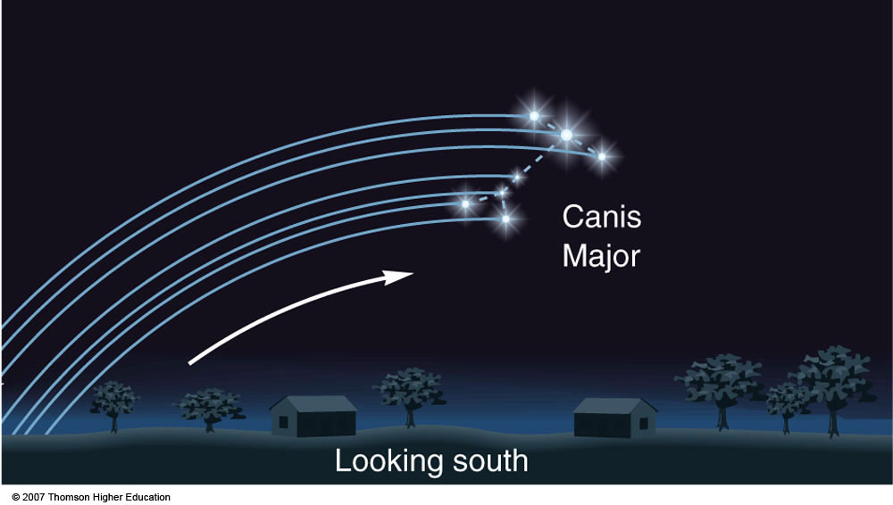
Motion of the sky
Looking South (from the Northern Hemisphere)
Pass through the South and set in the West.
Notes:
‹#›

Slide 16
VIDEOS!!!!
http://www.youtube.com/watch?v=3V3rmDG5J8A
http://www.youtube.com/watch?v=uHcRPJFR47Q
http://www.youtube.com/watch?v=ANAmiuAkyGQ
Notes:
‹#›

Slide 17
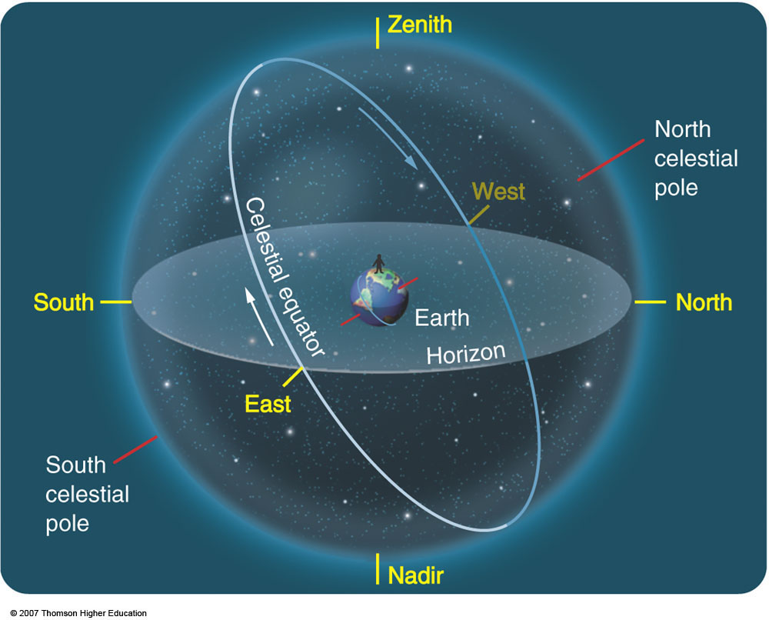
Celestial Sphere
Notes:
‹#›

Slide 18
Object Rise/Set Directions
1) The direction an object rises determines where it sets
An object rising due East will set due West
An object rising South-East will set in the South-West
An object rising North-East will set North-West
2) The direction an object rises determines the amount of time it is visible.

Slide 19
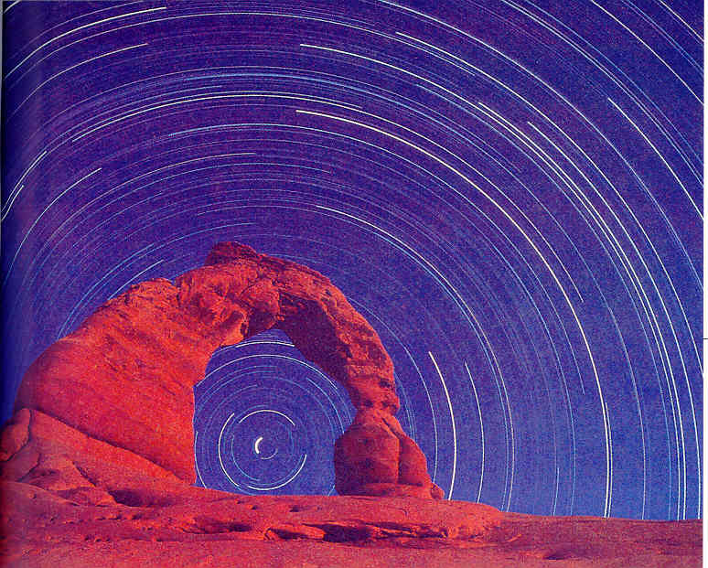
Concept Quiz
Which direction is the observer facing in this picture (photo was taken from the northern hemisphere)?
North
East
South
West
Notes:
‹#›

Slide 20
Concept Quiz
Which direction is the observer facing in this picture (photo was taken from the northern hemisphere)?
North
East
South
West
Notes:
‹#›

Slide 21
In your Lecture-Tutorials Book
Do “Position”, page 1, #1-9, 11 (skip #10)
Work in pairs or small groups
Ask other groups for help
Have fun!
I'll give you ~10 min.
Notes:
‹#›

Slide 22
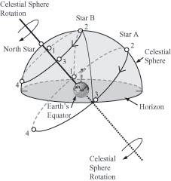
Motion of the sky
Notes:
‹#›

Slide 23
More!
Lecture-Tutorials “Motion” #1-6
Notes:
‹#›

Slide 24
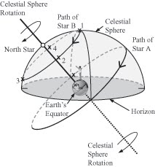
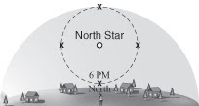
LT - Motion
Notes:
‹#›

Slide 25
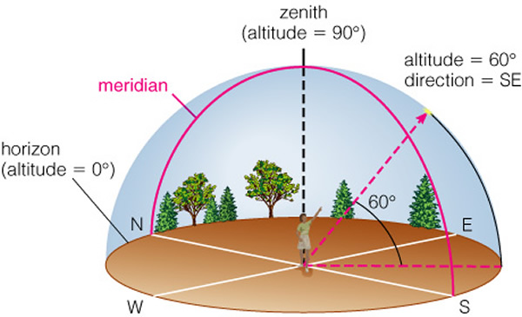
Clicker Quiz
Please put these rising stars in order from least time above horizon to most time (A is circumpolar)
A, B, C
C, A, B
B, A, C
C, B, A
A, C, B
A
B
C

Slide 26
Clicker Quiz
Please put these rising stars in order from least time above horizon to most time (A is circumpolar)
A, B, C
C, A, B
B, A, C
C, B, A
A, C, B
A
B
C

Slide 27
Lecture 2 Review – Time above Horizon
Every star takes 24 hours to complete a circle.
Each star is above the horizon for a different amount of time.
  A for 24 hours
  B for about 12 hours
  C for less than 12 hours
A
B
C

Slide 28
Celestial Sphere Definitions
Celestial equator: the projection of the Earth's equator onto the sphere.
Horizon: the limit to what can be seen from a particular vantage point
North/South Celestial Poles: the projection of the North/South Poles onto the Celestial Sphere
Zenith: the point directly overhead
Notes:
‹#›

Slide 29
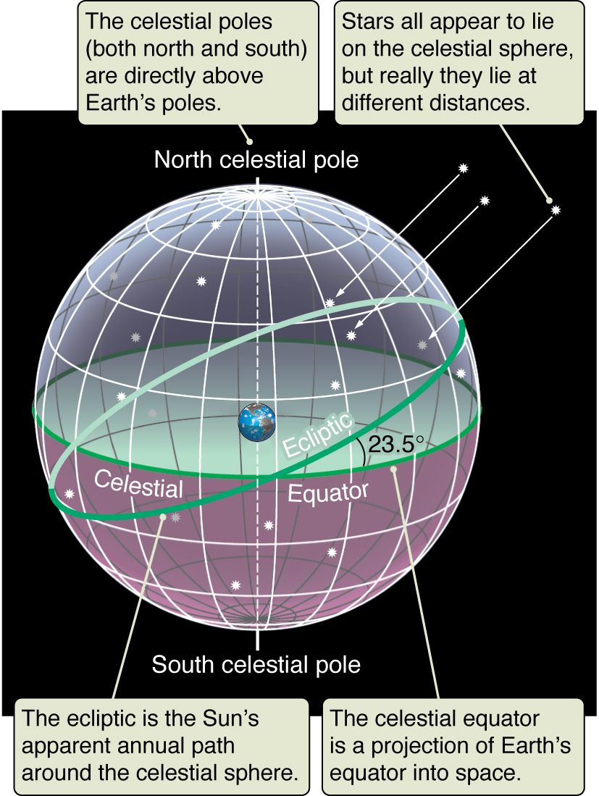
The Celestial Sphere
Ecliptic: Path of the Sun, inclined 23.5 degrees to equator
23.5 degrees !!!
Notes:
‹#›

Slide 30
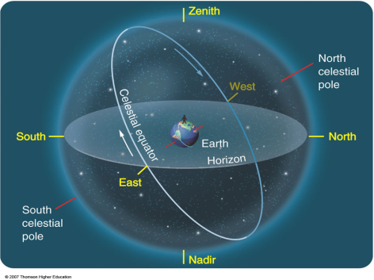

Three Views
You should be able to go back and forth between three different views of the sky:
Above Earth
Above the viewer
Viewer’s perspective

Slide 31
The Celestial Sphere Moves! (Daily)
Main points:
The motion of the stars can be understood as the 24 hour motion of the celestial sphere.
We see stars (and the Moon and the Sun) rise in the East and set in the West <- Important!
Stars appear to orbit the north celestial pole. In the north, there is a star very near the north celestial pole called the “North Star” or Polaris
Some stars are always visible - these are called “circumpolar”
Some stars are never visible!
What we see depends on the direction we are facing!
Notes:
‹#›

Slide 32
Animations
https://astro.unl.edu/naap/motion2/animations/ce_hc.html
Things to notice:
Circumpolar, and “not visible” regions
How these change with latitude on Earth
https://www.solarsystemscope.com
Things to notice:
Sun’s position with respect to the signs of the zodiac and how this changes throughout the year
Sun’s location with respect to the signs of the zodiac does not change throughout one day

Slide 33
The Night Sky
Goals for Today:
1) What does the Universe look like from Earth?
  We can see ~2000 stars, a few Galaxies and the Milky Way
2) What are constellations and asterisms?
  Constellations are regions on the sky enclosing groupings of stars. Asterisms are less-formal groupings of stars
3) What is the Celestial Sphere?
  The projection of all of space onto a sphere that we are inside of
Notes:
‹#›

Slide 34
A User's Guide to the Night Sky
4) How do stars move?
- Stars rise in the East and set in the West.
- They appear to circle around the North Celestial Pole (in the northern hemisphere)
- Their entire motion takes 24 hours
- The location where the rise determines where they will set
- Some stars are never visible
Words to know: Asterism, celestial north and south poles, horizon, zenith, altitude, circumpolar
Notes:
‹#›

Slide 35
More motions of the sky
Goals for Today:
  1) How do the star’s motions change with latitude?
  2) What is the significance of the signs of the Zodiac and the ecliptic
  3) Why do the constellations change throughout the year?
Notes:
‹#›

Slide 36
Concept Quiz
What is latitude? A coordinate that…
…specifies position in the north-south direction
…specifies position in the east-west direction
…specifies position in the vertical direction

Slide 37
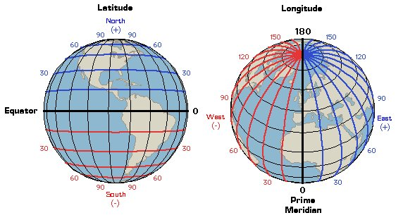
Concept Quiz
What is latitude? A coordinate that…
…specifies position in the north-south direction
…specifies position in the east-west direction
…specifies position in the vertical direction

Slide 38
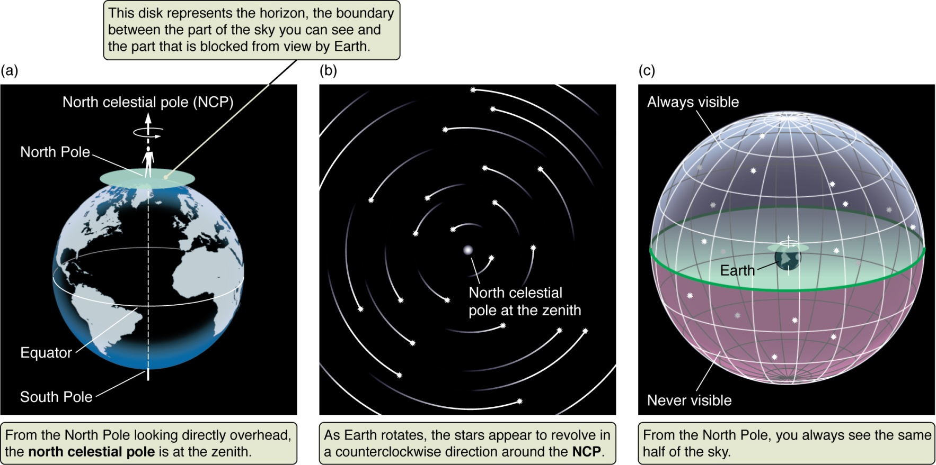
Motion of Stars at the North Pole
The north celestial pole is directly overhead.
Stars rotate counterclockwise in about 24 hours.
No stars rise or set: all are circumpolar.
Notes:
‹#›

Slide 39

Motion of the Sky at the North Pole

Slide 40
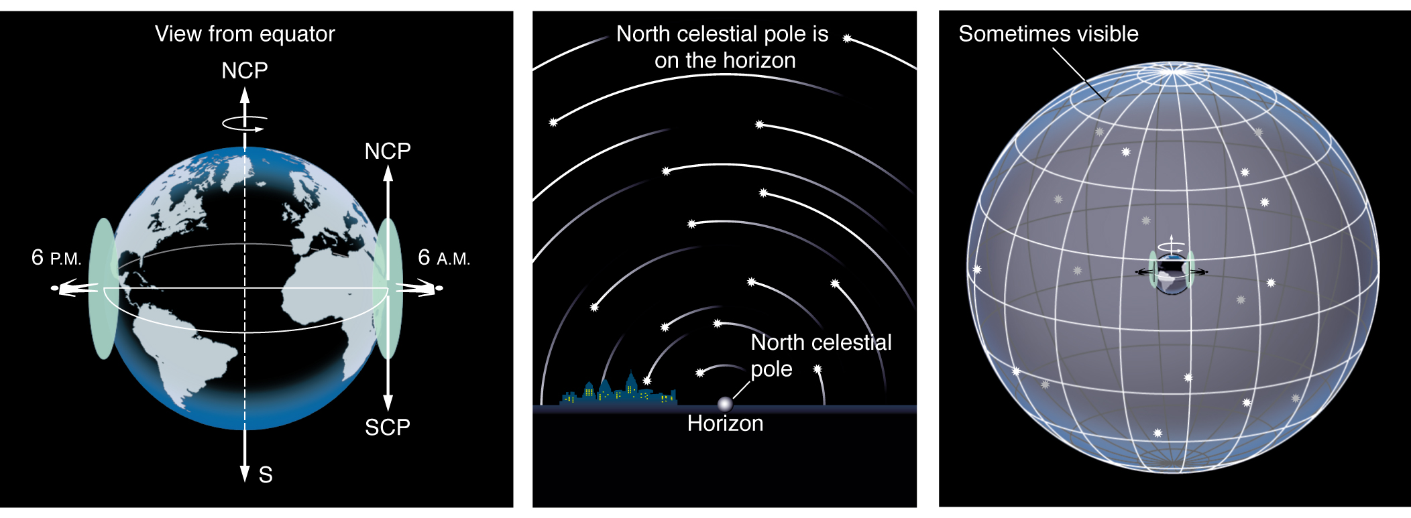
Motion of Stars at the Equator
All stars rise and set.
The celestial poles are on the northern
and southern horizons.
Observers can see the whole celestial sphere
as it rotates.
Notes:
‹#›

Slide 41
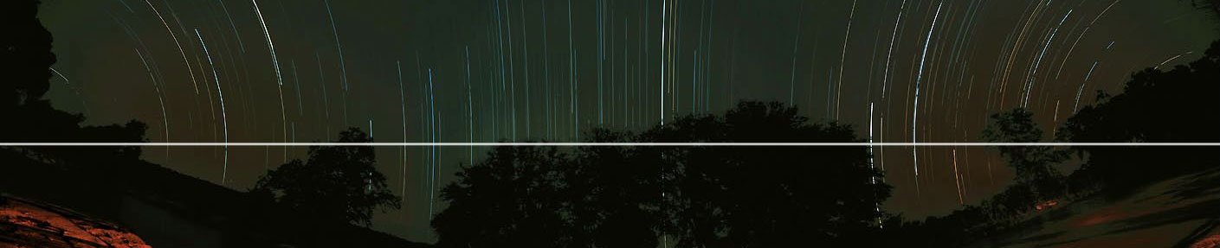
Motion of Stars at the Equator

Slide 42
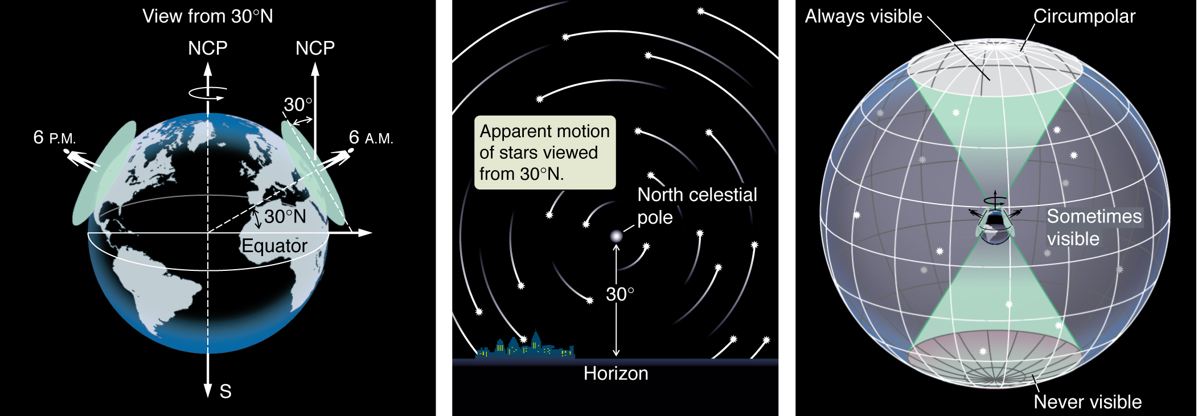
Motion of Stars Between Poles and Equator (Morgantown)
Some stars are circumpolar.
Some stars rise and set.
Some stars are never visible.
THE ALTITUDE OF THE POLE STAR IS YOUR LATITUDE!
Notes:
‹#›

Slide 43
Revolution versus Rotation
Motion #1: The daily motion of the stars in the sky is caused by the rotation of the Earth on its axis.
  This causes the daily motion of the star across the sky.
Motion #2: The yearly motion of the Earth around the Sun is called revolution.
  This causes the change in which stars are visible at night throughout the year.
  -> Revolvers rotate!

Slide 44
Earth Revolves around the Sun
Motion #1 – Earth rotating (daily)
Motion #2 – Earth revolving around the Sun (yearly)
Takes 365.242 days
We have a “leap year” every four years
  365.25 days on average
  Unless if year divisible by 100
    365.240
    Unless divisible by 400
      365.242
Notes:
‹#›

Slide 45
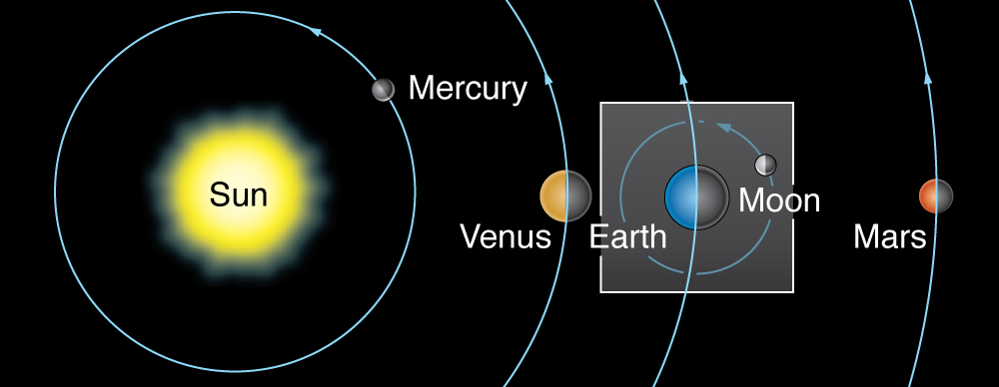
The Size of Earth’s Orbit
Earth’s orbit is nearly circular (within a couple percent).
The average distance to the Sun is called the astronomical unit, or AU. <- Vocab word of the day!
1 AU = 150 million km = 93 million miles (million = 10⁶)
Notes:
‹#›

Slide 46
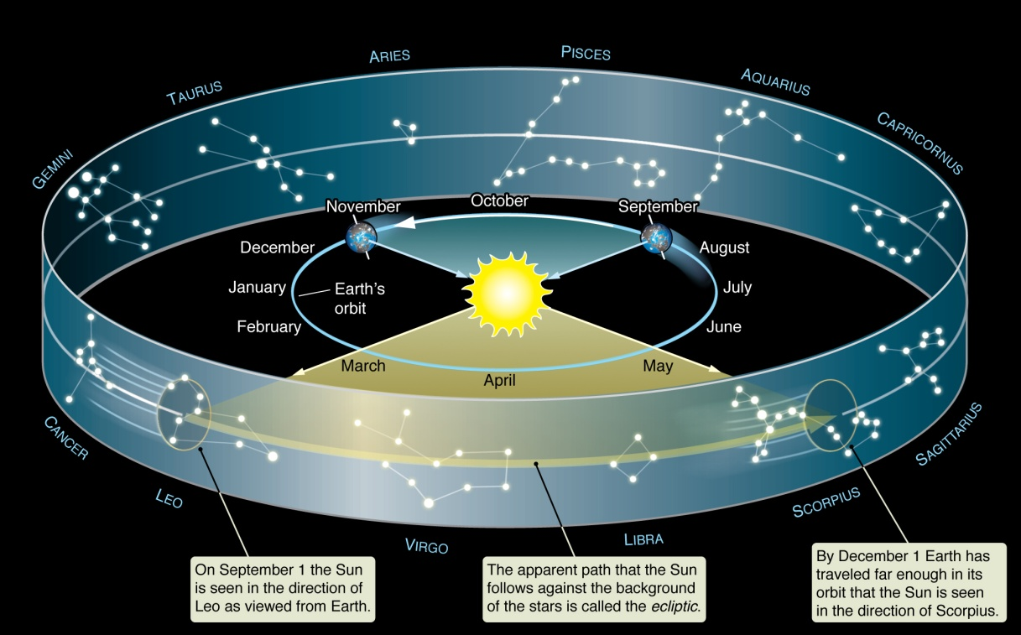
The Zodiac
As Earth revolves about the Sun, the Sun is seen against different constellations
These constellations are called the signs of the zodiac.
The constellations (and stars) we see depend on the season (motion #2)
  “Winter” constellations are up during the day in summer

Slide 47
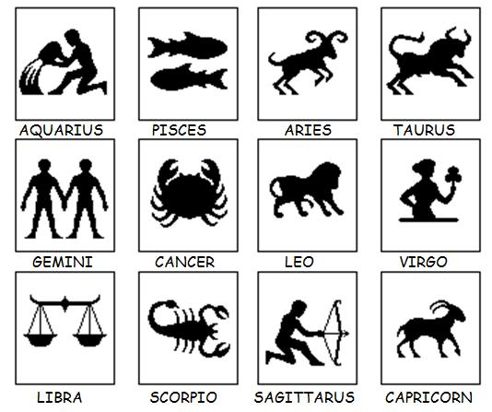
Signs of the Zodiac
The Babilonians first identified constellations along the ecliptic – the signs of the zodiac
Important: astrology, which uses the signs of the zodiac, is not science! Do not confuse it with astronomy!

Slide 48
The Ecliptic
The Sun’s is always found on the ecliptic
The signs of the zodiac are along the ecliptic
All planets and even the moon found near ecliptic – the plane of the Solar system
The Earth’s axis is tilted 23.5 degrees, so the ecliptic is inclined 23.5 degrees with respect to the celestial equator

Slide 49
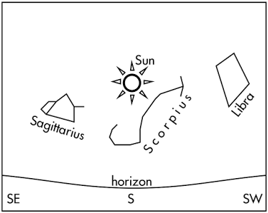
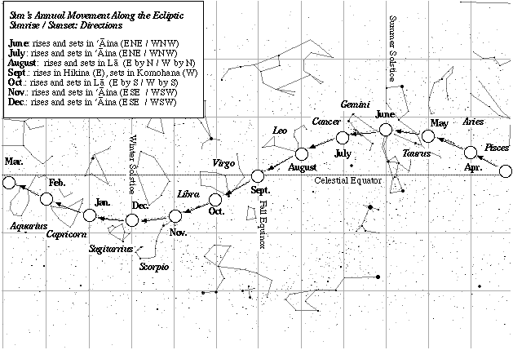
Sun and the Celestial Sphere
Sun fixed to celestial sphere during one day (almost)
  The Sun follows the ecliptic throughout the year, not the day!
(Stars and constellations shown here in their correct locations, but they cannot be viewed with the naked eye during the day, as shown)
(Animation again)

Slide 50
QUESTIONS!
LT book, “Ecliptic” starting on Page 13, #1-12
About 10 min

Slide 51
Yearly motions of the sky
Goals for Today:
  1) How do the star’s motions change with latitude?
  At poles, all stars are visible. For rest of planet, some stars circumpolar, some rise and set, and some are never visible.
  2) What is the significance of the signs of the Zodiac and the ecliptic
  They trace the path the Sun makes throughout the year
  3) Why do the constellations change throughout the year?
  Different parts of the sky are visible at night.
Notes:
‹#›

Slide 52
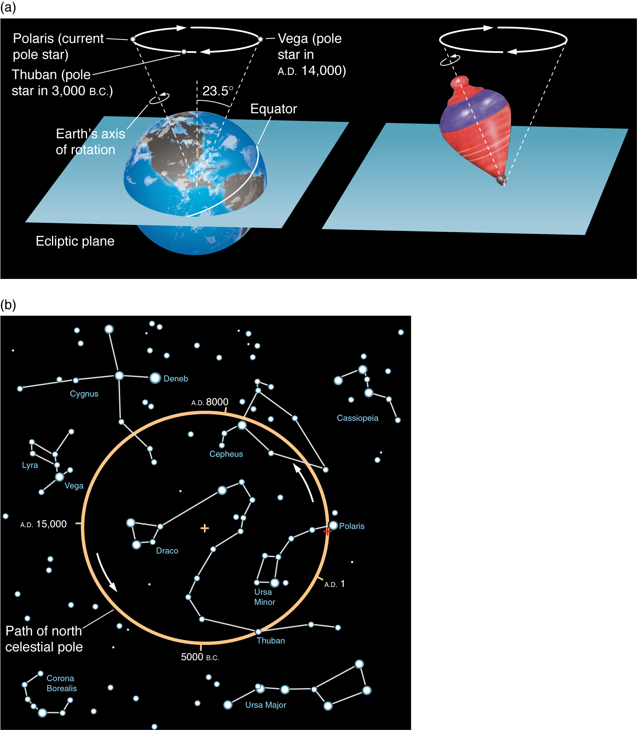
Precession
Currently the north celestial pole is near the bright star Polaris.
Earth’s axis wobbles with a period of 26,000 years.
Location of north and south Celestial Pole gradually shifts
Notes:
‹#›

Slide 53
Precession
Notes:
‹#›

