Slide 1
Horn telescope design and construction
A classroom radio telescope
Adapted from Daniel Bonnett, DSPIRA 2018
Chandler Academy, Kanawha County, West Virginia
Notes:
Source: Daniel Bonnett, DSPIRA 2018 construction presentation. Current construction instructions: https://wvurail.org/dspira/BuildingHornTelescope_Overview

Slide 2
Telescope design
Radio astronomy
The flared horn collects radio waves.
Its shape controls the telescope's response across the sky.
Classroom construction
Insulation board and a metal can make the telescope's receiver.
A wooden stand supports the telescope.
Notes:
Source: Daniel Bonnett, DSPIRA 2018 construction presentation. Current construction instructions: https://wvurail.org/dspira/BuildingHornTelescope_Overview

Slide 3
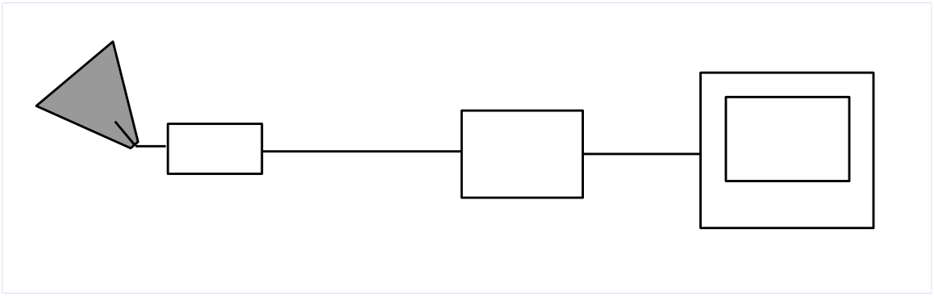
The receiver signal path
horn
cable
LNA
Airspy
Radio
computer
The low-noise amplifier (LNA) boosts the signal before the radio sends it to the computer.
Notes:
Source: Daniel Bonnett, DSPIRA 2018 construction presentation. Current construction instructions: https://wvurail.org/dspira/BuildingHornTelescope_Overview

Slide 4
Construction materials
Horn and receiver
Foil-faced insulation board
New, empty F-style gallon can
Copper probe and SMA connector
Foil tape and duct tape
Stand and cradle
Lumber and construction screws
Bolts, washers, and wing nuts
Use the linked guides for quantities and dimensions.
Notes:
Source: Daniel Bonnett, DSPIRA 2018 construction presentation. Current construction instructions: https://wvurail.org/dspira/BuildingHornTelescope_Overview

Slide 5
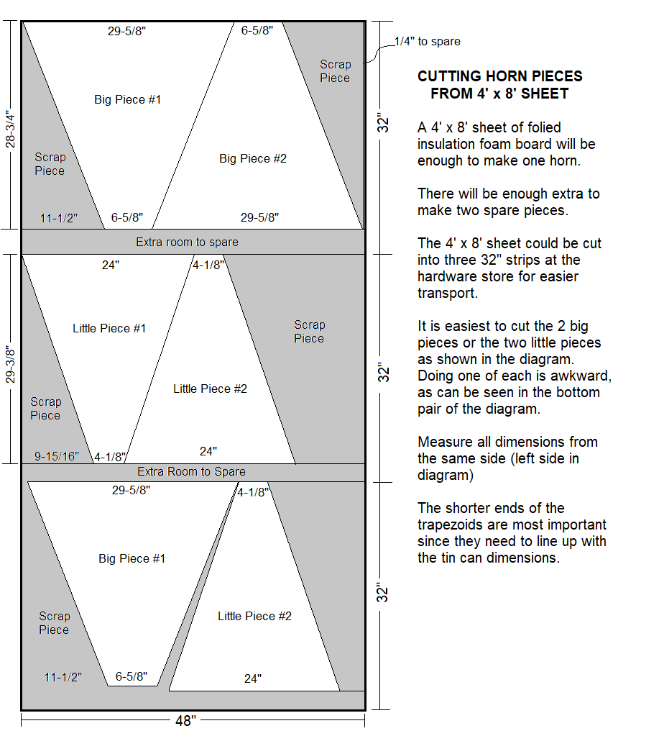
Horn panel cutting plan
Cut two large panels and two small panels.
Use the 2021 cutting guide for measurements.
One 4 × 8-foot sheet makes one horn.
2021 cutting plan. Open the full-size guide before cutting.
Notes:
Source: Daniel Bonnett, DSPIRA 2018 construction presentation. Current construction instructions: https://wvurail.org/dspira/BuildingHornTelescope_Overview

Slide 6
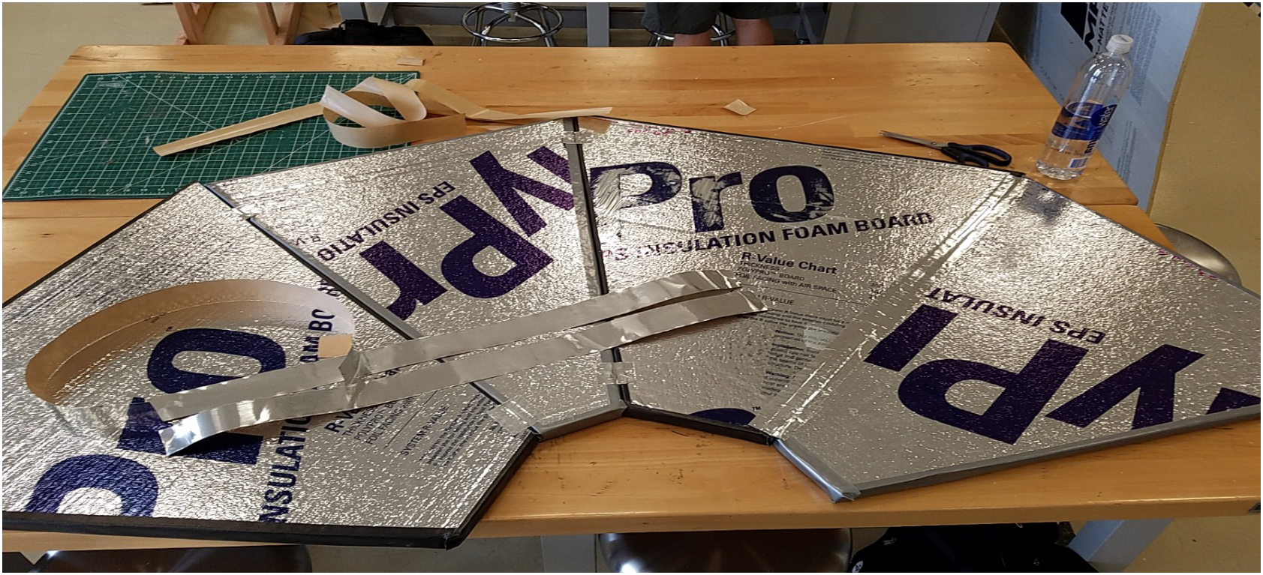
Joining the horn panels
Alternate large and small panels with the foil faces up.
Tape the adjoining edges, then fold the horn.
Seal the interior seams with foil tape.
Panels before folding. Photo: DSPIRA 2018.
Notes:
Source: Daniel Bonnett, DSPIRA 2018 construction presentation. Current construction instructions: https://wvurail.org/dspira/BuildingHornTelescope_Overview

Slide 7
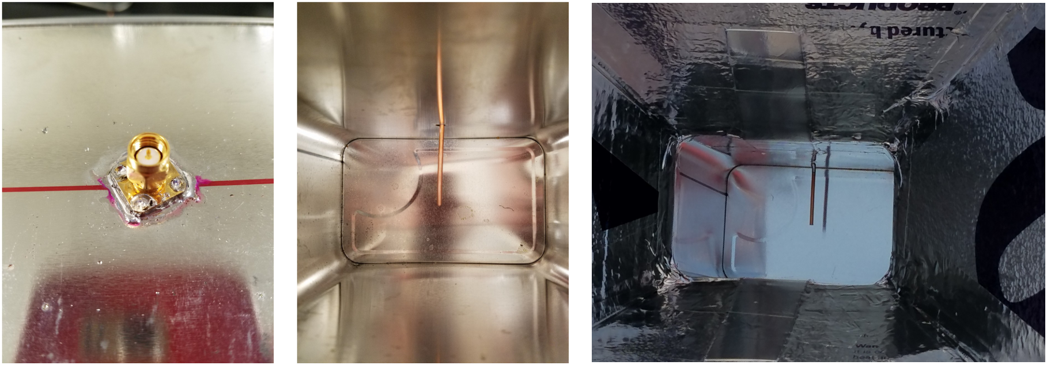
The can receiver
Use a new, empty can. The probe extends inside; the SMA connector stays outside. Photos: DSPIRA 2018.
Notes:
Source: Daniel Bonnett, DSPIRA 2018 construction presentation. Current construction instructions: https://wvurail.org/dspira/BuildingHornTelescope_Overview

Slide 8
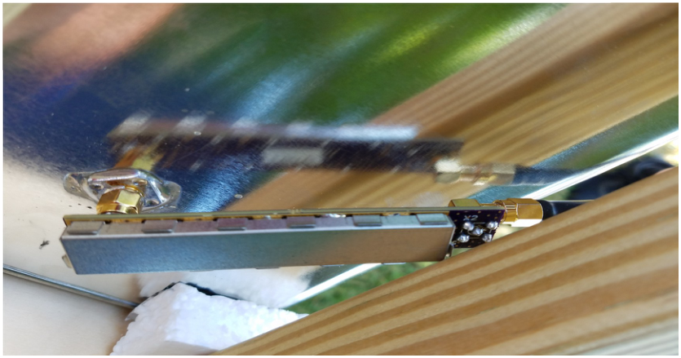
The low-noise amplifier
The LNA mounts directly on the can's SMA connector.
The cable connects the LNA to the radio.
Follow the receiver guide for power and connection settings.
LNA at the receiver. Photo: DSPIRA 2018.
Notes:
Source: Daniel Bonnett, DSPIRA 2018 construction presentation. Current construction instructions: https://wvurail.org/dspira/BuildingHornTelescope_Overview

Slide 9
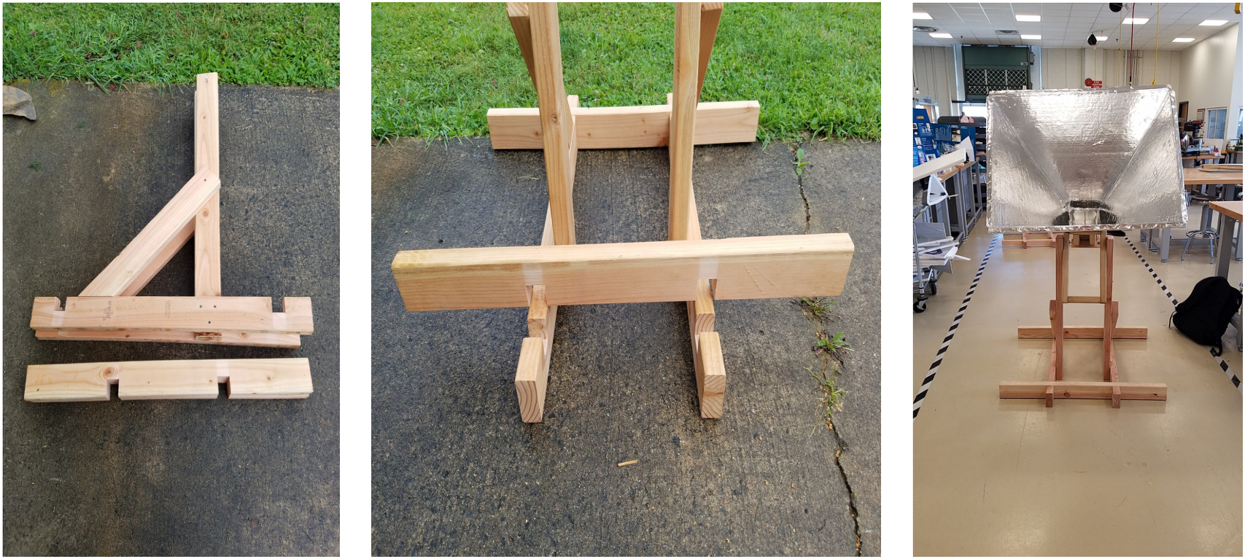
The telescope stand
Matching base notches and diagonal braces support the stand. Photos: DSPIRA 2018.
Notes:
Source: Daniel Bonnett, DSPIRA 2018 construction presentation. Current construction instructions: https://wvurail.org/dspira/BuildingHornTelescope_Overview

Slide 10
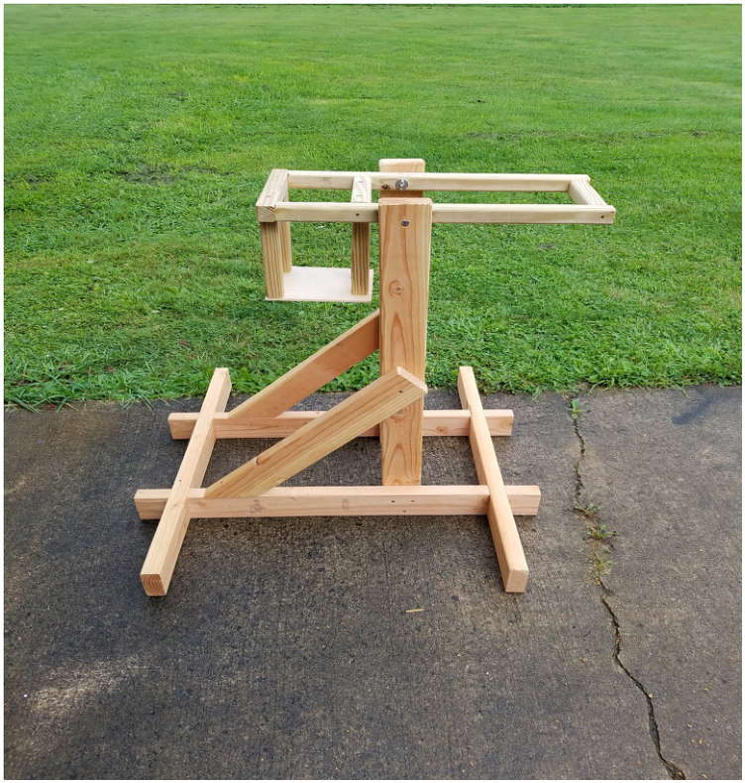
The horn cradle
The cradle holds the horn and adjusts its elevation.
Bolts, washers, and wing nuts connect it to the stand.
Check stability whenever you change the angle.
Cradle and stand. Photo: DSPIRA 2018.
Notes:
Source: Daniel Bonnett, DSPIRA 2018 construction presentation. Current construction instructions: https://wvurail.org/dspira/BuildingHornTelescope_Overview

Slide 11
Construction guides
Horn and can assembly
Stand assembly
Cradle assembly
Mini horn construction
Notes:
Source: Daniel Bonnett, DSPIRA 2018 construction presentation. Current construction instructions: https://wvurail.org/dspira/BuildingHornTelescope_Overview

