Slide 1

Galaxy Song!!!
From Monty Python’s “Meaning of Life”
http://www.youtube.com/watch?v=vIy76M-4txo
(PG-13) https://
www.youtube.com/watch?v=buqtdpuZxvk
Where are we?
http://www.youtube.com/watch?
v=17jymDn0W6U
Notes:
Source edition: assets/lessons/lectures/astronomy/motion-of-the-sky.pdf, page 1. Original author and figure credits remain on the slide. Text is editable; illustrations retain their source artwork.

Slide 2
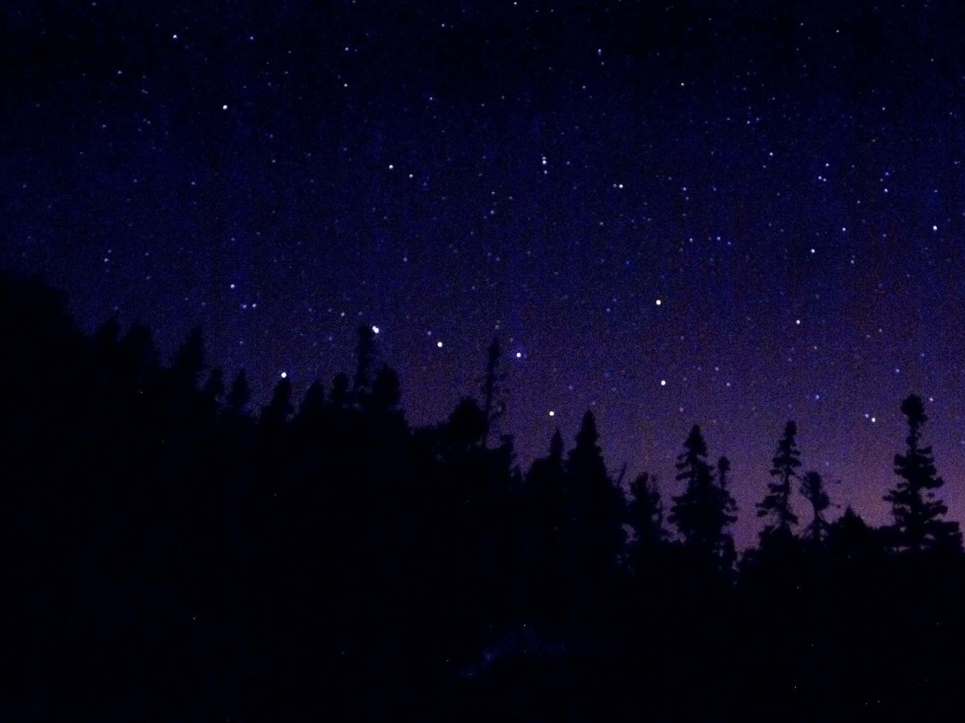
Motion of the sky
The Night Sky from Earth – Daily Motion
Notes:
Source edition: assets/lessons/lectures/astronomy/motion-of-the-sky.pdf, page 2. Original author and figure credits remain on the slide. Text is editable; illustrations retain their source artwork.

Slide 3
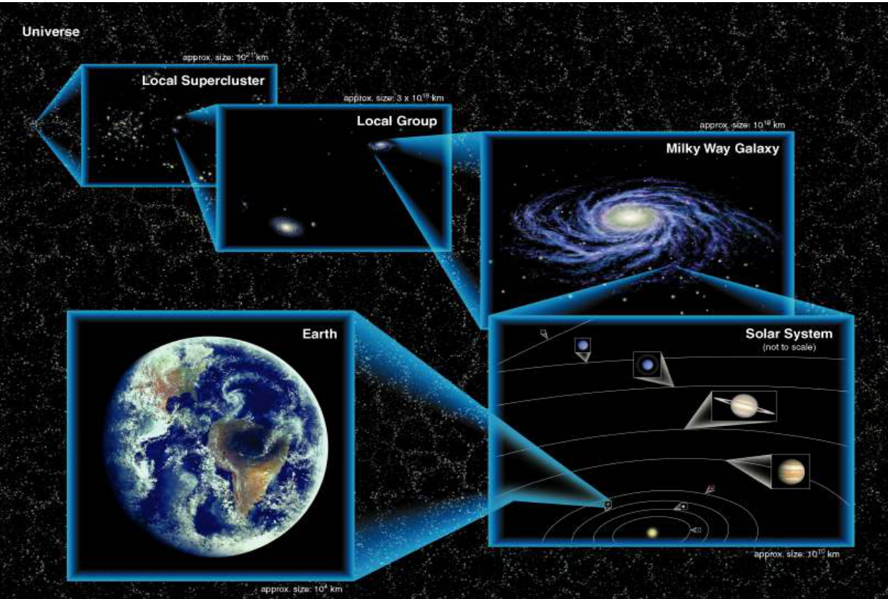
Lecture 1 Review (Where are we?)
Notes:
Source edition: assets/lessons/lectures/astronomy/motion-of-the-sky.pdf, page 3. Original author and figure credits remain on the slide. Text is editable; illustrations retain their source artwork.

Slide 4

The Night Sky
Goals for Today:
1) What does the Universe look like from
Earth?
2) What are constellations and asterisms?
3) What is the Celestial Sphere?
4)
How do stars move (daily)?
Words to know:
Asterism, celestial north
and south poles, horizon, zenith,
altitude, circumpolar
Notes:
Source edition: assets/lessons/lectures/astronomy/motion-of-the-sky.pdf, page 4. Original author and figure credits remain on the slide. Text is editable; illustrations retain their source artwork.

Slide 5
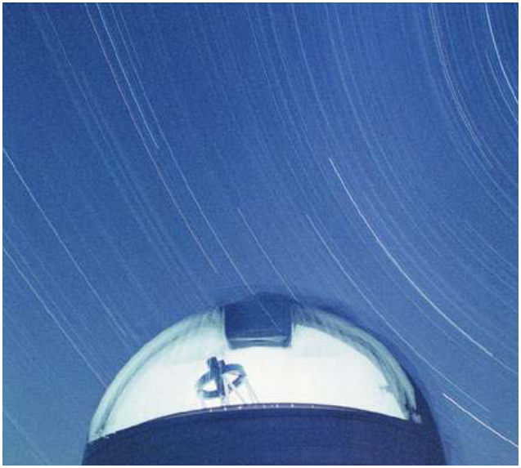
What does the Universe look like from Earth?
With the naked eye,
we can see more
than 2,000 stars.
We can also see the
Milky Way, most of
the planets, many
comets, a whole
bunch of satellites,
and some galaxies.
Notes:
Source edition: assets/lessons/lectures/astronomy/motion-of-the-sky.pdf, page 5. Original author and figure credits remain on the slide. Text is editable; illustrations retain their source artwork.

Slide 6
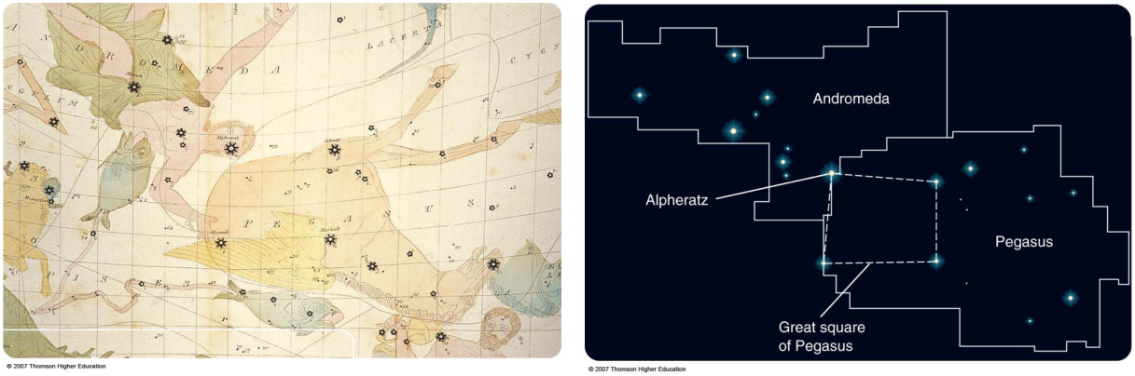
Constellations – Modern Definition
A
constellation
is a loose grouping of stars that
appear close together in the night sky
In ancient times, they included only bright stars.
Today, there are an agreed-upon set of 88
constellations that together divide the entire sky
•
Like a country boundary, “the star's
address”
Notes:
Source edition: assets/lessons/lectures/astronomy/motion-of-the-sky.pdf, page 6. Original author and figure credits remain on the slide. Text is editable; illustrations retain their source artwork.

Slide 7
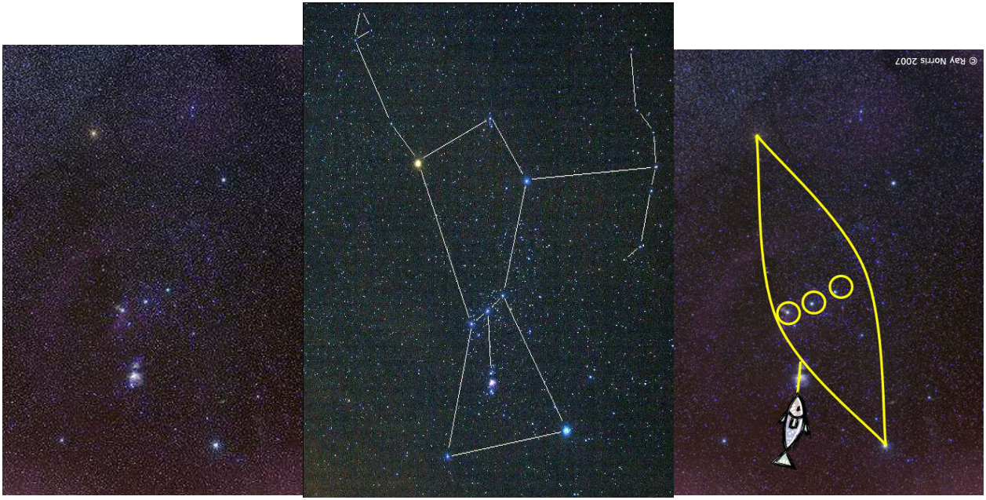
Constellations Culturally Defined
Constellations have been defined by many different cultures
Orion
Notes:
Source edition: assets/lessons/lectures/astronomy/motion-of-the-sky.pdf, page 7. Original author and figure credits remain on the slide. Text is editable; illustrations retain their source artwork.

Slide 8
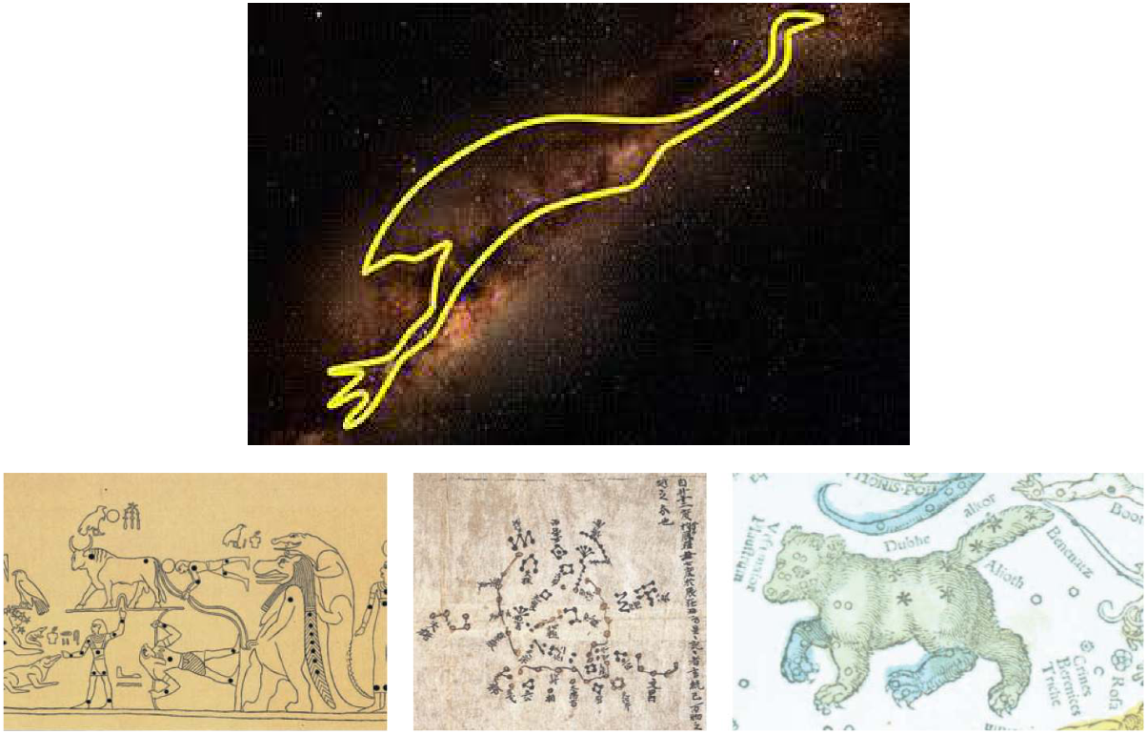
Ancient Constellations
Notes:
Source edition: assets/lessons/lectures/astronomy/motion-of-the-sky.pdf, page 8. Original author and figure credits remain on the slide. Text is editable; illustrations retain their source artwork.

Slide 9
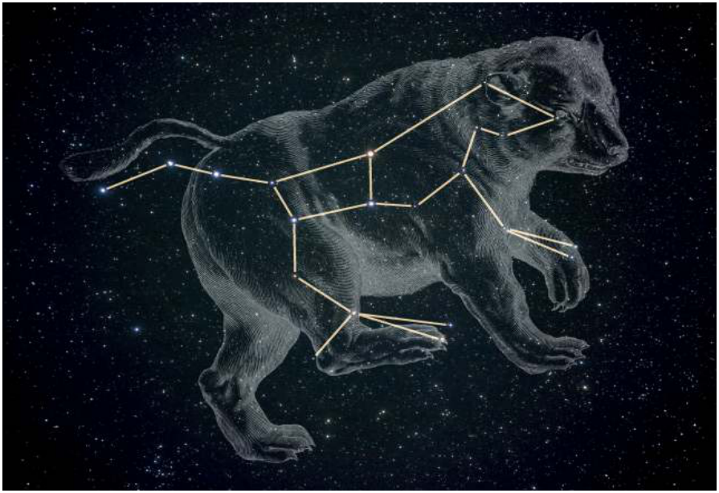
Asterisms
An
asterism
is a less formally defined grouping of stars,
that may be a part of one or more constellations; for
example, the Big Dipper in Ursa Major
Notes:
Source edition: assets/lessons/lectures/astronomy/motion-of-the-sky.pdf, page 9. Original author and figure credits remain on the slide. Text is editable; illustrations retain their source artwork.

Slide 10
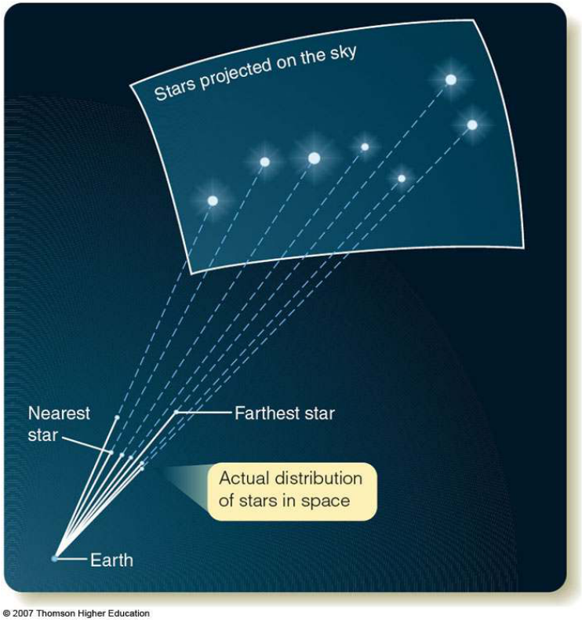
Constellations Are Not Real Groups
The stars in
constellations
and asterisms
are not
necessarily
physically
close to each
other.
Notes:
Source edition: assets/lessons/lectures/astronomy/motion-of-the-sky.pdf, page 10. Original author and figure credits remain on the slide. Text is editable; illustrations retain their source artwork.

Slide 11
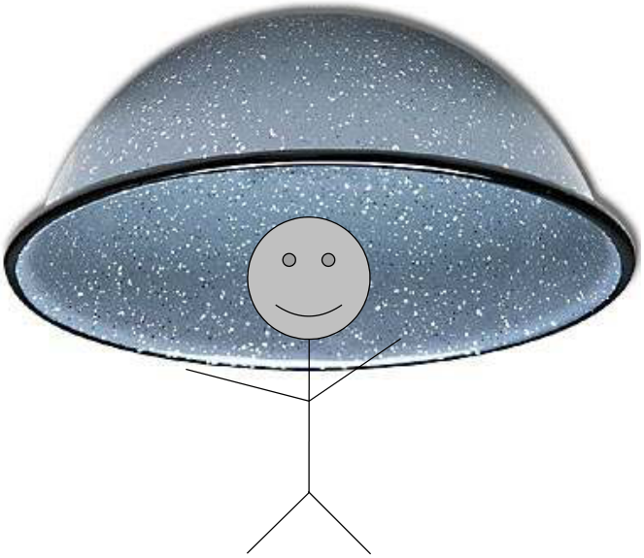
The Celestial Sphere
The
celestial sphere
is a
model
of the sky that helps
us visualize the location and motion of stars.
Notes:
Source edition: assets/lessons/lectures/astronomy/motion-of-the-sky.pdf, page 11. Original author and figure credits remain on the slide. Text is editable; illustrations retain their source artwork.

Slide 12
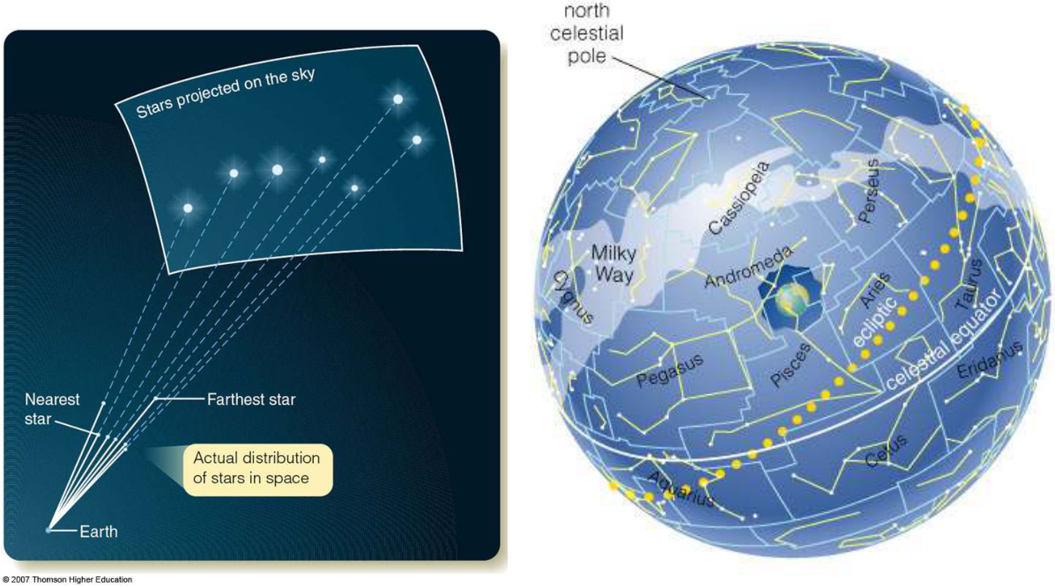
The Celestial Sphere is not Real!
It is a model - the stars are not literally on a sphere.
Notes:
Source edition: assets/lessons/lectures/astronomy/motion-of-the-sky.pdf, page 12. Original author and figure credits remain on the slide. Text is editable; illustrations retain their source artwork.

Slide 13
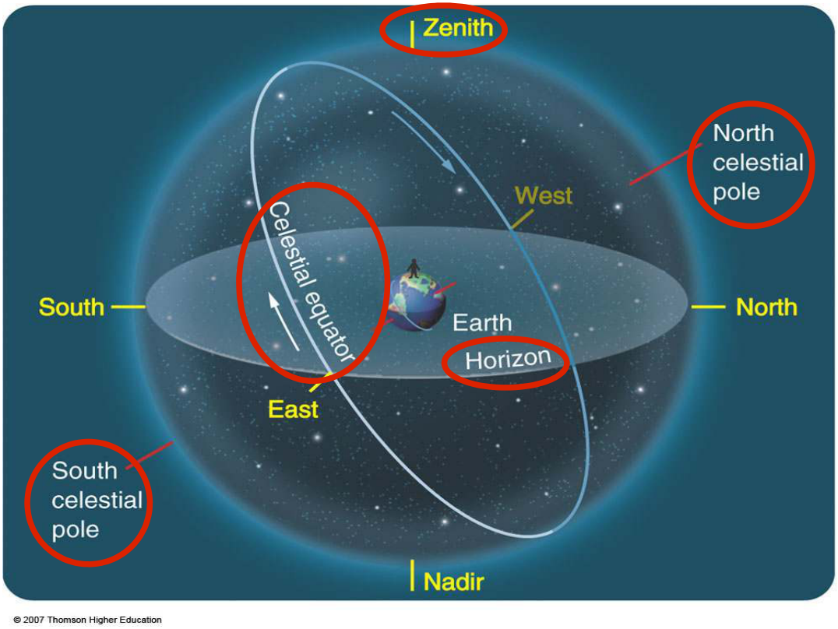
Celestial Sphere from Morgantown
Notes:
Source edition: assets/lessons/lectures/astronomy/motion-of-the-sky.pdf, page 13. Original author and figure credits remain on the slide. Text is editable; illustrations retain their source artwork.

Slide 14
Celestial Sphere Definitions
Celestial equator
:
the projection of the Earth's
equator onto the sphere.
Horizon
: the limit to what can be seen from a
particular vantage point
North/South Celestial Poles
: the projection of
the North/South Poles onto the Celestial
Sphere
Zenith
: the point directly overhead
Notes:
Source edition: assets/lessons/lectures/astronomy/motion-of-the-sky.pdf, page 14. Original author and figure credits remain on the slide. Text is editable; illustrations retain their source artwork.

Slide 15
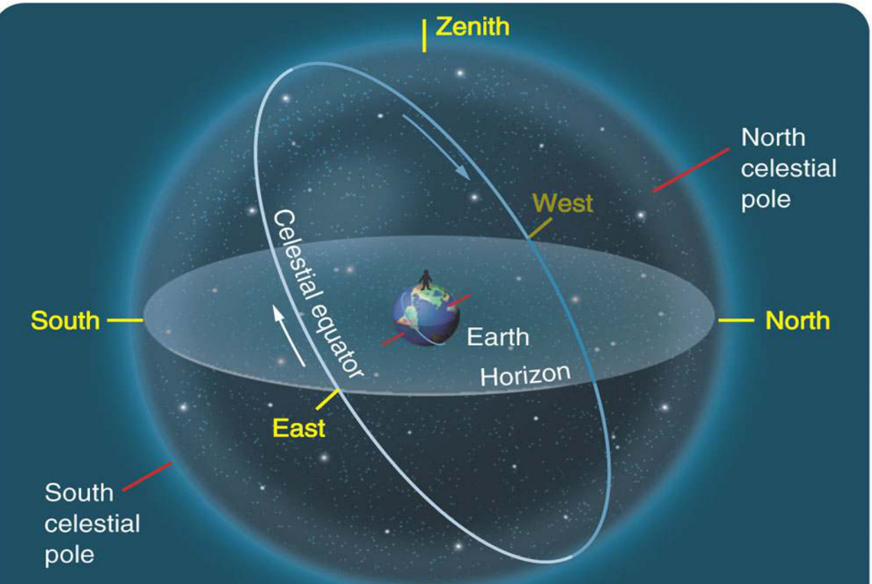
Another View
Notes:
Source edition: assets/lessons/lectures/astronomy/motion-of-the-sky.pdf, page 15. Original author and figure credits remain on the slide. Text is editable; illustrations retain their source artwork.

Slide 16
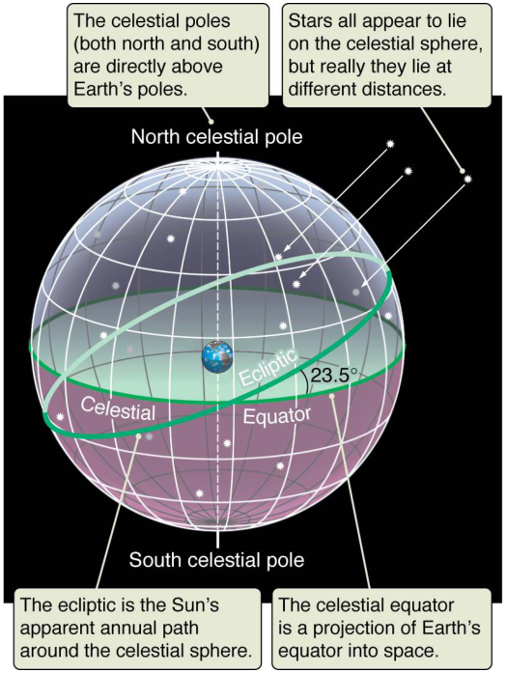
The Celestial Sphere
Ecliptic:
Path of the Sun,
inclined 23.5 degrees to
equator
23.5 degrees !!!
Notes:
Source edition: assets/lessons/lectures/astronomy/motion-of-the-sky.pdf, page 16. Original author and figure credits remain on the slide. Text is editable; illustrations retain their source artwork.

Slide 17
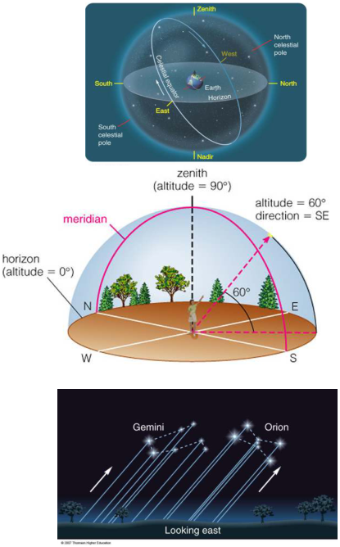
Three Views
You should be able to go back and
forth between three different views of
the sky:
1) Above Earth
2) Above the viewer
3) Viewer’s perspective
Notes:
Source edition: assets/lessons/lectures/astronomy/motion-of-the-sky.pdf, page 17. Original author and figure credits remain on the slide. Text is editable; illustrations retain their source artwork.

Slide 18
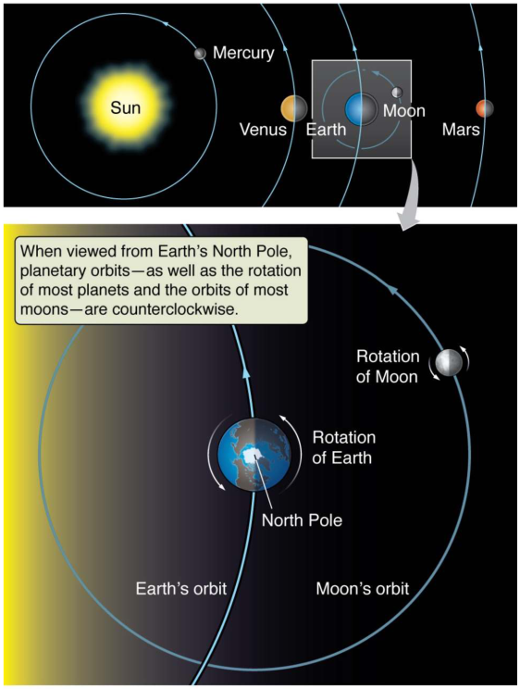
Earth Rotates on its Axis
There are two main
motions that affect what
we see in the sky:
Motion #1:
The Earth rotates on its
axis. This causes stars to
appear to rotate around
the north and south
celestial
poles. The
complete rotation of each
star takes 24 hours.
(Motion #2 will be
discussed next class)
Notes:
Source edition: assets/lessons/lectures/astronomy/motion-of-the-sky.pdf, page 18. Original author and figure credits remain on the slide. Text is editable; illustrations retain their source artwork.

Slide 19
The Celestial Sphere Moves! (Daily)
Main points:
1)
The motion of the stars can be understood as
the 24 hour motion of the celestial sphere.
2)
We see stars (and the Moon and the Sun) rise
in the East and set in the West
<- Important!
3)
Stars appear to orbit the north celestial pole
In the north, there is a star very near the north
celestial pole called the “North Star” or Polaris
4)
Some stars are always visible - these are called
“circumpolar”
5)
Some stars are never visible!
What we see depends on the direction we are facing!
Notes:
Source edition: assets/lessons/lectures/astronomy/motion-of-the-sky.pdf, page 19. Original author and figure credits remain on the slide. Text is editable; illustrations retain their source artwork.

Slide 20
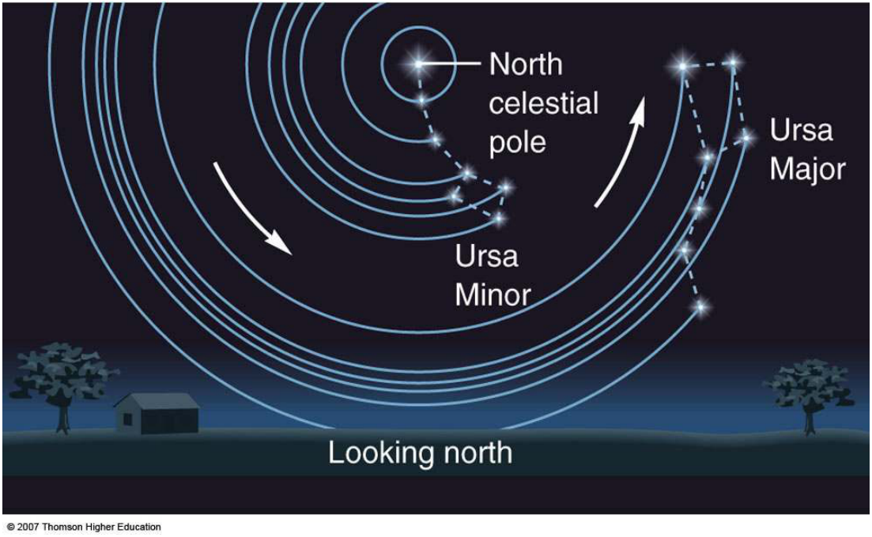
Motion of the sky
Looking North (from the Northern Hemisphere)
Some of these stars are
circumpolar
, never rising
or setting.
Notes:
Source edition: assets/lessons/lectures/astronomy/motion-of-the-sky.pdf, page 20. Original author and figure credits remain on the slide. Text is editable; illustrations retain their source artwork.

Slide 21
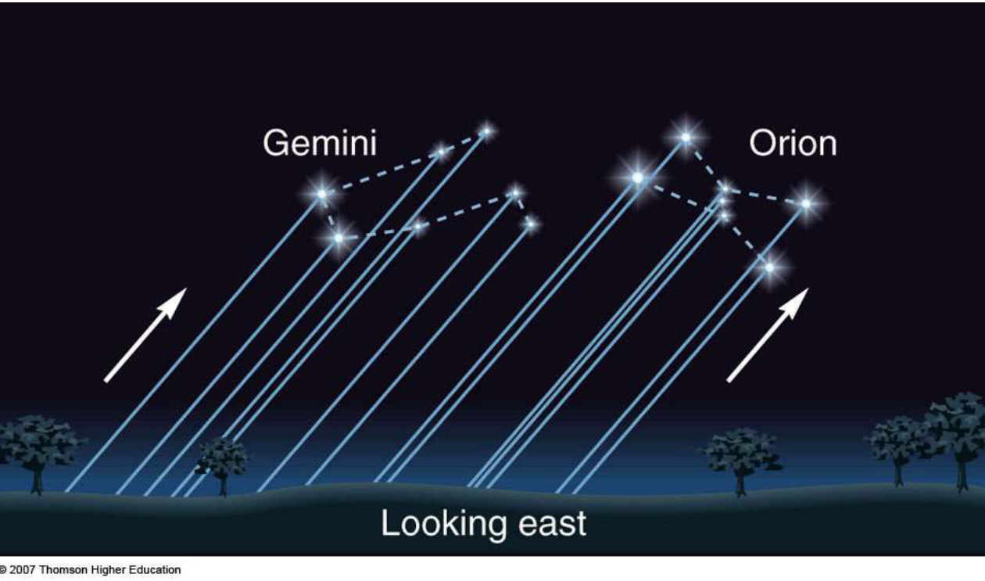
Motion of the sky
Looking East (from the Northern Hemisphere)
Stars rise in the East….
Notes:
Source edition: assets/lessons/lectures/astronomy/motion-of-the-sky.pdf, page 21. Original author and figure credits remain on the slide. Text is editable; illustrations retain their source artwork.

Slide 22
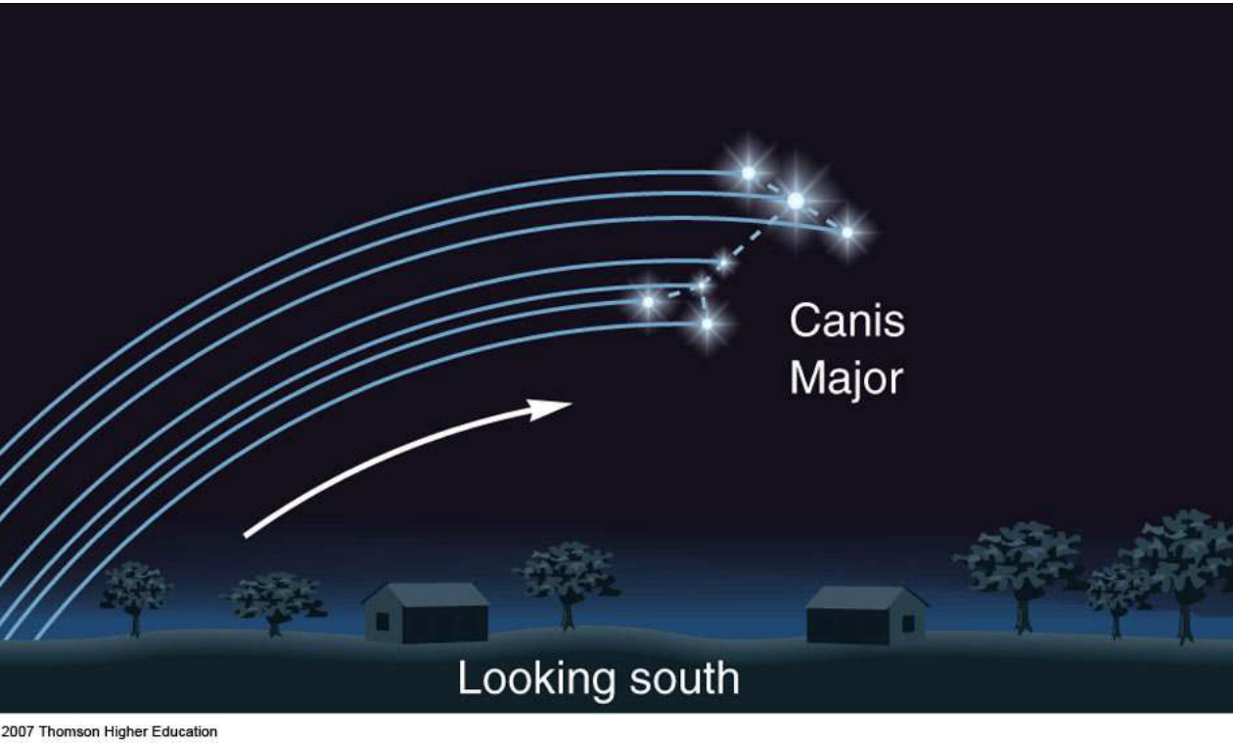
Motion of the sky
Looking South (from the Northern Hemisphere)
Pass through the South and set in the West.
Notes:
Source edition: assets/lessons/lectures/astronomy/motion-of-the-sky.pdf, page 22. Original author and figure credits remain on the slide. Text is editable; illustrations retain their source artwork.

Slide 23
VIDEOS!!!!
http://www.youtube.com/watch?
v=3V3rmDG5J8A
http://www.youtube.com/watch?
v=uHcRPJFR47Q
http://www.youtube.com/watch?
v=ANAmiuAkyGQ
Notes:
Source edition: assets/lessons/lectures/astronomy/motion-of-the-sky.pdf, page 23. Original author and figure credits remain on the slide. Text is editable; illustrations retain their source artwork.

Slide 24
Object Rise/Set Directions
1) The direction an object rises determines
where it sets
An object rising due East will set due West
An object rising South-East will set in the
South-West
An object rising North-East will set North-
West
2) The direction an object rises determines
the amount of time it is visible.
Notes:
Source edition: assets/lessons/lectures/astronomy/motion-of-the-sky.pdf, page 24. Original author and figure credits remain on the slide. Text is editable; illustrations retain their source artwork.

Slide 25
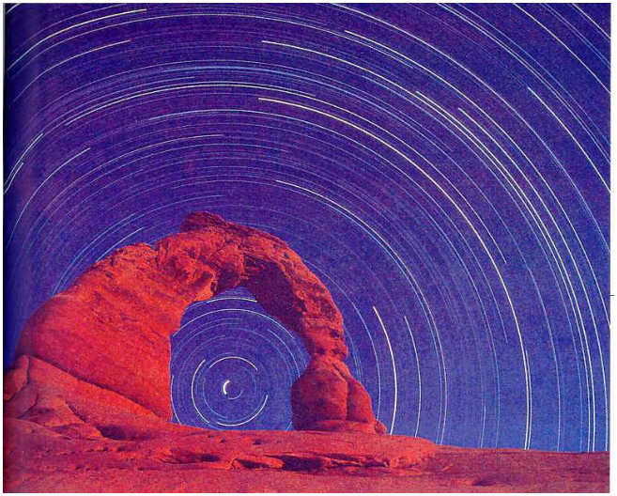
Concept Quiz
Which direction is the observer facing
in this picture (photo was taken from
the northern hemisphere)?
a) North
b) East
c)
South
d) West
Notes:
Source edition: assets/lessons/lectures/astronomy/motion-of-the-sky.pdf, page 25. Original author and figure credits remain on the slide. Text is editable; illustrations retain their source artwork.

Slide 26
Concept Quiz
Which direction is the observer facing
in this picture (photo was taken from
the northern hemisphere)?
a) North
b) East
c)
South
d) West
Notes:
Source edition: assets/lessons/lectures/astronomy/motion-of-the-sky.pdf, page 26. Original author and figure credits remain on the slide. Text is editable; illustrations retain their source artwork.

Slide 27
In your Lecture-Tutorials Book
Do “Position”, page 1, #1-9, 11 (skip
#10)
Work in pairs or small groups
Ask other groups for help
Have fun!
I'll give you ~10 min.
Notes:
Source edition: assets/lessons/lectures/astronomy/motion-of-the-sky.pdf, page 27. Original author and figure credits remain on the slide. Text is editable; illustrations retain their source artwork.

Slide 28
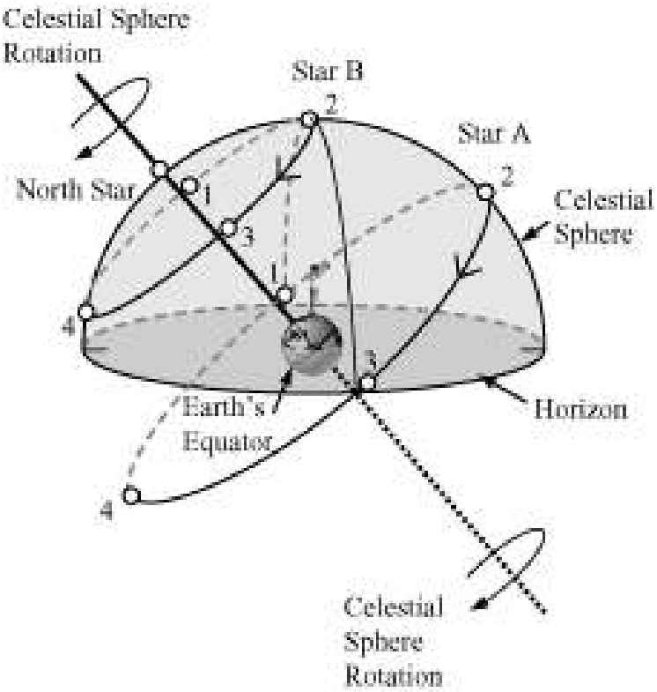
Motion of the sky
Notes:
Source edition: assets/lessons/lectures/astronomy/motion-of-the-sky.pdf, page 28. Original author and figure credits remain on the slide. Text is editable; illustrations retain their source artwork.

Slide 29
More!
Lecture-Tutorials “Motion” #1-6
Notes:
Source edition: assets/lessons/lectures/astronomy/motion-of-the-sky.pdf, page 29. Original author and figure credits remain on the slide. Text is editable; illustrations retain their source artwork.

Slide 30
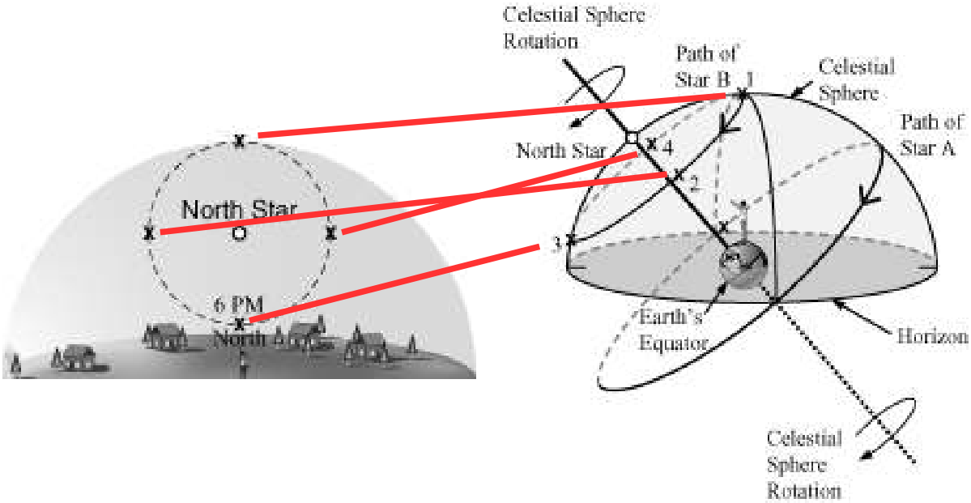
LT - Motion
Notes:
Source edition: assets/lessons/lectures/astronomy/motion-of-the-sky.pdf, page 30. Original author and figure credits remain on the slide. Text is editable; illustrations retain their source artwork.

Slide 31

Animations
Rotating Sky Explorer - UNL
https://astro.unl.edu/naap/motion2/animations/ce_hc.html
Things to notice:
1) Circumpolar, and “not visible”
regions
2) How these change with latitude on
Earth
https://www.solarsystemscope.com
Notes:
Source edition: assets/lessons/lectures/astronomy/motion-of-the-sky.pdf, page 31. Original author and figure credits remain on the slide. Text is editable; illustrations retain their source artwork.

Slide 32
The Night Sky
Goals for Today:
1) What does the Universe look like from Earth?
–
We can see ~2000 stars, a few Galaxies and the
Milky Way
2) What are constellations and asterisms?
–
Constellations are regions on the sky enclosing
groupings of stars. Asterisms are less-formal
groupings of stars
3) What is the Celestial Sphere?
–
The projection of all of space onto a sphere that we
are inside of
Notes:
Source edition: assets/lessons/lectures/astronomy/motion-of-the-sky.pdf, page 32. Original author and figure credits remain on the slide. Text is editable; illustrations retain their source artwork.

Slide 33
A User's Guide to the Night Sky
4) How do stars move?
- Stars rise in the East and set in the West.
- They appear to circle around the North
Celestial Pole (in the northern hemisphere)
- Their entire motion takes 24 hours
- The location where the rise determines
where they will set
- Some stars are never visible
Words to know: Asterism, celestial north and
south poles, horizon, zenith, altitude,
circumpolar
Notes:
Source edition: assets/lessons/lectures/astronomy/motion-of-the-sky.pdf, page 33. Original author and figure credits remain on the slide. Text is editable; illustrations retain their source artwork.

