Slide 1

All galaxies great and small
D.J. Pisano
July 13, 2017
Notes:
Source edition: assets/lessons/lectures/astronomy/all-galaxies-great-and-small.pdf, page 1. Original author and figure credits remain on the slide. Text is editable; illustrations retain their source artwork.

Slide 2
Populations of stars
Stars in galaxies can be divided into two
populations:
• Population I
• Population II
Population I stars are in the
disk.
They are
younger, bluer and contain more
metals.
Population II stars are in the
halo
and
bulge
.
They are older, redder, and contain fewer
metals.
Notes:
Source edition: assets/lessons/lectures/astronomy/all-galaxies-great-and-small.pdf, page 2. Original author and figure credits remain on the slide. Text is editable; illustrations retain their source artwork.

Slide 3
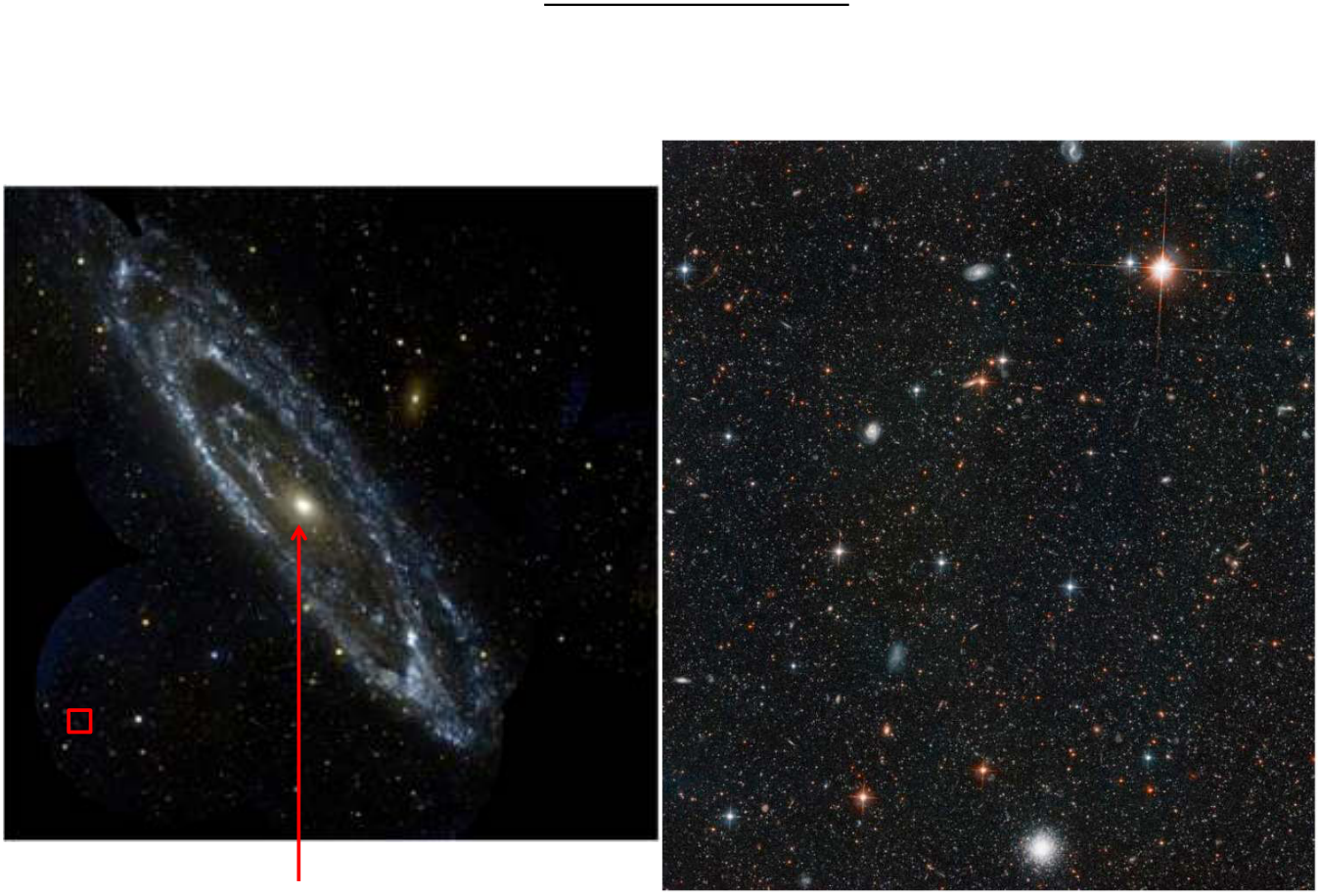
All galaxies great and small
For the bulge & halo:
Are they red or blue?
Are the stars lower or higher mass than the disk?
Are the stars younger or older than the disk stars?
Bulge
Halo stars
Notes:
Source edition: assets/lessons/lectures/astronomy/all-galaxies-great-and-small.pdf, page 3. Original author and figure credits remain on the slide. Text is editable; illustrations retain their source artwork.

Slide 4
Milky Way Structure
•
Disk
–
diameter of 30 kpc and 1 kpc thick near the Sun
–
Sun is located 8.5 kpc from center of Milky Way in the disk
–
active star formation in disk
•
Bulge
–
diameter of 4 kpc located at the center of the galaxy
–
more spherical than disk
–
supermassive black hole at the center (in nucleus)
•
Bar
–
seen in stars and dust, extends 6 kpc through center of galaxy
•
Halo
–
100s of kpc in diameter, only contains 2% of stars in galaxy
–
includes globular clusters and
dark matter
composing most of
the mass of galaxy.
Notes:
Source edition: assets/lessons/lectures/astronomy/all-galaxies-great-and-small.pdf, page 4. Original author and figure credits remain on the slide. Text is editable; illustrations retain their source artwork.

Slide 5
Ages of stars in the Milky Way
•
Disk stars: 0-10 billion years old, metal-rich
(Population I)
–
Spiral arms have stars < 100 million years old
–
stars in the rest of the disk, 0.2-10 billion years old
•
Bulge stars: 2-10 billion years old, metal-poor
(Population II)
•
Halo stars: 10-13 billion years old, very metal-
poor (Population II)
Notes:
Source edition: assets/lessons/lectures/astronomy/all-galaxies-great-and-small.pdf, page 5. Original author and figure credits remain on the slide. Text is editable; illustrations retain their source artwork.

Slide 6
All galaxies great and small
So what about other galaxies?
Notes:
Source edition: assets/lessons/lectures/astronomy/all-galaxies-great-and-small.pdf, page 6. Original author and figure credits remain on the slide. Text is editable; illustrations retain their source artwork.

Slide 7
All galaxies great and small
The Milky Way is just one of
billions of galaxies…
Notes:
Source edition: assets/lessons/lectures/astronomy/all-galaxies-great-and-small.pdf, page 7. Original author and figure credits remain on the slide. Text is editable; illustrations retain their source artwork.

Slide 8
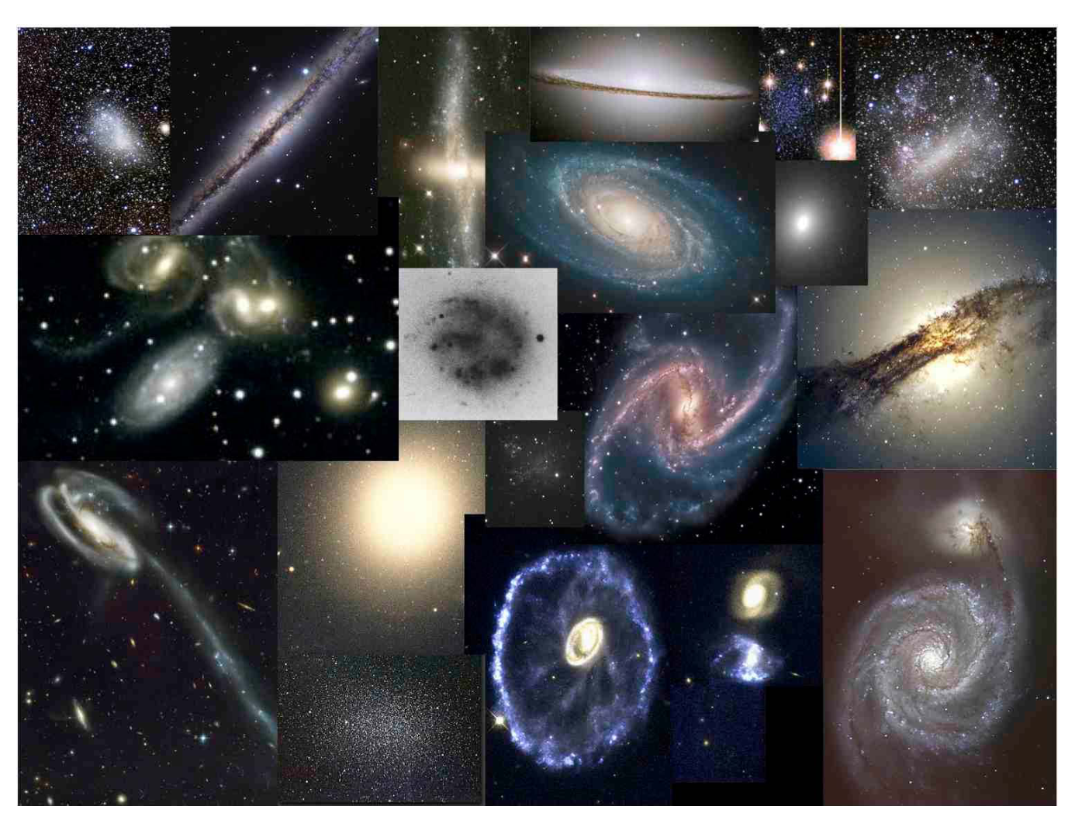
The Galaxy Zoo
Galaxies come in all shapes and sizes. To make sense of
them, astronomers classify them based on their appearance.
Notes:
Source edition: assets/lessons/lectures/astronomy/all-galaxies-great-and-small.pdf, page 8. Original author and figure credits remain on the slide. Text is editable; illustrations retain their source artwork.

Slide 9
Classifying objects
Before we try classifying galaxies, let’s start with
something more down-to-Earth:
Imagine that you are an alien visiting Earth and
want to learn about the human lifecycle, but you
only have 10 minutes to do so. So you take a
bunch of pictures to sort it out.
What conclusions can you divine just from
looking at the following photos?
Notes:
Source edition: assets/lessons/lectures/astronomy/all-galaxies-great-and-small.pdf, page 9. Original author and figure credits remain on the slide. Text is editable; illustrations retain their source artwork.

Slide 10

All galaxies great and small
Notes:
Source edition: assets/lessons/lectures/astronomy/all-galaxies-great-and-small.pdf, page 10. Original author and figure credits remain on the slide. Text is editable; illustrations retain their source artwork.

Slide 11
Classifying Galaxies
What did you notice about the galaxies you
looked at?
What properties of galaxies can we see in
the following slide that would be helpful to
classify them?
Which properties are
intrinsic
and which are
extrinsic
to the galaxy?
Notes:
Source edition: assets/lessons/lectures/astronomy/all-galaxies-great-and-small.pdf, page 11. Original author and figure credits remain on the slide. Text is editable; illustrations retain their source artwork.

Slide 12
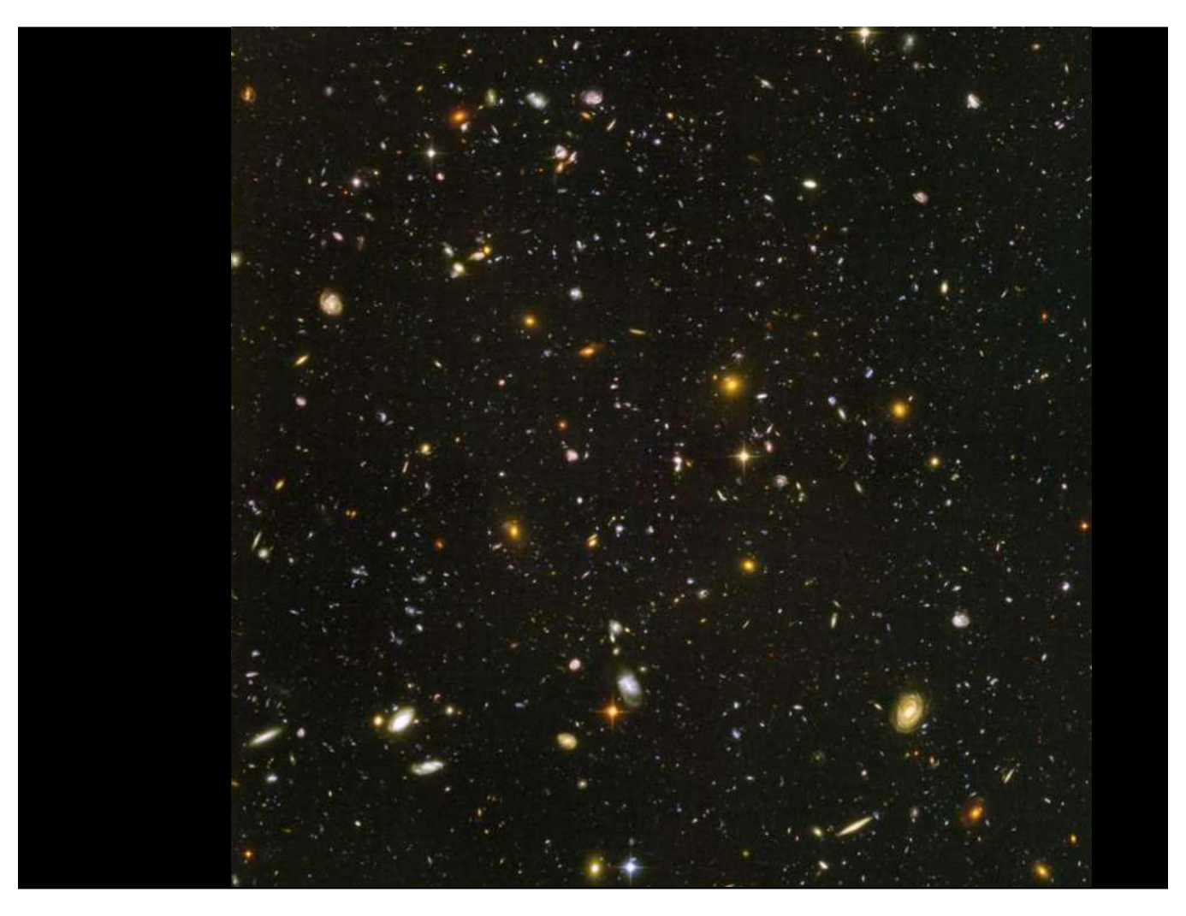
All galaxies great and small
Hubble
Ultra
Deep
Field
Notes:
Source edition: assets/lessons/lectures/astronomy/all-galaxies-great-and-small.pdf, page 12. Original author and figure credits remain on the slide. Text is editable; illustrations retain their source artwork.

Slide 13
Galaxy Properties
Intrinsic:
Extrinsic:
Luminosity
apparent brightness
Physical size
apparent size
morphology
distance
color
environment
mass
color?
others?
morphology?
others?
Notes:
Source edition: assets/lessons/lectures/astronomy/all-galaxies-great-and-small.pdf, page 13. Original author and figure credits remain on the slide. Text is editable; illustrations retain their source artwork.

Slide 14
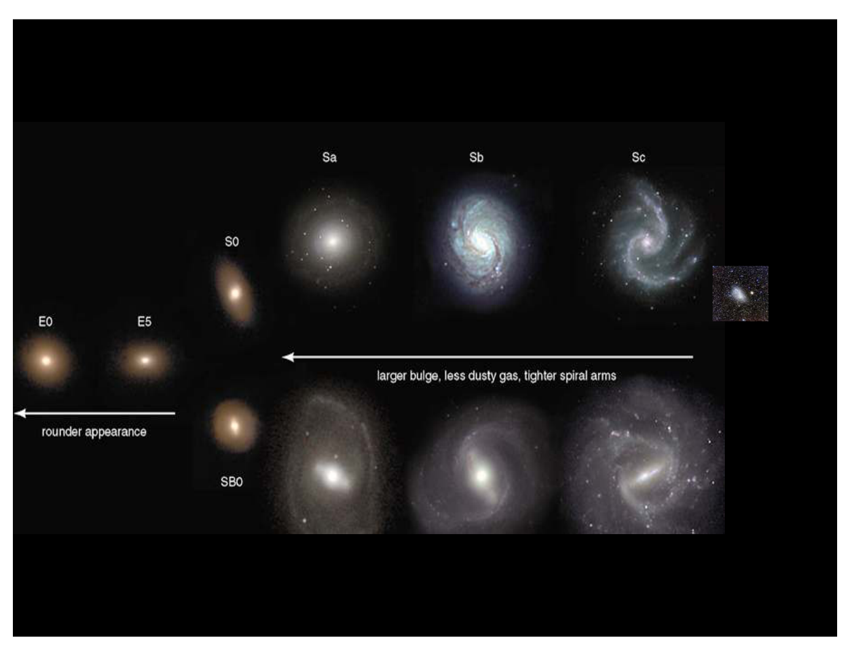
Hubble Tuning Fork
Irr
Ellipticals
Spirals
Irregulars
Notes:
Source edition: assets/lessons/lectures/astronomy/all-galaxies-great-and-small.pdf, page 14. Original author and figure credits remain on the slide. Text is editable; illustrations retain their source artwork.

Slide 15
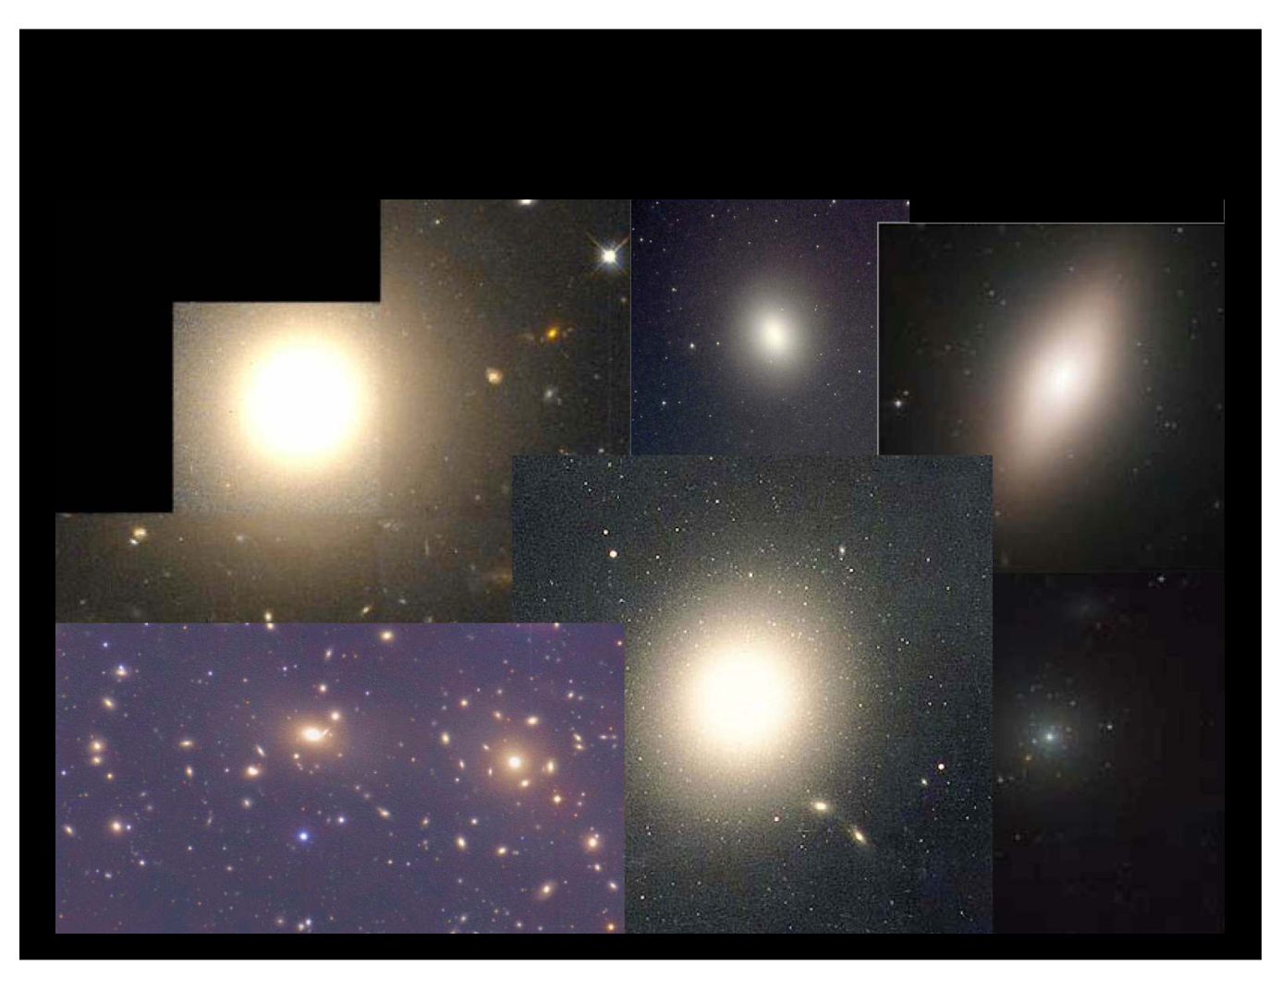
Elliptical Galaxies
Notes:
Source edition: assets/lessons/lectures/astronomy/all-galaxies-great-and-small.pdf, page 15. Original author and figure credits remain on the slide. Text is editable; illustrations retain their source artwork.

Slide 16
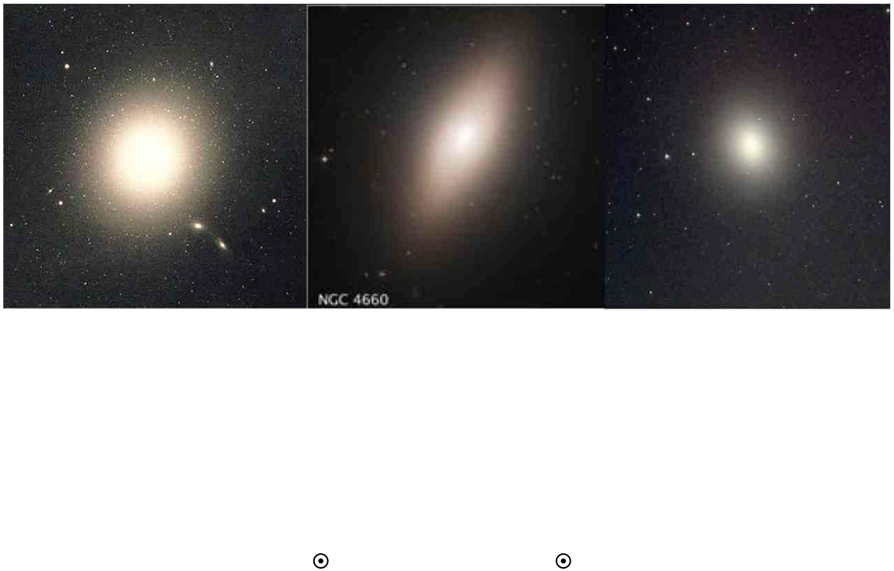
Elliptical Galaxies
•
Spherical, Football-shaped (oblong), or flattened football
(triaxial) collections of stars.
•
Very little gas or dust. Many have lots of X-ray emitting hot
gas. Mostly old stars.
•
Most reside in galaxy clusters
•
Luminosities ≥ 10
12
L
, Mass ≥ 10
12
M
. These represent the
most massive, luminous galaxies in the Universe.
•
However, some are
dwarfs
(much smaller than Milky Way).
Notes:
Source edition: assets/lessons/lectures/astronomy/all-galaxies-great-and-small.pdf, page 16. Original author and figure credits remain on the slide. Text is editable; illustrations retain their source artwork.

Slide 17
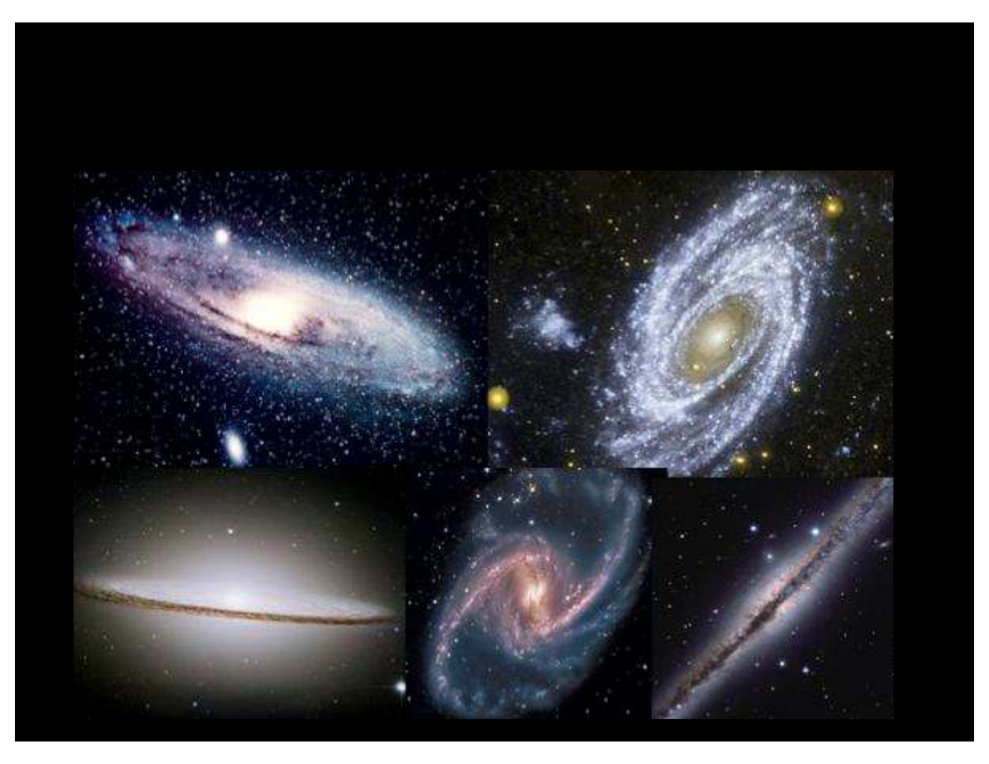
Spiral Galaxies
Notes:
Source edition: assets/lessons/lectures/astronomy/all-galaxies-great-and-small.pdf, page 17. Original author and figure credits remain on the slide. Text is editable; illustrations retain their source artwork.

Slide 18
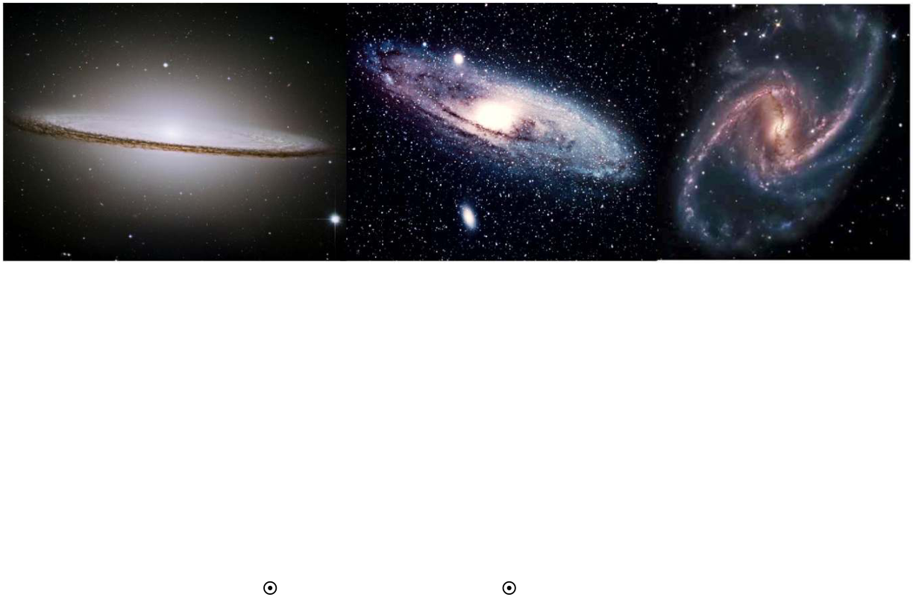
Spiral Galaxies
•
Rotating, flattened disks of stars, gas, and dust.
•
Have spiral arms and, sometimes, bars.
•
Also have bulges (some small) and halos (not visible here)
•
See at different angles from edge-on (left) to face-on (right).
•
Contain young and old stars.
•
Masses and luminosities similar to Milky Way:
L ~ 10
9
– 10
11
L
, M ~ 10
8
– 10
11
M
Notes:
Source edition: assets/lessons/lectures/astronomy/all-galaxies-great-and-small.pdf, page 18. Original author and figure credits remain on the slide. Text is editable; illustrations retain their source artwork.

Slide 19
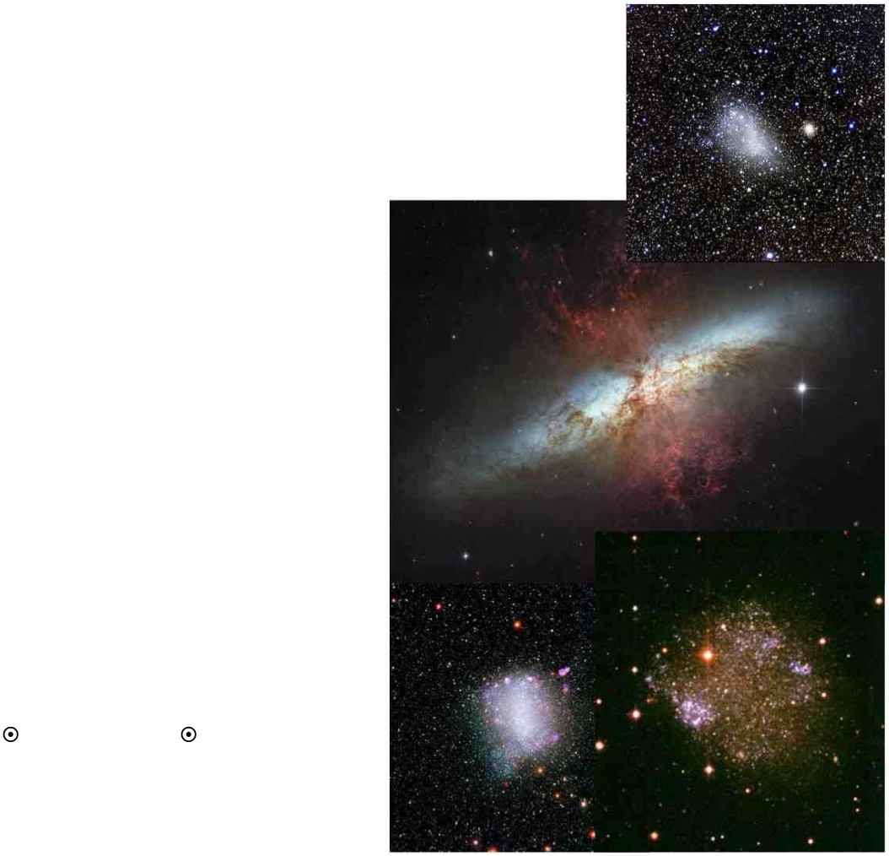
Irregular Galaxies
•
Fat-disks, but no spiral
structure. No bulge.
•
Dominated by young stars,
some old stars, but not many.
•
Often have lots of star
formation (middle image).
•
Along with spirals, they reside
in all environments.
•
Luminosities and masses
lower than spirals:
L ≤ 10
8
L
, M ≤ 10
8
M
Notes:
Source edition: assets/lessons/lectures/astronomy/all-galaxies-great-and-small.pdf, page 19. Original author and figure credits remain on the slide. Text is editable; illustrations retain their source artwork.

Slide 20
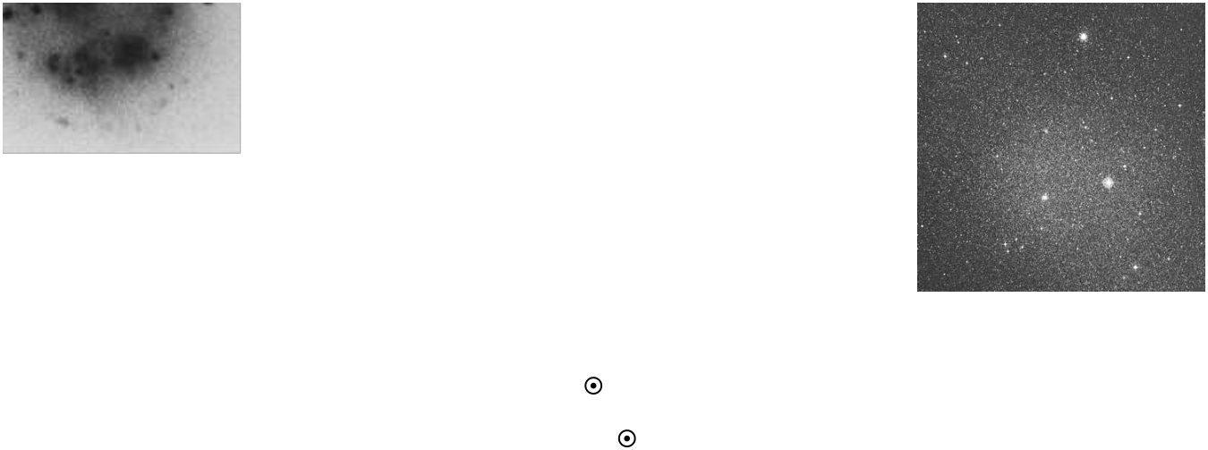
Dwarf galaxies
•
Galaxies that are much, much smaller than
giant
galaxies.
•
Luminosities as low as 10
3
L
(fainter than some stars)
•
Masses as low as 100-1000 M
•
Sizes of ~ 1 kpc, but some as low as 10’s of parsecs
(compared to 10-100 kpc for giant spirals and ellipticals)
•
Found in all environments
•
Dwarf irregulars may have some gas and dust and star
formation (left).
•
Dwarf spheroidals (or ellipticals) typically have no ongoing
star formation, and have fewer young stars (right).
Notes:
Source edition: assets/lessons/lectures/astronomy/all-galaxies-great-and-small.pdf, page 20. Original author and figure credits remain on the slide. Text is editable; illustrations retain their source artwork.

Slide 21
Which of the following is correctly ordered by increasing average mass?
A.
elliptical, spiral, irregular, dwarf spheroidal
B.
dwarf spheroidal, elliptical, irregular, spiral
C.
dwarf irregular, spiral, irregular, elliptical
D.
dwarf spheroidal, irregular, spiral, elliptical
Notes:
Source edition: assets/lessons/lectures/astronomy/all-galaxies-great-and-small.pdf, page 21. Original author and figure credits remain on the slide. Text is editable; illustrations retain their source artwork.

Slide 22
Which of the following would appear the most red?
A.
Irregulars
B.
Spirals
C.
Ellipticals
D.
Dwarf irregulars
E.
They are all the same.
Notes:
Source edition: assets/lessons/lectures/astronomy/all-galaxies-great-and-small.pdf, page 22. Original author and figure credits remain on the slide. Text is editable; illustrations retain their source artwork.

Slide 23
Which of the following typically lacks young stars?
A.
Irregulars
B.
Spirals
C.
Ellipticals
D.
Dwarf irregulars
E.
None of the above
Notes:
Source edition: assets/lessons/lectures/astronomy/all-galaxies-great-and-small.pdf, page 23. Original author and figure credits remain on the slide. Text is editable; illustrations retain their source artwork.

Slide 24
Which of the following contains old stars?
A.
Irregulars
B.
Spirals
C.
Ellipticals
D.
Dwarf irregulars
E.
They all contain very old stars
Notes:
Source edition: assets/lessons/lectures/astronomy/all-galaxies-great-and-small.pdf, page 24. Original author and figure credits remain on the slide. Text is editable; illustrations retain their source artwork.

Slide 25
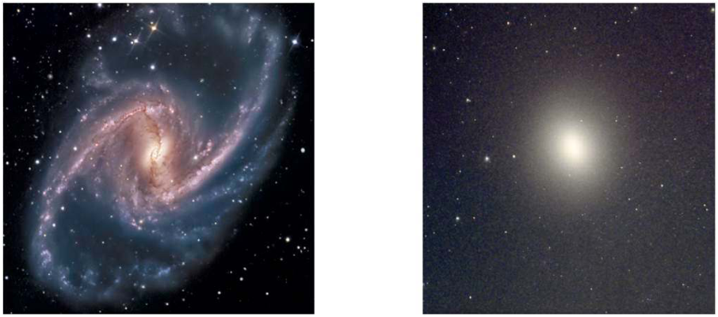
All galaxies great and small
A
B
In which of the galaxies above would
you expect to see bright, blue stars?
A.
Only galaxy A
B.
Only galaxy B
C.
Both galaxies
D.
Neither galaxy
Notes:
Source edition: assets/lessons/lectures/astronomy/all-galaxies-great-and-small.pdf, page 25. Original author and figure credits remain on the slide. Text is editable; illustrations retain their source artwork.

Slide 26
Why are the arms of spiral galaxies typically blue in color?
A.
They are usually moving towards us and are
Doppler shifted to blue wavelengths.
B.
The gas and dust in the arms filter out all but
the blue light from stars in the arms.
C.
Stars are forming in the arms, so there are high
mass, hot, blue stars in the arms.
D.
Almost all the stars are in the arms of the disk
of the galaxy and their light makes the arms
appear blue.
Notes:
Source edition: assets/lessons/lectures/astronomy/all-galaxies-great-and-small.pdf, page 26. Original author and figure credits remain on the slide. Text is editable; illustrations retain their source artwork.

Slide 27
A galaxy that appears to be populated by mostly red stars, likely:
A.
never had blue stars in the galaxy.
B.
had blue stars that are no longer present.
C.
has been around long enough for the blue stars
to all evolve into the red main sequence stars
we see.
D.
never contained enough gas to have blue stars
develop.
E.
has blue stars that are being blocked by dust.
Notes:
Source edition: assets/lessons/lectures/astronomy/all-galaxies-great-and-small.pdf, page 27. Original author and figure credits remain on the slide. Text is editable; illustrations retain their source artwork.

