Slide 1
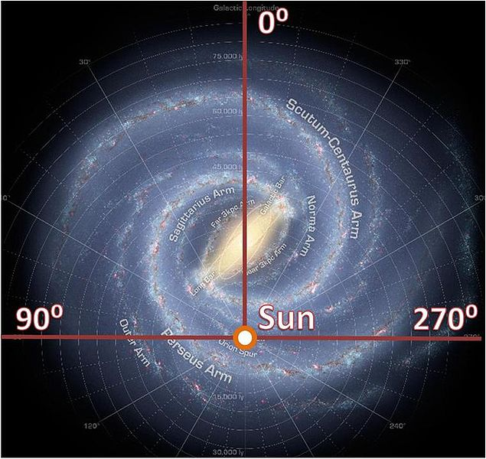
Galactic Rotation

Slide 2
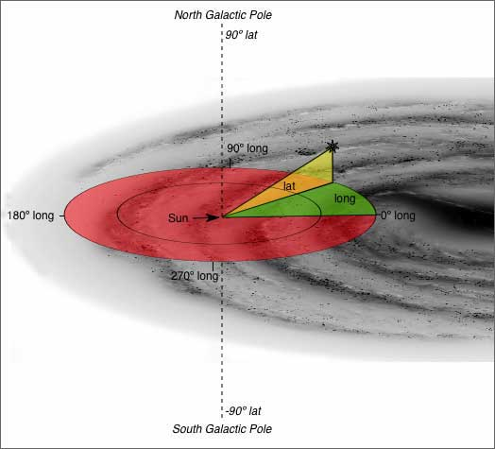
Galactic Coordinates Review

Slide 3
Quadrant I
IV
II
III

Slide 4
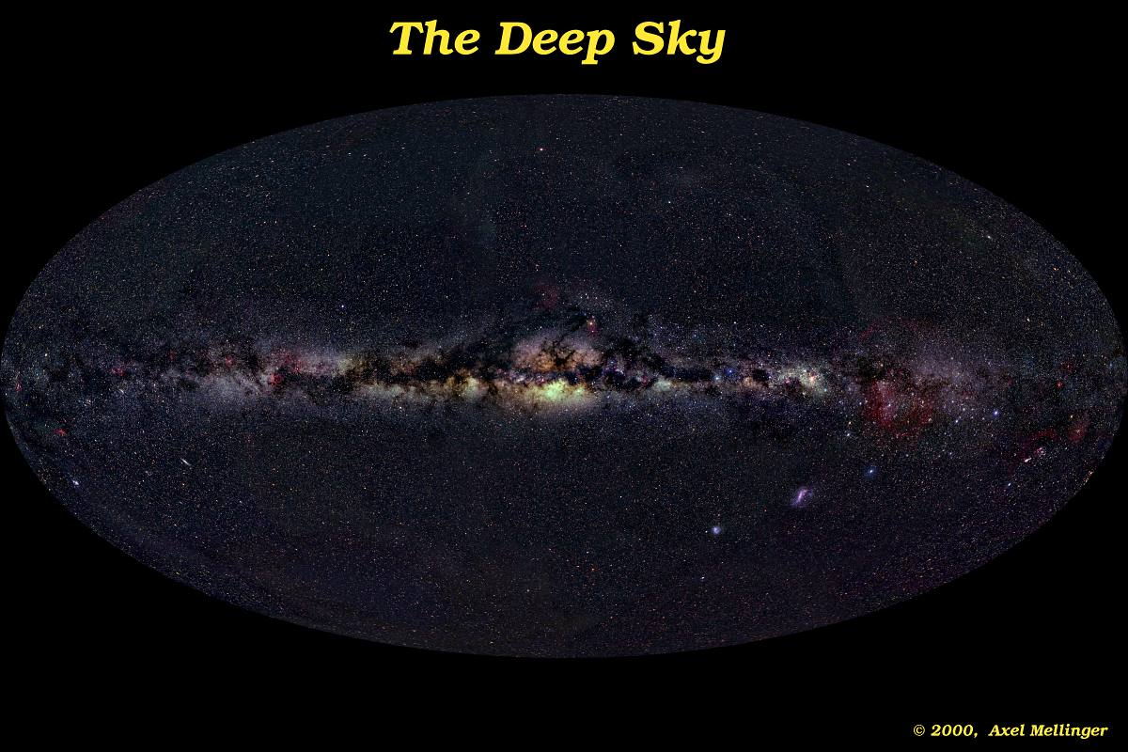
Galactic rotation

Slide 5
Galactic rotation
Positive Latitudes
180 deg.
Longitude
0 deg. Longitude
180 deg.
Longitude
Negative Latitudes

Slide 6
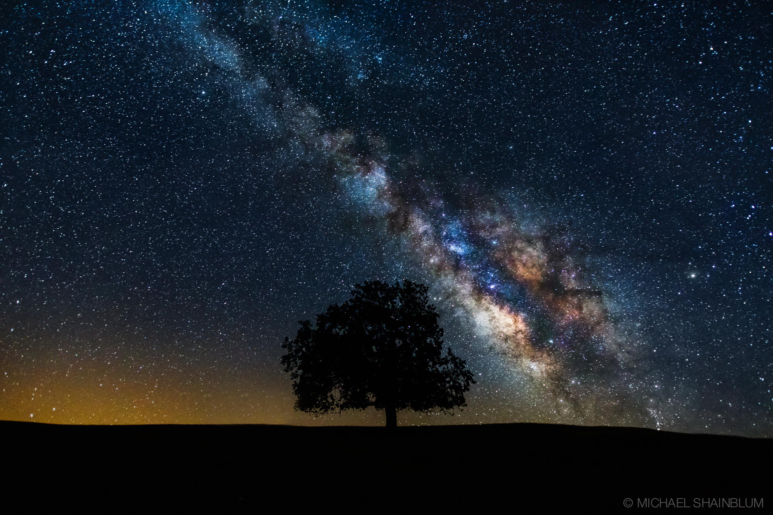
Galactic rotation
Positive Latitudes
0 deg. Longitude, 0deg. Latitude
Negative Latitudes

Slide 7
Relevant Motions
As we learned in the first lecture, everything is in motion!
The magnitude of the velocity shifts we measure depend on:
  the direction of that motion with respect to the source’s location
  The maximum magnitude of the relative velocity
  (so you can imagine there are lots of sines and cosines involved)

Slide 8
Relevant Motions
We only care about radial motions!
If θ is the angle between the motion of velocity v and the source, we are interested in
v_{rad} = v cos θ
the tangential component (which we cannot measure) is
v_{tan} = v sin θ
[but of course we actually have
two angles, the other one
going into the screen….]
v
v sin θ
θ
v cos θ

Slide 9
Relevant Motions
1) Earth rotation
  r = 6371km
    <|0.5| km/s
2) Earth revolution around Sun
  r = 1AU = 1.5e8km
    <|30| km/s
3) Sun non-circular motion
  Found from observations of nearby stars/gas
    ~|20| km/s
4) Sun (circular) motion around Galactic center relative to circular motion of source
    generally <|100| km/s

Slide 10
But First, Definitions: Blue and Red Shifts
Blue-shifted means the object is moving toward the observer. We define this as having a negative radial velocity.
Redshifted means the object is moving away from the observer. We define this as having a positive radial velocity.

Slide 11
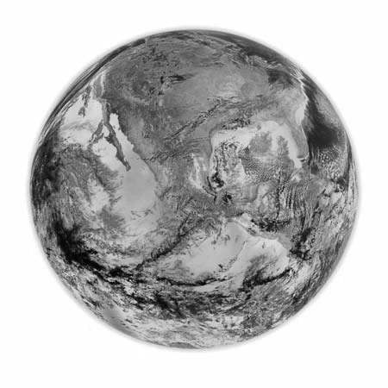
1. Earth Rotation
Blueshifted
Redshifted

Slide 12
2. Earth Revolution
Blueshifted
Redshifted

Slide 13
The Heliocentric Reference Frame
Correction for earth rotation and revolution puts us into the Heliocentric velocity frame.
Measurements in this velocity frame are what one would measure from the center of the Sun.
A related reference frame is “barycentric,” which instead uses the center of mass of the Solar System (essentially the same as Heliocentric).
These are frequently used for extragalactic observations, but we need to go one step further.

Slide 14
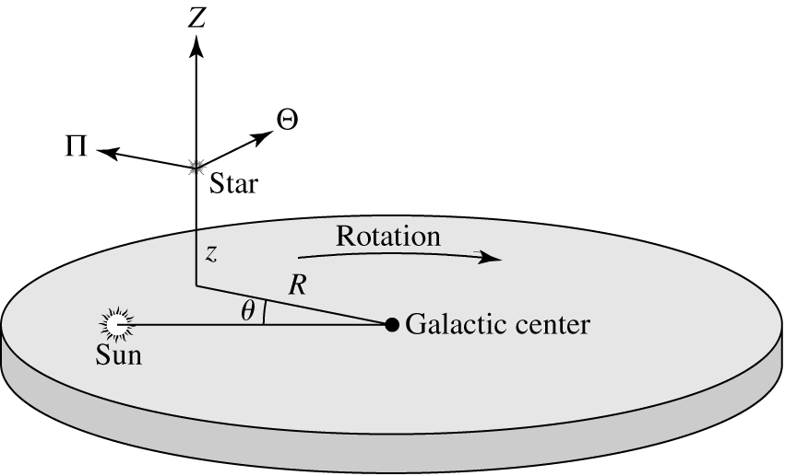
3. Sun Motion wrt Local Material

Slide 15
Local Standard of Rest (LSR)
We correct for these three effects so our measurements are in the local standard of rest (LSR) frame.
The LSR is the mean motion of the Sun about the Galactic center with respect to nearby material (stars and gas).
The goal of the LSR is to ensure that our measurements are comparable to those made at other times.

Slide 16
Local Standard of Rest (LSR)
The LSR frame therefore depends on:
The direction you are pointing your telescope
Your latitude on Earth
The time of day
These three combine to correct for the Earth’s rotation
4) The time of year
This allows us to correct for the Earth’s revolution
We can use the direction and the components of Solar rotation to correct to the LSR frame
http://www.gb.nrao.edu/GBT/setups/radvelcalc.html

Slide 17
4) LSR wrt Source Motion THIS IS WHAT WE MEASURE IN THE LSR FRAME
Quadrant I
IV
II
III

Slide 18
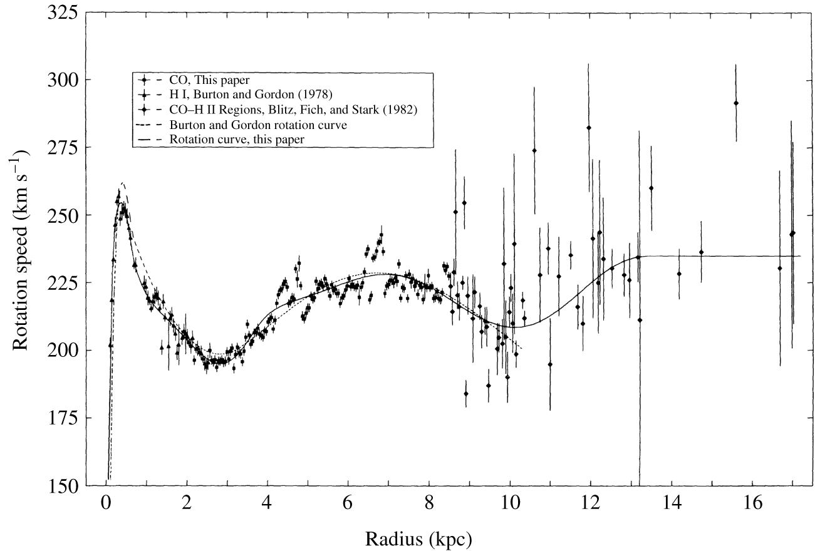
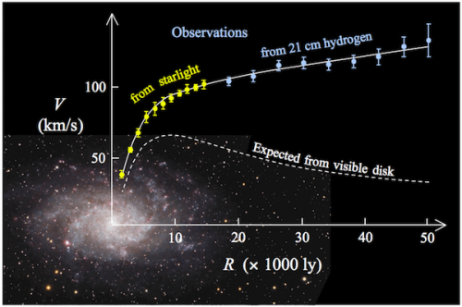
Galactic rotation
Milky Way
Other galaxy

Slide 19
Radial Velocity Measurements
Although the rotation curve is flat, the radial velocity (in the LSR frame) depends on the radial velocity of the source wrt to the radial velocity of the Sun.
V_{rad}= (ω-ω₀) R₀ sin l,
where ω is the angular velocity defined as v/R, R is the distance from the center of the Galaxy, l is the Galactic longitude, and the “0” subscripts denote Solar quantities. R₀ = 8.3kpc and ω₀ = 29 (km/s)/kpc.
-> We can use the measured radial velocity to determine R, the distance from the Galactic center to the source.

Slide 20
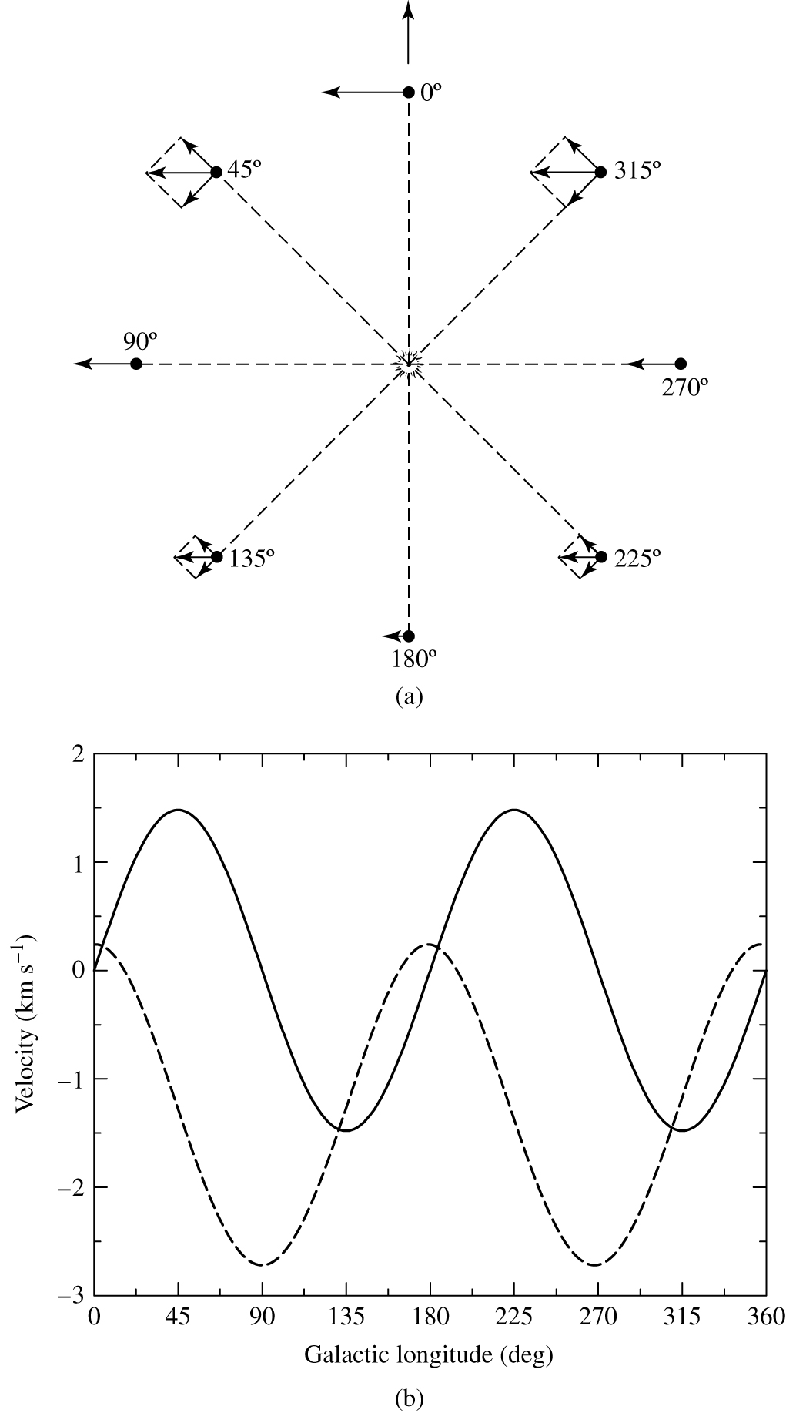
Galactic rotation
Radial (solid) and
transverse (dashed)
velocities as a
function of l.
Dependence is sin (2l)

Slide 21
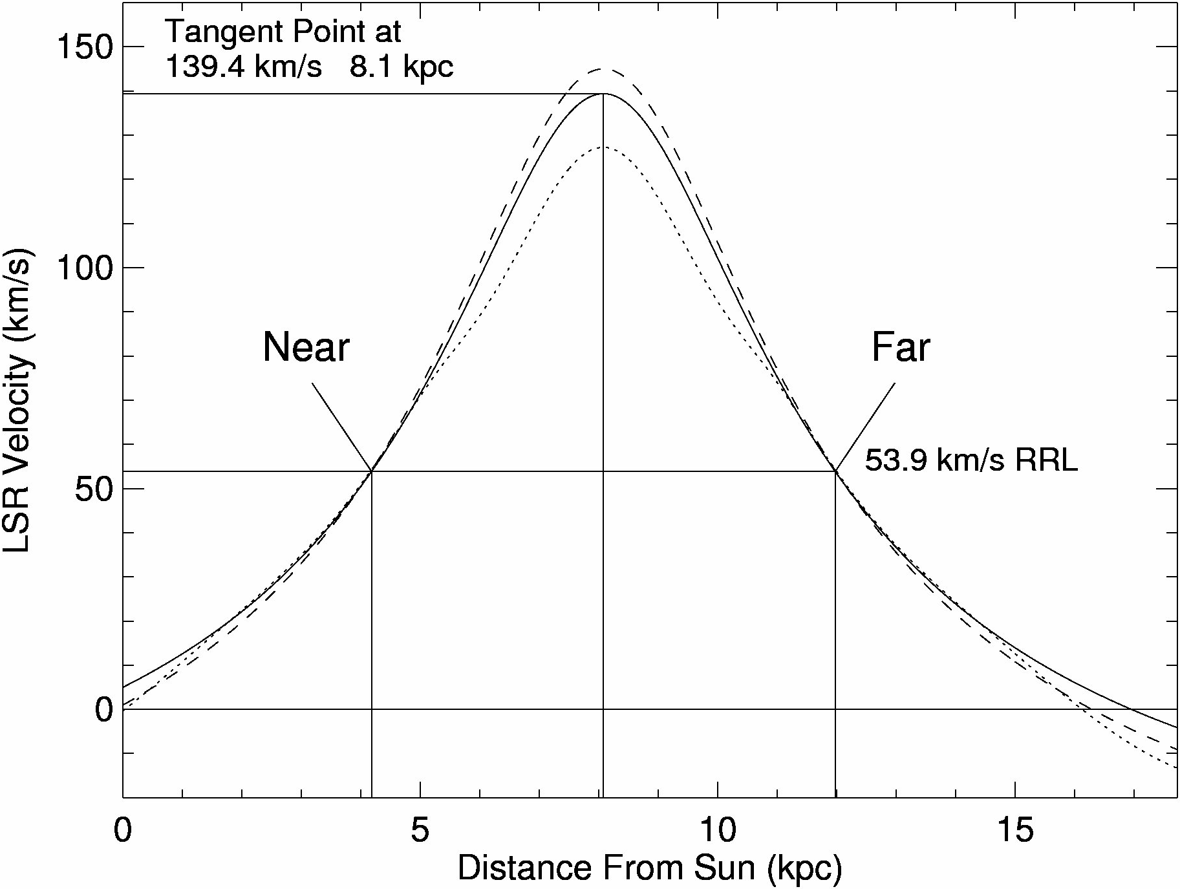
Galactic rotation
First Quadrant

Slide 22
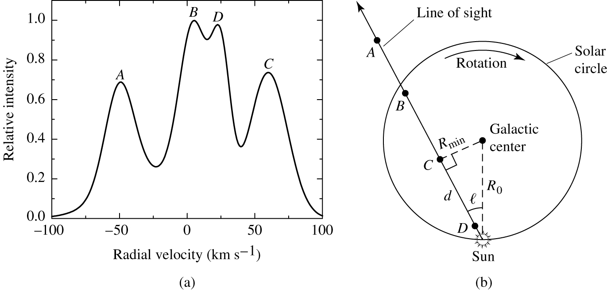
Galactic rotation

Slide 23
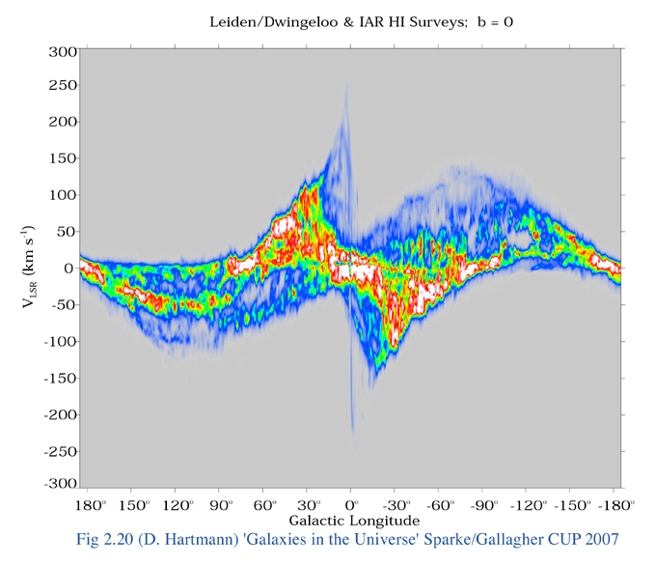
Longitude-Velocity Diagram

Slide 24
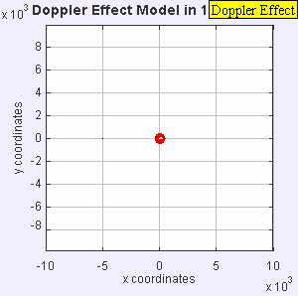
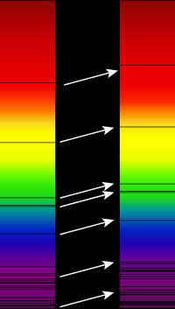

Doppler shift (images from Wikipedia)

Slide 25
Doppler Shift
We measure emission at a particular frequency.
Due to the Doppler shift, we can convert frequency to velocity. Assume you are measuring a spectral line at ν₀ = 1420.4MHz, but detect emission at ν = 1421.4MHz. The Doppler shift equation is:
v = (ν₀ - ν)c/ν₀ = Δνc/ν₀
where v is the velocity, c is the speed of light (c=3e5km/s).
Therefore, Δν = 1MHz = 1e6Hz and v = 1e6Hz * 3e5 km/s / 1420e6 Hz = -211 km/s
This assumes no reference frame - it’s just the relative radial velocity of the observatory wrt the source.

