Slide 1
Your Observations

Slide 2
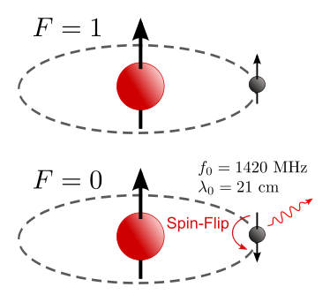
What are we measuring?
Your telescopes are sensitive to neutral hydrogen emission. We call this “HI”.
HI emits at 1420MHz, or 21cm. It is one of the brightest lines in the Universe, and was the first spectral line measured in outer space.
The 21cm line is due to a “spin-flip” transition. The electron and proton’s spin can be aligned or antialigned. This is incredibly rare, but the line is bright because there is so much HI.

Slide 3
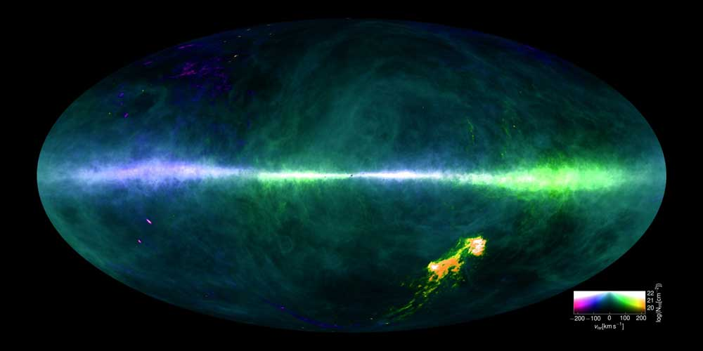
Why are we Measuring HI?
HI has two main observational benefits:
The 21cm line is at a frequency where electronics can be built relatively easily, and
there is HI everywhere! It can be observed in every direction on the sky.

Slide 4
How Should we Observe?
I don’t know! There are a couple ways:
Take data continuously as the sky passes overhead, or
Target a specific part of the sky

Slide 5
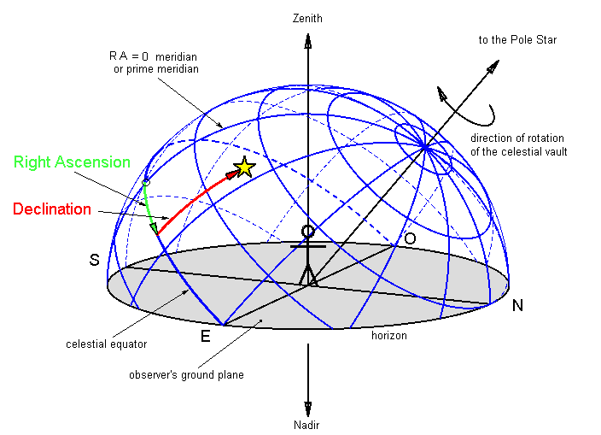
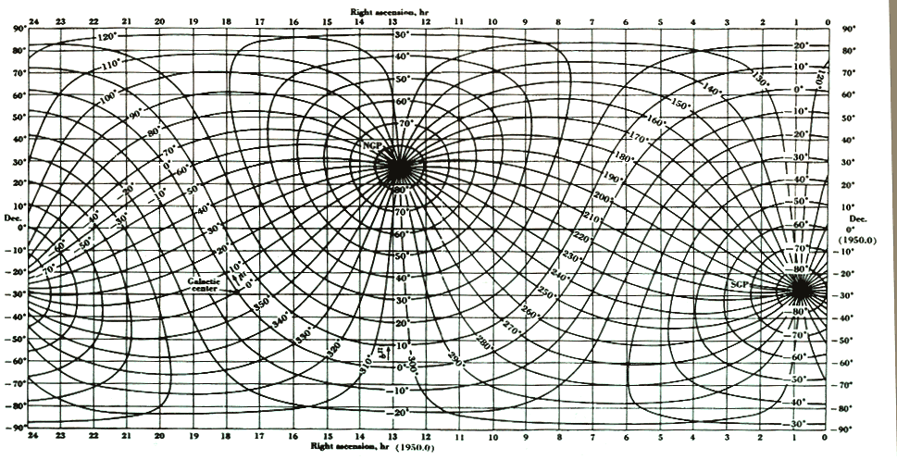
Drift Scans
Taking data continuously as the sky passes overhead is called a “drift scan.”
If the telescope is pointed in one location, you will get data at one dec, but all RAs.

Slide 6
How to do Drift Scans
The easy way:
Point the telescope somewhere and collect data for as long as you want
The harder way:
Pick a portion of the Galaxy you want to observe and determine its RA and Dec using
  the graph from last slide or
  this converter: heasarc.nasa.gov/cgi-bin/Tools/convcoord/convcoord.pl
Determine the current LST and use this to find when the source transits. Find the LST with:
  the Sun (very approximate) or
  this calculator http://www.wwu.edu/skywise/skymobile/skywatch.html
Point your telescope and collect data! You’ll need to determine the altitude using:
  the fact that the altitude of Dec = 90deg is your latitude on Earth or
  this equation: sin(alt) = sin(Dec) sin(lat) + cos(Dec) cos(HA) cos(lat), with HA = 0. For Lat = 39deg., alt = sin⁻¹ (0.63 sin(Dec) + 0.78 cos(Dec))

Slide 7
Pointed Observations
The is the same as the harder drift scan method. If there is a particular portion of the sky you want to observe:
Determine its longitude and latitude and convert that to RA and Dec using
  the graph from last slide or
  this converter: heasarc.nasa.gov/cgi-bin/Tools/convcoord/convcoord.pl
Determine the current LST and use this to find when the source transits. Find the LST with:
  the Sun (very approximate) or
  this calculator http://www.wwu.edu/skywise/skymobile/skywatch.html
Point your telescope and collect data! You’ll need to determine the altitude using:
  the fact that Dec = 90deg is your latitude on Earth or
  this equation: sin(alt) = sin(Dec) sin(lat) + cos(Dec) cos(HA) cos(lat), with HA = 0. For Lat = 39deg., alt = sin⁻¹ (0.63 sin(Dec) + 0.78 cos(Dec))

Slide 8
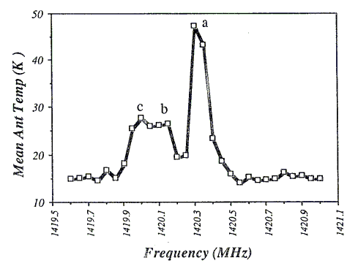
Turning into Velocities
Now you have data! YAY! Let’s put it into velocity using the Doppler correction:
v = (ν₀ - ν)c/ν₀ = Δνc/ν₀

Slide 9
Turning into Velocities
Let’s take Δν = 0.1MHz = 1e5Hz and v = 1e5Hz * 3e5 km/s / 1420.4e6 Hz = 21 km/s. This sets our scale….

Slide 10
Turning into Velocities
Let’s take Δν = 0.1MHz = 1e5Hz and v = 1e5Hz * 3e5 km/s / 1420.4e6 Hz = 21 km/s. This sets our scale….
0 -21 -63 -105 -147

Slide 11
Turning into Velocities
Let’s take Δν = 0.1MHz = 1e5Hz and v = 1e5Hz * 3e5 km/s / 1420.4e6 Hz = 21 km/s. This sets our scale….
+182 +147 +105 +63 +21
0 -21 -63 -105 -147
Velocity (km/s)

Slide 12
Correcting to the LSR Velocity Frame
Let’s assume our observations were taken now, toward Orion at (RA, Dec) = (+5:35:17, -5:23:28).
http://www.gb.nrao.edu/GBT/setups/radvelcalc.html

Slide 13
Correcting to the LSR Velocity Frame
Let’s assume our observations were taken now, toward (RA, Dec) = (+19h, +15deg.), or (l, b) = (47.3, 4.9)
http://www.gb.nrao.edu/GBT/setups/radvelcalc.html
I get:
v_helio = +0.34 km/s
v_lsr = -18.5 km/s
So the LSR velocity frame is moving toward us at 18.5 km/s. We must add 18.5 km/s to our velocity axis.

Slide 14
Turning into Velocities
Let’s take Δν = 0.1MHz = 1e5Hz and v = 1e5Hz * 3e5 km/s / 1420.4e6 Hz = 21 km/s. This sets our scale….
+200 +165 +123 +81 +39
18 -3 -45 -87 -129
Velocity (km/s)

Slide 15
Results!
+200 +165 +123 +81 +39
We have peaks at:
+39, +70, and +100 km/s
18 -3 -45 -87 -129
Velocity (km/s)

Slide 16
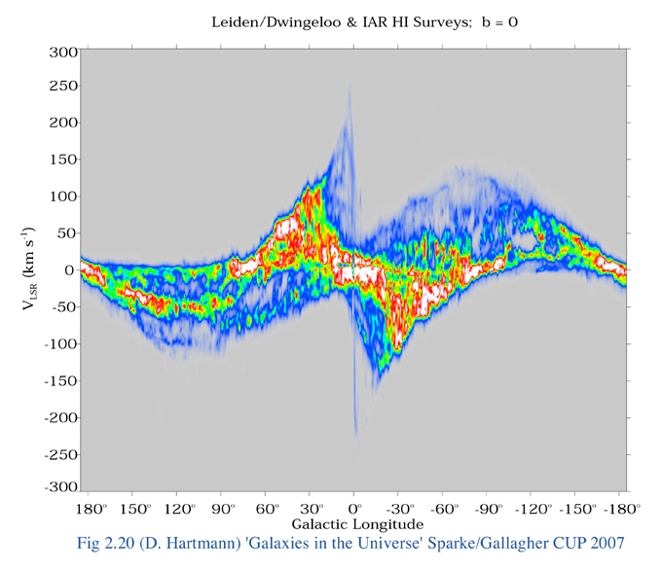
Your observations

Slide 17
Where is this gas?
V_{rad}= (ω-ω₀) R₀ sin l
where ω is the angular velocity defined as v/R, R is the distance from the center of the Galaxy, l is the Galactic longitude, and the “0” subscripts denote Solar quantities. R₀ = 8.3kpc and ω₀ = 29 (km/s)/kpc.
Let’s assume the rotation curve is completely flat, so v = 230km/s everywhere. Then, ω = 230 km/s / R
Rearranging,
ω = V_{rad} / (R₀sin l) + ω₀ = 230 km/s / R
or
R = 230 km/s / (V_{rad} / (8.3kpc sin l) + 29 (km/s) / kpc)

Slide 18
Where is this gas?
R = 230 km/s / (V_{rad} / (8.3 kpc sin l) + 29 (km/s) / kpc)
So for V_{rad} = +30, +70, +100 km/s at l= 47deg,
R = 6.8, 5.7, 5.1 kpc

Slide 19
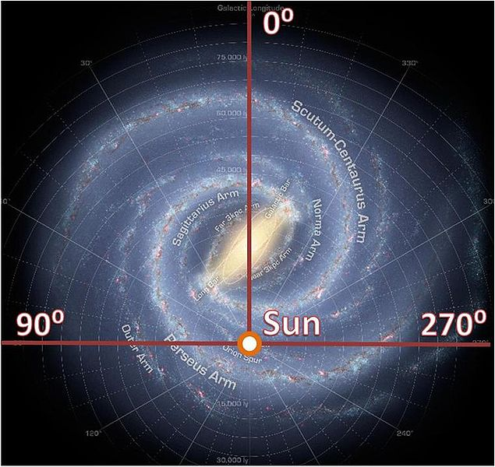
Your observations

