Slide 1

Stars
D.J. Pisano
Associate Professor of Physics & Astronomy
July 9, 2017
Notes:
Source edition: assets/lessons/lectures/astronomy/stars.pdf, page 1. Original author and figure credits remain on the slide. Text is editable; illustrations retain their source artwork.

Slide 2
For thousands of nearby stars we can find:
•
the total luminosity
•
the temperature (color or spectral
type)
•
the size (radius)
•
the mass
CAN WE FIND ANY RHYME, REASON, OR
RELATIONSHIPS?
Notes:
Source edition: assets/lessons/lectures/astronomy/stars.pdf, page 2. Original author and figure credits remain on the slide. Text is editable; illustrations retain their source artwork.

Slide 3
The H-R Diagram
•
done independently by Enjar
Hertzsprung and Henry Norris Russell
around 1910.
•
graph of luminosity (or absolute
magnitude) versus temperature (or
spectral class)
Notes:
Source edition: assets/lessons/lectures/astronomy/stars.pdf, page 3. Original author and figure credits remain on the slide. Text is editable; illustrations retain their source artwork.

Slide 4
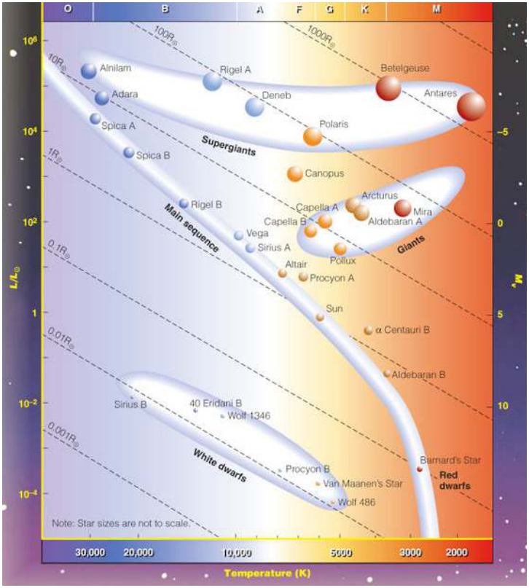
The H-R Diagram
The Hertzprung-
Russell (H-R) diagram
shows the relationship
between luminosity
and temperature
(absolute magnitude
and spectral class) for
stars.
Notes:
Source edition: assets/lessons/lectures/astronomy/stars.pdf, page 4. Original author and figure credits remain on the slide. Text is editable; illustrations retain their source artwork.

Slide 5
The H-R Diagram
The H-R diagram
shows that there is a
definite relationship
between the
luminosity (absolute
magnitude) of a star
and its temperature
(spectral class)
Notes:
Source edition: assets/lessons/lectures/astronomy/stars.pdf, page 5. Original author and figure credits remain on the slide. Text is editable; illustrations retain their source artwork.

Slide 6
Main Sequence
•
Goes from top left (
hot and
bright
) to bottom right (
cool and
dim
).
•
90% of the stars are in the Main
Sequence stage of their lives
•
Includes our Sun.
Notes:
Source edition: assets/lessons/lectures/astronomy/stars.pdf, page 6. Original author and figure credits remain on the slide. Text is editable; illustrations retain their source artwork.

Slide 7
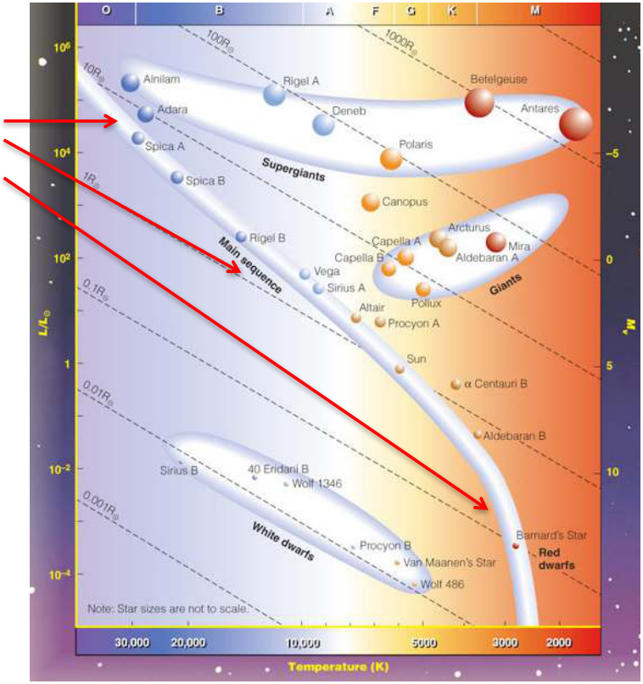
Main Sequence
The Main Sequence
runs from the lower
right to upper left of
the H-R diagram.
Hotter main sequence
stars are brighter.
Notes:
Source edition: assets/lessons/lectures/astronomy/stars.pdf, page 7. Original author and figure credits remain on the slide. Text is editable; illustrations retain their source artwork.

Slide 8

Red Giants
•
Really Big, Not Very Hot but
VERY BRIGHT!
•
Betelgeuse: 3500 K , 100,000
times more luminous than the sun
•
radius must be 1000x that of Sun!
Notes:
Source edition: assets/lessons/lectures/astronomy/stars.pdf, page 8. Original author and figure credits remain on the slide. Text is editable; illustrations retain their source artwork.

Slide 9
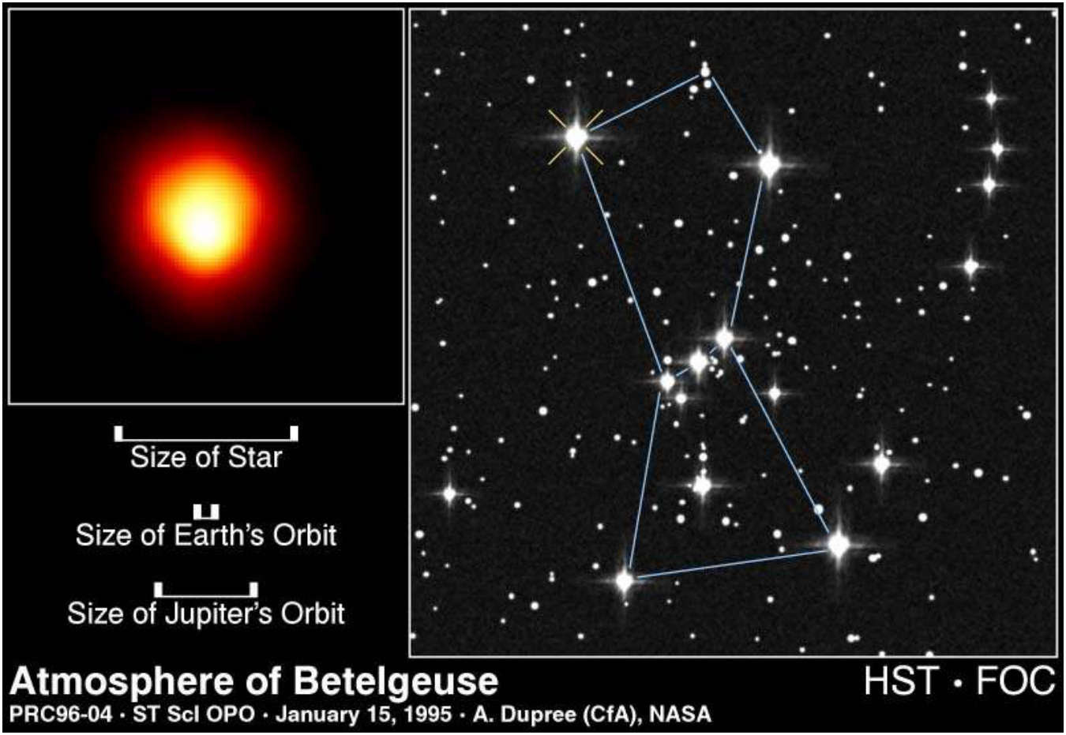
Stars
Notes:
Source edition: assets/lessons/lectures/astronomy/stars.pdf, page 9. Original author and figure credits remain on the slide. Text is editable; illustrations retain their source artwork.

Slide 10

Red Giants
Red Giant
and
Supergiant
stars are
located above and to
the right of the Main
Sequence.
Notes:
Source edition: assets/lessons/lectures/astronomy/stars.pdf, page 10. Original author and figure credits remain on the slide. Text is editable; illustrations retain their source artwork.

Slide 11
White Dwarfs
•
Very Small, Very Hot but
Not Very Bright
•
Sirius B
: 27,000 K, but gives
off 1000 times less light than
the Sun
•
100 times smaller than the
Sun
Notes:
Source edition: assets/lessons/lectures/astronomy/stars.pdf, page 11. Original author and figure credits remain on the slide. Text is editable; illustrations retain their source artwork.

Slide 12
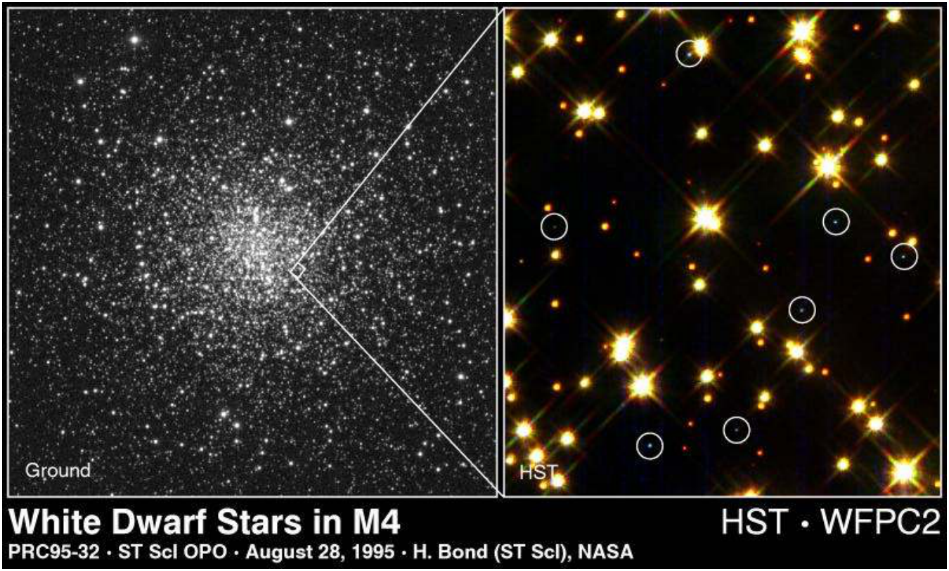
Stars
Notes:
Source edition: assets/lessons/lectures/astronomy/stars.pdf, page 12. Original author and figure credits remain on the slide. Text is editable; illustrations retain their source artwork.

Slide 13
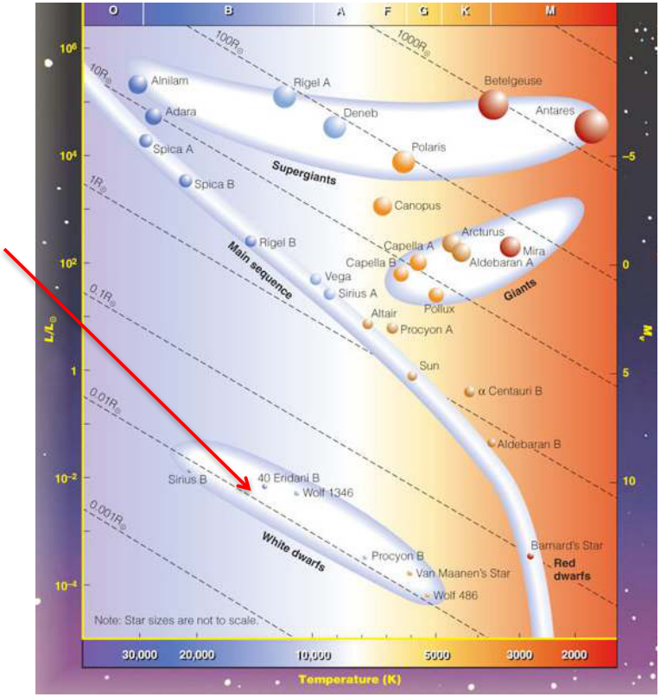
White Dwarfs
Tiny
white dwarf
stars
are located in the
bottom left of the H-R
diagram
Notes:
Source edition: assets/lessons/lectures/astronomy/stars.pdf, page 13. Original author and figure credits remain on the slide. Text is editable; illustrations retain their source artwork.

Slide 14

Determining the Sizes of Stars from an HR Diagram
•
The Smallest stars are the
tiny White Dwarf stars
and are found in the
Large
lower left corner of the
HR diagram
•
Main sequence stars span
a range of sizes from the
small found in the lower
right to the large found in
the upper left
•
The largest stars are the
Giant and Supergiant stars
which are found in the
upper right corner
Small
Notes:
Source edition: assets/lessons/lectures/astronomy/stars.pdf, page 14. Original author and figure credits remain on the slide. Text is editable; illustrations retain their source artwork.

Slide 15
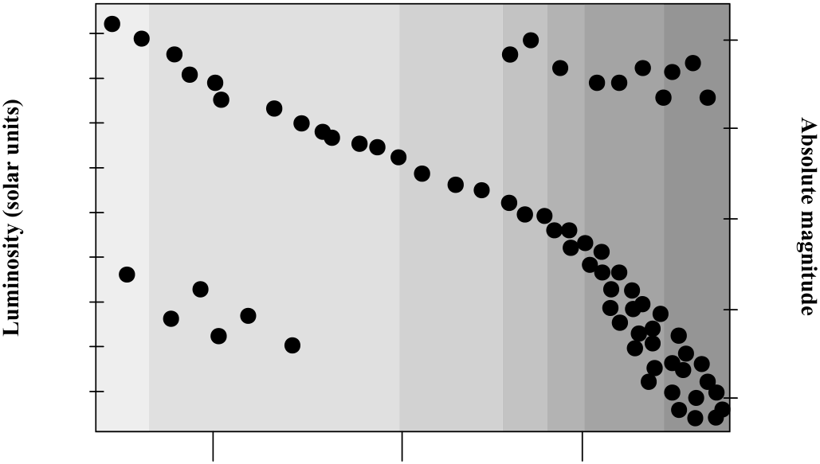
Stars
Spectral Type
O5
B5
A5
F5 G5
K5
M5
10,000
a
Red Giants
-5
d
1,000
b
100
0
10
Main
e
1
Sequence
5
.1
.01
f
10
.001
c
White Dwarfs
.0001
15
20,000
10,000
5,000
Temperature (K)
Notes:
Source edition: assets/lessons/lectures/astronomy/stars.pdf, page 15. Original author and figure credits remain on the slide. Text is editable; illustrations retain their source artwork.

Slide 16
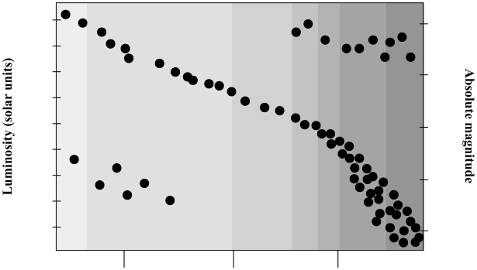
How does the size of star A compare with star D?
Spectral Type
O5
B5
A5
F5 G5
K5
M5
A.
Star A is larger
10,000
a
Red Giants
d
-5
B.
Star D is larger
1,000
b
100
0
C.
They are the same size.
10
Main
e
D.
There is insufficient
1
Sequence
5
.1
information to determine
.01
f
10
.001
c
this.
White Dwarfs
.0001
15
20,000
10,000
5,000
Temperature (K)
Notes:
Source edition: assets/lessons/lectures/astronomy/stars.pdf, page 16. Original author and figure credits remain on the slide. Text is editable; illustrations retain their source artwork.

Slide 17
What about stellar masses?
•
We can determine the masses of stars if
they have companions. These are
called
binary stars
.
•
We can measure the mass by using
Newton’s Laws and Kepler’s Laws, just
like in our solar system.
Notes:
Source edition: assets/lessons/lectures/astronomy/stars.pdf, page 17. Original author and figure credits remain on the slide. Text is editable; illustrations retain their source artwork.

Slide 18
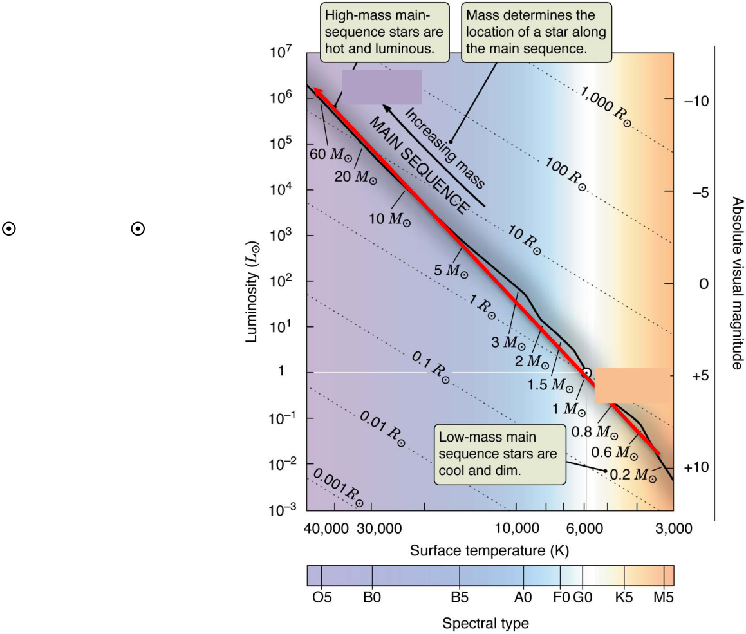
What about masses?
Large
•
Main Sequence
stars
range in mass from
0.1M
to 100M
.
•
The masses of
main
sequence
stars
increase with
luminosity,
temperature, and size.
Small
•
Mass increases from
lower right to upper
left.
Notes:
Source edition: assets/lessons/lectures/astronomy/stars.pdf, page 18. Original author and figure credits remain on the slide. Text is editable; illustrations retain their source artwork.

Slide 19
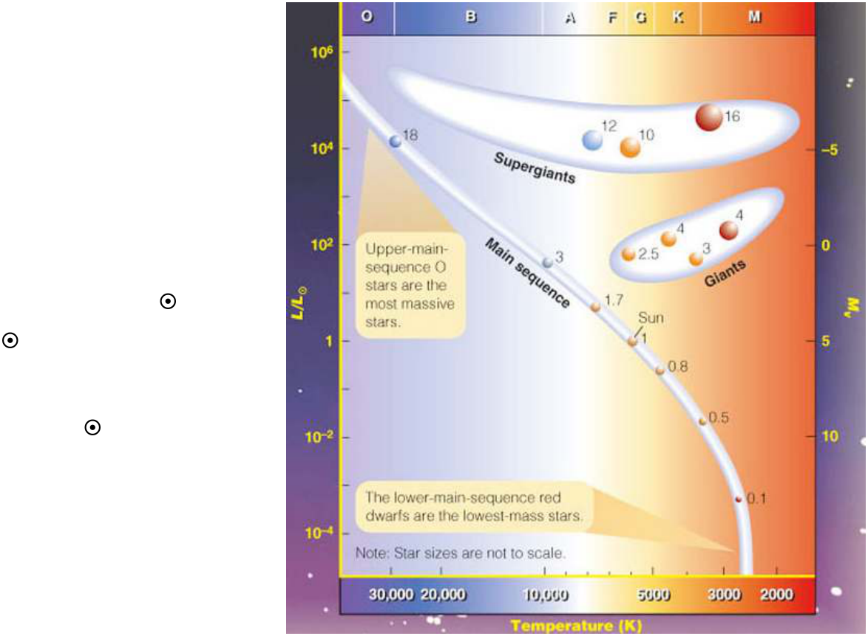
What about masses?
•
There is no simple
relationship for the
masses of non-main
sequence stars.
•
Red Giants and
Supergiants range
from about 1 M
to
20M
.
•
White Dwarfs are
about 1 M
.
Notes:
Source edition: assets/lessons/lectures/astronomy/stars.pdf, page 19. Original author and figure credits remain on the slide. Text is editable; illustrations retain their source artwork.

Slide 20
Stars
Why is there a Main
Sequence?
Notes:
Source edition: assets/lessons/lectures/astronomy/stars.pdf, page 20. Original author and figure credits remain on the slide. Text is editable; illustrations retain their source artwork.

Slide 21
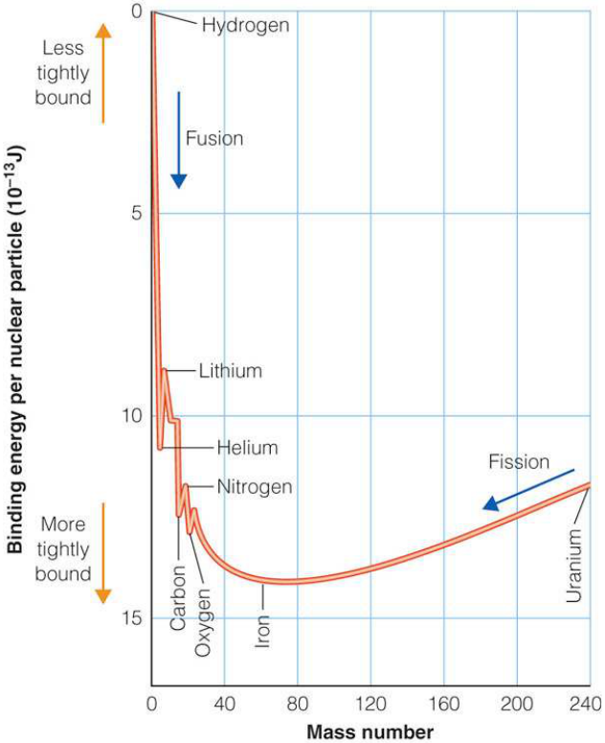
How to generate energy: Nuclear Fusion vs. Fission
•
Nuclear fusion is the
combination
of two atoms to
form a more massive atom
•
Nuclear fission is the
splitting
of one atom to form two less
massive atoms.
•
For light atoms, like hydrogen,
fusion produces energy. For
heavy atoms, it does not.
•
For heavy atoms, like
uranium, fission releases
energy. For light atoms, it
does not.
Notes:
Source edition: assets/lessons/lectures/astronomy/stars.pdf, page 21. Original author and figure credits remain on the slide. Text is editable; illustrations retain their source artwork.

Slide 22
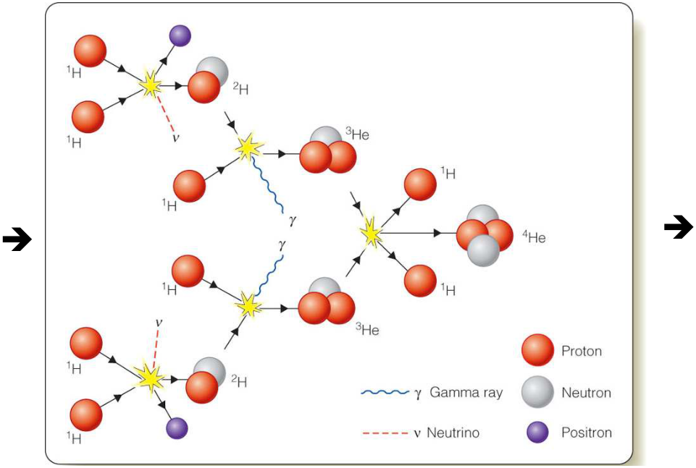
Nuclear Fusion
The centers of stars are hot enough and dense
enough to fuse hydrogen into helium.
4 H
1 He +
Energy!
Notes:
Source edition: assets/lessons/lectures/astronomy/stars.pdf, page 22. Original author and figure credits remain on the slide. Text is editable; illustrations retain their source artwork.

Slide 23
Nuclear Fusion
The hotter the core, the more fusion that occurs.
This is just one possible fusion process.
4 H
1 He +
Energy!
Notes:
Source edition: assets/lessons/lectures/astronomy/stars.pdf, page 23. Original author and figure credits remain on the slide. Text is editable; illustrations retain their source artwork.

Slide 24
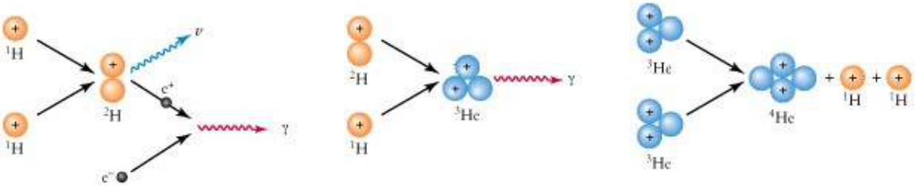
Nuclear Fusion
How do we know this happens in the center of the
Sun?
Photons (
γ
) take 10,000 years to escape Sun.
Neutrinos
(
ν
) flow freely from Sun and can be
detected on Earth.
Notes:
Source edition: assets/lessons/lectures/astronomy/stars.pdf, page 24. Original author and figure credits remain on the slide. Text is editable; illustrations retain their source artwork.

Slide 25
Neutrinos
•
Neutrinos have almost no mass and no electric
charge.
•
Neutrinos only weakly interact with matter. They
could pass through 1 light-year of lead without
interacting with any atoms.
•
65
billion
solar neutrinos pass through every square
centimeter of your body every second.
•
The number of solar neutrinos we can detect match
what is predicted to come from the reactions in the
core of the Sun providing evidence that our models
are correct.
Notes:
Source edition: assets/lessons/lectures/astronomy/stars.pdf, page 25. Original author and figure credits remain on the slide. Text is editable; illustrations retain their source artwork.

Slide 26
Why are stars stable?
•
Why don’t they collapse?
•
Why don’t they expand?
Notes:
Source edition: assets/lessons/lectures/astronomy/stars.pdf, page 26. Original author and figure credits remain on the slide. Text is editable; illustrations retain their source artwork.

Slide 27
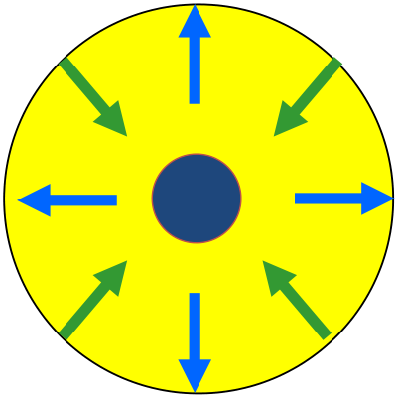
Balance
•
All main sequence stars are in
hydrostatic equilibrium.
•
Gravity
is pushing the star
inward.
Light
generated in the
core generates thermal
pressure pushing outwards.
•
During hydrostatic equilibrium,
these forces are balanced.
•
This balance is why the Main
Sequence exists.
Notes:
Source edition: assets/lessons/lectures/astronomy/stars.pdf, page 27. Original author and figure credits remain on the slide. Text is editable; illustrations retain their source artwork.

Slide 28
Balance
In a main sequence star, the
energy generated by nuclear
fusion is producing enough
outward pressure
to balance
the
inward pressure
from the
mass of the star.
The more massive a star,
the more energy it must
produce.
Notes:
Source edition: assets/lessons/lectures/astronomy/stars.pdf, page 28. Original author and figure credits remain on the slide. Text is editable; illustrations retain their source artwork.

Slide 29
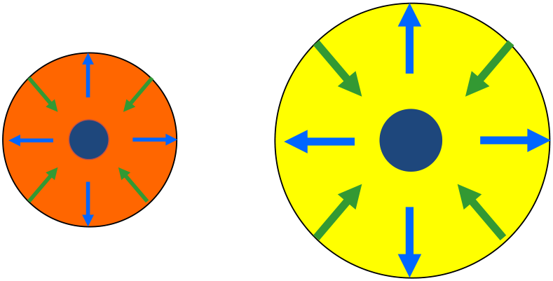
Mass-Luminosity Relation
Because main sequence stars are in
hydrostatic equilibrium,
more massive
stars are more luminous
.
Notes:
Source edition: assets/lessons/lectures/astronomy/stars.pdf, page 29. Original author and figure credits remain on the slide. Text is editable; illustrations retain their source artwork.

Slide 30
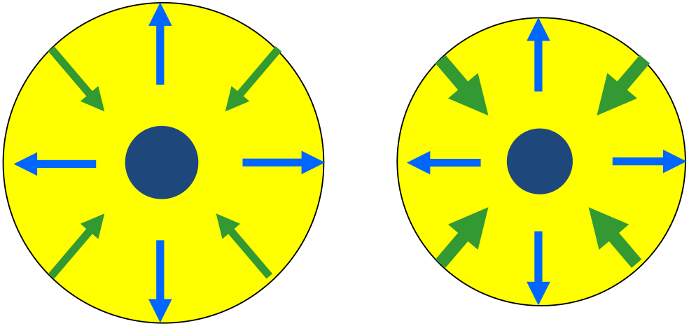
Mass-Luminosity Relation
If you increase the mass of a star, the
inward pressure increases.
Notes:
Source edition: assets/lessons/lectures/astronomy/stars.pdf, page 30. Original author and figure credits remain on the slide. Text is editable; illustrations retain their source artwork.

Slide 31
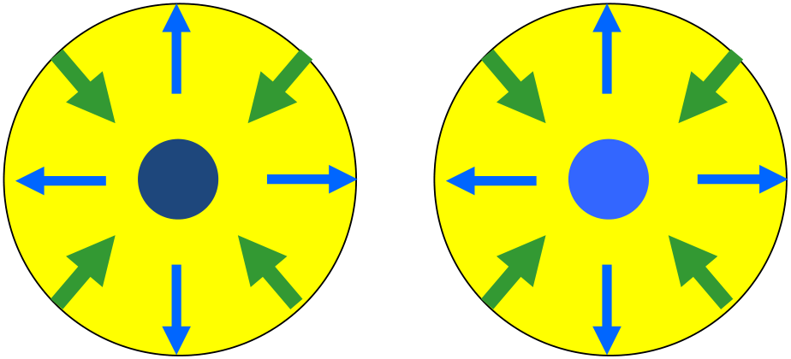
Mass-Luminosity Relation
This causes the core of the star to heat up
and produce more energy.
Notes:
Source edition: assets/lessons/lectures/astronomy/stars.pdf, page 31. Original author and figure credits remain on the slide. Text is editable; illustrations retain their source artwork.

Slide 32
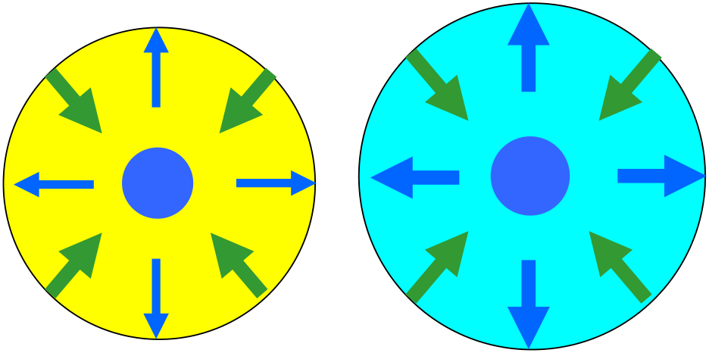
Mass-Luminosity Relation
Which increases the outward pressure, and
stabilizes the more luminous star.
Notes:
Source edition: assets/lessons/lectures/astronomy/stars.pdf, page 32. Original author and figure credits remain on the slide. Text is editable; illustrations retain their source artwork.

Slide 33
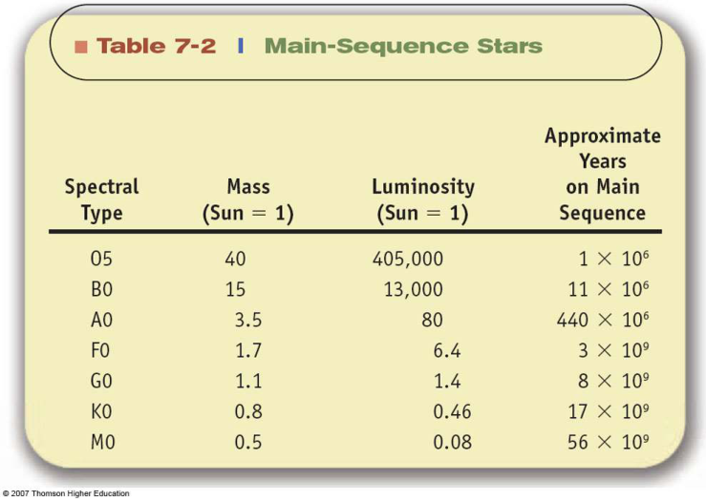
Implication of Mass-Luminosity Relation
More mass = More Luminosity = faster rate of fusion
=
Shorter lifetime on Main Sequence!
Notes:
Source edition: assets/lessons/lectures/astronomy/stars.pdf, page 33. Original author and figure credits remain on the slide. Text is editable; illustrations retain their source artwork.

Slide 34
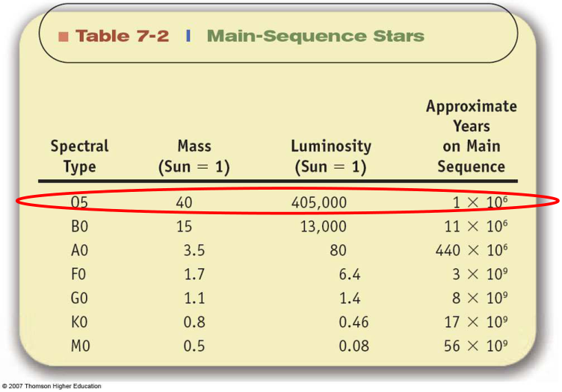
Implication of Mass-Luminosity Relation
More mass = More Luminosity =
Shorter life!
O Stars are very massive,
very luminous,
and very short-lived.
Notes:
Source edition: assets/lessons/lectures/astronomy/stars.pdf, page 34. Original author and figure credits remain on the slide. Text is editable; illustrations retain their source artwork.

Slide 35
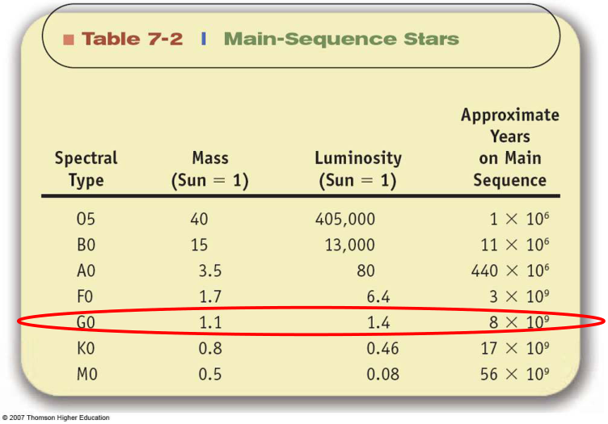
Implication of Mass-Luminosity Relation
More mass = More Luminosity =
Shorter life!
G stars (Sun-like)
are not very massive,
not very luminous,
and long-lived.
Notes:
Source edition: assets/lessons/lectures/astronomy/stars.pdf, page 35. Original author and figure credits remain on the slide. Text is editable; illustrations retain their source artwork.

Slide 36
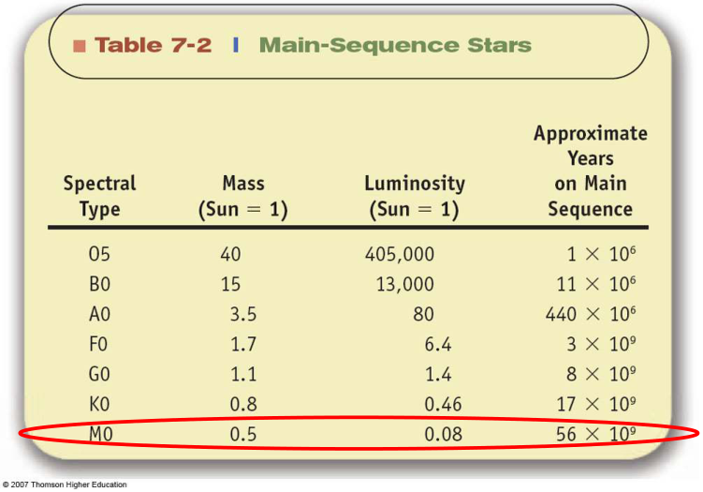
Implication of Mass-Luminosity Relation
More mass = More Luminosity =
Shorter life!
M stars have very little mass,
are very faint,
and very, very long-lived.
Notes:
Source edition: assets/lessons/lectures/astronomy/stars.pdf, page 36. Original author and figure credits remain on the slide. Text is editable; illustrations retain their source artwork.

Slide 37
Stellar Evolution
•
How do stars form?
•
How do stars die?
Notes:
Source edition: assets/lessons/lectures/astronomy/stars.pdf, page 37. Original author and figure credits remain on the slide. Text is editable; illustrations retain their source artwork.

Slide 38
Stages of Star Formation
1.
The Interstellar medium
– gas and dust
2.
A
protostar
forms from the coldest,
densest part of the ISM, a
molecular
cloud
3.
The protostar gets hot enough for fusion
in its center and becomes a
main
sequence star
.
4.
Lather, Rinse, Repeat.
Notes:
Source edition: assets/lessons/lectures/astronomy/stars.pdf, page 38. Original author and figure credits remain on the slide. Text is editable; illustrations retain their source artwork.

Slide 39
The Interstellar Medium (ISM)
•
99% Interstellar gas
75% Hydrogen (by mass)
24% Helium
1% everything else
•
1% dust
mostly Carbon and Silicon
Average density: 1 atom per cubic centimeter
vs. 10
19
per cubic centimeter for air.
Notes:
Source edition: assets/lessons/lectures/astronomy/stars.pdf, page 39. Original author and figure credits remain on the slide. Text is editable; illustrations retain their source artwork.

Slide 40
Components of the ISM
•
Hot Gas (10
6
K) – seen in X-ray light
•
Warm Gas (10
4
K) – traced by ionized
hydrogen.
•
Cool Gas (<10
4
K) – traced by neutral,
atomic hydrogen.
•
Cold Gas (10-300 K) – seen as molecular
clouds.
Stars only form in
cold, molecular clouds
Notes:
Source edition: assets/lessons/lectures/astronomy/stars.pdf, page 40. Original author and figure credits remain on the slide. Text is editable; illustrations retain their source artwork.

Slide 41
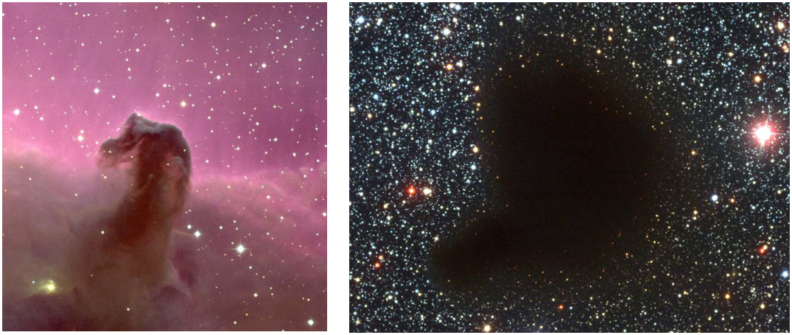
Components of the ISM
•
Cold Gas (10-300 K) – molecular clouds seen in dust and gas
Images of dust in molecular clouds blocking star light behind
them.
These are dark nebulae.
Notes:
Source edition: assets/lessons/lectures/astronomy/stars.pdf, page 41. Original author and figure credits remain on the slide. Text is editable; illustrations retain their source artwork.

Slide 42
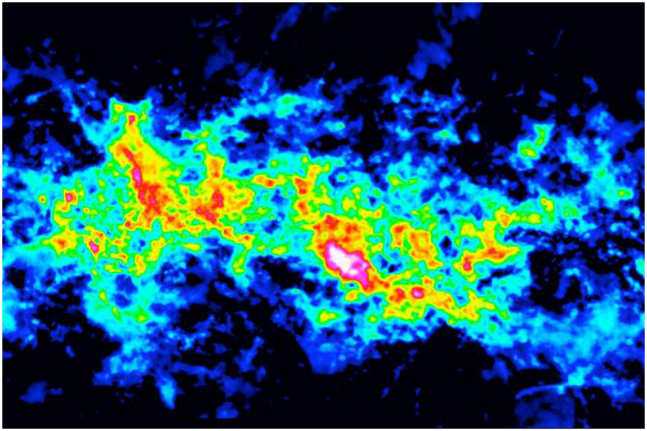
Components of the ISM
•
Cold Gas – molecular clouds seen in dust and gas
Radio map of molecules in a Giant Molecular Cloud
Notes:
Source edition: assets/lessons/lectures/astronomy/stars.pdf, page 42. Original author and figure credits remain on the slide. Text is editable; illustrations retain their source artwork.

Slide 43
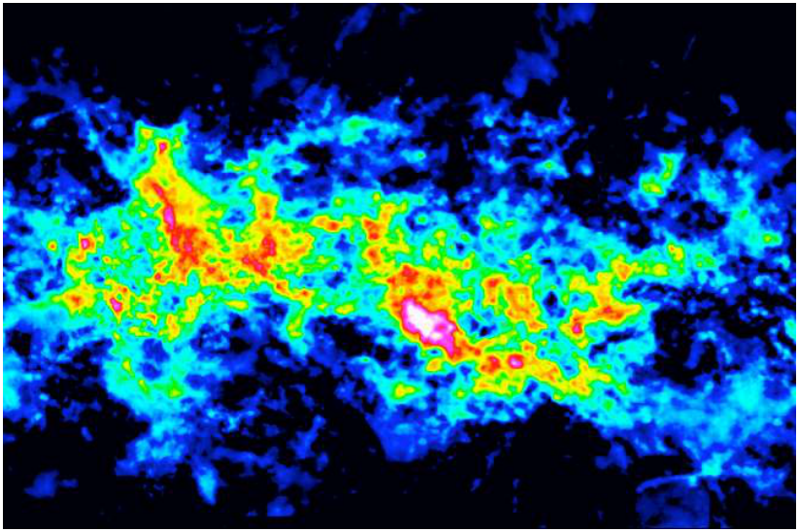
Molecular Clouds
The coldest and densest regions of the ISM will
form molecular clouds when compressed..
Notes:
Source edition: assets/lessons/lectures/astronomy/stars.pdf, page 43. Original author and figure credits remain on the slide. Text is editable; illustrations retain their source artwork.

Slide 44
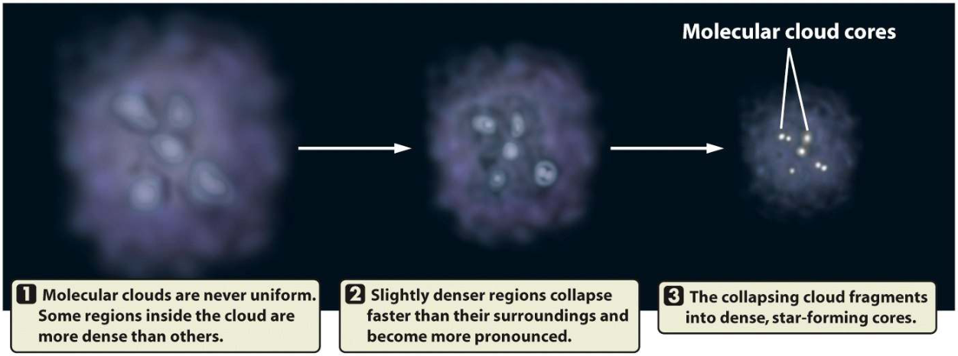
Densest parts of Molecular Cloud continue to collapse.
Notes:
Source edition: assets/lessons/lectures/astronomy/stars.pdf, page 44. Original author and figure credits remain on the slide. Text is editable; illustrations retain their source artwork.

Slide 45
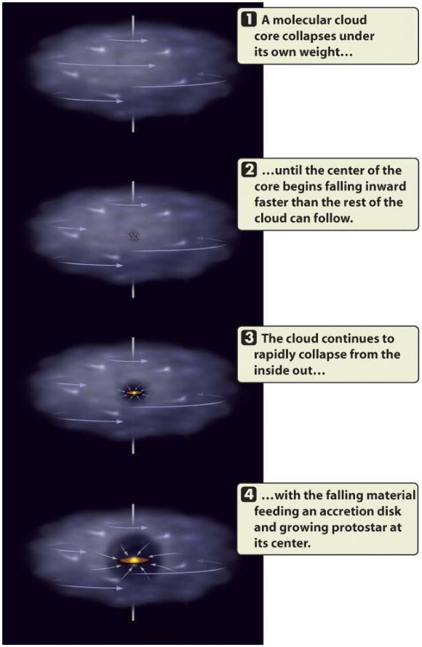
Stars
Each molecular core collapses
due to gravity from
its own
mass
. These cores are too cold
to support their mass, so they
continue to collapse and heat
up.
As the cores collapse they
begin to spin faster, eventually
forming a
protostar
surrounded
by an
accretion disk
of
material.
Notes:
Source edition: assets/lessons/lectures/astronomy/stars.pdf, page 45. Original author and figure credits remain on the slide. Text is editable; illustrations retain their source artwork.

Slide 46
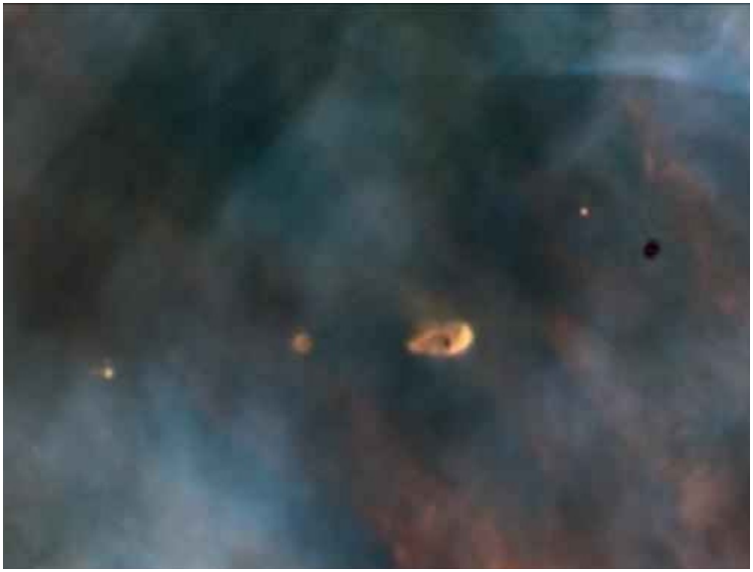
Protostars in Orion Nebula
These are protostars surrounded by
cocoons of dust and gas.
Notes:
Source edition: assets/lessons/lectures/astronomy/stars.pdf, page 46. Original author and figure credits remain on the slide. Text is editable; illustrations retain their source artwork.

Slide 47
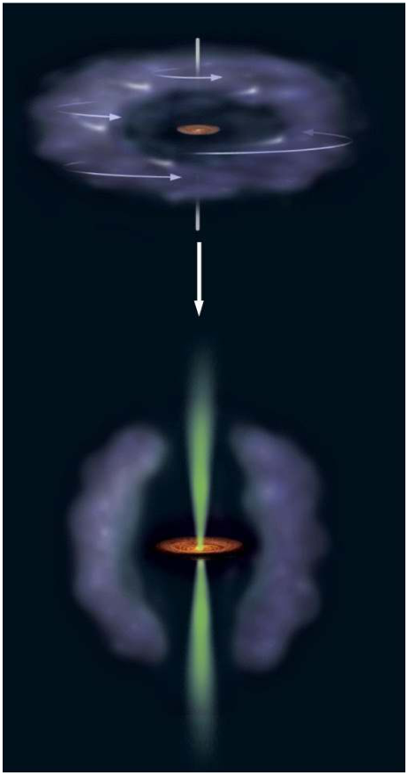
After a protostar forms
After a protostar with an
accretion disk forms,
material continues to fall
onto the “star” from the
disk.
Some material has too
much
angular momentum
to fall onto star and is
ejected as a
jet.
Notes:
Source edition: assets/lessons/lectures/astronomy/stars.pdf, page 47. Original author and figure credits remain on the slide. Text is editable; illustrations retain their source artwork.

Slide 48
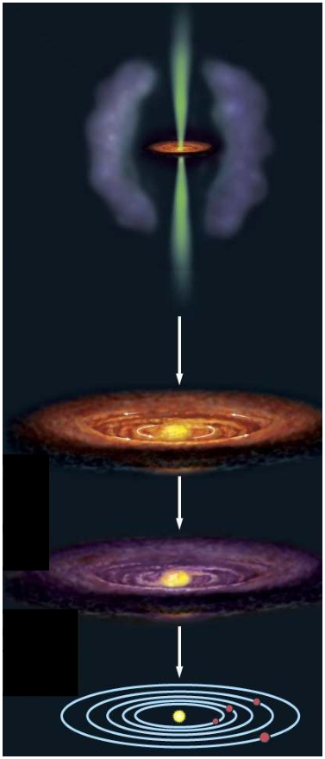
Protostellar jets
The jet blows away the
remaining gas and dust
surrounding the protostar.
The protostar continues to
collapse
due to gravity
and
heat up.
Eventually the core of the
protostar will be
dense enough
and hot enough
for fusion to
occur and then we have a main
sequence star.
Notes:
Source edition: assets/lessons/lectures/astronomy/stars.pdf, page 48. Original author and figure credits remain on the slide. Text is editable; illustrations retain their source artwork.

Slide 49
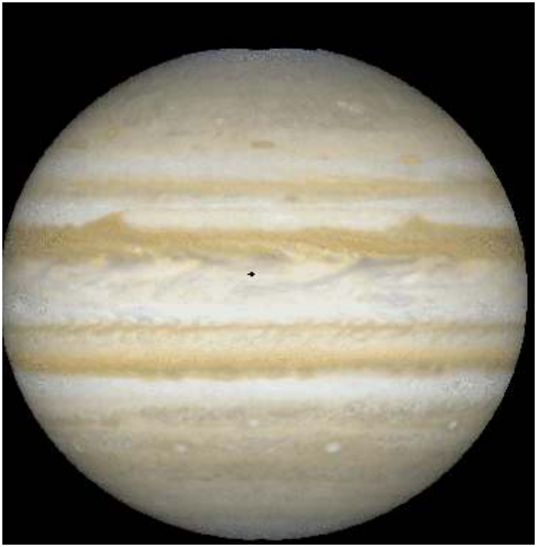
What happens if a protostar never gets hot enough for nuclear fusion?
•
Objects with less than
0.08 solar masses will
never
get hot enough for
fusion to occur in their
cores.
•
These are called
brown
dwarfs
.
•
They glow only from their
internal heat from their
collapse.
•
They have masses
greater than Jupiter and
less than M dwarfs.
Notes:
Source edition: assets/lessons/lectures/astronomy/stars.pdf, page 49. Original author and figure credits remain on the slide. Text is editable; illustrations retain their source artwork.

Slide 50
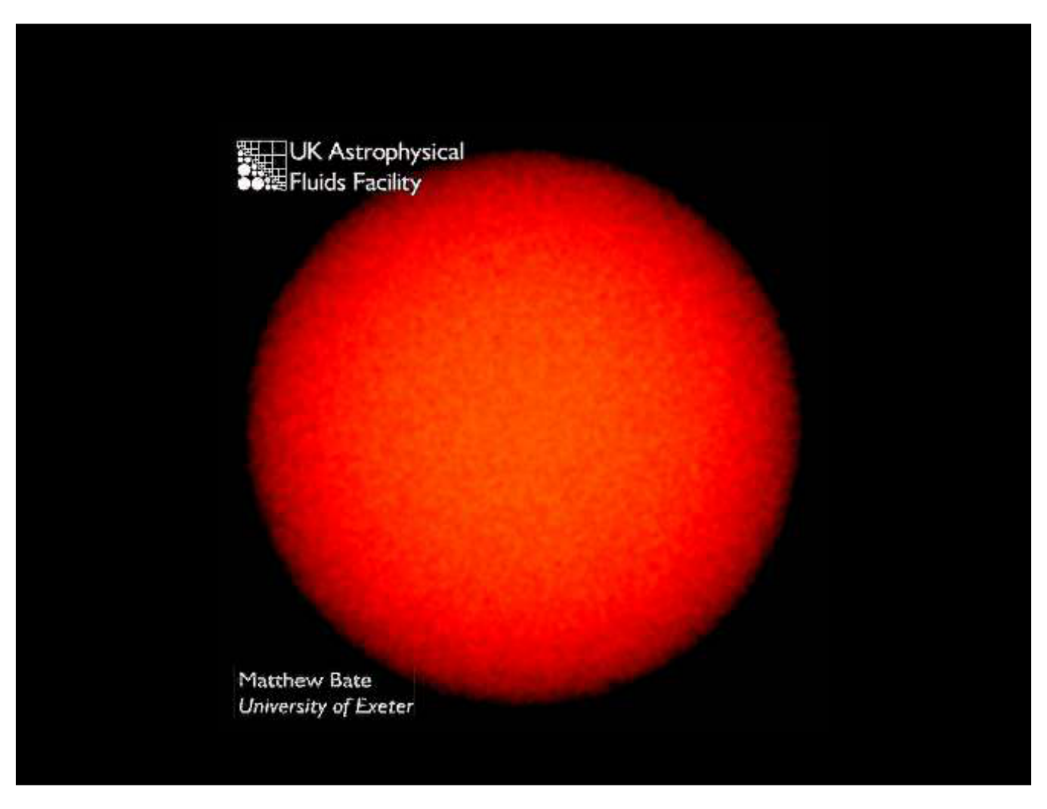
What does star formation look like?
Simulation of stars forming in a cluster from a gas cloud of 50 solar masses.
Notes:
Source edition: assets/lessons/lectures/astronomy/stars.pdf, page 50. Original author and figure credits remain on the slide. Text is editable; illustrations retain their source artwork.

Slide 51
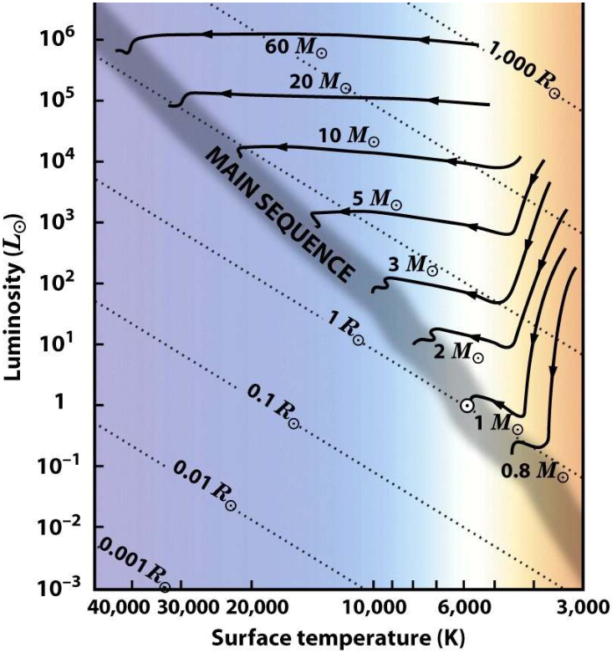
Protostars on the H-R Diagram
•
As stars form they
move on the HR
diagram.
•
The core is always
getting hotter.
•
High-mass stars remain
bright, but heat up as
they form.
•
Low-mass stars stay at
the same temperature
(until fusion starts), but
get fainter as they form.
Notes:
Source edition: assets/lessons/lectures/astronomy/stars.pdf, page 51. Original author and figure credits remain on the slide. Text is editable; illustrations retain their source artwork.

Slide 52
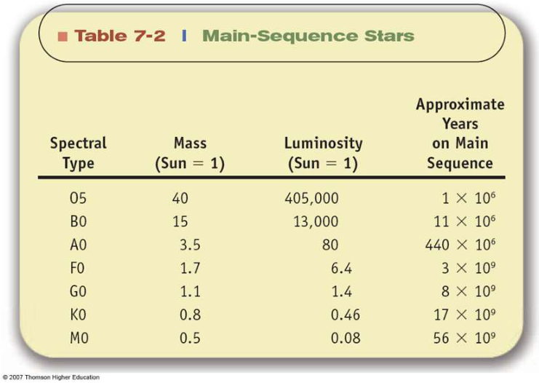
Implication of Mass-Luminosity Relation
More mass = More Luminosity = faster rate of fusion
=
Shorter lifetime on Main Sequence!
O Stars have 40x mass of Sun, live
10,000x shorter.
A stars have 3x mass of Sun, live
20x shorter.
M stars have half the mass of Sun,
and live 7x longer.
Notes:
Source edition: assets/lessons/lectures/astronomy/stars.pdf, page 52. Original author and figure credits remain on the slide. Text is editable; illustrations retain their source artwork.

Slide 53

Formation times
•
Just as massive stars
have short lifetimes,
B
they also form quickly.
•
B stars reach the
main sequence in
100,000 years
•
G stars form in 30
G
million years
•
M stars can take 1
M
billion years!
Notes:
Source edition: assets/lessons/lectures/astronomy/stars.pdf, page 53. Original author and figure credits remain on the slide. Text is editable; illustrations retain their source artwork.

