Slide 1
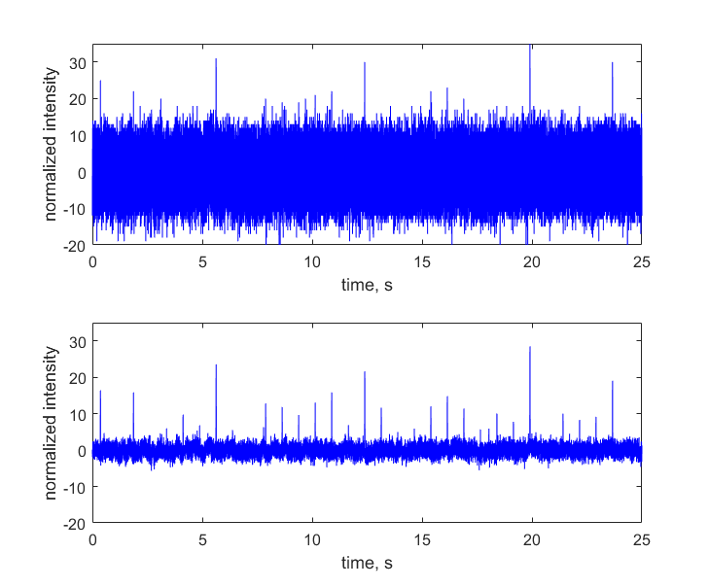
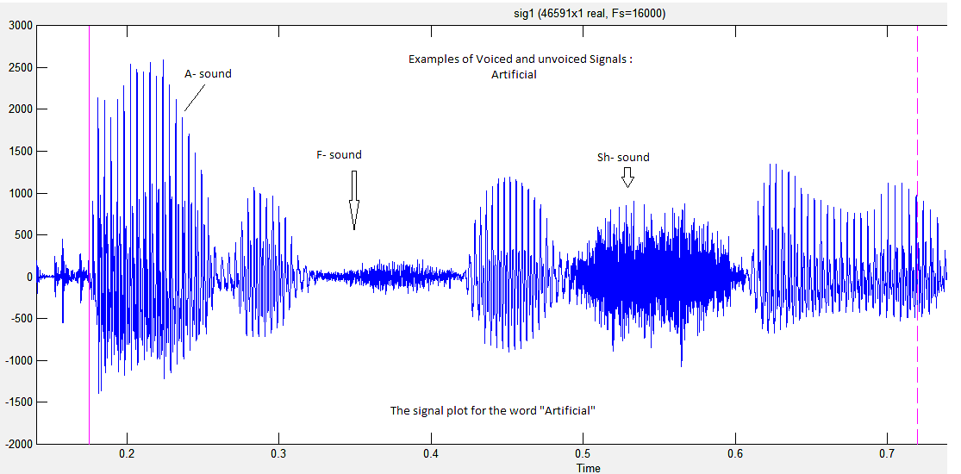
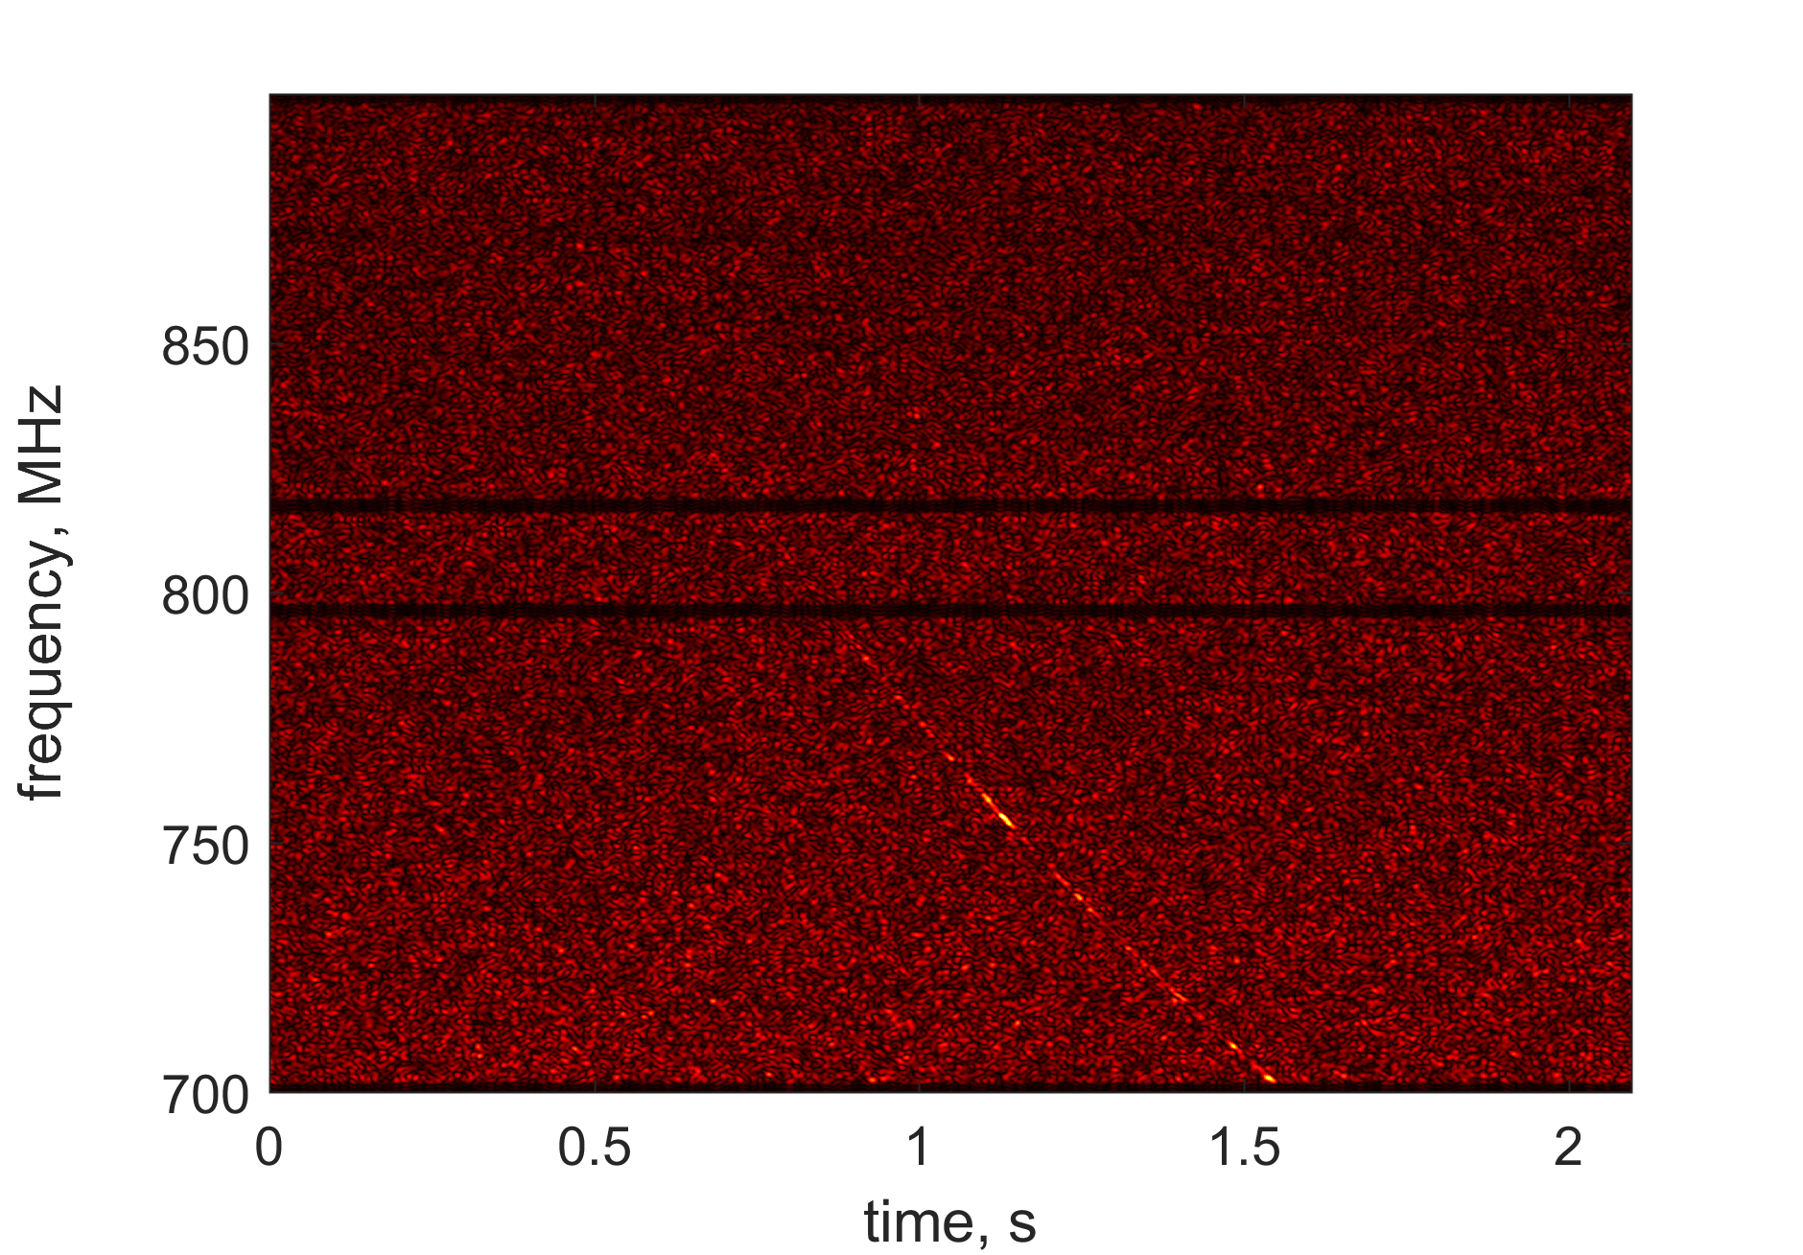
Periodic and non-periodic signals

Slide 2
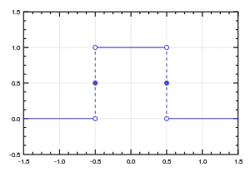
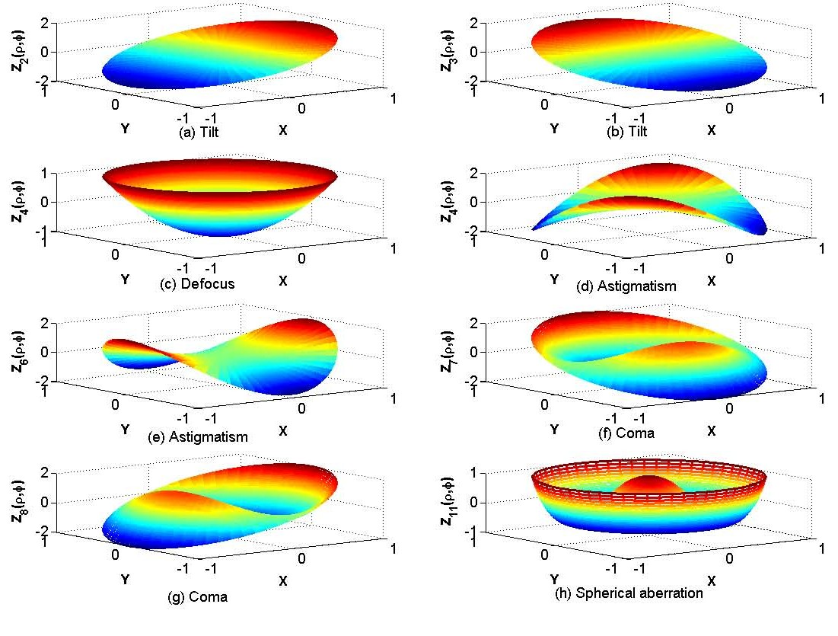
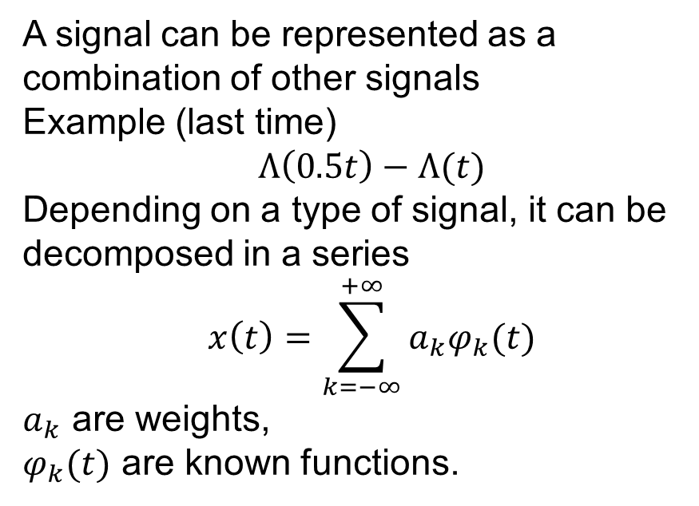
Signal decomposition
A signal can be represented as a combination of other signals
Example (last time)
$$Λ\left(0.5t\right)−Λ(t)$$
Depending on a type of signal, it can be decomposed in a series
$$x\left(t\right)=\sum_{k=−∞}^{+∞}{a_{k}φ_{k}(t)}$$
$a_{k}$ are weights,
$φ_{k}(t)$ are known functions.
Gate Functions
Zernike polynomials

Slide 3
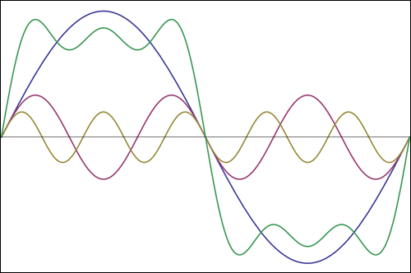
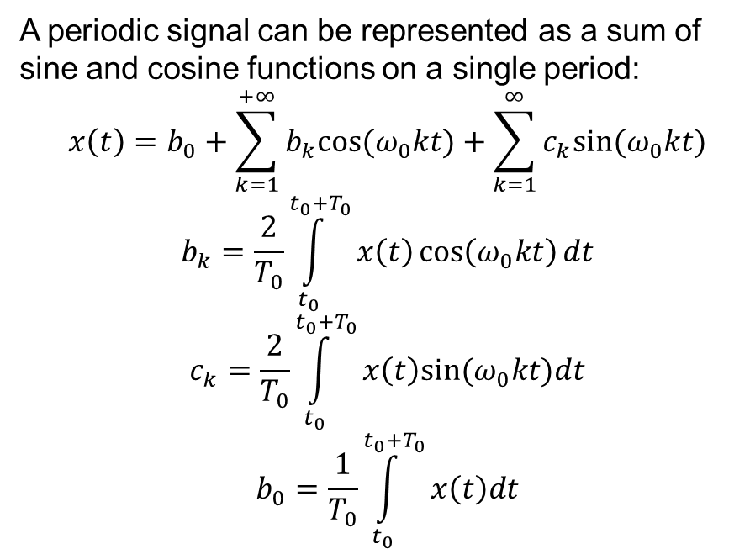
Trigonometric Series
A periodic signal can be represented as a sum of sine and cosine functions on a single period:
$$x\left(t\right)=b_{0}+\sum_{k=1}^{+∞}{b_{k}cos⁡(ω_{0}kt)}+\sum_{k=1}^{∞}{c_{k}sin(ω_{0}kt)}$$
$$b_{k}=\frac{2}{T_{0}}\int_{t_{0}}^{t_{0}+T_{0}}{x\left(t\right)\cos\left(ω_{0}kt\right)dt}$$
$$c_{k}=\frac{2}{T_{0}}\int_{t_{0}}^{t_{0}+T_{0}}{x\left(t\right)sin⁡(ω_{0}kt)dt}$$
$$b_{0}=\frac{1}{T_{0}}\int_{t_{0}}^{t_{0}+T_{0}}{x\left(t\right)dt}$$

Slide 4
Illustration

Slide 5
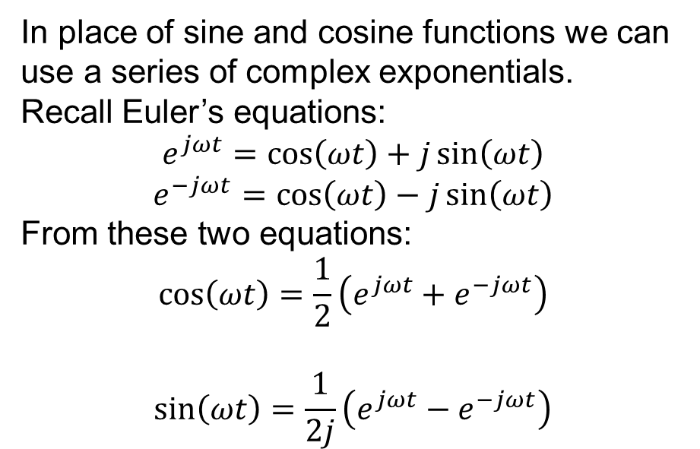
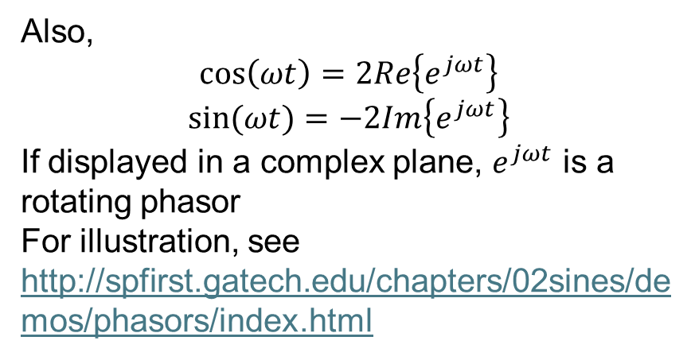
Complex Exponential Series: Background
In place of sine and cosine functions we can use a series of complex exponentials.
Recall Euler’s equations:
$$e^{jωt}=\cos\left(ωt\right)+j\sin\left(ωt\right)$$
$$e^{−jωt}=\cos\left(ωt\right)−j\sin\left(ωt\right)$$
From these two equations:
$$\cos\left(ωt\right)=\frac{1}{2}\left(e^{jωt}+e^{−jωt}\right)$$
$$\sin\left(ωt\right)=\frac{1}{2j}\left(e^{jωt}−e^{−jωt}\right)$$
Also,
$$\cos\left(ωt\right)=2Re\left\{e^{jωt}\right\}$$
$$\sin{(ωt)}=−2Im\left\{e^{jωt}\right\}$$
If displayed in a complex plane, $e^{jωt}$ is a rotating phasor
For illustration, see
http://spfirst.gatech.edu/chapters/02sines/demos/phasors/index.html

Slide 6
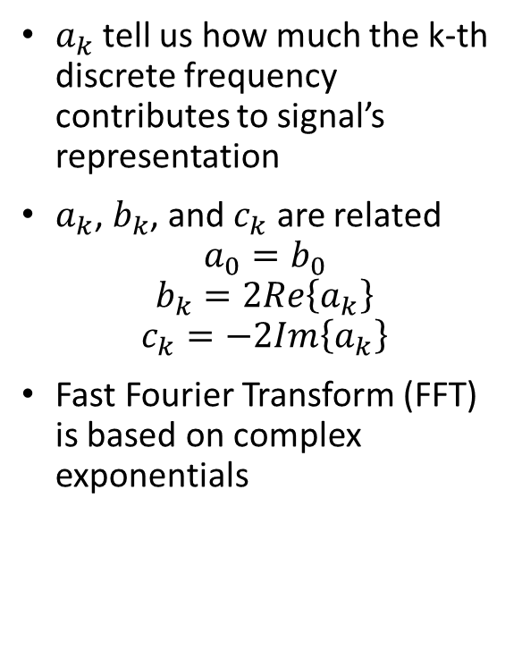
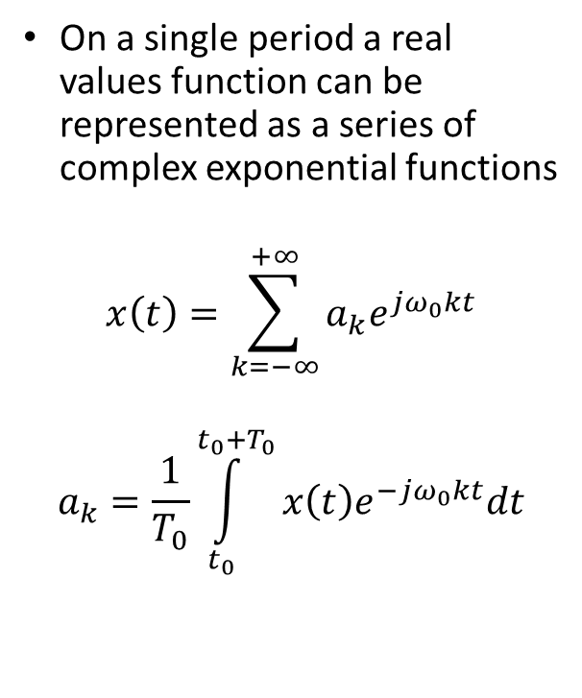
Complex Exponential Series
On a single period a real values function can be represented as a series of complex exponential functions
$$x\left(t\right)=\sum_{k=−∞}^{+∞}{a_{k}e^{jω_{0}kt}}$$
$$a_{k}=\frac{1}{T_{0}}\int_{t_{0}}^{t_{0}+T_{0}}{x\left(t\right)e^{−jω_{0}kt}dt}$$
$a_{k}$ tell us how much the k-th discrete frequency contributes to signal’s representation
$a_{k}$, $b_{k}$, and $c_{k}$ are related
$$a_{0}=b_{0}$$
$$b_{k}=2Re\left\{a_{k}\right\}$$
$$c_{k}=−2Im\left\{a_{k}\right\}$$
Fast Fourier Transform (FFT) is based on complex exponentials

Slide 7
Illustration: Radio Astronomy

