Slide 1

Stellar Evolution
D.J. Pisano
Associate Professor of Physics & Astronomy
July 10, 2017
Notes:
Source edition: assets/lessons/lectures/astronomy/stellar-evolution.pdf, page 1. Original author and figure credits remain on the slide. Text is editable; illustrations retain their source artwork.

Slide 2
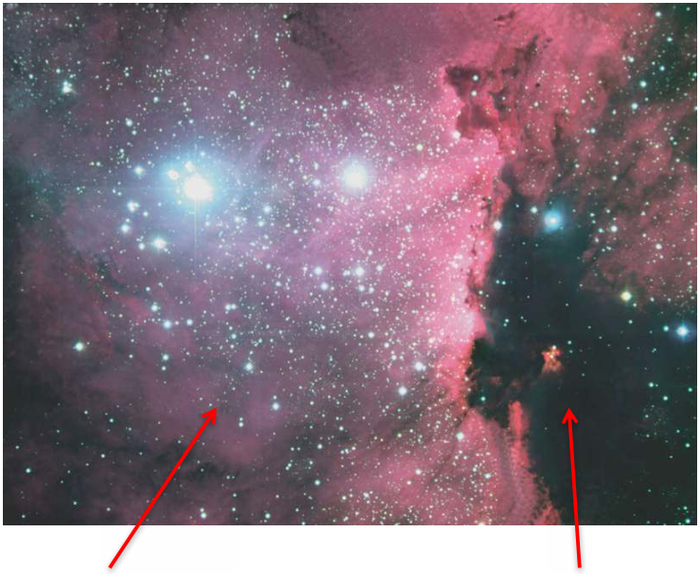
Star Clusters: stellar nurseries
•
As we saw in Orion and
in the simulations,
stars
form in clusters.
•
Young clusters (right)
are still forming stars
and remain surrounded
by hot gas and dust.
•
This gas is an example
of a
emission nebula
. It
is red from ionized
hydrogen (hydrogen that
has lost its electron).
Emission Nebula
Dark Nebula
(ionized gas)
(molecular cloud)
Notes:
Source edition: assets/lessons/lectures/astronomy/stellar-evolution.pdf, page 2. Original author and figure credits remain on the slide. Text is editable; illustrations retain their source artwork.

Slide 3
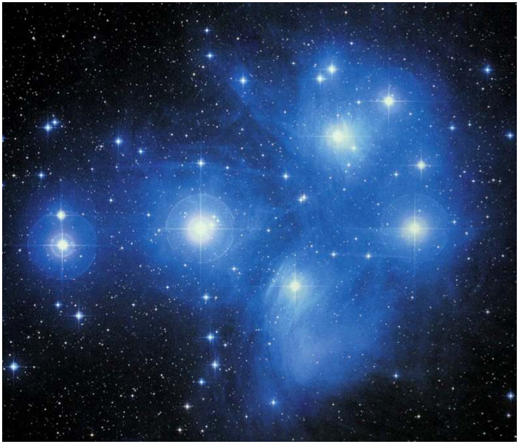
Star Clusters
•
As we saw in Orion and
in the simulations,
stars
form in clusters.
•
The Pleiades (right) are
100 million years old
and only have a little
gas and dust remaining.
•
This gas is an example
of a
reflection nebula
. It
is blue for the same
reason that the sky is.
Notes:
Source edition: assets/lessons/lectures/astronomy/stellar-evolution.pdf, page 3. Original author and figure credits remain on the slide. Text is editable; illustrations retain their source artwork.

Slide 4
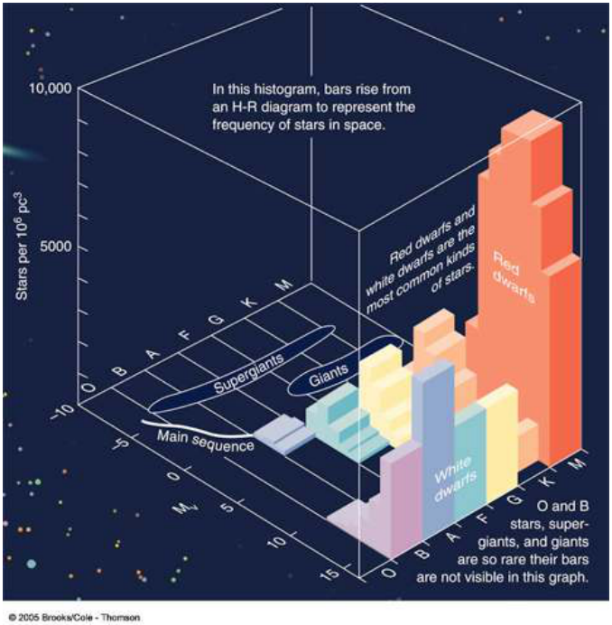
How common are different stars?
•
Low mass stars are
very common. (K
and M stars)
•
Sun-like stars are
rarer (G stars)
•
High mass (O and
B stars) are very
rare.
Notes:
Source edition: assets/lessons/lectures/astronomy/stellar-evolution.pdf, page 4. Original author and figure credits remain on the slide. Text is editable; illustrations retain their source artwork.

Slide 5
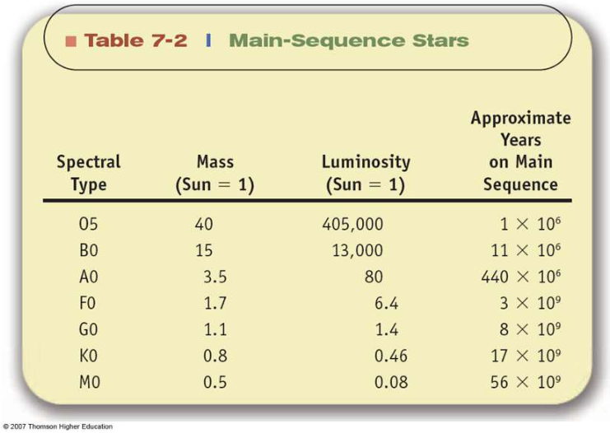
Implication of Mass-Luminosity Relation
More mass = More Luminosity = faster rate of fusion
=
Shorter lifetime on Main Sequence!
O Stars have 40x mass of Sun, live
10,000x shorter.
A stars have 3x mass of Sun, live
20x shorter.
M stars have half the mass of Sun,
and live 7x longer.
Notes:
Source edition: assets/lessons/lectures/astronomy/stellar-evolution.pdf, page 5. Original author and figure credits remain on the slide. Text is editable; illustrations retain their source artwork.

Slide 6
Stellar evolution
Stellar Evolution
What happens after the main
sequence?
Notes:
Source edition: assets/lessons/lectures/astronomy/stellar-evolution.pdf, page 6. Original author and figure credits remain on the slide. Text is editable; illustrations retain their source artwork.

Slide 7
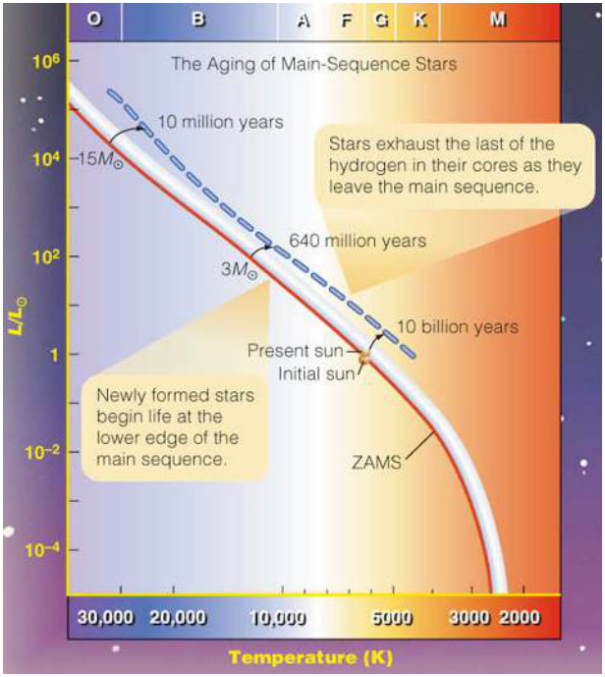
Evolution on the Main Sequence
As main sequence stars
consume their hydrogen,
the cores have to heat
up to continue fusion.
Therefore the stars get
bigger over time on the
main sequence.
Notes:
Source edition: assets/lessons/lectures/astronomy/stellar-evolution.pdf, page 7. Original author and figure credits remain on the slide. Text is editable; illustrations retain their source artwork.

Slide 8
What happens after the Main Sequence?
Stars spend 90% of their lifetime on the
main sequence fusing hydrogen into helium
in their cores.
What happens when the hydrogen runs out?
Notes:
Source edition: assets/lessons/lectures/astronomy/stellar-evolution.pdf, page 8. Original author and figure credits remain on the slide. Text is editable; illustrations retain their source artwork.

Slide 9
What happens after the Main Sequence?
What happens when the hydrogen runs out?
It depends on the
mass
of the star.
1.
Very low mass stars (M < 0.8 solar masses)
2.
Low mass stars (M < 8 solar masses)
3.
Low mass stars with companions (binary stars)
4.
High mass stars (M > 8 solar masses)
5.
Very high mass stars (much greater than 8
solar masses)
Notes:
Source edition: assets/lessons/lectures/astronomy/stellar-evolution.pdf, page 9. Original author and figure credits remain on the slide. Text is editable; illustrations retain their source artwork.

Slide 10
Very low mass stars
?
Every one of them is still on the main sequence.
Notes:
Source edition: assets/lessons/lectures/astronomy/stellar-evolution.pdf, page 10. Original author and figure credits remain on the slide. Text is editable; illustrations retain their source artwork.

Slide 11
Low mass stars (< 8 solar masses)
•
When a star like the Sun starts to run out
of hydrogen in the core, fusion slows
down.
•
The star is no longer in hydrostatic
equilibrium, and is
out of balance
.
•
Something has to happen to keep the star
from collapsing.
Notes:
Source edition: assets/lessons/lectures/astronomy/stellar-evolution.pdf, page 11. Original author and figure credits remain on the slide. Text is editable; illustrations retain their source artwork.

Slide 12
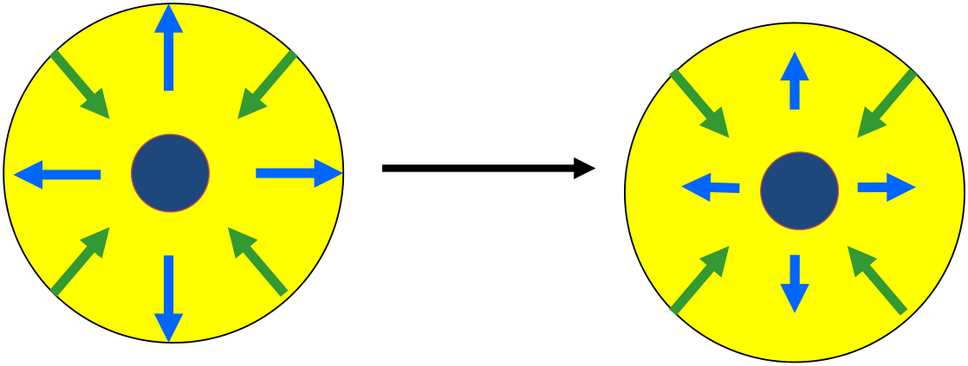
Out of balance
•
Start running out of hydrogen in the core, now
the outward pressure is less than the
gravitational collapse
Notes:
Source edition: assets/lessons/lectures/astronomy/stellar-evolution.pdf, page 12. Original author and figure credits remain on the slide. Text is editable; illustrations retain their source artwork.

Slide 13
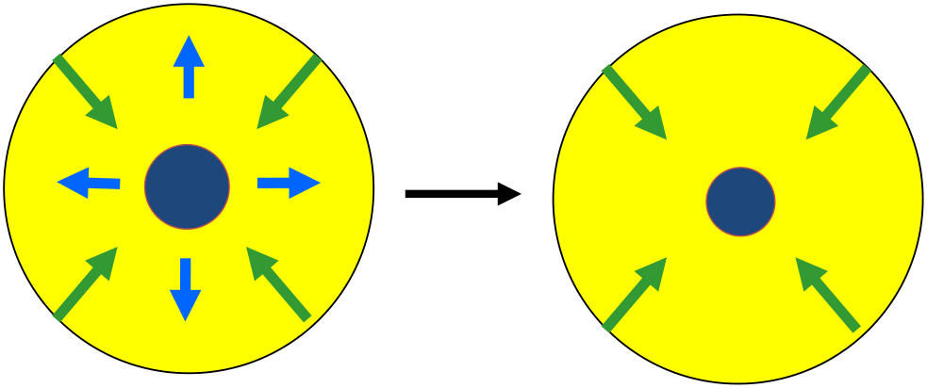
Out of balance
•
What will happen to the core?
Notes:
Source edition: assets/lessons/lectures/astronomy/stellar-evolution.pdf, page 13. Original author and figure credits remain on the slide. Text is editable; illustrations retain their source artwork.

Slide 14
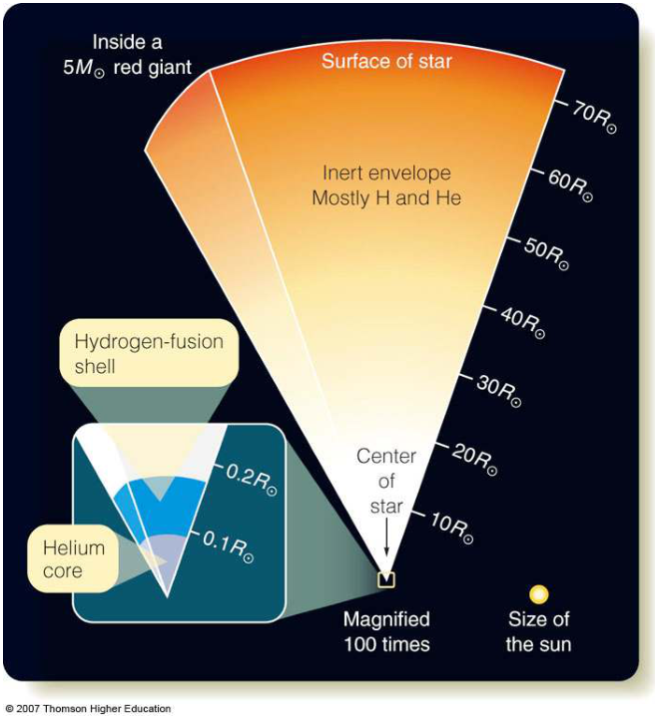
Main Sequence Star becomes a Red Giant
•
Star starts to collapse,
heating up central regions
until a
shell
around the
core is hot enough for
hydrogen fusion.
•
The energy from this shell
is enough to cause the
rest of the star to expand
into a red giant.
•
A stellar burp!
Notes:
Source edition: assets/lessons/lectures/astronomy/stellar-evolution.pdf, page 14. Original author and figure credits remain on the slide. Text is editable; illustrations retain their source artwork.

Slide 15
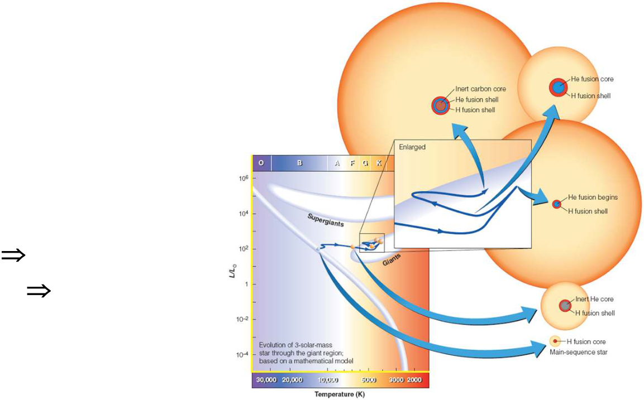
Helium fusion begins at the core of a giant
While the exterior layers
expand, the helium core
continues to contract and
eventually becomes hot
enough (100 million Kelvin) for
helium to begin to fuse into
carbon and oxygen
•
core helium fusion
•
3 He
C + energy
and
C + He
O + energy
Notes:
Source edition: assets/lessons/lectures/astronomy/stellar-evolution.pdf, page 15. Original author and figure credits remain on the slide. Text is editable; illustrations retain their source artwork.

Slide 16
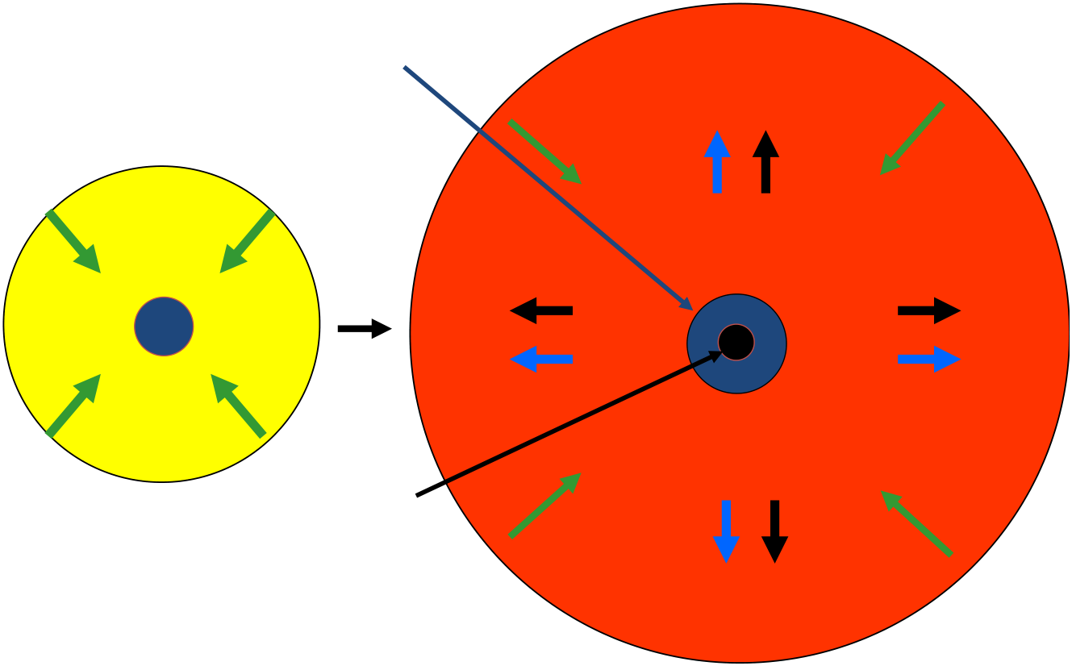
Main Sequence Stars become Red Giants
Hydrogen fusion
Helium fusion
Notes:
Source edition: assets/lessons/lectures/astronomy/stellar-evolution.pdf, page 16. Original author and figure credits remain on the slide. Text is editable; illustrations retain their source artwork.

Slide 17
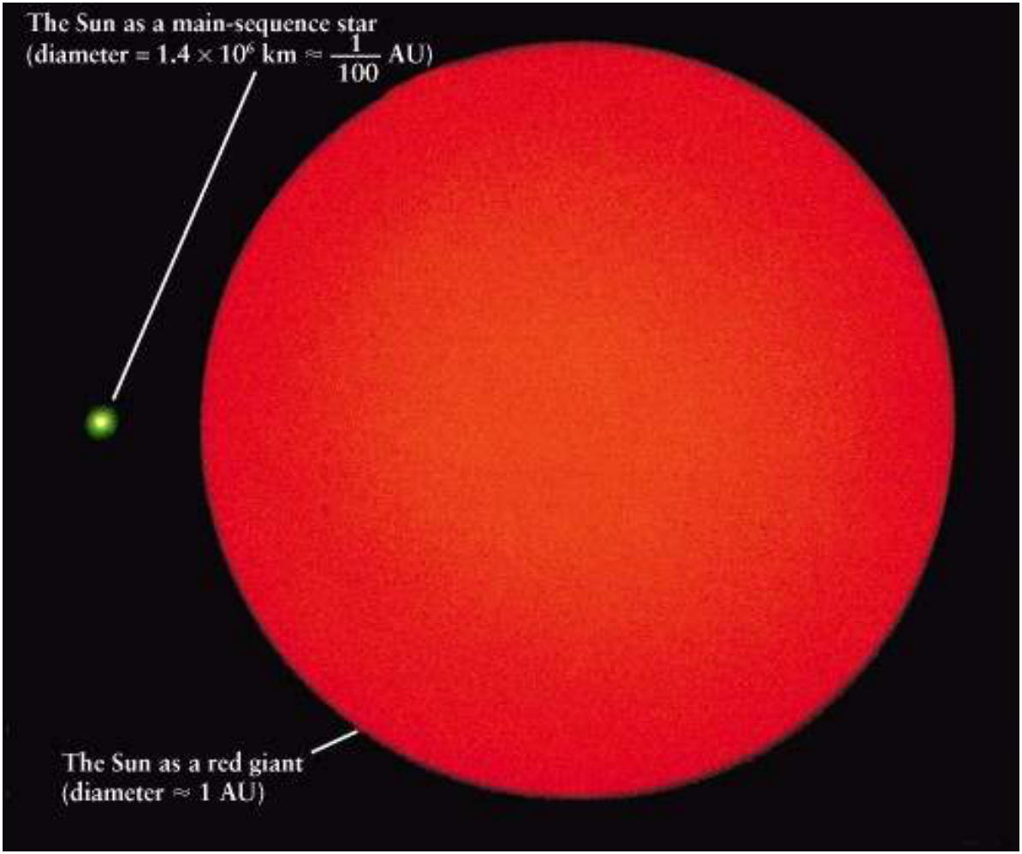
Stellar evolution
Notes:
Source edition: assets/lessons/lectures/astronomy/stellar-evolution.pdf, page 17. Original author and figure credits remain on the slide. Text is editable; illustrations retain their source artwork.

Slide 18
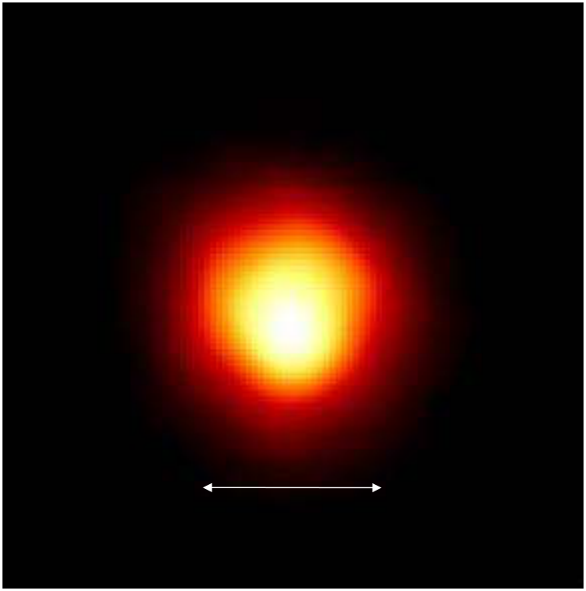
Red Giants
Betelgeuse
Jupiter’s Orbit
Notes:
Source edition: assets/lessons/lectures/astronomy/stellar-evolution.pdf, page 18. Original author and figure credits remain on the slide. Text is editable; illustrations retain their source artwork.

Slide 19
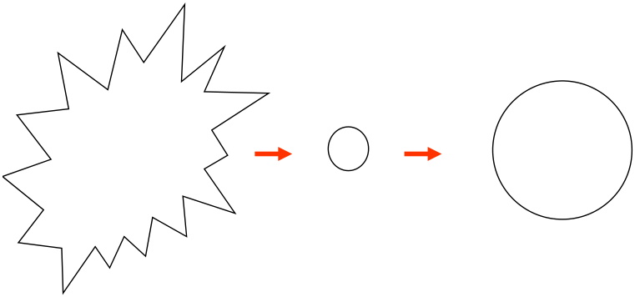
The Life of a Star
Main
Interstellar
Red
Sequence
Cloud (gas
Giant
Star
and dust)
Notes:
Source edition: assets/lessons/lectures/astronomy/stellar-evolution.pdf, page 19. Original author and figure credits remain on the slide. Text is editable; illustrations retain their source artwork.

Slide 20
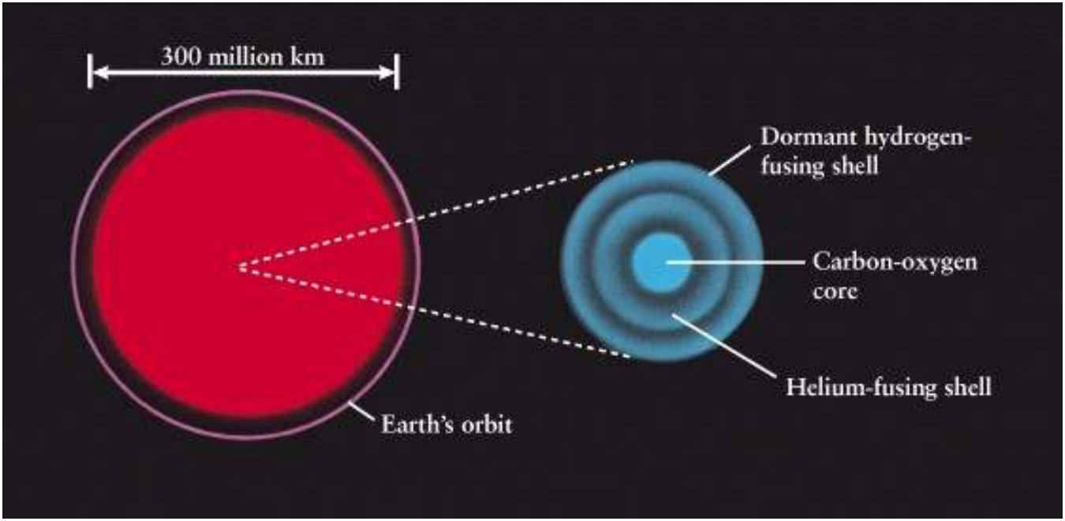
What happens when the star runs out of helium?
•
The core runs out of fuel!
•
Shell fusion of helium begins outside the core.
Notes:
Source edition: assets/lessons/lectures/astronomy/stellar-evolution.pdf, page 20. Original author and figure credits remain on the slide. Text is editable; illustrations retain their source artwork.

Slide 21
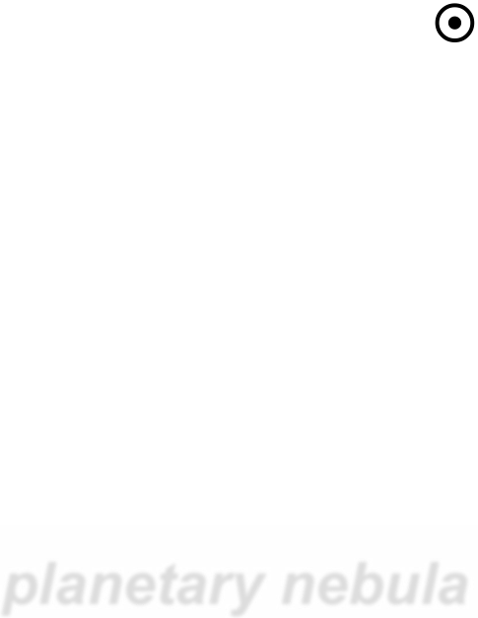
Low-mass stars
Low Mass stars (< 8 M
)
•
The core runs out of fuel!
•
Shell fusion begins outside the core.
•
Eventually the shell fusion creates too much
outward pressure and energy which
explosively push out the outer layers of the
star and produce a
planetary nebula
.
Notes:
Source edition: assets/lessons/lectures/astronomy/stellar-evolution.pdf, page 21. Original author and figure credits remain on the slide. Text is editable; illustrations retain their source artwork.

Slide 22
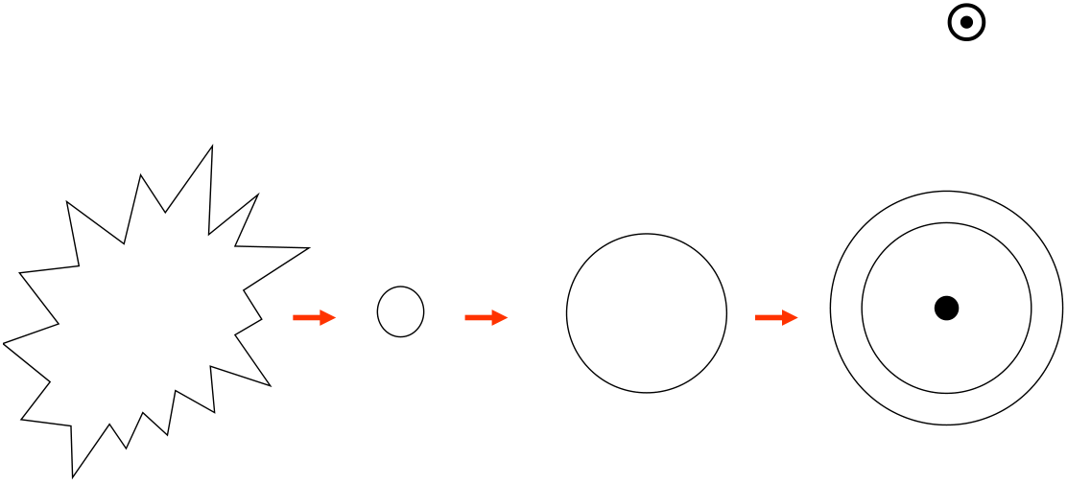
Low-mass stars
Low mass stars (< 8 M
)
Main
Interstellar
Red
Planetary
Cloud (gas and
Sequence
Giant
Nebula
dust)
Star
Notes:
Source edition: assets/lessons/lectures/astronomy/stellar-evolution.pdf, page 22. Original author and figure credits remain on the slide. Text is editable; illustrations retain their source artwork.

Slide 23
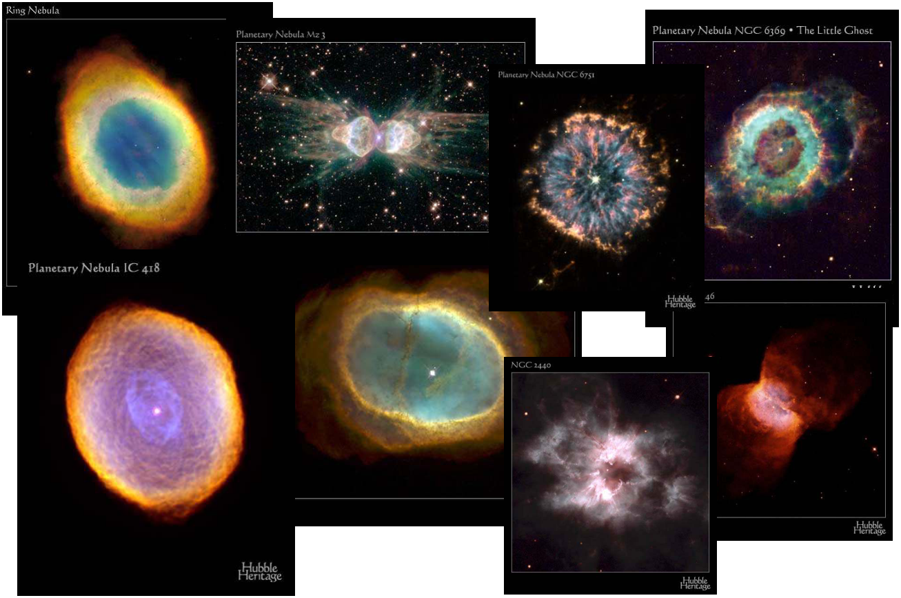
Planetary Nebulae
Notes:
Source edition: assets/lessons/lectures/astronomy/stellar-evolution.pdf, page 23. Original author and figure credits remain on the slide. Text is editable; illustrations retain their source artwork.

Slide 24

The burned-out core of a low-mass star becomes a white dwarf
•
When the planetary nebula disperses, all that is left
behind is the burned-out, hot core of the star, called a
white dwarf
.
•
A core with remaining mass less than 1.4 M
.
•
These tiny star remnants are approximately the size of
planet Earth
•
One cubic centimeter (like a sugar cube) of a white
dwarf star would weigh several tons.
Notes:
Source edition: assets/lessons/lectures/astronomy/stellar-evolution.pdf, page 24. Original author and figure credits remain on the slide. Text is editable; illustrations retain their source artwork.

Slide 25
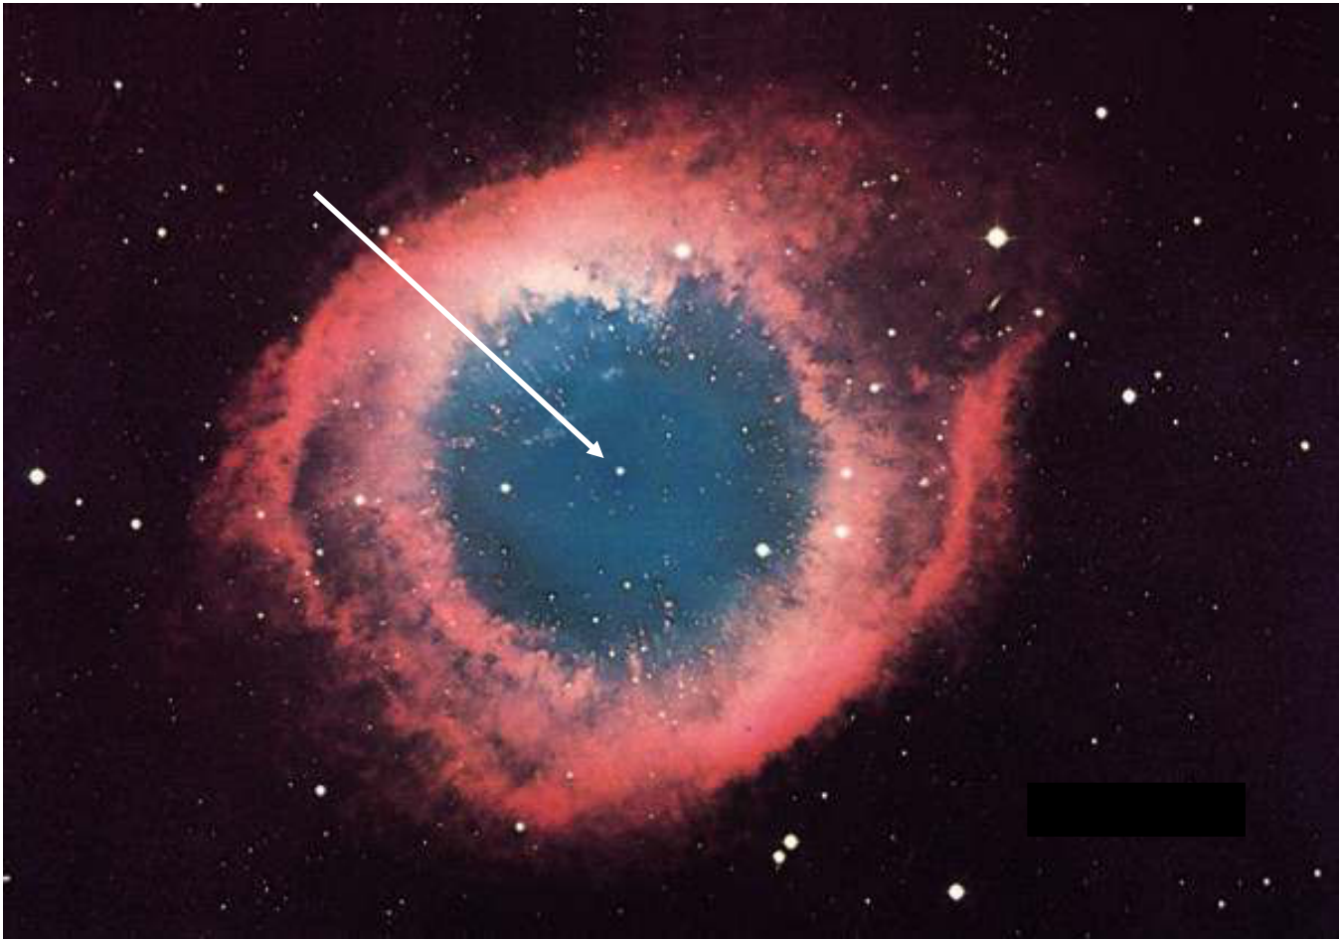
White Dwarf
Helix Nebula
Notes:
Source edition: assets/lessons/lectures/astronomy/stellar-evolution.pdf, page 25. Original author and figure credits remain on the slide. Text is editable; illustrations retain their source artwork.

Slide 26
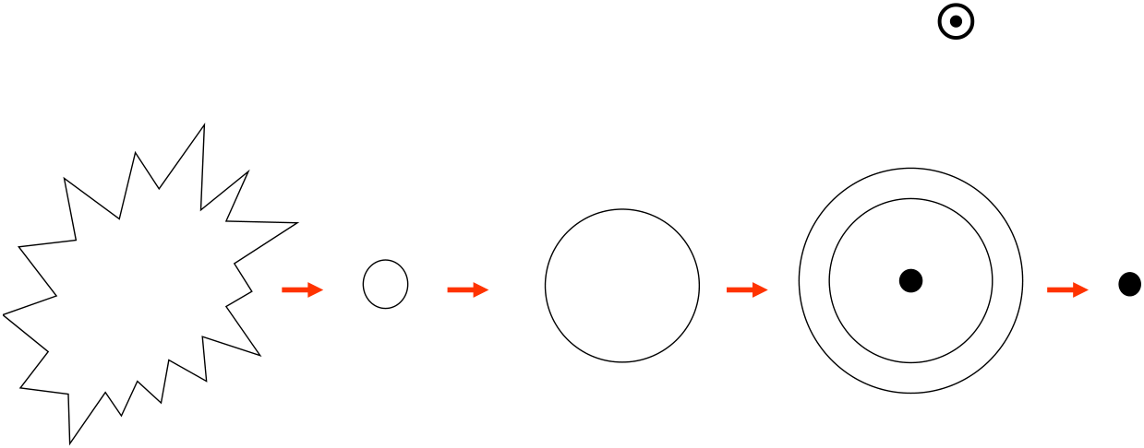
Low mass stars
(< 8 M
)
Main
White
Interstellar
Red
Planetary
Sequence
Giant
Nebula
Dwarf
Cloud (gas
Star
and dust)
Notes:
Source edition: assets/lessons/lectures/astronomy/stellar-evolution.pdf, page 26. Original author and figure credits remain on the slide. Text is editable; illustrations retain their source artwork.

Slide 27
What happens to white dwarfs? Do they just sit there??
If the white dwarfs are isolated,
yes.
They will cool down and
become BLACK DWARFS.
Notes:
Source edition: assets/lessons/lectures/astronomy/stellar-evolution.pdf, page 27. Original author and figure credits remain on the slide. Text is editable; illustrations retain their source artwork.

Slide 28
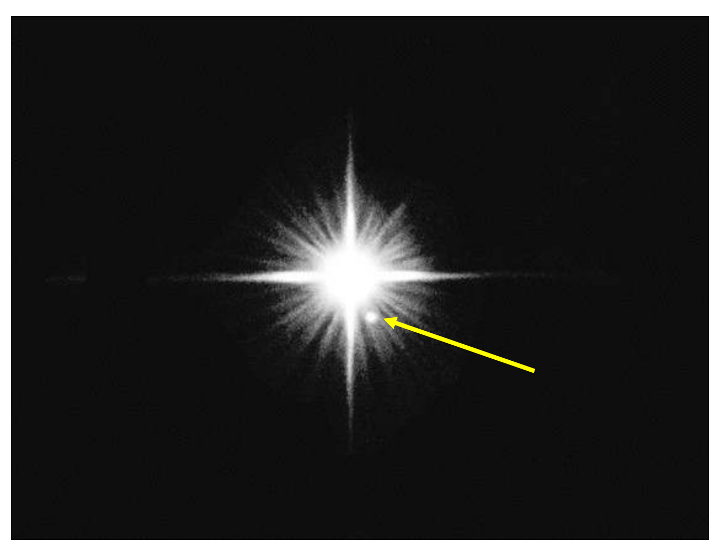
Sirius and its White Dwarf companion
white dwarf
Notes:
Source edition: assets/lessons/lectures/astronomy/stellar-evolution.pdf, page 28. Original author and figure credits remain on the slide. Text is editable; illustrations retain their source artwork.

Slide 29
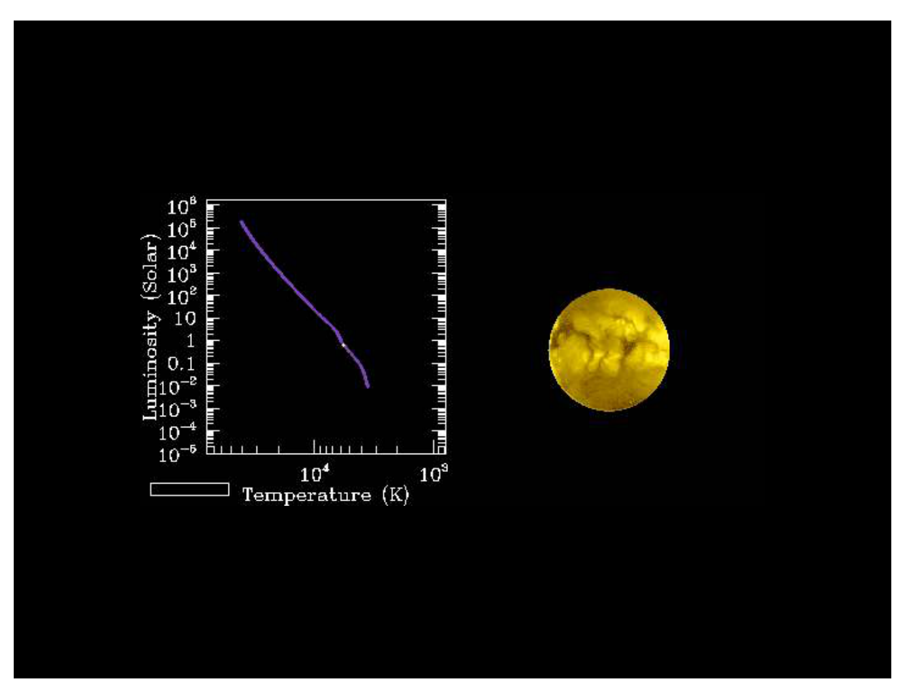
Evolution of a Low Mass Star
Notes:
Source edition: assets/lessons/lectures/astronomy/stellar-evolution.pdf, page 29. Original author and figure credits remain on the slide. Text is editable; illustrations retain their source artwork.

Slide 30
Low mass stars with companions
If a low mass star is a binary star (if it has a
companion), it will evolve in the same way,
except....
As its companion evolves and gets bigger,
the white dwarf can steal mass from it.
The stolen matter forms an external layer
which can quickly ignite and shine brightly
creating a
nova
.
Notes:
Source edition: assets/lessons/lectures/astronomy/stellar-evolution.pdf, page 30. Original author and figure credits remain on the slide. Text is editable; illustrations retain their source artwork.

Slide 31
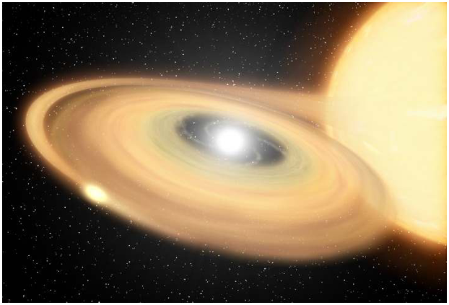
What’s a Nova?
•
A nova occurs in binary
systems where a white
dwarf is pulling mass from
its companion.
•
A nova is a relatively gentle
explosion of hydrogen gas
on the surface of a white
dwarf in a binary star
system.
•
This process does not
damage the white dwarf
and it can repeat.
Notes:
Source edition: assets/lessons/lectures/astronomy/stellar-evolution.pdf, page 31. Original author and figure credits remain on the slide. Text is editable; illustrations retain their source artwork.

Slide 32
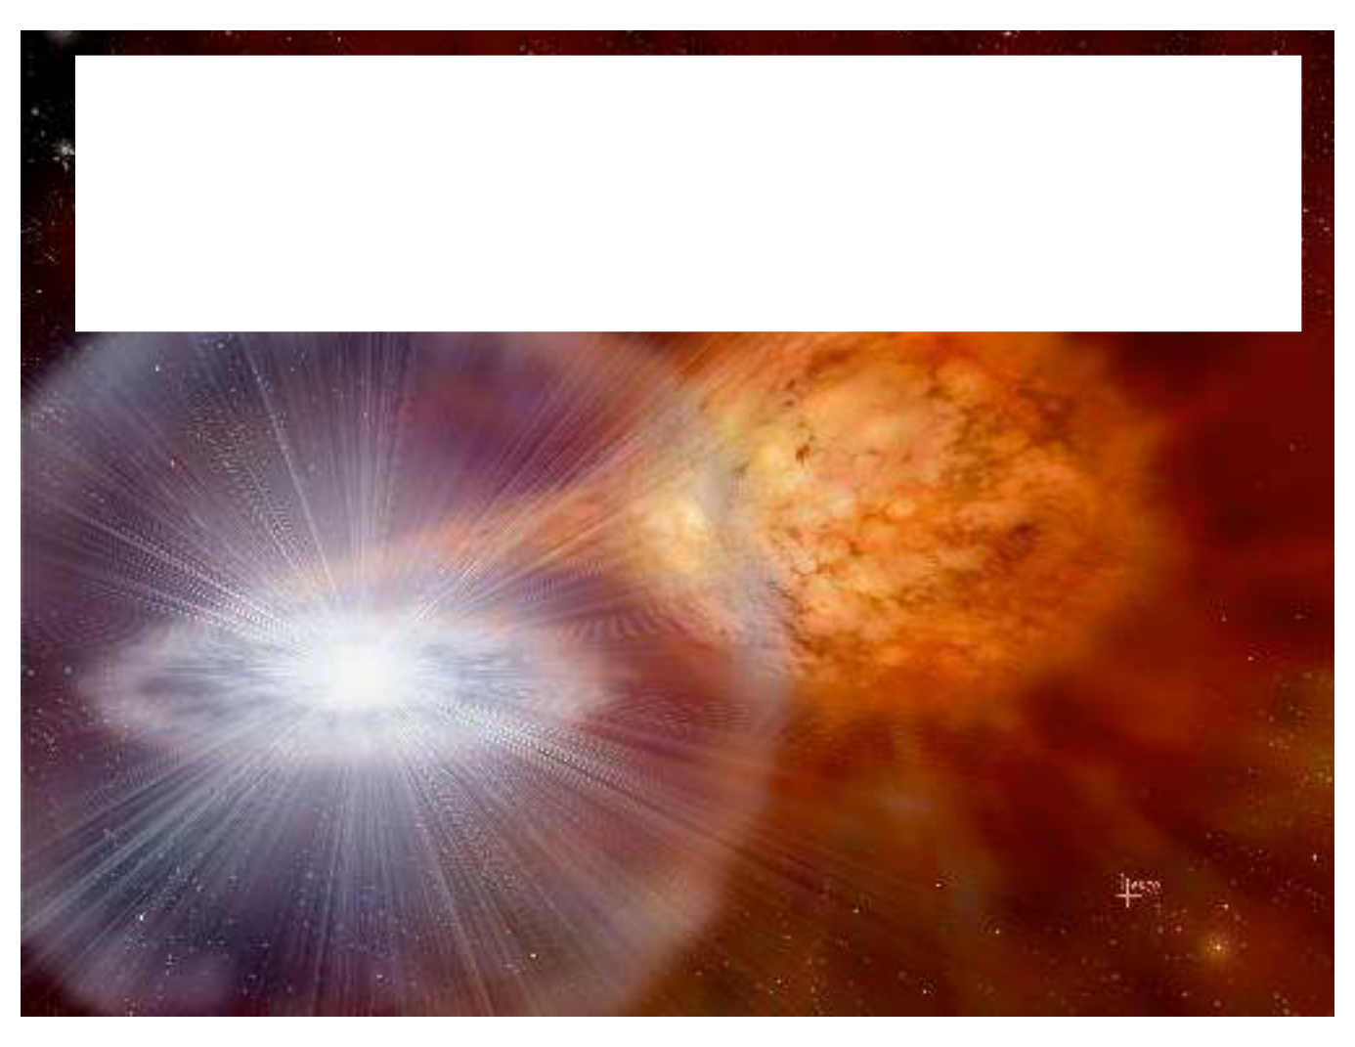
From a nova to a supernova
Sometimes the mass transfer can be
excessive
. So
excessive that the white dwarf will not be able to support
the mass it gains. So, what would have been a nova
becomes a
SUPERNOVA
!
Notes:
Source edition: assets/lessons/lectures/astronomy/stellar-evolution.pdf, page 32. Original author and figure credits remain on the slide. Text is editable; illustrations retain their source artwork.

Slide 33
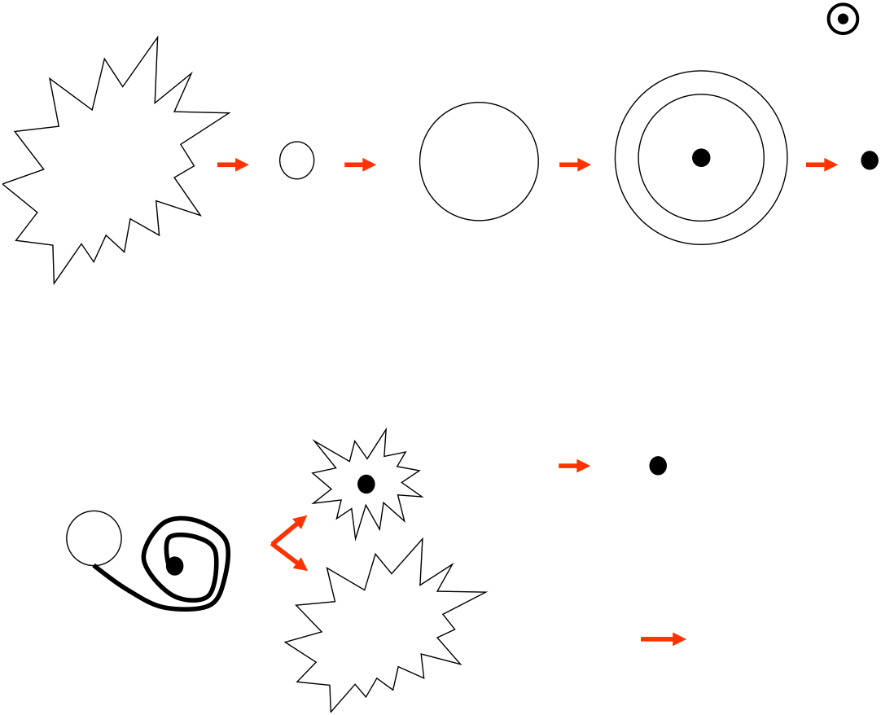
Low mass stars
(< 8 M
)
Interstellar
Main
Red
Planetary
White
Cloud (gas and
Sequence
Giant
Nebula
Dwarf
dust)
Star
Nova
White Dwarf
(can repeat
last 3 steps)
Pulling material
Leaves no
off of a
Supernova Ia
remnant!
companion star
Notes:
Source edition: assets/lessons/lectures/astronomy/stellar-evolution.pdf, page 33. Original author and figure credits remain on the slide. Text is editable; illustrations retain their source artwork.

Slide 34
High mass stars (> 8 solar masses)
•
Like low mass stars, they will become red giants
when they finish hydrogen fusion, but they will not
become white dwarfs with planetary nebulae.
•
Fusion in the core continues through many more
stages than for low mass stars. Each stage is
shorter than the next.
•
Heavier elements are produced:
–
carbon, (over 500,000 years)
–
oxygen, (over 600 years)
–
neon,
–
silicon, (over 6 months)
–
and so on up to iron (over 1 day)
Notes:
Source edition: assets/lessons/lectures/astronomy/stellar-evolution.pdf, page 34. Original author and figure credits remain on the slide. Text is editable; illustrations retain their source artwork.

Slide 35
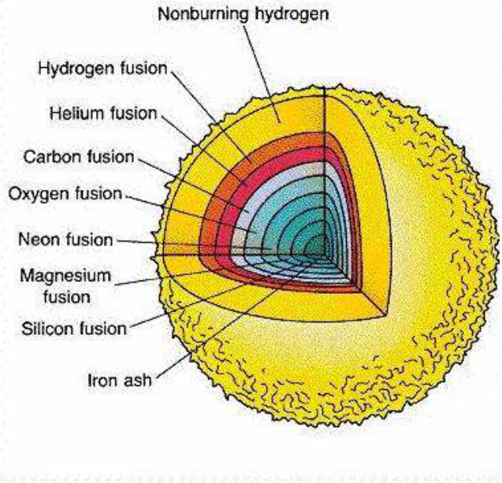
A series of different types of fusion reactions occur in high-mass stars
Notes:
Source edition: assets/lessons/lectures/astronomy/stellar-evolution.pdf, page 35. Original author and figure credits remain on the slide. Text is editable; illustrations retain their source artwork.

Slide 36
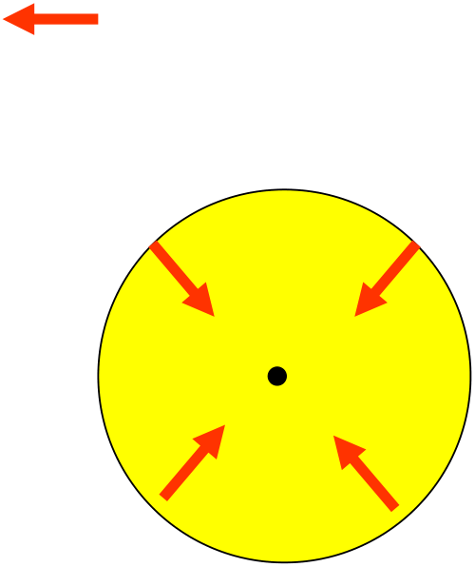
Core runs out of fuel!
Gravity
( ) wants to collapse the star!
Notes:
Source edition: assets/lessons/lectures/astronomy/stellar-evolution.pdf, page 36. Original author and figure credits remain on the slide. Text is editable; illustrations retain their source artwork.

Slide 37

High-mass stars
High-Mass Stars (> 8 M
)
•
The core and outer layers run out of
fuel.
•
The star then collapses, due to gravity.
•
The mass, however, is high enough
that nothing can balance the
gravitational collapse and…..
Notes:
Source edition: assets/lessons/lectures/astronomy/stellar-evolution.pdf, page 37. Original author and figure credits remain on the slide. Text is editable; illustrations retain their source artwork.

Slide 38
Supernovae -Type II
•
The collapsing outer layers of the star
will collapse against and bounce outward
off the compact collapsed core in an
explosive event sending out a
shockwave. This explosive event is
called a
Type II Supernova
!!!
•
During the Supernova, heavier elements
are created from fusion events, like
magnesium, lead, or gold.
Notes:
Source edition: assets/lessons/lectures/astronomy/stellar-evolution.pdf, page 38. Original author and figure credits remain on the slide. Text is editable; illustrations retain their source artwork.

Slide 39
A Supernova Type II occurred here before we did.
•
The atoms that created our world and
solar system come from nuclear fusion in
stars and from supernovae events!
•
We are all made of star stuff!
Notes:
Source edition: assets/lessons/lectures/astronomy/stellar-evolution.pdf, page 39. Original author and figure credits remain on the slide. Text is editable; illustrations retain their source artwork.

Slide 40
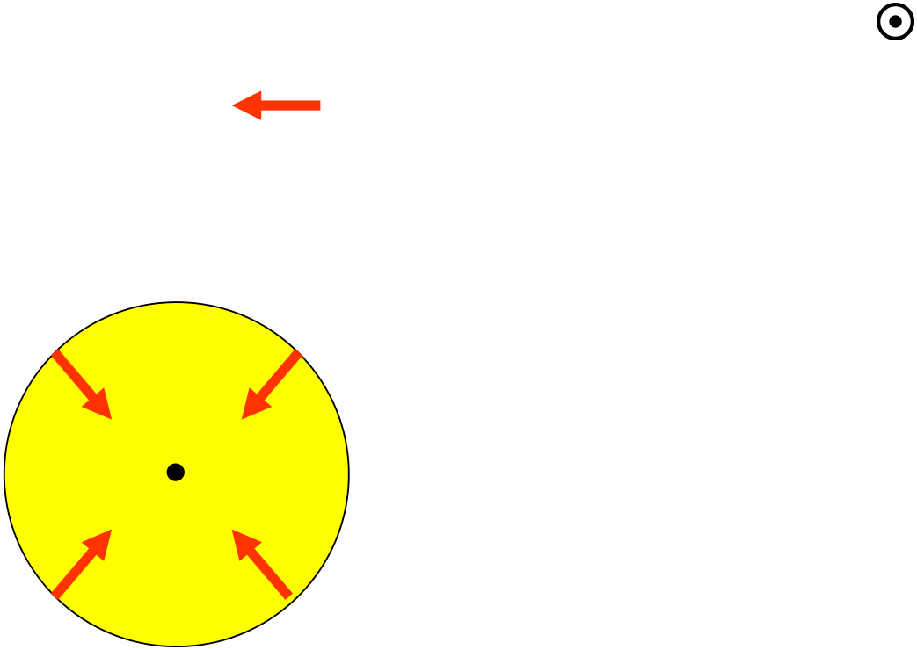
High-mass stars
High-Mass Stars (> 8 M
)
Gravity
(
)
wants to collapse the star
No outward pressure
=
implosion
Rebound of outer
layers against the
core
= supernova
Notes:
Source edition: assets/lessons/lectures/astronomy/stellar-evolution.pdf, page 40. Original author and figure credits remain on the slide. Text is editable; illustrations retain their source artwork.

Slide 41
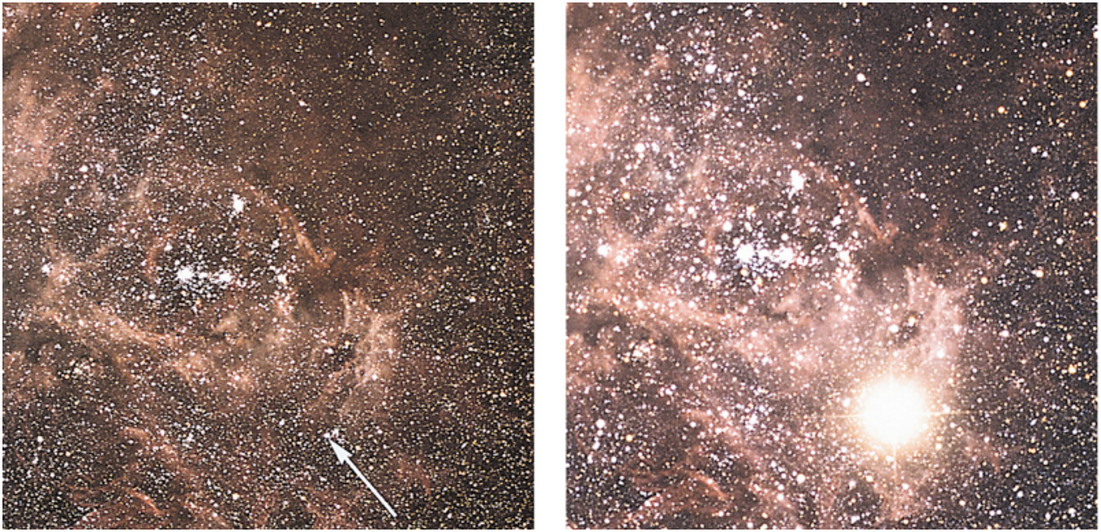
Supernovae
SN 1987A
Notes:
Source edition: assets/lessons/lectures/astronomy/stellar-evolution.pdf, page 41. Original author and figure credits remain on the slide. Text is editable; illustrations retain their source artwork.

Slide 42
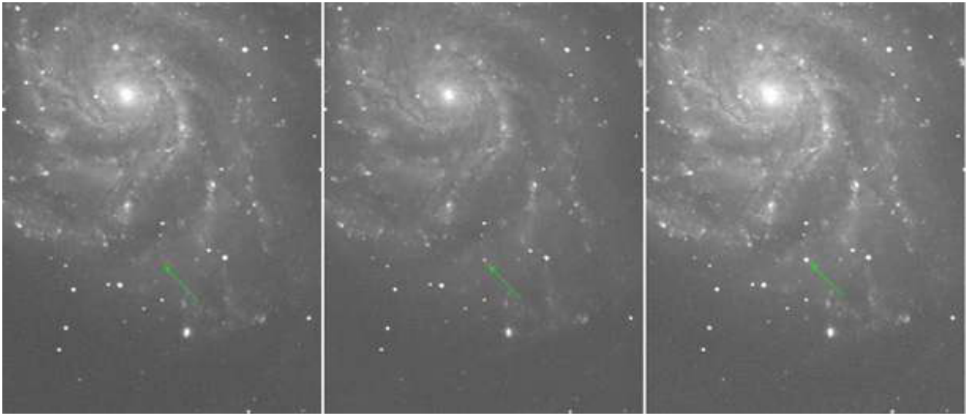
Supernovae
August 22, 2011
August 23, 2011
August 24, 2011
SN 2011fe in M101
Notes:
Source edition: assets/lessons/lectures/astronomy/stellar-evolution.pdf, page 42. Original author and figure credits remain on the slide. Text is editable; illustrations retain their source artwork.

Slide 43
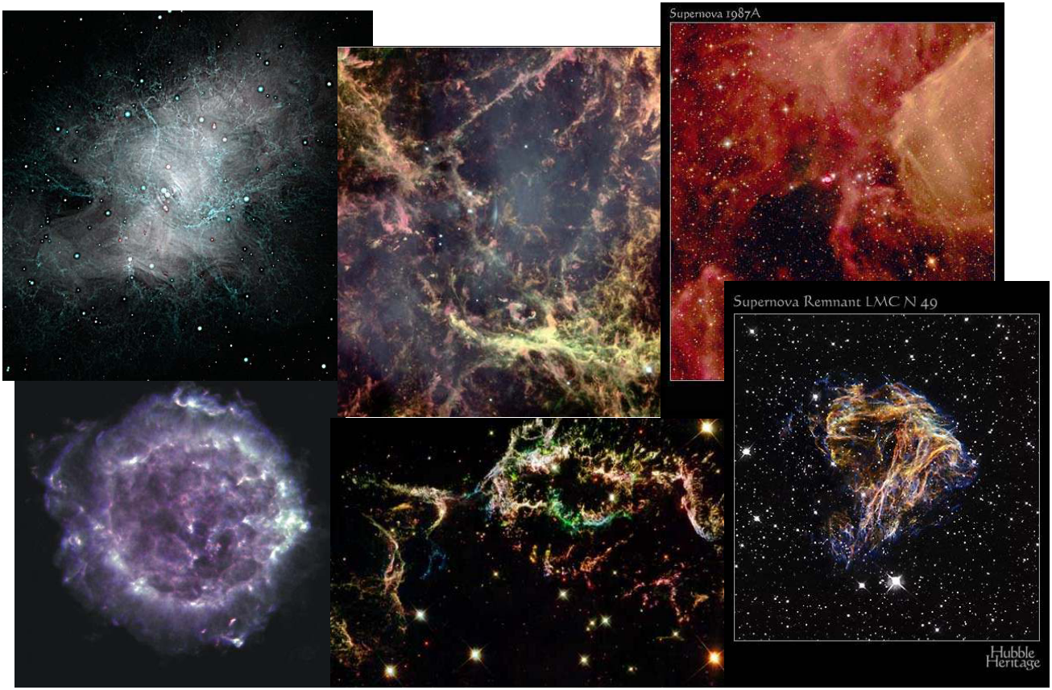
Supernova Remnants
Notes:
Source edition: assets/lessons/lectures/astronomy/stellar-evolution.pdf, page 43. Original author and figure credits remain on the slide. Text is editable; illustrations retain their source artwork.

Slide 44
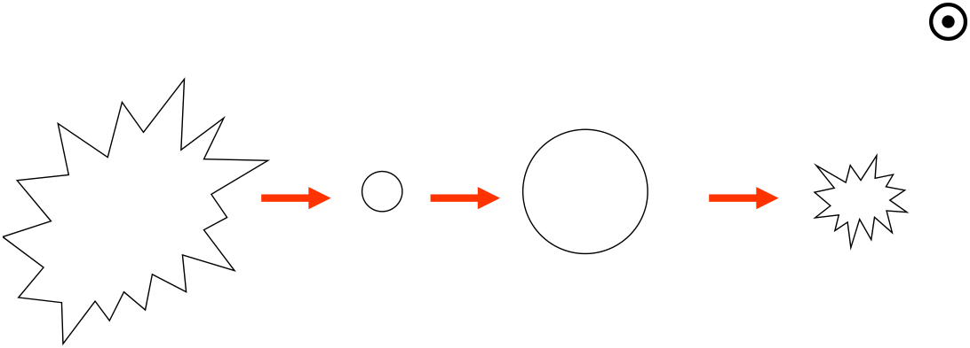
High-mass stars
High-Mass Stars (> 8 M
)
Interstellar
Big Main
Red
Type II
Cloud (gas
Sequence Star
Giant
Supernova
and dust)
Notes:
Source edition: assets/lessons/lectures/astronomy/stellar-evolution.pdf, page 44. Original author and figure credits remain on the slide. Text is editable; illustrations retain their source artwork.

Slide 45

Very high mass stars
•
Depending on the exact mass of the star, the
remnant of a high mass or a very high mass star
differ.
•
neutron star
– the really big ones: remaining mass of 1.4 to
about 3 M
•
black hole
– the
really really big ones
: remaining mass
greater than 3 M
We will discuss these objects
in more detail next class.
Notes:
Source edition: assets/lessons/lectures/astronomy/stellar-evolution.pdf, page 45. Original author and figure credits remain on the slide. Text is editable; illustrations retain their source artwork.

Slide 46
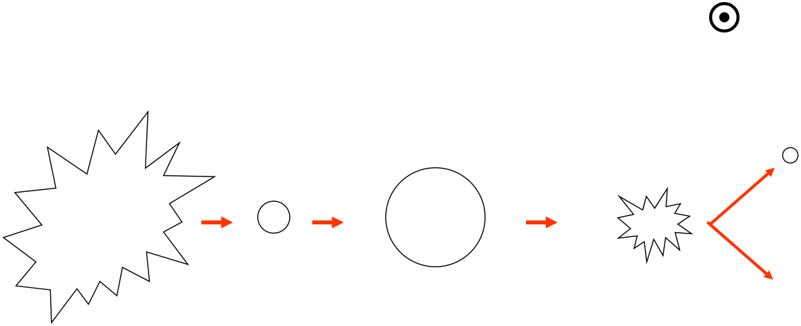
High-mass stars
High-Mass Stars (> 8 M
)
Neutron
Star
Big Main
Black Hole
Interstellar
Red
Cloud (gas
Sequence
Type II
Star
Giant
Supernova
and dust)
Notes:
Source edition: assets/lessons/lectures/astronomy/stellar-evolution.pdf, page 46. Original author and figure credits remain on the slide. Text is editable; illustrations retain their source artwork.

Slide 47
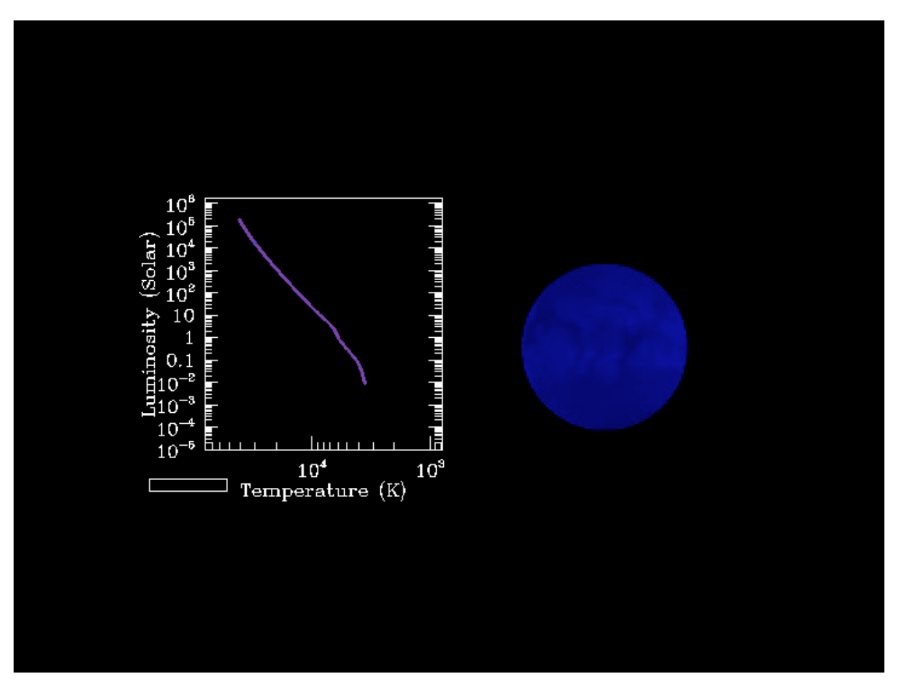
Evolution of a High Mass Star
Notes:
Source edition: assets/lessons/lectures/astronomy/stellar-evolution.pdf, page 47. Original author and figure credits remain on the slide. Text is editable; illustrations retain their source artwork.

Slide 48
Stellar evolution: review question
Which of the following lists, in the correct
order, is a possible evolutionary path for a
star?
A.
Red Giant, Neutron Star, White Dwarf, nothing
B.
Red Giant, Type I Supernova, Black Hole
C.
Red Giant, Type II Supernova, Planetary Nebula,
Neutron Star
D.
Red Giant, Planetary Nebula, White Dwarf
E.
Red Giant, Planetary Nebula, Black Hole
Notes:
Source edition: assets/lessons/lectures/astronomy/stellar-evolution.pdf, page 48. Original author and figure credits remain on the slide. Text is editable; illustrations retain their source artwork.

Slide 49
Novae: review question
For a white dwarf to become a nova
it is necessary for it to
A.
have a binary companion
B.
become a black hole
C.
have begun life as a high-mass star
D.
rejoin the main sequence
Notes:
Source edition: assets/lessons/lectures/astronomy/stellar-evolution.pdf, page 49. Original author and figure credits remain on the slide. Text is editable; illustrations retain their source artwork.

Slide 50
How did astronomers figure all of this out???
Star Clusters
•
Since stars form in clusters, you get a
snapshot of stellar evolution at a moment
of time for all masses of stars.
•
We can observe stars of different masses
at different stages of their evolution.
Notes:
Source edition: assets/lessons/lectures/astronomy/stellar-evolution.pdf, page 50. Original author and figure credits remain on the slide. Text is editable; illustrations retain their source artwork.

Slide 51
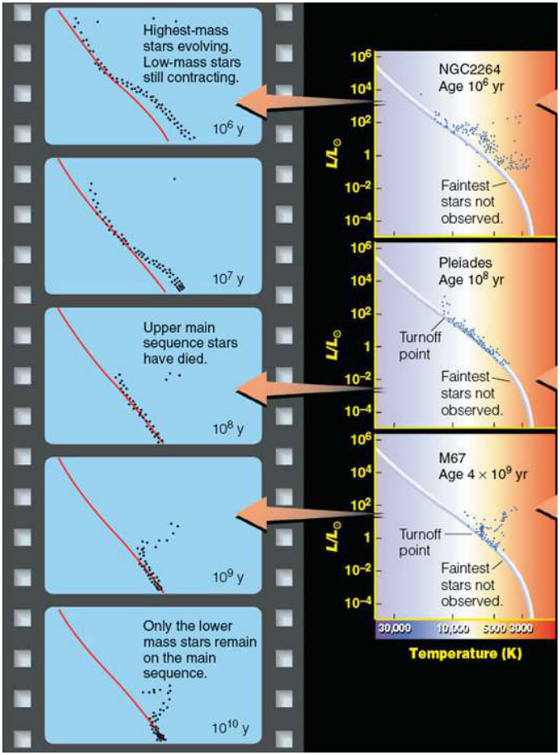
Example HR Diagrams
•
The HR diagrams look
different for star clusters of
different ages.
•
Young clusters have
massive stars already
evolving off the main
sequence while low mass
stars have yet to reach it.
•
Old Clusters only have low
mass stars still on the main
sequence.
Notes:
Source edition: assets/lessons/lectures/astronomy/stellar-evolution.pdf, page 51. Original author and figure credits remain on the slide. Text is editable; illustrations retain their source artwork.

