Slide 1
EE 329: Fourier Series Brief Project Overview
February 2, 2018

Slide 2
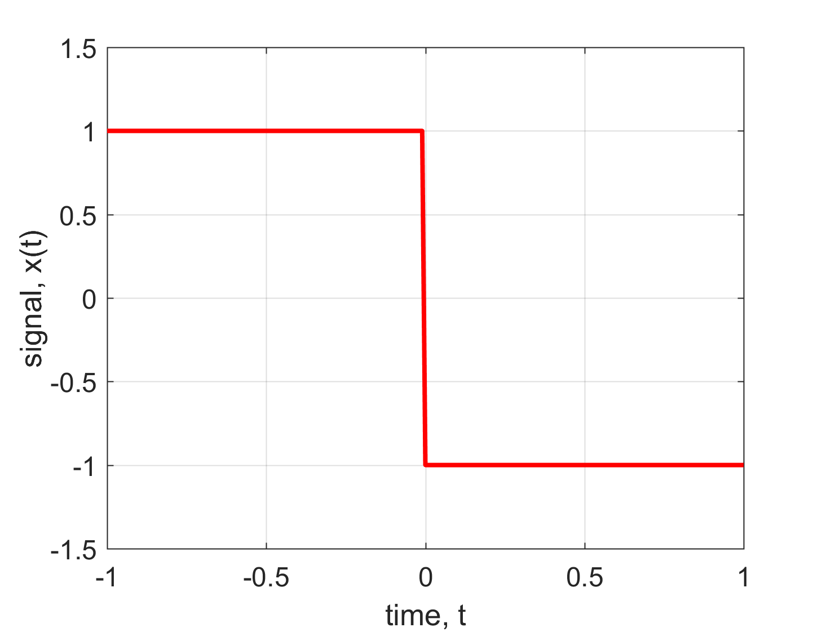
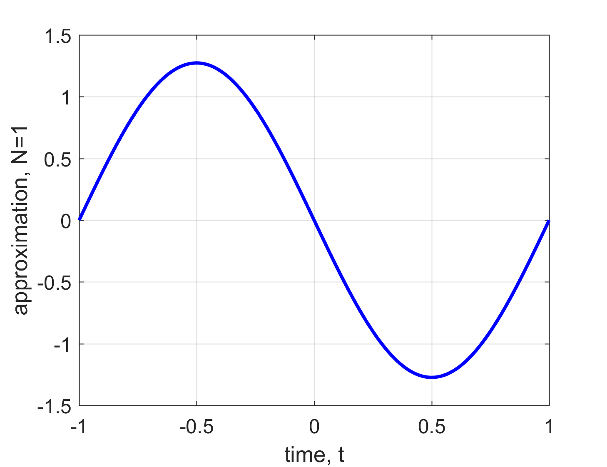
Order of Approximation N = 1
February 2, 2018

Slide 3
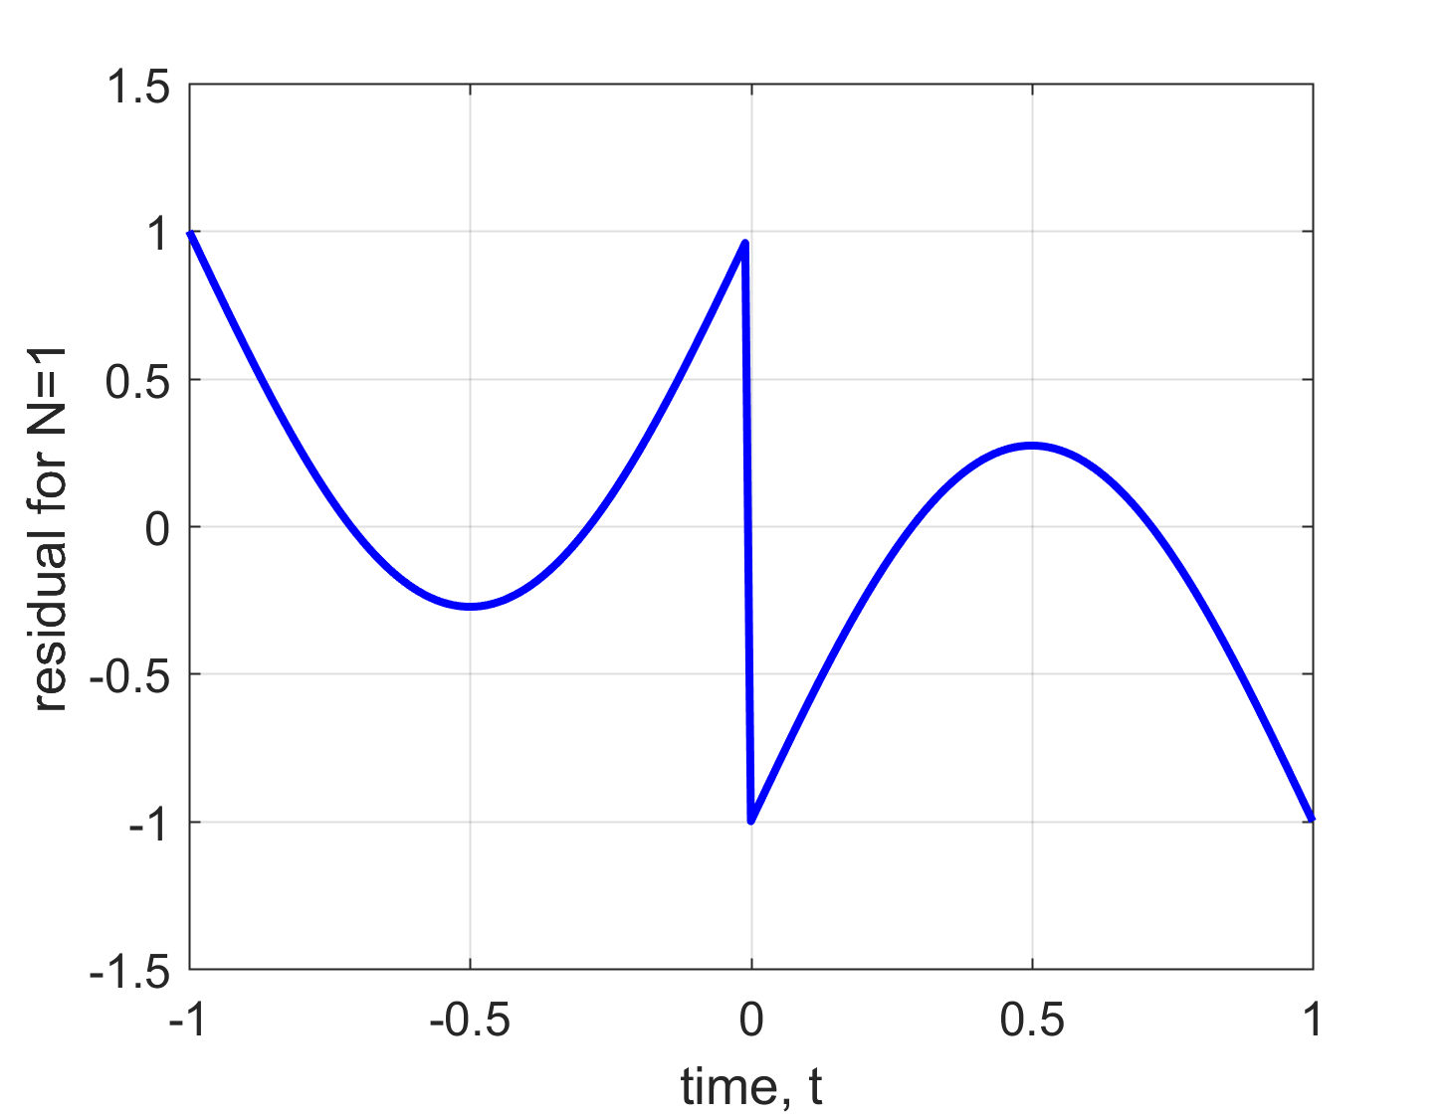
Subtract the two signals
Residual power = 0.1964
(Watts)
February 2, 2018

Slide 4
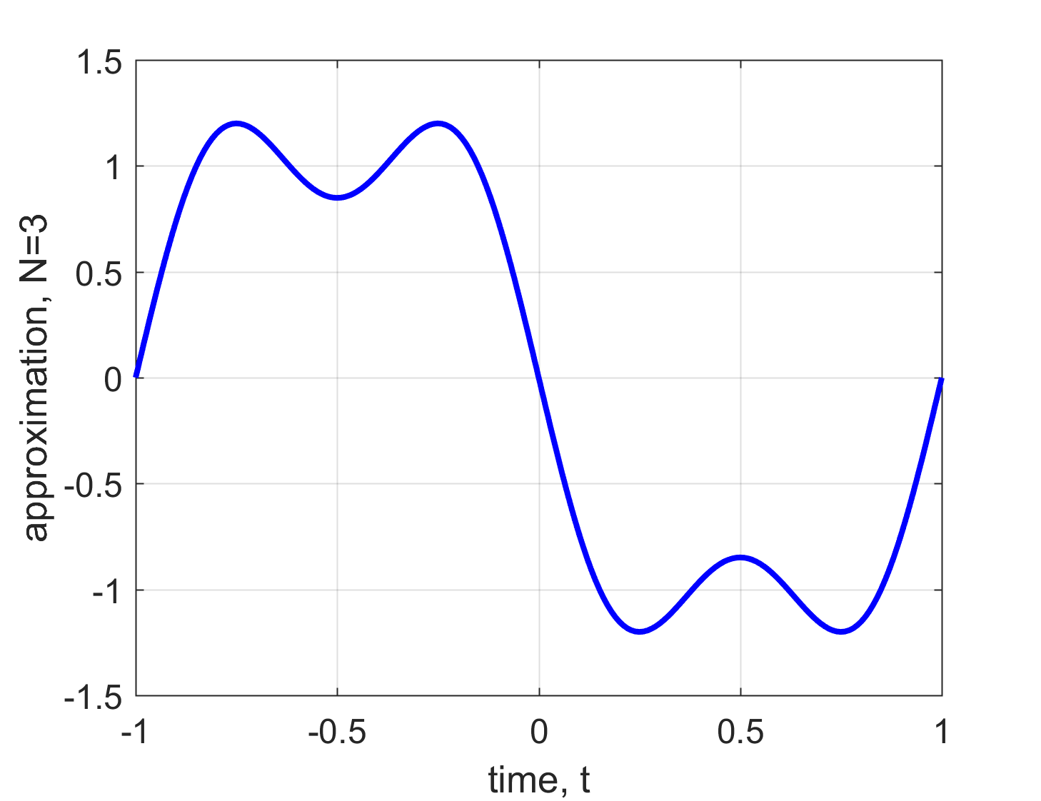
Order of Approximation N = 3
February 2, 2018

Slide 5
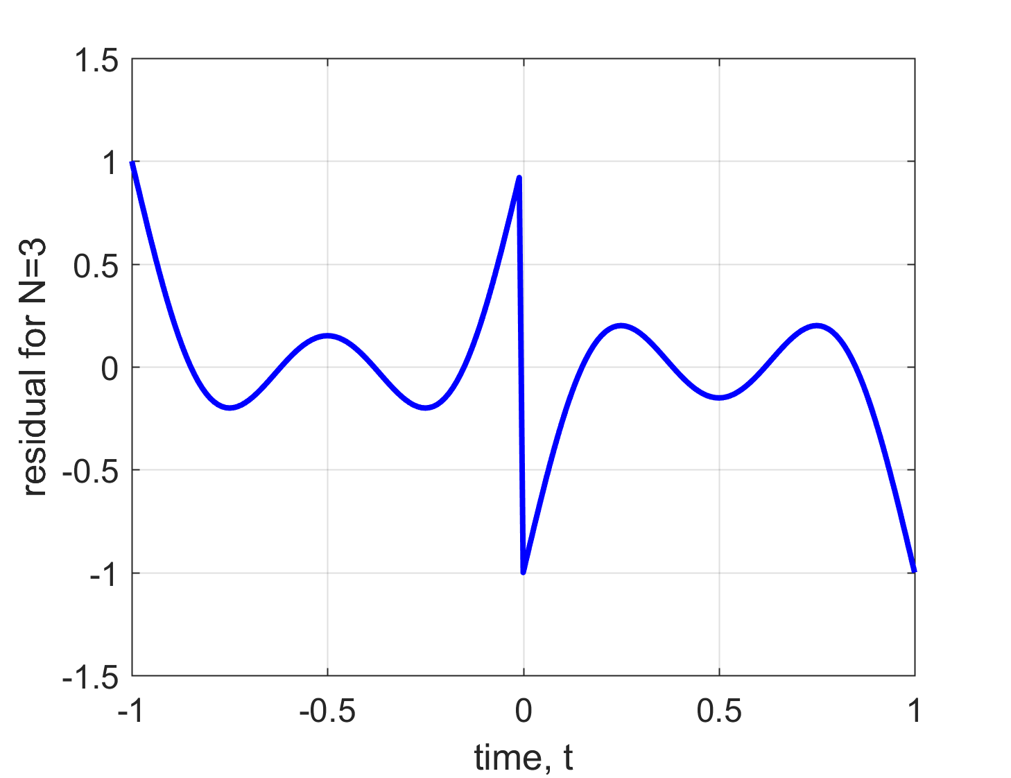
Subtract the two signals
Residual power = 0.1046
February 2, 2018

Slide 6
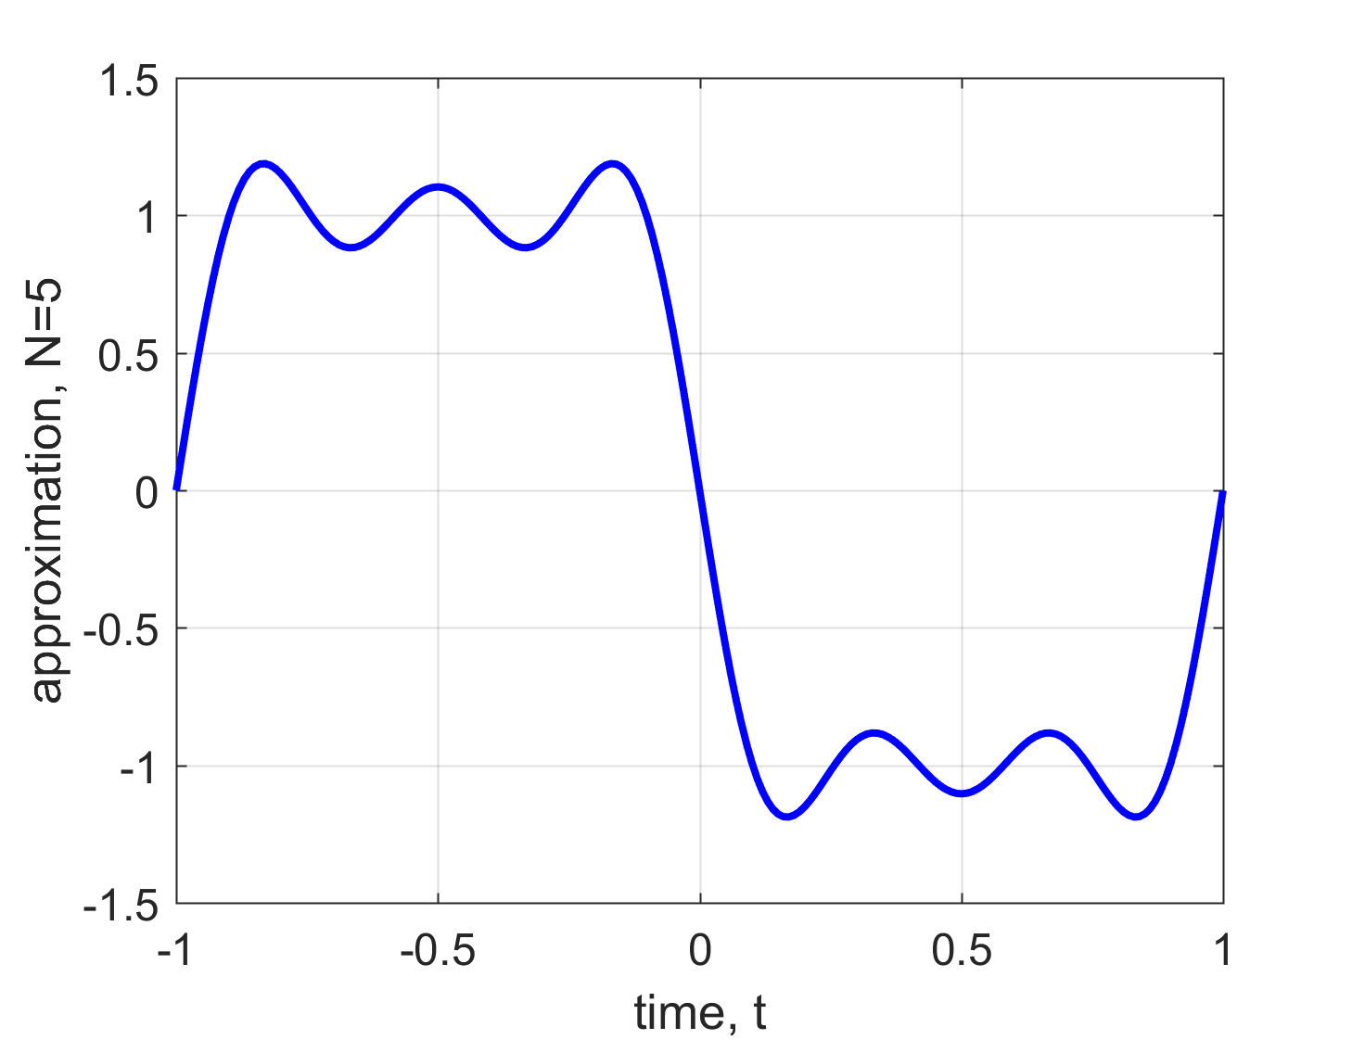
Order of Approximation N = 5
February 2, 2018

Slide 7
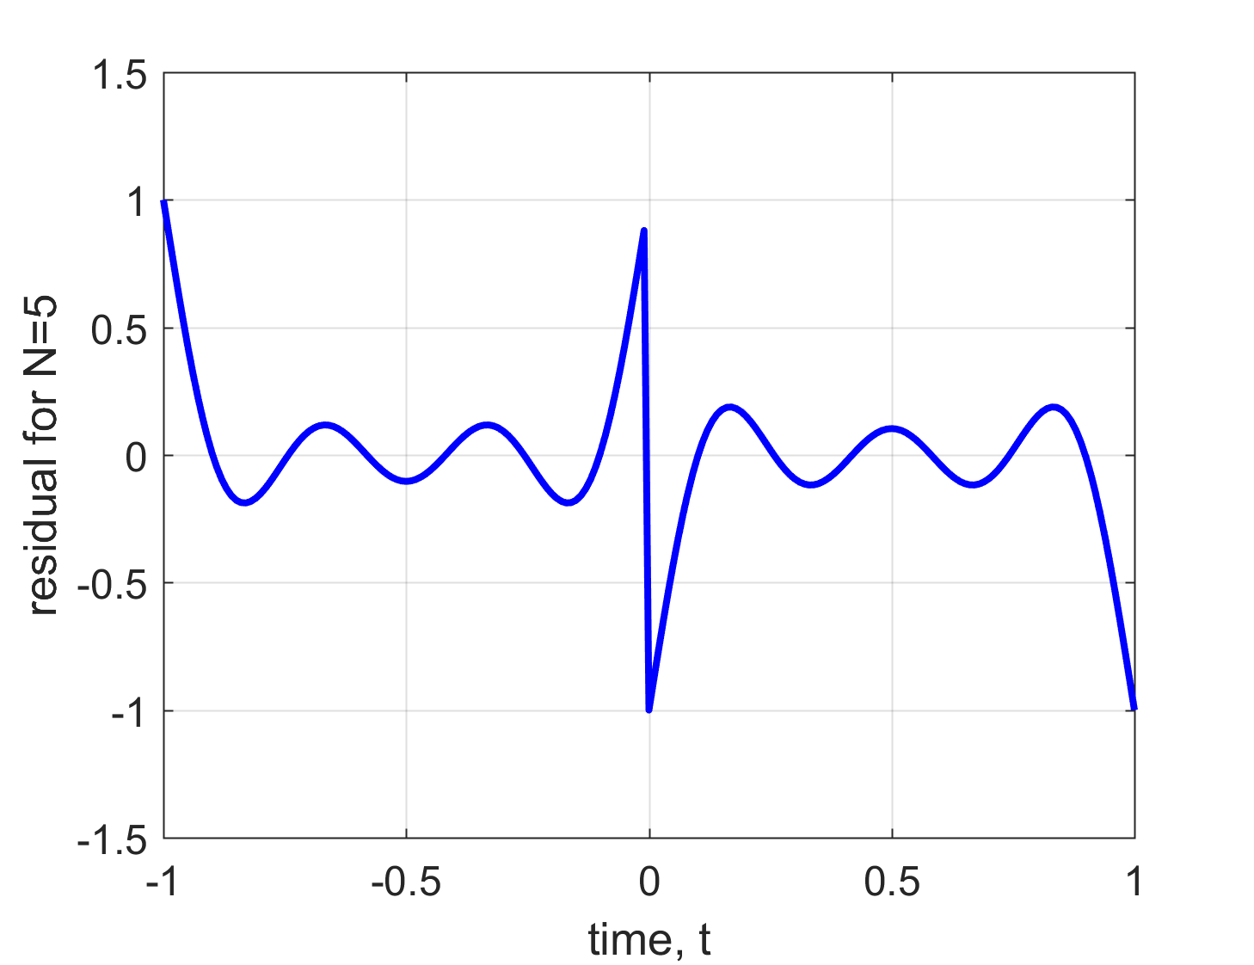
Subtract the two signals
Residual power = 0.0723
February 2, 2018

Slide 8
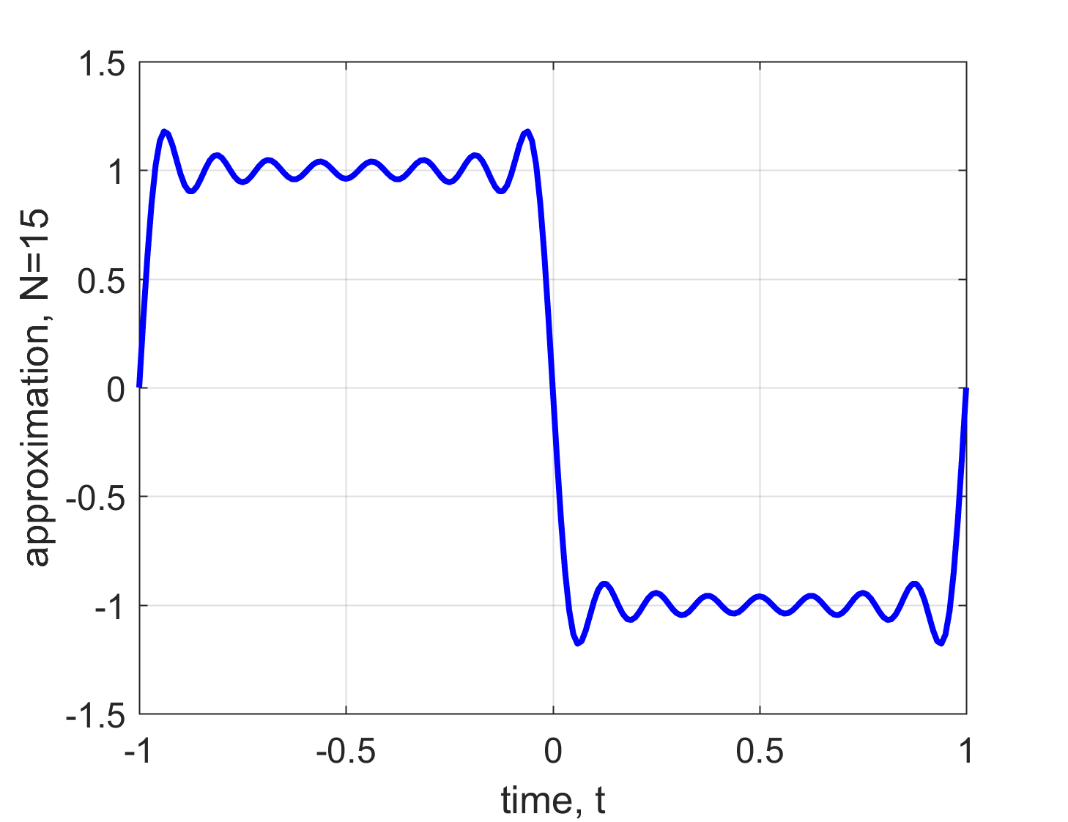
Order of Approximation N = 15
February 2, 2018

Slide 9
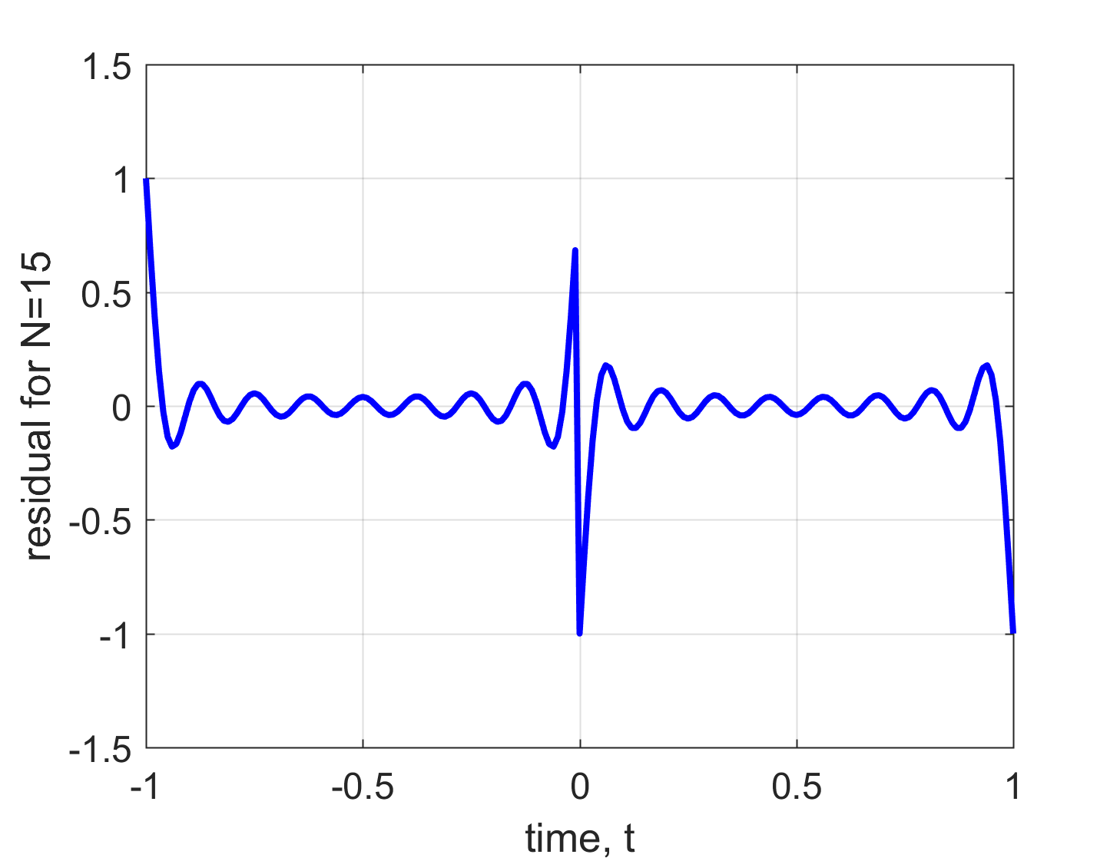
Subtract the two signals
Residual power = 0.031 4
February 2, 2018

Slide 10
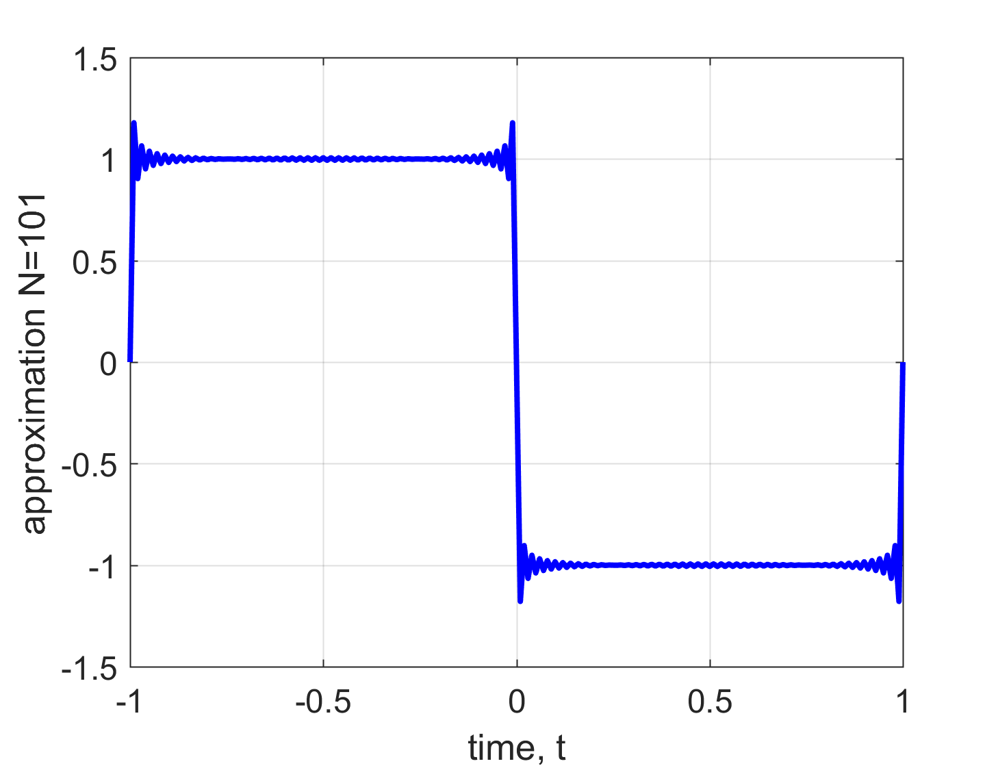
Order of Approximation N = 101
February 2, 2018

Slide 11
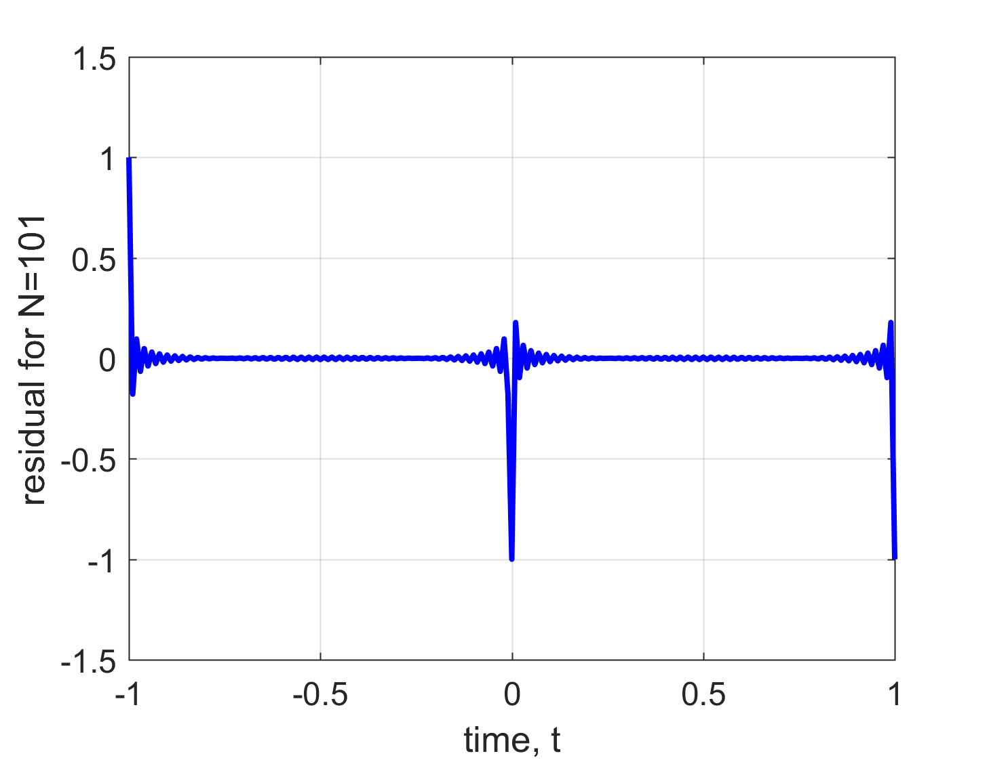
Subtract the two signals
Residual power = 0.0161
February 2, 2018

