Slide 1

Preparing the People Who Teach
A Casual Academic Management System, and the training to go with it
Wei Song

Slide 2
Why the School Needs a Casual Academic Pool
Convenors cannot staff a course well if they cannot see who is available.
TODAY
WITH A POOL
Course convenor
Course convenor
Ask a colleague
Remember someone
Hope somebody asks
THE POOL
Everyone willing and able — and what each of them has taught
?
The right tutor
Whoever comes to mind. Strong students who never hear about it never apply, and nothing carries from one trimester to the next.
Search by course. See who has already taught it. Contact them directly — and the record carries forward.

Slide 3
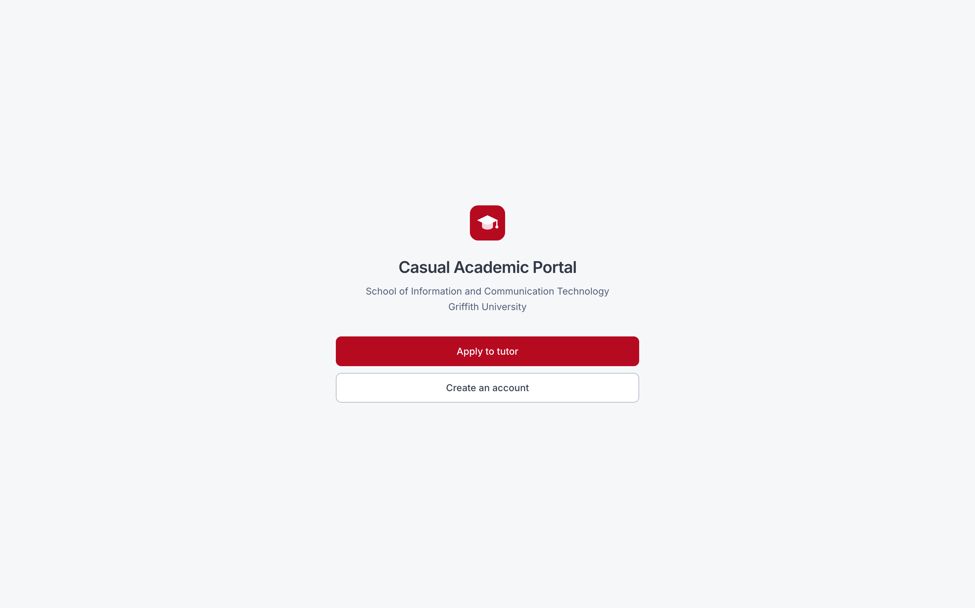

A Tutor Pool for the School
▪ The School has never had a list of who is willing and able to tutor. This is that list.
Candidates have their own portal
Convenors have theirs

Slide 4
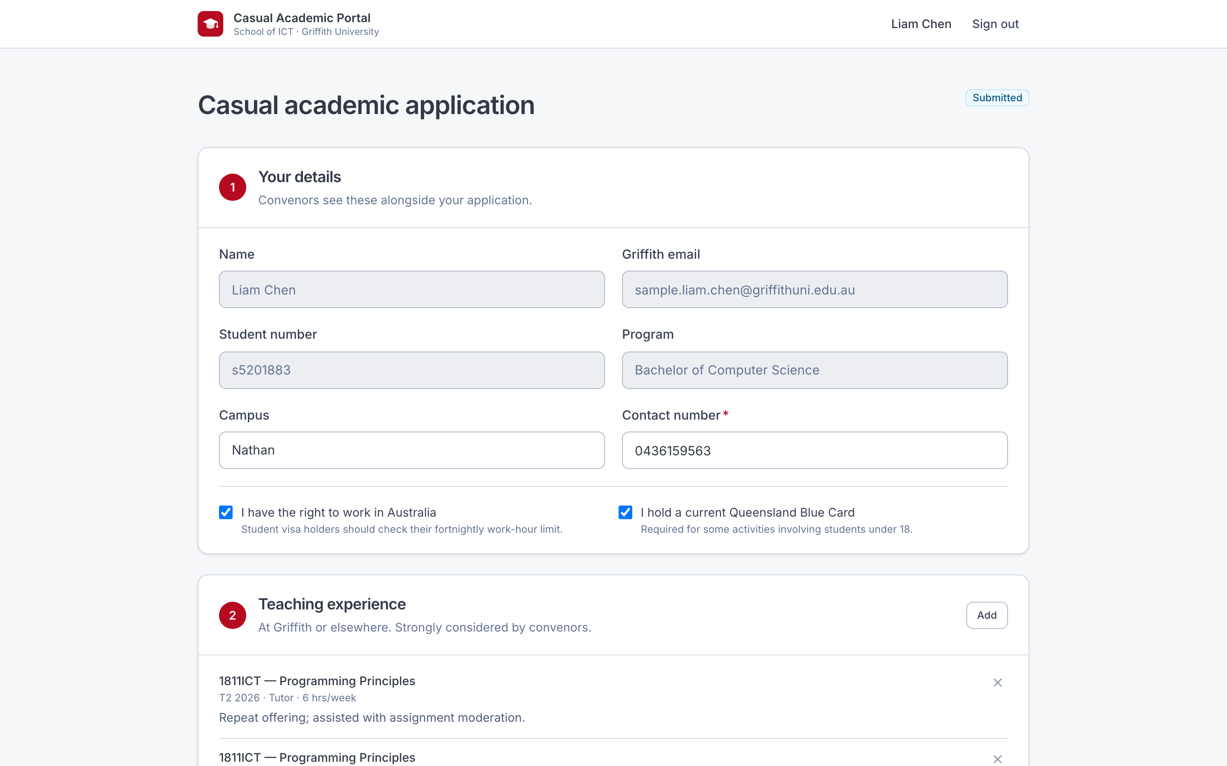
The Candidate's View
Details, teaching experience, ranked course choices, a supporting statement
Always open
Starts blank each visit, so nothing stale is resubmitted by accident

Slide 5
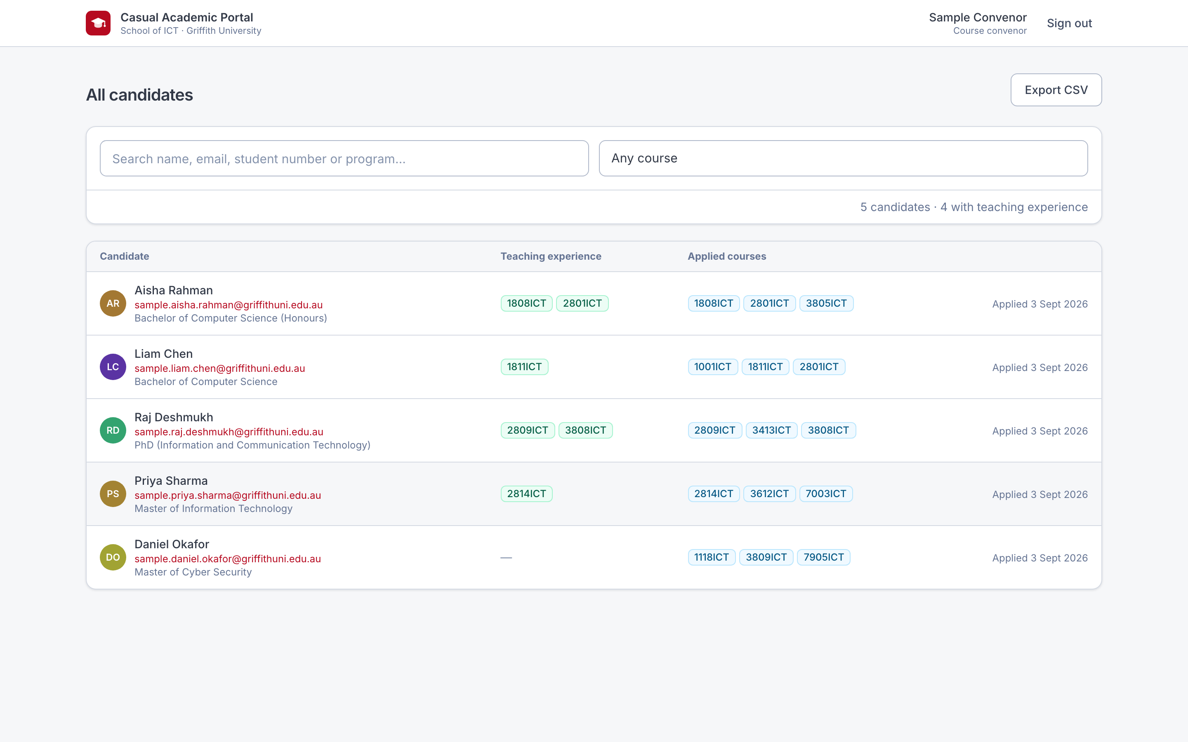
The Convenor's View
Everyone registered — not only this trimester's applicants
Two columns: what they have taught, and what they have applied for
Filter by a course; those who have taught it are listed first

Slide 6
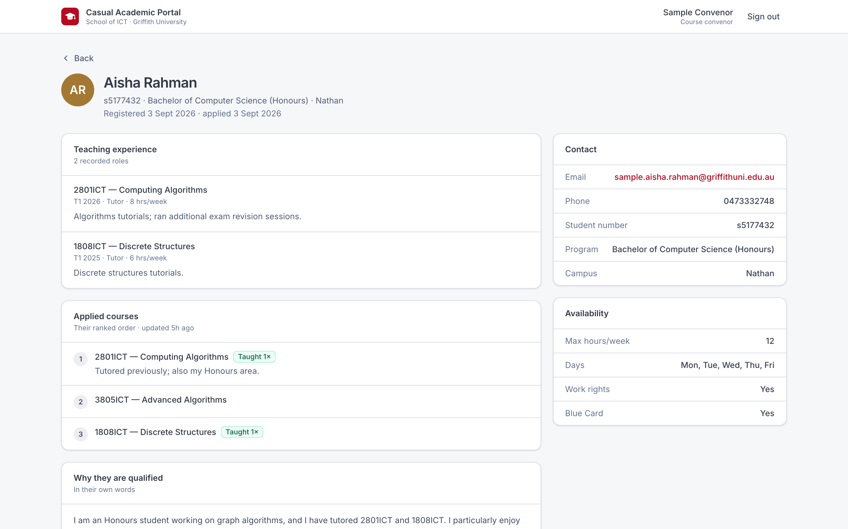
One Candidate
Everything known about them, in one place
Full teaching history, by course and trimester
Their applied courses, in their own ranked order
Their statement, contact details and availability

Slide 7
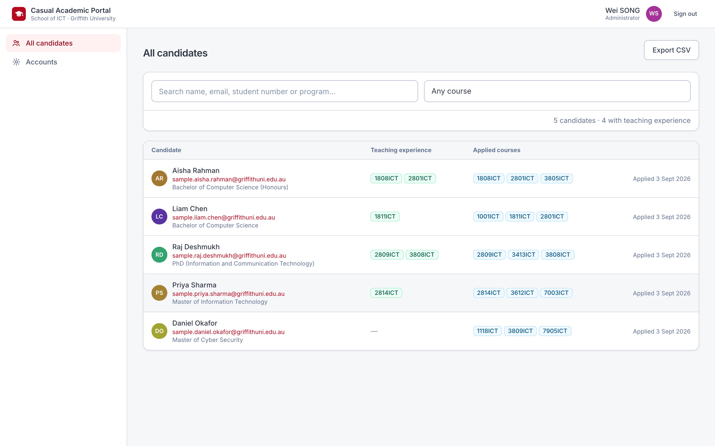
The Administrator's View
The School-wide picture, and the accounts behind it
Every candidate, across all 187 courses
Create and manage convenor accounts
Export to CSV at any point, for the School office

Slide 8
A Week 0 Workshop
Three hours, before teaching starts, for everyone tutoring for the first time.
What a tutor does
Not a second lecturer. Find out what students did not understand.
The tutorial model
Review · supported practice · consolidation. Draft your own first session.
Micro-teaching
Deliver a five-minute concept review to a peer, with feedback both ways.
Helping without answering
Hands off the keyboard. Ask before you tell.
Marking consistently
Everyone marks the same submission, then compares the spread.
Conduct and escalation
Boundaries, integrity, students in difficulty. Escalate, don't absorb.
Senior tutor panel
Experienced ICT tutors — the most credible voice in the room.
▪ Half the time is spent doing, not listening.
Deliberately excludes University compliance training and course-specific content — both are covered elsewhere.

Slide 9
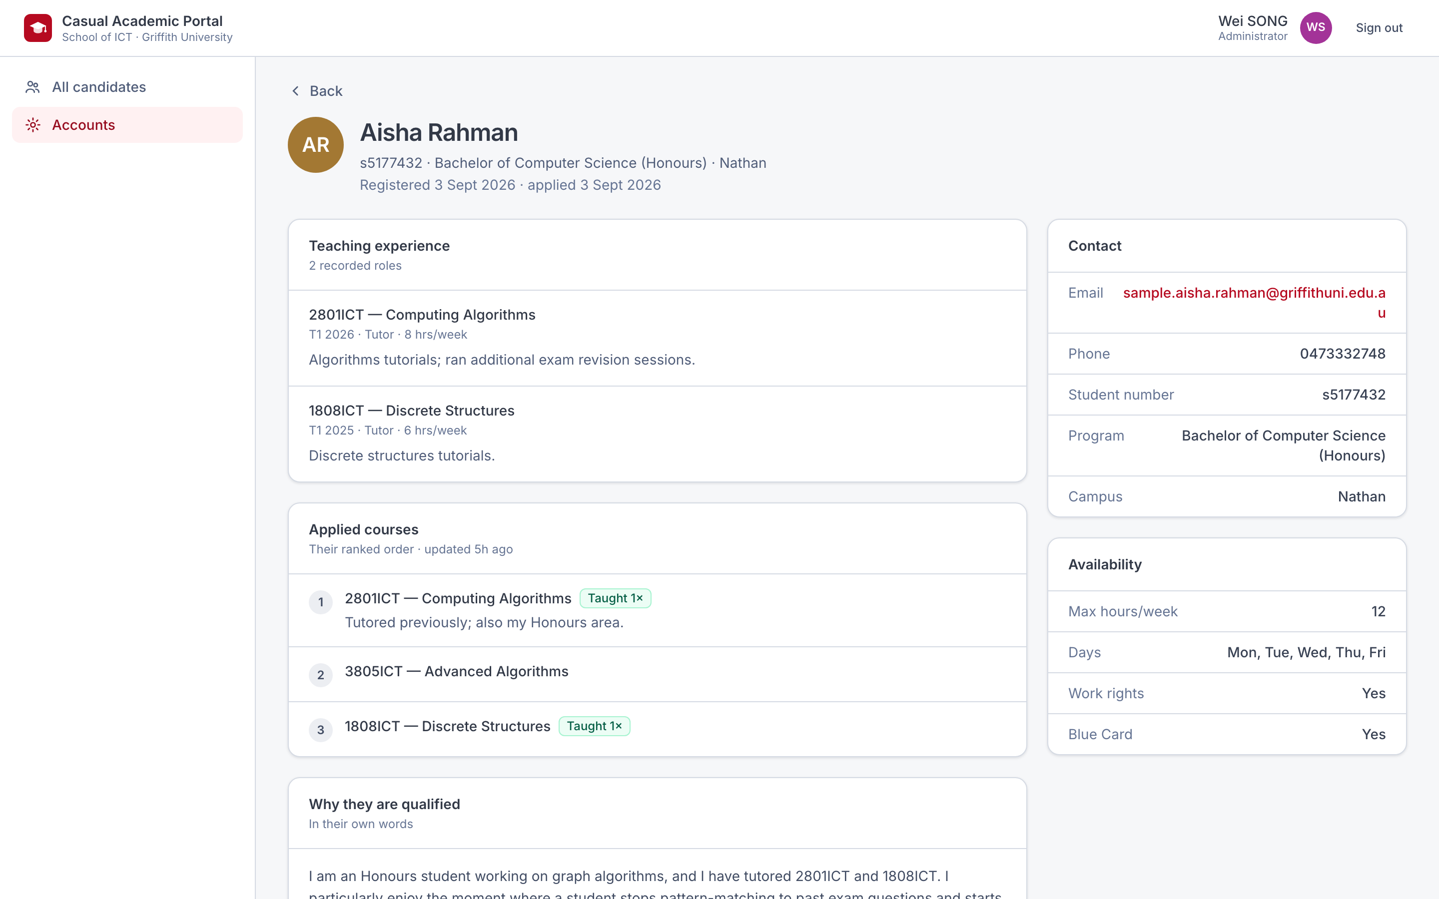
Please Try It Yourself
The system is live. These accounts are for you to use during or after this meeting.
Candidate
wweisong.github.io/griffith-ict-casual-academic
Mock Account: sample.liam.chen@griffithuni.edu.au
Password: SamplePortal#2027
Course convenor
wweisong.github.io/griffith-ict-casual-academic/#/staff
Mock Account: sample.convenor@griffith.edu.au
Password: SamplePortal#2027
Administrator access on request. The candidates shown are sample records, not real students.

Slide 10
How the Pool Fills, and Keeps Filling
The system is a tutor pool. This is the cycle that stocks it, every trimester.
1 INVITE
Convenors invite students
who did well in the course
5 TEACH
2 APPLY
Shared tutorial model.
Week 3 check-in
THE TUTOR POOL
Who they are, what they have taught, what they want to teach
One standing application:
experience, ranked courses
4 PREPARE
3 SELECT
Week 0 workshop
Three hours
Search the pool by course.
Contact directly
▪ Step 1 is how the pool gets stocked. Step 4 is the part the School does not have yet.

