Slide 1
Making architecture matter (Martin Fowler)
NiKo, SaschA, Julian, yassine, Rene, Andrea

Slide 2
„Software-Architekt“
„Architekt Astronaut“: Senior-Architekt, der seit 10-20 Jahren keinen Code mehr geschrieben hat
Annahme: Architekt muss keinen Code schreiben
Aber: Wer im technischen Bereich arbeitet, sollte mit dem Programmieren vertraut sein
Notes:
Doesn’t like the word „software architecture”:
Image of a senior in a company setting rules, standards onto how software should be written but hasten actually written any software for 10 or 20 years
Also known as “architecture astronauts”
If you’re a technical person, you have to be comfortable with the act of programming
Open-source community has always believed: code is important
Notion that an architect is beyond programming
But If you’re an architect, you shouldn’t be programming anymore -> That feels wrong!

Slide 3
Was ist (Software-) Architektur?
Definition 1 (ANSI/IEEE Std 1471-2000):
„fundamental organization of a system, embodied in its components, their relationships to each other and the environment, and the principles governing its design and evolution”
-> Ralph Johnson: Was sind die „ high level most critical components”?
Definition 1 (Ralph Johnson):
“Expert developer’s shared understanding of the system design”
Wirklich wichtig: Kommunikation
Architektur ist eine sehr soziale Angelegenheit
Wichtig: gutes gemeinsames Verständnis
Notes:
Definition 1: “fundamental organization of a system, embodied in its components, their relationships to each other and the environment, and the principles governing its design and evolution” (ANSI/IEEE Std 1471-2000)
Ralf Johnson (one of the 4 authors of the design pattern book) has a problem with that definition:
What are the highest level most critical components?
How do you select which components / which relationships are important?
What matters that makes some of them architectural or not?
What really matters is talking to the expert developers -> they will have some common understanding of how the thing (Software project) works
It is hat common understanding that is effectively the architecture
Johnson’s definition 1: “Expert developer’s shared understanding of the system design”
Architecture is very much a social thing
It is that fuzzy embedded understanding that really matters
Wirklich wichtig: Kommunikation zwischen den erfahrenen Entwickler
Architektur ist eine sehr soziale Angelegenheit
Wichtig: gutes gemeinsames Verständnis zwischen den Personen, die das Projekt leiten
Documents with the title “architecture” are usually just an imperfect presentation of that shared understanding
Important to make a software project grow successfully: a good shared understanding between the people who are leading a project -> that’s really what matters

Slide 4
Was ist (Software-) Architektur?
Definition 2: „The set of design decisions that must be made early”
Definition 2 (Ralph Johnson): „ The decisions that you wish you could get right early”
Entscheidungen, die schwer zu ändern sind
z. B.: die Wahl der Programmiersprache
Notes:
Definition 2: “The set of design decisions that must be made early”
Architecture should be the decisions you need to make early on
Johnson’s definition 2: “the decisions that you wish you could get right early”
You may not have the information you need for the decisions you want to make early on
You only learn about the software product should be structured like as you’re building it
You are concerned about the decisions that are hard to change
The choice of programming language is a decision that’s hard to change but not considered a top-level component
Entscheidungen, die schwer zu ändern sind
z.B.: die Wahl der Programmuiersprache ist im Nachhinein schwer zu ändern, zählt aber nicht als top-level Komponente

Slide 5
Architektur ist…
gemeinsames Verständnis
schwer zu verändern
… „the important stuff. Whatever that is.“
Notes:
Short summary: architecture is shared understanding and hard to change -> short definition: “the important stuff. Whatever that is”
If you’re trying to think about your software system and what its architecture is, the first thing you have to do is to fire out what is important?
What do we as the technical leadership of a project consider to be the most important things?
What is the key things about this system? What is the most important thing in the codebase? -> the key thing is that decision about what is important

Slide 6
Warum ist Architektur wichtig?
Häufige Anforderung: „ We need to put less effort on quality so we can build more features for our next release”
Zwei Arten von Qualität
Äußere Qualität
Innere Qualität
Notes:
Why is it important: “We need to put less effort on quality so we can build more features for our next release”
Reaction of a lot of people
Frustration
Argument: we got to do a decent job as software professionals (like a moral response)
battle between craftsmanship and economics
Architektur: innere Qualität
Nicht sichtbar nach außen
Oftmals wird billigere Software bevorzugt

Slide 7
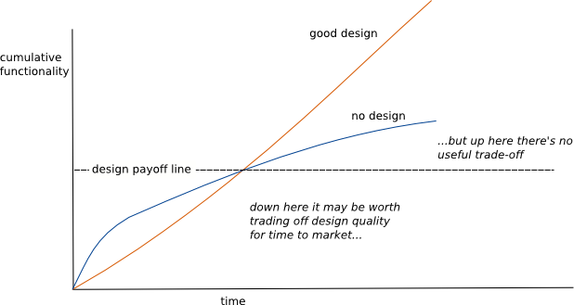
Warum ist Architektur wichtig?
Innere Qualität = langfristiger Erfolg
Quelle: https://martinfowler.com/bliki/DesignStaminaHypothesis.html
Notes:
Maybe on the outside one would choose a cheaper software with less (internal) quality that does the same as the software with higher quality
What matters in terms of internal quality is the long-term picture
Design Stamina Hypothesis
shows the software of an architecture that grows over time
as time goes on you want to add new features it seams to get harder, because the existing codebase slows you down as you add more code
it doesn’t have to be this way: if you have a good architecture and you keep attention to keeping it healthy and refactoring regularly and making sure that the software code base is clean, you can get a different experience

Slide 8
Fazit
Gute Software-Architektur…
Ist bereits in Komponenten unterteilt
macht es einfach, zu ermitteln, wo Veränderungen vorgenommen werden sollen
Gute Software-Architektur ist wichtig, damit
Software durch Features schnell weiterentwickelt werden kann
Kontinuierlich und schnell Entwicklung („constinuous deployment“)
Kontinuierlich und schnell neue Software geliefert werden kann („continuous delivery“)
Notes:
you can build new features faster and faster, because the software is already componentized and it’s easy to find where to make the changes
it’s easily possible to accelerate
that’s why software architecture is important
buying the cheap software is a win for the moment
but a software with better internal software will be able to make new features more and more rapidly -> the cheap/slow one can’t keep up anymore

