Slide 1
Project # 2
Extract, Transform and Load (ETL)
10 December, 2021

Slide 2
Agenda
ETL Overview
TEAM
1
2
Database Design
3
Challenges
4
Questions

Slide 3



ETL Overview
Extract
Transform
Load
Data Sources
Data Cleaning and Transformation
Data Load
Asasd
asd
Asasd
asd
Asasd
asd

Slide 4
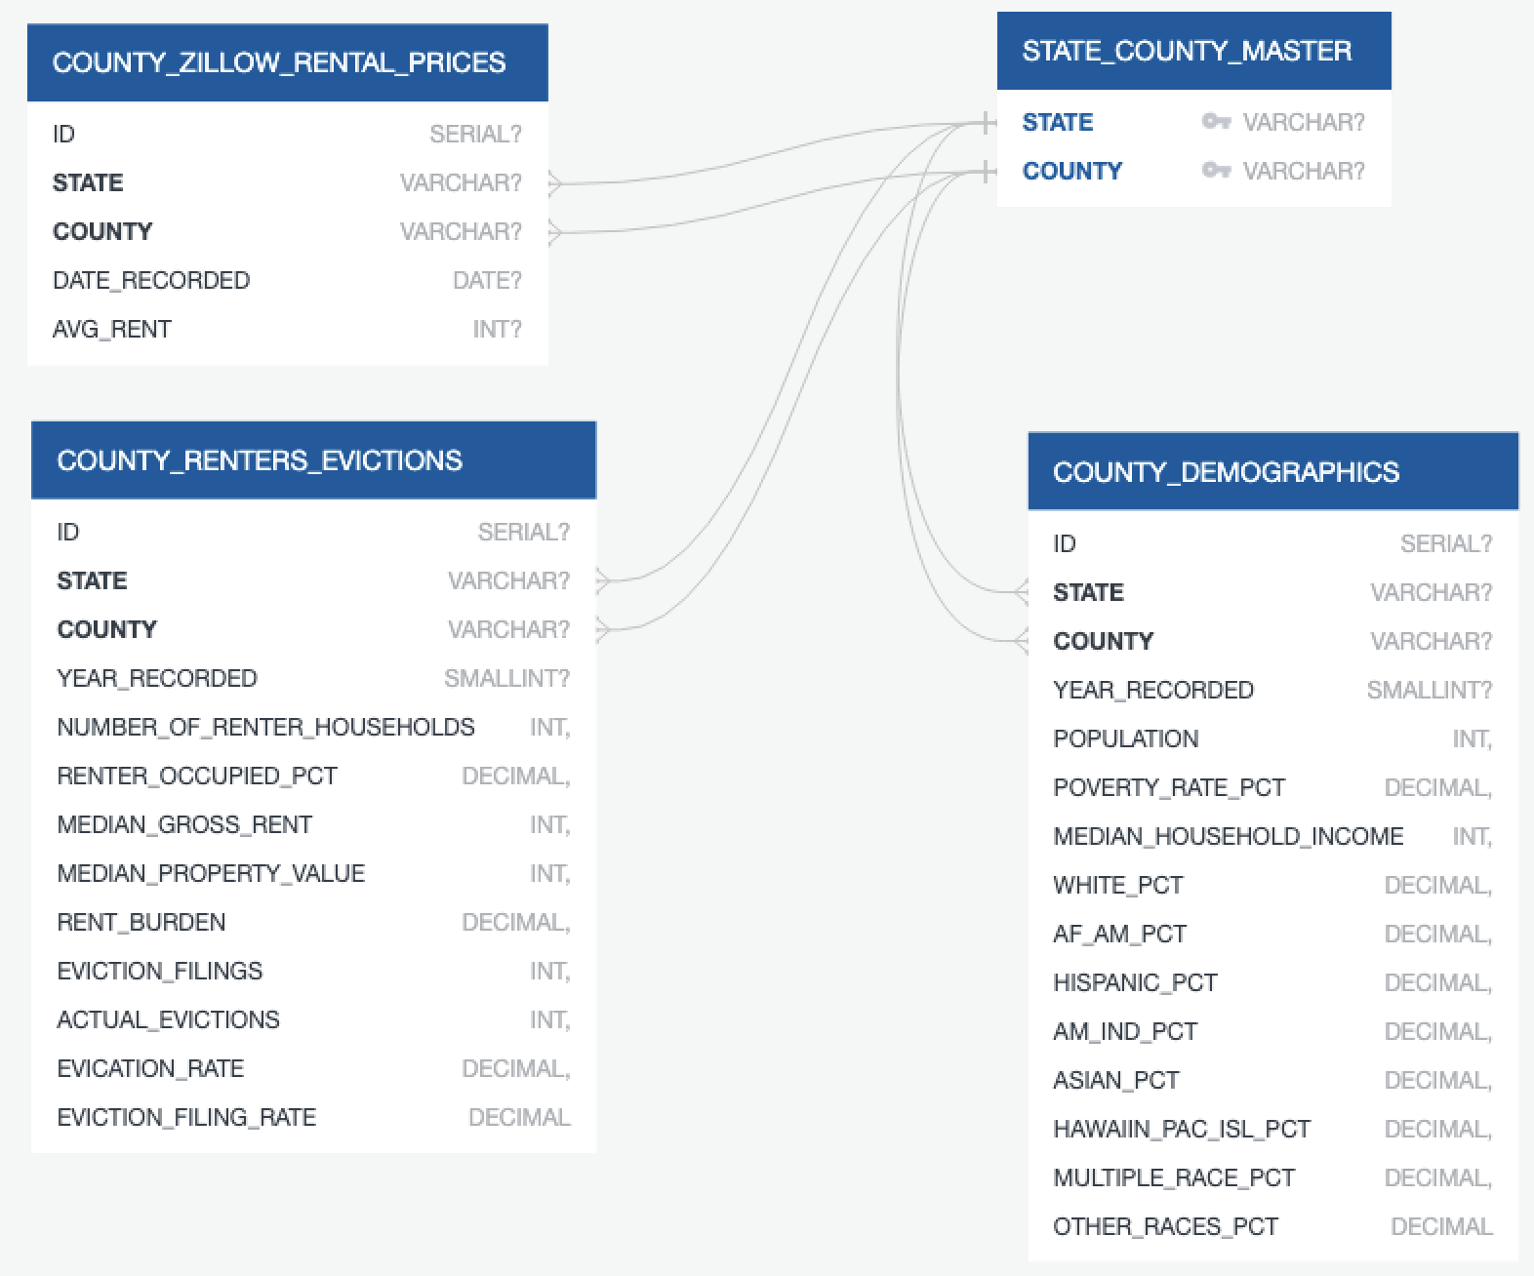
Database Design
Describe each table in 2 sentences

Slide 5
Challenges
List some of the challenges faced through the process

