Slide 1
Project 4: 2022 NBA Draft Predictions

Slide 2

Starting Lineup
NOTE:
To change images on this slide, select a picture and delete it. Then click the Insert Picture icon
in the placeholder to insert your own image.
Steven Broyles
Ryan “Fin” Finley
Cornelia “Ceci” Hinton
Thea James
Jennifer Long
Hazel Morris
Wesley Watkins

Slide 3
Game Plan
What questions did we want to answer with this project?
Based on the college stats of past draft classes, what is the likelihood of 2022 college players getting drafted to the NBA?
What variables are most important when predicting this?
Our Dataset
https://www.Kaggle.com/adityak2003/college-basketball-players-20092021
CollegeBasketballPlayers2009-2021.csv
61,061 rows and 65 columns
CollegeBasketballPlayers2022.csv
3,978 rows and 65 columns
DraftedPlayers2009-2021.xlsx
781 rows and 7 columns

Slide 4
First Half
Cleaning the Data
Merged the CollegeBasketballPlayers2009-2021.csv with DraftedPlayers2009-2021.csv
Changed our “pick” column to read drafted or undrafted
Dropped nulls and unnecessary columns
Created new csv from merged and cleaned DataFrame
Building our Model and Predicting
Used newly merged csv
Train, test, split using particular columns for X data
Random Forest Classifier
Used cleaned CollegeBasketballPlayers2022.csv for predicting draft probability
Created new csv from the probability of 2022 college players being drafted

Slide 5

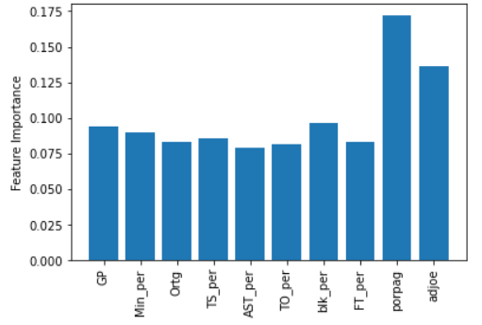
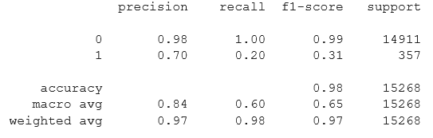
Timeout
Feature Importances
Most heavily weighted features are:
Points Over Replacement Per Adjusted Game
Adjusted Offensive Efficiency
Model Scores
Classification Report

Slide 6
Second Half
Visualizations
Tableau
Took the average of the YesDraft, color coded, filtered by players, and separated by conference
Website
https://wwatkins142.github.io/project-4-team-pikachu/

Slide 7
Blocks
Our Limitations
NBA looks for specific draft positions based on the needs of the team
Draft probability is relative to other players in the dataset
Dataset doesn’t include some top draft prospects (G-league or International players)
Less than 1% of dataset removed during merge due to wildcard characters
Example: Cam Thomas vs. Cameron Thomas
Want to fit the model to columns that have different datatypes
Example: conference column is a string datatype
Our dataset did not come with a data dictionary

Slide 8
Overtime
What would we do if we had more time?
Section on the website to predict NBA draft probability based on stats inputted
Dropdown menu for user to select player to view their draft probability and other stats
Included more features in the Random Forest Classifier model

Slide 9
Questions?

