Slide 1
Spoofing and countermeasures
for speaker verification
1th Report

Slide 2
Contents
About ASV
Two direction
Evaluation metrics
Spoofing and countermeasure

Slide 3
1. About ASV
Feature extraction
Speaker modelling and classification
Possible attack points

Slide 4
1.1 Feature extraction
short-term spectral ⬄ voice timbre
Prosodic ⬄ prosody
high-level idiolectal features ⬄ language content

Slide 5
1.1.1 short-term spectral
from short frames typically of 20–30 ms duration
describe the short-term spectral envelope
Eg : MFCC LPCC PLP

Slide 6
MFCC
Extraction steps
1. Framing
2. DFT
3. Calculate the Meier filter bank
4. log
5. DCT
Code

Slide 7
1.1.2 Prosodic
fundamental frequency ⬄ pitch of the voice
duration ⬄ length of sounds
intensity ⬄ loudness, or prominence
spectral characteristics ⬄ timbre or voice quality

Slide 8
1.1.3 high-level idiolectal features
speaker behaviour
lexical cues
Easy in replay

Slide 9
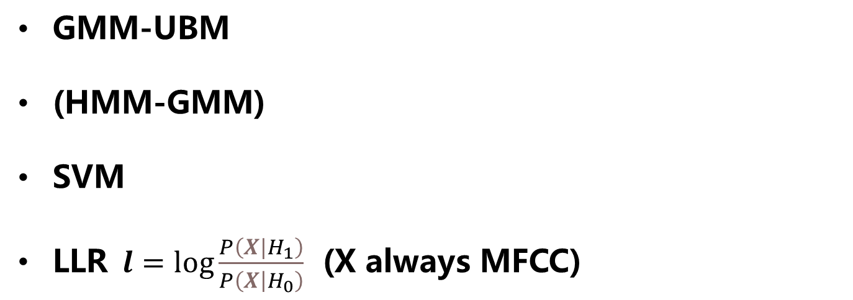
1.2 Speaker modelling and classification
GMM-UBM
(HMM-GMM)
SVM
$\text{LLR} l=\log{\frac{P\left(X|H_{1}\right)}{P\left(\left.X\right|H_{0}\right)}}$ (X always MFCC)

Slide 10
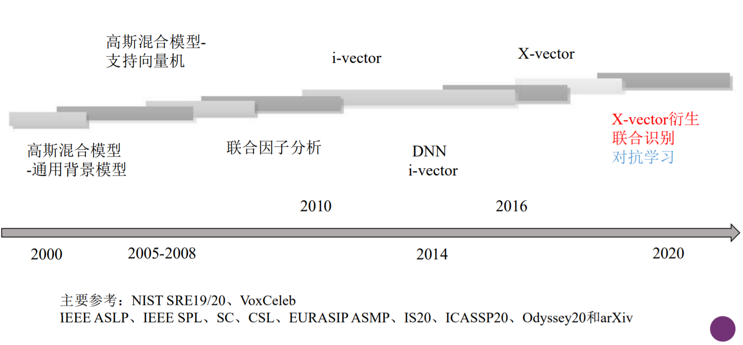
History

Slide 11
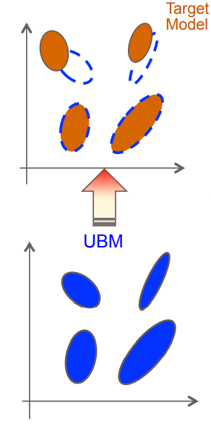
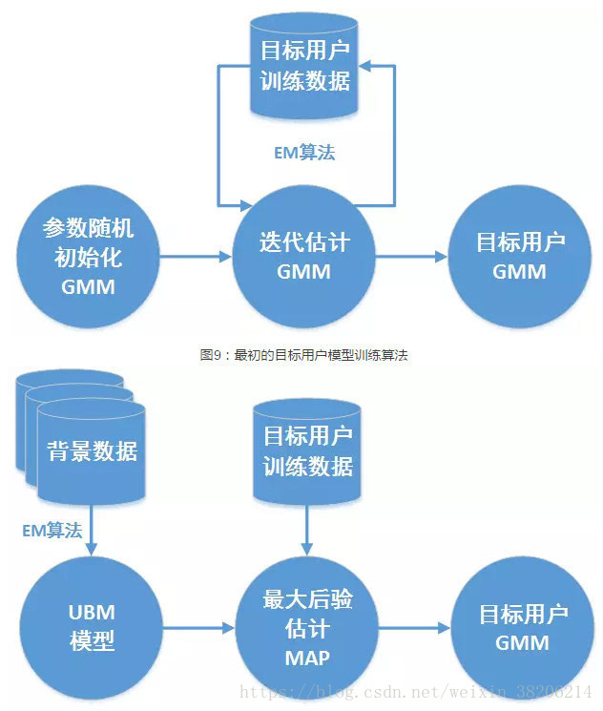
1.2.1 GMM-UBM
We do not have
enough data!
UBM ->
MAP ->
GMM

Slide 12
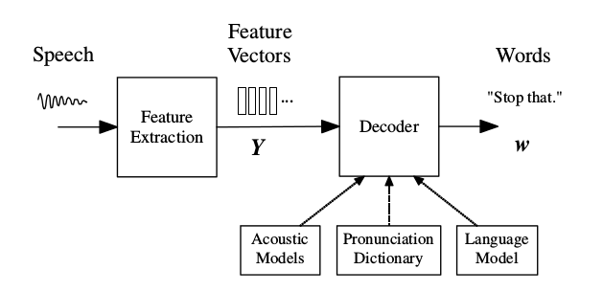
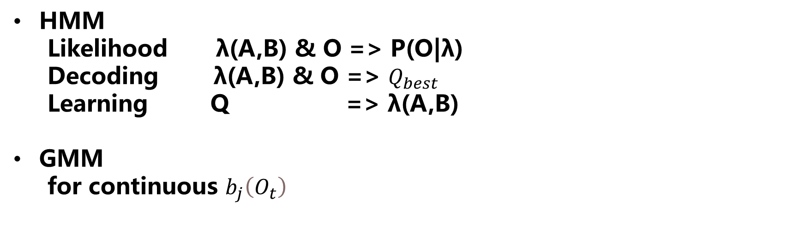
1.2.2 HMM-GMM
HMM
Likelihood λ(A,B) & O => P(O|λ)
Decoding λ(A,B) & O => $Q_{best}$
Learning Q => λ(A,B)
GMM
for continuous $b_{j}\left(O_{t}\right)$

Slide 13
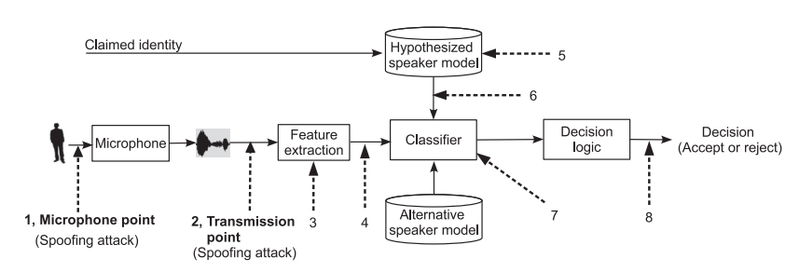
1.3 Possible attack points
Direct attacks *
1: microphone level (impersonation and replay )
2: transmission level (speech synthesis and voice conversion)
Speaker modelling and classification
3~8

Slide 14
2. Two direction
continue with the traditional pursuit of improved fundamental performance
involves the design of specific or generalised spoofing countermeasures

Slide 15
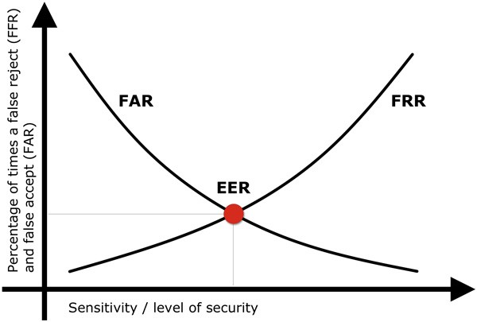
3. Evaluation metrics
FAR : unauthorised persons are incorrectly accepted
FFR : authorised persons are incorrectly rejected.
EER : where FAR=FFR

Slide 16
4. Spoofing and countermeasure
Impersonation
Replay
Speech synthesis
Voice conversion

Slide 17
4.1 Impersonation
attacks using human-altered voices
About Impersonation
an attacker tries to mimic a target speaker’s voice timbre and prosody without computer-aided technologies.
Spoofing
Countermeasures

Slide 18
4.1.1 Spoofing
Speaker modelling and classification
untrained impersonators => ×
the use of ASV systems to attack other ASV =>√
Feature extraction
speaking rates => √
F0 (fundamental frequency) => ×
formants => ×

Slide 19
4.1.2 Countermeasures
the design of appropriate countermeasures might be challenging (people not computer)
used quadratic discriminant on the first two formants to quantify the amount of acoustic variation on a vowel-byvowel basis.

Slide 20
4.2 Replay
About Replay
use a pre-recorded speech sample collected from a genuine target speaker
Spoofing
Countermeasures

Slide 21
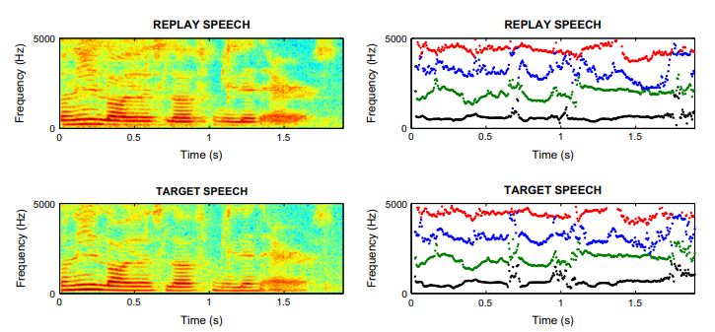
4.2.1 Spoofing
digit sequence ASV system with attacks constructed from the concatenation of pre-recorded, isolated digits. (HMM,1999)
used pre-recorded speech samples which were collected using a far-field microphone and then replayed in a mobile telephony scenario. (2011)

Slide 22
4.2.2 Countermeasures
the comparison of new access samples with stored instances of past access attempts.
spectral ratio and modulation indexes (noise and reverberation)
the detection of channel noise (additional channel noise)

Slide 23
4.3 Speech synthesis
text-to-speech (TTS)
About Speech synthesis
TTS is a technique for generating intelligible, natural-sounding artificial speech for any arbitrary text.
Spoofing
Countermeasures

Slide 24
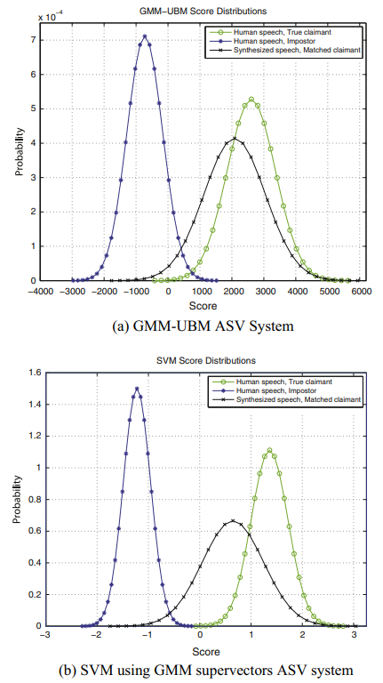
4.3.1 Spoofing
use a state-of-the-art HMM-based speech
synthesizer attack two ASV system
generally use relatively large-scale datasets,
usually of high-quality clean speech.

Slide 25
4.3.2 Countermeasures
Most approaches to detect synthetic speech rely on processing artefacts specific to a particular synthesis algorithm.
the dynamic variation in the speech parameters ⬄less
The higher order cepstral coefficients ⬄less variance
differences between vocoders and natural speech
F0 statistics (other)

Slide 26
4.4 Voice conversion
About Speech synthesis
manipulate the speech of a given speaker so that it resembles in some sense that of another target speaker
spectral mapping : voice timbre
prosody conversion : prosodic features (such as fundamental frequency and duration
Spoofing
Countermeasures

Slide 27
4.4.1 Spoofing
the vulnerability of a GMM-UBM ASV system.
artificial signals attack
with large-scale datasets with a large number of speakers
produce speech with clearly audible artefacts

Slide 28
4.4.2 Countermeasures
Voice conversion bears some similarity to speech synthesis
use the vocoder as a means of discriminating converted speech from natural speech. (cos-phase or MGD-phase)
dynamic speech variability

Slide 29
References
Spoofing and countermeasures for speaker verification: A survey (2015)
Voice Mimicry Attacks Assisted by Automatic Speaker Verification
(2019)
http://fancyerii.github.io/2019/03/14/dl-book/
《声纹识别技术前沿与团队工作进展》 2020
https://blog.csdn.net/weixin_38206214/article/details/81084456
https://en.wikipedia.org/wiki/Prosody_(linguistics)

