Slide 1
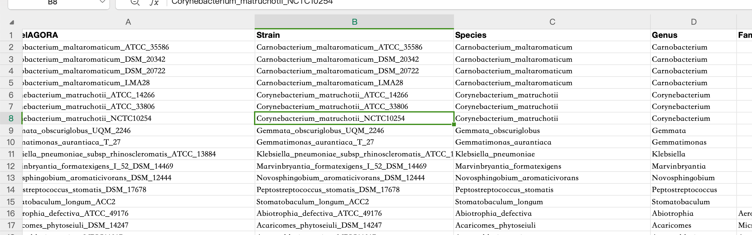
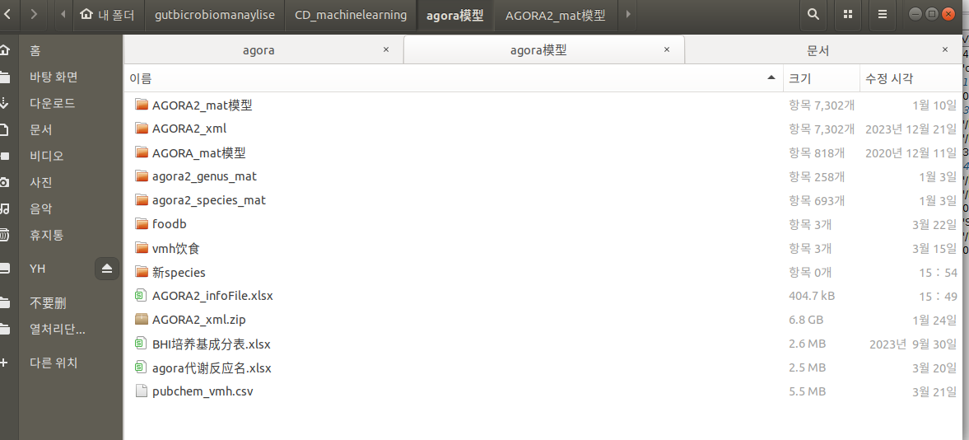
% Make a model of the corresponding level (phylumn, class, order, family, genus, species).
modPath='/home/tako/gutbicrobiomanaylise/CD_machinelearning/agora模型/AGORA2_mat模型'
panPath='/home/tako/gutbicrobiomanaylise/CD_machinelearning/agora模型/新species'
taxonLevel='Species';
taxTable='/home/tako/gutbicrobiomanaylise/CD_machinelearning/agora模型/AGORA2_infoFile.xlsx'
createPanModels(modPath,panPath,taxonLevel,32,taxTable);
AGORA2_infoFile.xlsx

Slide 2
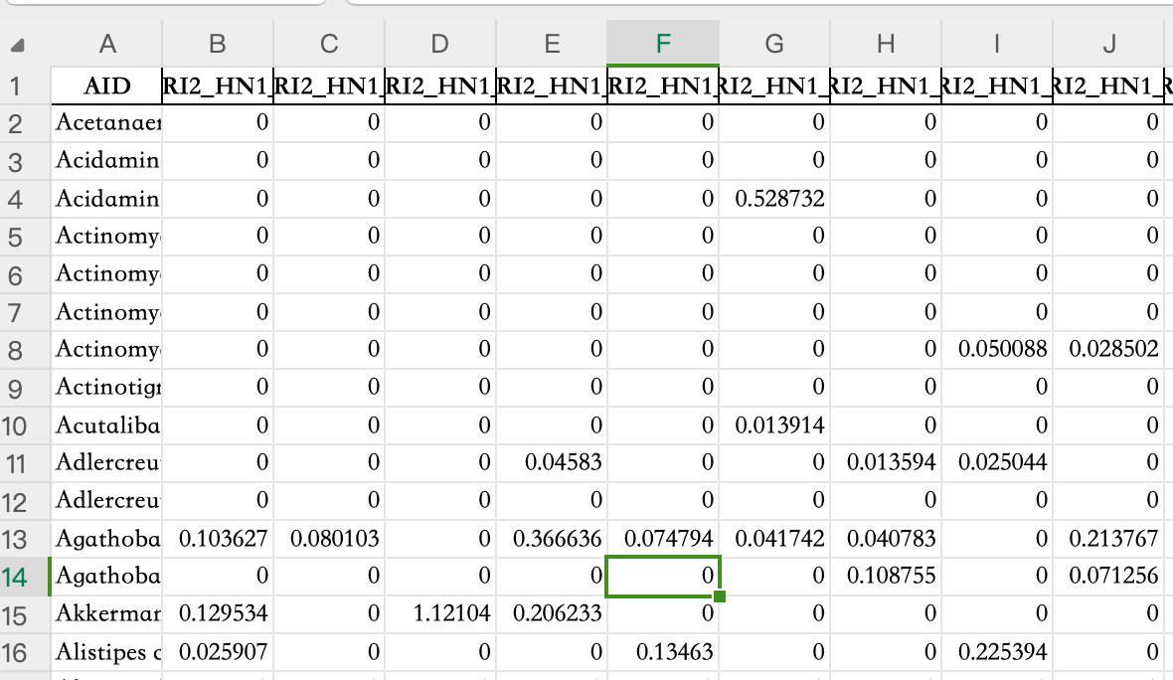
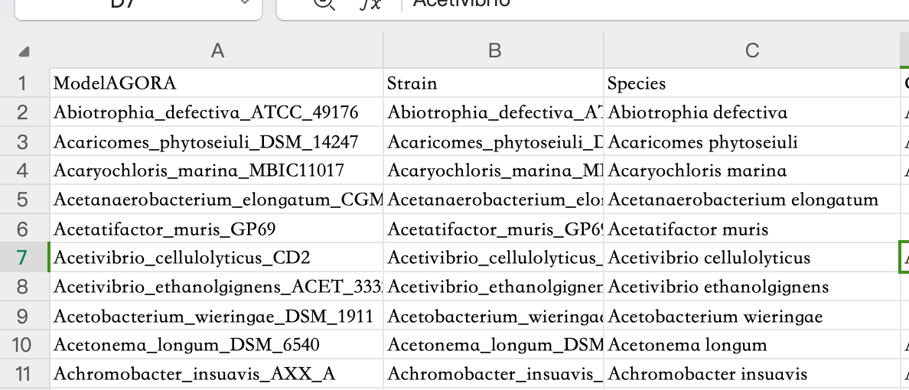
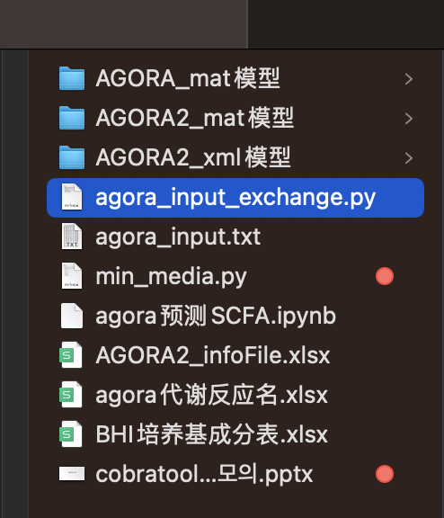
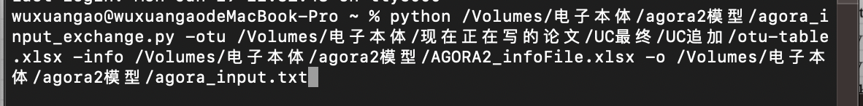
First, we need to prepare two tables: otu_table and agora_info.
otu_table.xlsx
AGORA2_infoFile.xlsx
Then open the command window and run the following code. The red part writes the path of otu_table.xlsx, and the purple part writes the path of AGORA2_infoFile.xlsx
python agora_input_exchange.py -otu otu_table.xlsx -info AGORA2_infoFile.xlsx -o agora_input.txt

Slide 3
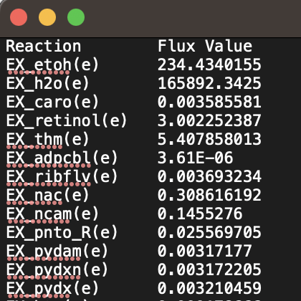
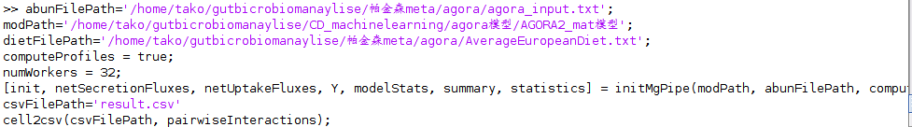
abunFilePath='/home/tako/gutbicrobiomanaylise/帕金森meta/agora/agora_input.txt';
modPath='/home/tako/gutbicrobiomanaylise/CD_machinelearning/agora模型/AGORA2_mat模型';
dietFilePath='/home/tako/gutbicrobiomanaylise/帕金森meta/agora/AverageEuropeanDiet.txt';
computeProfiles = true;
numWorkers = 32;
[init, netSecretionFluxes, netUptakeFluxes, Y, modelStats, summary, statistics] = initMgPipe(modPath, abunFilePath, computeProfiles, 'dietFilePath', dietFilePath, 'numWorkers', numWorkers);
csvFilePath='result.csv'
cell2csv(csvFilePath, pairwiseInteractions);
The blue one is for agora_input.txt created on the previous page
The red one is for the folder where the model is located
The orange one is for the diet composition file AverageEuropeanDiet.txt
AverageEuropeanDiet.txt

Slide 4
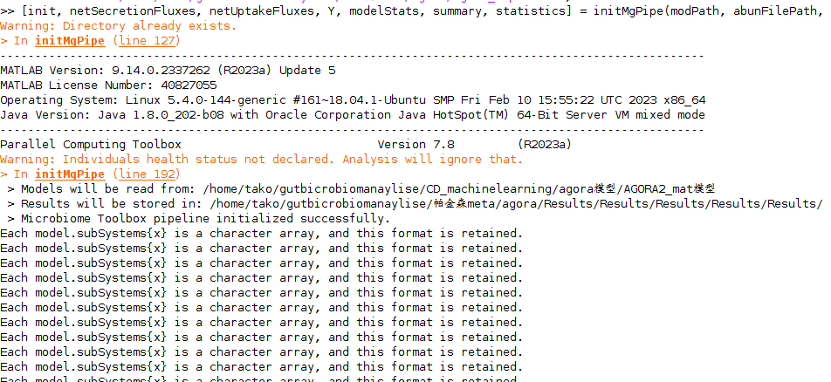
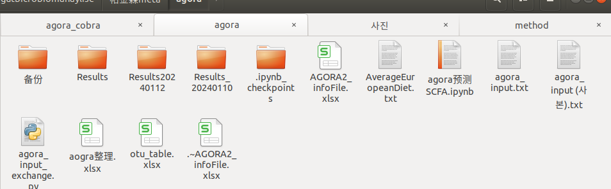
This is a screenshot of the normal operation. Below is the Results folder that will be generated. The run will last 1~2 days, depending on the number of samples.

Slide 5
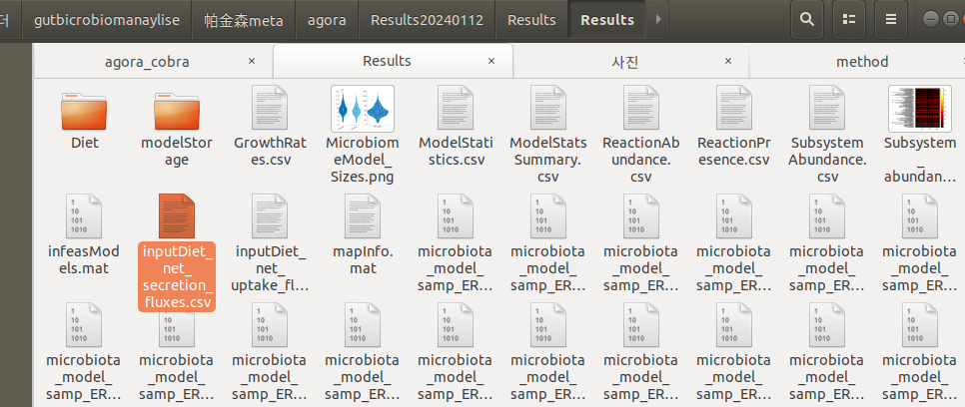
进入Result文件夹，然后找到inputDiet_net_secretion_fluxes.csv文件，这个就是代谢所产生的结果文件。

Slide 6
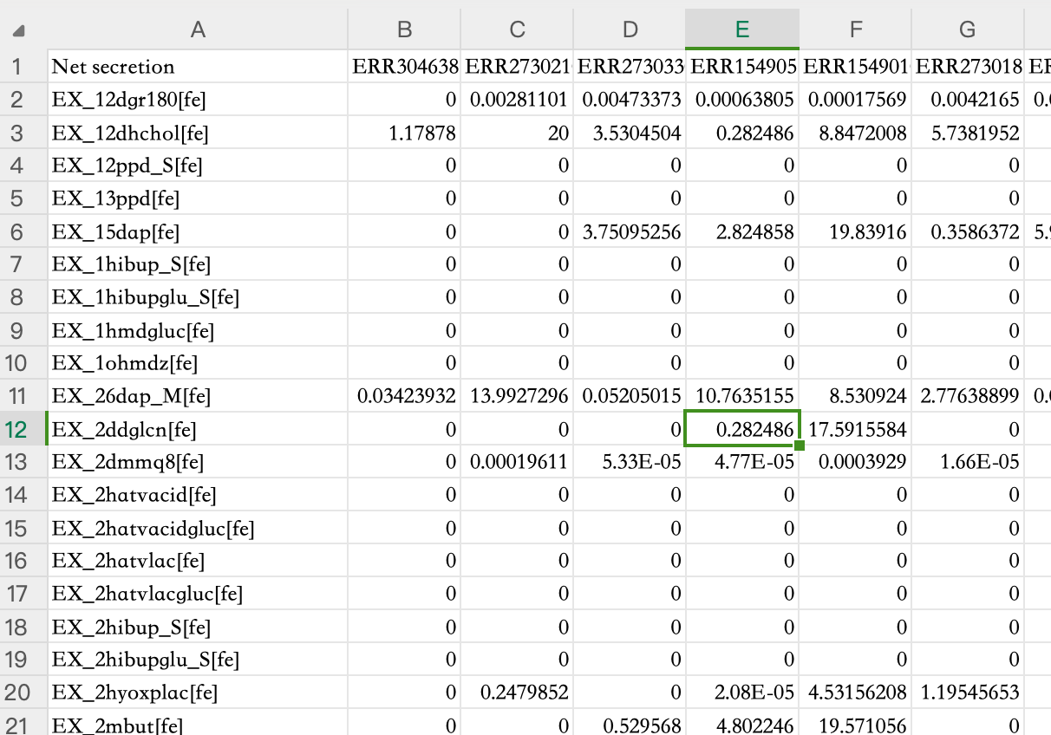
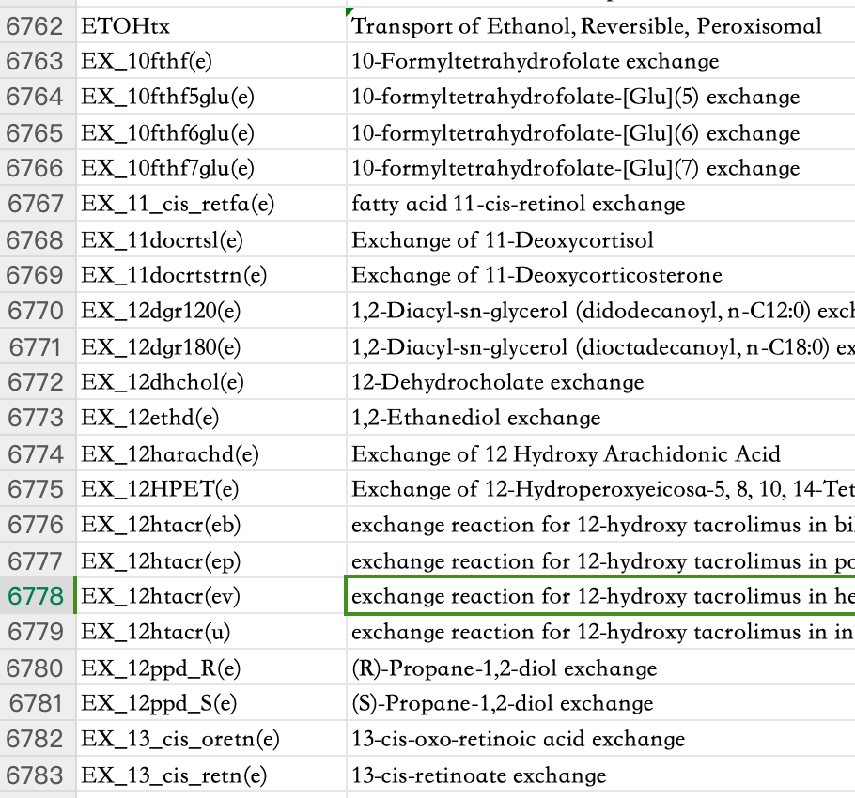
inputDiet_net_secretion_fluxes.csv
agora代谢反应名.xlsx
Each of the first columns of this file is a metabolite produced. The first step is to find the corresponding actual metabolite name. The list file of metabolite names is called the reaction worksheet in agora metabolic reaction name.xlsx. It should be noted here that the suffixes such as [fe] and (e) need to be deleted in advance when matching, and only the name after EX_ is needed.

