Slide 1
System Parameters
Algorithmic Parameters
Data Import
Data Preprocessing
Decoding
Data Postprocessing
Data Export

Slide 2
System parameters

Slide 3
Algorithmic parameters

Slide 4
Data preprocessing
Set the ct value for negative pools as 50
Set the pooling status such as “negative” and “positive” as 0 and 1 respectively

Slide 5
Data import module
1st stage data import
2nd stage data import
n^{th} stage data import
+
+
…
+

Slide 7
Data components for importing
Pooling test data
Standard curve data

Slide 8
Data components for importing
Pooling test data
Naming: virusID_Trial-trialIndex_Stage-stageIndex_Encoded_KWALDSTEIN_TimeStamp.xlsx
Each trial corresponds to an experiment
Each stage corresponds to a request
For requests made in the same trial (or experiment), the time stamps are the same
Ex: MHV-1_Trial-1_Stage-1_Encoded_KWALDSTEIN_202010042110.xlsx
Ex: MHV-1_Trial-1_Stage-2_Encoded_KWALDSTEIN_202010042110.xlsx
Ex: MHV-1_Trial-1_Stage-3_Encoded_KWALDSTEIN_202010042110.xlsx
Ex: COVID-19_Trial-1_Stage-1_Encoded_KWALDSTEIN_202010281100.xlsx
Ex: COVID-19_Trial-1_Stage-2_Encoded_KWALDSTEIN_202010281100.xlsx

Slide 9
Data components for importing
Standard data
Naming: virusID_Trial-trialIndex_Stage-stageIndex_StdCurve_KWALDSTEIN_TimeStamp.xlsx
Each trial corresponds to an experiment
Each stage corresponds to a request
For requests made in the same trial (or experiment), the time stamps are the same
Ex: MHV-1_Trial-1_Stage-1_StdCurve_KWALDSTEIN_202010042110.xlsx
Ex: MHV-1_Trial-1_Stage-2_StdCurve _KWALDSTEIN_202010042110.xlsx
Ex: MHV-1_Trial-1_Stage-3_StdCurve _KWALDSTEIN_202010042110.xlsx
Ex: COVID-19_Trial-1_Stage-1_StdCurve _KWALDSTEIN_202010281100.xlsx
Ex: COVID-19_Trial-1_Stage-2_StdCurve _KWALDSTEIN_202010281100.xlsx

Slide 10
Decoding modules
Qualitative decoding: determine status of individual samples as ‘P’ (positive), ‘N’ (negative), or ‘U’ (potential positive)
Quantitative decoding: determine virus load of individual samples

Slide 11
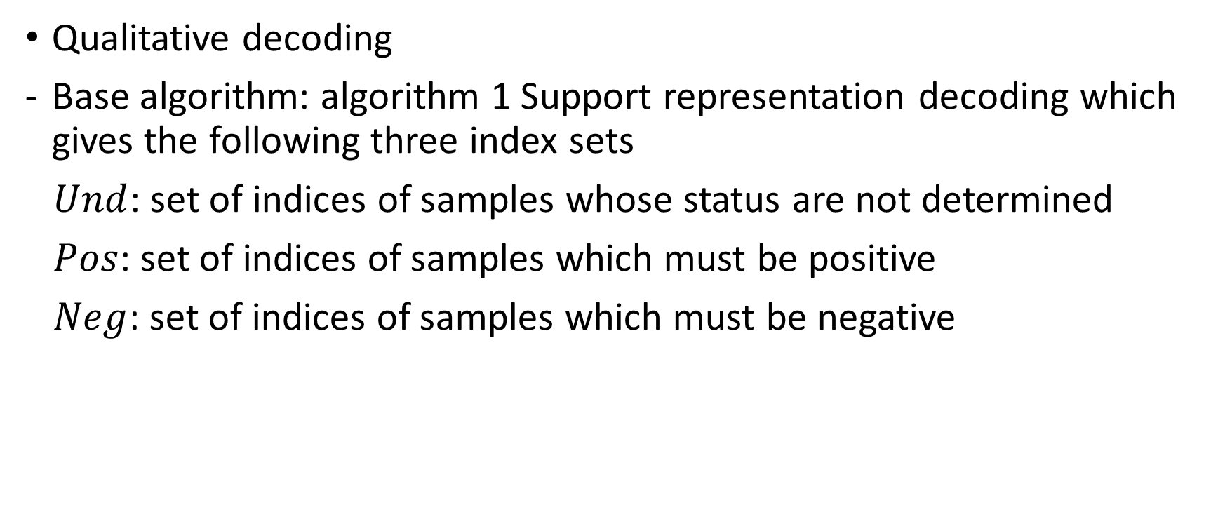
Decoding modules
Qualitative decoding
Base algorithm: algorithm 1 Support representation decoding which gives the following three index sets
$Und$: set of indices of samples whose status are not determined
$Pos$: set of indices of samples which must be positive
$Neg$: set of indices of samples which must be negative

Slide 12
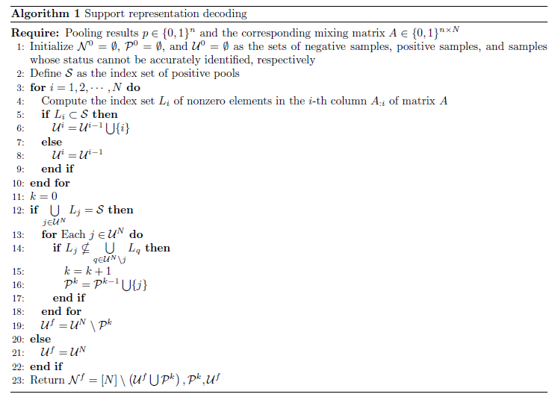
Decoding modules

Slide 13
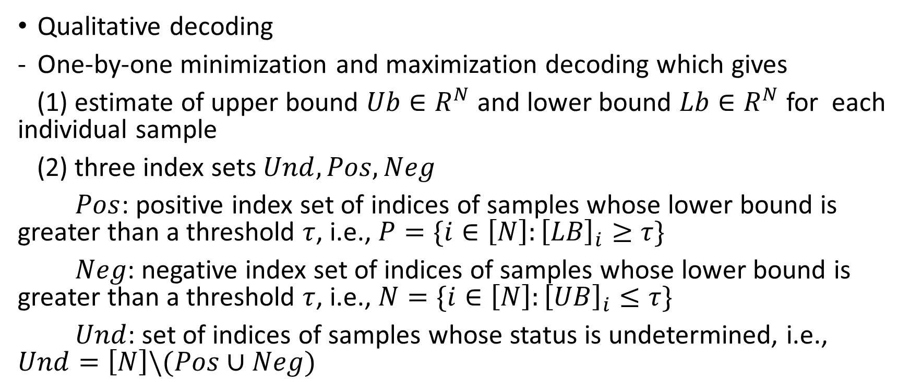
Decoding modules
Qualitative decoding
One-by-one minimization and maximization decoding which gives
(1) estimate of upper bound $Ub∈R^{N}$ and lower bound $Lb∈R^{N}$ for each individual sample
(2) three index sets $Und,Pos,Neg$
$Pos$: positive index set of indices of samples whose lower bound is greater than a threshold $τ$, i.e., $P=\{i∈\left[N\right]:{\left[LB\right]}_{i}≥τ\}$
$Neg$: negative index set of indices of samples whose lower bound is greater than a threshold $τ$, i.e., $N=\{i∈\left[N\right]:{\left[UB\right]}_{i}≤τ\}$
$Und$: set of indices of samples whose status is undetermined, i.e., $Und=\left[N\right]\backslash (Pos∪Neg)$

Slide 14
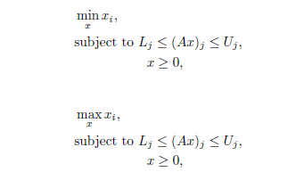
Decoding modules
One-by-one minimization and maximization decoding

Slide 15
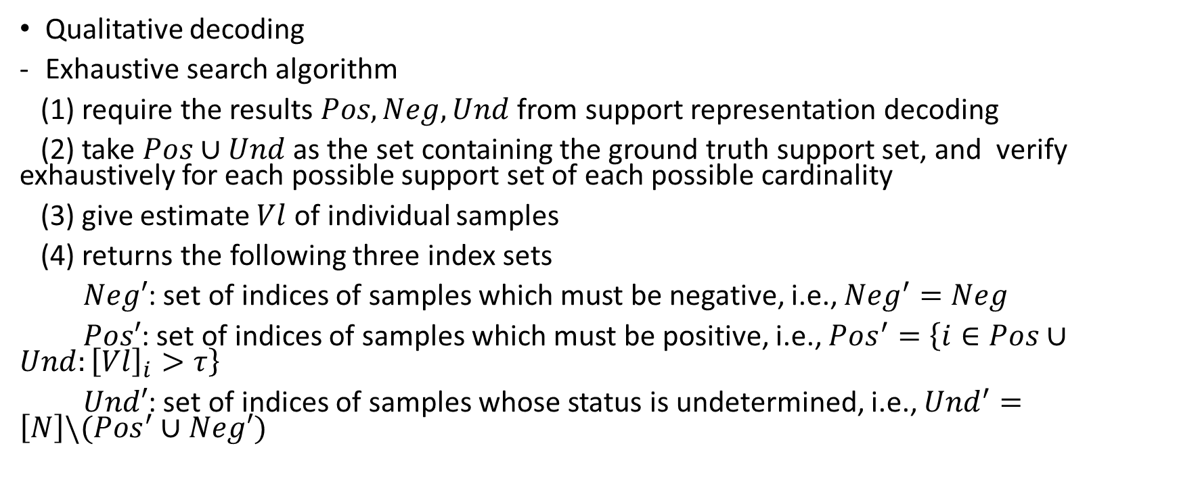
Decoding modules
Qualitative decoding
Exhaustive search algorithm
(1) require the results $Pos,Neg,Und$ from support representation decoding
(2) take $Pos∪Und$ as the set containing the ground truth support set, and verify exhaustively for each possible support set of each possible cardinality
(3) give estimate $Vl$ of individual samples
(4) returns the following three index sets
$Neg′$: set of indices of samples which must be negative, i.e., ${Neg}^{′}=Neg$
$Pos′$: set of indices of samples which must be positive, i.e., ${Pos}^{′}=\left\{i∈Pos∪Und:{\left[Vl\right]}_{i}>τ\right\}$
$Und′$: set of indices of samples whose status is undetermined, i.e., ${Und}^{′}=\left[N\right]\backslash ({Pos}^{′}∪Neg′)$

Slide 16
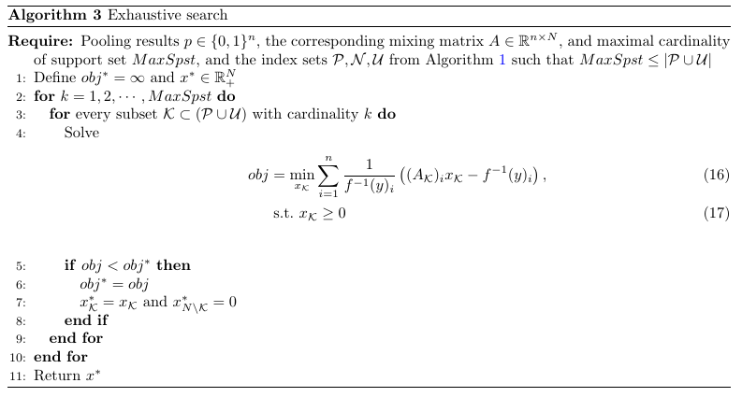
Decoding modules
Exhaustive decoding

Slide 17
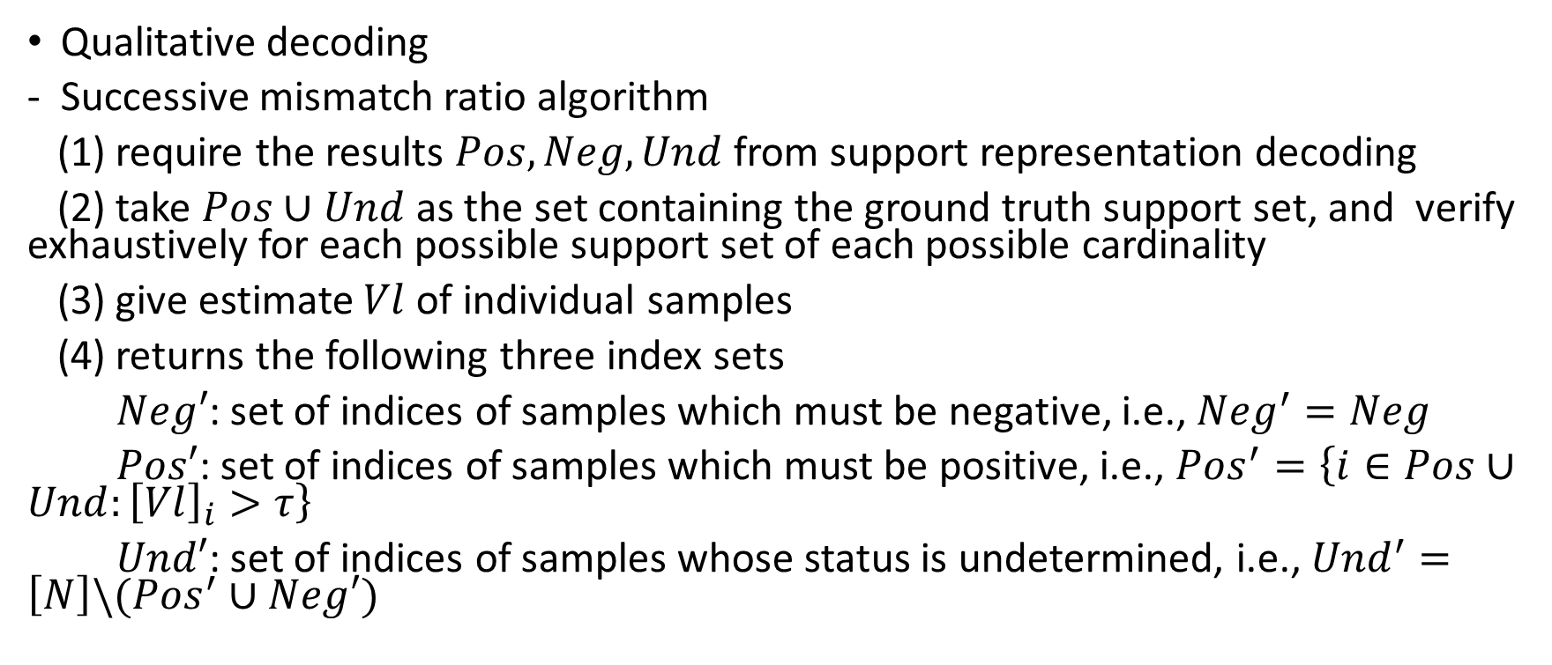
Decoding modules
Qualitative decoding
Successive mismatch ratio algorithm
(1) require the results $Pos,Neg,Und$ from support representation decoding
(2) take $Pos∪Und$ as the set containing the ground truth support set, and verify exhaustively for each possible support set of each possible cardinality
(3) give estimate $Vl$ of individual samples
(4) returns the following three index sets
$Neg′$: set of indices of samples which must be negative, i.e., ${Neg}^{′}=Neg$
$Pos′$: set of indices of samples which must be positive, i.e., ${Pos}^{′}=\left\{i∈Pos∪Und:{\left[Vl\right]}_{i}>τ\right\}$
$Und′$: set of indices of samples whose status is undetermined, i.e., ${Und}^{′}=\left[N\right]\backslash ({Pos}^{′}∪Neg′)$

Slide 18
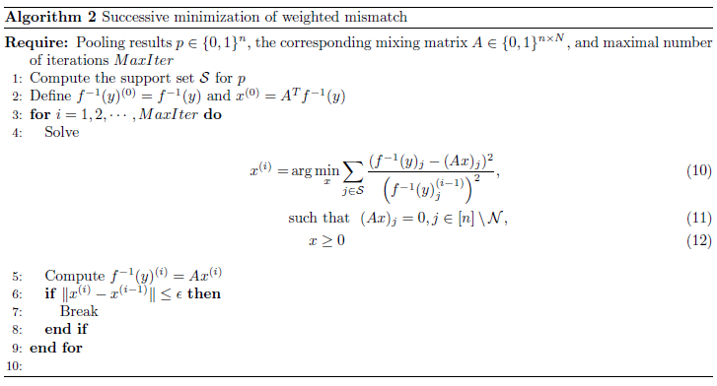
Decoding modules

Slide 19
Parameters setup
Parameters associated with system
Params.ctValType: specify which group of pooling results to use for decoding. Set to be “primary” if only the pooling results from the main group are used, or “secondary” if only the pooling results from the duplicate group are used, or ‘all’ if the pooling results from both the main group and duplicate group are used. Empirically, there is no big difference between using pooling results from one group or both the two groups. Default value “all”
-

Slide 20
Parameters setup
Parameters associated with group testing
Params.posNumPrior: number of positives as prior knowledge. If it’s already known that there is only one positive, set it to be 1. Otherwise, set it to be 0. Default value 0.

Slide 21
Parameters setup
Parameters associated with OBO_MM
- Params.vloadMin: a virus load threshold for specifying status of individual samples. If the upper bound estimate is smaller than this threshold, then the sample is claimed to be negative. If the lower bound estimate is larger than this threshold, then the sample is claimed to be positive. Default value 1e-6.

Slide 22
Parameters setup
Parameters associated with EXHAUSTIVE
- Params.vloadMin: a virus load threshold for specifying status of individual samples. If the estimate is larger than this threshold, then the sample is claimed to be positive. Default value 1e-6.
Params.exhaustiveMode:
Params.earlyTolCtVal:
Params.exhaustiveMaxIterSucc

Slide 23
Parameters setup
Parameters associated with MISMATCHRATIO_SUCC
- Params.vloadMin: a virus load threshold for specifying status of individual samples. If the estimate is larger than this threshold, then the sample is claimed to be positive. Default value 1e-6.
Params.MaxIterSucc: maximal number of iterations for performing successive mismatch minimization.
Params.mismatchratio_norm: type of norm for evaluating the mismatch ratio. Set to be “L1” if evaluating using L1 norm, or “L2” if evaluating using L2 norm. Default value “L2”.

Slide 24
Decoding module
Optimizers

Slide 25
Data components for exporting
Qualitative data or sample status
Quantitative data or sample virus load

Slide 26
Getting started
Main_dec.m

Slide 27
Getting started – testing different solvers
Choose virus type: Params.virusID = ‘MHV-1]
Choose mixing matrix size: Params.MatSize = [3,7]
Choose trail experiment index: Params.trialInd = 1
Choose number of adaptive request: Params.stageNum=2
Adjustable variable
Choose optimization solver: Params.solver = ‘EXHAUSTIVE’, or ‘OBO_MM’, or ‘MISMATCHRATIO_SUCC’
Run the program

