Slide 1
orbyte.
Tomorrow’s business
readiness assistant
For restaurant SMEs in Malaysia
TEAM ALLSTAR
Phan Yi Yan / Lim Jia Vei / Chin Yi Shen
Lee Wing Ho / Wong Xing You
ALLSTAR / ORBYTE
01
Notes:
EN: Imagine tomorrow's afternoon service. Rain threatens your outdoor tables, indoor seating is full, and the front pickup point is closed. Orbyte helps a restaurant owner check which backup plan fits the known conditions, confirm what is missing, and approve a concrete next step. We are Team Allstar.
中文提示：先用餐厅老板的情境开场，再介绍队名。
Scope: Restaurant SME MVP. Do not describe a validated commercial product or promise that a checked plan will succeed.
Sources: project README.md and implemented React/Flask application, inspected 25 October 2026.

Slide 2
Tomorrow’s operational blind spots
A useful alert still leaves
a planning job
What affects our service window?
Which backup plan can we actually use?
What do we need to confirm?
Initial users: independent restaurants and cafés with outdoor seating or pickup operations
ALLSTAR / ORBYTE
02
Notes:
EN: Weather alerts and local notices tell an owner what might happen. The owner still has to relate each event to opening hours, capacity, entrances and delivery arrangements. A fallback can fail because another condition blocks it. Our starting users are independent restaurants and cafés with outdoor seating or pickup operations. This is the problem hypothesis behind the MVP, not the result of completed merchant research.
中文提示：强调“知道事件”和“找到可执行方案”之间仍有判断工作。
Source: user problem statement and implemented business profile fields. No market statistics or interview results are claimed.

Slide 3
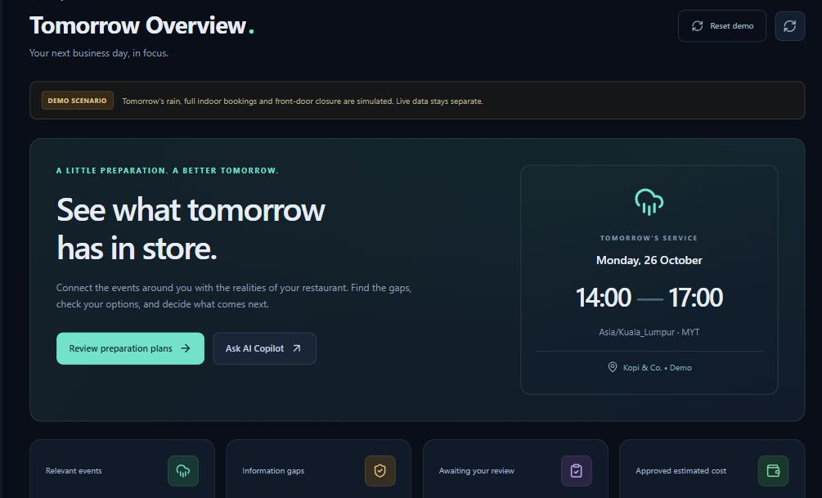
One readiness workflow
Discover relevant events
Check business conditions
Confirm information gaps
Approve exact actions
Track the preparation
Actual MVP interface. Rain and road closure in this scenario are simulated.
ALLSTAR / ORBYTE
03
Notes:
EN: Orbyte brings tomorrow's events together with the saved business profile. It checks alternative plans, turns a missing condition into a confirmation question, and keeps the owner responsible for approving the action. The same record then tracks execution and completion. The workflow links the initial evidence to the final preparation task.
中文提示：按发现、检查、确认、批准、追踪讲一遍，不要逐个介绍七个导航。
Source: README.md, server.py routes and current local demo screenshot. Local screenshot captured 25 October 2026, using simulated events for 26 October.

Slide 4
A backup plan can have its own conflict
Simulated service: tomorrow, 14:00–17:00 MYT
Candidate plan | Known condition | Rule result
Move guests indoors | 40 of 40 indoor seats booked | Conflict
Use front pickup | Closure overlaps the service | Conflict
Use rear pickup | Tomorrow’s rear access unknown | Insufficient data
Checks cover known conditions. They cannot guarantee operational success.
ALLSTAR / ORBYTE
04
Notes:
EN: Here is our core scenario. The selected service is tomorrow from two to five in the afternoon. Rain affects sixteen outdoor seats. Moving guests indoors conflicts with the saved booking count: all forty indoor seats are taken. Front pickup conflicts with an overlapping closure. Rear pickup stays at insufficient data because access for tomorrow is unknown. The rule engine reports these states and the evidence behind them. It prioritizes known conflicts and ignores events outside the service window.
中文提示：这是核心差异，放慢讲三个判断以及理由。
Source: domain.py evaluate(), initial_state(True), server.py /api/checks. All figures are seeded demonstration conditions, not actual restaurant results.

Slide 5
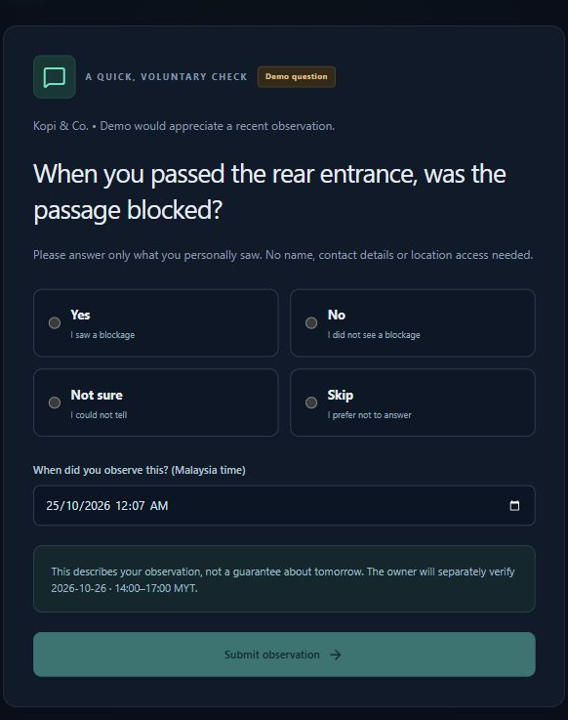
A recent observation needs a future check
Customer: “No blockage seen”
Saved as an unverified lead
Observation time stays attached
Owner verifies tomorrow’s
14:00–17:00 access
The plan updates after that check
ALLSTAR / ORBYTE
05
Notes:
EN: When rear access is unknown, the owner can share a short voluntary question. Customers choose yes, no, not sure or skip, with an observation time and no required personal details. A no-blockage answer tells us what the customer saw recently. It does not establish tomorrow's access. The owner must check the target service window and record that verification before the rear plan can become conditions met. Conflicting answers remain unresolved until an owner check.
中文提示：顾客问的是“有没有堵住”。选择 No 表示没有看到堵塞，不是“后门不能用”。强调今天的线索不能自动成为明天的事实。
Source: PublicFeedback.jsx, server.py /public/questions/.../responses and /questions/.../verify, domain.py rules. Screenshot is an actual voluntary demo question.

Slide 6
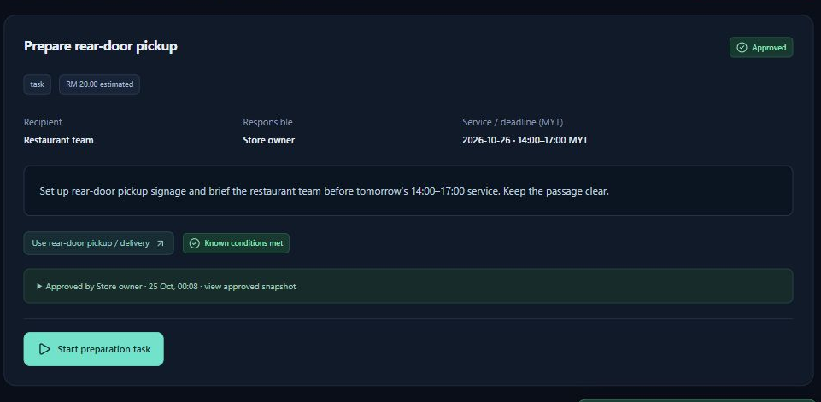
The owner approves the exact action
Recipient and responsible person
Exact instructions and service time
Estimated cost in RM
Approval snapshot
Execution status
Completion note
Changed conditions trigger a new review for actions that have not executed.
ALLSTAR / ORBYTE
06
Notes:
EN: Once the rear plan meets the known conditions, the owner can prepare a pickup task. This example records the team, service window, instructions and an estimated cost of RM twenty. Approval saves the owner's display name, time and content snapshot. Execution is a separate step, and the owner records the completion note. If relevant conditions change before execution, the action needs review and approval again. External notices are simulated in this MVP.
中文提示：RM20 只是演示中的老板预计成本，不是节省金额，也不是订阅价格。说明批准和执行是两个步骤。
Sources: server.py action transition endpoints, domain.py changed(), screenshot action-approved.png. No real customer notification is sent.

Slide 7
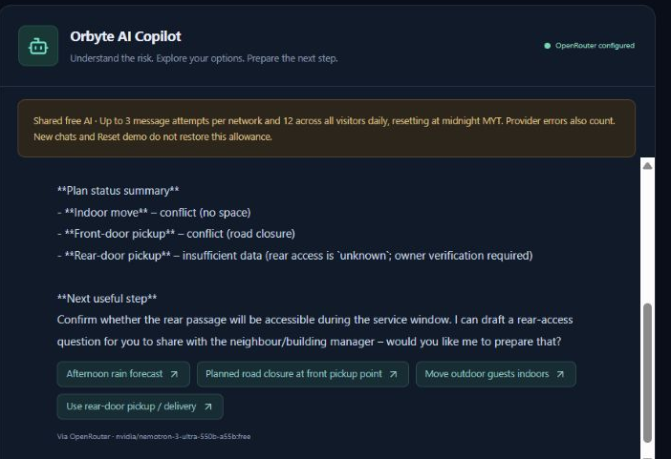
AI Copilot explains and prepares
“Can we switch
to delivery?”
Reads the latest conditions
Explains conflicts and gaps
Creates reviewable drafts
Owner approval stays
outside the model’s tools
ALLSTAR / ORBYTE
07
Notes:
EN: The Copilot is a real OpenRouter integration. Every turn reloads the current store context. It can read events and checks, test temporary assumptions, inspect confirmations and tasks, and create question or action drafts. The backend validates tool arguments and verifies the record references returned to the owner. The model explains the rules' results. It has no tools to approve, execute, verify access or complete a task. Assumptions in a conversation do not overwrite saved business facts.
中文提示：清楚说真实模型调用，不是写死的聊天。模型负责解释，规则负责状态，老板负责批准。
Sources: copilot.py tool allowlist and loop, server.py chat endpoint. Screenshot captures a successful deployed OpenRouter conversation on 24 October 2026. The model shown is one free-route selection, not a promised fixed model. Relevant context is sent to OpenRouter when the owner submits a chat.

Slide 8
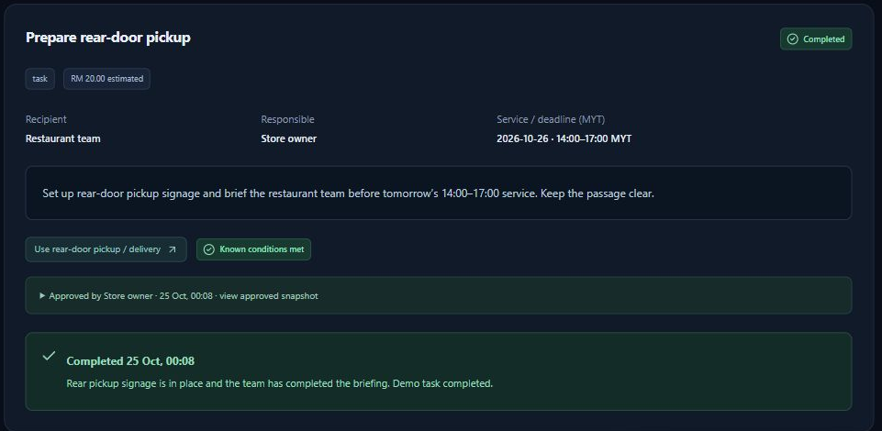
A working MVP with a tested decision flow
35
Backend rule and API tests
3
Frontend currency and time tests
Technical validation only. Merchant outcomes and willingness to pay remain untested.
ALLSTAR / ORBYTE
08
Notes:
EN: We have a deployed demo and a local installation. The implemented stack is React, Flask and SQLite. Automated checks cover the rule and API workflow, plus currency and Malaysian time formatting. We also exercised the deployed feedback, verification, approval and completion journey, and a real AI reply. These are technical validation results. We have not yet measured merchant time saved, revenue protection or customer adoption.
中文提示：用“已完成、已测通”证明完成度，不把技术测试数量讲成商业效果。
Sources: test_app.py contains 35 tests in the last verified run, src/lib.test.js contains 3 tests. Previous deployment verification and actual screenshots. This is engineering evidence, not merchant outcome evidence.

Slide 9
A focused restaurant pilot
Proposed pilot, not launched
5 restaurants
2 weeks
Pricing hypothesis
RM 49.00
per store per month
Measure preparation time, unresolved
conditions and tasks finished before service
Validate willingness to pay
and the cost to serve
ALLSTAR / ORBYTE
09
Notes:
EN: Our next step is a proposed pilot with five restaurants over two weeks. We would measure preparation time, unresolved conditions and whether approved tasks finish before service. We would also ask which alerts matter and whether the owner would pay. An initial pricing hypothesis is RM forty-nine per store per month, subject to merchant feedback and hosting and AI costs. No pilot partner, revenue or commercial pricing has been validated yet.
中文提示：所有数字都是下一步实验设定。没有签约用户、收入或已验证定价。若评委追问市场规模，先说明尚未做市场测算。
Source: Team Allstar proposed validation plan for this pitch. This slide contains explicitly labeled hypotheses, not existing traction.

Slide 10
Orbyte by Team Allstar
Tomorrow’s business
readiness assistant
Seeking restaurant pilot partners
and operational feedback
Try the demo
https://orbyte-readiness-demo.onrender.com
ALLSTAR / ORBYTE
10
Notes:
EN: Orbyte gives restaurant owners a way to check tomorrow's plan, resolve the missing conditions and approve the preparation. Our next step is a small restaurant pilot with real operational feedback. You can explore the online demo using the link on screen. The public website contains simulated business data, and its free hosting may need a short wake-up period. Thank you.
中文提示：结尾邀请评委试用，说明期待餐厅试点与产品反馈。
Demo: https://orbyte-readiness-demo.onrender.com
Repository: https://github.com/WXY0609/Orbyte-Smart-SME-Challenge (private; not a public access link).
Public demo uses anonymous browser workspaces and ephemeral storage. Live operational data is available only in the local installation.

Slide 11
Architecture and responsibility
Layer | Implemented responsibility | Authority boundary
React | Profile, evidence and action views | Explicit owner operations
Flask rules | Time overlap and plan conditions | Establishes check status
OpenRouter | Explanation and draft tools | Cannot approve or execute
SQLite | Workspaces, messages and audit | Temporary on free hosting
Relevant business context goes to OpenRouter when a chat message is submitted.
ALLSTAR / APPENDIX
11
Notes:
EN: React presents the workflow. Flask owns validation, rule evaluation, approvals and execution transitions. SQLite persists state and conversations. Open-Meteo supplies tomorrow's weather in the local Live workspace. OpenRouter receives the relevant business context and invokes an allowlist of backend tools. The free hosted demo isolates anonymous browser workspaces and limits AI attempts. This is not an authenticated production merchant system.
中文提示：评委问“为什么不直接用 ChatGPT”时，解释结构化资料、确定性规则、验证和批准状态机的作用。
Sources: server.py, domain.py, storage.py, copilot.py, Dockerfile and render.yaml. Official provider documentation: https://openrouter.ai/docs/guides/features/tool-calling and https://open-meteo.com/en/docs.

Slide 12
MVP scope and next steps
Available now
Before real merchant deployment
Public simulated demo
Local Live weather and merchant notices
Rule checks and owner verification
Approval records and task tracking
Owner authentication
Durable records and AI limits
More official notice integrations
Real messaging and additional stores
Public demo: free hosting can sleep and reset data. External notification sends are simulated.
ALLSTAR / APPENDIX
12
Notes:
EN: Today, the public website is a synthetic demo with separate browser workspaces. Its free hosting may sleep and erase records, and the AI allowance is three attempts per network and twelve globally each Malaysian day while the counters persist. The local Live workspace can fetch real weather and use merchant-entered notices. Next, owner authentication and durable records and quota counters are prerequisites for real merchant deployment. Official notice integrations, real messaging and additional stores are future work.
中文提示：不要说公开网站已经支持真实店铺运营，也不要说通知已经真的发出。主动区分演示版和正式运营版。
Sources: README.md, render.yaml and server.py. Free service behavior: https://render.com/docs/free. Roadmap items are planned, not implemented.

