Slide 1
6.1
不确定性的量化

Slide 2
主要内容
不确定性（Probability）
语法和语义（Syntax and Semantics）
推理（Inference）
独立性和贝叶斯法则（Independence and Bayes‘ Rule）

Slide 3


用概率来量化不确定性
A_{t} ：起飞前t分钟出发前往机场。
A_{t}能保证准时到达机场吗？
环境部分可观察的（道路状况，交通状况），动作的不确定性（爆胎）等等。
用概率来处理不确定性：
在目前所掌握的信息证据条件下，A₂₅能让我准时到达的概率是0.04
Notes:
Problems:
所处世界的部分可观察性(道路状况，交通状况等等)
noisy sensors (traffic reports)
uncertainty in action outcomes (flat tire, etc.)
immense complexity of modeling and predicting traffic

Slide 4


在不确定条件下做决定
假设智能体相信下面的概率:
  P(A₂₅ gets me there on time | …) = 0.04
  P(A₉₀ gets me there on time | …) = 0.70
  P(A₁₂₀ gets me there on time | …) = 0.95
  P(A₁₄₄₀ gets me there on time | …) = 0.9999
那他应该如何做决定? 决策理论（Decision theory）：probability theory + utility theory
Notes:
取决于他对于误机与等待时间的偏好。
效用理论（Utility theory）用来表示和推理偏好的理论
取决于他对于误机与等待时间的偏好。
效用理论（Utility theory）用来表示和推理偏好的理论
也就是说理性决策依赖于这些目标将被实现的可能性和程度，依赖于各种目标的相对重要性。
决策理论（Decision theory）：probability theory + utility theory

Slide 5
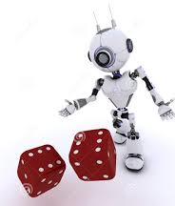
概率基础
基本元素: 随机变量
布尔型随机变量（Boolean random variables）
  e.g., Cavity (do I have a cavity?)
离散型随机变量（Discrete random variables）
  e.g., Weather is one of <sunny,rainy,cloudy,snow>
Notes:
Domain values must be exhaustive and mutually exclusive

Slide 6


概率基础
给随机变量赋一个值就形成一个原子命题：
e.g., Weather = sunny,
Cavity = false (abbreviated as ¬cavity)
复合命题由原子命题和逻辑连接词构成：
e.g., Weather = sunny ∨ Cavity = false
Notes:
Domain values must be exhaustive and mutually exclusive

Slide 7
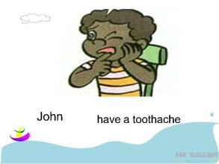
概率基础
原子事件（Atomic event）: 不确定环境状态的一个完整描述。
  例如：如果环境仅由两个布尔型变量：Cavity 和 Toothache来描述，则只有4个不同的原子事件：
    Cavity = false ∧Toothache = false
    Cavity = false ∧ Toothache = true
    Cavity = true ∧ Toothache = false
    Cavity = true ∧ Toothache = true
Notes:
原子事件是相互排斥，并且所有的原子事件能形成所有环境状态

Slide 8
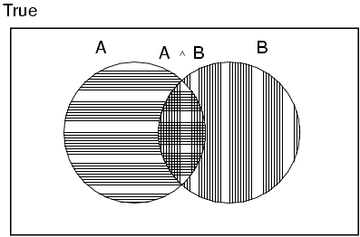
概率公理
对于任意的命题A, B
  0 ≤ P(A) ≤ 1
  P(true) = 1 and P(false) = 0
  P(A ∨ B) = P(A) + P(B) - P(A ∧ B)

Slide 9
先验概率
先验概率（无条件概率）：
  e.g., P(Cavity = true) = 0.1
概率分布： 给出所有可能的赋值对应的概率值
  P(Weather) = <0.72,0.1,0.08,0.1>
联合概率分布：给出任何一个由随机变量集构成的环境中的原子事件的概率值。
Notes:
correspond to belief prior to arrival of any (new) evidence
variables gives the probability of every atomic event on those random variables
Every question about a domain can be answered by the joint distribution
(, i.e., sums to 1)
for a set of random Every question about a domain can be answered by the joint distribution

Slide 10

先验概率
联合概率分布：给出任何一个由随机变量集构成的环境中的原子事件的概率值。
  P(Weather , Cavity) =
Weather = sunny rainy cloudy snow
Cavity = true 0.144 0.02 0.016 0.02
Cavity = false 0.576 0.08 0.064 0.08
Notes:
correspond to belief prior to arrival of any (new) evidence
variables gives the probability of every atomic event on those random variables
Every question about a domain can be answered by the joint distribution
(, i.e., sums to 1)
for a set of random Every question about a domain can be answered by the joint distribution

Slide 11

条件概率
条件概率(后验概率)
  e.g., P(cavity | toothache) = 0.8
  与领域知识相关的推理是很重要的
  P(cavity | toothache, sunny) = P(cavity | toothache)
  P(cavity | toothache , cavity) = 1
Notes:
i.e., given that toothache is all I know

Slide 12
条件概率
  条件概率分布：
  P(Cavity | Toothache)
Toothache = true false
Cavity = true 0.680 0.72
Cavity = false 0.320 0.28
Notes:
correspond to belief prior to arrival of any (new) evidence
variables gives the probability of every atomic event on those random variables
Every question about a domain can be answered by the joint distribution
(, i.e., sums to 1)
for a set of random Every question about a domain can be answered by the joint distribution

Slide 13

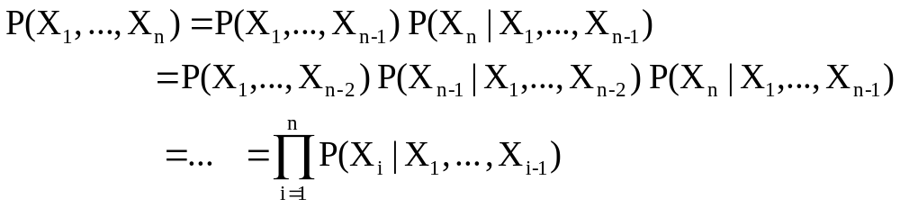
条件概率
条件概率的定义：
  P(a | b) = P(a ∧ b) / P(b) if P(b) > 0
乘法法则（Product rule ）：
  P(a ∧ b) = P(a | b) P(b) = P(b | a) P(a)
链式法则（Chain rule ）：
Notes:
is derived by successive application of product rule:

