Slide 1
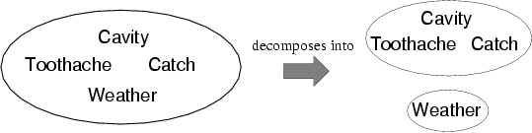

独立性
A 和 B是独立的当且仅当
P(A|B) = P(A) 或 P(B|A) = P(B) 或 P(A, B) = P(A) P(B)
  P(Toothache, Catch, Cavity, Weather)
  = P(Toothache, Catch, Cavity) P(Weather)
32 个表条目减少成12
Notes:
绝对独立强大，但罕见对于 n个相互独立的有偏差的硬币, O(2^{n}) →O(n)Dentistry is a large field with hundreds of variables, none of which are independent. What to do?

Slide 2

条件独立性
在给定Cavity条件下Catch 条件独立 于Toothache
  P(Catch | Toothache,Cavity) = P(Catch | Cavity)
  P(Toothache | Catch, Cavity) = P(Toothache | Cavity)
  P(Toothache, Catch | Cavity) =P(Toothache|Cavity)P(Catch | Cavity)

Slide 3

条件独立性
P(Toothache, Catch, Cavity)
  = P(Toothache | Catch, Cavity) P(Catch, Cavity)
  = P(Toothache | Catch, Cavity) P(Catch | Cavity) P(Cavity)
  = P(Toothache | Cavity) P(Catch | Cavity) P(Cavity)
条件独立性是最基本和最强大的不确定环境的知识表达形式。
Notes:
多数情况下，可以将联合分布表中的项个数从n的指数级减少到n的线性级

Slide 4

贝叶斯法则
乘法法则：P(a∧b) = P(a | b) P(b) = P(b | a) P(a)
⇒贝叶斯法则： P(a | b) = P(b | a) P(a) / P(b)
P(Y|X) = P(X|Y) P(Y) / P(X) = αP(X|Y) P(Y)
从因果概率中来估计诊断概率：
  P(Cause|Effect) = P(Effect|Cause) P(Cause) / P(Effect)
  假如：假设 M表示脑膜炎，S表示僵硬的脖子
    P(m|s) = P(s|m) P(m) / P(s) = 0.8 × 0.0001 / 0.1 = 0.0008
Notes:
Note: posterior probability of meningitis still very small!

Slide 5

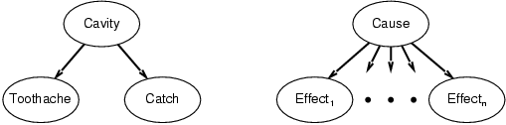
贝叶斯法则和条件独立性
P(Cavity | toothache ∧ catch)
  = αP(toothache ∧ catch | Cavity) P(Cavity)
  = αP(toothache | Cavity) P(catch | Cavity) P(Cavity)
朴素贝叶斯模型:

