Slide 1
Computer Systems:
A Programmer’s Perspective
程序设计与计算机系统
Lecture 1
Intro
November 23, 2015
Wu junmin (jmwu@ustc.edu.cn)

Slide 2
Outline
Course Theme
Five great realities of computer systems
Administrative Matters
Lecture topics and assignments

Slide 3
Course Theme
Abstraction is good, but don’t forget reality!
Courses to date emphasize abstraction
  Abstract data types
  Asymptotic analysis
These abstractions have limits
  Especially in the presence of bugs
  Need to understand underlying implementations
Useful outcomes
  Become more effective programmers
    Able to find and eliminate bugs efficiently
    Able to understand and tune program performance
  Prepare for other “systems” classes
    Compilers, Operating Systems, Networks, Computer Architecture, Embedded Systems

Slide 4
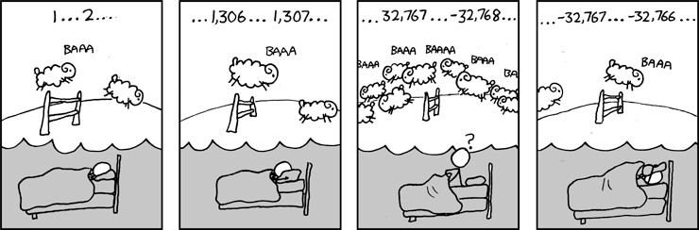
Great Reality #1
Int’s are not Integers, Float’s are not Reals
Examples
  Is x² ≥ 0?
    Float’s: Yes!
    Int’s:
      40000 * 40000 --> 1600000000
      50000 * 50000 --> ??
  Is (x + y) + z = x + (y + z)?
    Unsigned & Signed Int’s: Yes!
    Float’s:
      (1e20 + -1e20) + 3.14 --> 3.14
      1e20 + (-1e20 + 3.14) --> ??
-1794967296
0

Slide 5
Code Security Example
/* Kernel memory region holding user-accessible data */
#define KSIZE 1024
char kbuf[KSIZE];
/* Copy at most maxlen bytes from kernel region to user buffer */
int copy_from_kernel(void *user_dest, int maxlen) {
/* Byte count len is minimum of buffer size and maxlen */
int len = KSIZE < maxlen ? KSIZE : maxlen;
memcpy(user_dest, kbuf, len);
return len;
}
Similar to code found in FreeBSD’s implementation of getpeername
There are legions of smart people trying to find vulnerabilities in programs

Slide 6
Typical Usage
/* Kernel memory region holding user-accessible data */
#define KSIZE 1024
char kbuf[KSIZE];
/* Copy at most maxlen bytes from kernel region to user buffer */
int copy_from_kernel(void *user_dest, int maxlen) {
/* Byte count len is minimum of buffer size and maxlen */
int len = KSIZE < maxlen ? KSIZE : maxlen;
memcpy(user_dest, kbuf, len);
return len;
}
#define MSIZE 528
void getstuff() {
char mybuf[MSIZE];
copy_from_kernel(mybuf, MSIZE);
printf(“%s\n”, mybuf);
}

Slide 7
Malicious Usage
/* Kernel memory region holding user-accessible data */
#define KSIZE 1024
char kbuf[KSIZE];
/* Copy at most maxlen bytes from kernel region to user buffer */
int copy_from_kernel(void *user_dest, int maxlen) {
/* Byte count len is minimum of buffer size and maxlen */
int len = KSIZE < maxlen ? KSIZE : maxlen;
memcpy(user_dest, kbuf, len);
return len;
}
#define MSIZE 528
void getstuff() {
char mybuf[MSIZE];
copy_from_kernel(mybuf, -MSIZE);
. . .
}

Slide 8
Computer Arithmetic
Does not generate random values
  Arithmetic operations have important mathematical properties
Cannot assume “usual” properties
  Due to finiteness of representations
  Integer operations satisfy “ring” properties
    Commutativity, associativity, distributivity
  Floating point operations satisfy “ordering” properties
    Monotonicity, values of signs
Observation
  Need to understand which abstractions apply in which contexts
  Important issues for compiler writers and serious application programmers

Slide 9
Great Reality #2
You’ve got to know assembly
Chances are, you’ll never write program in assembly
  Compilers are much better & more patient than you are
But :Understanding assembly is key to machine-level execution model
  Behavior of programs in presence of bugs
    High-level language model breaks down
  Tuning program performance
    Understand optimizations done/not done by the compiler
    Understanding sources of program inefficiency
  Implementing system software
    Compiler has machine code as target
    Operating systems must manage process state
  Creating/fighting malware
    x86 assembly is the language of choice!

Slide 10
Assembly Code Example
Time Stamp Counter
  Special 64-bit register in Intel-compatible machines
  Incremented every clock cycle
  Read with rdtsc instruction
Application
  Measure time required by procedure
    In units of clock cycles
  double t;
  start_counter();
  P();
  t = get_counter();
  printf("P required %f clock cycles\n", t);

Slide 11
Code to Read Counter
  Write small amount of assembly code using GCC’s asm facility
  Inserts assembly code into machine code generated by compiler
static unsigned cyc_hi = 0;
static unsigned cyc_lo = 0;
/* Set *hi and *lo to the high and low order bits
of the cycle counter.
*/
void access_counter(unsigned *hi, unsigned *lo)
{
asm("rdtsc; movl %%edx,%0; movl %%eax,%1"
: "=r" (*hi), "=r" (*lo)
:
: "%edx", "%eax");
}
Notes:
GCC Extended assembly syntax
asm( assembler syntax
: output operands /*optional */
: input operands /* optional */
: list of clobbered registers /* optional */
);
GCC Extended assembly syntax
asm( assembler syntax
: output operands /*optional */
: input operands /* optional */
: list of clobbered registers /* optional */
);

Slide 12
Code to Read Counter
/* Record the current value of the cycle counter. */
void start_counter()
{
access_counter(&cyc_hi, &cyc_lo);
}
/* Number of cycles since the last call to start_counter. */
double get_counter()
{
unsigned ncyc_hi, ncyc_lo;
unsigned hi, lo, borrow;
/* Get cycle counter */
access_counter(&ncyc_hi, &ncyc_lo);
/* Do double precision subtraction */
lo = ncyc_lo - cyc_lo;
borrow = lo > ncyc_lo;
hi = ncyc_hi - cyc_hi - borrow;
return (double) hi * (1 << 30) * 4 + lo;
}

Slide 13
Measuring Time
Trickier than it Might Look
  Many sources of variation
Example
  Sum integers from 1 to n
    n Cycles Cycles/n
    100 961 9.61
    1,000 8,407 8.41
    1,000 8,426 8.43
    10,000 82,861 8.29
    10,000 82,876 8.29
    1,000,000 8,419,907 8.42
    1,000,000 8,425,181 8.43
    1,000,000,000 8,371,2305,591 8.37

Slide 14
Great Reality #3 Memory Matters
Random Access Memory is an unphysical abstraction
Memory is not unbounded
  It must be allocated and managed
  Many applications are memory dominated
Memory performance is not uniform
  Cache and virtual memory effects can greatly affect program performance
  Adapting program to characteristics of memory system can lead to major speed improvements
Memory referencing bugs especially pernicious
  Effects are distant in both time and space

Slide 15
Memory Referencing Bug Example
double fun(int i)
{
volatile double d[1] = {3.14};
volatile long int a[2];
a[i] = 1073741824; /* Possibly out of bounds */
return d[0];
}
fun(0) ➙ 3.14
fun(1) ➙ 3.14
fun(2) ➙ 3.1399998664856
fun(3) ➙ 2.00000061035156
fun(4) ➙ 3.14, then segmentation fault
Result is architecture specific

Slide 16
Memory Referencing Bug Example
double fun(int i)
{
volatile double d[1] = {3.14};
volatile long int a[2];
a[i] = 1073741824; /* Possibly out of bounds */
return d[0];
}
fun(0) ➙ 3.14
fun(1) ➙ 3.14
fun(2) ➙ 3.1399998664856
fun(3) ➙ 2.00000061035156
fun(4) ➙ 3.14, then segmentation fault
Explanation:
Saved State | 4
d7 ... d4 | 3
d3 ... d0 | 2
a[1] | 1
a[0] | 0
Location accessed by fun(i)

Slide 17
Memory Referencing Errors
C and C++ do not provide any memory protection
  Out of bounds array references
  Invalid pointer values
  Abuses of malloc/free
Can lead to nasty bugs
  Whether or not bug has any effect depends on system and compiler
  Action at a distance
    Corrupted object logically unrelated to one being accessed
    Effect of bug may be first observed long after it is generated
How can I deal with this?
  Program in Java,Ruby, or ML
  Understand what possible interactions may occur
  Use or develop tools to detect referencing errors (e.g. Valgrind)

Slide 18
Memory System Performance Example
void copyij(int src[2048][2048],
int dst[2048][2048])
{
int i,j;
for (i = 0; i < 2048; i++)
for (j = 0; j < 2048; j++)
dst[i][j] = src[i][j];
}
void copyji(int src[2048][2048],
int dst[2048][2048])
{
int i,j;
for (j = 0; j < 2048; j++)
for (i = 0; i < 2048; i++)
dst[i][j] = src[i][j];
}
59,393,288 clock cycles
1,277,877,876 clock cycles
(Measured on 2GHz
Intel Pentium 4)
21.5 times slower!
  Hierarchical memory organization
  Performance depends on access patterns
    Including how step through multi-dimensional array

Slide 19
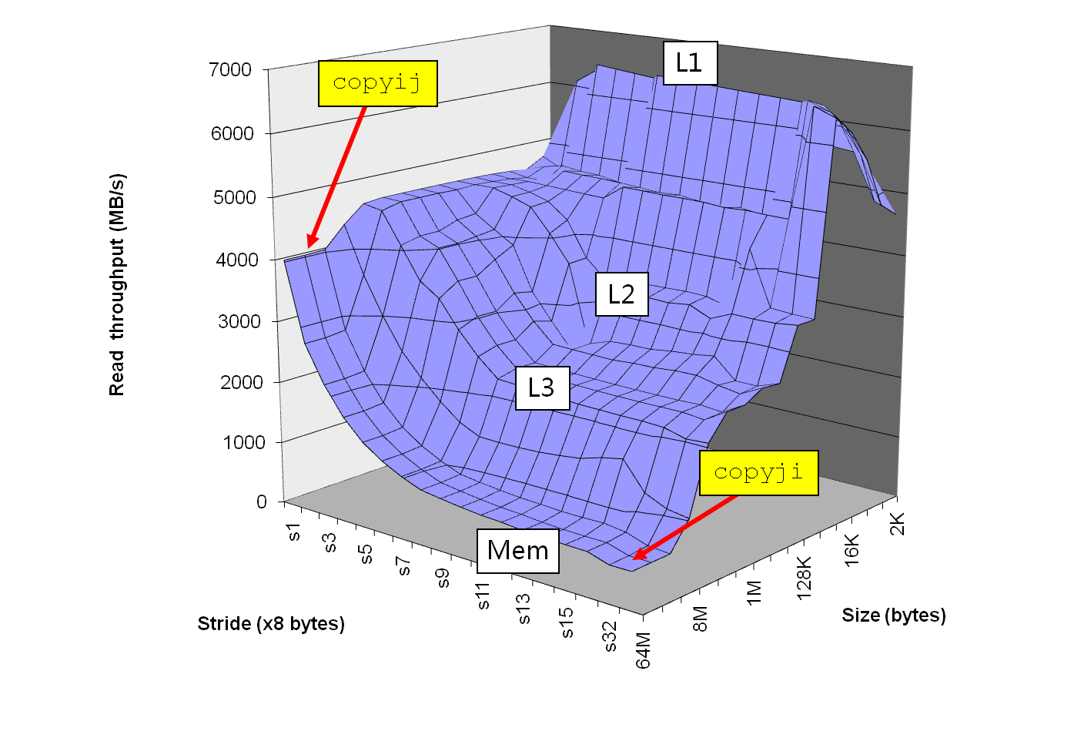
The Memory Mountain
Intel Core i7
2.67 GHz
32 KB L1 d-cache
256 KB L2 cache
8 MB L3 cache

Slide 20
Great Reality #4
There’s more to performance than asymptotic complexity
Constant factors matter too!
And even exact op count does not predict performance
  Easily see 10:1 performance range depending on how code written
  Must optimize at multiple levels: algorithm, data representations, procedures, and loops
Must understand system to optimize performance
  How programs compiled and executed
  How to measure program performance and identify bottlenecks
  How to improve performance without destroying code modularity and generality

Slide 21
Memory Performance Example
Implementations of Matrix-Matrix Multiplication
  Multiple ways to nest loops
/* ijk */
for (i=0; i<n; i++) {
for (j=0; j<n; j++) {
sum = 0.0;
for (k=0; k<n; k++)
sum += a[i][k] * b[k][j];
c[i][j] += sum;
}
}
/* ikj */
for (i=0; i<n; i++) {
for (k=0; k<n; k++) {
r = a[i][k];
for (j=0; j<n; j++)
c[i][j] += r * b[k][j];
}
}

Slide 22
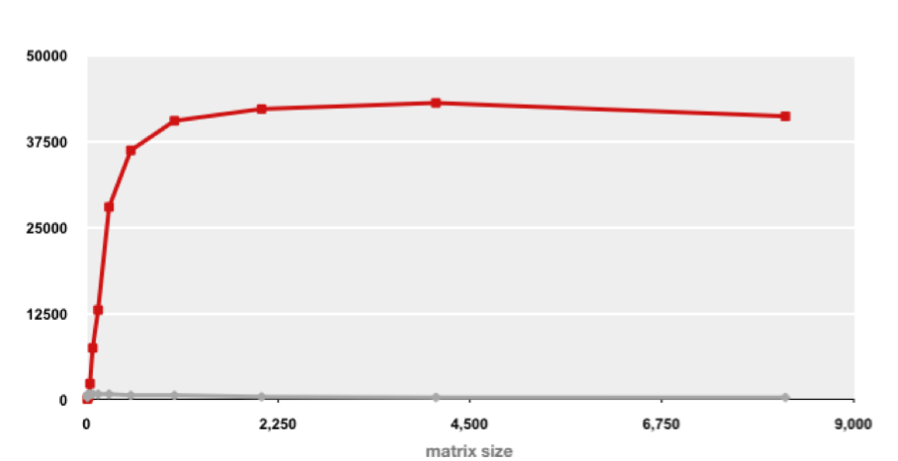
Example Matrix Multiplication
Matrix-Matrix Multiplication (MMM) on 2 x Core 2 Duo 3 GHz (double precision)
Gflop/s
Best code (K. Goto)
160x
Triple loop
Standard desktop computer, vendor compiler, using optimization flags
Both implementations have exactly the same operations count (2n³)
What is going on?

Slide 23
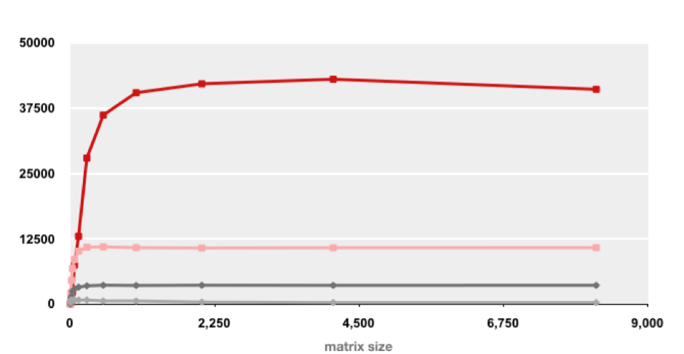
MMM Plot: Analysis
Matrix-Matrix Multiplication (MMM) on 2 x Core 2 Duo 3 GHz
Gflop/s
Multiple threads: 4x
Vector instructions: 4x
Memory hierarchy and other optimizations: 20x
Reason for 20x: Blocking or tiling, loop unrolling, array scalarization, instruction scheduling, search to find best choice
Effect: fewer register spills, L1/L2 cache misses, and TLB misses

Slide 24
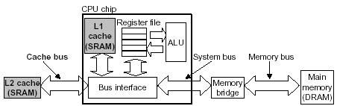
Memory System

Slide 25
Great Reality #5
Computers do more than execute programs
They need to get data in and out
  I/O system critical to program reliability and performance
They communicate with each other over networks
  Many system-level issues arise in presence of network
    Concurrent operations by autonomous processes
    Coping with unreliable media
    Cross platform compatibility
    Complex performance issues

Slide 26
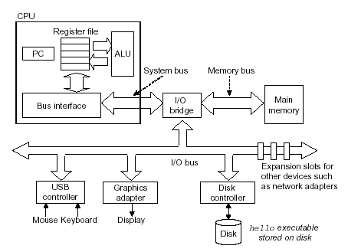
Hardware Organization (Naïve)

Slide 27
Outline
Course Theme
Five great realities of computer systems
Administrative Matters
Lecture topics and assignments

Slide 28
Course Perspective
Most Systems Courses are Builder-Centric
  Computer Architecture
    Design pipelined processor in Verilog
  Operating Systems
    Implement large portions of operating system
  Compilers
    Write compiler for simple language
  Networking
    Implement and simulate network protocols

Slide 29
Course Perspective (Cont.)
Our Course is Programmer-Centric
  Purpose is to show how knowing more about the underlying system, leads one to be a more effective programmer
  Enable you to
    Write programs that are more reliable and efficient
    Incorporate features that require hooks into OS
      E.g., concurrency, signal handlers
  Not just a course for dedicated hackers
    We bring out the hidden hacker in everyone
  Cover material in this course that you won’t see elsewhere

Slide 30
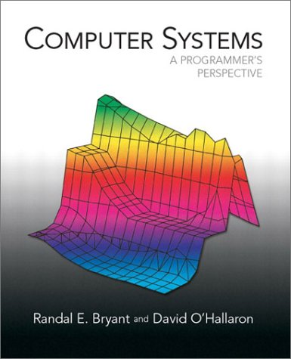
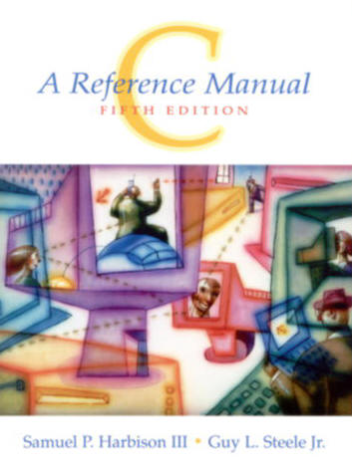
Course Administration
Instructor: 吴俊敏 jmwu@ustc.edu.cn
TA： 朱小东 xdzhu001@mail.ustc.edu.cn
Lab：思贤楼408室(Multicore system and application)
Materials: 软件学院信息平台
TextBook:
  Randal E. Bryant and David R. O’Hallaron, “Computer Systems: A Programmer’s Perspective”, 英文版.第二版，机械工业出版社（2011）http://csapp.cs.cmu.edu/
  中译本，深入理解计算机系统（原书第二版），龚亦利等译，机械工业出版社(2011)
Reference Book:
  Samuel P. Harbison III and Guy L. Steele Jr., “C A Reference Manual 5th Edition”,Prentice Hall, 2002
  http://careferencemanual.com/

Slide 31
Grading
Lab : 25
Homework Assignments: 15
Class Participation: 10(5+5)
Final Exam: 50

Slide 32
About the Textbook
Authors:
  Randal E. Bryant: CMU, Professor, ACM IEEE Fellow
  O’Hallaron: CMU，Professor
Organization:
  Introduction
  Representing and Manipulating Information
  Machine-Level Representing of Programs
  Processor Architecture
  Optimizing Program Performance
  The Memory Hierarchy
  Linking
  Exceptional Control Flow
  Virtual Memory
  System-Level I/O
  Network Programming
  Concurrent Programming

Slide 33
Course Structure
Lectures:
  1 Lec on Introduction (chap.1,11-23)
  2 lec on Information Representing (chap.2,11-24,11-30)
  3 lecs on Machine Language (chap.3, 12-1,12-7,12-8)
  1 lecs on Code Optimization(chap.5,12-14)
  1 lecs on Linking (chap.7,12-15)
  1 lecs on Exception Control(chap.8,12-21)
  1 lecs on Memory Hierarchy (chap.6,12-22)
  2 lecs on Virtual Memory(Chap.10,12-28,12-29)
  1 lec on I/O(Chap.11,1-4)
  1 lecs on Network Programming(Chap.12,1-5)
  2 lecs on Concurrent Programming(Chap.13,1-11,1-12)

Slide 34
Outline
Course Theme
Five great realities of computer systems
Administrative Matters
Lecture topics and assignments

Slide 35
Programs and Data
Topics
  Bits operations, arithmetic, assembly language programs
  Representation of C control and data structures
  Includes aspects of architecture and compilers
Assignments
  L1: Manipulating bits
  L2: Defusing a binary bomb
  L3: Hacking a buffer bomb

Slide 36
The Memory Hierarchy
Topics
  Memory technology, memory hierarchy, caches, disks, locality
  Includes aspects of architecture and OS.
Assignments
  L4 (Perflab): Optimize the performance of an application kernel function.
    Learn how to exploit locality in your programs.

Slide 37
Linking and Exceptional Control Flow
Topics
  Object files, static and dynamic linking, libraries, loading
  Hardware exceptions, processes, process control, Unix signals, nonlocal jumps
  Includes aspects of compilers, OS, and architecture

Slide 38
Virtual memory
Topics
  Virtual memory, address translation, dynamic storage allocation
  Includes aspects of architecture and OS
Assignments
  L5: Writing your own malloc package
    Get a real feel for systems programming

Slide 39
I/O, Networking, and Concurrency
Topics
  High level and low-level I/O, network programming
  Internet services, Web servers
  concurrency, concurrent server design, threads
  I/O multiplexing with select.
  Includes aspects of networking, OS, and architecture.

Slide 40
L1:Data Lab
Students implement simple logical and arithmetic functions, but using a highly restricted subset of C.
For example, they must compute the absolute value of a number using only bit-level operations.
This lab helps students understand the bit-level representations of C data types and the bit-level behavior of the operations on data.

Slide 41
L2:Bomb Lab
A "binary bomb" is a program provided to students as an object code file.
When run, it prompts the user to type in 6 different strings. If any of these is incorrect, the bomb ``explodes,'' printing an error message and logging the event on a grading server.
Students must ``defuse'' their own unique bomb by disassembling and reverse engineering the program to determine what the 6 strings should be.
The lab teaches students to understand assembly language, and also forces them to learn how to use a debugger. It's also great fun. A legendary lab among the CMU undergrads.

Slide 42
L3: Buffer Lab
Students modify the run-time behavior of a binary executable by exploiting a buffer overflow bug.
This lab teaches the students about the stack discipline and teaches them about the danger of writing code that is vulnerable to buffer overflow attacks.

Slide 43
L4:Performance Lab
Students must optimize the performance of an application kernel function such as convolution or matrix transposition.
This lab provides a very clear demonstration of the properties of cache memories, and gives students experience with low-level program optimization.

Slide 44
L5: Malloc Lab
Students implement their own versions of malloc, free, and realloc.
This lab gives students a clear understanding of data layout and organization, and requires them to evaluate different trade-offs between space and time efficiency.
One of our favorite labs. When students finish this one, they really understand pointers!

Slide 45
Acknowledgement
This course was developed and fine-tuned by Randal E. Bryant and David O’Hallaron. They wrote The Book!

Slide 46
Have a Great Semester!

