Slide 1
9.6 Partial orderings

Slide 2
Content
Partial Order
  Linear order（线序）
  Quasiorder（拟序）
  Product Partial Order（乘积偏序）
  Lexicographic Order（词典顺序）
Hasse Diagram（哈斯图）
Topological Sorting（拓扑排序）
Isomorphism（同构）
Principle of Correspondence（对应原理）
College of Computer Science & Technology, BUPT

Slide 3
Review
Properties of relations on a set A:
  Reflexive(自反的）
  Irreflexive（反自反的）
  Symmetric（对称的）
  Asymmetric（非对称的）
  Antisymmetric（反对称的）
  Transitive（传递的）
College of Computer Science & Technology, BUPT

Slide 4
PARTIALLY ORDERED SETS (偏序集合）
Partial order（偏序关系）:A relation R on a set A is called a partial order if R is reflexive（自反）, antisymmetric（反对称）, and transitive（传递）.
Partially ordered set:The set A together with the partial order R is called a partially ordered set, or simply a poset, and we will denote this poset by (A, R).
College of Computer Science & Technology, BUPT

Slide 5
Examples
(⁺,≤)
(⁺,≥)
(⁺,|)
(⁺,<)is not a poset
College of Computer Science & Technology, BUPT

Slide 6
linear order（线序关系）
If (A, ≤) is a poset, the elements a and b are said to be
  Comparable（可比的） if a ≤ b or b ≤ a.
  incomparable (不可比的）if neither a ≤ b nor b ≤ a.
If every pair of elements in a poset A is comparable, we say that A is a linearly ordered set（全序集合）or totally ordered, and the partial order is called a linear order（全序关系或线序关系）. We also say that A is a chain（链）.
  (⁺,≤)
  (⁺,|) is not a chain.
College of Computer Science & Technology, BUPT

Slide 7
Well-ordered set
Well-ordered set:The poset A together with the total ordering R and such that every nonempty subset of A has a least element is called a well-ordered set.
(Z⁺×Z⁺,≤) is Well-ordered set.
(Z , ≤) is not Well-ordered set.
College of Computer Science & Technology, BUPT

Slide 8
Theorem 1良序归纳原理
The principle of well-ordered induction: Suppose (S,≤) is a well-ordered set. Then P(x) is true for all x∈S, if
INDUCTIVE STEP: for every y∈S, if P(x) is true for all x∈S with x<y, Then P(y) is true.
意义:良序集的命题证明简化.
College of Computer Science & Technology, BUPT

Slide 9
Quasiorder(拟序关系）
Quasiorder: A relation R on a set A is called quasiorder if it is transitive and reflexive.
  Example:
    (P(S),⊆)
College of Computer Science & Technology, BUPT

Slide 10
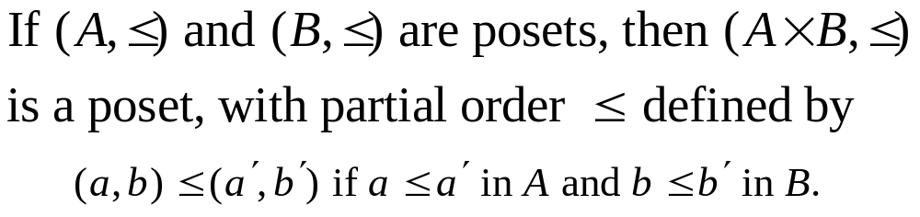
Product partial order （乘积偏序）
This ordering is called product partial order.
College of Computer Science & Technology, BUPT

Slide 11
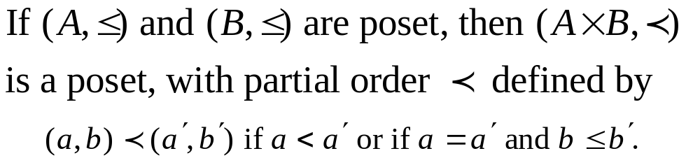
Lexicographic order （词典顺序）
This ordering is called lexicographic, or “dictionary” order.
College of Computer Science & Technology, BUPT

Slide 12
Hasse Diagrams（哈塞图）
Hasse Diagram is the digraph of a partial order on a finite set A that
  deletes all self-cycles
  eliminates all edges that are implied by the transitive property
  draws the digraph with all edges pointing upward
College of Computer Science & Technology, BUPT

Slide 13
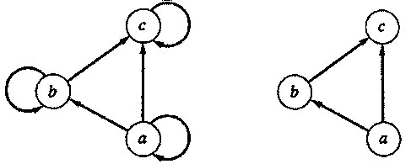
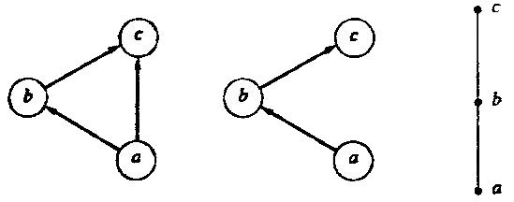
Hasse Diagram
College of Computer Science & Technology, BUPT

Slide 14
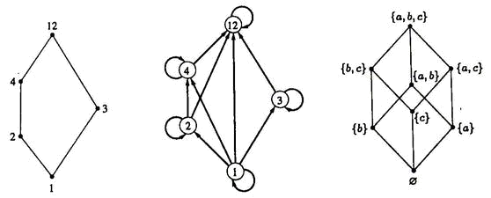
Hasse Diagram
({1, 2, 3, 4, 12}, |)
(P({a, b, c}), ⊆)
College of Computer Science & Technology, BUPT

Slide 15
Isomorphism（同构）
Let (A, ≤) and (A’, ≤’) be posets and let f :A→A’ be a one-to-one correspondence between A and A’. The function f is called an isomorphism from (A, ≤) to (A’, ≤’) if, for any a and b in A,
  a ≤ b if and only if f(a) ≤’ f(b).
If f : A→A’ is an isomorphism, we say that (A, ≤) and (A’, ≤’) are isomorphic posets.
College of Computer Science & Technology, BUPT

Slide 16
Isomorphism: Example
Let (Z⁺, ≤) and (E⁺, ≤) be posets. The function f : Z⁺ → E⁺ given by
  f(a) = 2a
is an isomorphism from (Z⁺ , ≤) to (E⁺ , ≤)
Proof
  First, is onto and one-to-one
  Second, a ≤ b iff 2a ≤ 2b
College of Computer Science & Technology, BUPT

Slide 17
Principle of correspondence （对应原理）
  Suppose that f：A→A’ is an isomorphism from a poset (A, ≤) to a poset (A’, ≤’). Suppose also that B is a subset of A, and B’ = f(B) is the corresponding subset of A’. Then
If the elements of B have any property relating to one another or to other elements of A, and if this property can be defined entirely in terms of the relation ≤, then the elements of B’ must possess exactly the same property, defined in terms of ≤’ .
  two finite isomorphic posets must have the same Hasse diagram.
College of Computer Science & Technology, BUPT

Slide 18
Extremal elements
maximal element（极大元）
minimal element（极小元）
greatest element（最大元）
  denoted by I and often called the unit element（单位元）
least element（最小元）
  denoted by 0 and often called the zero element（零元）
College of Computer Science & Technology, BUPT

Slide 19
Maximal(minimal) element
An element a ∈ A is called a maximal element of A if there is no element c in A such that a<c.
An element b ∈ A is called a minimal element of A if there is no element c in A such that c<b.
College of Computer Science & Technology, BUPT

Slide 20
Greatest (least ) element
An element a ∈A is called a greatest element of A if x ≤ a for all x ∈ A.
An element a ∈A is called a least element of A if a ≤ x for all x ∈ A.
The greatest element of a poset, if it exists, is denoted by I, and is often called the unit element. Similarly, the least element is called zero element.
College of Computer Science & Technology, BUPT

Slide 21
Lub（最小上界） Glb（最大下界）
Consider a poset and a subset B of A.
  An element a ∈ A is called a upper bound（上界） of B if b≤a for all b ∈ B.
  An element a ∈ A is called a lower bound（下界）of B if a≤b for all b ∈ B.
  An element a ∈ A is called a least upper bound (LUB) of B if a is an upper bound of B and a≤a’, whenever a’ is an upper bound of B.
  An element a ∈ A is called a greatest lower bound (GLB) of B if a is an lower bound of B and a’≤a, whenever a’ is an lower bound of B.
College of Computer Science & Technology, BUPT

Slide 22
Theorem
Let (A, ≤) be a poset
  If A is a finite nonempty, then A has at least one maximal element and at least one minimal element.
  A has at most one greatest element and at most one least element.
  A subset B of A has at most one LUB and at most one GLB.
College of Computer Science & Technology, BUPT

Slide 23
Theorem
Suppose that (A, ≤) and (A’, ≤’) are isomorphic posets under the isomorphism f: A→A’.
  If a is a maximal (minimal) element of (A, ≤), then f(a) is a maximal (minimal) element of (A’, ≤’).
  If a is a greatest (least) element of (A, ≤), then f(a) is a greatest (least) element of (A’, ≤’).
  If a is an upper bound (lower bound, least upper bound, greatest lower bound) of (A, ≤), then f(a) is an upper bound (lower bound, least upper bound, greatest lower bound) of (A’, ≤’).
  If every subset of (A, ≤) has a LUB (GLB), then every subset of (A’, ≤’) has a LUB (GLB).
College of Computer Science & Technology, BUPT

Slide 24
Topological Sorting
（拓扑排序）
If A is a poset with partial order ≤, we sometimes need to find a linear order ° for the set A that will merely be an extension of the given partial order in the sense that if a ≤ b, then a ° b.
The process of constructing a linear order such as ° is called topological sorting
College of Computer Science & Technology, BUPT

Slide 25
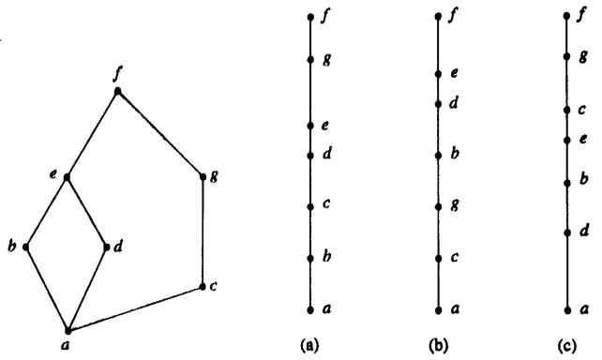
Example
College of Computer Science & Technology, BUPT

Slide 26
SORT Algorithm
For finding a topological sorting of a finite poset (A, ≤).
Step1 Choose a minimal element a of A.
Step2 Make a the next entry of SORT and replace A with A-{a}.
Step3 Repeat steps 1 and 2 until A={}.
End of Algorithm
College of Computer Science & Technology, BUPT

Slide 27
Lattice
A lattice is a poset in which every subset {a,b} consisting of two elements has a least upper bound and a greatest lower bound.
  denote LUB({a,b}) by a∨b and call it the join（并） of a and b.
  denote GLB({a,b}) by a∧b and call it the meet（交） of a and b.
College of Computer Science & Technology, BUPT

Slide 28
Example
Let S be a set and let L = P(S).
  As we have seen, ⊆, containment, is a partial order on L. Let A and B belong to the poset (L, ⊆).
A∨B is the set A∪B.
  To see that, note that A⊆A∪B, B ⊆ A∪B, and if A ⊆ C and B ⊆ C, then it follows that A∪B ⊆ C.
Similarly, A∧B is the set A∩B.
Thus, L is a lattice.
College of Computer Science & Technology, BUPT

Slide 29
Example
S={a,b,c}
{a,b,c}
{a,c}
{b,c}
{a,b}
{c}
{a}
{b}
{}
College of Computer Science & Technology, BUPT

Slide 30
Example
Let n be a positive integer and D_{n} be the set of all positive divisors of n.
D₃₀={1,2,3,5,6,10,15,30}
  a ∨ b=LCM(a,b)
  a ∧ b=GCD(a,b)
30
10
15
6
2
5
3
1
College of Computer Science & Technology, BUPT

Slide 31
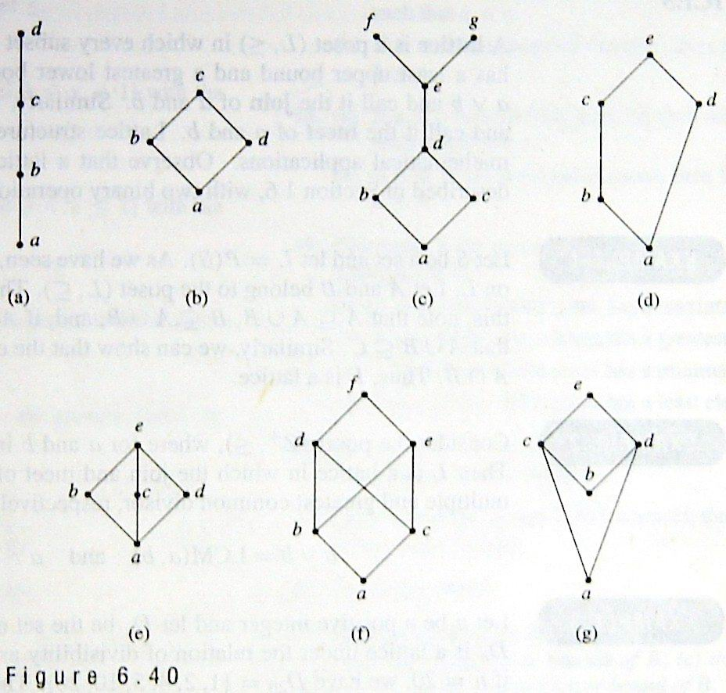
Example
College of Computer Science & Technology, BUPT

Slide 32
Theorem
If (L₁, ≤) and (L₂, ≤) are lattices, then (L, ≤) is a lattice, where
  L = L₁×L₂
  the partial order ≤ of L is the product partial order.
College of Computer Science & Technology, BUPT

Slide 33
Proof
We denote the join and meet in L₁ by ∨₁ and∧₁, respectively, and the join and meet in L₂ by ∨₂ and ∧₂, respectively. Then L is a poset.
We now need to show that if (a₁, b₁) and (a₂, b₂)∈L, then (a₁, b₁)∨(a₂, b₂) and (a₁, b₁)∧(a₂, b₂) exist in L. We leave it as an exercise to verify that
  (a₁, b₁)∨(a₂, b₂) = (a₁ ∨₁ a₂, b₁ ∨₂ b₂)
  (a₁, b₁)∧(a₂, b₂) = (a₁ ∧₁ a₂, b₁ ∧₂ b₂).
Thus L is a lattice.
College of Computer Science & Technology, BUPT

Slide 34
Example
L₁ L_{2’} =L₁ × L₁ L₂ L= L₁× L₂
(1₁ ,1₂)
1₁
(1₁ ,1₁)
1₂
(1₁ ,a)
(1₁ ,b)
(0₁ ,1₂)
(0₁ ,1₁)
a
b
(1₁ ,0₁)
(1₁ ,0₂)
(0₁ ,a)
(0₁ ,b)
0₁
(0₁ ,0₁)
0₂
(0₁ ,0₂)
College of Computer Science & Technology, BUPT

Slide 35
Sublattice（子格）
Let (L, ≤) be a lattice. A nonempty subset S of L is called a sublattice of L
  if a∨b ∈ S and a∧b∈S whenever a ∈ S and b ∈ S.
College of Computer Science & Technology, BUPT

Slide 36
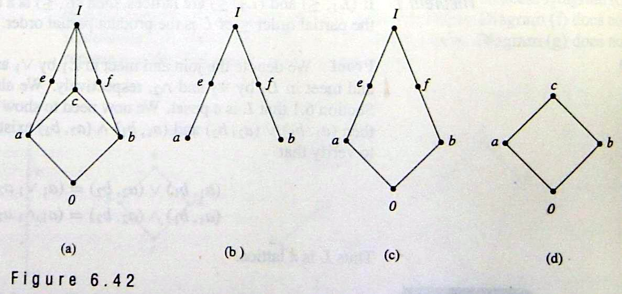
Sublattice
Example : (D_{n}, |) is a sublattice of (Z⁺, |)
Example
College of Computer Science & Technology, BUPT

Slide 37
Isomorphic Lattices（同构格）
If f: L₁→L₂ is an isomorphism from the poset (L₁, ≤₁) to the poset (L₂, ≤₂)
  L₁ is a lattice if and only if L₂ is a lattice.
  If a and b are elements of L₁, then
    f(a∧b) = f(a) ∧ f(b)
    f(a∨b) = f(a) ∨ f(b).
If two lattices are isomorphic, as posets, we say they are Isomorphic Lattices.
College of Computer Science & Technology, BUPT

Slide 38
Properties of Lattices
Recall the meaning of a∨b and a∧b:
  a ≤ a∨b and b ≤ a∨b ; a∨b is an upper bound of a and b.
  If a ≤ c and b ≤ c , then a∨b ≤ c; a∨b is the least upper bound of a and b.
  a ∧ b ≤ a and a ∧ b ≤ b ; a ∧ b is an lower bound of a and b.
  If c ≤ a and c ≤ b, then c ≤ a ∧ b; a ∧ b is the greatest lower bound of a and b.
College of Computer Science & Technology, BUPT

Slide 39
Theorem
Let L be a lattice. Then for every a and b in L,
  a∨b = b if and only if a≤b.
  a∧b = a if and only if a≤b.
  a∧b = a if and only if a∨b = b
College of Computer Science & Technology, BUPT

Slide 40
Proof of a∨b = b if and only if a≤b.
⇒ only if
  Suppose a∨b = b, so a∨b ≤ b (reflexive)
  a∨b is an upper bound of a and b, so a ≤ a∨b
  So, a ≤ b (transitive)
⇐ if
  Suppose a≤b
  b≤b (reflexive), b is an upper bound of a and b
  So a∨b≤b (by definition of lub)
  But, b≤a∨b (by definition of ub)
  Therefore, a∨b = b (antisymmetric)
College of Computer Science & Technology, BUPT

Slide 41
Theorem
Let L be a lattice. Then
  Idempotent Properties（等幂律）
    (a) a∨a = a
    (b) a∧a = a
  Commutative Properties（交换律）
    (a) a∨b = b∨a
    (b) a∧b = b∧a
  Associative Properties（结合律）
    (a) a∨(b∨c) = (a∨b)∨c
    (b) a∧(b∧c) = (a∧b) ∧c
  Absorption Properties（吸收律）
    (a) a∨(a∧b) = a
    (b) a∧(a∨b) = a
College of Computer Science & Technology, BUPT

Slide 42
Proof of 4. (a)
Since a∧b≤a and a≤a, we see that a is an upper bound of a∧b and a; so a∨(a∧b)≤a. On the other hand, by the definition of LUB, we have a≤a∨(a∧b), so a∨(a∧b) = a.
  Q.E.D
It follows from property 3 that we can write a∨(b∨c) and (a∨b) ∨c merely as a∨b∨c, and similarly for a∧b∧c.
College of Computer Science & Technology, BUPT

Slide 43
Theorem
Let L be a lattice. Then for every a, b, and c in L,
If a≤b, then
  a∨c ≤ b∨c.
  a∧c ≤ b∧c.
a≤c and b≤c if and only if a∨b≤c.
c≤a and c≤b if and only if c≤a∧b.
If a≤b and c≤d, then
  a∨c ≤ b∨d.
  a∧c ≤ b∧d.
College of Computer Science & Technology, BUPT

Slide 44
Special Types of Lattices
A lattice L is said to be bounded（有界的） if it has a greatest element I and a least element 0 .
(Z⁺,|) is not bounded.
(Z,≤) is not bounded.
College of Computer Science & Technology, BUPT

Slide 45
Example
The lattice P(S) of all subsets of a set S, as defined in Example 1, is bounded. Its greatest element is S and its least element is ∅
If L is a bounded lattice, then for all a ∈ A,
  0 ≤a≤I
  a∨0 = a
  a∧0 = 0
  a∨I = I
  a∧I = a
College of Computer Science & Technology, BUPT

Slide 46
Theorem
Let L = {a₁, a₂, …, a_{n}} be a finite lattice. Then L is bounded.
Proof
  The greatest element of L is a₁∨a₂∨… ∨a_{n},
  and its least element is a₁∧a₂∧…∧a_{n}
College of Computer Science & Technology, BUPT

Slide 47
Distributive lattice（分配格）
A lattice is called distributive if for any elements a, b, and c in L we have the following distributive properties.
  a∧(b∨c) = (a∧b)∨(a∧c)
  a∨(b∧c) = (a∨b)∧(a∨c)
If L is not distributive, we say that L is nondistributive
College of Computer Science & Technology, BUPT

Slide 48
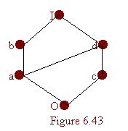
Example
The lattice shown in Figure 6.43 is distributive, as can be seen by verifying the distributive properties for all ordered triples chosen from the elements a, b, c, and d.
College of Computer Science & Technology, BUPT

Slide 49
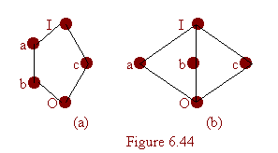
nondistributive lattices
The lattice shown in Figure 6.44 are nondistributive.
College of Computer Science & Technology, BUPT

Slide 50
Theorem
A lattic L is nondistributive if and only if it contains a sublattice that is isomorphic to one of the above two lattices.
Proof:
  omitted
College of Computer Science & Technology, BUPT

Slide 51
Complement（补元）
Let L be a bounded lattice with greatest element I and least element 0, and let a ∈ L. An element a’ L is called a complement of a if
  a∨a’ = I and a∧a’ = 0
Note that
  0’ = I and I’ = 0.
An element a in a lattice need not have a complement, and it may have more than one complement.
College of Computer Science & Technology, BUPT

Slide 52
Example
The lattices in Figure 6.44 each have the property that every element has a complement. The element c in both cases has two complements, a and b.
College of Computer Science & Technology, BUPT

Slide 53
Theorem
Let L be a bounded distributive lattice. If a complement exists, it is unique.
(1₁ ,1₂)
(1₁ ,a)
(1₁ ,b)
(0₁ ,1₂)
(1₁ ,0₂)
(0₁ ,a)
(0₁ ,b)
(0₁ ,0₂)
College of Computer Science & Technology, BUPT

Slide 54
Proof
Let a’ and a’’ be complements of the element a∈L. Then
  a∨a’ = I, a∨a’’ = I, a∧a’ = 0, a∧a’’ = 0.
Using the distributive laws, we obtain
  a’ = a’∨0 = a’∨(a∧a’’) = (a’∨a) ∧(a’∨a’’) = I∧(a’ ∨a’’) = a’∨a’’
Also
  a’’ = a’’∨0 = a’’∨(a∧a’)= (a’’∨a)∧(a’’∨a’) = I∧(a’’∨a’) = a’∨a’’
Hence a’ = a’’.
College of Computer Science & Technology, BUPT

Slide 55
Complemented（有补格）
A lattice is called complemented if it is bounded and if every element in L has a complement.
In this case, the complements are not unique.
College of Computer Science & Technology, BUPT

Slide 56
Homework
§9.6
  12, 28, 36, 44
College of Computer Science & Technology, BUPT

