Slide 1

Model checking
chenbo2008@ustc.edu.cn
2018.12.10

Slide 2
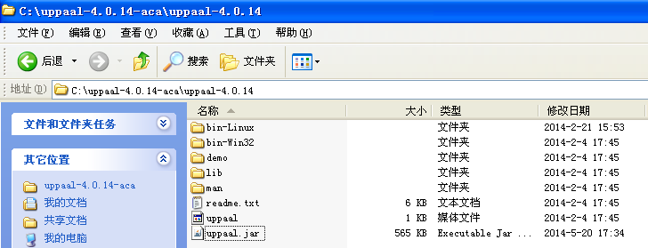
Uppaal
Below an exercise in modeling and analysis using the model checker Uppaal.
Download uppaal :
www.uppaal.com
www.uppaal.org
* Installation Guide
Before you install please make sure that you have Java 6 installed(JDK).

Slide 3
Time automation
press?
Off
press?
x:=0
Light
press?
Bright
x<=3
x>3
press?
Requirements: If a user quickly presses the light control twice, then the light should get brighter; on the other hand, if the user slowly presses the light control twice, the light should turn off.
Solution: Add a real-valued clock, x.

Slide 4
Time automation
Clocks: x, y
Guard
Boolean combination of comparisons with
Integer/rational bounds
n
Action
used
for synchronization
x<=5 & y>3
Reset
Action performed on clocks
a
x := 0
m

Slide 5
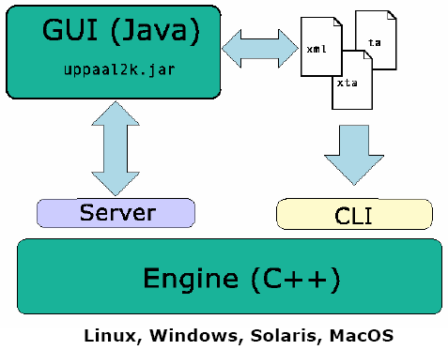
introduction
UPPAAL is an integrated tool environment for modeling, simulation and verification of real time system modeled as network of timed automata.
Particular emphasis will be put on hands-on application of validation tools including the real-time validation tool UPPAAL, UPPAAL Cora, "commercial" tools such as SPIN, visualSTATE, and tools for simulation such as Simulink and Ptolemy.

Slide 6
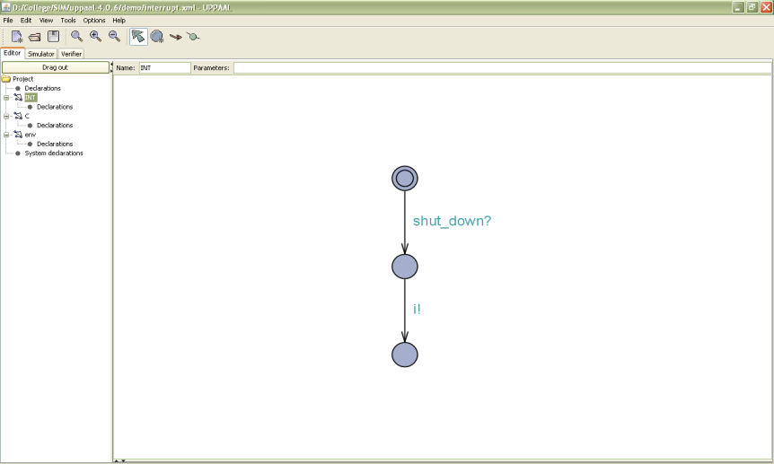
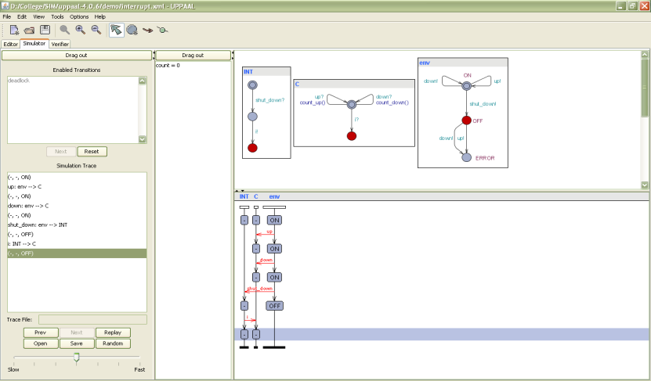
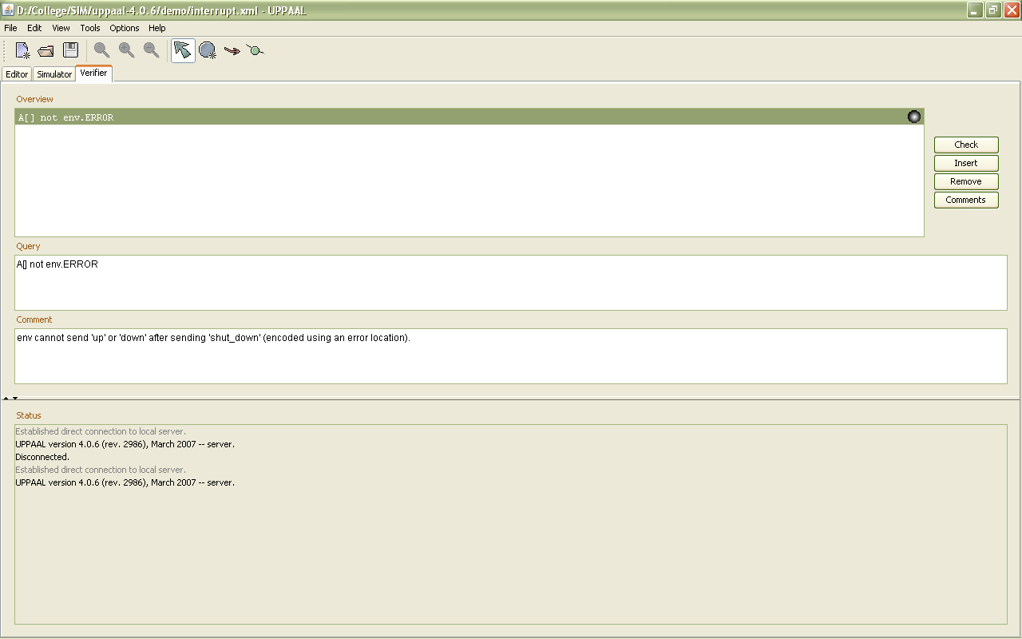
Architecture
Editor (Modeller)
Simulator
Verifier

Slide 7
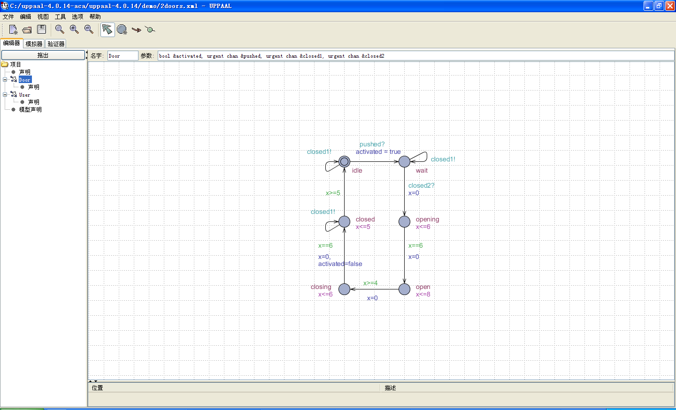
Architecture

Slide 8
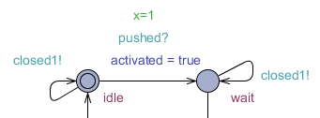

Architecture
the transitions of the automata can be labeled with three different types of labels:
  Guard：expressing a condition on the values of clocks and integer variables that must be satisified in order for the transition to be enabled.
  synchronization channel ：hand-shaking synchronization, urgent, broadcast.
  Update：number of clock resets and assignments to integer variables.
Guard
channel
update
Guard
channel

Slide 9
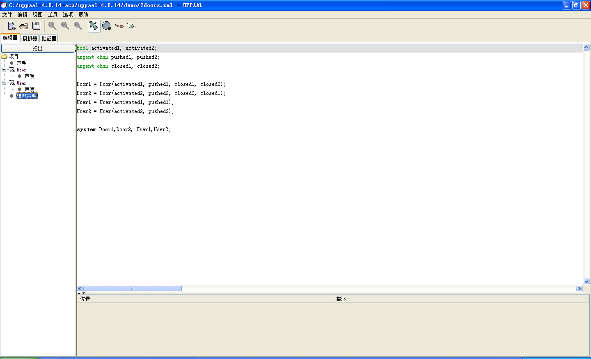
Architecture

Slide 10
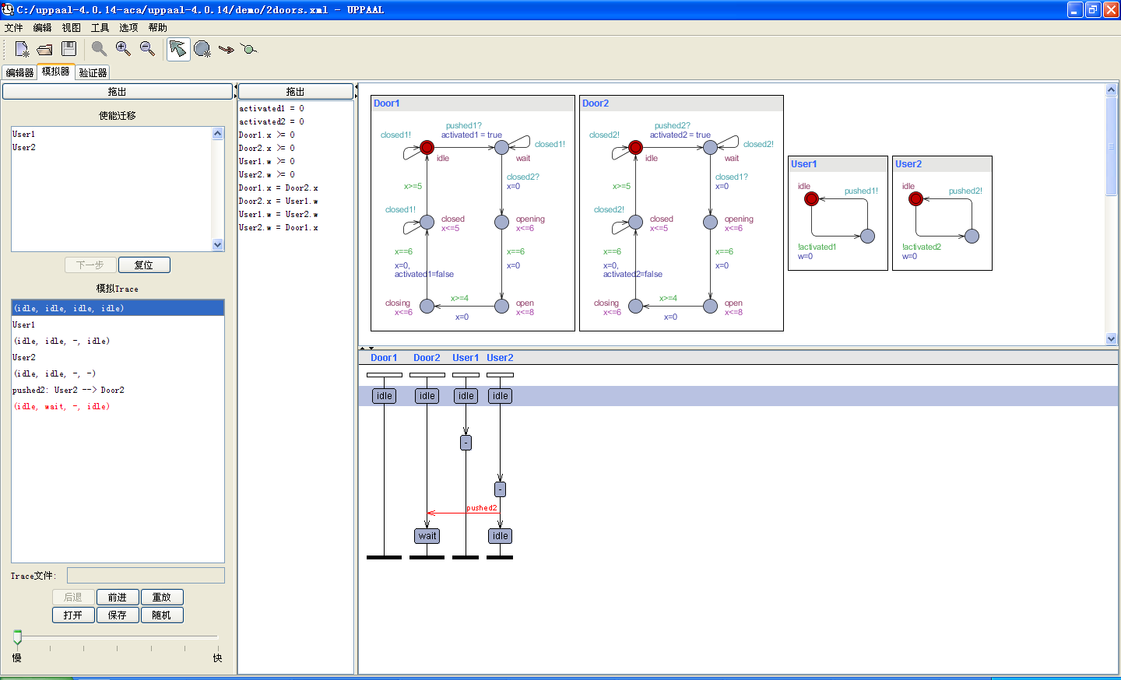
Architecture

Slide 11
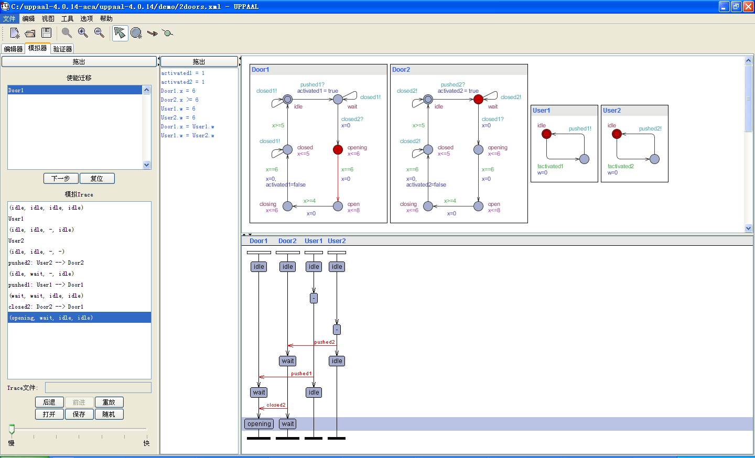
Architecture

Slide 12
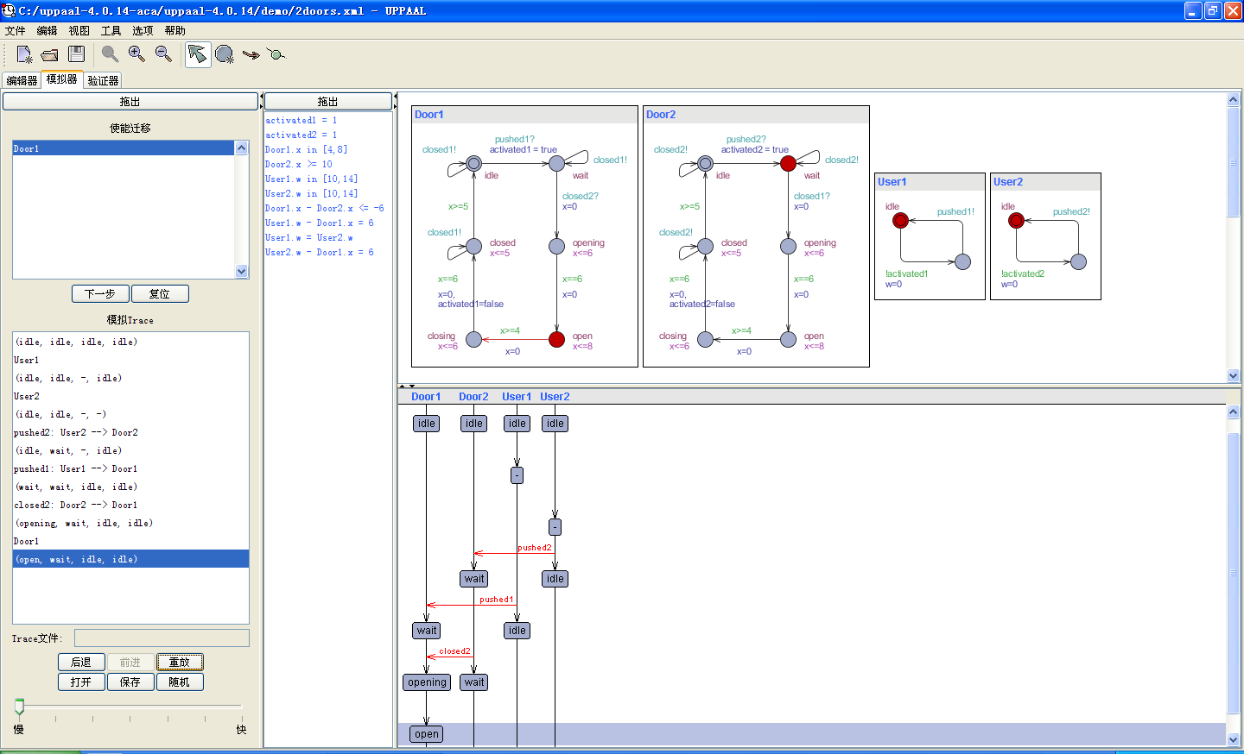
Architecture

Slide 13
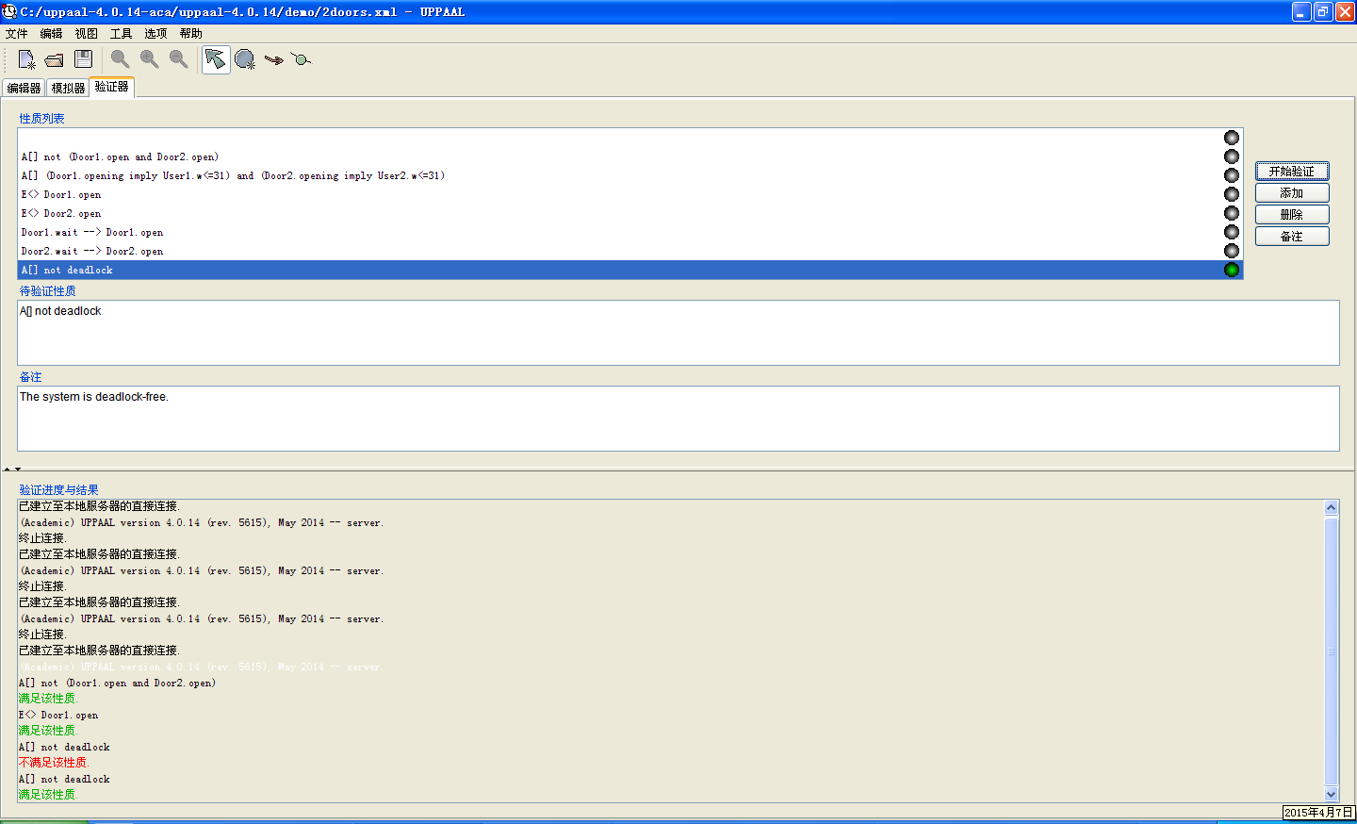
Architecture
A[] not deadlock

Slide 14
The Query Language
Reachability Properties :Does there exist a pathstarting at the initial state, such that ϕ is eventually satisfied along that path. In Uppaal, we write this property using the syntax E<> ϕ.
Safety Properties :Safety properties are on the form: “something bad will never happen”, In Uppaal these properties are formulated positively, e.g., something good is invariantly true. In Uppaal we write A[] ϕ and E[] ϕ, respectively.
Liveness Properties: Liveness properties are of the form: something will eventually happen, In Uppaal these properties are written as A<> ϕ and ϕ --> ψ, respectively.

Slide 15
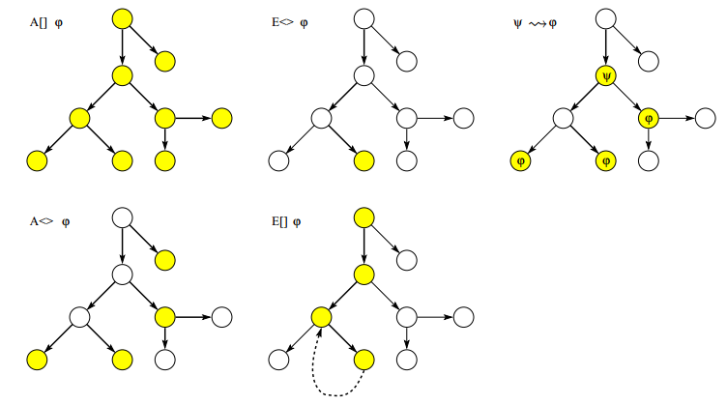
The Query Language

Slide 16
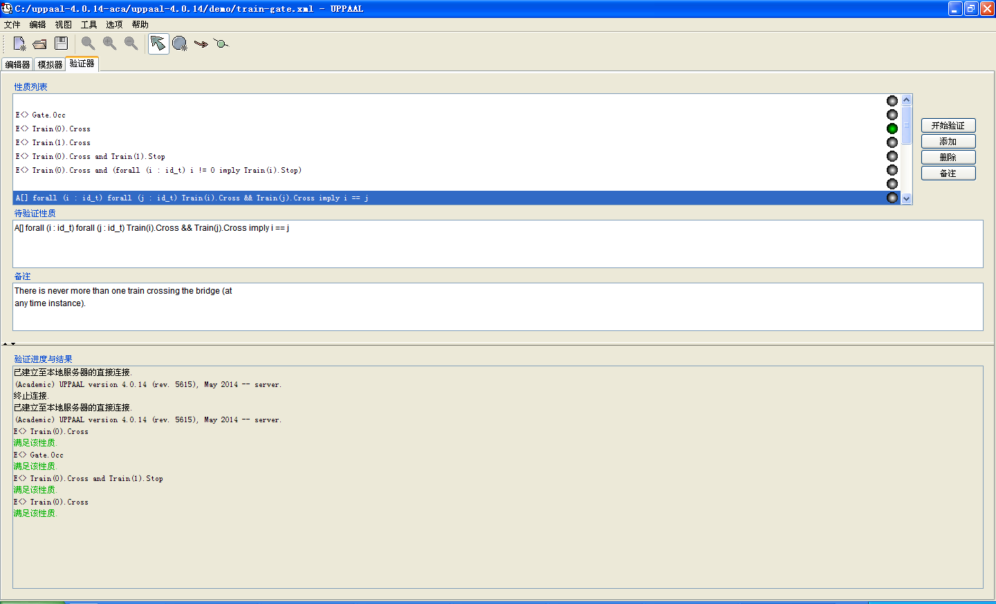
The Query Language

Slide 17
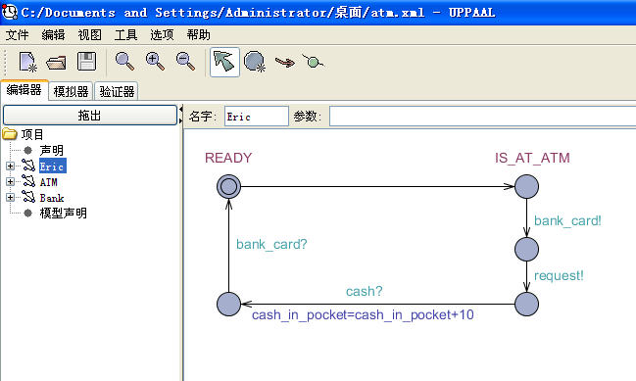
Exercise
ATM.pdf
Question1?
Question2?

