Slide 1
第十三讲 无线局域网

Slide 2
本章内容
无线局域网
MAC子层

Slide 3
Characteristics of selected wireless links
200
802.11n
54
802.11a,g
802.11a,g point-to-point
5-11
802.11b
4G: LTWE WIMAX
4
3G: UMTS/WCDMA-HSPDA, CDMA2000-1xEVDO
Data rate (Mbps)
1
802.15
.384
2.5G: UMTS/WCDMA, CDMA2000
.056
2G: IS-95, CDMA, GSM
Indoor
10-30m
Outdoor
50-200m
Mid-range
outdoor
200m – 4 Km
Long-range
outdoor
5Km – 20 Km

Slide 4
局域网的扩展
无线局域网和有线局域网的应用场景
有线局域网
骨干网
服务器、工作站等通常位于有线局域网
无线局域网
大的空旷场所（机场、车站）
厂房、股票交易所、古迹、仓库

Slide 5



















Elements of a wireless network
infrastructure mode
base station connects mobiles into wired network
handoff: mobile changes base station providing connection into wired network
network
infrastructure

Slide 6
无线局域网的配置
有线网络作为backbone
控制模块（CM）扮演无线局域网的接入点
具有交换或者路由的能力
Hub等用户模块（UM）也是组成部分
单cell的配置，仅有一个CM
多cell的配置，多个CM，通过有线网络连接

Slide 7
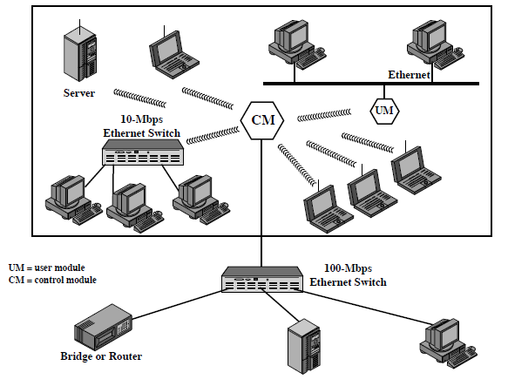
单Cell配置

Slide 8
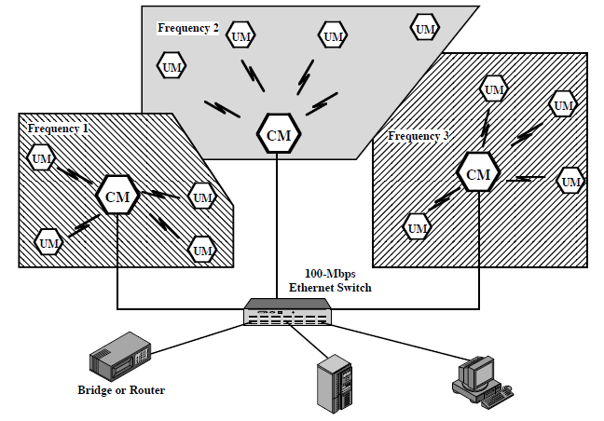
多Cell配置

Slide 9
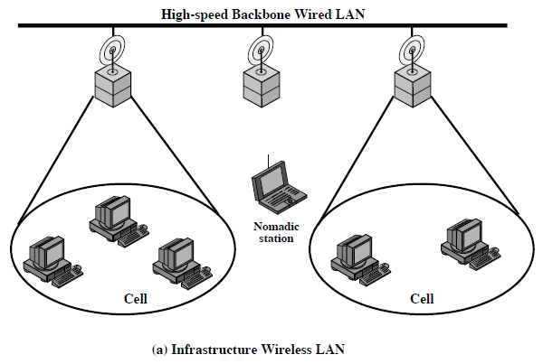
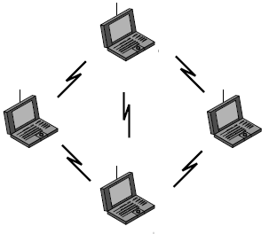
无线局域网的应用
大楼间互连：使用点对点无线连接两个路由器或者桥接器
Nomadic接入：移动设备接入网络，笔记本、PDA接入办公或者校园网
Ad hoc组网：为临时的需求建立临时的网络

Slide 10
Wireless network taxonomy
single hop
multiple hops
host connects to
base station (WiFi,
WiMAX, cellular)
which connects to
larger Internet
host may have to
relay through several
wireless nodes to
connect to larger
Internet: mesh net
infrastructure
(e.g., APs)
no base station, no
connection to larger
Internet. May have to
relay to reach other
a given wireless node
MANET, VANET
no
infrastructure
no base station, no
connection to larger
Internet (Bluetooth,
ad hoc nets)

Slide 11
对无线局域网的要求
吞吐量
节点数量：数百个
连接骨干局域网
覆盖区域：直径100~300米
电池能量考虑：MAC协议需要考虑节量，例如，频繁地握手或者持续地监测接入点的MAC协议不可取
健壮性和安全性
多个网络覆盖：一个地区应该允许被多个网络覆盖
不涉及频段授权
Cell之间的切换、漫游
动态配置：动态地添加、删除、或者重配置终端系统

Slide 12
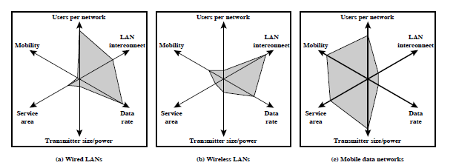
比较三种技术
三种无线局域网
红外（IR）局域网
扩频局域网
窄带微波

Slide 13
红外局域网
对比微波的优势
有无限频段，理论上有无限带宽
尚未regulated
设备便宜
能够被浅色的物体反射
天花板可以反射整个房间的信号
不能穿墙
没有“隔墙有耳”的安全问题
不同房间不会相互干扰

Slide 14
红外局域网的缺陷
大量的各类辐射形成干扰
阳光、灯光均包含红外波噪声，对信号形成干扰
需要较大能量发射，但是大功率红外线对眼有害
有限的传输距离
红外数据传输技术
有向波束
全向传输
散射

Slide 15
有向红外波束
用于点对点连接
传输距离取决于发射信号的能量和对准目标
对准的红外有向波束可以传输数公里
足以用于大楼间连接
全向传输
基站位于所有无线终端的视距内
基站通常位于天花板
基站是一个多端口信号中继器
天花板基站可以在整个房间中广播收到的IR信号
无线终端的发射天线对准天花板基站
散射
无线终端的发射天线对准天花板散射基站
IR信号被基站向所有方向散射，被所有终端接收

Slide 16
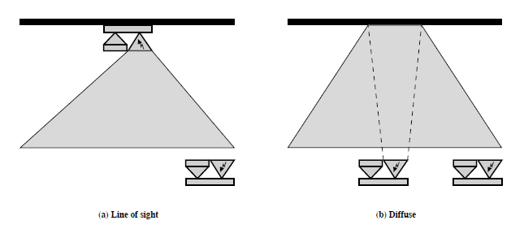
全向视距传输和散射

Slide 17
扩频局域网
多cell的配置
每个cell内，peer-to-peer或者hub
Peer-to-Peer
介质访问算法，例如CSMA
适合构造ad hoc网络

Slide 18
Hub
连接backbone
可能包含接入控制（access control）
例如，802.11 point coordination function
可能以多端口信号中继器的方式工作
自动切换（handoff）
移动终端就近连接Hub，当信号能量弱时切换
Cell中的移动节点
和hub点对点通信，或者
在cell内全向广播

Slide 19
窄带微波局域网
使用微波频段传输信号，带宽仅够满足传播信号
授权的窄带微波
通常使用多cell的配置
避免干扰
未授权的窄带微波
使用ISM频段（Industrial, Scientific, and Medical）

Slide 20
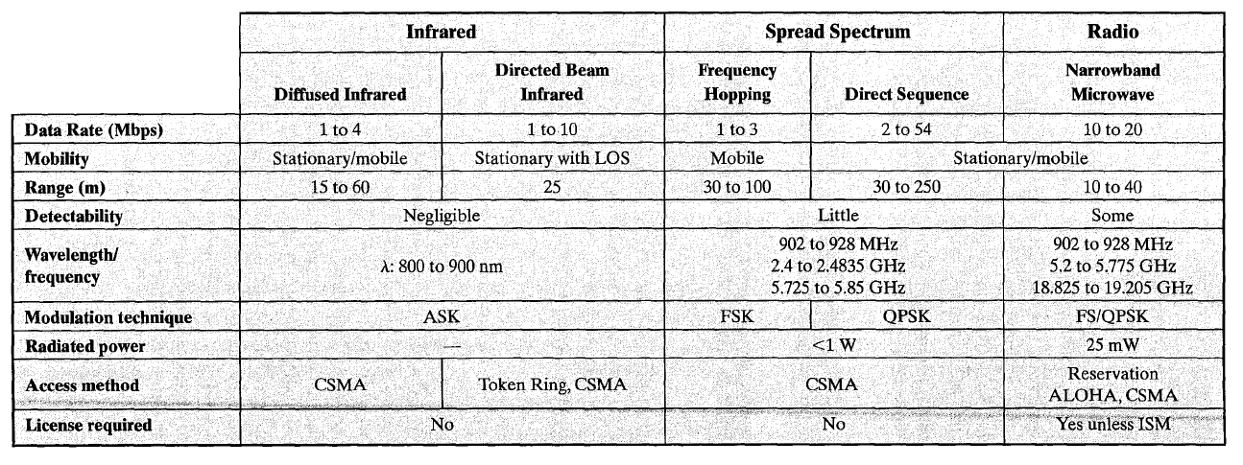

Slide 21
multiple access protocols

Slide 22




Multiple access links, protocols
two types of “links”:
point-to-point
PPP for dial-up access
point-to-point link between Ethernet switch, host
broadcast (shared wire or medium)
old-fashioned Ethernet
upstream HFC
802.11 wireless LAN
shared wire (e.g.,
cabled Ethernet)
shared RF
(e.g., 802.11 WiFi)
shared RF
(satellite)
humans at a
cocktail party
(shared air, acoustical)

Slide 23
Multiple access protocols
single shared broadcast channel
two or more simultaneous transmissions by nodes: interference
collision if node receives two or more signals at the same time
multiple access protocol
distributed algorithm that determines how nodes share channel, i.e., determine when node can transmit
communication about channel sharing must use channel itself!
no out-of-band channel for coordination

Slide 24
An ideal multiple access protocol
given: broadcast channel of rate R bps
desiderata:
1. when one node wants to transmit, it can send at rate R.
2. when M nodes want to transmit, each can send at average rate R/M
3. fully decentralized:
no special node to coordinate transmissions
no synchronization of clocks, slots
4. simple

Slide 25
MAC protocols: taxonomy
three broad classes:
channel partitioning
divide channel into smaller “pieces” (time slots, frequency, code)
allocate piece to node for exclusive use
random access
channel not divided, allow collisions
“recover” from collisions
“taking turns”
nodes take turns, but nodes with more to send can take longer turns

Slide 26
Channel partitioning MAC protocols: TDMA
TDMA: time division multiple access
access to channel in "rounds"
each station gets fixed length slot (length = pkt trans time) in each round
unused slots go idle
example: 6-station LAN, 1,3,4 have pkt, slots 2,5,6 idle
6-slot
frame
6-slot
frame
1
3
4
1
3
4

Slide 27
Channel partitioning MAC protocols: FDMA
FDMA: frequency division multiple access
channel spectrum divided into frequency bands
each station assigned fixed frequency band
unused transmission time in frequency bands go idle
example: 6-station LAN, 1,3,4 have pkt, frequency bands 2,5,6 idle
time
frequency bands
FDM cable

Slide 28
Random access protocols
when node has packet to send
transmit at full channel data rate R.
no a priori coordination among nodes
two or more transmitting nodes ➜ “collision”,
random access MAC protocol specifies:
how to detect collisions
how to recover from collisions (e.g., via delayed retransmissions)
examples of random access MAC protocols:
slotted ALOHA
ALOHA
CSMA, CSMA/CD, CSMA/CA

Slide 29
Slotted ALOHA
assumptions:
all frames same size
time divided into equal size slots (time to transmit 1 frame)
nodes start to transmit only slot beginning
nodes are synchronized
if 2 or more nodes transmit in slot, all nodes detect collision
operation:
when node obtains fresh frame, transmits in next slot
if no collision: node can send new frame in next slot
if collision: node retransmits frame in each subsequent slot with prob. p until success

Slide 30
Slotted ALOHA
node 1
1
1
1
1
node 2
2
2
2
node 3
3
3
3
C
E
C
S
E
C
E
S
S
Pros:
single active node can continuously transmit at full rate of channel
highly decentralized: only slots in nodes need to be in sync
simple
Cons:
collisions, wasting slots
idle slots
nodes may be able to detect collision in less than time to transmit packet
clock synchronization

Slide 31
Slotted ALOHA: efficiency
efficiency: long-run fraction of successful slots (many nodes, all with many frames to send)
max efficiency: find p* that maximizes Np(1-p)^{N-1}
for many nodes, take limit of Np*(1-p*)^{N-1} as N goes to infinity, gives:
max efficiency = 1/e = .37
suppose: N nodes with many frames to send, each transmits in slot with probability p
prob that given node has success in a slot = p(1-p)^{N-1}
prob that any node has a success = Np(1-p)^{N-1}
at best: channel
used for useful
transmissions 37%
of time!
!

Slide 32
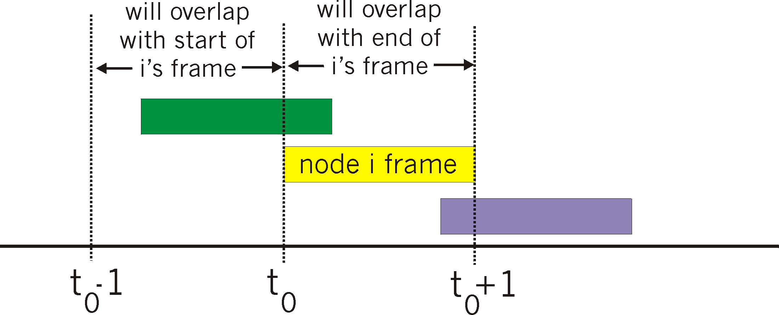
Pure (unslotted) ALOHA
unslotted Aloha: simpler, no synchronization
when frame first arrives
transmit immediately
collision probability increases:
frame sent at t₀ collides with other frames sent in [t₀-1,t₀+1]

Slide 33
Pure ALOHA efficiency
P(success by given node) = P(node transmits) .
P(no other node transmits in [t₀-1,t₀] .
P(no other node transmits in [t₀,t₀+1]
= p . (1-p)^{N-1 .} (1-p)^{N-1}
= p . (1-p)^{2(N-1)}
… choosing optimum p and then letting n
= 1/(2e) = .18
even worse than slotted Aloha!

Slide 34
CSMA (carrier sense multiple access)
CSMA: listen before transmit:
if channel sensed idle: transmit entire frame
if channel sensed busy, defer transmission
human analogy: don’t interrupt others!

Slide 35
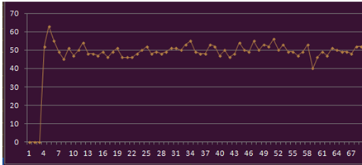
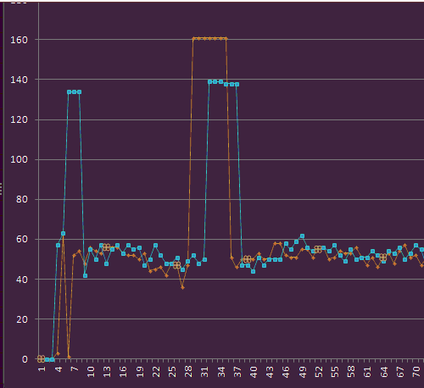
CSMA scenario

Slide 36
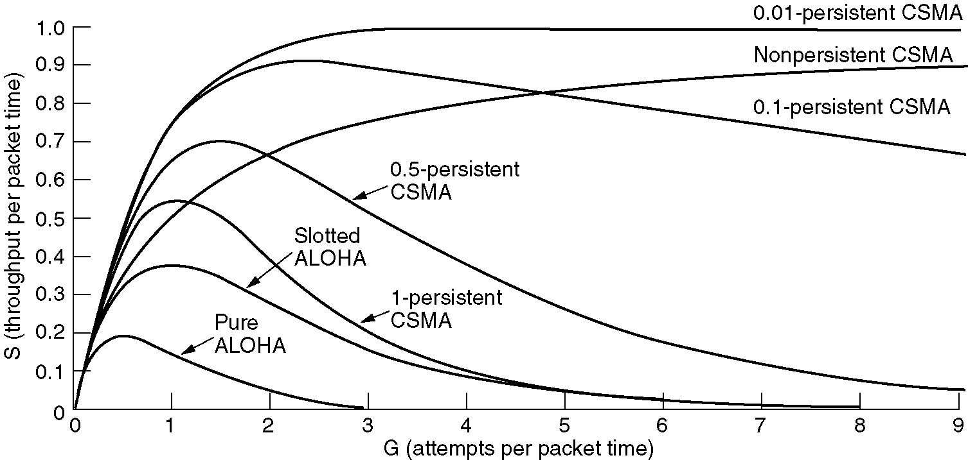
performance of concerned protocol

Slide 37
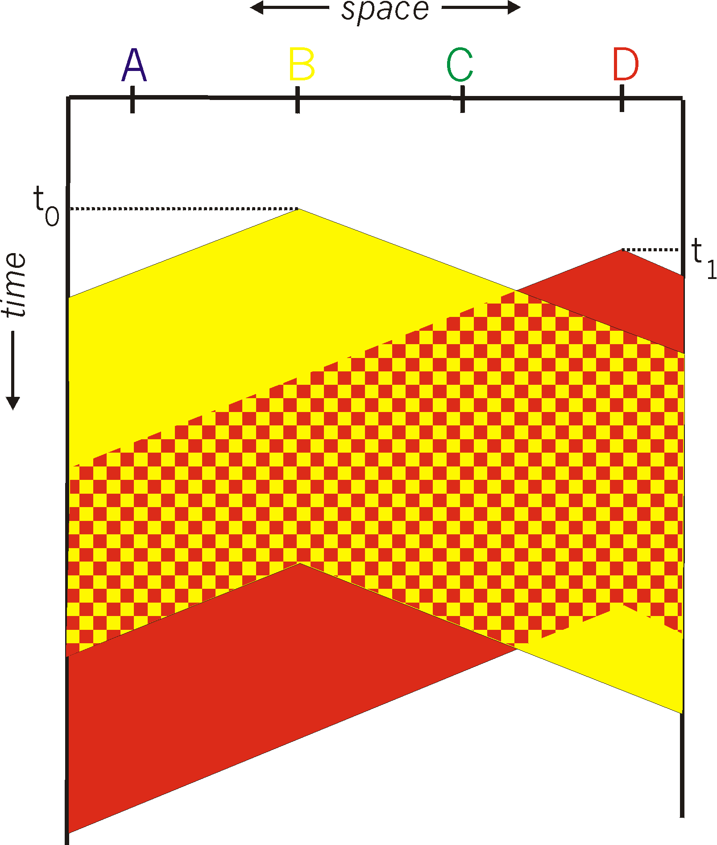
CSMA collisions
spatial layout of nodes
collisions can still occur: propagation delay means two nodes may not hear each other’s transmission
collision: entire packet transmission time wasted
distance & propagation delay play role in determining collision probability

Slide 38
CSMA/CD (collision detection)
CSMA/CD: carrier sensing, deferral as in CSMA
collisions detected within short time
colliding transmissions aborted, reducing channel wastage
collision detection:
easy in wired LANs: measure signal strengths, compare transmitted, received signals
difficult in wireless LANs: received signal strength overwhelmed by local transmission strength
human analogy: the polite conversationalist

Slide 39
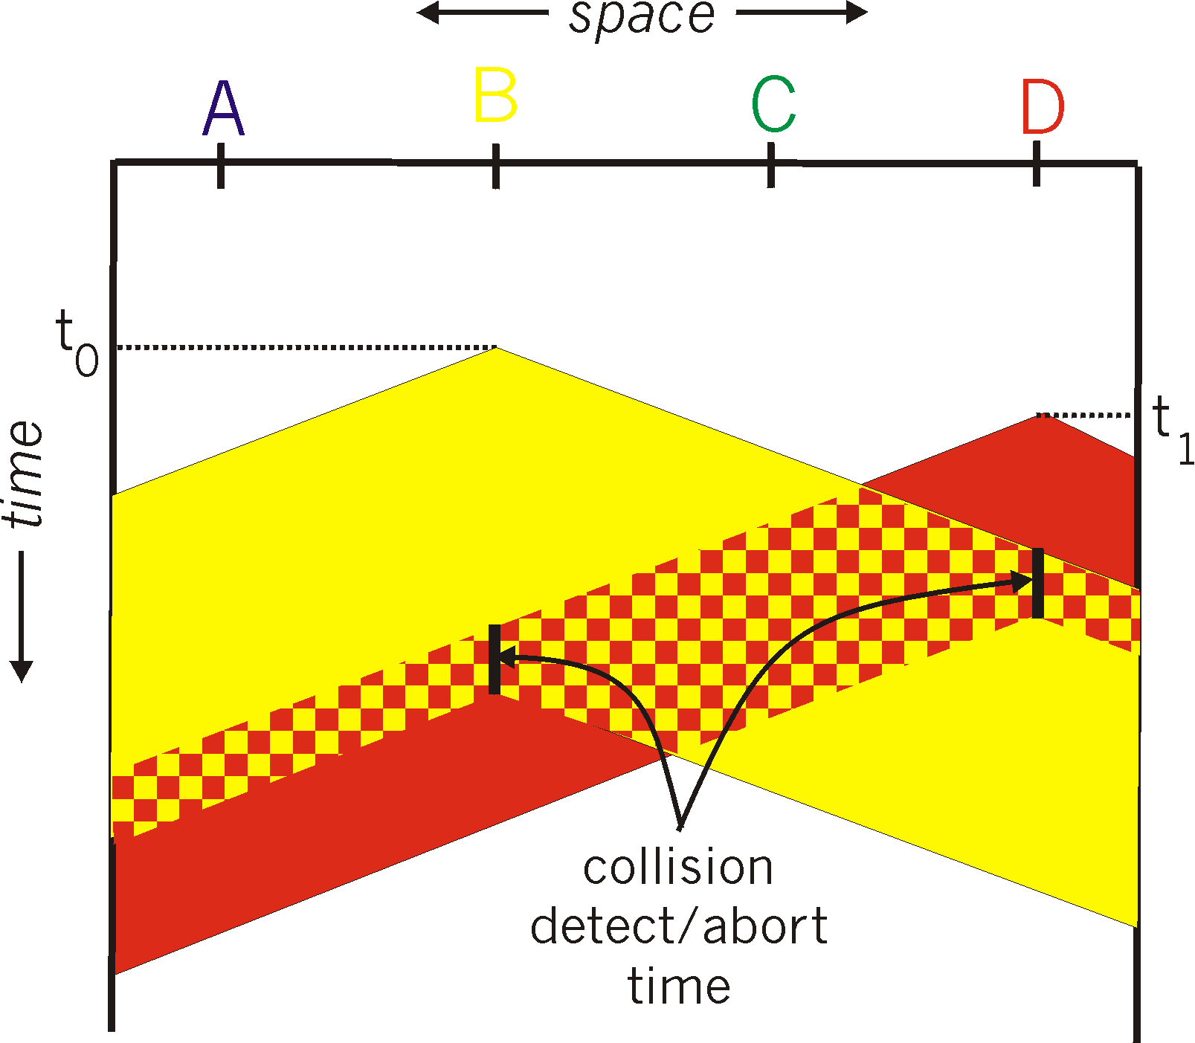
CSMA/CD (collision detection)
spatial layout of nodes

Slide 40
Ethernet CSMA/CD algorithm
1. NIC receives datagram from network layer, creates frame
2. If NIC senses channel idle, starts frame transmission. If NIC senses channel busy, waits until channel idle, then transmits.
3. If NIC transmits entire frame without detecting another transmission, NIC is done with frame !
4. If NIC detects another transmission while transmitting, aborts and sends jam signal
5. After aborting, NIC enters binary (exponential) backoff:
after mth collision, NIC chooses K at random from {0,1,2, …, 2^{m}-1}. NIC waits K·512 bit times, returns to Step 2
longer backoff interval with more collisions

Slide 41
CSMA/CD efficiency
T_{prop} = max prop delay between 2 nodes in LAN
t_{trans} = time to transmit max-size frame
efficiency goes to 1
as t_{prop} goes to 0
as t_{trans} goes to infinity
better performance than ALOHA: and simple, cheap, decentralized!

Slide 42
CSMA/CA (collision avoid)

Slide 43
“Taking turns” MAC protocols
channel partitioning MAC protocols:
share channel efficiently and fairly at high load
inefficient at low load: delay in channel access, 1/N bandwidth allocated even if only 1 active node!
random access MAC protocols
efficient at low load: single node can fully utilize channel
high load: collision overhead
“taking turns” protocols
look for best of both worlds!

Slide 44

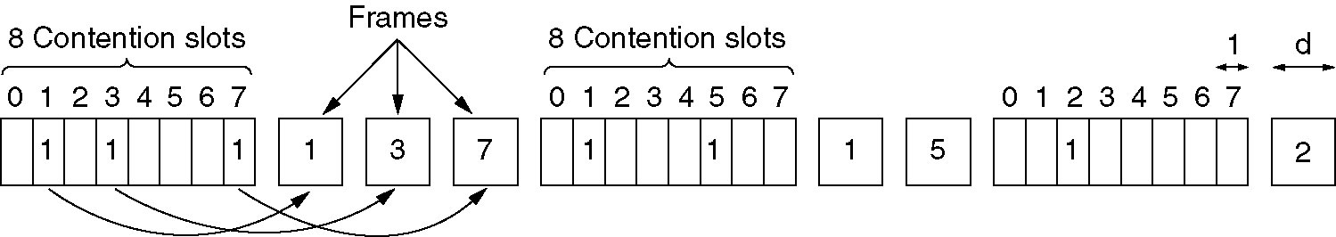
“Taking turns” MAC protocols
polling:
master node “invites” slave nodes to transmit in turn
typically used with “dumb” slave devices
concerns:
polling overhead
latency
single point of failure (master)
data
poll
master
data
slaves

Slide 45
“Taking turns” MAC protocols
token passing:
control token passed from one node to next sequentially.
token message
concerns:
token overhead
latency
single point of failure (token)
T
(nothing
to send)
T
data

Slide 46
Summary of MAC protocols
channel partitioning, by time, frequency or code
Time Division, Frequency Division
random access (dynamic),
ALOHA, S-ALOHA, CSMA, CSMA/CD
carrier sensing: easy in some technologies (wire), hard in others (wireless)
CSMA/CD used in Ethernet
CSMA/CA used in 802.11
taking turns
polling from central site, token passing
bluetooth, FDDI, token ring

